Slide 1
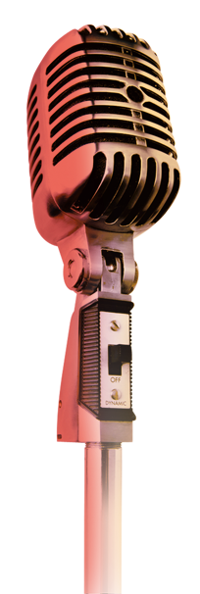
The Art of Public Speaking
2020

Slide 2
Contents
Introduction
Demonstration

Slide 3
Contents of the Introduction
Teaching Objectives
Teaching Procedures
&
Assessment
Teaching Highlights
1
2
3

Slide 4
Part 1
University information
Target students
Objectives of
• Course
• Unit
• Demonstration
Teaching Objectives

Slide 5
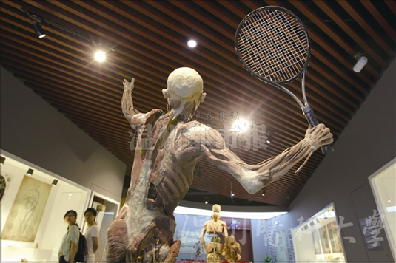
University Information
Medical University
Professional competency
Humanistic qualities

Slide 6
Target Students
Career prospects:
Medical
International
Spokespersons
Copywriters
Secretaries
Executives
Public health
Language proficiency:
Intermediate level
Medical English
Public speaking skills
in medical contexts

Slide 7
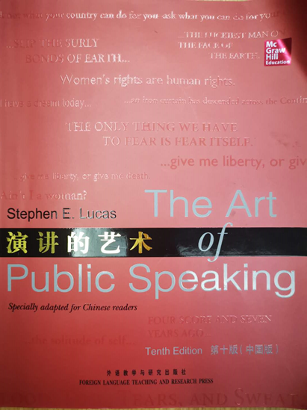
Course Objectives
Speaking Confidently and Ethically
1
3
Critical thinking skills
A patriotic & cosmopolitan outlook
Autonomous & cooperative learning abilities
2
4
Moral sense & public spirit

Slide 8
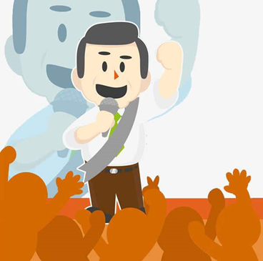
Unit Objectives
Realize the significance of confidence & ethics in speechmaking
Identify and apply the four ethical speaking guidelines
Master the techniques of overcoming stage fright
Heighten ethical sensibility towards life and society

Slide 9
Demo Class Objective
Realize the significance of confidence & ethics in speechmaking
Identify and apply the four ethical speeking guidelines
Master the techniques of overcoming stage fright
Heighten ethical sensibility towards life and society

Slide 10
Part 2
Teaching Procedures
Teaching methodology
Teaching steps

Slide 11
Teaching Methodology
Motivating
Enabling
Assessing
1
2
3
Production-Oriented Approach
Production task: create a speech on COVID-19
Set up scaffolding to guide learning
Adopt TSCA to consolidate and assess learning

Slide 12
Motivating Phase
Write a speech script on COVID-19
Watch online class videos and finish tasks
Read relevant materials beyond the text
Major purpose:
Utilize autonomous learning tasks to develop independent thinking and autonomous learning abilities.

Slide 13
Enabling Phase
Main tasks
Refine & deepen understanding of the ethical guidelines
Complete a true-or-false quiz on Teacher Mate
Strengthen patriotic pride & cultural confidence
Compare & discuss 2 COVID-19-related speeches by President Xi & President Trump
Major purposes

Slide 14
Assessing Phase
Before class | Students upload scripts online. The teacher selects samples for assessment, and designs criteria for explicit and implicit assessment.
In class | The teacher demonstrates assessment procedures. Students do peer assessment.
After class | Students revise speeches and submit them for automatic assessment. The teacher gives feedback on discussion forums.
TSCA

Slide 15
Criteria for Explict & Implicit Assessment
Dimensions | Specifications | Scale
Goals （30%） | The goals are ethically sound. | 1 2 3 4 5
Preparations （30%） | The speech is appropriate for the target audience. | 1 2 3 4 5
 | There is no erroneous information. | 1 2 3 4 5
 | There is no misleading advice. | 1 2 3 4 5
 | The writer has explored the topic thoroughly. | 1 2 3 4 5
Honesty （40%） | There is no blatant contempt for the truth. | 1 2 3 4 5
 | The Statistics are accurate. | 1 2 3 4 5
 | The writer doesn't quote out of context. | 1 2 3 4 5
 | The writer doesn't misrepresent sources. | 1 2 3 4 5
 | The writer doesn't paint tentative findings as firm conclusions. | 1 2 3 4 5
 | The writer doesn't portray a few details as the whole story. | 1 2 3 4 5
 | The writer doesn't cite unusual cases as typical examples. | 1 2 3 4 5
 | The writer doesn't substitute innuendo and half-truths for evidence and proof. | 1 2 3 4 5
 | The writer doesn't plagiarize. | 1 2 3 4 5

Slide 16
Part 3
Teaching Highlights
Whole-person education
Ideological and moral education

Slide 17
Whole-person Education
Language skills
Overall character
Moral sense
Domain knowledge
Public spirit

Slide 18
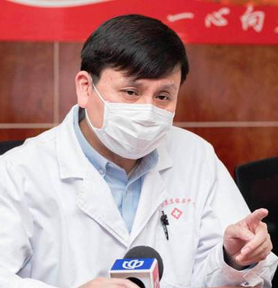
Plain-spoken good doctor
Smooth-talking spin doctor

Slide 19
Demonstration
Part 1
Introduction
Part 2
Theory & Case Study
Part 3
Peer-review

Slide 20
Being an
Ethical Speaker
Unit 2 Session 2

Slide 21
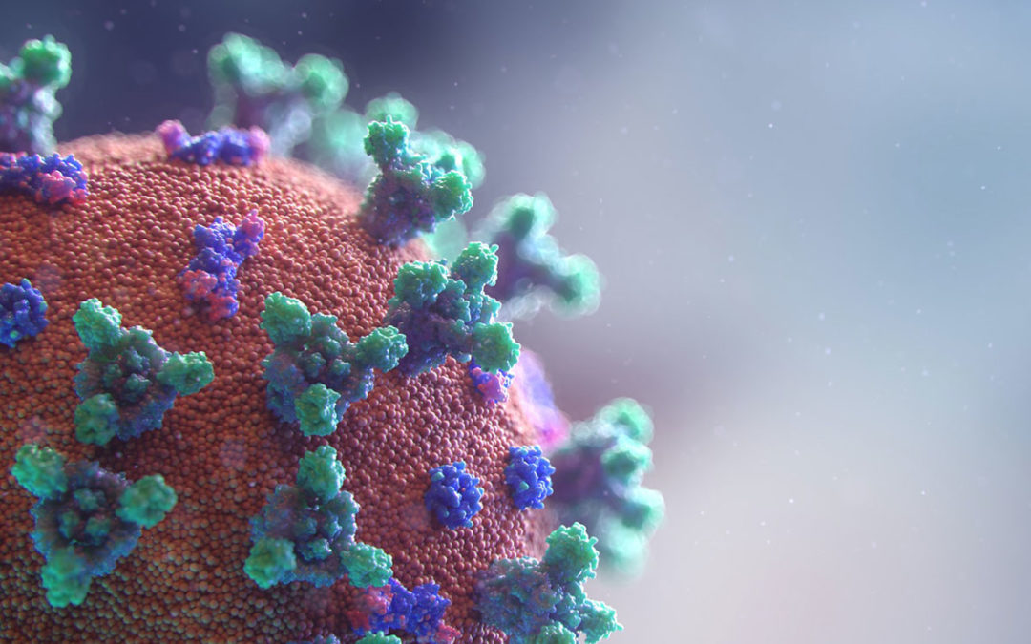
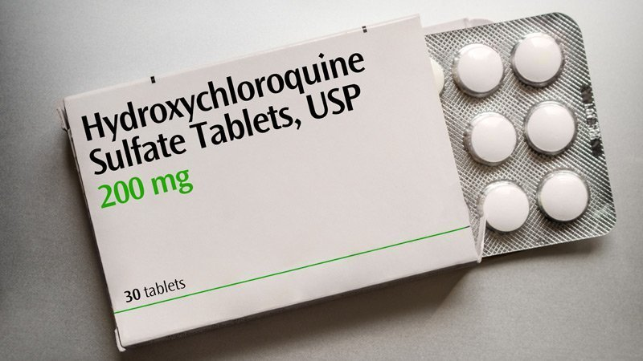
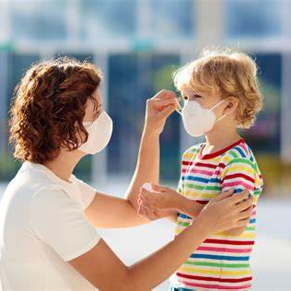
Part 1 Introduction
1
COVID-19 originated in Wuhan, China.
2
COVID-19 was purposefully lab-made.
COVID-19
True or False
3
Hydroxychloroquine is helpful in treating COVID-19.
4
There is no need to wear masks unless you are in direct contact with symptomatic COVID-19 patients.

Slide 22
Part 2 Theory & Case Study - Ethics
Immoral
Unfair
Moral
Unjust
Fair
Dishonest
Just
Honest
Ethics
is the branch of philosophy that deals with issues of right and wrong in human affairs.

Slide 23
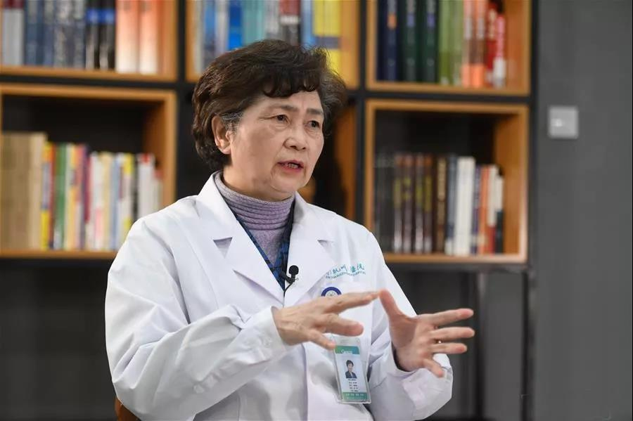
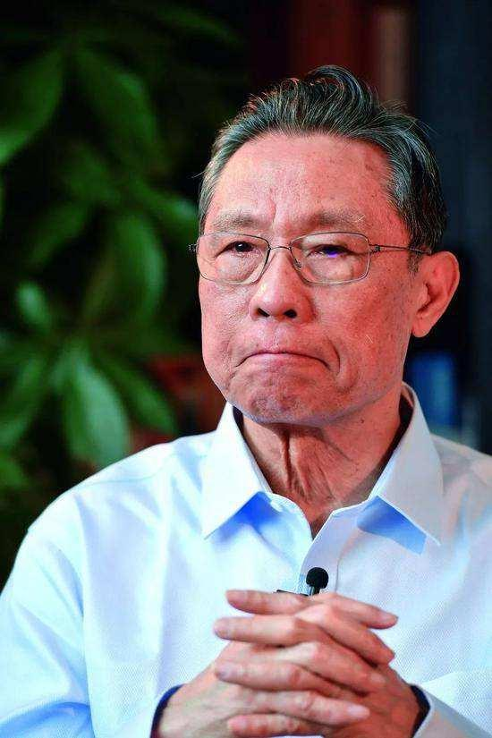
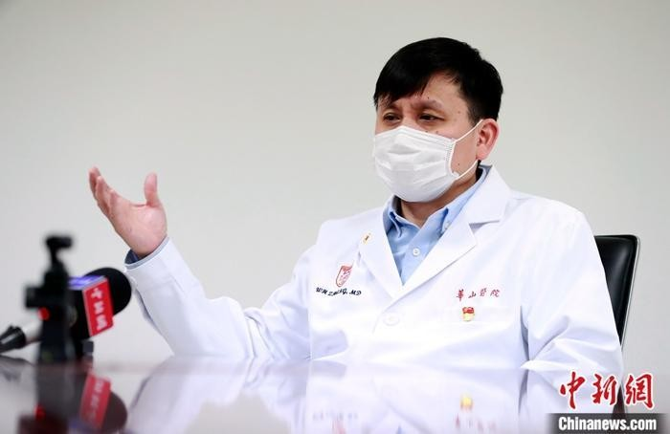
Part 2 Theory & Case Study – Medical professionals
Scientific discipline
&
Courage for the truth
Ethics
&
Professional competency

Slide 24
Part 2 Theory & Case Study – Four Guidelines
1. Make sure your goals are ethically sound
2. Be fully prepared for each speech
4
Guidelines
3. Be honest in what you say
4. Put ethical principles into practice

Slide 25
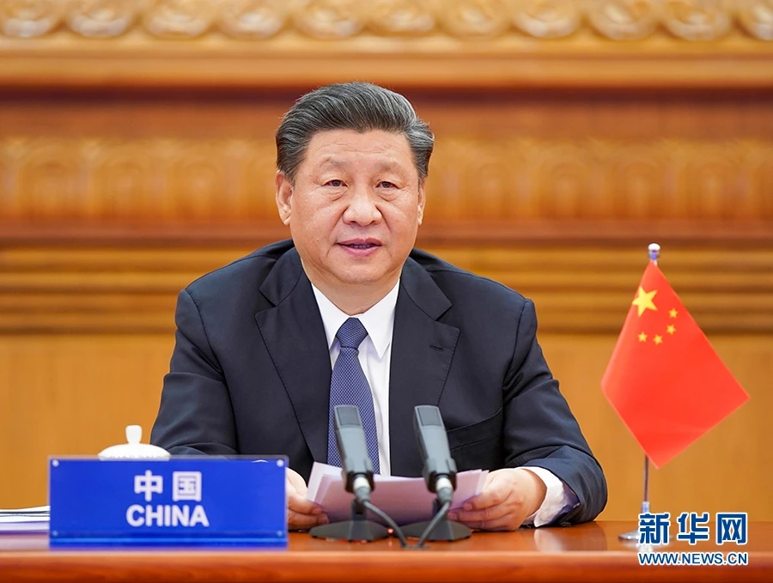
Part 2 Theory & Case Study – Reading & Discussion
1
Summarize the goals of this speech.
2
Give your comments.
Excerpts
At the most difficult moment in our fight against the outbreak, China received assistance and help from a lot of members of the global community. Such expressions of friendship will always be remembered and cherished by the Chinese people.
[...]
At such a moment, it is imperative for the international community to strengthen confidence, act with unity and work together in a collective response. We must comprehensively step up international cooperation and foster greater synergy so that humanity as one could win the battle against such a major infectious disease.
[...]
Now is a crucial moment, a time for us to rise up to challenge and act with swiftness. I am convinced that through solidarity and mutual assistance, we will prevail over this outbreak and we all will embrace a brighter future for mankind!
Working Together to Defeat the COVID-19 Outbreak
at the Extraordinary G20 Leaders' Summit via video link in Beijing

Slide 26
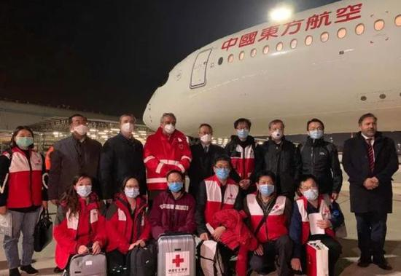
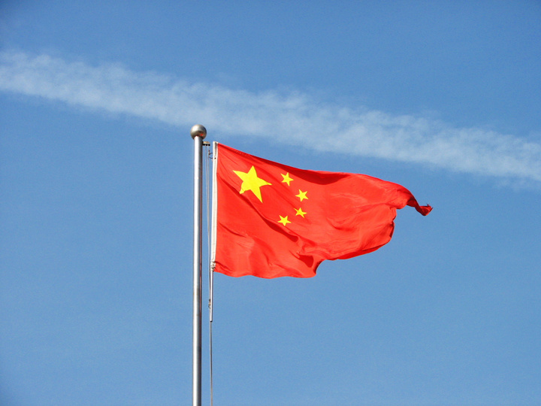
Part 2 Theory & Case Study – Goals of speech
1
Embodies the responsibility a powerful country should have
2
Shows the international perspective and cooperative strategy
3
Strengthens the sense of national confidence and pride

Slide 27
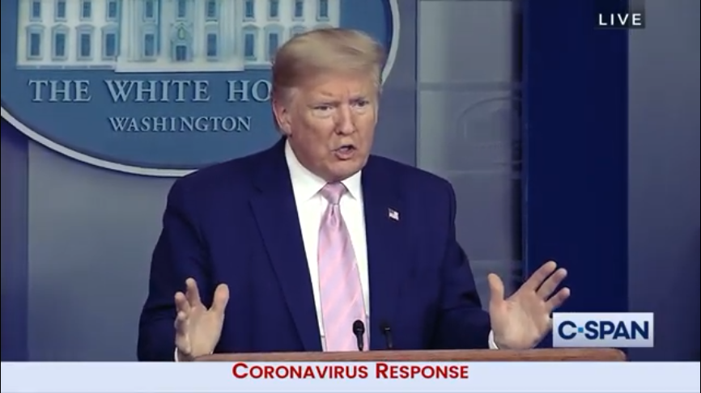
Part 2 Theory & Case Study – Viewing, Listening, Speaking
Is he fully prepared for the speech? Give your comments.
1
He didn't do a thorough job of studying and researching the topic.
2
He was communicating erroneous information.
3
He was giving misleading advice.

Slide 28
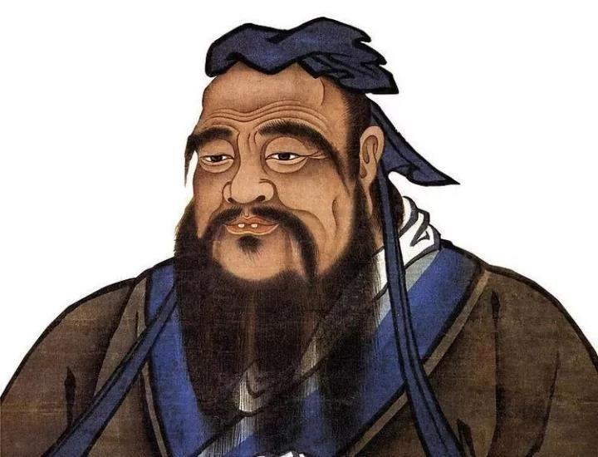
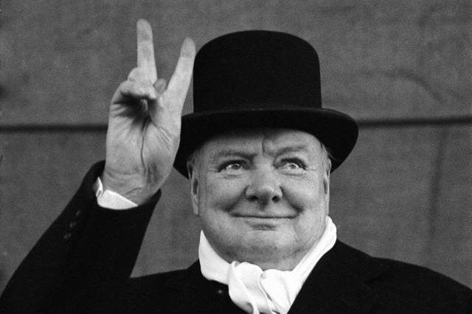
Part 2 Theory & Case Study - Honesty
If you are sincere, people will repose trust in you.
信则人任焉。出自：《论语·阳货》
The first step is to be honest, and then to be noble.
It’s a duty to be accurate and fair in presenting information when making a speech.

Slide 29
Part 2 Theory & Case Study - Forms of Dishonesty & Examples
rumours claiming that the virus is man-made
According to the situation report of World Health Organization, 224, 172 people had died of the disease globally. (date?)
A 104-year-old man recovered quickly from the disease, surely we have nothing to worry about.
blatant contempt for the truth
incomplete statistics
cite unusual cases as typical examples

Slide 30
Part 3 Peer Review – Group work
Selected work

Slide 31
Part 3 Peer Review - Criteria
Dimensions | Specifications | Scale
Goals （30%） | The goals are ethically sound. | 1 2 3 4 5
Preparations （30%） | The speech is appropriate for the target audience. | 1 2 3 4 5
 | There is no erroneous information. | 1 2 3 4 5
 | There is no misleading advice. | 1 2 3 4 5
 | The writer has explored the topic thoroughly. | 1 2 3 4 5
Honesty （40%） | There is no blatant contempt for the truth. | 1 2 3 4 5
 | The Statistics are accurate. | 1 2 3 4 5
 | The writer doesn't quote out of context. | 1 2 3 4 5
 | The writer doesn't misrepresent sources. | 1 2 3 4 5
 | The writer doesn't paint tentative findings as firm conclusions. | 1 2 3 4 5
 | The writer doesn't portray a few details as the whole story. | 1 2 3 4 5
 | The writer doesn't cite unusual cases as typical examples. | 1 2 3 4 5
 | The writer doesn't substitute innuendo and half-truths for evidence and proof. | 1 2 3 4 5
 | The writer doesn't plagiarize. | 1 2 3 4 5

Slide 32
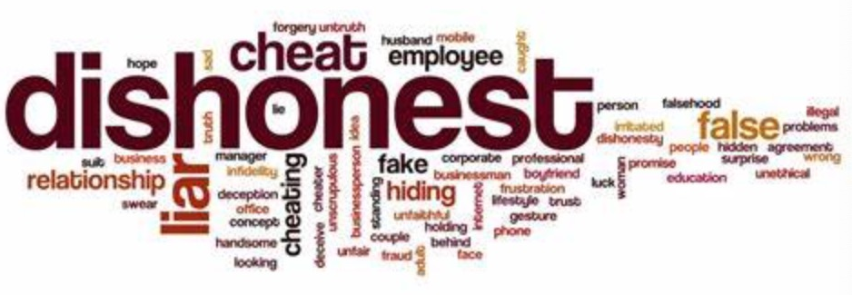
Part 3 Peer Review - Report
Instances of dishonesty?

Slide 33
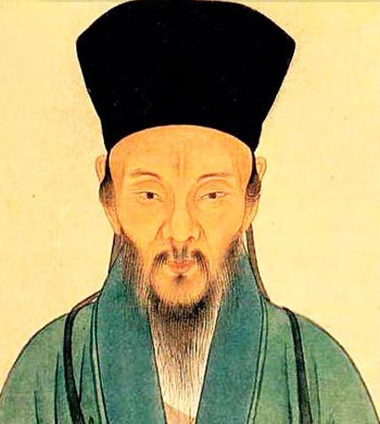
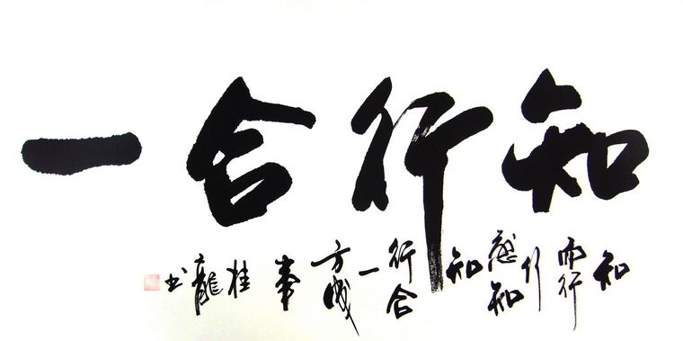
Review of the objective
Knowledge and action are one.
Always put all the other ethical guidelines into practice.
王阳明

Slide 34
Resources
Websites：
UMOOCs (湖北大学慕课)：
http://moocs.unipus.cn/course/285?tag=yyyjysJSFZTW11073
UMOOCs (集美大学慕课)：
https://moocs.unipus.cn/course/417/task/28352/show
(What is ethics in public speaking and why it is important)
https://moocs.unipus.cn/course/417/task/28353/show
(How to be an ethical speaker)
Chinese Text Project: https://ctext.org
WeChat Official Accounts：
外研社高等英语资讯 (linkandthink)
CGTN (cgtnofficial)
中国日报双语新闻 (Chinadaily_Mobile)
中国日报 (CHINADAILYWX)

Slide 35
References
[1] Sun Shuguang, Wen Qiufang. Teacher-student collaborative assessment (TSCA) in integrated language classrooms [J]. Indonesian Journal of Applied Linguistics, 2018(8): 369-379.
[2] 陈亚平. 显隐性学能对二语习得的作用 [J]. 外语教学与研究(外国语文双月刊), 2019(5): 723-734.
[3] 韩宝成. 整体外语教育及其核心理念 [J]. 外语教学, 2018(2): 52-56.
[4] 孙有中. 思辨英语教学原则 [J]. 外语教学与研究(外国语文双月刊), 2019(6): 825-837.
[5] 文秋芳. 构建“产出导向法”理论体系 [J]. 外语教学与研究, 2015(4): 547-558.
[6] 文秋芳.“师生合作评价”: “产出导向法”创设的新评价形式 [J]. 外语界, 2016(5): 37-43.
[7] 文秋芳, 毕争. 产出导向法与任务教学法的异同评述 [J]. 外语教学, 2020(4): 41-46.
[8] 文旭, 文卫平等. 外语教育的新理念与新路径 [J]. 外语教学与研究(外国语文双月刊), 2020(1): 17-24.
[9] 张文娟. 基于“产出导向法”的大学英语课堂教学实践 [J]. 外语与外语教学, 2016(2): 106-114.

Slide 36
Thank You

