Slide 1
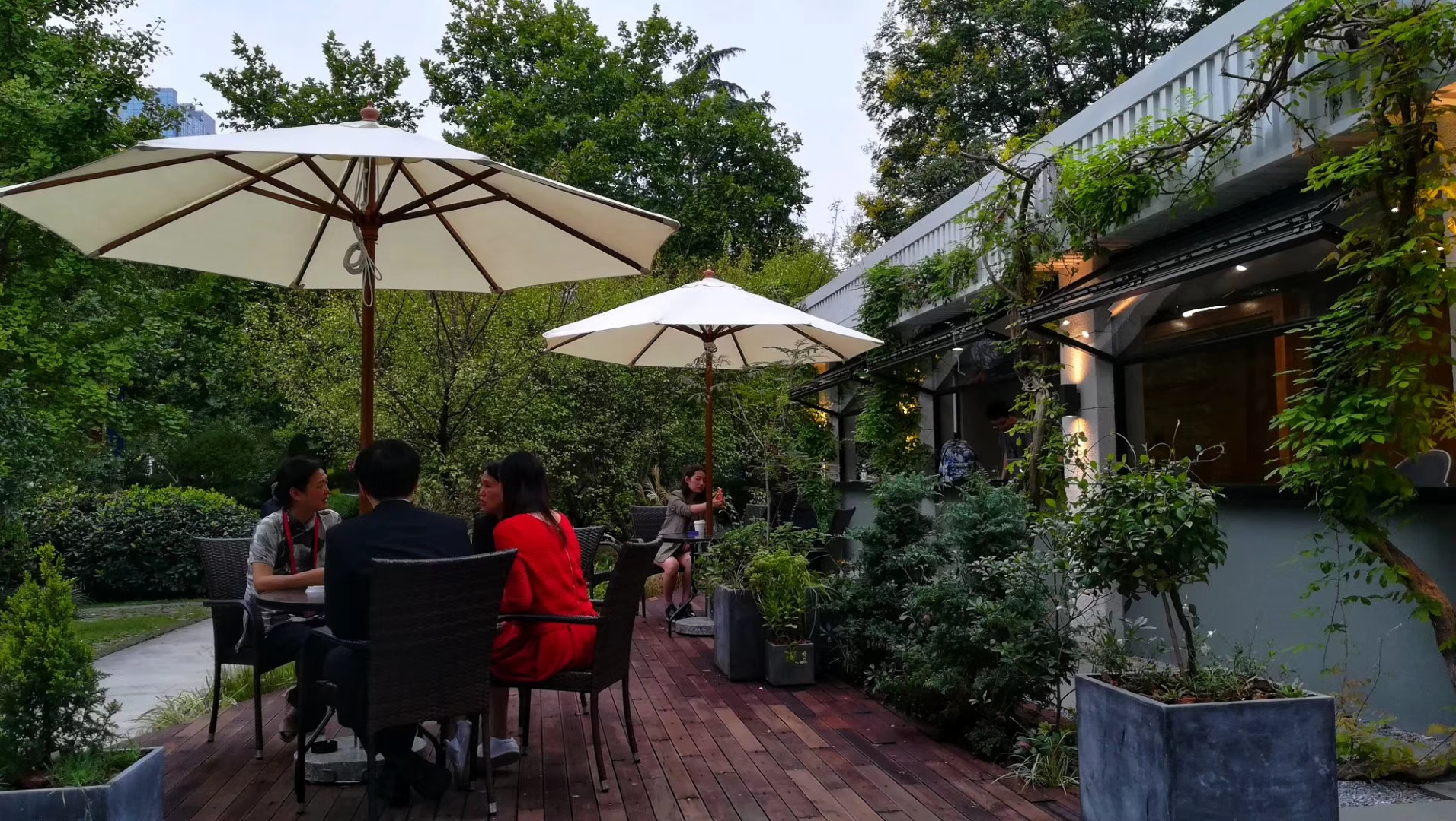
2020年外研社“教学之星”大赛
Intercultural Communication

Slide 2
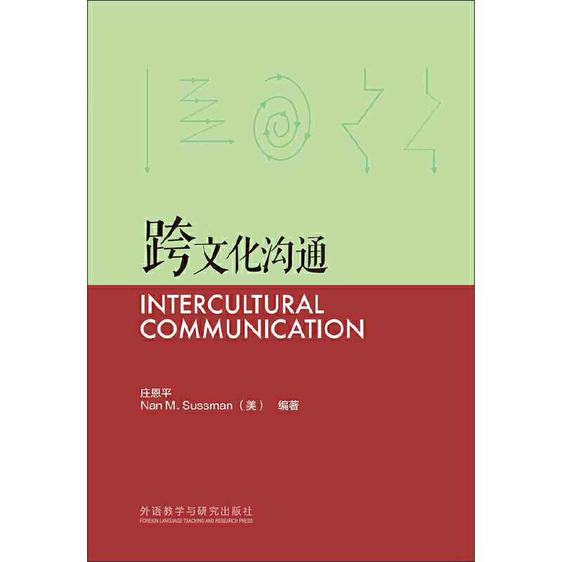
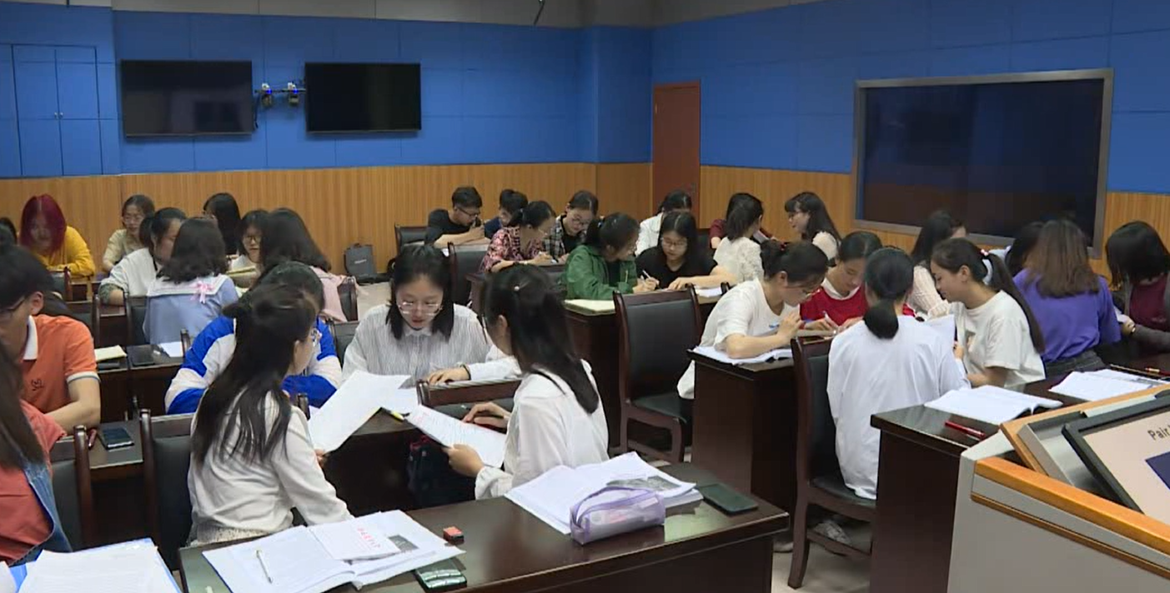
About the course and students
The textbook
Students:the third-year English Majors

Slide 3
1
Teaching Objectives
CONTENTS
2
2
Teaching Philosophy
3
Teaching Practice

Slide 4
01
Course Objectives
Unit Objectives
Teaching Objectives

Slide 5
1. Teching Objectives
1.1
Course Objectives
To develop the skills necessary to read, evaluate, and use intercultural theories.
To identify challenges that arise from these differences in intercultural interactions.
To acquire knowledge, skills and attitudes that increase intercultural competence.
To perform basic qualitative and quantitative intercultural research.
...

Slide 6
1. Teching Objectives
1.2
Unit Objectives
A
To know the nature of stereotype
B
To analyze the causes of stereotypes
Stereotype
C
To establish effective strategies to deal with stereotypes
“Unit 3 Barriers in Intercultural Communication, Reading 2”

Slide 7
02
Social Cognitive Theory：
How We Learn From the Behavior of Others
Teaching Philosophy

Slide 8
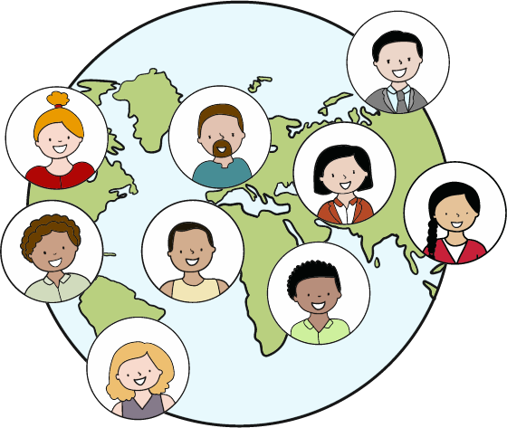
2. Teaching Philosophy
Intercultural Communication:
a process of a dialogue with culturally different others and the self

Slide 9
03
Teaching Modules
Teaching Mode
Teaching Practice
Teaching Evaluation

Slide 10
3. Teaching Practice
3.1
Teaching Modules
Intercultural
Perception
Intercultural Competence
Intercultural
Practice
phenomena
barriers
adaptation
knowledge
skills
attitudes
awareness
education
business
public diplomacy

Slide 11
3. 3 Teaching Practice
3.2
Teaching Mode
EXPAND
Being
knowledge, skills & attitudes
EXPLORE
Doing
causes and solutions
EXPERIENCE
Seeing
differences in multiple cultures
“ Experience-Explore-Expand(3E)” Teaching Mode

Slide 12
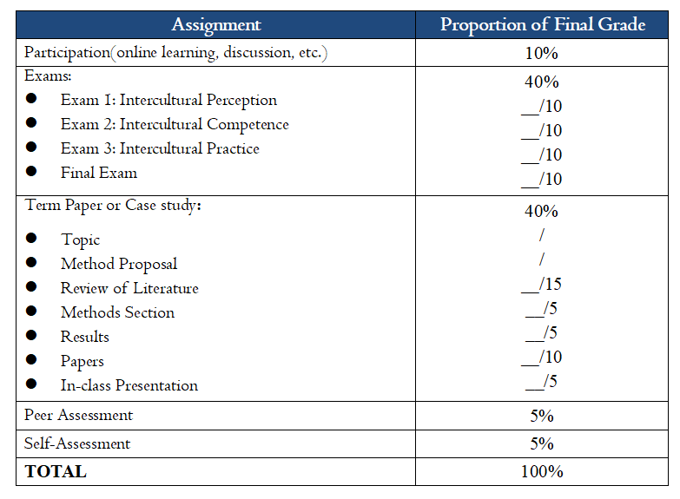
3. 3 Teaching Practice
3.3
Teaching Evaluation
Highlights
The Constructive Evaluation
Specific, measurable and achievable
Multiple evaluation tools available
Focus on improvement
Educational purposes

Slide 13
Unit 3 Barriers in Intercultural Communication
Stereotype

Slide 14
Revision
Key points
1. Relationship between globalization and intercultural communication
2. Six reasons to study intercultural communication

Slide 15
Preview Assignment
Find an example of stereotype in your eyes.
Preview
Work
Ling Chen.(Eds). (2017)Stereotyping and communication, Intercultural Communication. Berlin: De Gruyter Mouto. https://www.degruyter.com/view/title/505782
Reading
p.538-p.542

Slide 16
Learning Objectives
1
To know the nature of stereotype
2
To analyze the causes of stereotypes
3
To establish effective strategies to deal with stereotypes

Slide 17
Definition
Contents
Causes
Strategies

Slide 18
1
Definition

Slide 19
01
Definition
What is a stereotype?
Stereotypes are forms of generalization about some group of people. (textbook, p. 59)
ABOUT

Slide 20
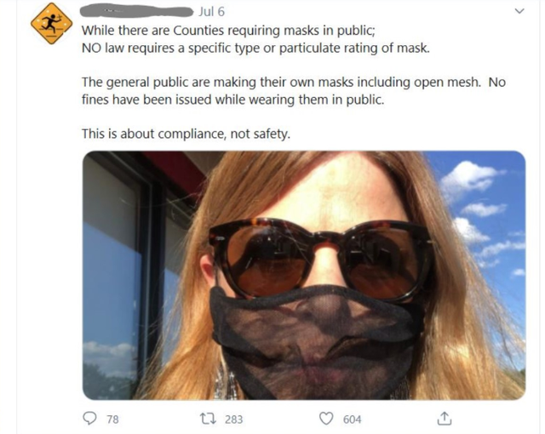
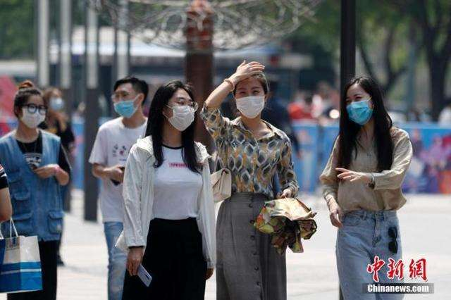
02
Case Study

Slide 21
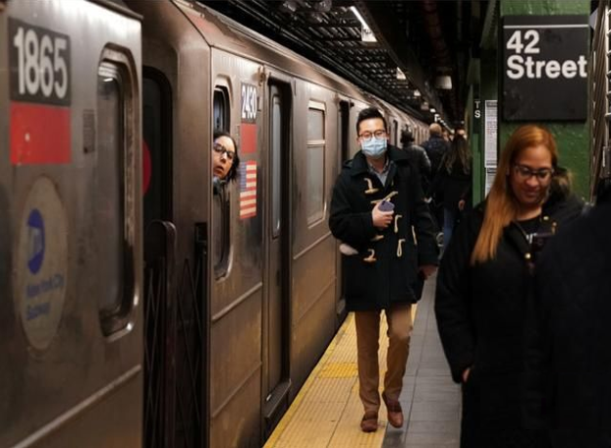
02
Case Study
Common Stereotypes about Mask-Wearing
Westerners think
Asians think
only seriously-ill patients need masks.
most diseases could cure naturally.
people with masks are gangsters.
they lack discipline.
they are irresponsible .
they are ignorant.

Slide 22
02
Case Study
Other Common Stereotypes
Westerners think
Asians think
Asians conform to rules easily.
Asian people are all good at math.
Asian people eat dogs and other weird things.
.
Westerners are individualists.
Western food is boring.
Westerners have religious belief.
Stereotypes are inaccurate.
Do not stereotype!

Slide 23
02
Case Study
What are the causes of holding these stereotypes?

Slide 24
2
Causes

Slide 25
Ling Chen.(Eds). (2017)Stereotyping and communication, Intercultural Communication. Berlin: De Gruyter Mouto. https://www.degruyter.com/view/title/505782
02
Causes
Simplistic Division of
Ingroups and Outgroups
01
02
Social Interactions
03
Media Influence

Slide 26
02
Causes： Media Influence

Slide 27
3
Strategies

Slide 28
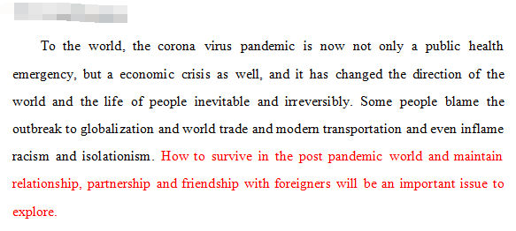
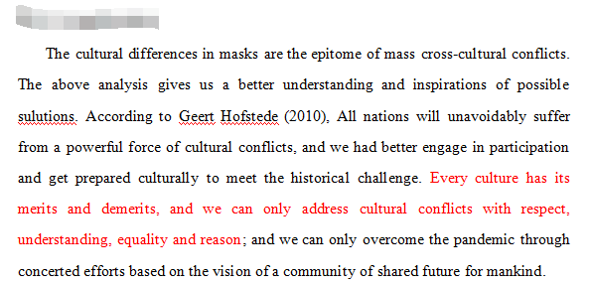
Class Writing Show

Slide 29
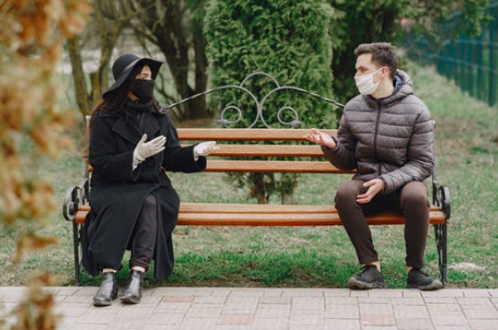
03
Strategies

Slide 30
03
Strategies
Accept different voices
Respect different ideas
Learn from each other
Develop mutually

Slide 31
Recap
Generalization
Case study
Definition
Ingroups and outgroups
Social Interactions
Media Influence
Causes
Strategies
Accept
Respect
Learn
Develop

Slide 32
Assignments
Interviewing:
Interview a friend about the way he/she deals with stereotypes.
2. Reading:
What’s Wrong in Unit 4 of the textbook.(P73-76)
3. Discussion:
What should be the cultural barrier if you would study abroad?

Slide 33
THANK YOU

