Slide 1
2020 FLtrp
star teacher contest

Slide 2
contents
Introduction
Students
Text
Teaching design
Demonstration

Slide 3
民族
Students
汉族
回族
蒙古族
哈萨克族
满族
藏族
朝鲜族
布依族
壮族
彝族
维吾尔族
土家族
黎族
瑶族
俄罗斯族
东乡族
高山族
Students by ethnicity （Fall, 2019）

Slide 4
Text Book
Text
Unit 1 Your College Years
Self-identity
National-identity
Global-identity

Slide 5
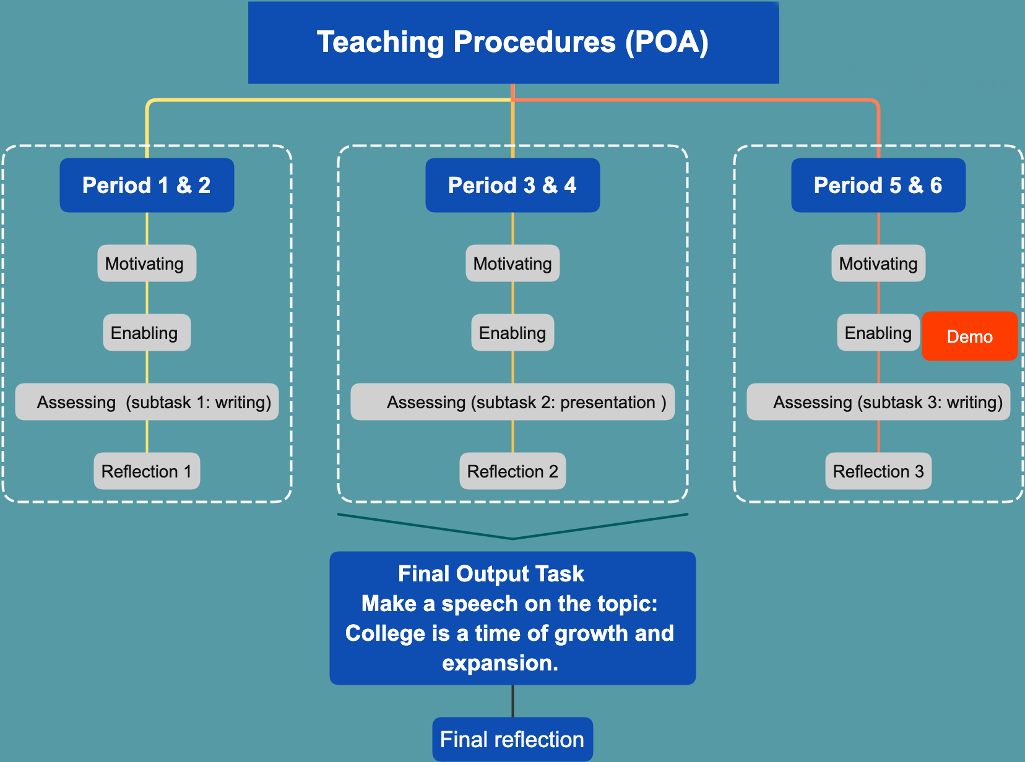
teaching design

Slide 7
four highlights
Promoting collaborative learning
Focusing on progress rather than ranking
Fostering autonomous learners
Enhancing moral education

Slide 8
unit 1 Your college years
Bob Harter

Slide 9
contents
Review
Discussion:
Global Citizen Activities
Writing:
Event Proposal

Slide 10
Who Am I

Slide 11
Who Am I

Slide 12
Who Am I

Slide 14
awareness
responsibility
participation

Slide 15
What global citizen activities can we hold?

Slide 16
global Issues

Slide 17
global Issues

Slide 18
global Issues

Slide 19
global Issues

Slide 20
global Issues

Slide 21
global Issues

Slide 22
global Issues

Slide 23
global Issues

Slide 24
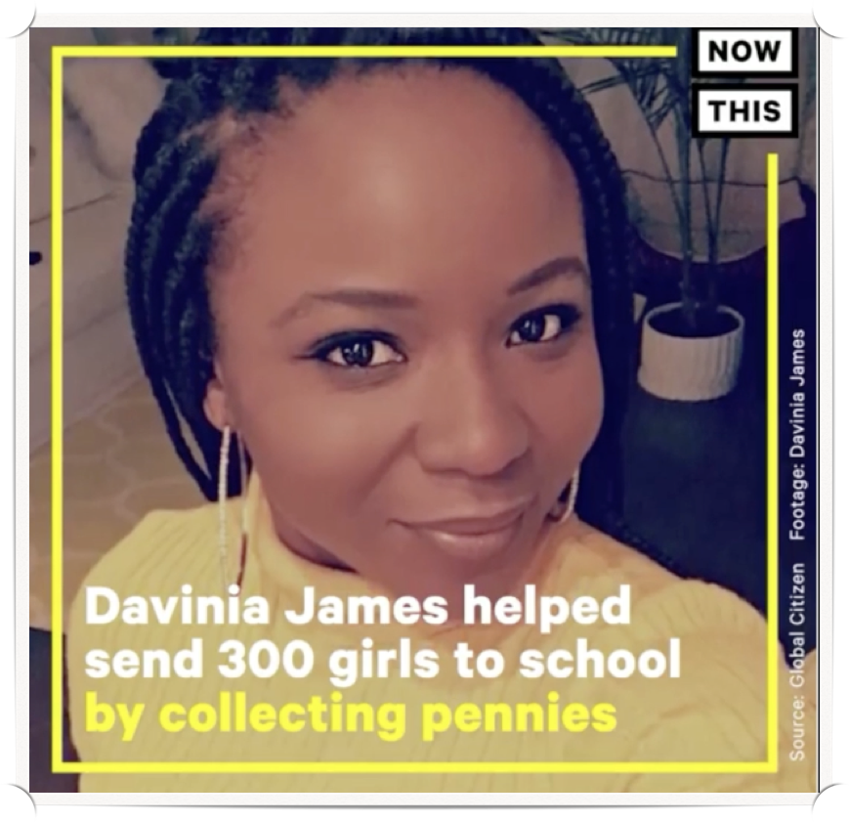
Davinia James
born in Jamaica
collecting 1.5 million pennies
helping 300 girls in Afghanistan

Slide 25
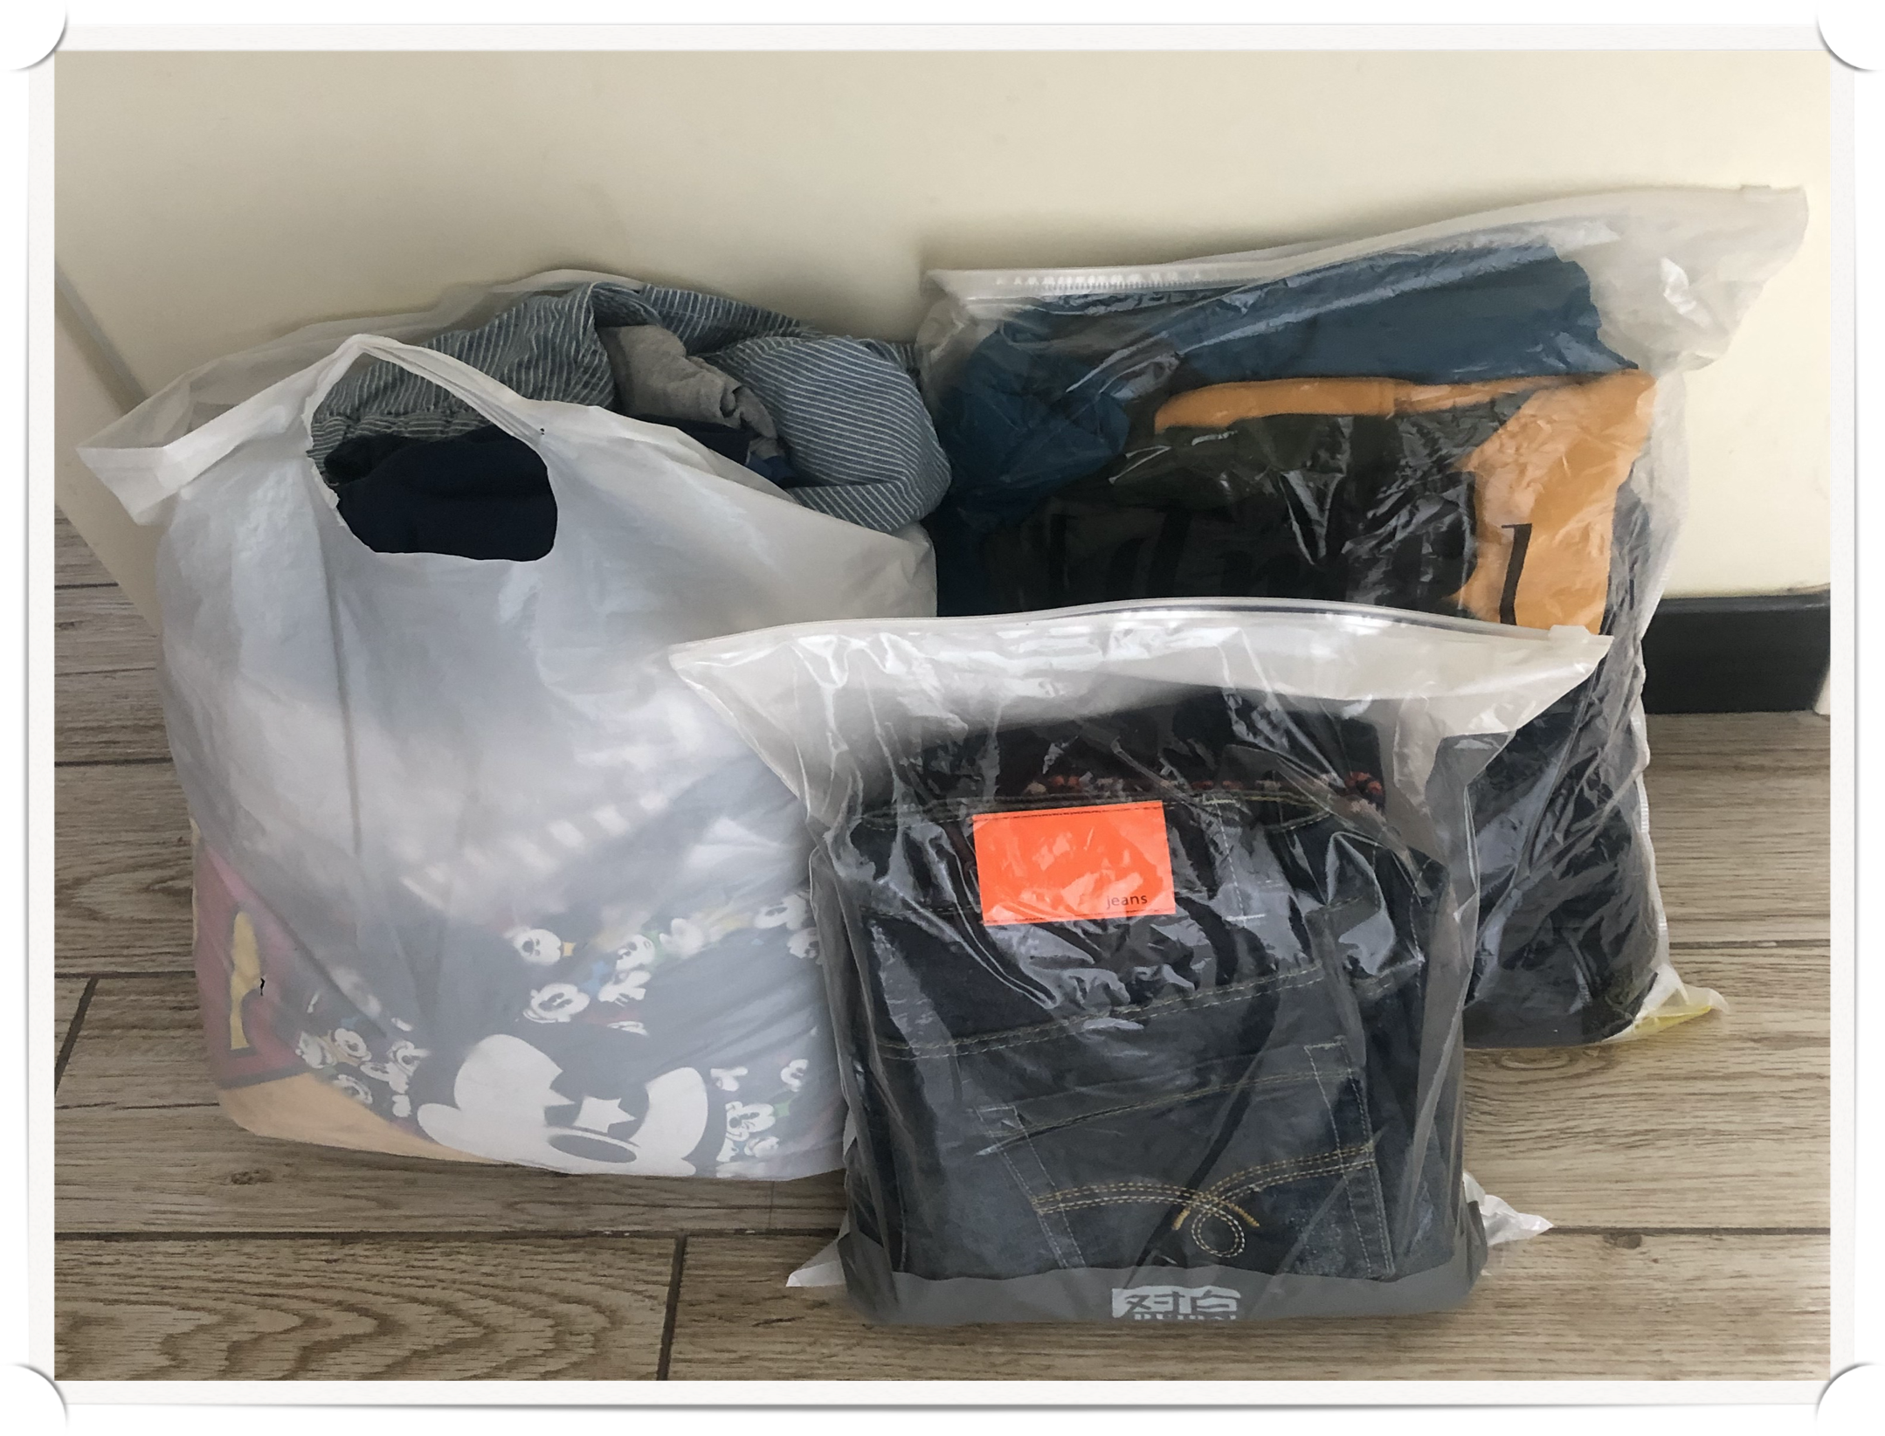
A professor
Davinia James
2007
collecting used clothes and books
Nujiang Lisu
Autonomous Prefecture
born in Jamaica
collecting 1.5 million pennies
helping 300 girls in Afghanistan

Slide 26
What global citizen activities can English major students hold?
- Group Discussion

Slide 27
Design a global citizen activity as an English major
Writing

Slide 28
Event Proposal (exposition)
Introduction
Body
Conclusion

Slide 29
Event Proposal (exposition)
Introduction
Hook
Body
Thesis
Conclusion

Slide 30
Event Proposal (exposition)
Body
Introduction
Conclusion

Slide 31
Event Proposal (exposition)
Body
Introduction
budget
objectives
flow
supplies
Conclusion
event details

Slide 32
Event Proposal (exposition)
Conclusion
Introduction
Thesis restated
Body
Broader significance

Slide 33
Event Proposal (exposition)
Introduction
Body
Conclusion
Objectives
Hook
Event details
Thesis restated
Flow
Broader
significance
Thesis
Budget
Supplies

Slide 34
Before handing in your writing
Peer
assessment
Peer
assessment
Self assessment
Teacher
assessment
Reader 1
Reader 2
Writer
Teacher
Focus:
language
Focus: ideas,
organization
Score your own writing
Assess performances of: writer
reader 1
reader 2

Slide 35
Marking symbols for writing
Error types | Symbol | Error types | Symbol
Spelling | Sp | Punctuation | P
Wrong word | WW | Capitalization | C
Word order | WO | Tense | T
Word missing | V | Redundant word | \

Slide 36
Before handing in your writing
Peer
assessment
Peer
assessment
Self assessment
Teacher
assessment
Reader 1
Reader 2
Writer
Teacher
Focus:
language
Focus: ideas,
organization
Score your own writing
Assess performances of: writer
reader 1
reader 2

Slide 37
Thank You

