Slide 1
College English Learning: Functions & the Humanities
2020 FLTRP Star Teacher Contest

Slide 2
The Teaching Context
1
The Demo Class Design
Contents
2
4
3
University, Students & Text
Learning outcomes
The TATE Model
Procedures & Assessment
Innovation in Teaching
3

Slide 3
Part 1
Teaching
Context
University, Students & The Text

Slide 4
Our university:
“A STEM University in LOST HORIZON”
诗和远方中的理工科院校

Slide 5
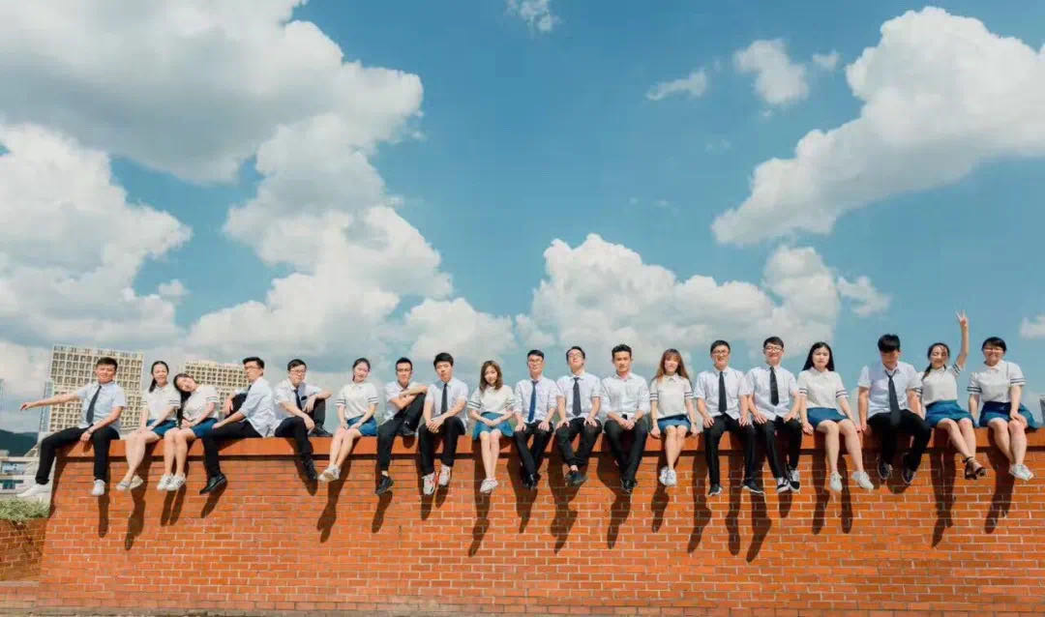
Our Students
Self-portraits in class Life in Quantity
Social media profiles
Life of Quality

Slide 6
The Text
Unit 2 Book 2
Feature
College-The Ladder to Success
Unit Goals
The humanities:
Memory & imagination
Criticality & aesthetics
Science: Truth
An essay on advantages of studying the humanities

Slide 7
Part 2
The Demo
Unit Design
University, Students & The Text

Slide 8
The Demo Unit Design
Goals
Procedures
Assessment
Linguistic and non-linguistic learning opportunities
The TATE model:
Task-supported
& focus on form
An Engaging App: Rain Class
Video Sharing Platform:
Flipgrid

Slide 9
Goals : Our Mission and Vision
Embedded learning opportunities
Linguistic learning outcomes
1. Values of the humanities
2. Voices of the humanities VS
STEM discourse
1. Systems-related
2. Skill-related
3. Discourse-related:
3. Transformation of Personas
Utility, Morality and Beauty

Slide 10
The TATE Model (Anderson 2020)
Text
Exploration
meaning-content
Post-task evaluation
Analysis
Task ***
target features of grammar or lexis
productive skills practice
* Task + form focus (before, during and after)
* Implicit + explicit learning

Slide 11
Procedure: Text
Time frames
Procedures
Embedded goals: the value of the humanities
Despite being red, Mars is a cold place
Phase | Time frame | Procedure | Possible occurrences and responses
Text | 30-35 m Online Offline | Prior to the class 1. SPOC & Quiz (on signposts) During the class 1. Activity: Mix and Match 2. The meaning-content of the text | Stronger readers : one more similar passage The weaker: a few minutes more for dictionary use
It’s a gas giant and the biggest planet
Yes, this is the ringed one. It’s a gas giant

Slide 12
Procedure: Analysis
Embedded goals: cognitive development with the humanities
Phase | Time frame | Goal & Procedure | Possible occurrences and responses
Analysis | 30-45 m In class | 1. Activity: sentences reconstruction (using gerund as subjective) 2. Activity: arrange order of values 3. Discussion: Why in the order of the text? | Errors in using gerund: Noticing & awareness-raising (corpora)

Slide 13
Procedure: Task
Task performance: An Algorithm in My Life: The Humanities
Embedded goals: The humanities VS science
Phase | Time frame | Procedure | Possible occurrences and responses
Task | 40-45 m Online | 1. Reflection and action plans 2. i-Write writing (draft) 3. Online sharing of videos on “Flipgrid” | Translanguaging
It’s a gas giant and the biggest planet

Slide 14
Flipgrid

Slide 15
Procedure: Exploration
Embedded goals: metamorphosis
Phase | Time frame | Procedure | Possible occurrences and responses
Post-task | 25-30 m In class | 1. Self-, peer, and teacher evaluation 2. Input of alternative lexis, functional exponents and structures | Responsive focus on emergent language use
It’s a gas giant and the biggest planet

Slide 16
Assessment
U Campus
Rain Class
Flipgrid
TEACHERS Proactive & Reactive
+
+
Exercises
Textbooks
exercises
Instant Monitoring
Quizzes
Post
Video Sharing
Self-, peer- and teacher evaluation

Slide 17
Part 3
Innovation in Teaching
Innovation/high order/challenge

Slide 18
Innovation in teaching
Toolbox:
Teachers:
Text:
AR technology /Video sharing platform
Transformation: Social science/Science
Learner-oriented constructive approaches

Slide 19
References
* 教学设计：
[1] 大学英语教学指南（教育部2017最新版）
[2] 中华人民共和国教育部,教育部关于深化本科教育教学改革, 全面提高人才培养质量的意见, 2019-10-30, http://www.moe.gov.cn/srcsite/A08/s7056/201910/t20191011_402759.html
[3] 中华人民共和国教育部,普通高等学校本科专业类教学质量国家标准[S].北京:高等教育出版 社,2018.
[4]季佩英等.基于语言课程设计模型的大学英语课程设置与评估[J]. 中国外语，2016(1):68-76.
[5] Anderson, J. Affordance，learning opportunities, and the lesson plan pro forma. ELT Journal 69(3):228-238.
[6] Anderson, J. The TATE model: a curriculum design framework for language teaching. ELT Journal 74(2): 175-184.
* 语言与育人融合：
[8]文旭. 从 “自 由 ”到 “全 人 ” ———美国大学育人理念的嬗变及其对我国外语教学的启示[J]. 外语教学理论与实践.2017(2):50-56.
[9]朱桂荣. 外语教育改革背景下日本初中英语教材育人观的体现研究[J].外语教育研究前沿,2019(3):28-35.
* 反思性教学：
[10]Gibbs, G (1988) Learning by Doing: A guide to teaching and learning methods. Oxford Polytechnic.

Slide 20
Thanks

Slide 21
The humanities: Out of date?
New Horizon College English
UNIT 2

Slide 22
Learning outcome
signpost
Read
Reflect
React
complex ideas and understand their meanings
on the true value of humanities
by planning to learn more about humanitiy
By the end of lesson, Stem students will be able to

Slide 23
Part 1: Review
1. SPOC video prior to class
2. A quiz on “Signposts” in reading
The analysis and feedback on your preview

Slide 24
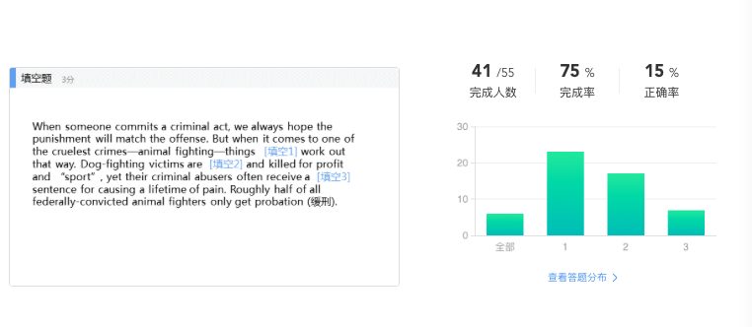
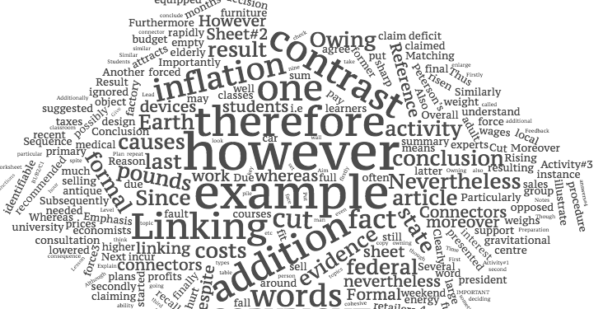
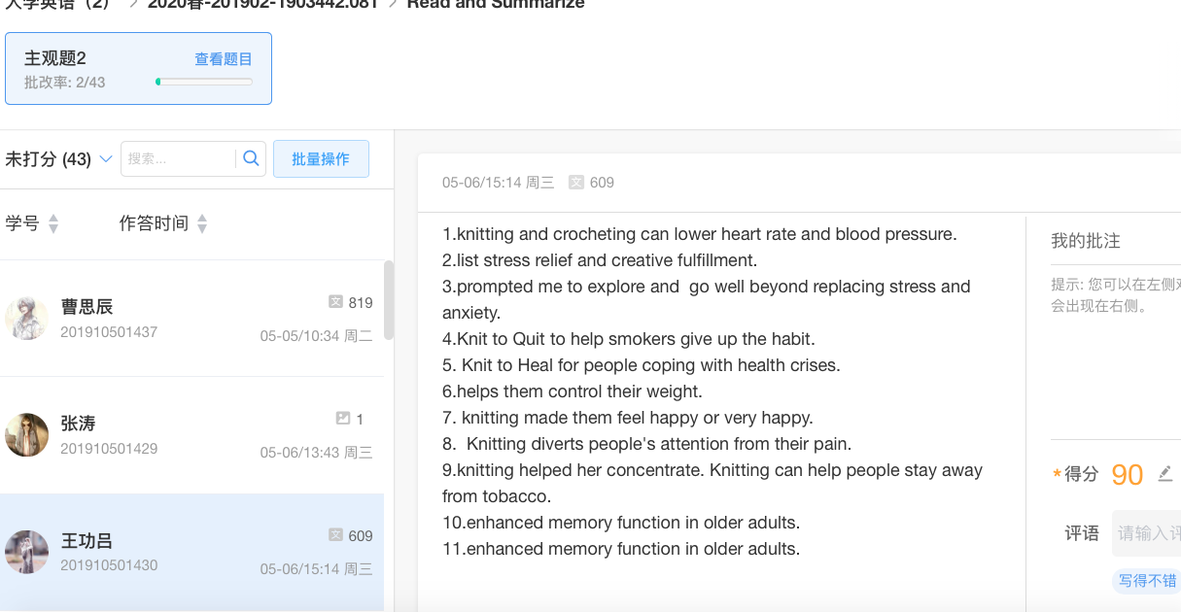
Resource & Quiz on signposts prior to the class

Slide 25
Part 2: Read & Reflect
Step 1: A reading activity
Step 2: The logic behind the sequence of true value
The true value of the humanities

Slide 26
The Reading Strategy: Signposts
Superlative degree
Emphasis
comparison
Similarly, likewise, Again and Also…
contrast
The best. Most importantly. Indeed. In fact
Rather, However, In contrast, conversely

Slide 28
Signpost 1: very (P5)
Meaning: used to emphasize

Slide 29
Reading with Signposts
Studying the humanities improves our ability to read and write. No matter what we do in life, we will have a huge advantage if we can read complex ideas and understand their meaning. We will have a bright career if we are the person in the office who can write a clear and elegant analysis of those ideas!
Signpost 1：very
P5：From the beginning of time, this inner aspect of our being, this drive that can be constructive or destructive, has captured our imagination. The stories of this amazing struggle have formed the basis of cultures the world over. Historians, architects, authors, philosophers and artists have captured the words, images and meanings of this inner struggle in the form of story, music, myth, painting, architecture, sculpture, landscape and traditions. These men and women developed artistic “languages” that help us understand these aspirations and also educate generations. This fertile body of work from ancient times, the very foundation of civilization, forms the basis of study of the humanities.

Slide 30
An activity
Signposts
Value
Order
What phrases?
What pattern?
Why the order?
To utilize signposting phrases to spot the true value of humanities and list them in order

Slide 31
Reading with Signposts
Signpost 2：no matter
Studying the humanities improves our ability to read and write. No matter what we do in life, we will have a huge advantage if we can read complex ideas and understand their meaning…
Signpost 3：Most importantly
…Yet, very few people have the ability to create a spectacular brand: the iPod. Most importantly, studying the humanities invests us with great insight and self-awareness, thereby releasing our creative energy and talent in a positive and constructive manner.
Studying the humanities improves our ability to read and write. No matter what we do in life, we will have a huge advantage if we can read complex ideas and understand their meaning. We will have a bright career if we are the person in the office who can write a clear and elegant analysis of those ideas!
Signpost 4： the best
Perhaps the best argument in favor of the humanities is the scope of possibilities that are widely open to us. …It‘s easy to see that the humanities can prepare us for many different careers and jobs we can undertake…

Slide 32
The True Value of the Humanities
The very
No matter
Most importantly
The best argument
The ideal
P5: The very foundation of civilization
P6: Read complex ideas & understand them
P7: Great insight releases our creativity
P8: The scope of possibilities
P9: A pairing of technical knowledge & inner insight

Slide 33
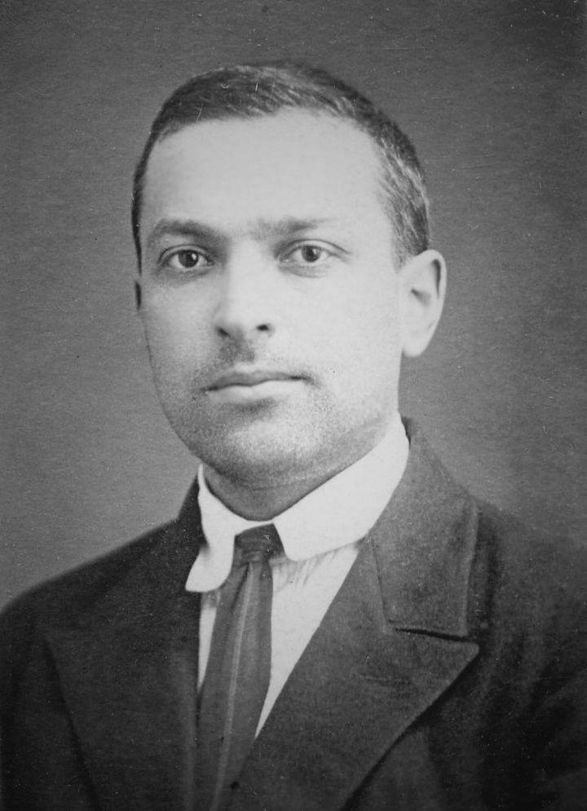
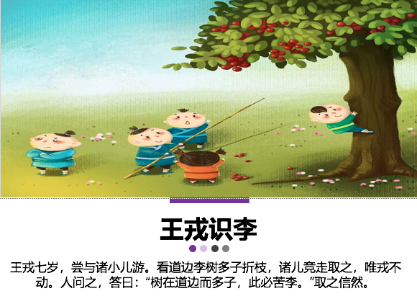
Why this sequence?
P5. Capture
P6. Understand
Learn about civilization
be clear and elegant
P7. Gain insight
P8. Expand scope
行千里、破万卷 尽精微、致广大 《中庸》
Cognitive development:
Social interaction (Vygotsky 2000）
Release creativity
Make breakthroughs

Slide 34
Part 3: React
Actions to take to be a well-rounded person

Slide 35
Assignment:
What‘s your plan of studying the humanities in terms of the 4 aspects?
The very foundation of civilisation
Our ability to read and write
The release of creativity
The scope
To capture the fertile body of work:
culture
Vision
Myth
Painting
Architecture
Sculpture
To understand complex idea
Write clear
Write elegant
How to make an ipod from a MP3 player
(be spectacular)
Potential
breakthrough

Slide 36
Flipgrid

Slide 37
To be a well-rounded person
Natural Sciences = utility (STEM students: triumph)
Social Sciences = morality
The Humanities = beauty

Slide 38
Thanks
XXX
136XXXX8163
chriswangcq@126.com

