Slide 1
Unit 5 Why Culture Counts
2020 FLTRP Star Teacher Contest

Slide 2
Introduction
Demonstration

Slide 3
Contents of the Introduction
Materializing Our University’s Pedagogical Model
Integrating Language Training and Moral Education
Highlights and Innovations

Slide 4
1. Materializing Our University’s Pedagogical Model
cultivating capabilities & developing of individualities
improving students’ English communication skills and intercultural competences
- basic English proficiency
- innovative, curious, and self-expressive attitude
Five-C Standards for Foreign Language Learning

Slide 5
1. Materializing Our University’s Pedagogical Model
Five-C Standards
Communication
Cultures
Connections
Comparisons
Communities

Slide 6
1. Materializing Our University’s Pedagogical Model
Language Skills
Intercultural
Competences
Online Resources
Extra Readings
Video
Materials

Slide 7
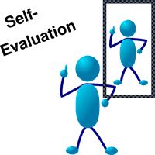
1. Materializing Our University’s Pedagogical Model
Multiple Evaluation:
No. | Evaluation Content | Proportion
1 | Attendance / Participation | 10%
2 | Internet Assignment | 10%
3 | Group Work | 10%
4 | Transcultural Discussion | 10%
5 | In-class Reflection | 5%
6 | Mid-term Exam | 20%
7 | Final Exam | 30%
8 | Final Reflective Essay | 5%

Slide 8
2. Integrating Language Training & Moral Education
Text for the Lesson
Objectives for the Lesson
Plan for the Lesson

Slide 9
2.1 Text for the Lesson
Unit 5 Why Culture Counts
narrates from the perspective of a second-generation Chinese American
features vivid dialogues
reveals the stereotypes of Chinese culture
1. train writing skills
2. improve intercultural awareness
3. strengthen cultural confidence

Slide 10
2.2 Objectives for the Lesson
We expect students to be able to:
1. talk about one stereotype of either Chinese or Western culture
2. write a short story that prioritizes dialogues
3. be aware of cultural differences between China and America
4. know the significance of dialogues in writing and intercultural relations

Slide 11
2.3 Plan for the Lesson
Session 1 (90 mins)
Session 2 (90 mins)
Session 3 (90 mins)
Period 1
Period 2
Period 1
Period 2
Period 1
Period 2
University’s Principle
Five-C Standards
Dual
Goal
+
+

Slide 12
Session 2 Demo Session:
Tips for writing vivid dialogues
Roles of dialogues in a narrative and intercultural communication
Stereotypes of Chinese culture
Significance of constructive dialogue

Slide 13
3. Highlights and Innovations
Pedagogical theory: Five-C standards
Blended teaching mode: online courses & classroom activities
Dual principle: language training & moral education
characterizing in narration
Effective Dialogues
constructing positive intercultural relations

Slide 14
References
[1] American Council on the Teaching of Foreign Languages (ACTFL). Standards for Foreign Language Learning: Preparing for the 21st Century [S]. Kansas: Allen Press, 1996.
[2] 多元智能理论视角下“大学英语”教学评价体系的构建[J]. 淮海工学院学报 (人文社会科学版), 2019, (17): 135-137.
[4] 借鉴美国多元教学评价探讨大学英语多元评价体系[J]. 高教论坛, 2016, (5): 122-128.
[5] Why Culture Counts, New Horizon College English 4, 郑树棠, 2015.
[5] 唐建福. 美国 5C 标准下综合英语教学设计研究[J]. 江苏外语教学研究, 2016, (2): 4-6.
[6] 王宁, 刘晓琳, 张建丽. 基于“5C”标准的大学英语主题式教学设计[J]. 长沙理工大学学报(社会科学版), 2014, (29): 128-131.
[7] 王守仁.《大学英语教学指南》要点解读[J].外语界,2016（3）：2-10.

Slide 15
Introduction
Demonstration

Slide 16
T e x t A :
S p e a k i n g C h i n e s e
i n A m e r i c a

Slide 17
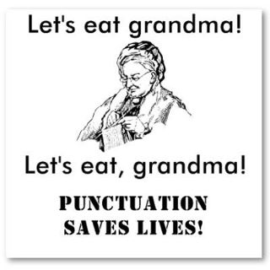

Slide 18
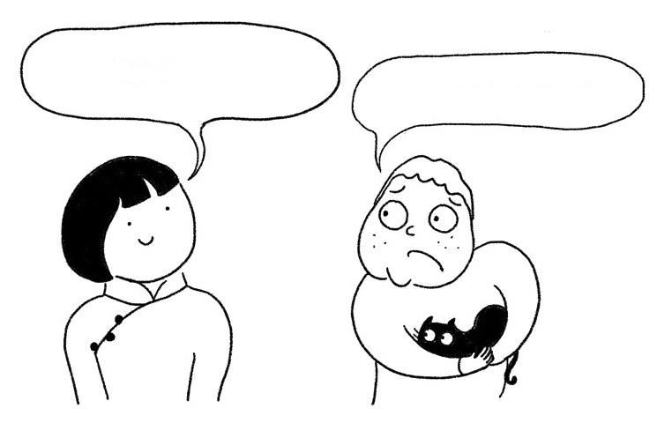
I’m from China.
Nice to meet you.
Don’t eat my cat.

Slide 19
Writing skill: an Effective Dialogue
Why?
What?
How?

Slide 20
Why do we need dialogues in a narrative?

Slide 21
personalities
backgrounds
moods
Dialogues
interests
feelings
thoughts

Slide 22
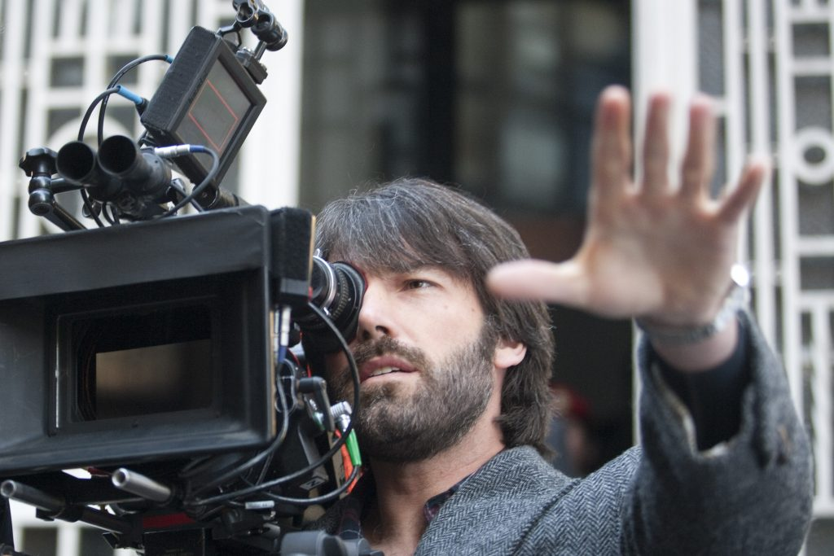
Question: What’s the man’s job?
Director.
Picture’s up! Quiet on the set! Roll sound! Roll Camera! And.…action!
fulfill characterization

Slide 23
2. How to write effective dialogues in a narrative?

Slide 24
Fleshing out Dialogues
dialogue tags
he said
they said
a child said
a man said
a woman said
alternate dialogue tags
he screamed
they laughed
a child complained
a man argued
a woman sighed
action tag
“Don’t touch that,” Tom grabbed his son’s hand before it landed on the hot stove.

Slide 25
What dialogues should we use?

Slide 26
What is the purpose of the dialogue?

Slide 27
A dialogue from the text (Para. 5-7 )
Do you think that Sau-sau is really full?
What does the author’s mother really mean?
“Full, I’m already full,” Sau-sau muttered weakly, eying the scallop. “Ai!” exclaimed my mother. “Nobody wants it. It will only rot!” Sau-sau sighed, acting as if she were doing my mother a favour by taking the scrap off the tray and sparing us the trouble of wrapping the leftovers in foil.

Slide 29
A dialogue from the text (Para. 5-7 )
Suppose you were an American reader, you know nothing about Chinese culture, what would you think of Sau-sau and Mother?
“Full, I’m already full,” Sau-sau muttered weakly, eying the scallop. “Ai!” exclaimed my mother. “Nobody wants it. It will only rot!” Sau-sau sighed, acting as if she were doing my mother a favour by taking the scrap off the tray and sparing us the trouble of wrapping the leftovers in foil.

Slide 30
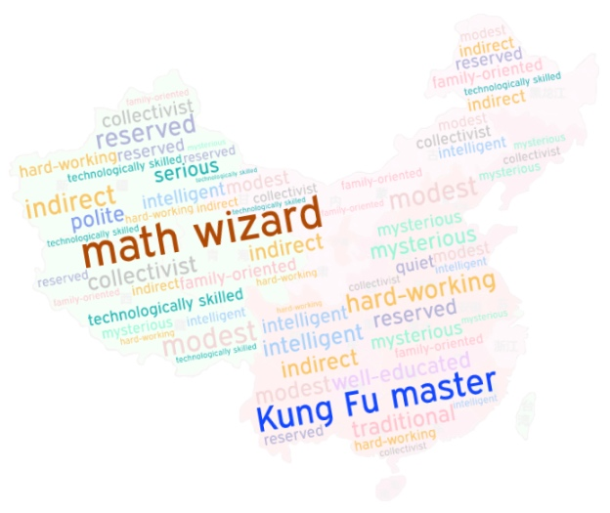
Source: Zhu Lin (2016, November 1). A Comparative Look at Chinese and American Stereotypes. Journal of Intercultural Communication, 42. Retrieved May 3, 2020, from https://immi.se/intercultural/nr42/zhu.html

Slide 31
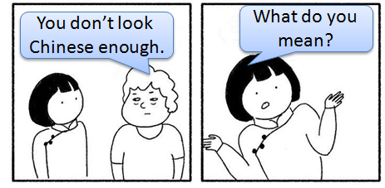
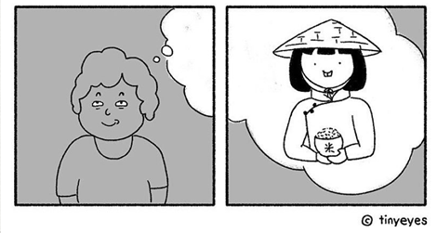
A stereotype is a double-edged sword.
- Distinguish a particular culture
- Reduce outside members' anxiety
- Simplified generalizations
- Barriers of communication

Slide 32
Truth is not born nor is it to be found inside the head of an individual person. It is born between people collectively searching for truth, in the process of their dialogic interaction.
—— Mikhail Bakhtin

Slide 33
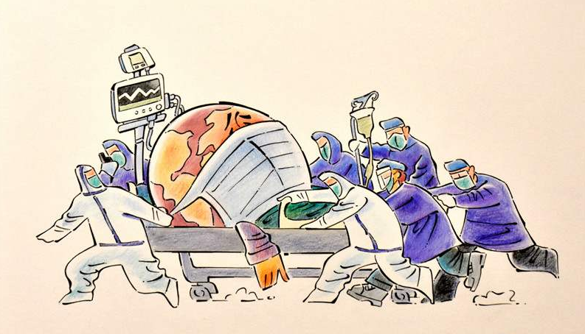

Slide 34
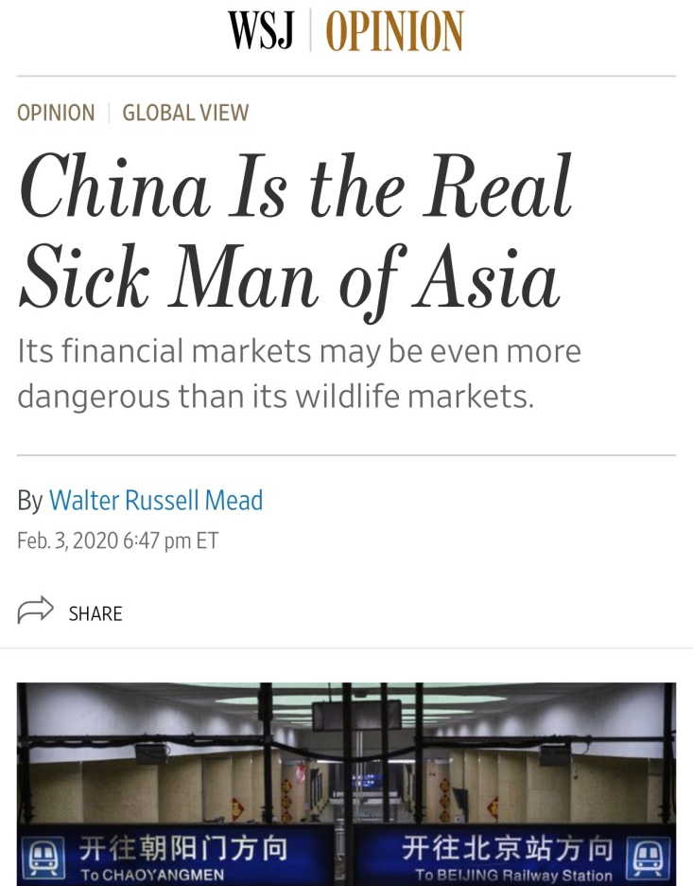
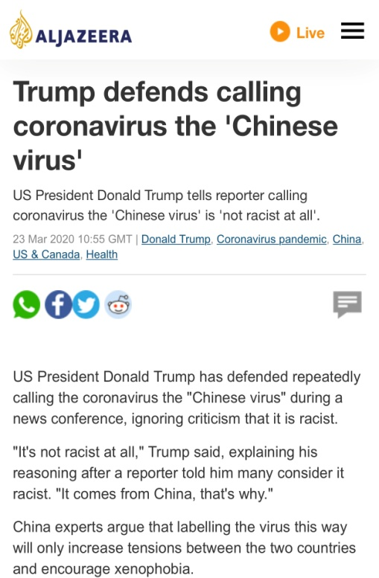
Stigmatize
污名化

Slide 35
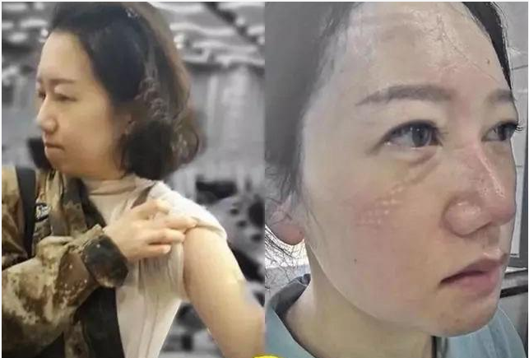
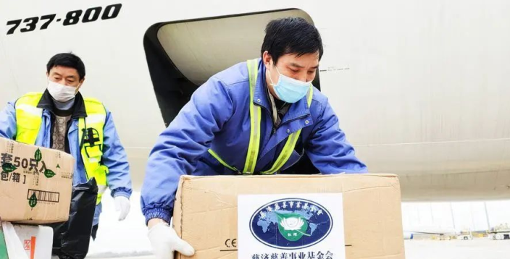
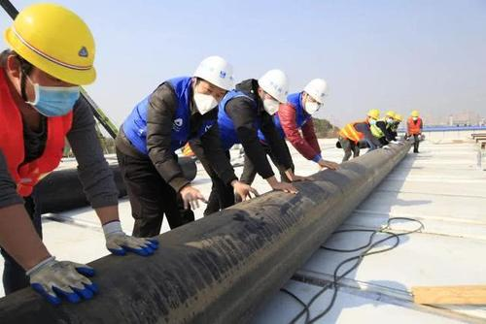
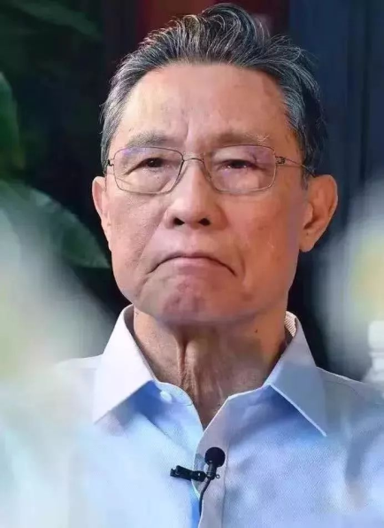
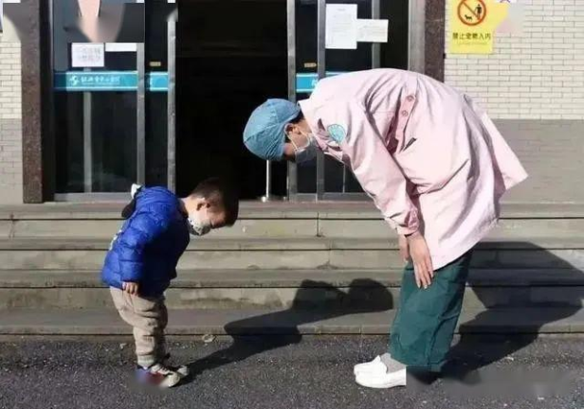
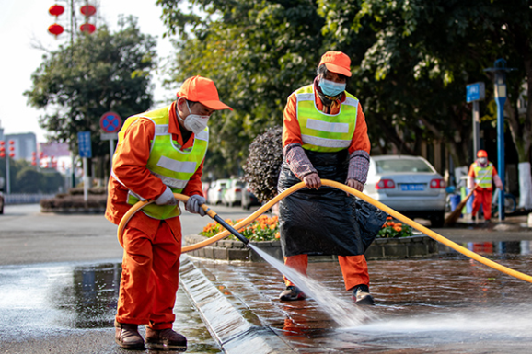
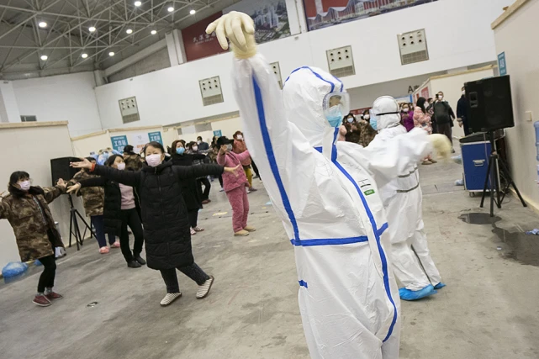
China’s fight against COVID-19
Chinese qualities:
Unity
Diligence
Bravery
Optimism
Wisdom
Kindness
Integrity
…

Slide 36
Harmony prevails by way of difference;
Togetherness endures by way of reciprocity.
和而不同，美美与共。
——著名社会学家、人类学家 费孝通

Slide 37
Let’s transcend stereotypes. Let’s take the initiative to seek dialogues.

Slide 38
An effective dialogue
A community of shared destiny

Slide 39
Assignment
Modify your dialogue using what we have learned today, submit it on before our next class.
Share writings in your group and choose the best one.

Slide 40
感
谢
T h a n k
y o u

