Slide 1
FLTRP STAR TEACHERS 2020
A Learner-Centered Instructional Design
for
College English 3

Slide 2
The ADDIE Model of Instructional Design
1
Analyze
needs; learning styles
2
Design
goals; objectives; materials
3
Develop
strategies; procedures;activities
4
Implement
scaffolding; discovery-learning
5
Evaluate
self-regulated learning;effectiveness

Slide 3
I. ANALYZE
1. Needs:
intrinsic: English listening & speaking > reading & writing
external: English learning & life learning
2. Learning Style & Learning Environment:
Mostly engineering majors in an average Tier 3 university hosting over 100 international students.

Slide 4
II. DESIGN
GOALS
College English 3 as the goalkeeper for global competence
OBJECTIVES
Knowledge
Skills
MATERIALS
Unit 1 Discovering Yourself@Unipus
Ding Talk virtual classroom
References ； PowerPoint slides
Attitudes
Values

Slide 5
2.1 Learning Goals of College English 3
To further develop learners’ ESL competencies and prepare them for our increasingly globalized world as competent college grads, Chinese citizens, and young adults capable of living, thinking and acting ethically with clear purposes of life.

Slide 6
2.2 Learning Objectives Framework
English Curriculum (CCIP)
Critical Reading Competence
Communicative Competence
Intercultural Competence
Professional Development Competence
Life Curriculum (SBVS)
Self Development
Behaviorial Health
Value Orientation
Sense of Responsibility

Slide 7
2. 3 Unit 1 Discovering Yourself
Text A Catching Crabs
Text B We Are All Dying
Text C Rites of Passage

Slide 8
2.4 Learning Objectives for Unit 1
1. Communicative Reading：learners can understand, respond and evaluate the ideas in all 3 texts.
2. Communicative Competence：learners can describe and discuss the form and content of the texts;
can present Text A as a 3-act play in the classroom.
3. Self Development: learners can caution against crab mentality (demo) and act now for what they want in life.
4. Value Orientation & Intercultural Learning: learners can compare views of life in Text B with their own, and that of Laozi and Zhuangzi.

Slide 9
2.5 Learning Objectives for Demo Session
1. Communicative Competence: the story as a performance text; discussions about metaphorical thinking & crab mentality
2. Critical Reading: Why crabbing? Why the story？
3. Self Development & Professional Development: thinking for oneself in career planning.
4. Behavioral Health: caution against crab mentality
5. Value Orientation: emotional learning of gratitude;
aesthetic education

Slide 10
III. DEVELOP
Strategies
1.Drama-Based Pedagogy (DBP)
2. Inquiry-based Learning (IBL)
Procedures
1. Pre-class self-regulated learning (Unipus; drama adaptation)
2. In-class tasks: Why crabbing? What is crab mentality and metaphorical thinking? Why the story?
Activities
1. Act 3 of Text-based drama (Paras.19-35) & Collaborative Assessment
2. Discovery-learning: Why crabbing (multiple choice)
3. Pair Work: Memory is (like) —— （metaphorical thinking)
4. Group Discussion: My Career Plan and Risks of Being Pulled Back
5. Discovery-learning: Why the story (multiple choice)

Slide 11
IV. IMPLEMENT
Why crabbing?
Father's point & his metaphorical thinking
crab mentality
career plan & risks of being pulled back
Why the story?
a memory of love & gratitude told in first-person narration
Salvador Dalí's oil “The Persistence of Memory”(1931)
(emotional learning & aesthetic education)
Lead-in: Video performance of Act 3
As wrap-up only

Slide 12
V. EVALUATE
Drama project as implicit summative assessment of self-regulated learning;
rubrics for collaborative subjective assessment
Pair work & group discussion as implicit assessment
4
1
Objective assessment for why crabbing and why the story.
3
2
Uploaded videos as part of portfolio for formative assessment.

Slide 13
References
Brown, A.H & Green, R. D.(2016). The Essentials of Instructional Design,3rd edition. New York & London: Routledge.
Dawson, K. & Lee, B.K (2018). Drama-based Pedagogy: Activating Learning Across the Curriculum. Bristol:Intellect Books.
Greennall, S. &文秋芳 （2017). New Standard College English· Real Communication: An Integrated Course, 2nd edition. Beijing: Foreign
Language Teaching and Research Press.
Lakoff, G.& Johnson, M. (1980). Metaphors We Live By. Chicago: University of Chicago Press.
Mayfrield, M.(2014). Thinking for Yourself. Boston: Wadsworth.
Mitchell, R., Myles, F.& Marsden, E. (2013). Second Language Learning Theories, 3rd edition. London& New York: Routledge.
Seel N.M, etal(2017). Instructional Design for Learning. Rotterdam: Sense Publishers.
Water, M., McAvoy, M & Hunt, K (2014). Drama and Education: Performance Methodologies for Teaching and Learning. London & New
York: Routledge.
Wen, Q.F. [文秋芳] (2015). 构建“产出导向法”理论体系[J]. 外语教学与研 究，47 (4):547-558.
Winston,J. (2011).Second Language Learning Through Drama: Practical Techniques and Applications. London & New York: Routledge.

Slide 14
Unit 1 Discovering Yourself

Slide 15
Reading 1: Catching Crabs

Slide 16
Adaptation of Active Reading 1
Act 1
“OMG, it is my final year at college!”
Act 2
“To be a lawyer or to a writer?”
Act 3
“Son, let's go crabbing!”

Slide 18
Assessment | A | B | C | D | E
Creative Writing (Adaptation) |  | √
English Expression | √
Collaboration | √
Performance |  | √
Remarkable Details | Casting of “Dad” and son (Andy) Tones and rhythms to express emotions. localization of “sisters and brothers” into “cousins”. Vocabulary: “fellow captives” (crabs)
Overall Impression | √

Slide 19
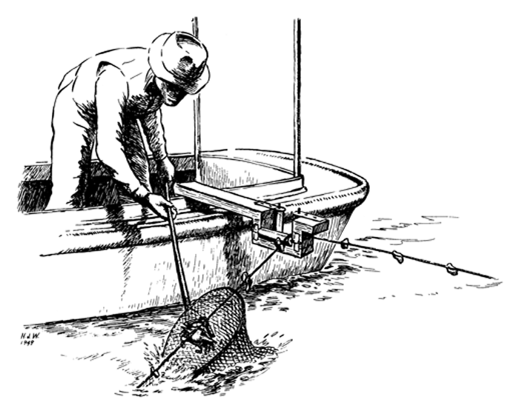
Act 3 “Son, Let's go crabbing”
Why Crabbing?

Slide 20
Why does the father take the boy to go crabbing?
A. They both love the sport.
B. It’s a Thanksgiving family tradition.
C. Father wants to bond better (feel closer) with his son.
D. Father has a point to make with crabs in the bucket.

Slide 21
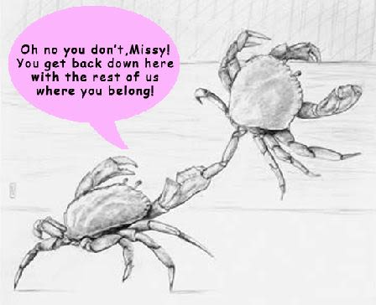
Think Metaphorically
Don’t get pulled back by others.

Slide 22
Metaphorical Thinking （隐喻思维）
All the world’s a stage,
And all the men and women merely players;
– As You Like It
（《皆大欢喜》） William Shakespeare (1564-1616)

Slide 23
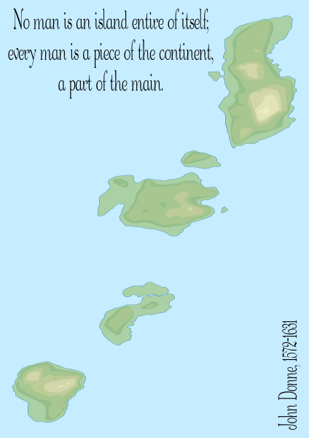

Slide 24
Pair Work: Metaphorical Thinking ( 2 m.)
Life is ______.
Memory is ______.

Slide 25
“Our ordinary conceptual system, in terms of which we both think and act, is fundamentally metaphorical in nature.”
― George Lakoff & Mark Johnson, Metaphors We Live By （1980）

Slide 26
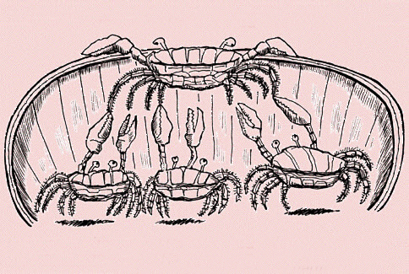
Crab Mentality (螃蟹心理)
…“Don’t get pulled back by the others, spend some time figuring out who you are and what you want in life”…
―Para. 28

Slide 27
Look back at the classes you’re taking, and think about which ones were most productive for you personally.
Then think about what’s really important to you, what really interests you, what skills you have.
Try to figure out where you want to live, where you want to go, what you want to earn, how you want to work.
And if you can’t answer these questions now, then take some time to find out. Because if you don’t, you’ll never be happy.”
― Para. 28

Slide 28
Group Discussion (5 m.)
In groups of four, discuss:
My Career Plan and Chances of Being Pulled back

Slide 29
Why does the author tell us the story of catching crabs?
A. He misses his final year at college.
B. He misses crabbing with his father.
C. He wants to return his father of gift of love by spreading his word in appreciation (gratitude).
D. He wants to prove his plan of becoming a writer has succeeded.

Slide 30
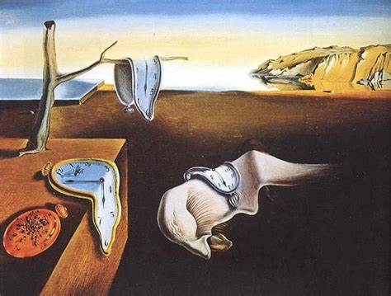
The Persistence of Memory
Oil on canvas 1931
Salvador Dalí

