Slide 1
FLTRP Star Teacher
Part A Introduction
2020

Slide 2
Contents
1
One Guideline
2
Two Participants
Contents
3
Three Focuses

Slide 3
1. One Guideline
Advanced
Innovative
Challenging
Golden Course
Language
Morality

Slide 4
2. Two Participants
Interview
about TikTok
Students’ preparation
Language / Ideas
Reports
Critical and logical thinking
Raw materials
Unit 5
News 24/7
Teacher’s restructuring
New knowledge
Language
Morality
Objectives
Language: Identify and refute logical fallacies
Morality: 1) Critical and logical thinking
2) Deeper love for China

Slide 5
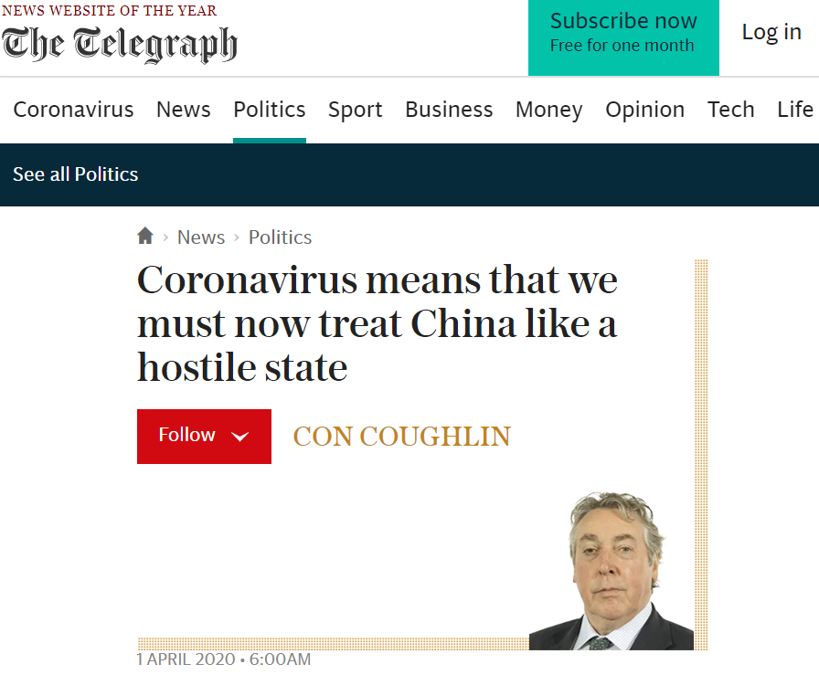
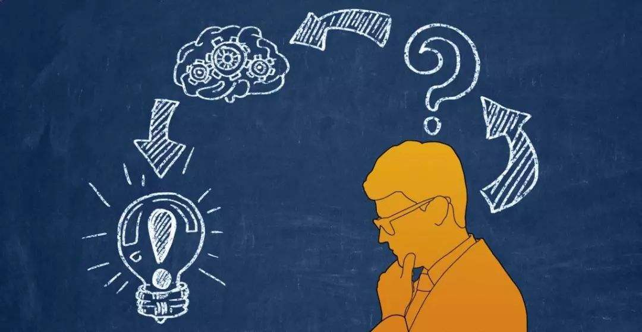
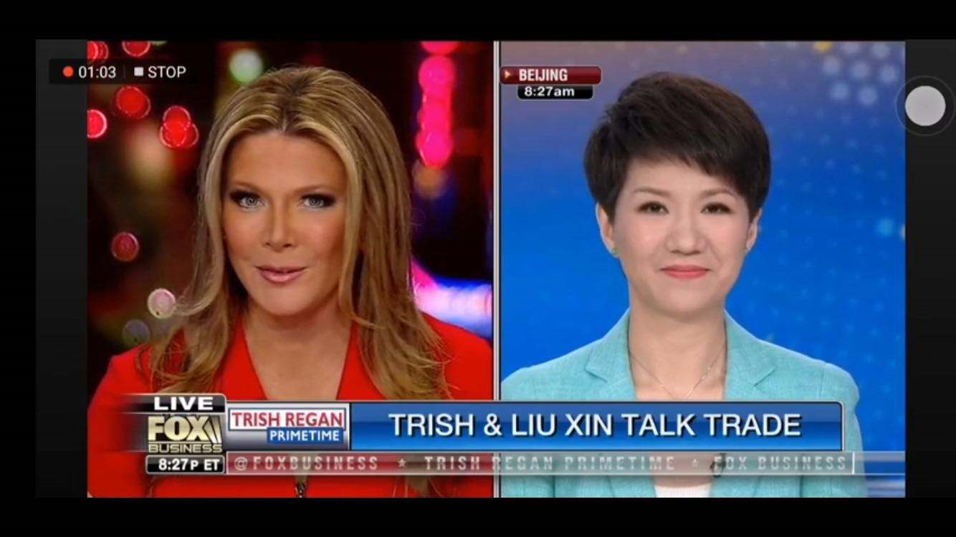
3. Three Focuses
Learning Objectives
L
Identify and refute logical fallacies
Analyze Liu Xin’s debate
M
Foster students’ critical and logical thinking
Inspire students’ deeper love for China
Assignment
Teaching
Process
L
Refute the logical fallacies in international news
Topic
M
Encourage students to speak up for China
Select TikTok as the topic
L
Guide the students to think critically about its pros and cons
M

Slide 6
“123” Principle
One
Guideline
Two
Participants
Three
Focuses

Slide 7
References
[1] 蔡基刚, (2018), 高校外语界“金课”打造的标准和内容探索,《浙江外国语学院学报》, (6), 1-5。
[2] 梅强, (2018), 以点引线, 以线带面 —— 高校两类全覆盖课程思政探索与实践,《中国大学教学》, (9), 20-22。
[3] 吴岩, (2018), 建设中国“金课”,《中国大学教学》, (12), 4-9。
[4] 陈雪贞, (2019), 最优化理论视角下大学英语课程思政的教学实现,《中国大学教学》, (10), 45-48。
[5] 崔戈, (2019), “大思政”格局下外语“课程思政”建设的探索与实践, 《思想理论教育导刊》, (7), 138-140。
[6] 魏勤, 黄智燕, (2019), 博雅教育与高校英语教师人文素养研究,《西安外国语大学学报》, (4), 66-70。
[7] 夏文红, 何芳, (2019), 大学英语“课程思政”的使命担当,《人民论坛》, (30), 108-109。
[8] 文秋芳, (2019), 外语“金课”与“金牌外语教师团队”,《外语教育研究前沿》, (4), 3-10。
[9] 冯智文, (2020), 中国外语金课的内涵及其建设方略,《外语教学》, (2), 59-63。

Slide 8
Part B Demonstration

Slide 9
Review
Two refutation strategies:
1) Refute the argument by putting it in a larger context.
2) Refute the evidence by pointing out its limitations.

Slide 10
Review
Language structures to signal your refutation:
Refuting (general and/or specific)
Acknowledging the existence of opposing view
1) Some people may argue that … , but …
2) It may be argued that … , however, …
3) An opposing view states that … , but …
4) Of course …, but …
…

Slide 11
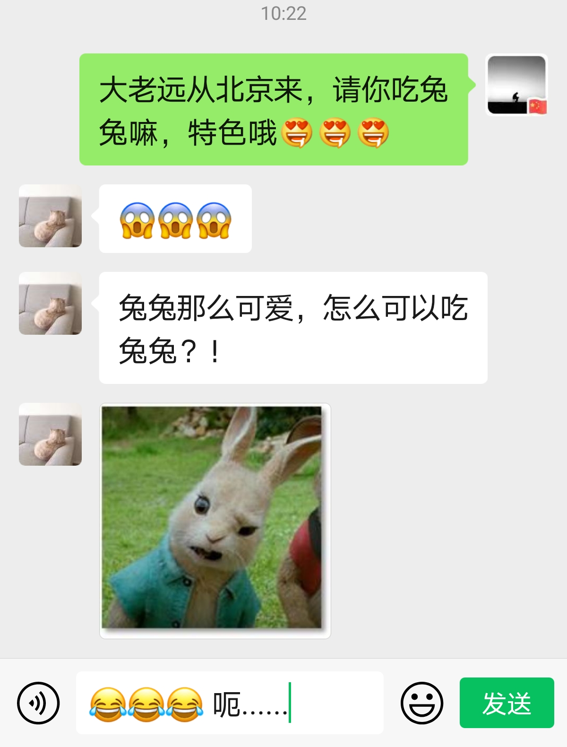
Lead-in

Slide 12
Lead-in
Logical Fallacy
“Rabbits are so cute! How can we eat them!”
Emotional！
Reasoning Process

Slide 13
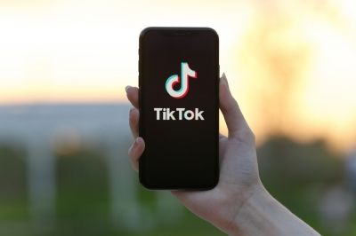
Refuting Logical Fallacies
Q1: Are they being emotional?
From a parent：
Your parents worked so hard to put you in college.
How could you spend so much time on TikTok?
Refutation: Our parents may say that … , however, …

Slide 14
Refuting Logical Fallacies
Q2: Are they over-generalizing?
Expectation
From a classmate:
The products sold on TikTok are all fake.
Because I have bought some fruits on TikTok and I was really disappointed with what I got.
Reality
Refutation: Someone may argue that … , however, …

Slide 15
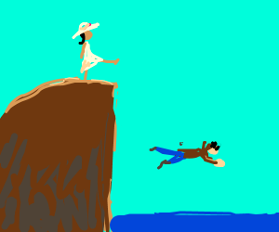
Refuting Logical Fallacies
Q3: Are they jumping to conclusions?
From a friend:
If you start playing TikTok,
you’ll get addicted to it.
If you are addicted to it,
you’ll ignore studying.
If you ignore studying,
your life will be over!
Refutation: It may be argued that … , but, …

Slide 16
Extension
Liu Xin and Trish Regan’s Debate
Evidence taken from the WTO, DoJ and FBI cases

Slide 17
Extension
Liu Xin and Trish Regan’s Debate
Acknowledging
Refuting
Of course there are cases where individuals and companies …
You can’t say simply because these cases are happening …
Over-generalizing!

Slide 18
Summary
Q1: Are they being emotional?
Logical Fallacy
Q2: Are they over-generalizing?
Logical Thinking !
Q3: Are they jumping in conclusions?

Slide 19
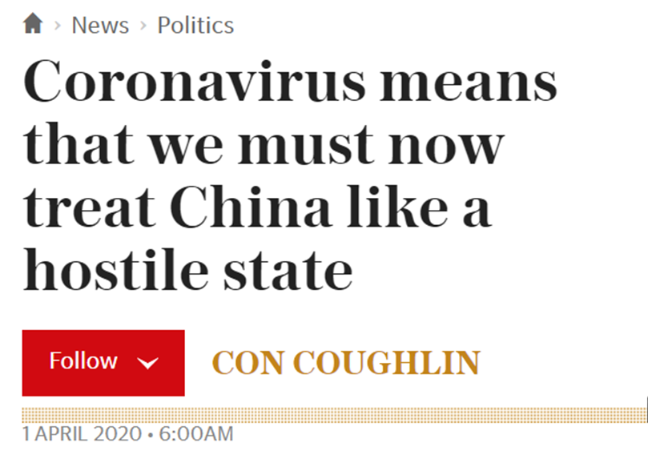
Assignment
Read the news carefully, analyze its argument and then write a refutation to speak up for our motherland!
Requirements:
Deadline: 2020/08/23
Submit your writing (at least 250 words) on iWrite.
Use proper refutation strategies and structures!
Find the full version on iWrite.

Slide 20
Further Resources
A. More about logical fallacies:
UMOOCs: 《批判思维与英文写作》
Session 11. Common Logical Fallacies
C. More about new media
B. Full version of Liu Xin’s debate:
On our WeChat learning platform

Slide 21
Thank you!

