Slide 1
Note-taking in Consecutive Interpreting

Slide 2
Introduction
Teaching Context
Teaching Methodology
Teaching Design

Slide 3
Teaching Context
01
Comprehensive university
Serving the local area
University
02
Third-year English majors
Solid English foundation
Student
Family and Society
Covid-19
03
Unit Topic

Slide 4
Teaching Methodology
motivating stage, enabling stage
and assessing stage
Production-oriented Approach
language competency, learning competency, critical thinking competency, cultural competency, creative competency and collaborative competency
Key Competency
Humanistic Elements
form students’ values and perceptions

Slide 5
Teaching Design
Knowledge
To understand the practice materials,
Learn new words and expressions
1
Skill
Teaching Objectives
To master basic note taking skills,
Improve the quality of interpretation
2
Emotion/Morality
3
To appreciate love and sacrifice,
Develop global vision and critical thinking

Slide 6
Teaching Design
8 Sessions
Session 1 | Motivating | General principles of note-taking
Session2 | Enabling | Quality and effectiveness of note-taking
Session 3-4 |  | Practice and Enhancement
Session 5-8 | Assessing | Production and general assessment
Teaching Objecties
Notes:
6

Slide 7
Teaching Design
Session 2
Stage | Motivating | Scenario: an email for help
 | Enabling | Discussion of notes
 | Assessing | Practice and evaluation
Highlight | Practice material | Volunteering and global collaboration
Teaching Objecties
Notes:
7

Slide 8
Demonstration
延时符

Slide 9
Note-taking in Consecutive Interpreting

Slide 10
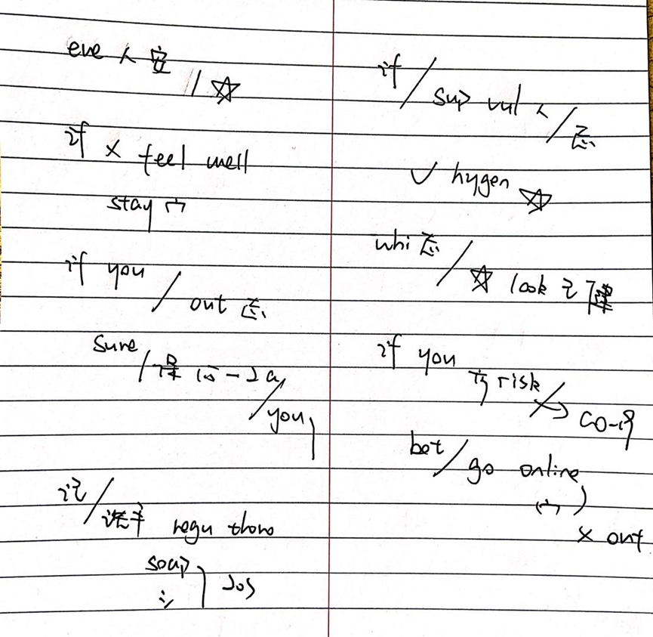
Original text:
Everyone’s safety is a priority. If you are not feeling well, stay home. If you do go out to volunteer, make sure you maintain 1.5 metres or 2 arms length between you and those around you. Remember to wash your hands regularly and thoroughly with soap and water for at least 20 seconds, or use hand sanitizer. If you are supporting vulnerable people as a volunteer, good hygiene and physical distancing is even more important. And while volunteering, it is really important that you look after your own health. If you’re in a higher risk category for COVID-19, It may be better that you volunteer online or from home, and don’t go out.
延时符

Slide 11
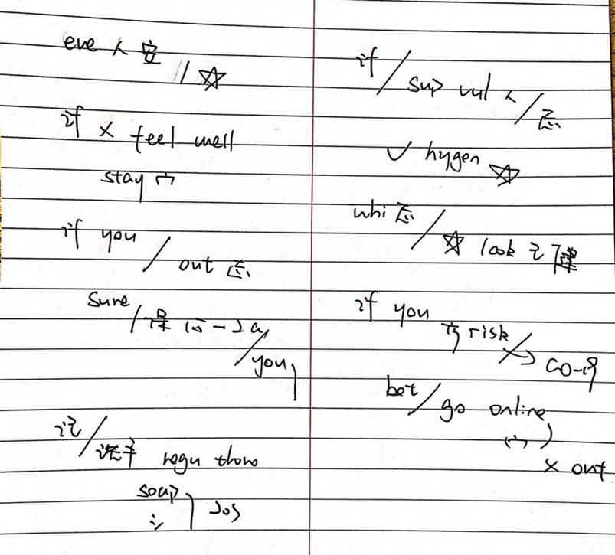
\
1. SVO structure
S
O
O
V
2. Non-contextual information (figures,
proper names, and enumeration)
V
3. Keywords that represent
the whole meaning cluster
m

Slide 12
Skill Drill
The COVID-19 Pandemic Is the Challenge of Our Generation

Slide 13
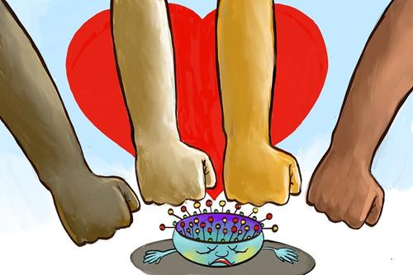
Further Discussion
What have we learned from COVID-19?

Slide 14
Assignment
Assignment：prepare a 3-minite speech based on the topic What I’ve Learned from COVID-19. You will deliver your speech next time.

Slide 15
Evaluation
Achievement Assessing Checklist
5=Excellent 4=Good 3=Satisfactory 2= Fair 1=Poor
√Self-evaluation △Peer-evaluation ○ Teacher-evaluation
 | Assessment criteria | 5 | 4 | 3 | 2 | 1
Knowledge and Skill | Be familiar with the general principles of note taking.
 | Can take note in a concise and clear way.
 | Can gradually balance the effort to listen, analyze information and take note.
 | Can understand intermediate listening materials on topics of society and family.
 | Can use new words and expressions learned in this unit
 | Be more competent to accomplish a task through cooperation with classmates.
Moral Perception and Values | Be able to appreciate love and sacrifice in the level of individuals, societies, and countries.
 | Have grasped a deeper understanding of the concept “a community with a shared future”.

Slide 16
Thank you
延时符

