Slide 1
Unit 15
Youth and Ambition

Slide 2
Contents
Teaching Context
01
Introduction
Teaching Procedure
Highlights
02
Demo Class

Slide 3
Teaching Context
1
University
2
Students
Material
3
4
Objectives
5
Methodology

Slide 4
Teaching Context
Normal University
Our University
Morality
Professional Skills
Freshmen
Our Students
Future English Teachers

Slide 5
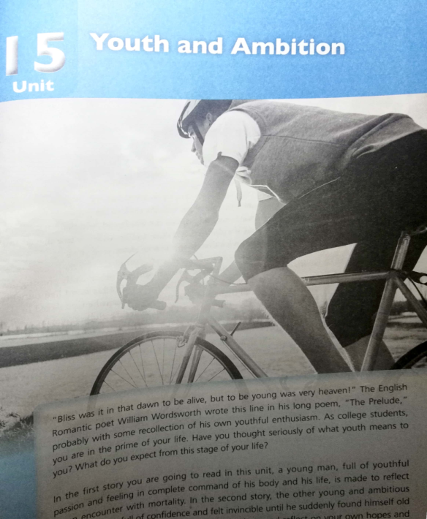
Teaching Context
Teaching Material

Slide 6
Teaching Context
Teaching Objectives
Knowledge
To identify six narrative elements;
To write a narrative with rhetorical devices
Competence
To improve professional competence
Morality
To share their experience of frustration;
To work out measures to deal with frustration

Slide 7
Teaching Context
Methodology
Motivating
Enabling
Assessing
POA
Scenario
Texts
Videos
Activities
TSCA
Production
Unit Production
Learning + Producing

Slide 8
Teaching Procedure
Three Sections
Unit Production
Section 3
Section 2
Narrative Writing
Section 1
Sub-task 3
Sub-task 2
Sub-task 1
“An Experience of Growing up in Frustration”

Slide 9
Teaching Procedure
Section 1
Sub-task 1
An Experience of Growing up in Frustration (Using 6 Narrative Elements)
Before Class
In Class
After Class
Motivating
Enabling
Submit the 1st draft
A scenario
Group report
Text analysis
Theme exploration
Online assessing
In-time assessing
Online assessing

Slide 10
Teaching Procedure
Section 2
Sub-task 2
An Experience of Growing up in Frustration (Using Rhetorical Devices)
Before Class
In Class
After Class
A video on metaphor
Enabling
Submit the 2nd draft
Revising the 1st draft
Metaphor exploring
Critical reading
Group discussing
Online assessing
In-time assessing
Online assessing

Slide 11
Teaching Procedure
Section 3
Sub-task 3
An Experience of Growing up in Frustration (Developing the Theme)
Before Class
In Class
After Class
Preparing storytelling
Enabling
Polish the final draft
Preparing in-class assessment
Intercultural discussing
Group storytelling
Revising the 2nd draft
Tasks assessing
Online assessing
TSCA (Checklists)
Online assessing

Slide 12
口语评价表
写作评价表
评价维度 | 标准 | 等级 |  |  |  | 学生 自评 | 学生 互评 | 教师 评价
Cognitive | Positive participation | A | B | C | D
 | Serious attitude | A | B | C | D
 | Positive attitude to frustration | A | B | C | D
 | Epiphany from frustration | A | B | C | D
 | A good sense of responsibility | A | B | C | D
 | Lofty ideals | A | B | C | D
 | Chinese Dreams combined with personal achievement | A | B | C | D
Teaching | An interesting beginning | A | B | C | D
 | Well-planned organization | A | B | C | D
 | Logical plot | A | B | C | D
 | Vivid characterization | A | B | C | D
 | Accurate language | A | B | C | D
 | Fluent expression | A | B | C | D
 | A complete structure | A | B | C | D
 | Body language | A | B | C | D
 | Vocal variety | A | B | C | D
 | Vivid end | A | B | C | D
 | Story completed in time limit | A | B | C | D
Social | Effective communication | A | B | C | D
 | Cooperative teamwork | A | B | C | D
 | Organizing skill | A | B | C | D
 | Cross-cultural competence | A | B | C | D
评价维度 | 标准 | 等级 |  |  |  | 学生自评 | 学生互评 | 教师评价
Cognitive | Positive participation | A | B | C | D
 | Serious attitude | A | B | C | D
 | Positive attitude to frustration | A | B | C | D
 | Epiphany from frustration | A | B | C | D
 | A good sense of responsibility | A | B | C | D
 | Lofty ideals | A | B | C | D
 | Chinese Dreams combined with personal achievement | A | B | C | D
Teaching | A creative beginning | A | B | C | D
 | Well-planned organization | A | B | C | D
 | Logical plot | A | B | C | D
 | Vivid characterization | A | B | C | D
 | A detailed description | A | B | C | D
 | Good coherence | A | B | C | D
 | A complete structure | A | B | C | D
 | Accurate language | A | B | C | D
 | Proper rhetoric | A | B | C | D
 | A distinct theme | A | B | C | D
 | Positive viewpoint | A | B | C | D
Social | Effective communication | A | B | C | D
 | Cooperative teamwork | A | B | C | D
 | Organizing skills | A | B | C | D
 | Cross-cultural competence | A | B | C | D

Slide 13
Teaching Procedure
Section 3
Sub-task 3
An Experience of Growing up in Frustration (Developing the Theme)
Before Class
In Class
After Class
Preparing storytelling
Enabling
Polish the final draft
Preparing in-class assessment
Intercultural discussing
Group storytelling
Revising the 2nd draft
Tasks assessing
Online assessing
TSCA (Checklists)
Online assessing

Slide 14
Demo Class
To understand and use metaphor in narrative writing
Objectives
To work out measures to deal with frustration
To learn how to cultivate their future students’ sense of responsibility

Slide 15
Demo Class
Learning
Before Class
In Class
After Class
1. Watch a video on
metaphor;
2. Write the 1st draft;
3. Assessing online
1. Polish the 1st draft
with metaphor;
2. Assessing online
1. Provide a scenario;
2. Tentative production;
3. Production task
Motivating
1. Identify metaphors;
2. Make sentences;
3. Discuss in groups
Enabling
Metaphor + Frustration
1. Peer-assessment;
2. Self-assessment;
3. Teacher’s assessment
Assessing
Language + Competence
Growth of Youth

Slide 16
Demo Class
Evaluation Checklist
Aspects | Standards | Grades |  |  |  | Peer-assessment
Language | Identifying metaphor | A | B | C | D
 | Using metaphor correctly | A | B | C | D
 | Making sentences with metaphor | A | B | C | D
 | Polishing sentences with metaphor | A | B | C | D
Competence | Positive participation | A | B | C | D
 | Effective communication | A | B | C | D
 | Dealing with frustration positively | A | B | C | D
 | Cooperative teamwork | A | B | C | D
Morality | Positive attitude to frustration | A | B | C | D
 | Awareness of responsibility | A | B | C | D
 | Lofty ideals | A | B | C | D
 | Chinese Dreams combined with personal achievement | A | B | C | D

Slide 17
Demo Class
Learning
Before Class
In Class
After Class
1. Watch a video on
metaphor;
2. Write the 1st draft;
3. Assessing online
1. Polish the 1st draft
with metaphor;
2. Assessing online
1. Provide a scenario;
2. Tentative production;
3. Production task
Motivating
1. Identify metaphors;
2. Make sentences;
3. Discuss in groups
Enabling
Metaphor + Frustration
1. Peer-assessment;
2. Self-assessment;
3. Teacher’s assessment
Assessing
Language + Competence
Growth of Youth

Slide 18
Three Highlights
Morality-oriented
Learning-centered
Profession-based
Highlights

Slide 19
Thank you！

Slide 20
Text A
A Sunrise on the Veld

Slide 21
Motivating
Scenario

Slide 22
Motivating
Tentative Production
I can learn from frustration. I must be hopeful for my life.
Frustration is a friend of hope.

Slide 23
Motivating
Revising the First Draft:
Production Task
An Experience of Growing up in Frustration
Requirements:
150-200 words
Using metaphor, especially that of frustration

Slide 24
Enabling
Task 1: Identify Metaphor
1. Medical workers are angels, saving and protecting lives.
2. The world is a village and community of shared future for mankind.
3. I have so much to do; it seems that I lived in a world of troubles.
√
√
Medical
workers
angels
are
A be B
Target domain
Source domain
Similarity

Slide 25
Enabling
Home
1
5
Bush again
Human society
Mature
Home is society.
Five Scenes
Bush is nature.
Bush
2
4
Back home
Nature
3
Face responsibility
Ants Nibbling Scene
Frustration is f_________
in his growth.
ertilizer
Frustration
Metaphorical Meanings in the Text

Slide 26
Enabling
Task 2: Make Sentences with Metaphor about Frustration
What is frustration?

Slide 27
Enabling
gift
hope
gift
reef
hope
encyclopedia
Frustration
is
soil
reef
Metaphors of Frustration

Slide 28
Enabling
As a student, what kind of frustrations do you have?
Be discouraged in job-hunting
Lack motivation
Lose money
Frustration
Fail in exam
Be poor in relationship

Slide 29
Enabling
How would you overcome frustration?
Face it and ask why;
1
Take it as an opportunity
for a fresh start;
When you hoist the sails to cross the sea,
you’ll ride the wind and cleave the waves.
2
Steps
Make a self-development
plan;
3
Take a new action.
4

Slide 30
Enabling
Making Sentences
What is frustration in your eyes?
Frustration
is
？

Slide 31
Enabling
Sample Revision
… frustration can motivate me to move forward as long as I keep studying diligently.
…frustration is the soil of ambition; because of it, the seeds of struggle can blossom everywhere.

Slide 32
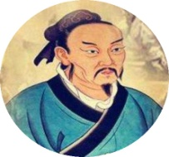
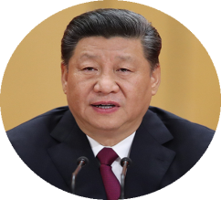
Enabling
Task 3: Group Discussion
…temper his will power, fatigue his muscles and bones, starve his stomach and destitute his body…
A nation will prosper only when its young people thrive.
The strong ones always rise from frustrations and never lose their hearts.
Responsibility

Slide 33
Enabling
As future teachers, how would you cultivate
your students’ sense of responsibility?
Group Discussion
For the world
For our country
For yourself

Slide 34
Enabling
1
Our responsibility today lies in no one else but solely in the youth of China.
2
Their wisdom makes China a more perceptive nation.
3
Their wealth makes China a more prosperous nation.
4
Their strength makes China an unyielding nation.

Slide 35
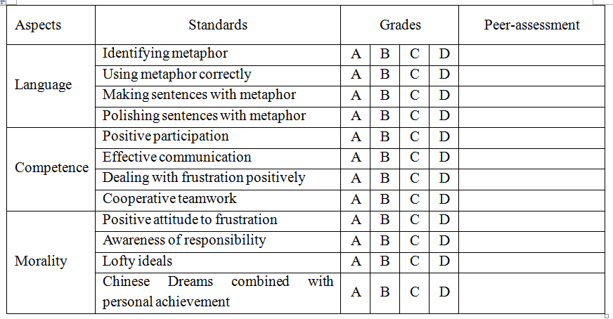
Assessing
Checklist

Slide 36
Assignment
Polish your first draft with metaphor;
1
2
Prepare your story on frustration orally

Slide 37
Thank you！

