Slide 1
2020 FLTRP
Star Teacher Contest

Slide 2

Our University
Application-oriented

Slide 3

Our Students
A-level freshmen / business major / highly-motivated / E-generation
Language proficiency: intermediate English learners
Competences: lack of critical thinking & collaboration

Slide 4

Unit 3 Life Stories
Text A
Audrey Hepburn
― A true angel in this world

Slide 5
Teaching Objectives
Course
Unit
Cross-cultural Awareness
Cultural Confidence
Dedication
Responsibility
Cultural Confidence
Dedication
Responsibility
Values
Innovation
Critical Thinking
Collaboration
Autonomous Learning
Critical Thinking
Collaboration
Autonomous Learning
Competences
Chronological Order
Six Elements
Facts vs. Opinions
Knowledge
Language Proficiency
Advanced Language Skills

Slide 6
Multiple Assessments
Teacher
Peer
Self
Performance in Class
Summative
60%
Formative
40%
Explicit & Implicit
Unipus
Tests &
Assignments

Slide 7
Design Features of the Unit
Advanced
· Cultivating Comprehensive Competences
· Focusing on High-order Cognitive Abilities
Innovative
  Cultivation of Morality and Integrity
  · Blended Learning
  · Task-based Teaching with Multiple Assessments
Challenging
  · Concept Clarification
  · Multiple-input and Multiple-output

Slide 8
Teaching Procedures of the Unit
UMOOCs, Unipus
Pre-class
（online）
Practice
Discussion
Blended
Learning
Lecture
In-class
(offline)
Moral Education
Role-play*
Interaction*
UMOOCs, iWrite
After-class
（online）
Practice
Sharing

Slide 9
Sessions | Periods | In-class
Session 1 | Period 1 | Pre-reading Discussion Skimming Intensive Reading
 | Period 2
Session 2 | Period 3 | Quiz & Review Facts vs. Opinions Peer Review
 | Period 4
Session 3 | Period 5 | Group Presentation Feedback & Assistance
 | Period 6

Slide 10
Design Proposal of Demo Class
Cultural Confidence
Values
Facts vs. Opinions
Critical
Thinking
Competence
Advanced Language Skill
Knowledge

Slide 11
Advanced
Assessment
Lead-in
How to distinguish facts from opinions?
Innovative
Application
Definitions
hard
easy
Challenging
Difficult Points
Criterion
Indicators

Slide 12

Demo Class
How to Distinguish Facts from Opinions ?

Slide 13
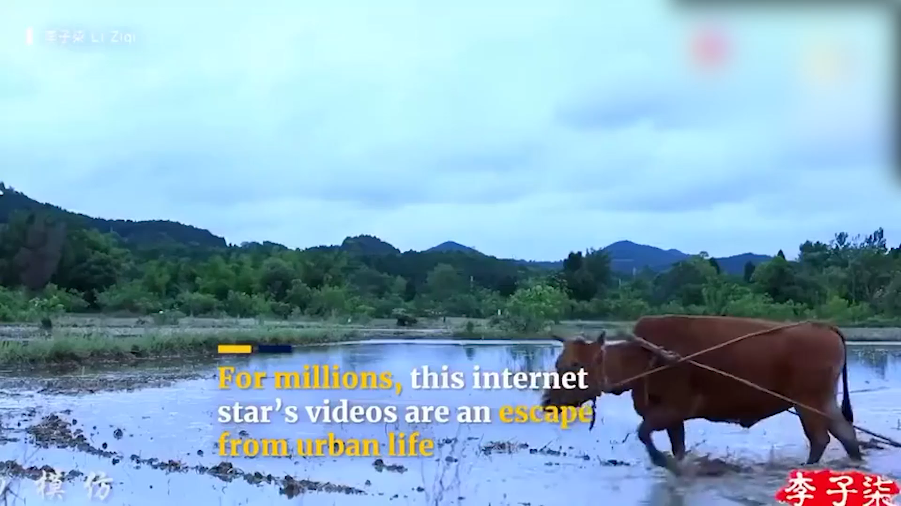

Slide 14

Facts vs. Opinions

Slide 15


A
F
C
O
Knowing
Believing
Tom is a boy.
Tom is the smartest boy in our class.
Undebatable
Debatable
B
F
D
O
Facts
Opinions
The Pacific Ocean
forms the western coast of the United States.
Being in the ocean is scary.

Slide 16

Definitions
Facts are things we know for certain to exist, or be true, or have happened.
Facts are things we know for certain to exist, or be true, or have happened.
Opinions are things we believe to exist, or be true, or have happened.
Opinions are things we believe to exist, or be true, or have happened.

Slide 17
Differences
Facts
VS
Opinions
Knowing
Believing
Undebatable
Debatable

Slide 18


Criterion
Debatable ?
Facts
Opinions

Slide 19
Opinion Indicators
Can you name some words that indicate opinions?

Slide 20
Opinion Indicators
weird
sweeter
the greatest
patiently
comparatively
Judgments
believe
reckon
deem
consider
in my opinion
Subjectivity
appear
apparently
approximately
the odds are
more often than not
Probabilities

Slide 21
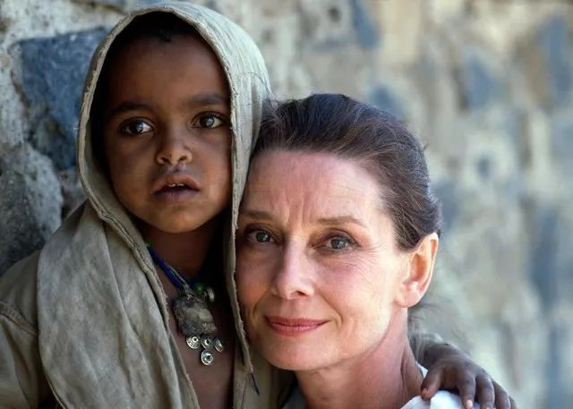
Difficult Points
Audrey was grabbed off the street by Nazis and placed in line to be sent to a work camp. (Para. 3)
Becoming famous never changed Audrey’s generous and compassionate character. (Para. 7)
Fact
Opinion

Slide 22
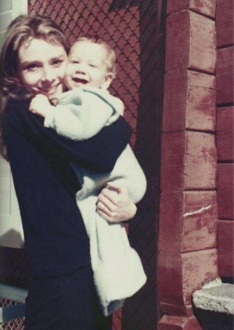
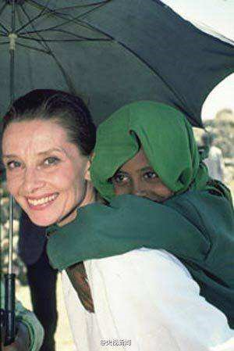
Difficult Points
She was an exemplary mother to her two sons and a UNICEF Ambassador of Goodwill serving victims in war-torn countries. (Para. 2)
She was an exemplary mother to her two sons and a UNICEF Ambassador of Goodwill serving victims in war-torn countries. (Para. 2)
Combination of fact and opinion

Slide 23
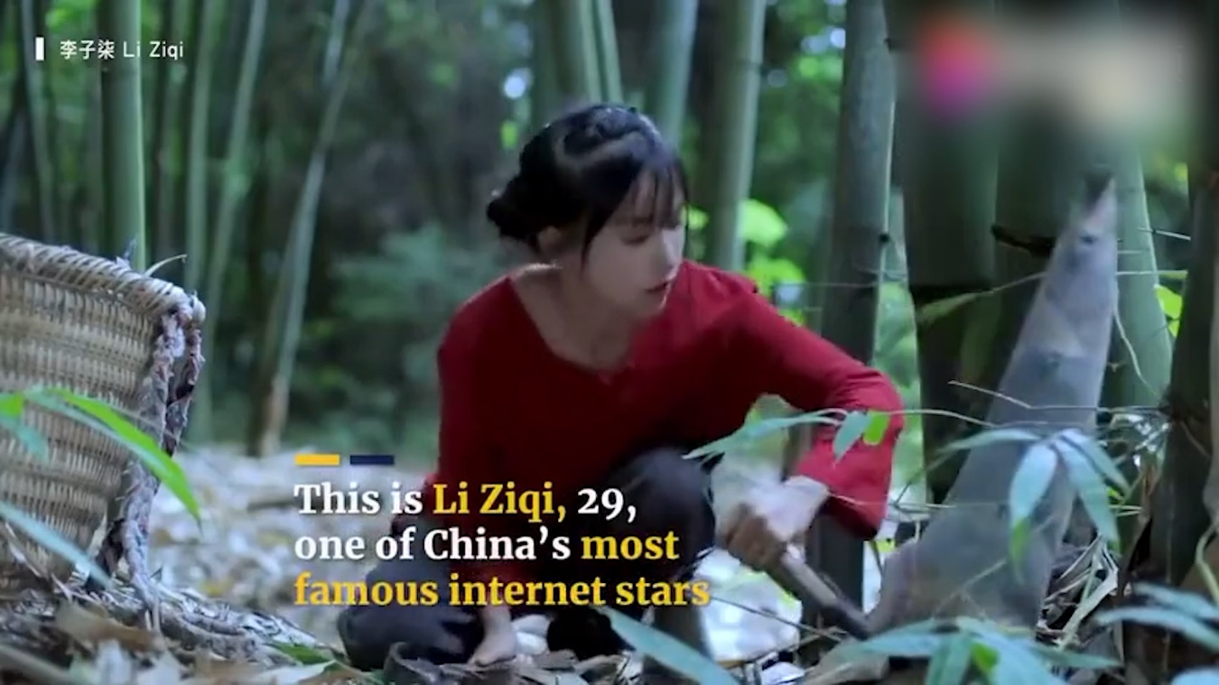
Fact? Opinion? Combination?

Slide 24
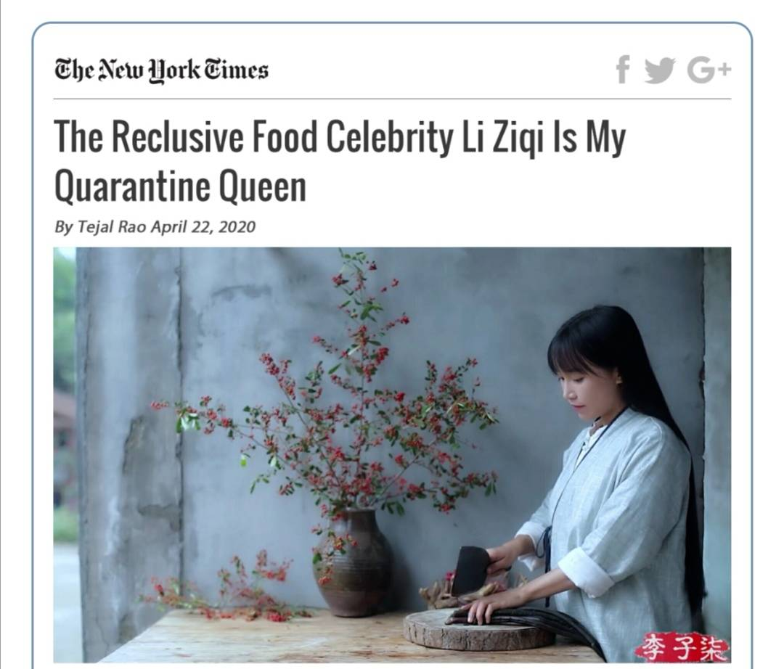
Application

Slide 25
① In the 12-minute video, which already has over millions of views, Ms. Li pushes garlic cloves into a patch of earth outside her home.
② For a worldwide audience in isolation, her D.I.Y. pastoral fantasies have become a source of escape and comfort.
③ Ms. Li, who lives in a in and rarely speaks to press, a Disney princess in her , wearing a silvery , trudging in the .
Fact
reliable
Opinion
village
Sichuan Province
looks not unlike
crown braids
fur cape
gracefully
snow
Combination of fact and opinion

Slide 26
Select Events
Perspective
Make Inferences
Use Modifiers

Slide 27
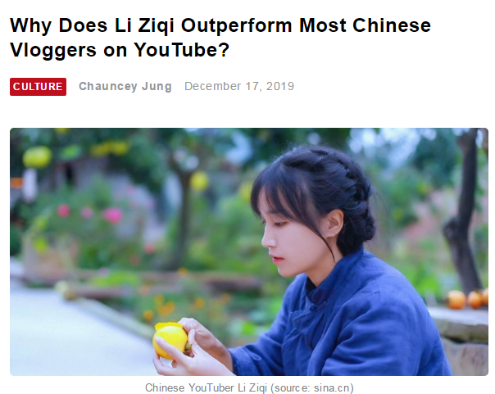
Able to earn millions of dollars per year, critics of Li started to call her videos “products of hypocrisy as her videos neither reflect the reality of Chinese rural areas nor represent the reality of Chinese society”. The videos are criticized of creating a “fabricated fantasy” and enhancing stereotype against Chinese on Youtube.
Able to earn millions of dollars per year, critics of Li started to call her videos “products of hypocrisy as her videos neither reflect the reality of Chinese rural areas nor represent the reality of Chinese society”. The videos are criticized of creating a “fabricated fantasy” and enhancing stereotype against Chinese on Youtube.

Slide 28
01
02
Think Critically
Read Extensively
Examine Closely

Slide 29


Your perspective
My perspective
?
She is a Chinese
culture promoter.

Slide 30
Assignment 1
Individual Work:
Read and examine the articles about Li Ziqi on Unipus.
Group Work:
Polish your second draft to make sure you have clearly presented your perspective.

Slide 31
Assignment 2
Individual Work:
 | Self-assessment Checklist | Yes | No | Not Sure
1 | Do you know the significance of distinguishing facts from opinions ?
2 | Do you know the differences between facts and opinions ?
3 | Do you know the criterion of distinguishing facts from opinions ?
4 | Do you understand the difficult points ?
5 | Do you know how to present your perspectives ?

Slide 32
Thank You !

