Slide 1
Teaching Design for Comprehensive English Course
Based on POA

Slide 2
01
Introduction
Contents
02
Teaching Design
03
Demonstration

Slide 3
01
Introduction
Teaching
material
Our university
Target students

Slide 4
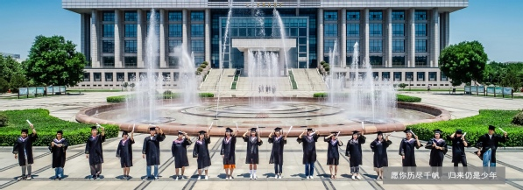
Our university
◇ engineering and technology
◇multiple disciplines
◇integration of scientific research into teaching
◇ application research oriented

Slide 5
Cultivating goal
Application-oriented talents
Our university
New Liberal Arts
2020 Teaching Guide
Cultivating
Goal
Inter-disciplinary talents
Talents with humanistic quality

Slide 6
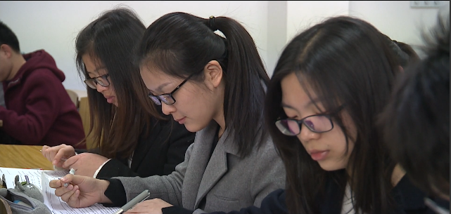
Target students
They need to
improve comprehensive language skills in speaking, especially in writing.
Sophomores
Competence
TEM-4
Majoring in English & Translation
Necessary English communicative competence
Getting ready for TEM-4

Slide 7
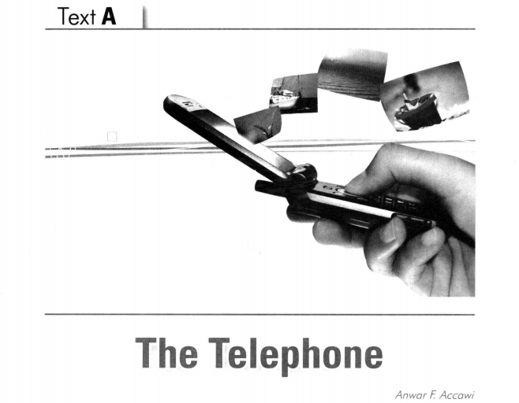
Teaching material
01
02
03
Unit 6
Teaching session
Session 2
延迟符

Slide 8
02
Teaching Design
Learning objectives
Teaching
theory
Teaching procedures

Slide 9
Course objectives
English proficiency
Global vision
English proficiency
Global vision
Moral values
Moral values
Critical thinking
Cooperative skills
Critical thinking
Cooperative skills

Slide 10
Learning objectives
1
3
Describe the changes (before and after)
Make a short video about changes brought by new technology
2014
4
2
Write a structured passage on contrast
Take a critical attitude towards changes
2014

Slide 11
Teaching theory
Production-oriented Approach
Task-initiating
TSCA
Motivating
Enabling
Assessing
Scaffolding

Slide 12
Teaching procedures
language
preparation
After-
class
writing task
(subtask 2)
Pre-
class
Session1
online
In-
class
oral report (subtask 1)

Slide 13
Teaching procedures
revise the draft
and finish unit project
Pre-
class
After-
class
assessment
Session2
In-
class
the use of contrast in writing

Slide 14
Teaching procedures
group
cooperation
Pre-
class
After-
class
revision and
reflection
Session3
online
In-
class
video presentation

Slide 15
Teaching procedures
subtask1
subtask2
unit project
an oral report about telephone
writing task about new technology
make a short video based on subtask 2

Slide 16
Highlights
1
Combination of text topics with reality
Moral cultivation—take a critical attitude towards changes
2
3
Multidimensional assessment—Rubrics

Slide 17
Multidimensional assessment
formative&
summative
self
peer
teacher
direct&
indirect
Production

Slide 18
Rubric for oral report
Criterion | Excellent(10 pts) | Good(8-9 pts) | Fair(5-7 pts) | Poor(below 4 pts)
Pronunciation | Pronounces majority of words correctly and speaks clearly | Pronounces most of the words correctly and speak clearly | Speaks clearly; mispronounces some words | Difficult to understand, and mispronounces more than 5 key words
Vocabulary | Appropriately uses correct vocabulary | Appropriately uses correct vocabulary | Sometimes appropriately uses correct vocabulary and grammar | Rarely uses or doesn’t appropriately use correct vocabulary
Grammar | Uses correct grammar(verb tenses, etc.) | Uses correct grammar most of the time | Sometimes uses correct grammar | Rarely uses or doesn’t use grammar
Fluency | Oral report without any long pauses | Oral report with some pauses | Oral report is struggling or takes long pauses | Oral report with little flow or none at all; takes constant pauses

Slide 19
Rubric for writing
Criterion | Excellent(15pts) | Good(12-14 pts) | Fair(8-11) | Poor(5-7) | Bad (below 4)
Content& Development (50%) | Content is comprehensive and clear. Clear and easy to follow | Content is accurate. Responses are adequate, Mostly clear and easy to follow | Content isn’t comprehensive. Inadequate responses are not easy to follow | Content is incomplete. Major points are unclear. | Cut and pasted content, major points are unclear.
Organization & Structure(30 %) | Well-organized | mostly clear | not easy to follow,, needs improvement. | confusing | No apparent organization /structure
Format& Grammar(20%) | No errors | Good format, no more than 2 errors | Mostly organized, lacking clear structure | Disorganized and hard to follow, need skills | No format, skills need.

Slide 20
Rubric for video-making
 | Good | Fair | Poor | Failure
Content(40’) | Included all the information and lasted for 3 minutes or more. | Included most of the information lasted for 3 minutes or more. | Included one of the information lasted for less than 3 minutes. | Not included
Pronunciation(20’) | Pronounced all words correctly. | Pronounced most words correctly. | Mispronounced more than 7 words. | No pronunciation
Grammar(10’) | Used full sentences with correct grammatical structures. | Used some full sentences, some fragments; most grammatically correct. | Did not use full sentences. | No grammatically correct sentences
Technique(20’) | The volume is good for voice, there is no noise, no technical problem. | The volume is fair for voice, there is noise, and there are some technical problems. | The volume is poor for voice, and there is considerable noise, and several technical problems. | No recording
Delivery(10’) | Attached the video on time. | Attached the video on time. | Attached the video late. | No delivery

Slide 21
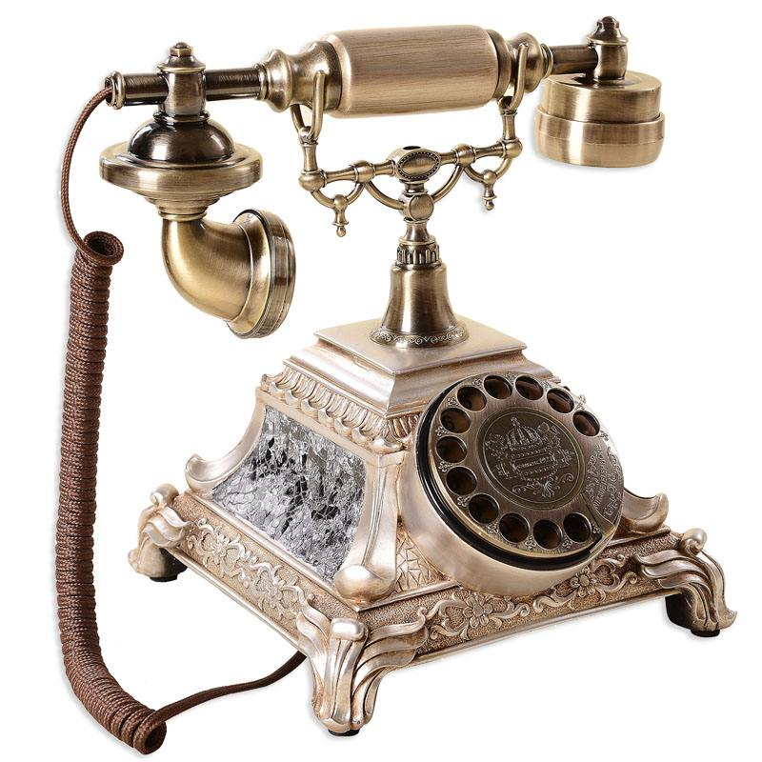
Unit 6 The Telephone
Session 2

Slide 22
English Contest for Science and Technology

Slide 23
Topic
Life before and after the coming of new technology

Slide 24
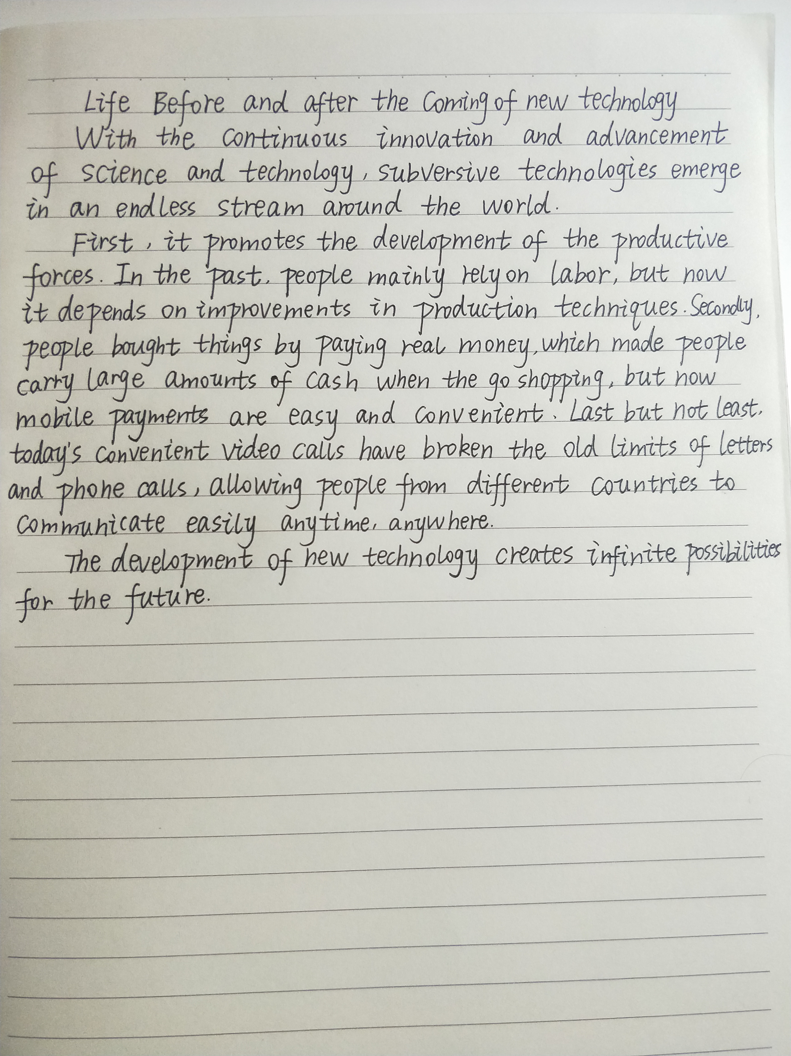
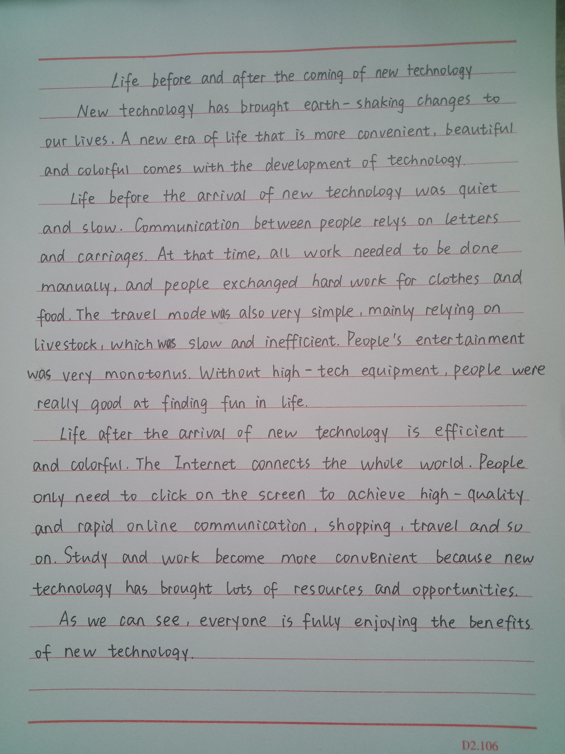
Sample texts
Sample 1
contrast

Slide 25
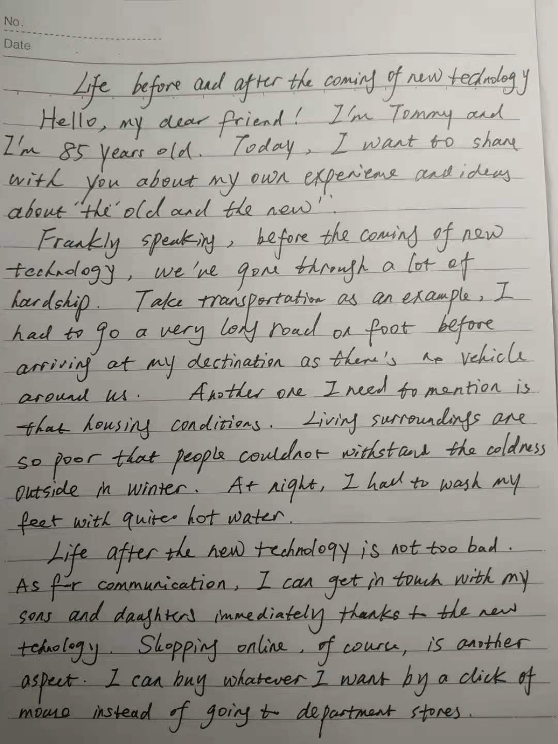
Sample text
Problem in using contrast
Point1
transportation
communication
Point1
Point2
housing condition
shopping online
Point2
Some contrastive points are not organized in corresponding sequence.
Point1
Point2

Slide 26
Changes before and after the coming of telephone
 | Before | After
village center
Im Kaleem’s house
Abu Raja’s dikkan
BULLETS:
Argue about politics, drink coffee, play cards or backgammon
Exchange rumor, glance
at the phone,…
activities
general atmosphere
Bustling at any time of day, laughter, noise
Laughter, noise trailed off, stopped…
Lucrative business,
run errands to make money
Lose lucrative business
Move to Sidon, then to U.S.
for me

Slide 27
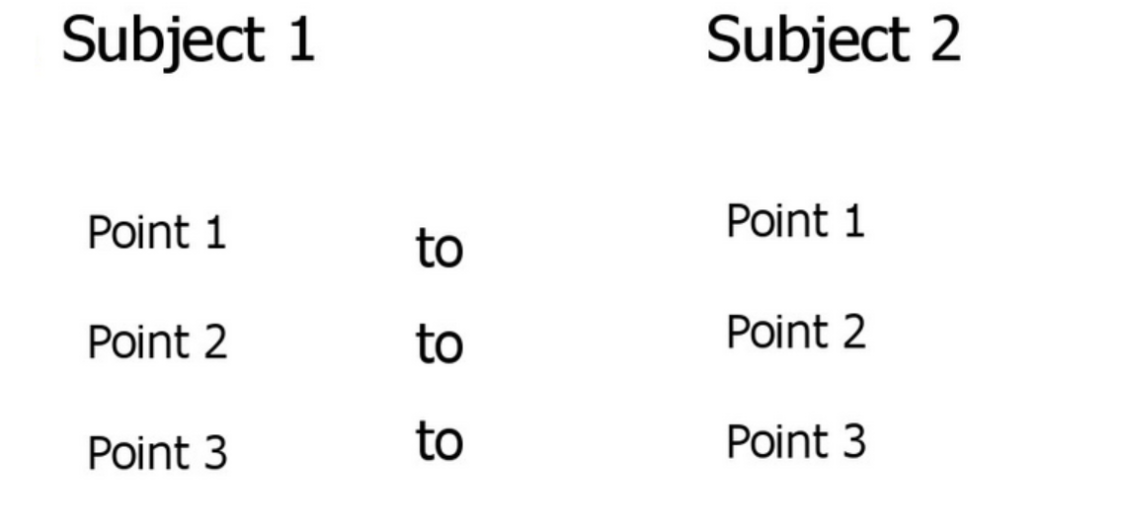
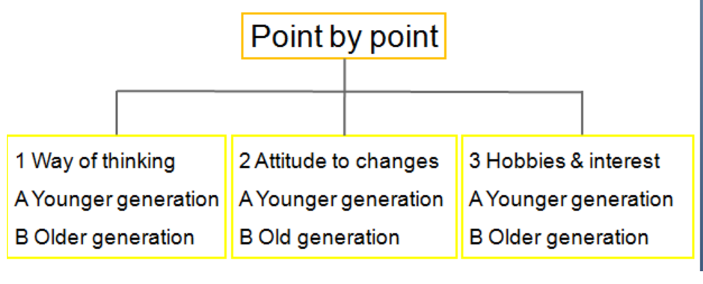
Contrast
to present each of the two subjects separately, covering the points completely
to discuss the two subjects for each point of contrast
Subject by Subject
VS
Point by Point

Slide 28
Contrastive Points
Importance
How to arrange these points?
Typicality

Slide 29
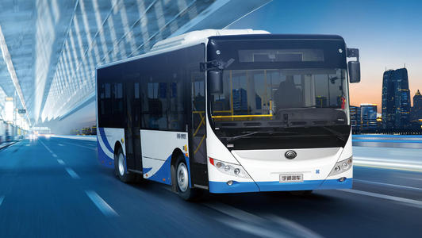
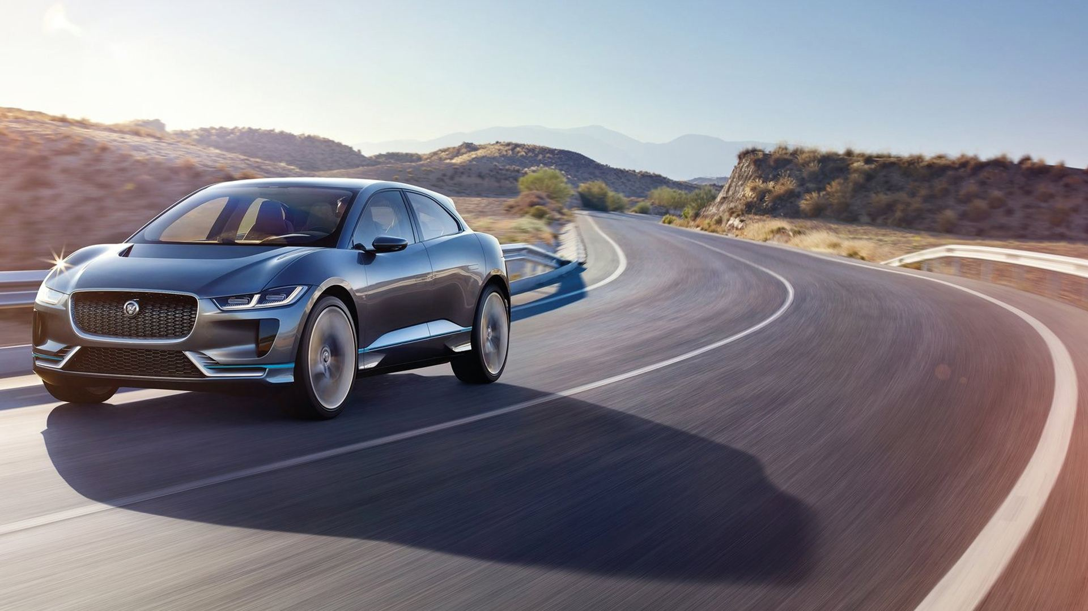
Contrast these two means of transportation, and your points?
Workflow
Bus
Car

Slide 30
Contrastive Points
Cost
Sanitation
More
Environment
Safety
Fun
Comfort
Convenience

Slide 31
Contrastive Points
Less important and typical points:
When you make a contrast in your writing, arrange your points properly.
sanitation, fun
Note

Slide 32
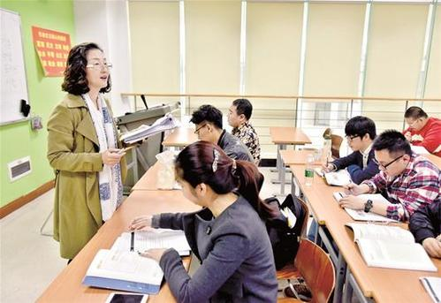
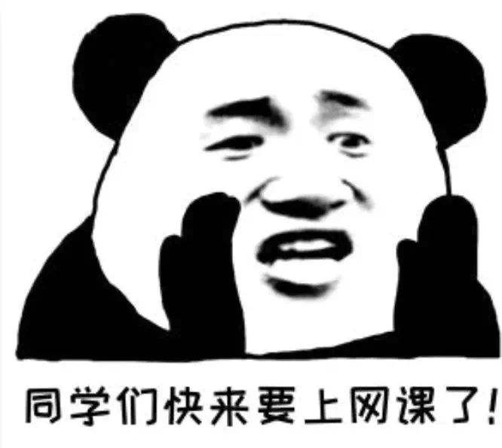
Example
Classroom Learning
Online Learning

Slide 33
Attitude towards change
Utilize
Enjoy
Positive
Change
Negative
Minimize
Eradicate

Slide 34
Summary
Changes brought by telephone
An act of examining differences
Contrast
Two methods
Two principles

Slide 35
Assignment
Polish your first draft by using contrast properly
1
2
Finish making the short video and make further preparation for the contest

Slide 36
Thank You

