Slide 1
Language Teaching with Virtues Cultivation
Teaching Design

Slide 2
Language teaching with virtues cultivation
1. Course design – objectives, approaches
2. Unit design – objectives, procedures
3. Highlights

Slide 3
Course design – objectives
Intercultural leadership
oriented from International qualifications
language competence
critical thinking
socialist core values
patriotism
International vision
Students as professional commanding officers
Teachers as diplomatic interpreters
Education is not information, but transformation.

Slide 4
Course design – approaches
intercultural
persuasive
skillful
Task-based language teaching
Virtues cultivation

Slide 5
Unit design – objectives
New Standard College English (Second Edition)2
Unit 7 Passage 1 Hiroshima
1. Knowledge: words and expressions
2. Skill: an informative speech with cases
3. Thinking: critical thinking with cases questioning
4. Attitudes: harmony, patriotism, empathy

Slide 6
Unit design – procedures
Task: make a speech of How to remember history
Procedures | Arrangements | Time
Before class | self-study on Unipus | //
Pre-task | reading, discussion, thinking training | 2 hours
Task phase | revision of the speech | 1 hour
Post-task | Extensive reading | 1 hour
After class | Make a video, assessment | //

Slide 7
Highlights
1. High requirements in the virtues cultivation.
2. Accurate positioning in language teaching and virtues cultivation.
3. Combination of language teaching, thinking training and virtues cultivation.

Slide 8
Hiroshima-
the “liveliest” city in Japan

Slide 9
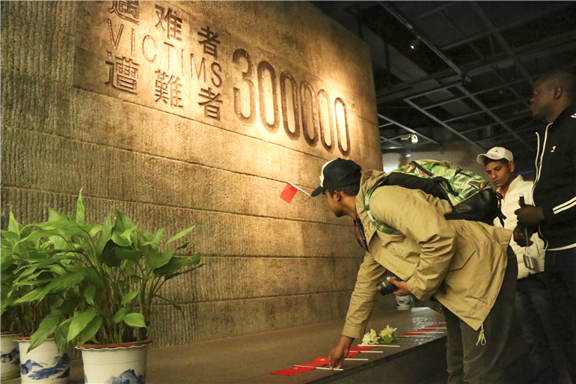
[ TASK ]
You are going to make a speech on the topic How to Remember History to those international military students who will mourn the victims in Nanjing Massacre online.

Slide 10
multi-angle
persuasive
metaphor
quote
parallel sentences

Slide 11
cases
1. model case
__________________________
2. contrary case
________________________
3. related cases
________________________

Slide 12
[SPEAKING]
Things we’ve done to remember history

Slide 13
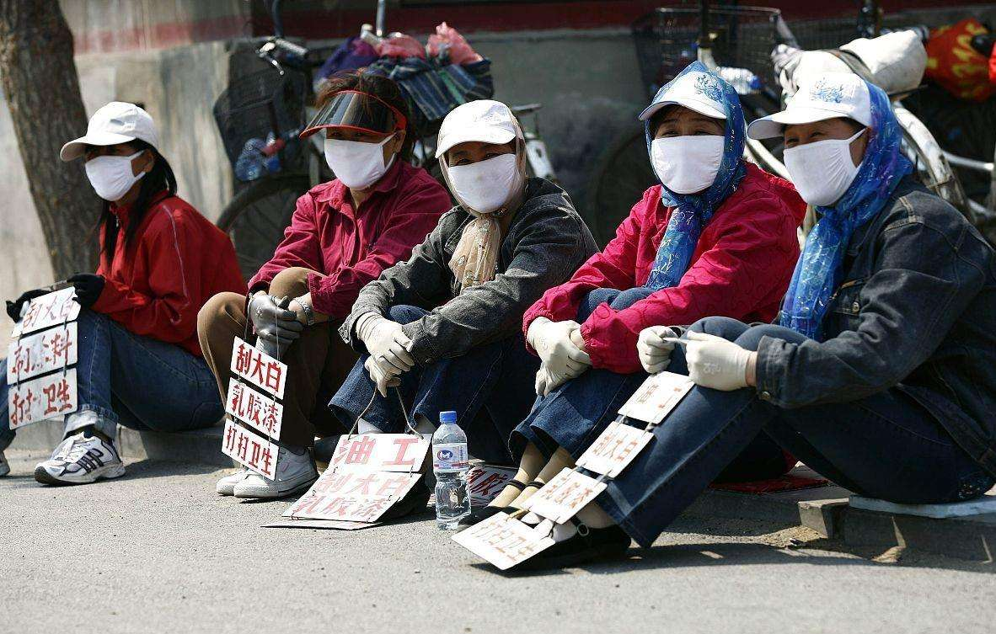
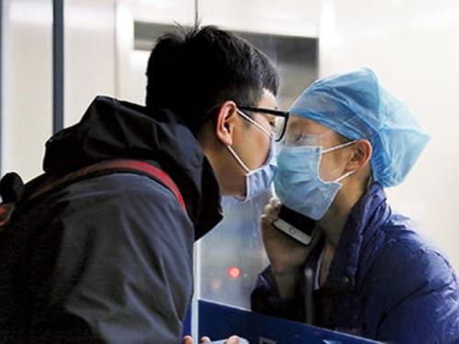
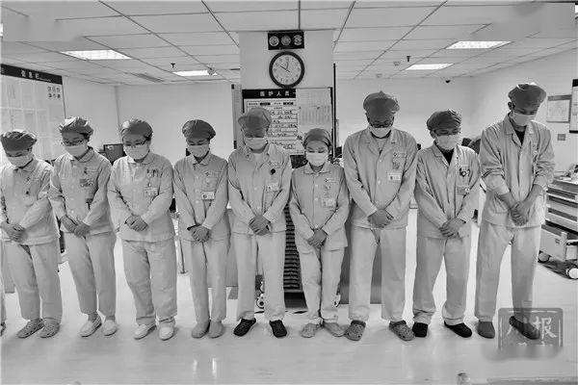
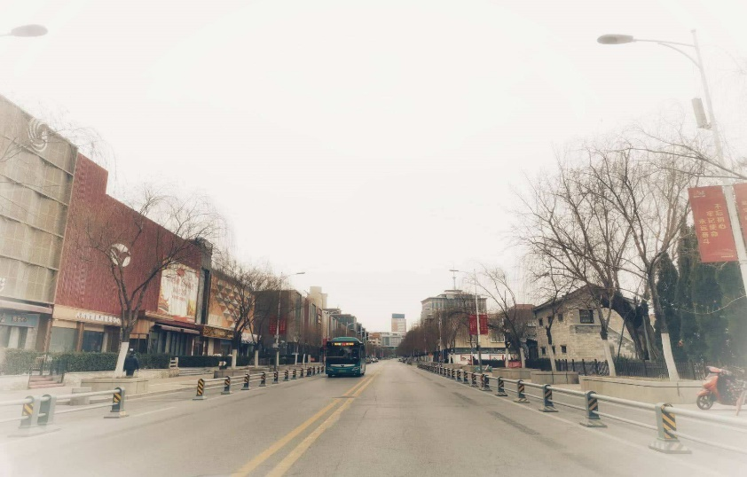

Slide 14
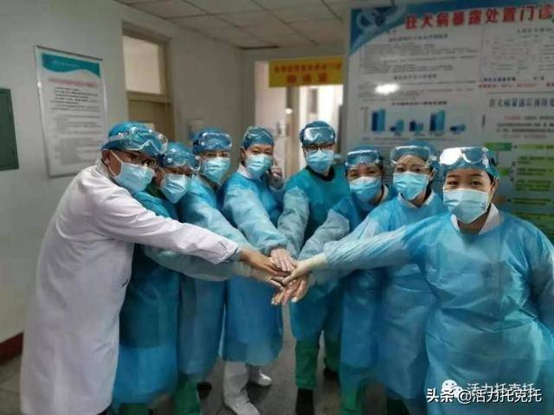
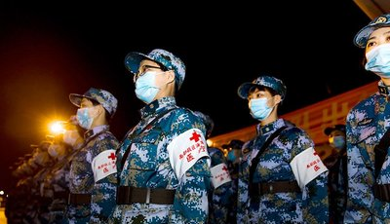
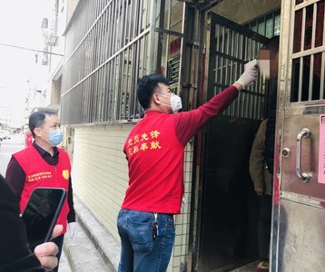
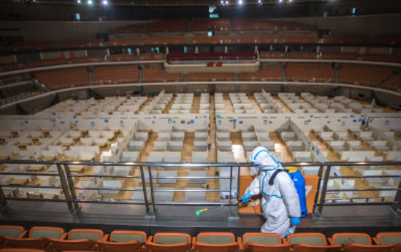
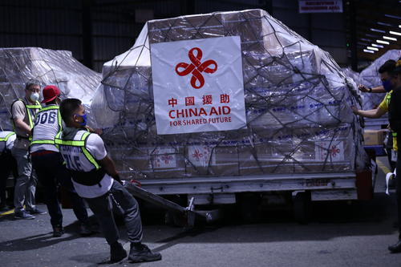

Slide 15
[SPEAKING]
What will happen if we forget the pain?

Slide 16
[SPEAKING]
How to remember history?

Slide 17
cases
1. model case
books, memorials, documentaries, …
Feelings
model case
2. contrary case
innocence of the consequences of…
Failure
contrary case
model case
3. related cases
Nanjing, covid-19, …
Finding happiness
related cases

Slide 18
Homework
Exercises
Speech

Slide 19
THANKS

