Slide 1
2020年外研社
全 国 半 决 赛
2020年8月8日

Slide 2
Contents
1
Course Introduction
2
Unit Design
3
Teaching Demo

Slide 3
Contents
1
Course Introduction
2
Unit Design
3
Teaching Demo

Slide 4
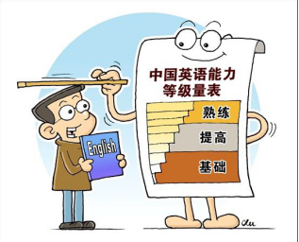
Course Objectives
Problem-analyzing & problem-solving ability
Cooperative & communicative ability
Cross-cultural awareness & international vision

Slide 5
48
44

Slide 6
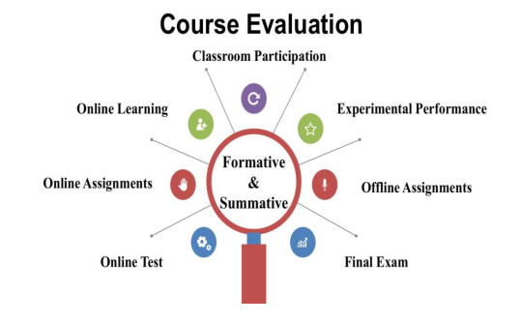

Slide 8
Contents
1
Course Introduction
2
Unit Design
3
Teaching Demo

Slide 9
Textbook
New Horizon College English ( Book 1)
Unit 3 Digital Campus
Text A College Life in the Internet Age

Slide 10
Target Students
First year non-English & non-art majors
English level: relatively low
CET4: Preparing

Slide 11
Teaching Objectives
(Innovation)
Generate writing ability
polishing expository essay
The Challenges of Studying Abroad
Generate language proficiency
new words & expressions
cause & effect
Generate communicative skills
fulfilling task by group discussion and cooperation
Generate patriotic awareness & cultural confidence
intriguing students' patriotism in face of COVID-19
Generate critical thinking competence
conducting debate on the prospect of online learning

Slide 12
Teaching Approach
Production-oriented Approach
Motivating
Enabling
Assessing
Situational Teaching Approach
Situation
creating
Problem
raising
Critical
thinking
Problem
solving

Slide 13
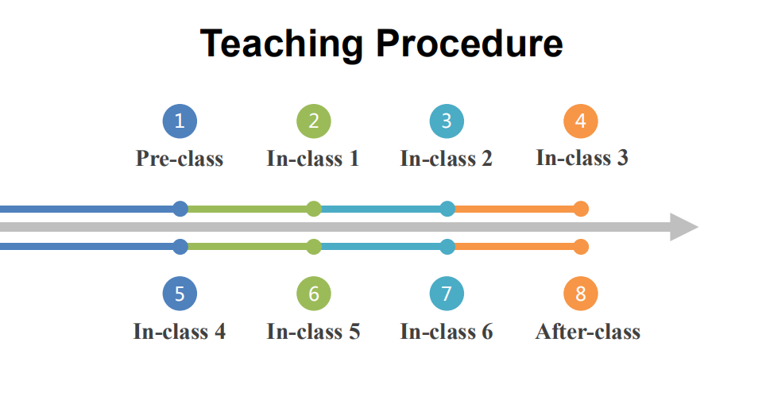

Slide 14
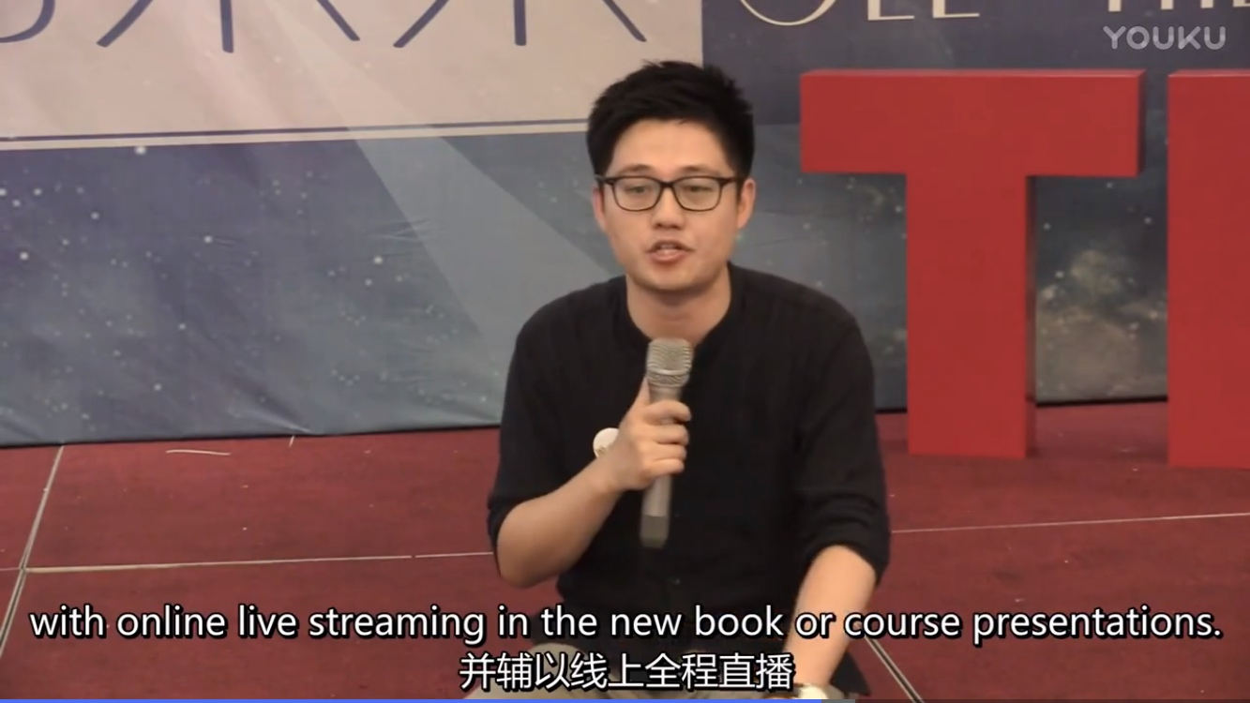
Pre-class
Generate:
Critical thinking competence
Patriotic awareness
Cultural confidence
International vision
01
watch video
Preview Text A
College Life in the Internet Age
prepare for classroom study
添加标题
添加标题
添加标题
video 1
video 2
video 3

Slide 15
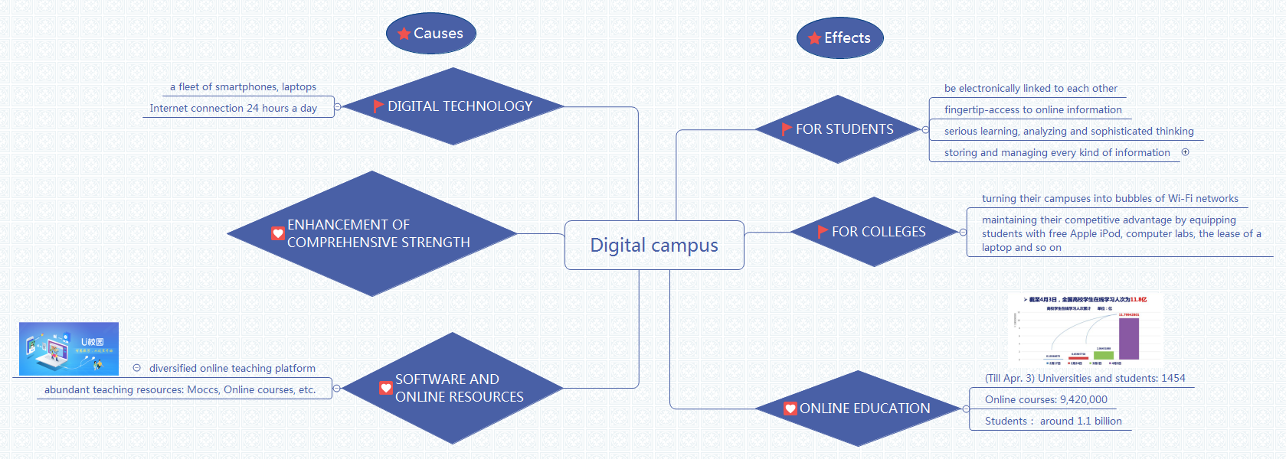
In-class (1-2)
Generate:
International mind
Nationality pride
Cultural confidence
A
Watch video
Lead-in
Theme exploration
COVID-19
Online education
B
Reflect in chain
Global reading
Structure
analysis
C
cause & effect
D
Mind map

Slide 16
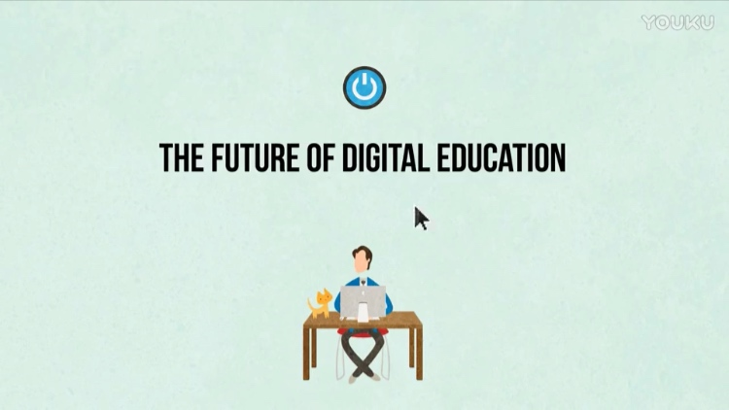
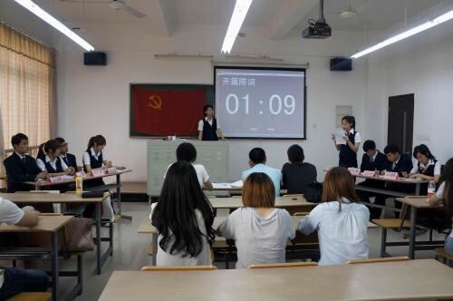
Generate:
Language proficiency
Communicative & cooperative ability
Critical thinking competence
In-class (3-4)
A
Watch video
Detail
Spotting
The future of digital education
B
Brainstorming
Advantages and disadvantages of different way of teaching and learning
Critical thinking
C
Intensive reading
useful expressions; cause & effect
Debate
D
The future of digital education: gloomy or rosy?

Slide 17
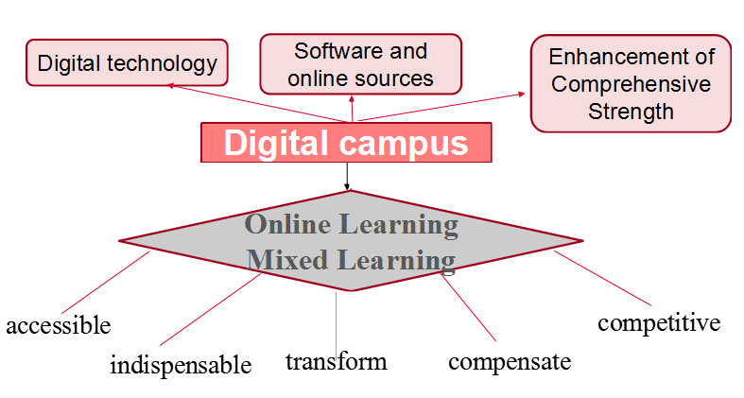
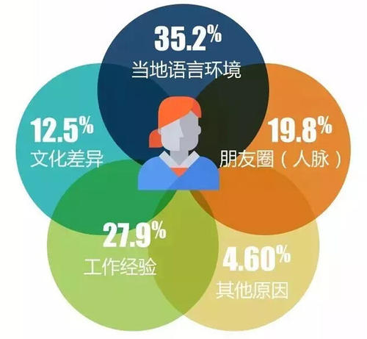
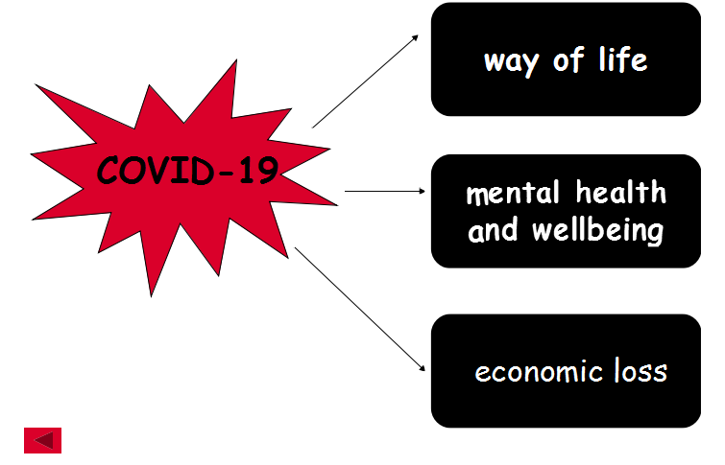
Generate:
Critical thinking competence
Writing ability
Patriotic emotion
In-class (5-6)
A
Bridge-in
Cause
effect
cause
digital campus
effect
B
Critical thinking
Critical
thinking
Whether to study abroad
C
Writing device analysis
cause
Writing
polishing
The challenges of studying abroad
effect
COVID-19 association
D
cause & effect

Slide 18
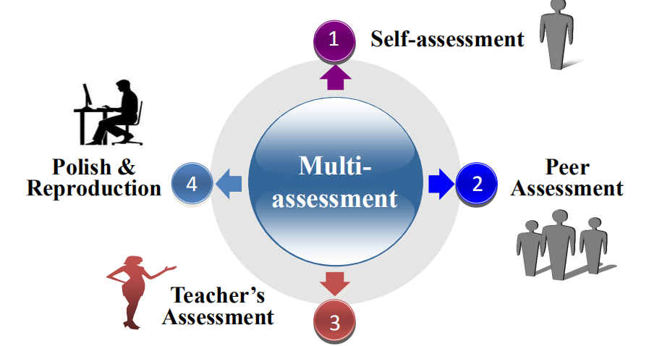
After-class
Generate:
Writing competence
Communicative ability
Multi-assessed
Polishing expository essay:
The popularity of online learning

Slide 19
Contents
1
Course Introduction
2
Unit Design
3
Teaching Demo

Slide 20
Unit 3
Digital Campus

Slide 21
Teaching Objectives
to accumulate information and facts about the theme
to practice and improve writing skills
Critical thinking:
to think critically about the theme
Emotion:
to generate patriotism and culture confidence
Knowledge:
Skills:
Skills:
Emotion:

Slide 22
Contents
1
Bridge-in
1
2
Pre-task
2
3
Participatory Learning
3
Post-task
4

Slide 23
Bridge-in
2
Post-task
Pre-task
Participatory Learning
Digital technology
Software and online sources
Enhancement of Comprehensive Strength
Pre-task
Cause
Digital campus
Online Learning
Mixed Learning
Effect
compensate
accessible
transform
competitive
indispensable

Slide 24
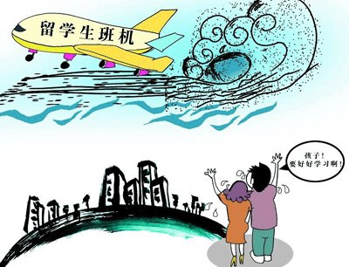
Bridge-in
Participatory Learning
Post-task
Pre-task
2
If you have a chance to study abroad right now, do you want to go?
Pre-task

Slide 25
Separate the wheat from the chaff
Bridge-in
Participatory Learning
Post-task
Pre-task
2
Pre-task

Slide 26
Bridge-in
Participatory Learning
Post-task
Pre-task
2

Slide 27
Bridge-in
Participatory Learning
Post-task
Pre-task
2
The Challenges of Studying Abroad
cause 2
cause 1
cause 3
cultural
difference
cost of living
loneliness
independence
effect

Slide 28
Cause
Effect

Slide 29
cause 2
cause 1
cause 3
cause
effect
effect 1
effect 3
effect 2

Slide 30
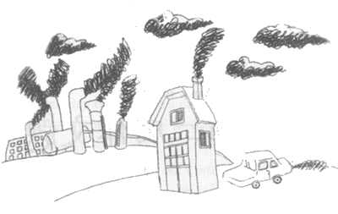
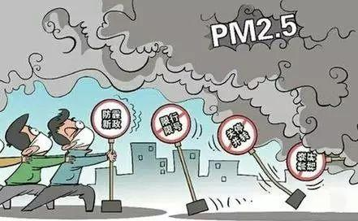
What is the cause of air pollution?

Slide 31
Vehicle exhaust
Air pollution
Uncontrolled factory
gasses
Burning of
low quality coal

Slide 32
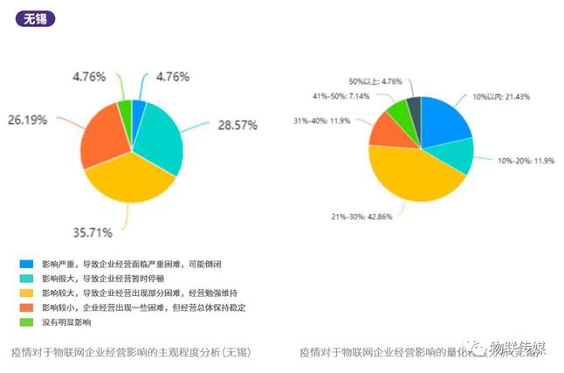
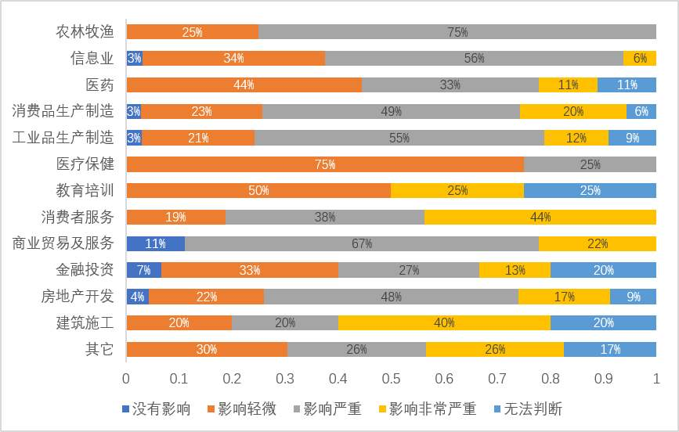
What’s the effect of COVID-19 ?

Slide 33
way of life
COVID-19
mental health
and wellbeing
economic loss

Slide 34
Bridge-in
2
Post-task
Pre-test
Participatory Learning
Pre-task
Assignments
Polish your essay--“The Popularity of Online Learning” using cause-and-effect writing device.
1
Think about the learning way you think the most appropriate.
2

Slide 35
Thank you!

