Slide 1
Unit 2 The Magic of Words
Introduction

Slide 2
Contents
01
02
03
Teaching Objectives
Teaching Design
Assessment
延迟符

Slide 3


Teaching Objectives
PART ONE
延迟符
延迟符

Slide 4



Teaching Objectives
Course Objectives
1
knowledge instruction
Students
·Non-English majors
·Freshmen
·CSE4--CSE5
·Suffering speaking and
listening anxieties
2
capacity training
3
moral-belief-building
延迟符

Slide 5




Teaching Objectives
Unit Objectives
Live Streaming: Recommend Made-in-China Products
Knowledge
Skills
Ability
Emotion&Value
Listening
·Distinguish facts
from opinions
Speaking
·Express facts
and opinions
·
·Collaboration
·Critical thinking
·Logical thinking
·Perceive character-
istics and the magic
power of language
·Develop national
pride and cultural
confidence
DOFO Structure
· Introduce
products
logically and
persuasively

Slide 6
Teaching
Design
PART TWO
延迟符
延迟符

Slide 7
Teaching Design
 | pre-class （online 1 period） | in-class （offline 2 periods） | after-class （online 1 period）
Lesson 1 | Teacher assigns the unit project. Ss watch video clips and finish pre-class survey. | Ss do listening and speaking practices. Teacher explains D&O in DOFO structure. | Ss perfect sub-project and finish the peer-assessment/ self-assessment worksheets.
 | Ss finish listening assignments and search information for unit project. | Ss do listening, viewing and speaking practice. Teacher explains F&O in DOFO structure. | Ss submit unit project. Teacher conducts delayed evaluation.
Lesson 2
课时分配：线上4学时+ 线下4学时

Slide 8


Teaching Design
methodology
Learning-centered
Learning-using Integrated
Cultural Exchange
P O A
Core Capability
延迟符

Slide 9

Teaching Design
Recommend Made-in-China products to students from our partner college in America by means of commercial live streaming.
编辑标题
点击文本框即可进行编辑输入相关内容点击文本框即可进行编辑输入相关内容点击文本框即可进行编辑
D
O
F
O

Slide 10
D
O
DEFINITION
F
O
OUTLINE
logical introduction
trustworthy or authentic
fact
fact
fact
&
&
&
opinion
opinion
opinion
attractive or vivid

Slide 11
Stage | Content
Before class (one period - 45 mins) | Ss watch the micro lectures on listening skills about how to distinguish facts from opinions in Unipus.
In class (two periods- 90 mins) | Activity 1: Motivating by video clips of commercial live streaming Activity 2: Motivating by pictures and vivid examples of live streamers Activity 3: Motivating/Enabling by Ss’ presentation and teacher’s feedbacks, which leads to F & O in DOFO structure
 | Activity 4: Enabling--Ss enhance listening abilities by watching the project-oriented materials. Activity 5: Enabling--Based on the input materials, Ss enhance speaking skills by teacher’s lecturing on what F and O are, why and how to use them and Ss then practice on F & O in DOFO structure & Assessing Activity 6: Enabling--Ss try to apply F & O to achieve the live streaming sales & Assessing
 | Activity 7: Strengthen what Ss have learned & assign homework
After class (one period- 45 mins) | Ss fill in the self-assessment worksheet and modify their commercial live streaming to achieve the final project. That is, by presenting DOFO structure, Ss publicize “Made in China” products and live stream the selected products to foreign students. Ss submit the projects in the form of videos and finish listening materials in iExplore 2 and further listening of lesson 2 & peer/ teacher's delayed assessment.

Slide 12
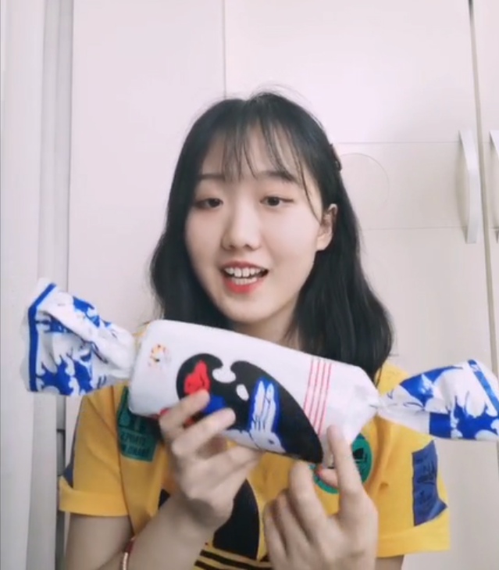
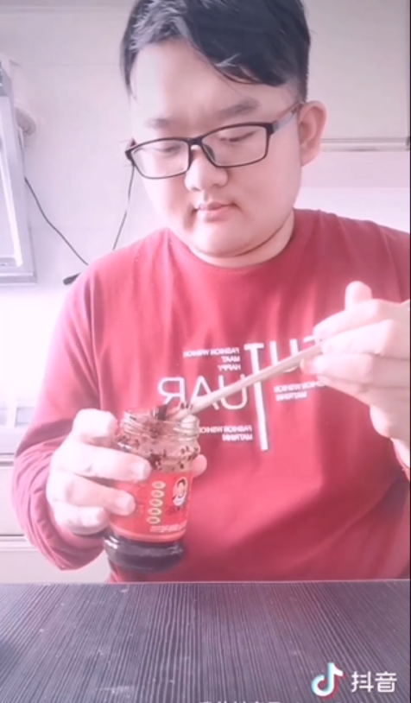
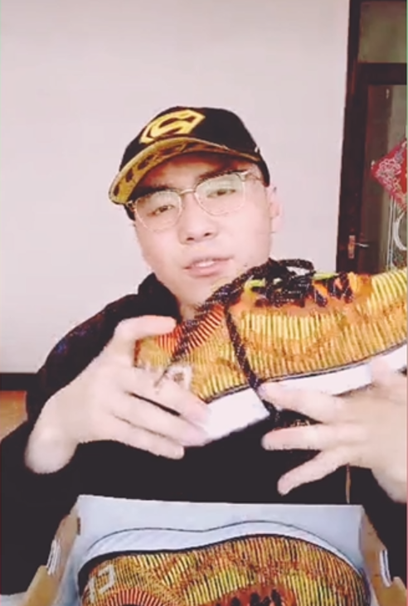
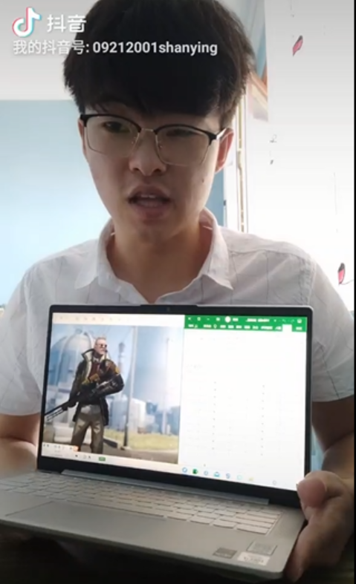
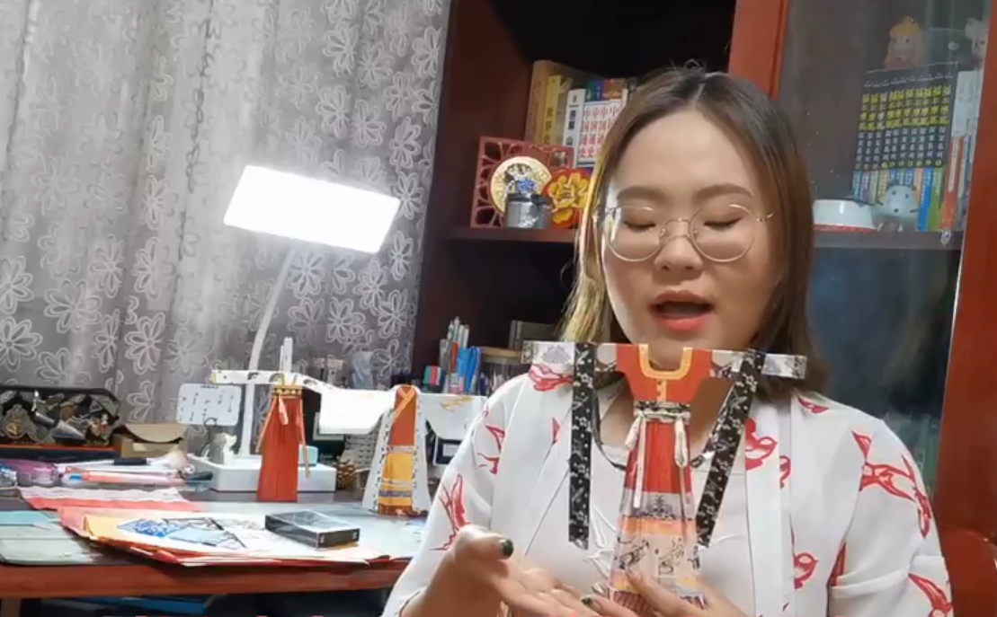
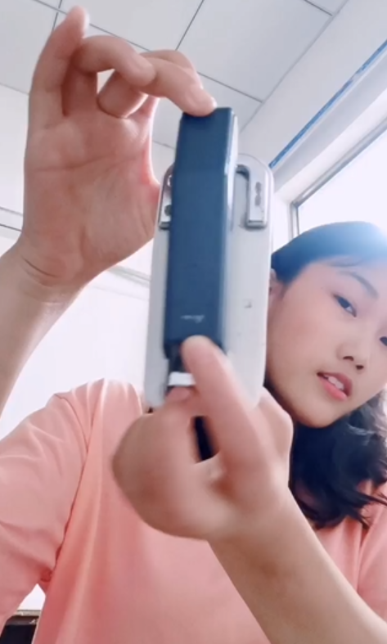
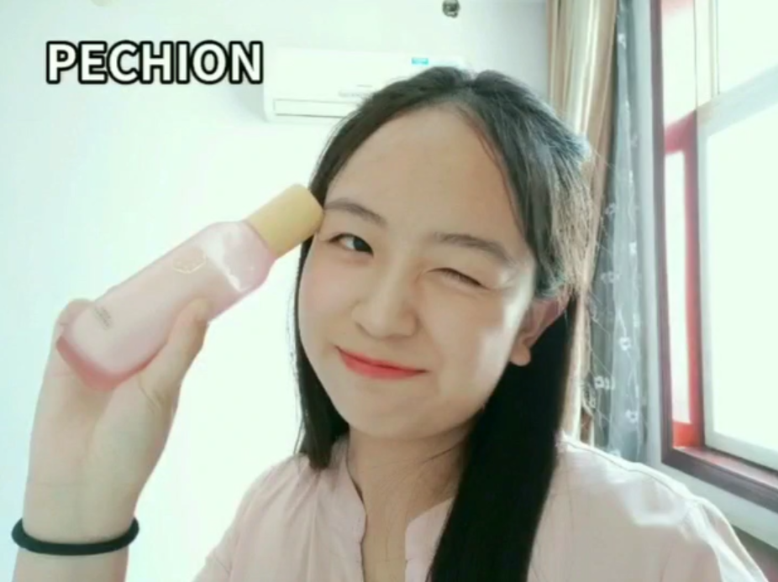
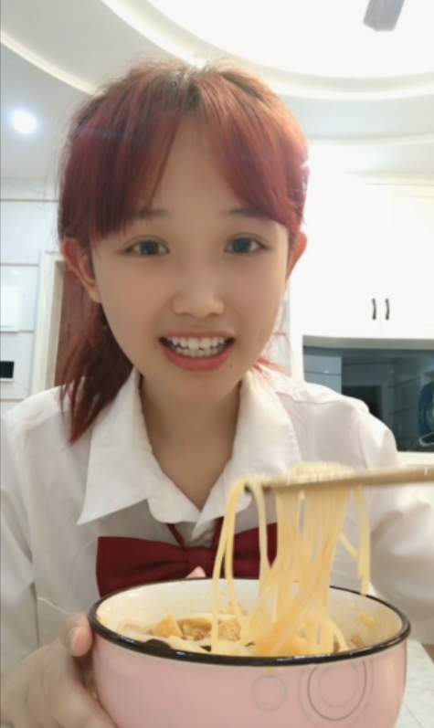


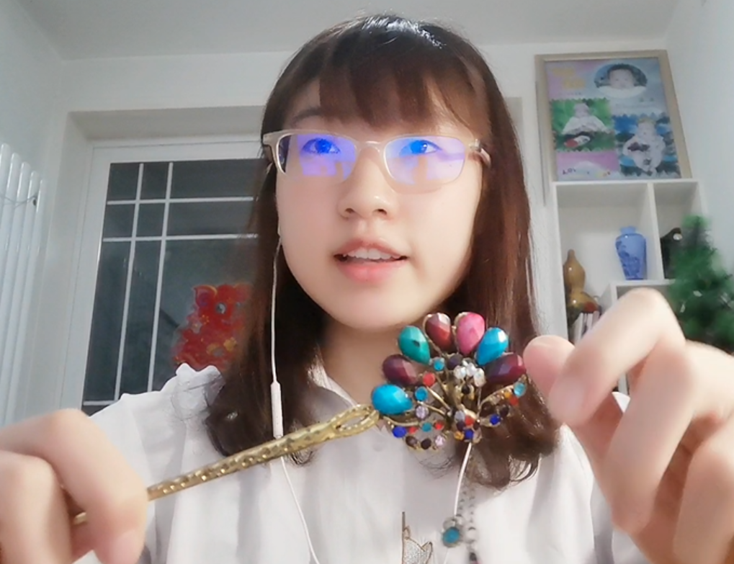
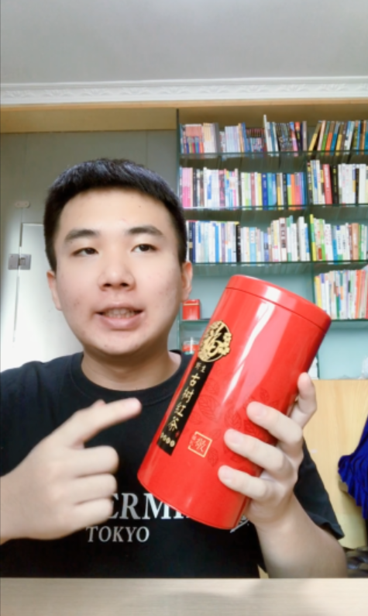
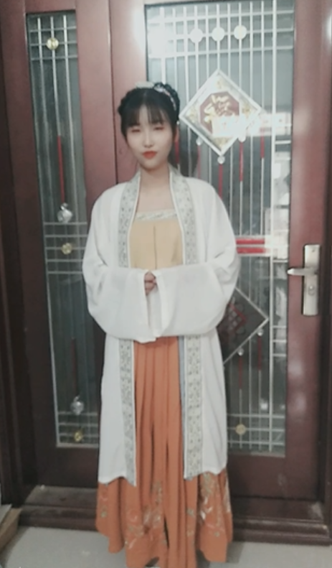
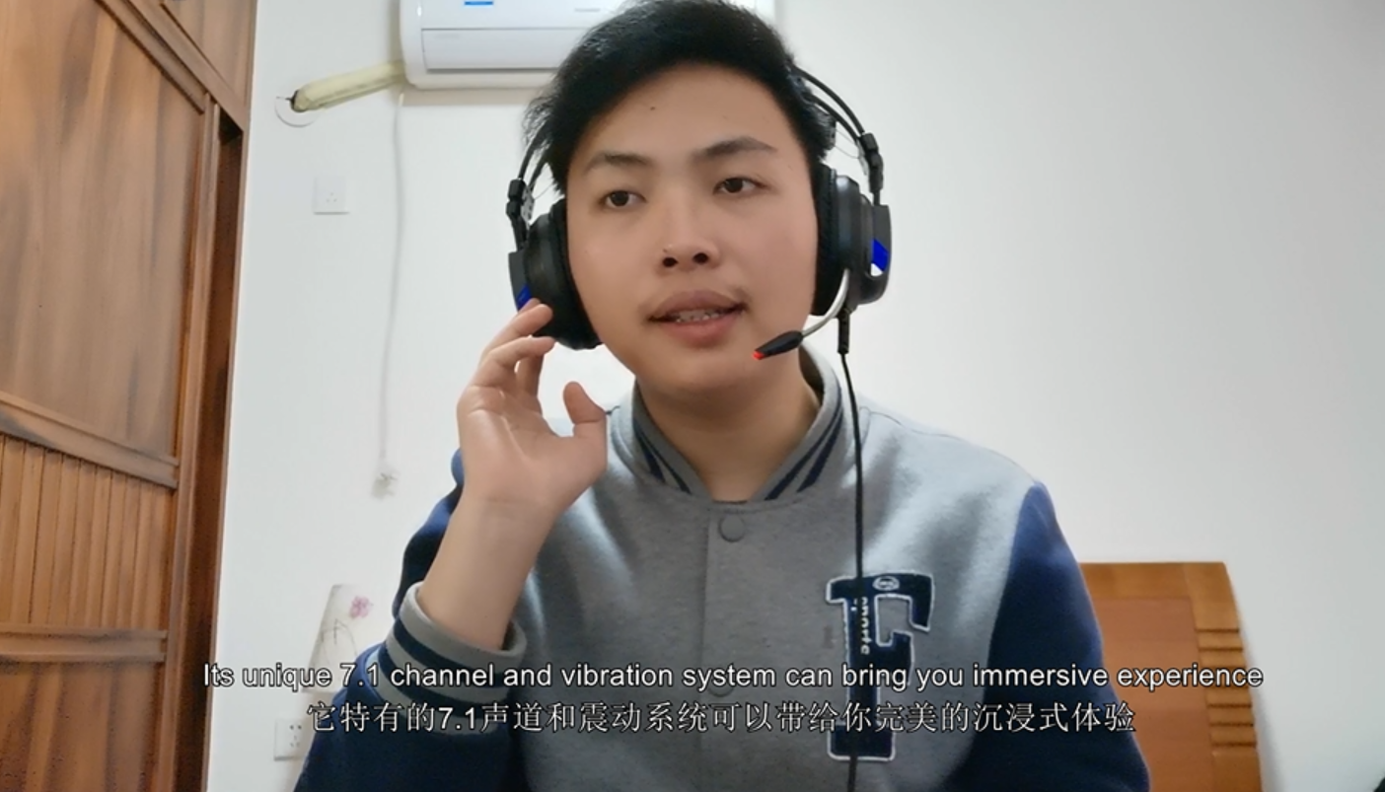
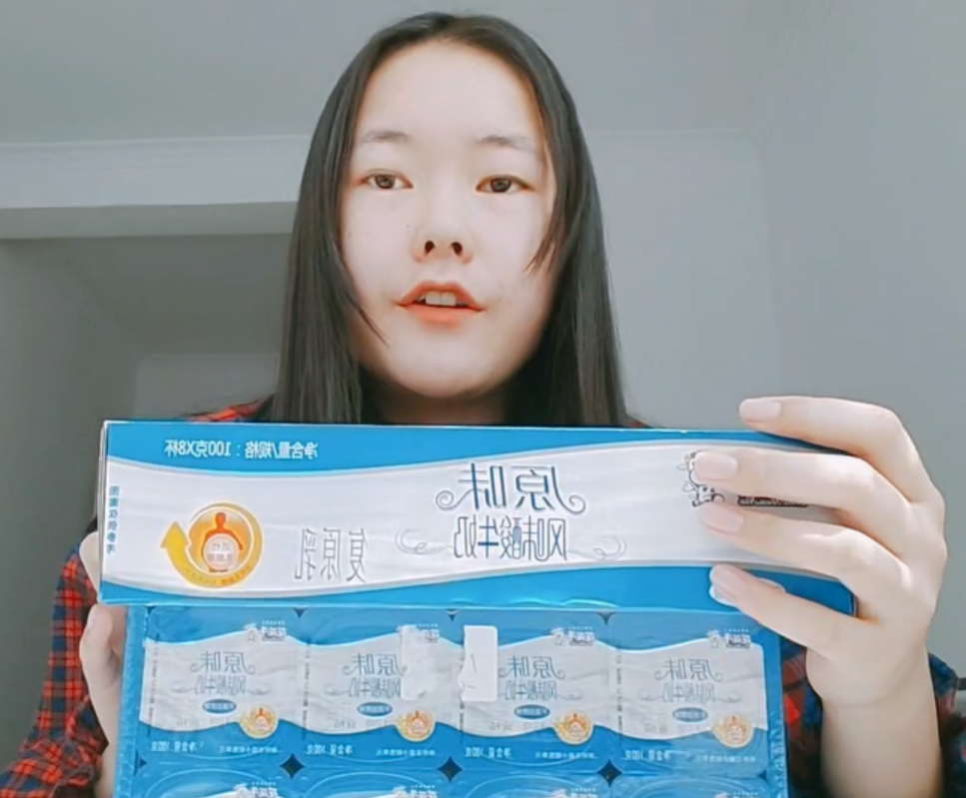

Slide 13
Assessment
PART THREE

Slide 14

Assessment
    Assessment Being Learning
formative assessment
+
summative assessment
self-assessment
+
peer-assessment
+
teacher's delayed assessment
peer-assessment
+
teacher's immediate assessment
编辑标题
编辑标题
点击文本框即可进行编辑输入相关内容点击文本框即可进行编辑输入相关内容点击文本框即可进行编辑
Course Evaluation
Pre-class
After-class
In-class

Slide 15
Assessment
pre-class
listening
group collaboration
ideological
education
in-class
speaking
productive
activity
after-class

Slide 16
DOFO
Language Competence
Learning
Competence
Critical Thinking Competence
Creative
Competence
Cultural
Competence
Collaborative Competence

Slide 17
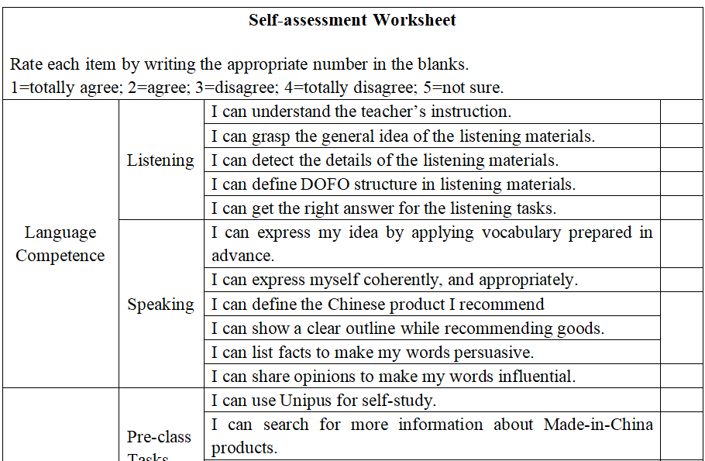
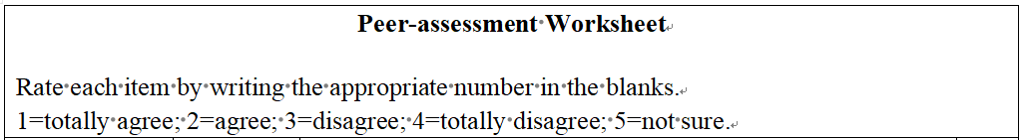
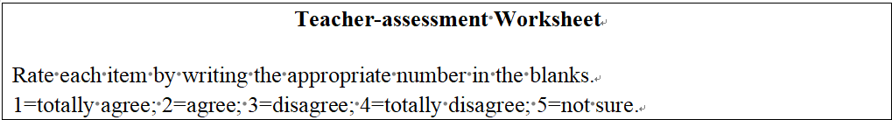
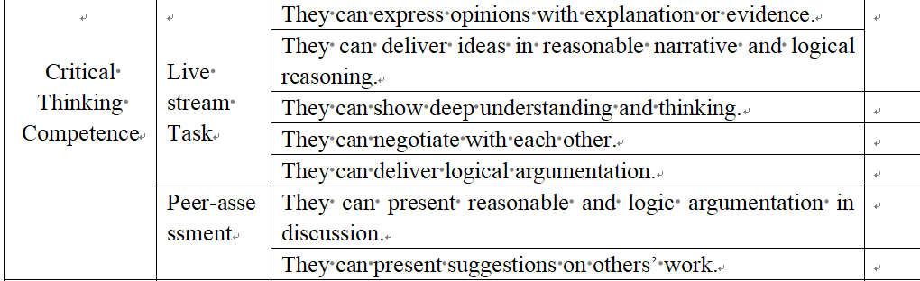
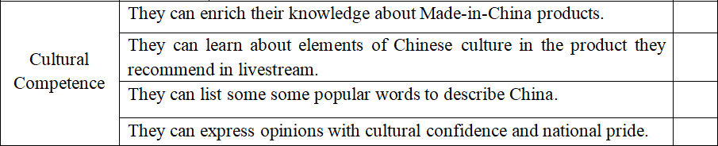

Slide 18
Unit 2 The Magic of Words
Demo Class

Slide 19
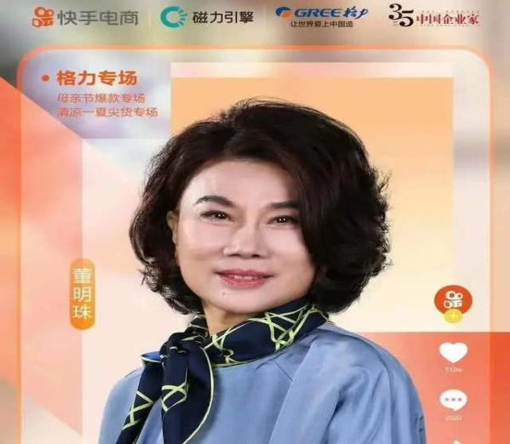

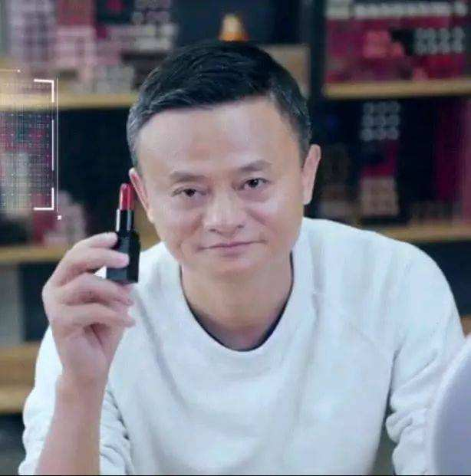

Live Streaming
Promoting and Selling Products on the Internet in Real Time
The
Magic of
Words

Slide 20
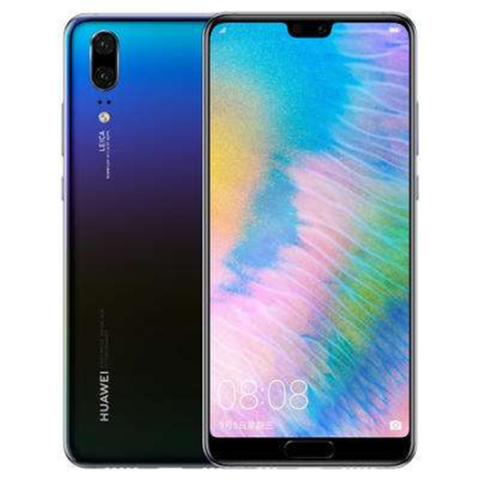



Assignment
Live Streamer
Foreign Students
Shooting a Video

Slide 21
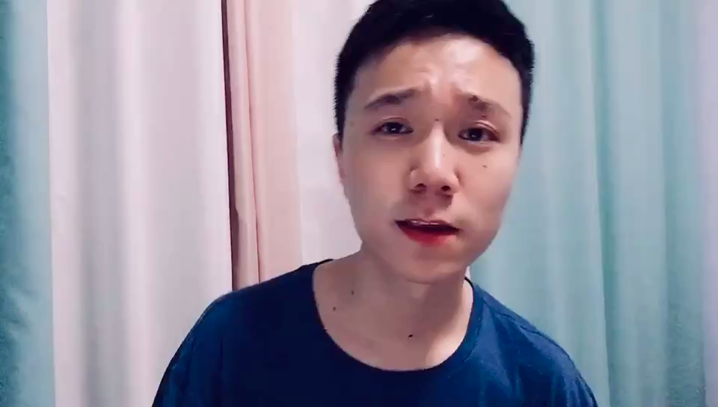

Slide 22

inexpensive
popular
fashionable
famous

Slide 23
inexpensive
popular
opinions
fashionable
famous

Slide 24
high-tech
inexpensive
popular
price
opinions
facts
famous
fashionable
features

Slide 25

Attractive
&
Authentic

Slide 26

Haier Pad

Slide 27


Looking for a stylish, great value tablet computer?
Well, here are two you must check out.
Introducing the 7 inch and 8 inch limited
edition Haier pad from Haier.
Slim and light weight, with elegant brushed aluminum casings, they are also great to hold.
If you are new to tablets, you will find these Haier designs great for listening to music,
watching videos, sending and receiving
emails, playing games, and much more.

Slide 28
size
... listening to music,
watching videos,
sending and receiving
emails, playing games,
and much more...
Introducing the 7 inch
and 8 inch limited
edition Haier pad
from Haier.
facts
aluminum casings
function
material

Slide 29
adjective
opinions
If you are new to tablets, you will find these Haier designs great for…
Looking for a stylish, great value tablet computer?
Slim and light weight,
with elegant ...
Well, here are two you must check out.
they are also great to hold
modal verb

Slide 30
Looking for a stylish, great value tablet
computer?
Well, here are two you must check out.
facts
Introducing the 7 inch and 8 inch limited
edition Haier pad from Haier.
opinions
facts
opinions
Slim and light weight, with elegant brushed
aluminum casings,
opinions
facts
they are also great to hold.
If you are new to tablets, you will find these Haier designs great for
listening to music,
watching videos, sending and receiving
emails, playing games, and much more.

Slide 31
OPINION
FACT
Facts: something that actually happened or empirically true and
can be supported by evidence.
Opinions: personal beliefs or judgements that are not founded on proof or certainty.
Look for Signal Words:
numbers statistics
record history
nonfiction document
data prove
verified eyewitness
Look for Signal Words:
good/bad might
believe should
think guess
always interpretation
never point of view
Facts are certainties
Opinions are disputable

Slide 32

Quick
Response

Slide 33


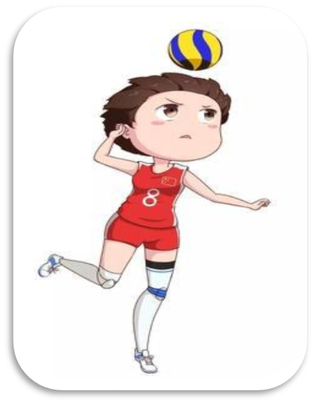
VS
Chinese Women Volleyball
Team is so great.
Till 2019 Chinese Women Volleyball
Team won ten World Championship.

Slide 34
Chinese Women Volleyball
Team is so great.

Slide 35
Till 2019 Chinese Women Volleyball
Team won ten World Championship.

Slide 36

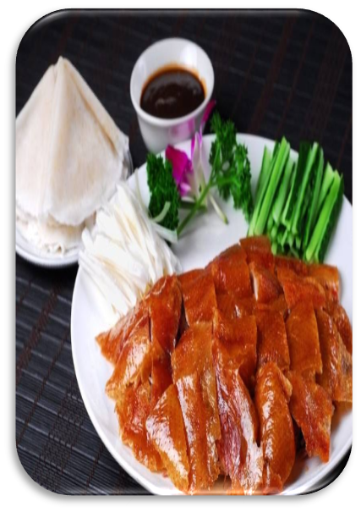

VS
The Beijing Duck is very delicious,
tender and crisp.
The skin of Beijing Duck is air-dried
and brushed with a layer of sugar.

Slide 37
The Beijing Duck is very delicious,
tender and crisp.

Slide 38
The skin of Beijing Duck is air-dried
and brushed with a layer of sugar.

Slide 39


The flag of China was raised
on the summit of Mount
Qomolangma.
It is the most challenging experience
to climb Mount Qomolangma.

Slide 40
The flag of China was raised
on the summit of Mount
Qomolangma.

Slide 41
It is the most challenging experience
to climb Mount Qomolangma.

Slide 42
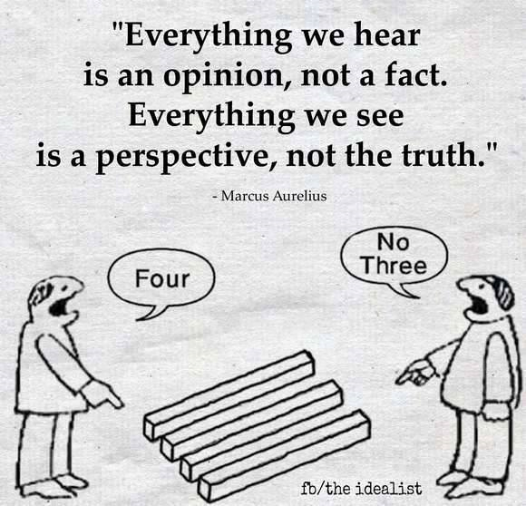
Critical Thinking
facts
VS
opinions
Judgement of Truth

Slide 43
facts
Trustworthy and Authentic
&
Attractive and Vivid
opinions

Slide 44

facts
&
opinions

Slide 45
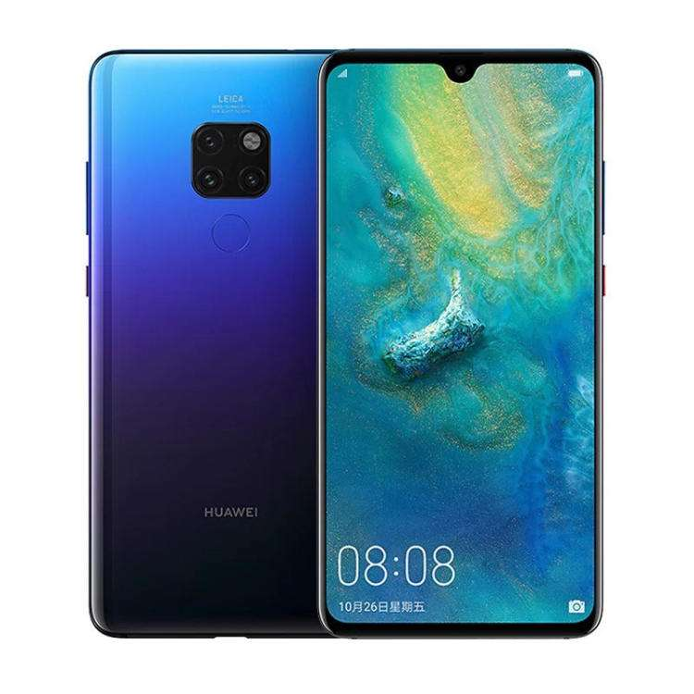

Please polish the former live streaming about Huawei mobilephone.

Slide 46
Assessment Worksheet
1：Poor; 2: Fair; 3: Satisfactory; 4: Good; 5: Very Good
Assessment Checklist
1
2
3
4
5
Ss can apply new words prepared
autonomously in their expression.
Ss can deliver the presentation with
appropriate and smooth pronunciation.
Ss can deliver the presentation clearly
using FACTS and OPINIONS .
Ss can deliver their speech with strong
emotion and passion.

Slide 47

Buy My Goods
Live Streamer
Buy My Story
Cultural Communicator

Slide 48
Thank you!
Notes:
亮亮图文旗舰店https://liangliangtuwen.tmall.com

