Slide 1

English Debate

Slide 2
Course Introduction
Language Purpose
Educational Purpose
Know the basics of British Parliamentary debate
Learn debating rules and relating expressions
Cultivate critical thinking ability
2. Broaden international view
3. Analyze problems rationally

Slide 3
Theoretical Basis
Production Oriented Approach
Learning centered principle
Output-driven hypothesis
Learning-using integration
principle
Input-enabling hypothesis
Whole-person education
principle
Selective-learning hypothesis

Slide 4
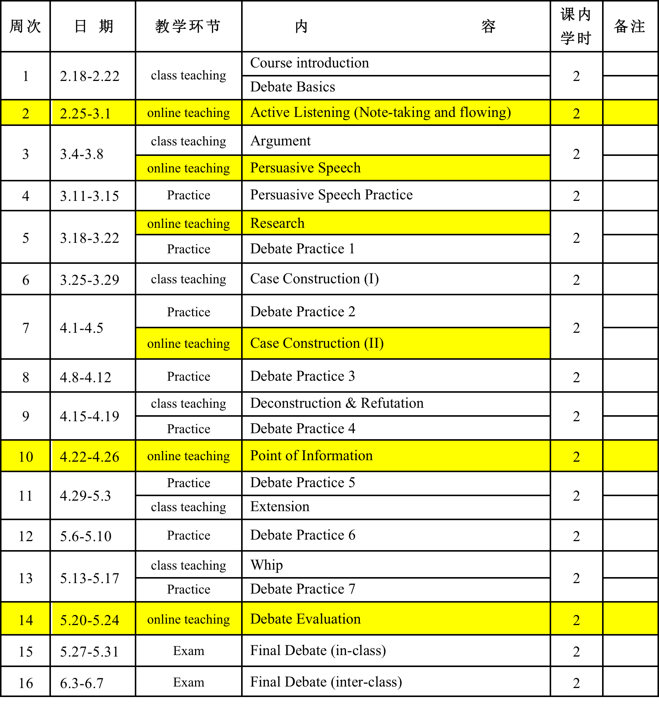
Teaching Syllabus

Slide 5
Technological Support
Mooc
Before Class
Course web
Rain Class
QQ Group
During Class
Course web
Course web
Course blog
After Class
Questionnaire
Star

Slide 6
Ideological and Political Education
School life
Personal quality
individual
Future career
Life planning
Debate topic
country
Social phenomenon
Value judgment
International affair
Patriotism
globe
Epidemic relating
words
Vocabulary contest
Second
Class
activity
Tribute to hero
Team work
Critical thinking
Debate contest

Slide 7
Lecture Introduction
Language Purpose
Educational Purpose
Enable Ss to identify ad hominem fallacy
2. Learn how to refute argument with ad
hominem fallacy
Understand the Confucius statement thoroughly
Enable Ss to elaborate personal opinion flawlessly

Slide 8
Teaching Process
Motivating
A scenario in daily life
Concept
Identification
Enabling
Language pattern
Refutation
Assessing
Self-assessment
Peer review
Teacher’s evaluation

Slide 9
Motivating
Steps
Requirements
Teacher describes relevant scenario
Students try to accomplish required productive activity
Teacher explains learning objectives and productive activities
Scenario with high communicative value; cognitive challenging
Make students aware of their problems in finishing the task and arouse their desire to overcome the deficiency
Enable students to recognize both linguistic and communicative objectives, describes tasks

Slide 10
Enabling
Steps
Requirements
Teacher divides a large productive task into several mini-tasks
Teacher provides selective materials accordingly
Students practice a task once they finish their selective learning
Teacher gives guidance and checks learning outcomes
Students are able to describe the logical links between mini-tasks
Students are able to understand the links between segments of given materials and each mini-tasks
Enable students to select relevant ideas, language pattern, or discourse structure
Students use what they have learnt to accomplish their task

Slide 11
Assessing
Steps
Requirements
Self-assessment
Teacher gives criteria and guidance to evaluate
Students submit their products
Students give a peer review before next class
Teacher select typical products and evaluate collaboratively with students in next class
Students are able to check how do they learn in class
Make criteria clearly and easy to check by students
Submit products with required format before deadline
Each student grades two products
Teacher needs to prepare detailed evaluation of all students.

Slide 12

Ad Hominem Fallacy
Debate in English

Slide 13
iPrepare
01

Slide 14
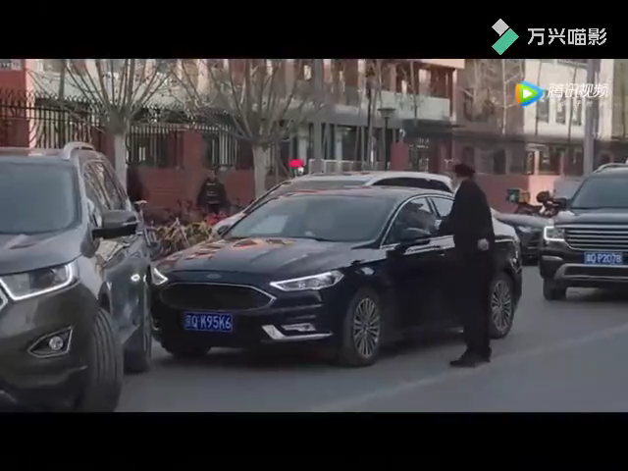
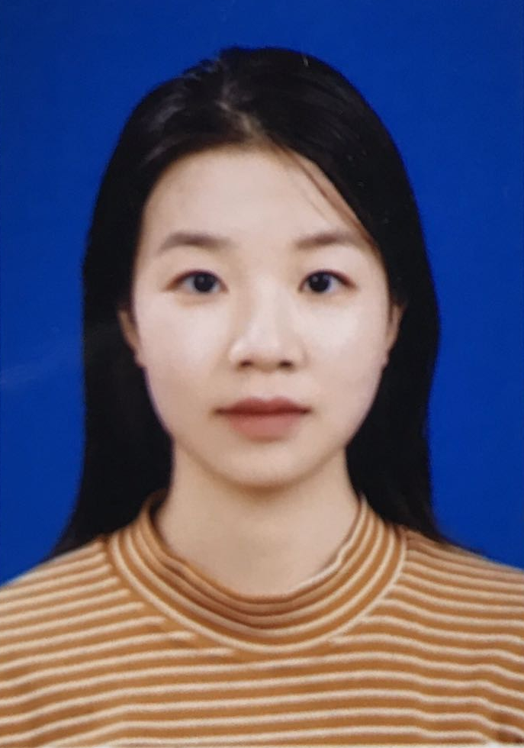
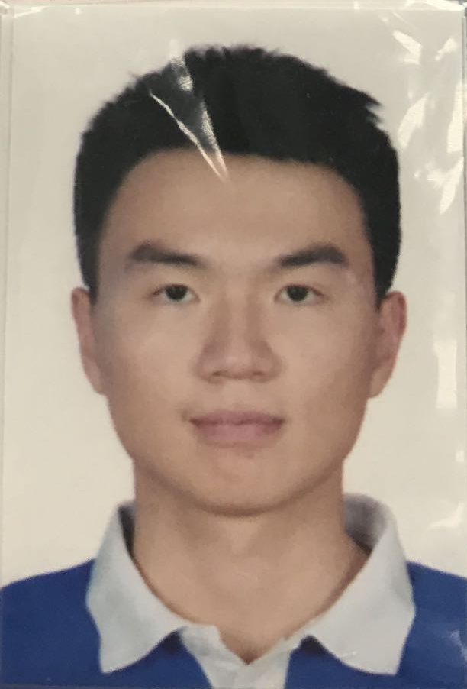
iPrepare - Watch a video clip
王喆
王远蒙

Slide 15

主观题
10分
Suppose you were the female driver, how would you respond to the male driver. Please record your answer and submit it via the rain class.
作答

Slide 16



iPrepare - Demo of Ss’ submission
Li Ao （李翱）
I would be terribly irritated by the male driver; unfortunately, however, I may probably just burst into tears feeling sad for myself, since I have no awareness of what the appropriate response would be.
Liu Qingyang (刘清扬）
Even though I’m a man, I still found the male driver’s words absurd. So if I were the female driver, chances are high that I would have a fierce quarrel with him before the police has come.

Slide 17
iExplore
02

Slide 18


iExplore – Ad Hominem Argument
Definition
An ad hominem argument is an argument directed against a person, rather than against what that person says.
- from the Cambridge Dictionary

Slide 19
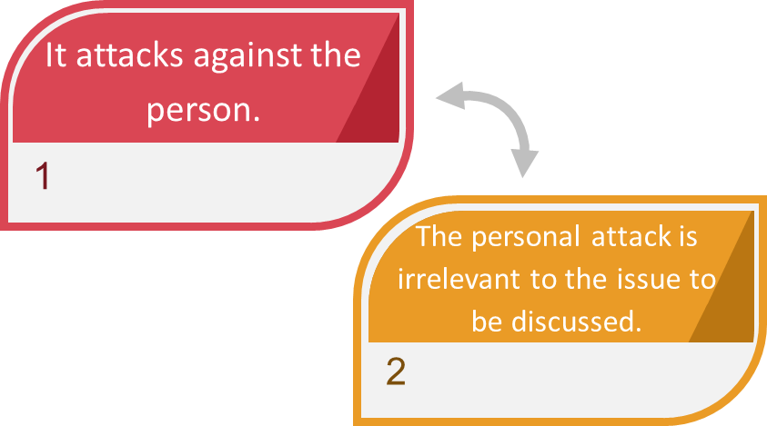
iExplore – Conditions of Ad Hominem Fallacy

Slide 20

iExplore – Female Driver Ad Hominem Fallacy

Slide 21


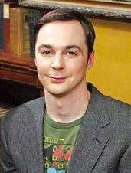

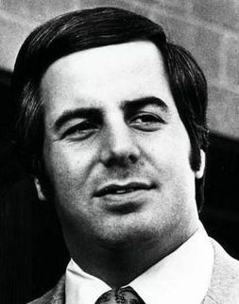

iExplore – Cause of Ad Hominem Fallacy (Prejudice)
Criminal?
A
B
A
B
Scientist?
Doctor?
A
B

Slide 22
iExplore – Cause of Ad Hominem Fallacy (Multiple-choice)
Criminal
A
B
A
B
Scientist
Doctor
A
B

Slide 23
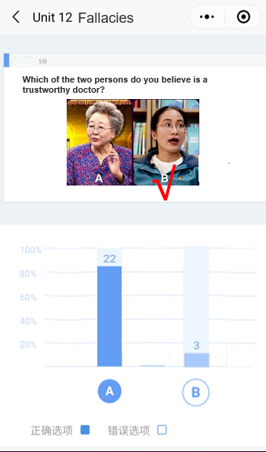
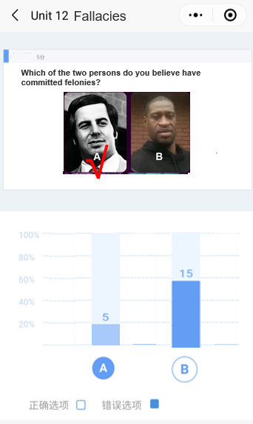
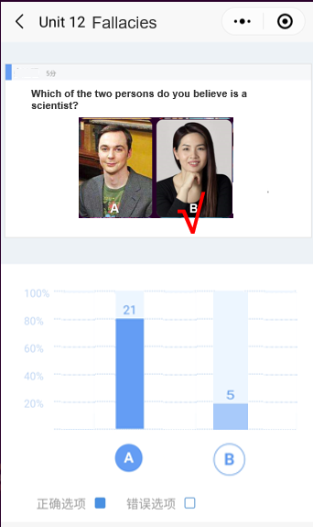
iExplore – Cause of Ad Hominem Fallacy (Multiple-choice)
Which of the two persons do you believe is a scientist?

Slide 24
iExplore – Cause of Ad Hominem Fallacy (Prejudice)
Character
Physical appearance
Credential
Race
A
B
A
B
Gender
Age
A
B

Slide 25


iExplore –
Cause of Ad Hominem
Fallacy

Slide 26
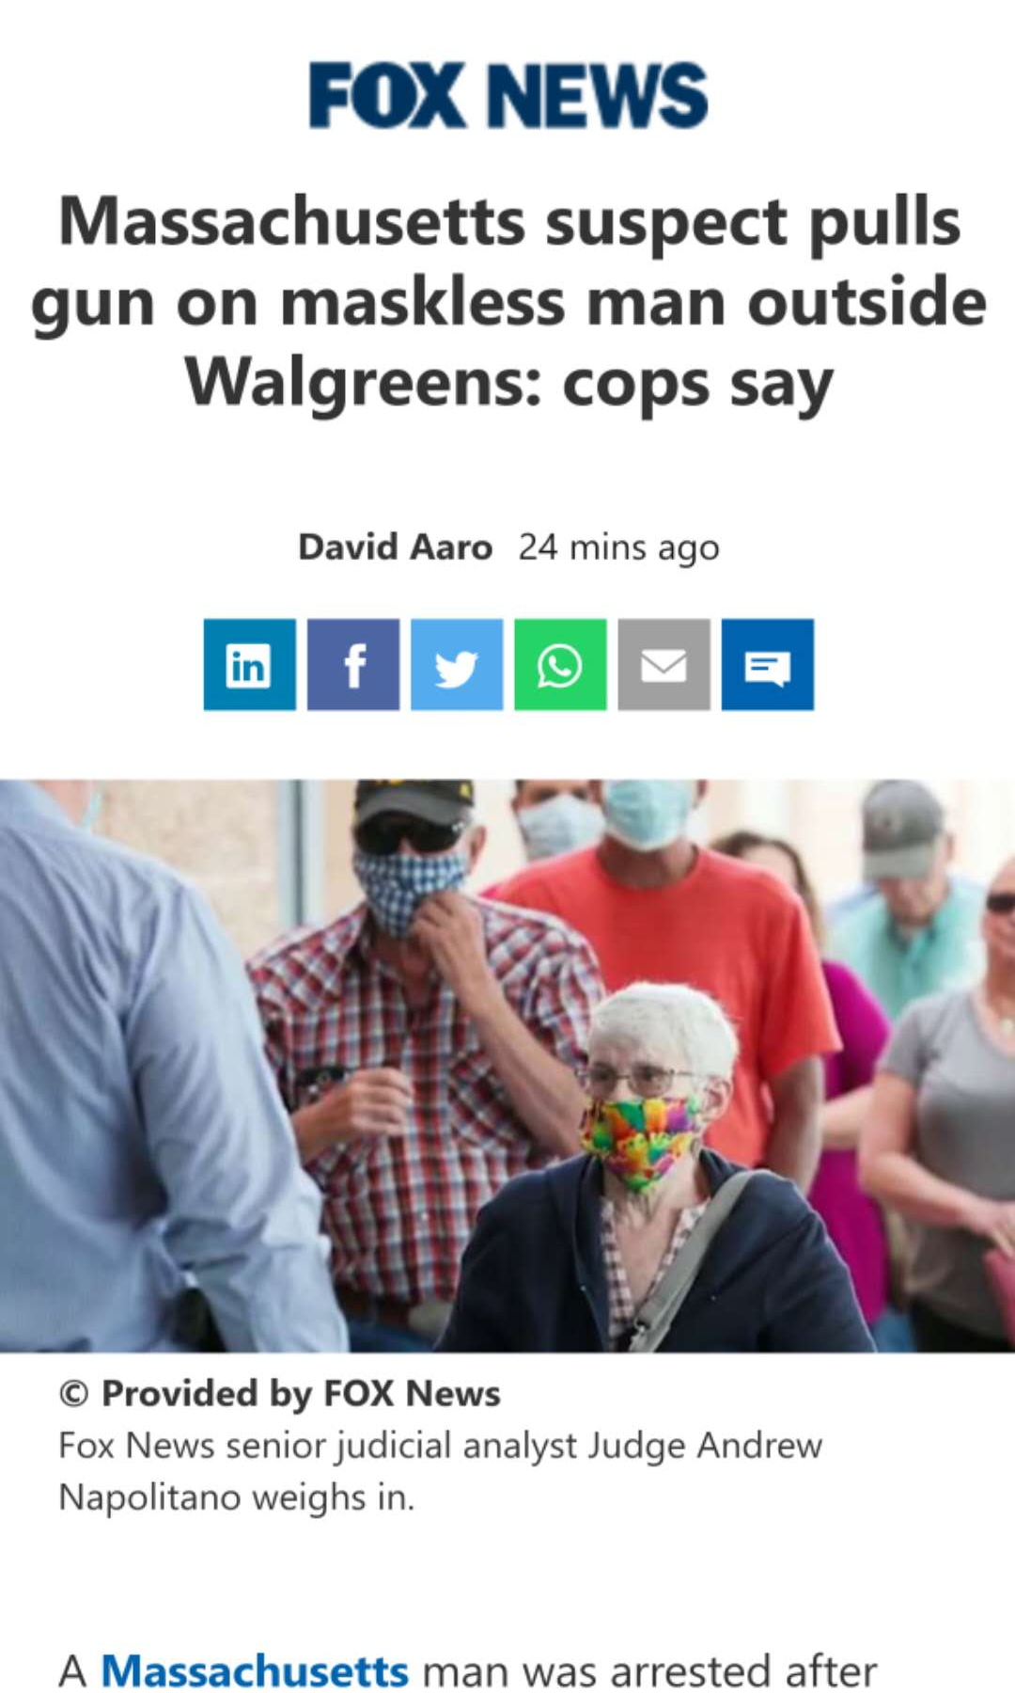
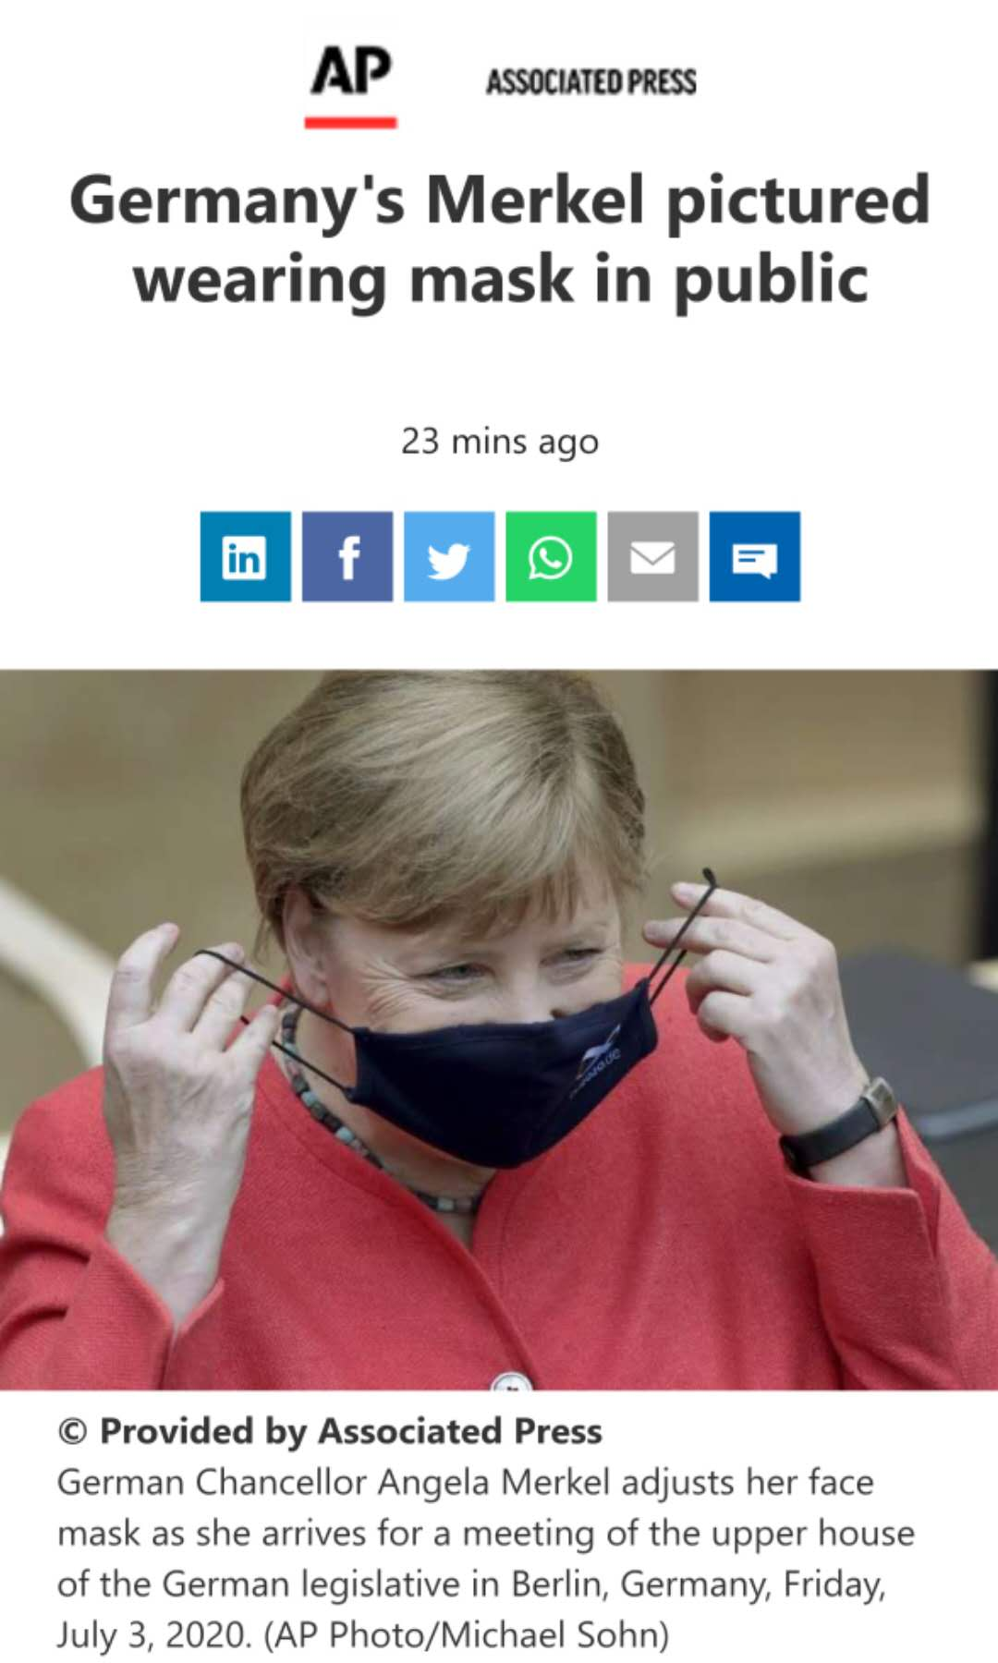
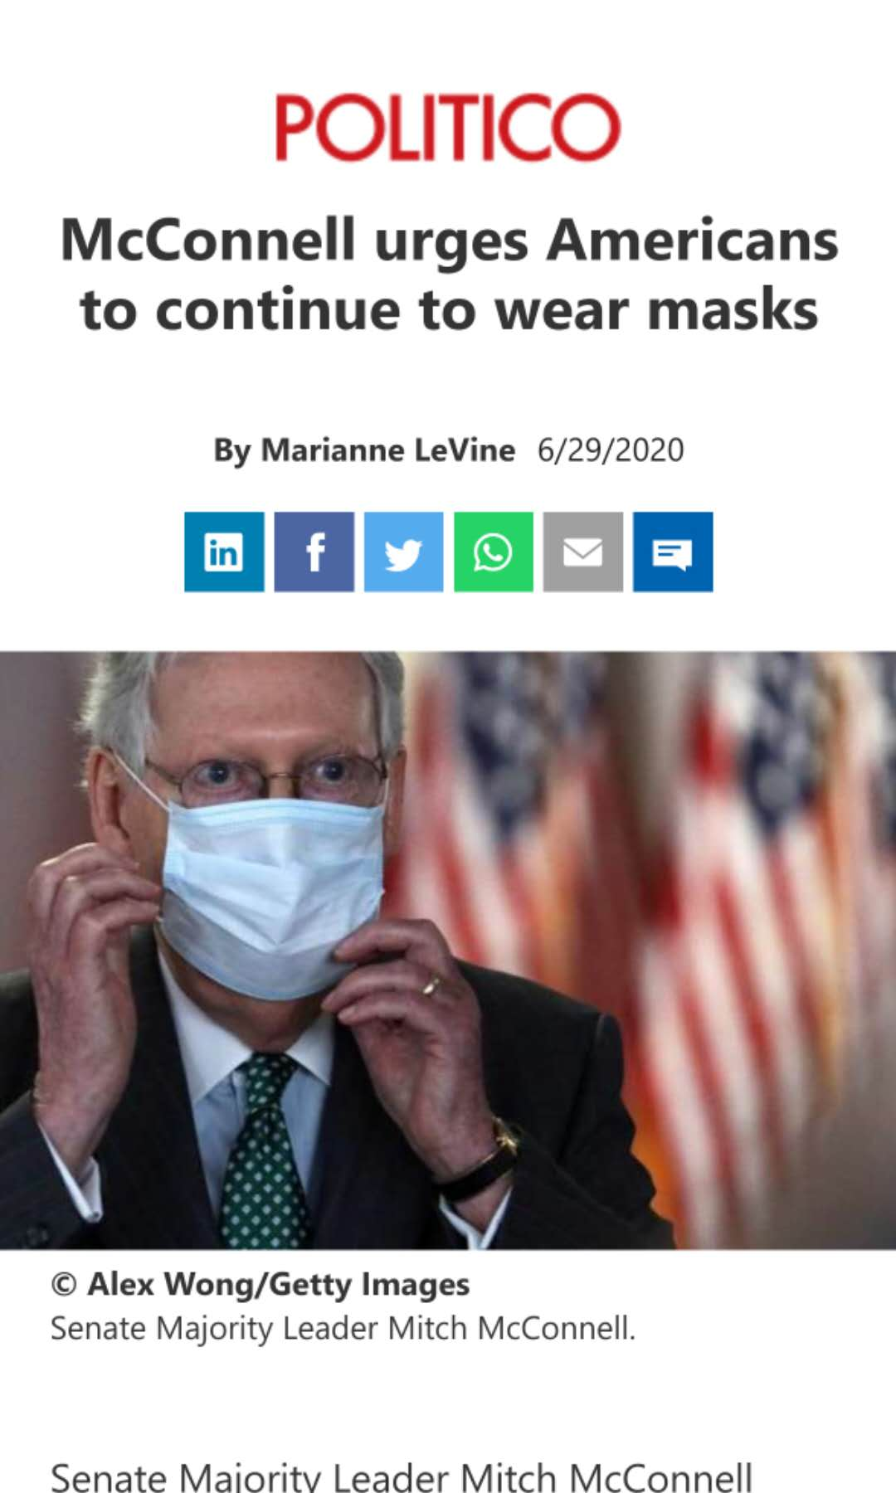
iExplore – Identify Ad Hominem Fallacy

Slide 27
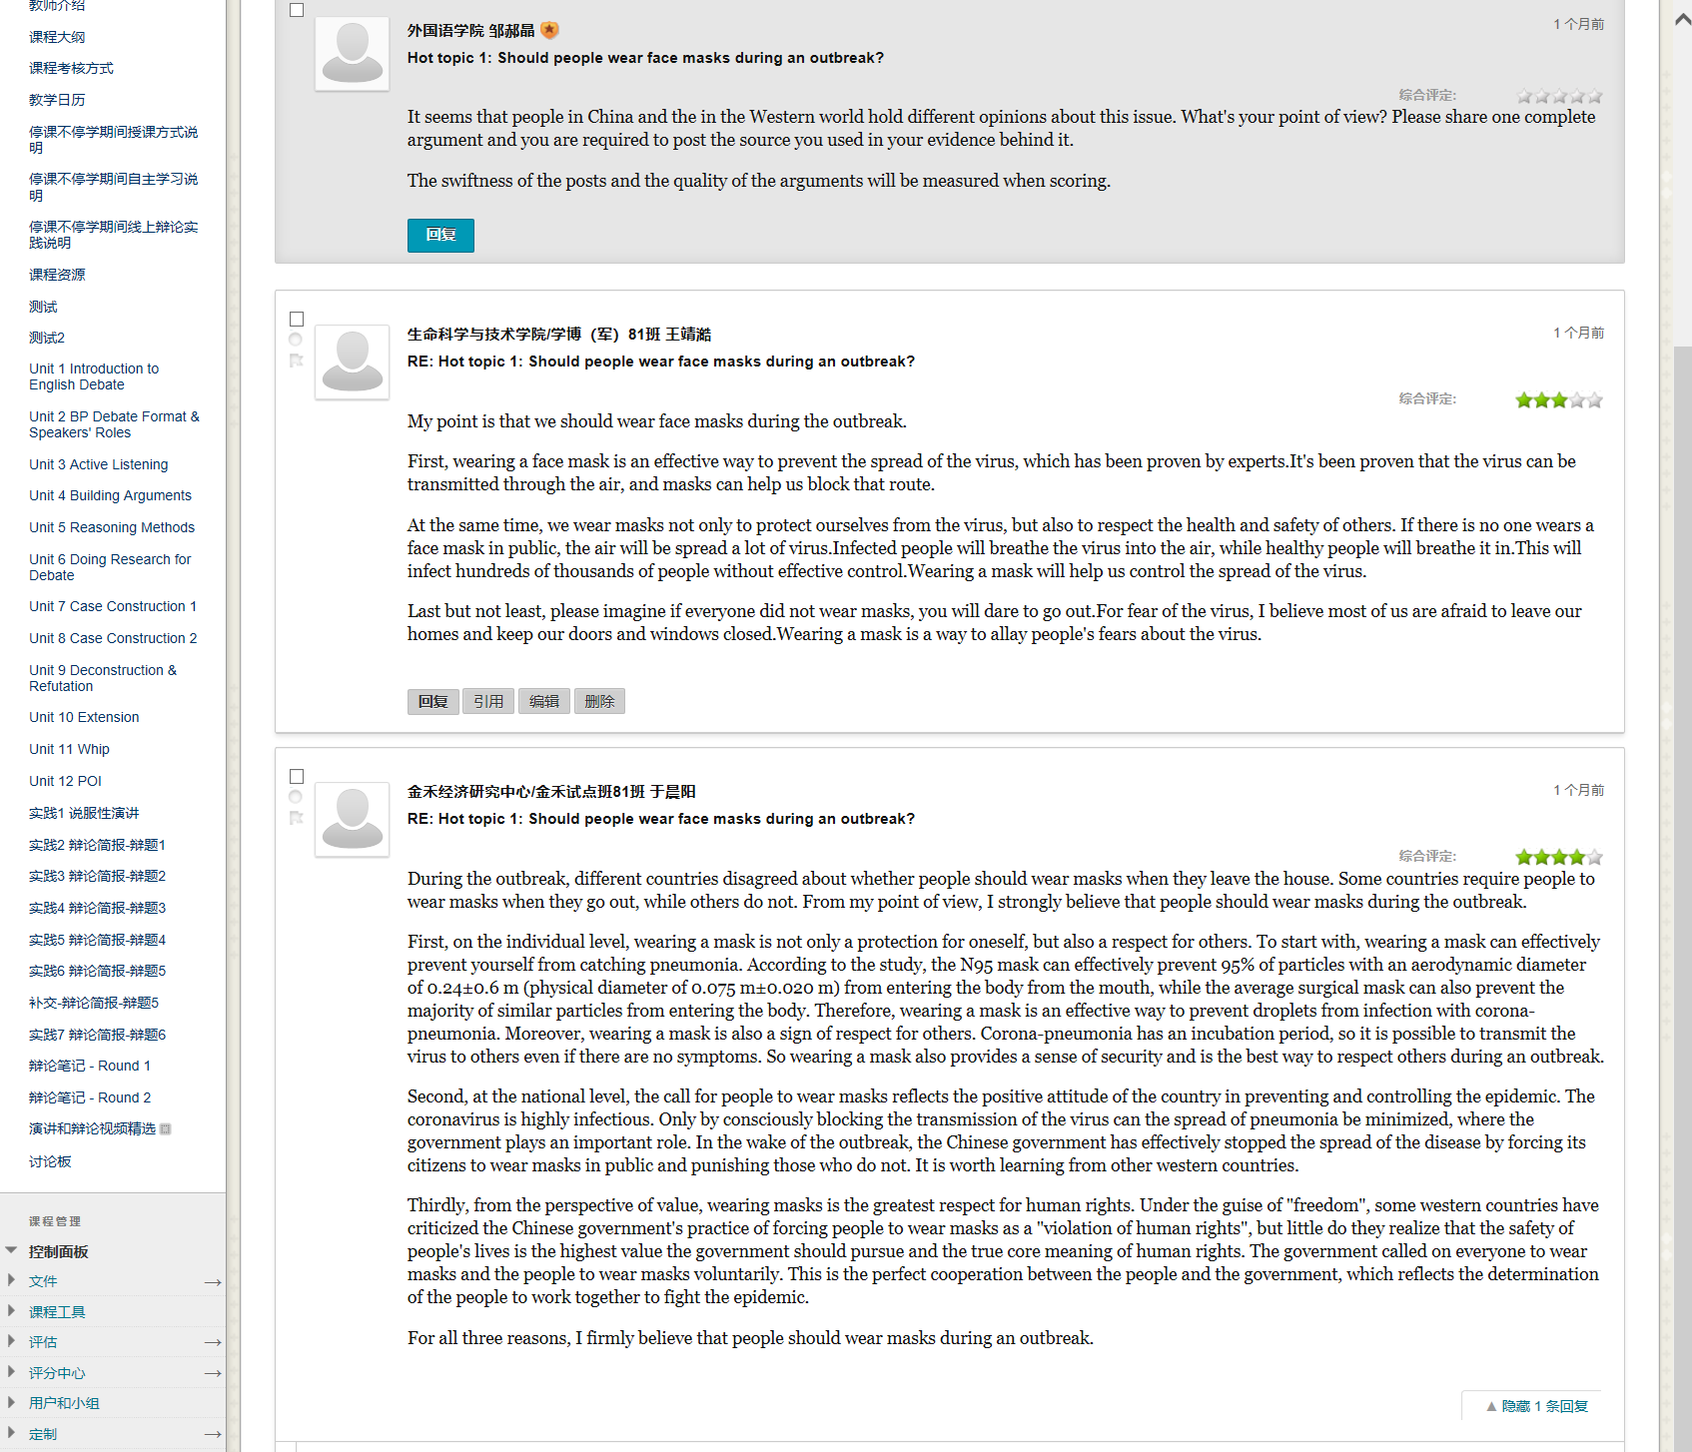

Slide 28

iExplore – Identify Ad Hominem Fallacy
Wearing a face mask will make you sick.
1
Only sick people wear a face mask.
2
Masks will weaken your immune system.
3

Slide 29
iProduce
03

Slide 30
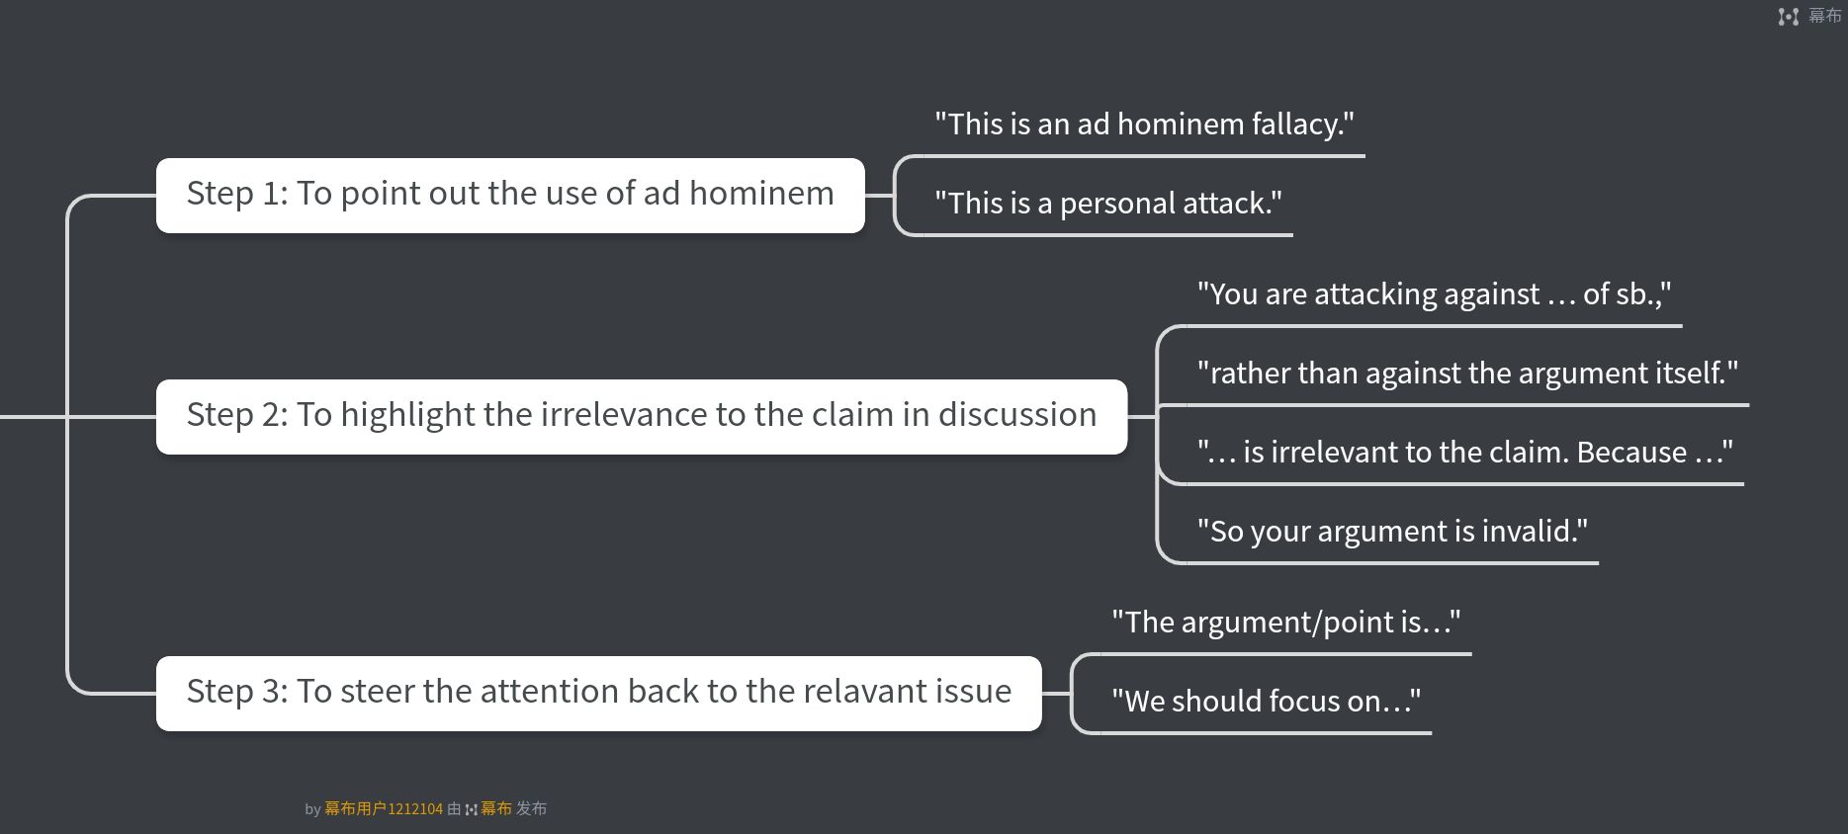
iProduce – Respond to Ad Hominem Fallacy
Step 1: To point out the use of ad hominem
Step 2: To highlight the irrelevance to the claim in discussion
Step 3: To steer the attention back to the relevant issue

Slide 31
iProduce – Refute to female Driver Ad Hominem Fallacy

Slide 32

iProduce – Respond to Ad Hominem Fallacy
“This is an ad hominem fallacy.”
“This is a personal attack.”
1
“You are attacking against the … of someone, rather than against the argument itself.” “…is irrelevant to the claim. ”
2
“The argument/point is about … ”
“We should focus on …”
3

Slide 33

iProduce – Identify and Refute Ad Hominem Fallacy

Slide 34
Recap the Content
Ad Hominem Fallacy
01
The Definition
The Cause
02
03
How to Identify it
How to Respond to It
04
Notes:
模板来自于 http://meihua.docer.com/

Slide 35
Word Bank
ad hominem adjective /ˌædˈhɒm.ɪ.nəm/
(of a criticism, etc.) directed against a person, rather than against what that person says:
an ad hominem attack on his rival
fallacy noun /ˈfæl.ə.si/
an idea that a lot of people think is true but is in fact false:
[ + that ] It is a common fallacy that women are worse drivers than men.
prejudice noun /ˈpredʒ.ə.dɪs/
an unfair and unreasonable opinion or feeling, especially when formed without enough
thought or knowledge:
Laws against racial prejudice must be strictly enforced.
inherently adverb /ɪnˈher.ənt.li/
in a way that exists as a natural or basic part of something:
There's nothing inherently wrong with his ideas.
refutation noun /ˌref.juˈteɪ.ʃən/
the act of saying or proving that a person, statement, opinion, etc. is wrong or false:
She published a refutation in the newspapers two days later.

Slide 36
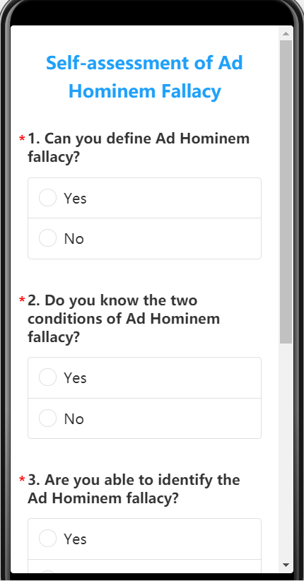


Slide 37
THANK
YOU

