Slide 1

Introduction

Slide 2

CONTENTS
Part Ⅰ Teaching Context
Part Ⅱ Teaching Objectives
Part Ⅲ Teaching Design

Slide 3


Teaching Context

Slide 4
Teaching Context
Our University
Our Students
Normal university
●Freshmen of non-English majors
●Class A of Humanity Department
General Goal of This Course
● Cultivate the Comprehensive language proficiency
● Enhance culture awareness
Notes:
com

Slide 5

Teaching Objectives

Slide 6

Teaching Content
Unit 5 Section A
Spend or save – The student’s dilemma
the relevant ideological-political education element: the virtue of thrift

Slide 7
Teaching Objectives
• design and conduct the surveys
• report the findings
Knowledge
Emotion
Skill
• understand and inherit Chinese people’s traditional virtue of thrift
• learn the proper use of the writing techniques in the comparison and contrast essays

Slide 8

Teaching Design

Slide 9
Teaching Methodologies
Project Based Learning
Model
Blended Teaching Model

Slide 10
Teaching Procedures
Step 1
Step2
Step 3
Step 4
Step 5
The Teacher’s guidance
The ideological and political education
The Teacher’s Evaluation
Assignment
Review
An Alipay’s annual account statement of 2020
The driving question
The task：Oral report
The writing techniques
The Chinese poems proverbs and sayings
The benefits of saving

Slide 11
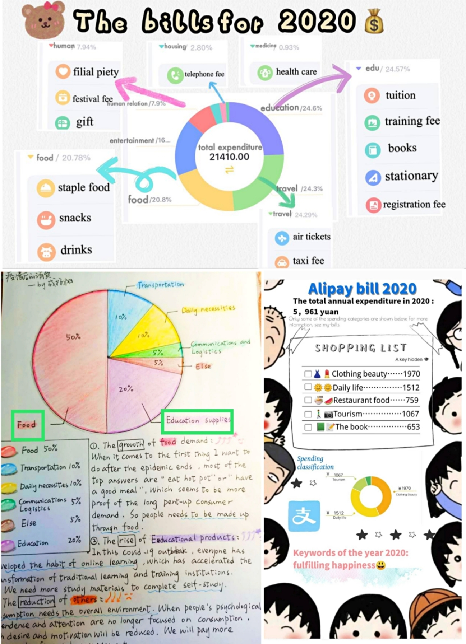

Slide 12
03
01
02
Self-evaluation
Teacher’s evaluation
Peer’s evaluation

Slide 13
Thank You

Slide 14
Unit 2 Spend or save —
The student's dilemma
New Horizon College English (Reading and Writing) Volume 2

Slide 15
Teaching procedures under PBL
Driving
question
Students'
voice and
choice
In-depth
enquiry
Reflection

Slide 16
1. Driving question+2. Students' voice and choice
Driving question: How should college students budget their money?
Task assigned and finished: work in groups and design a short questionnaire (3-5 questions) regarding spending habits. Make a report in the class.

Slide 17
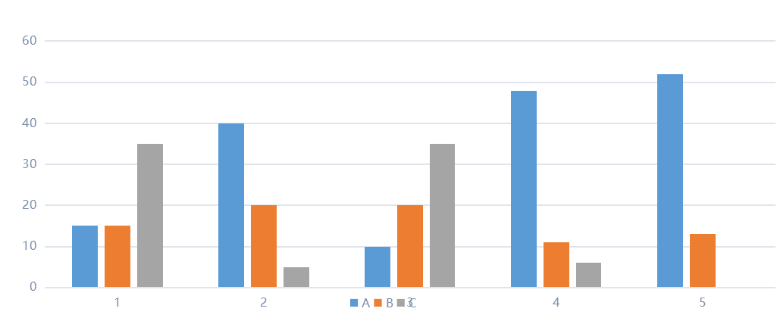


A Survey on College Students' Spending Habits
1. What do you always do with the extra money every month?
A. save as next month's expense B. buy study necessities C. spend it for clothes or high-tech products
2. Are you tempted to buy lots of unnecessary goods on line?
A. always B. sometimes C. never
3. Do you have the habit of accounting your daily expenses?
A. yes B.sometimes C. no
4. Are you penniless by the end of every month?
A. always B. sometimes C. never
5. Are you a spender or saver?
A. spender B saver

Slide 18
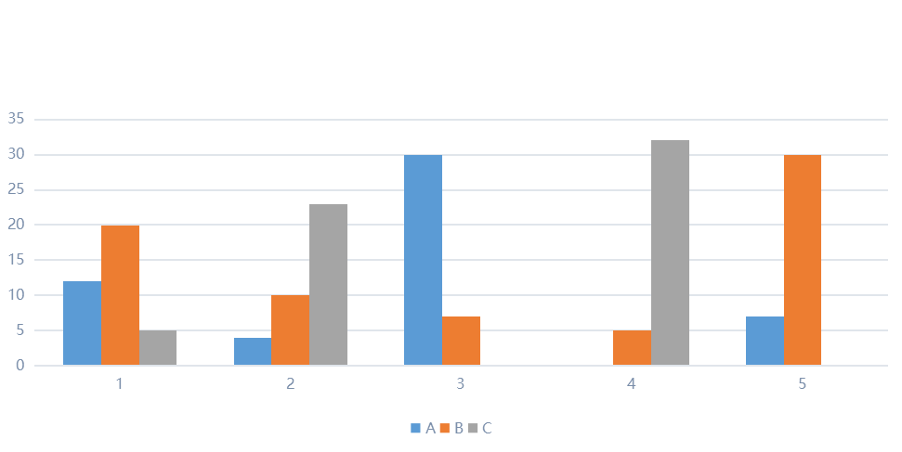
A Survey on Parents' Spending Habits
1. What do you always do with the extra money?
A. deposit the money in the bank B. invest C. spend it all for entertainment or social interaction
2. Are you tempted to buy lots of unnecessary goods on line?
A. always B. sometimes C. never
3. Do you spend money according to your budget?
A. always B. sometimes C. never
4. Are you penniless by the end of every month?
A. always B. sometimes C. never
5. Are you a spender or saver?
A. spender B saver

Slide 19
Comparison and contrast subject by subject
subject by subject
college students'
spending habits
talk about all the points regarding one side
Parents' spending habits
extra money spending
buying goods online
daily expense accounting
...
extra money spending
buying goods online
daily expense accounting
...
talk about all the points regarding another side
similarities/differences

Slide 20
Comparison and contrast subject by subject
practice:
The surveys show us a different picture of college students and parents' spending habits.
_______________________________________________________________________________________________________________________________________________________________________________________
We can get the conclusion that college students tend to be spenders while parents prefer to save their money .

Slide 21
3. In-depth enquiry
1.Why do our parents choose to save rather than spend?
habit/tradition/save for their children
2.Are you often educated by them to save more money?
How?
精打细算，有吃有穿，大吃大喝，当屋卖窝。
紧紧手，年年有。

Slide 22
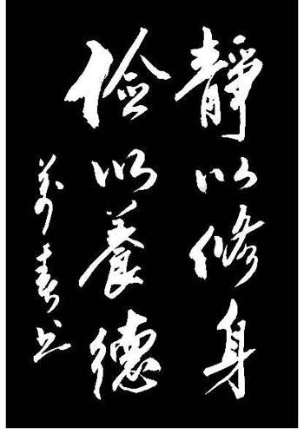
3. In-depth enquiry
《咏史》李商隐
历览前贤国与家，
成由勤俭破由奢。
何须琥珀方为枕，
岂得真珠始是车。
......
国
家

Slide 23
3. In-depth enquiry
Match the Chinese with the English.
1. Reserve for deficiency in abundance, and think of thrift at ease. | A. 俭节则昌，淫佚则亡。
2. Quietude promotes learning, and frugality cultivates virtue. | B. 取之有度，用之有节。
3. Take it properly, and use it thriftily. | C. 图匮于丰，防俭于逸。
4. Thrift makes prosperity, while waste leads to decline. | D. 静以修身，俭以养德。

Slide 24

3. In-depth enquiry
The benefits of saving:
Contributing to the country's prosperity
Staying safe when meeting unexpected troubles
Owning more options in life decisions
Feeling less stressed with extra money in hand

Slide 25
4. Reflection
spend?
save?
permissive perspective:
ads
credit cards
...
upright message:
schools
parents
politicians
...

Slide 26



4. Reflection
Driving question:
How should I budget my money?
Assignment:
In the end of 2020, what do you expect your Alipay annual account statement will be like? Draw it and share it on Unipus!

