Slide 1
A Viewing, Listening
and Speaking Course
2020
U8：Everyone has a story to tell
Anti-pandemic stories in China

Slide 2
01
Teaching Context
02
Teaching Objectives
Contents
03
Teaching Procedure
04
Highlights

Slide 3
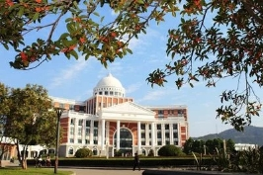
Teaching Context
Teaching Objectives
Teaching Procedure
Highlights
University
1) Medical university
2) Future medical professionals

Slide 4
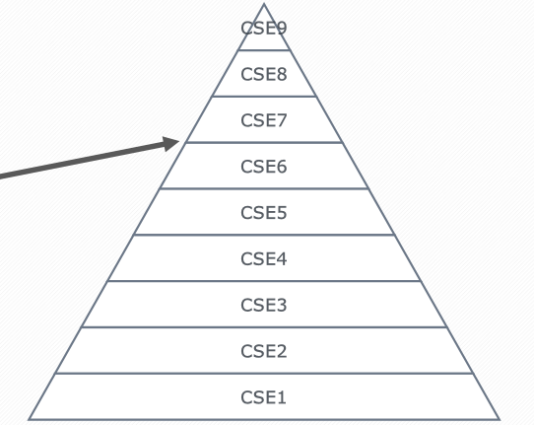
Teaching Context
Teaching Objectives
Teaching Procedure
Highlights
Students
1) Intermediate level
2) Story-telling skills
2.1 Master basic skills to tell stories
2.2 Lack compelling plots
China's Standards of English Lanugage Ability, 2018

Slide 5

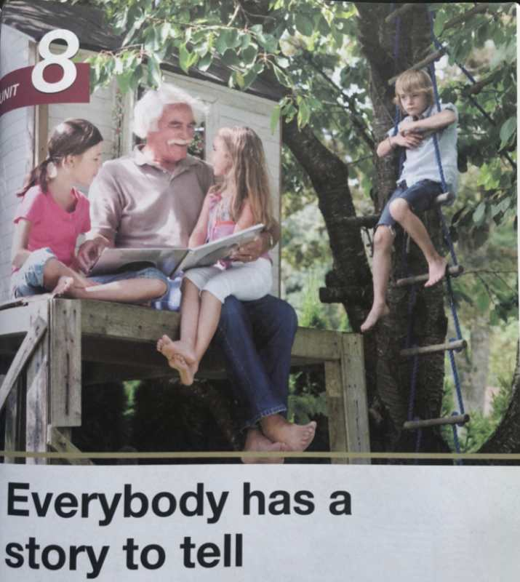


Teaching Context
Teaching Objectives
Teaching Procedure
Highlights
Teaching materials
Textbook & Unipus

Slide 6
Teaching Context
Teaching Objectives
Teaching Procedure
Highlights
Course Objectives
1) Language goals
Listening and speaking skills
Communicative skills
Information searching skills
Skills to summarize, analyze, criticize, and solve problems
2) Educational goals
Independent learning and cooperative learning
Selective learning and lifelong learning
Responsibility as future caretakers and as Chinese citizens

Slide 7
Teaching Context
Teaching Objectives
Teaching Procedure
Highlights
Unit Topic: Everybody has a story to tell
Task
During COVID-19 outbreak, have you heard any touching stories about Chinese civilians and medical professionals combating the pandemic?

Slide 8
Teaching Context
Teaching Objectives
Teaching Procedure
Highlights
Unit Learning Objectives
1) Major Language Objectives
① anti-pandemic vocabulary
② conflicts and achievements in story-telling
2) Major Educational Objectives
① a sense to spread Chinese culture
② a sense of innovation, bravery and optimism when faced
with difficulties

Slide 9

Teaching Context
Teaching Objectives
Teaching Procedure
Highlights
Activating Students' prior knowledge
Task Trial
Pre-evaluation
Pre-class
Motivating
In-class
Demo
Enabling
Summary
Extension
Post-class
Improvement Reflection Assessment

Slide 10
Teaching Context
Teaching Objectives
Teaching Procedure
Highlights
POA
Activating Students' prior knowledge
Task Trial
Pre-evaluation
Pre-class
Output
Motivating
Feedback
Supervison
Scaffolding
Assessment
In-class
Enabling
Summary
Extension
Post-class
Improvement Reflection Assessment
Assessment

Slide 11

Teaching Context
Teaching Objectives
Teaching Procedure
Highlights
Dynamic
Assessment
Activating Students' prior knowledge
Task Trial
Pre-evaluation
Pre-class
Peer-assessment
Motivating
In-class
Teacher assessment
Peer assessment
Enabling
Summary
Extension
Post-class
Improvement Reflection Assessment
Teacher assessment
Self-assessment

Slide 12
Works cited:
[1] Wen, Q. F. The production-oriented approach to teaching university students English in
China[J]. Language Teaching. 2016.
[2] Lidz C. Dynamic Assessment (learning potential testing, testing the limits)[A]. In
Fernandez-Ballesteros (ed.). Encyclopedia of Psychological Assessment [C]. London: SAGE,
2003. 337-343.
[3] Vygotsky L. Mind in Society: The Development of Higher Psychological Processes[M].
Cambridge, MA.: Harvard University Press, 1978.
[4] 李丹弟. 基于动态评价理论的英语语言学课程评价模式研究[J]. 外语界, 2015(6): 19-25+84.
[5] 文秋芳. 输出驱动假设在大学英语教学中的应用：思考与建议[J]. 外语界, 2013(6): 14-22.
[6] 文秋芳. 构建“产出导向法”理论体系[J]. 外语教学与研究, 2015(4): 547-558.
[7] 文秋芳. “师生合作评价”：“产出导向法”创设的新评价形式[J]. 外语界, 2016(5): 37-43.
[8] 叶萍. 同伴互评法在英语演讲课堂中的应用研究[J]. 外语教学, 2014(4): 46-50.

Slide 13
01
Motivating
02
Enabling
Demo
03
Extension
04
Summary

Slide 14

Conflicts and Achievements in Story-telling
Beibei Zhao

Slide 15


Motivating
Enabling
Extension
Summary
What is the conflict and achievement in the story?

Slide 16


Motivating
Enabling
Extension
Summary
Conflict:
But some ingredients couldn't be found in France. It is hard to find alternatives.
Dr. Hu soon learned their dilemma, he accordingly adjusted some ingredients available in France. Gradually, thanks to Dr. Hu’s relentless effort, their condition improved a lot, with their symptoms changing from severe to mild, and their lives were gradually going back to normal.
Dr. Hu immediately made a prescription from traditional Chinese medicine, and it has been proven to be effective in curbing the virus. But some ingredients are not commonly seen in France, and it would also be difficult for patients to find useful alternatives in the place they live. It seemed like they were in the middle of nowhere.
Achievement:
Dr. Hu accordingly adjusted some ingredients available in France. Gradually, their condition improved a lot from severe to mild.

Slide 17
Motivating
Enabling
Extension
Summary
Situation 1
Conflict (Problem)
With the surge of number of confirmed cases, the beds in the hospital dwindled and the medical workers turned shorthanded, leading to a point where a vicious circle seemed to appear.
Situation 2
Conflict (Problem)
Impacted by the growing numbers of confirmed cases day by day, we woke up and received loads of worrying news about the crisis, including calls for support from numerous hospitals due to the shortage of medical materials.

Slide 18
Motivating
Enabling
Extension
Summary
Sample Answer 1
Conflict (Problem): With the surge of number of confirmed cases, the beds in the hospital dwindled and the medical workers turned shorthanded, leading to a point where a vicious circle seemed to appear.
Achievement (Solution): Thanks to construction workers who worked around the clock, within tens of days, the Leishengshan and Huoshengshan Hospitals were built and many teams of medical staff rushed to Wuhan to support, bringing hope to those affected patients and to the war against the virus as a whole!

Slide 19
Motivating
Enabling
Extension
Summary
Situation 1
Conflict (Problem)
With the surge of number of confirmed cases, the beds in the hospital dwindled and the medical workers turned shorthanded, leading to a point where a vicious circle seemed to appear.
Situation 2
Conflict (Problem)
Impacted by the growing numbers of confirmed cases day by day, we woke up and received loads of worrying news about the crisis, including calls for support from numerous hospitals due to the shortage of medical materials.

Slide 20
Motivating
Enabling
Extension
Summary
Sample Answer 2
Conflict (Problem): Impacted by the growing numbers of confirmed cases day by day, we woke up and received loads of worrying news about the crisis, including calls for support from numerous hospitals due to the shortage of medical materials.
Achievement(Solution): Thanks to the selfless workers who gave up holidays to work in shifts around the clock, the production of protective equipment such as surgical masks and protective suits could be ensured. And the doctors and nurses who were combating the virus at frontline could go all out without any fear from the lack of “bullets”. In this case, they will certainly win the war!

Slide 21
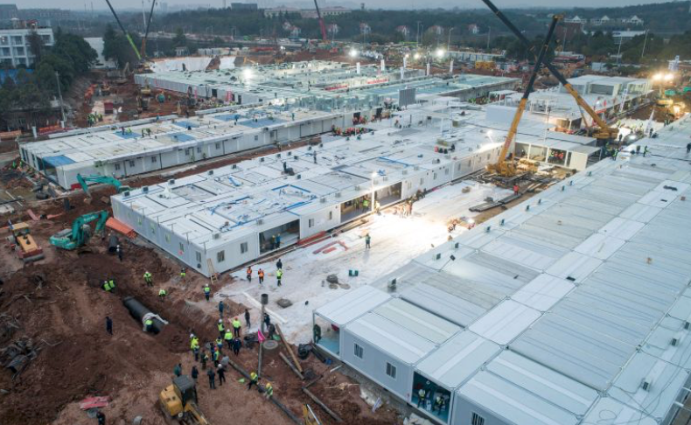
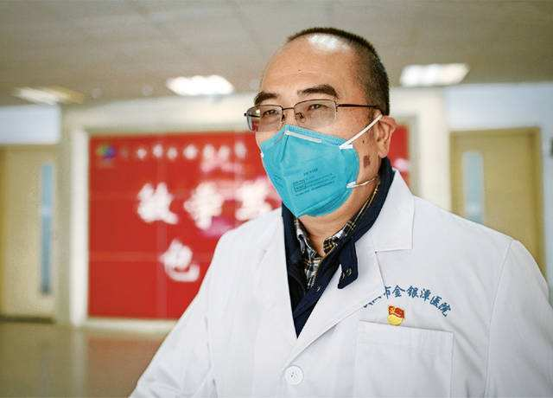
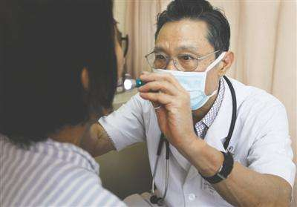
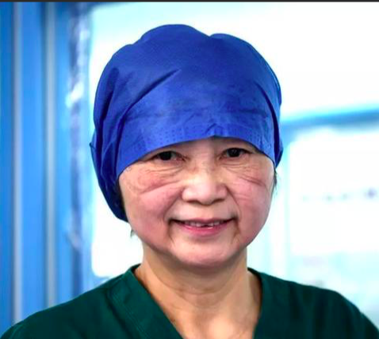
China’s contributions to COVID-19 control
Motivating
Enabling
Extension
Summary
Makeshift hospitals
Courageous medical staff
“Hang on Wuhan, we stand with you!”

Slide 22

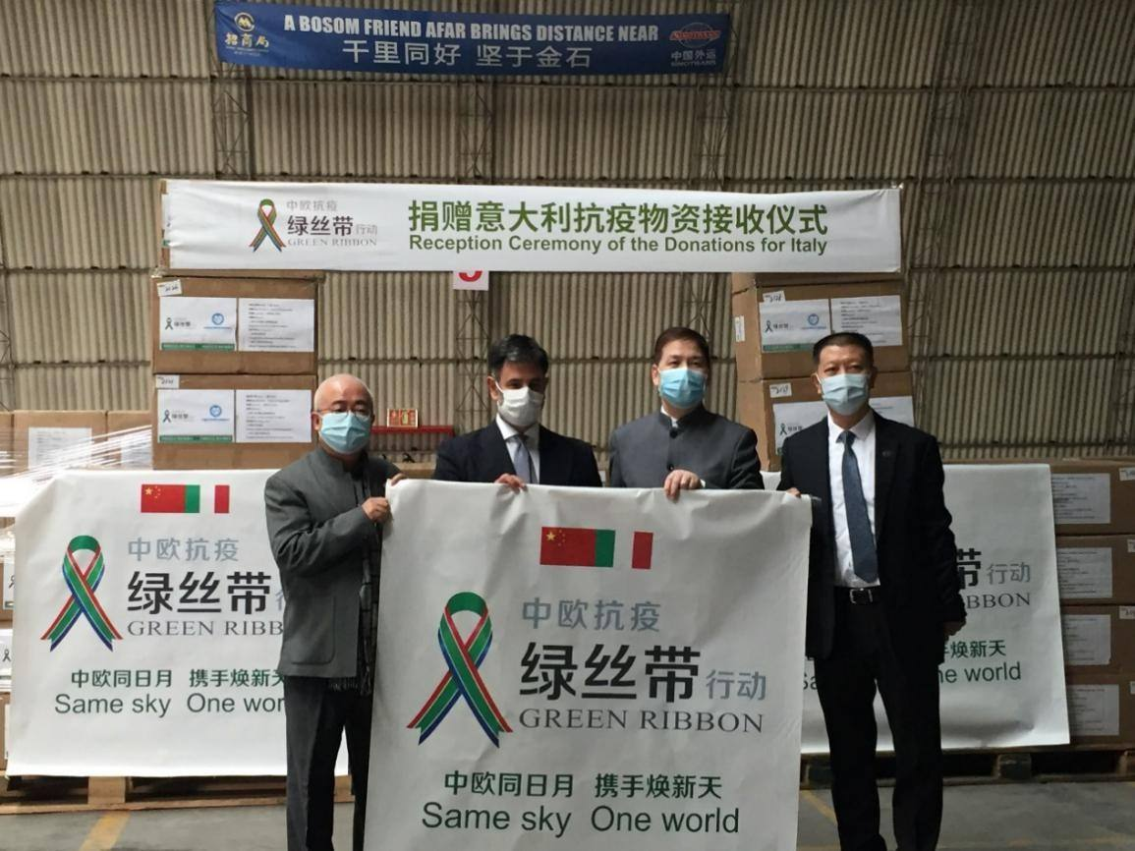

Motivating
Enabling
Extension
Summary
China’s contributions to COVID-19 control
127 countries
4 international organizations
surgical masks & protective gears & testing reagents
expert teams to other countries

Slide 23
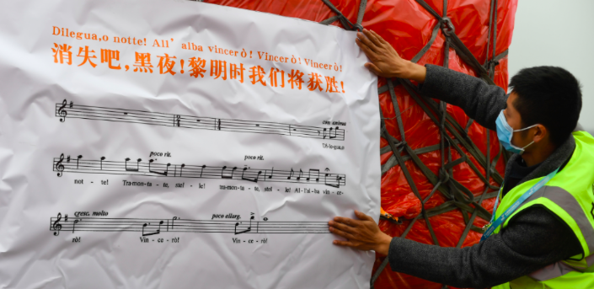
Motivating
Enabling
Extension
Summary
Every cloud has a silver lining.

Slide 24







References
Articles
Beijing, China. (2020, June. 8). Fighting Covid-19: China in Action. China Daily Global.
https://epaper.chinadaily.com.cn/a/202006/08/WS5edd76f5a3107831ec752924.html
Beijing, China. (2020, Feb. 3). Doctor on the front line knows time is precious. China Daily Global. https://www.chinadaily.com.cn/a/202002/03/WS5e376d49a310128217274414.html
Beijing, China. (2020, March. 2). China produces over 110 million face masks a day amid COVID-19. CGTN.
https://news.cgtn.com/news/2020-03-02/China-produces-over-110-million-face-masks-a-day-amid-COVID-19-Ox4nmbVjMI/index.html
WeChat Official Accounts
外研社高等英语资讯（linkandthink） 21世纪英文报（i21Century）
CHINADAILY（RealTimeChina） 中国日报双语新闻（Chinadaily_Mobile）
CGTN（cgtnofficial） 新华社（xinhuafabu1）
胡臻国医工作室（gh_81bdd2db230e）

Slide 25
Thank You!

