Slide 1
Part I: Teaching Design

Slide 2
CONTENTS
01
Students Analysis
02
Learning Objectives
03
Teaching Methodology
04
Teaching Procedure
05
Teaching Assessment

Slide 3
Unit 4
Nature: To Warship or to Conquer
TEXT A: Achieving Sustainable
Environmentalism

Slide 4
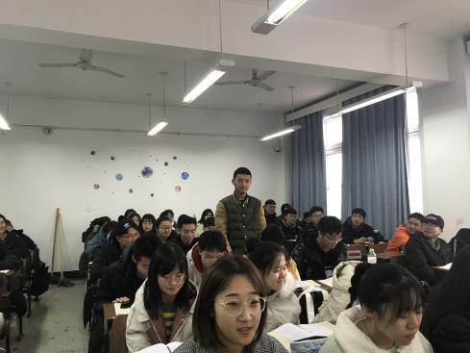
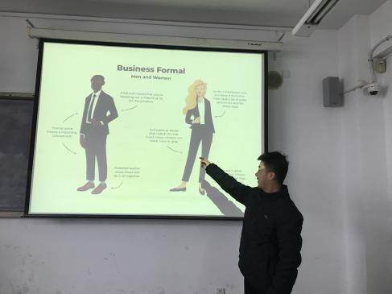
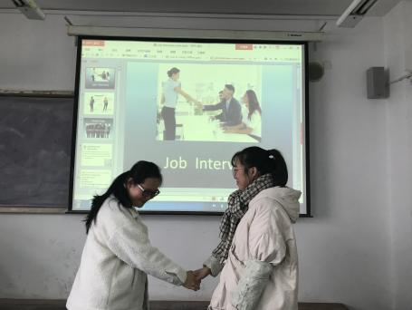
Students
Analysis
Learning Objectives
Teaching Procedures
Teaching Assessment
Students
Analysis
Teaching Methodology
2nd year student
Major in science and engineering
You can simply impress your audience and add a unique zing.

Slide 5
Which one is your advantage in English learning?
Which skill do you want to grasp most in English learning?
Which one is your biggest difficulty in English learning?
Which is your biggest motivation of English learning?

Slide 6
Students
Analysis
Learning Objectives
Teaching Methodology
Teaching Procedures
Teaching Assessment
Group-learning
Critical thinking
Strong learning motivation
Reading & Listening proficiency
Lack of writing and speaking
competence

Slide 7
Learning Objectives
Teaching Procedures
Teaching Assessment
Students
Analysis
Learning Objectives
Teaching Methodology
To acquire:
Core linguisitic knowledge
Writing: Counter-argument & Rebuttal
Speaking: Environmental issue
To cultivate:
Healthy environmental consciousness
Socialist Ecological Civilization
Language
Lucid waters and lush mountains are invaluable assets.
Skill & Ability
Morality
Nature and Man are united as one.
To discuss:
Human development vs. environmental protection
Chinese environmentalism vs. Western environmentalism

Slide 8
Students
Analysis
Learning Objectives
Teaching Methodology
Teaching Procedures
Teaching Assessment
Teaching Methodology
Scaffolding
Design
Guide
Enabling
Production-oriented Approach
Motivating
(POA, Wen Qiufang,2018)
Assessing
Task-driven approach
Check
Remedial teaching

Slide 9
Teaching Procedures
Teaching Assessment
Students
Analysis
Learning Objectives
Teaching Methodology
Teaching Procedures
The Production Task
Written Task
Oral Task

Slide 10
Teaching Procedures
Teaching Assessment
Students
Analysis
Learning Objectives
Teaching Methodology
Teaching Procedures
Session 1 （Period 1-2）
Pre-class
Mooc
Text Study
Language
In-class
Production Task
Supplement materials analysis
After-class
Writing technique: Counter-argument & Rebuttal
On-line writing
(批改网）

Slide 11
Teaching Procedures
Teaching Assessment
Students
Analysis
Learning Objectives
Teaching Methodology
Teaching Procedures
Session 2 （Period 3-4）
Pre-class
Review the 1st draft
sample
In-class
After-class

Slide 12
Teaching Procedures
Teaching Assessment
Students
Analysis
Learning Objectives
Teaching Methodology
Teaching Procedures
In-Class
Writing Practice
Language
Idea
Structure
recognition
recall
use
Reading material
video material
Self-assessment
Sample writing
1st draft review
Peer review
Argumentative Writing
Debate
Enabling
TSCA

Slide 13
Students
Analysis
Teaching Procedures
Teaching Assessment
Learning Objectives
Teaching Methodology
Teaching Procedures
Learning Objectives
Teaching Methodology
Teaching Assessment
Session 2 （Period 3-4）
Pre-class
Review the 1st draft
sample
In-class
After-class
On-line writing, 2nd draft
(批改网）

Slide 14
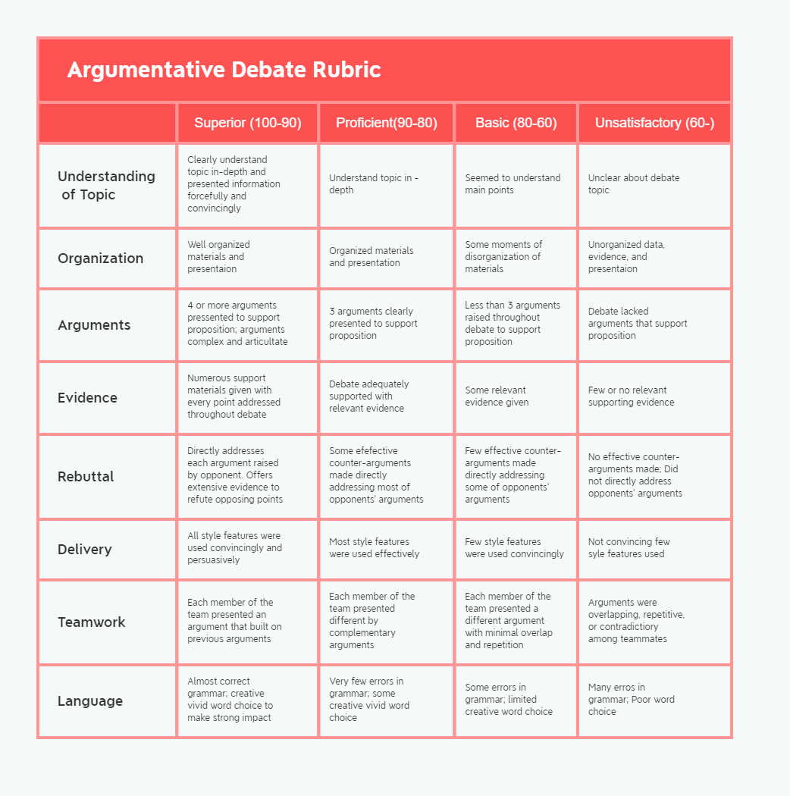
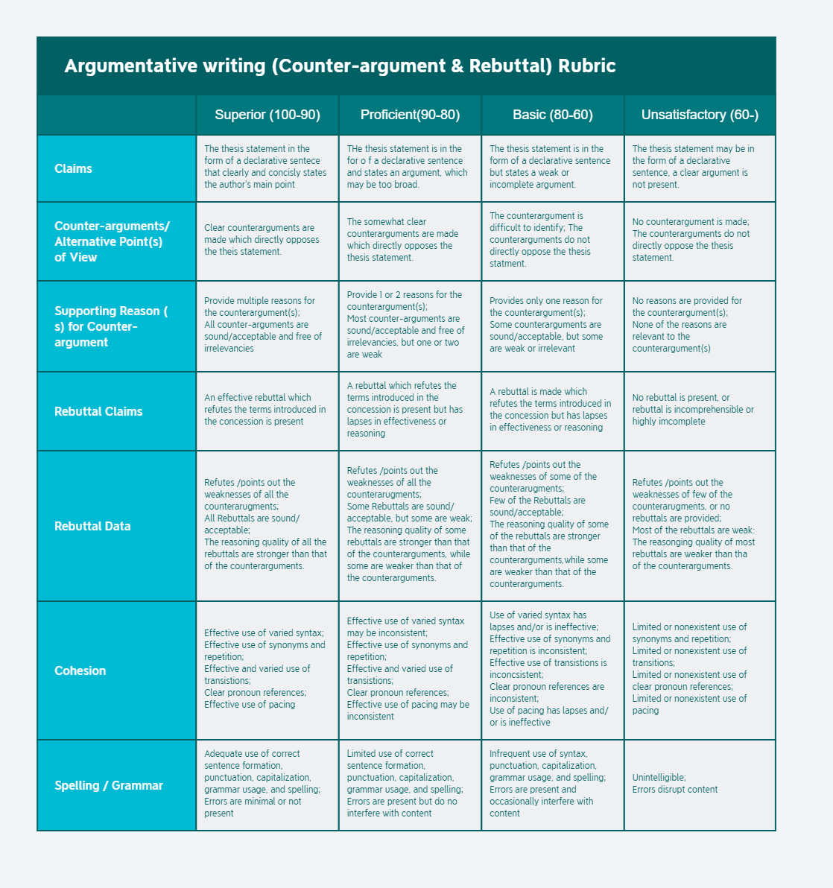
Teaching Procedures
Teaching Assessment
Students
Analysis
Learning Objectives
Teaching Methodology
Teaching Procedures
Session 3 （Period 5-6）
Pre-class
Revize the 2nd online draft
Debate preparation
In-class
Peer Review
2nd draft improvement
Self-assessment
After-class
Class Debate
Unit Project:
Final Writing draft
Micro Video

Slide 15
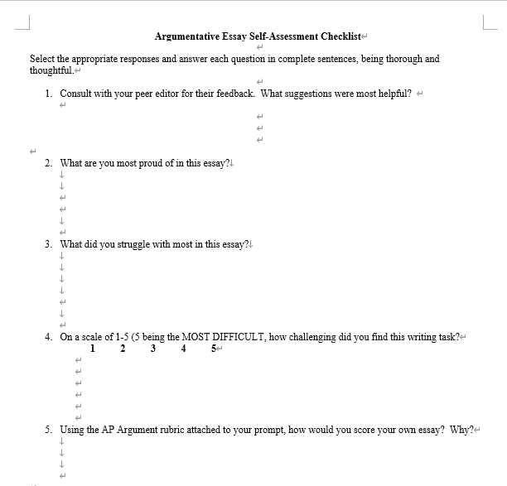
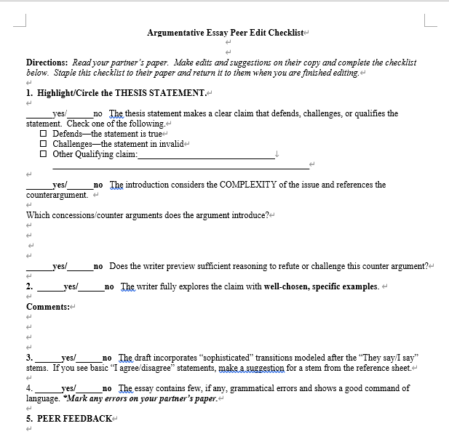
Teaching Procedures
Teaching Assessment
Students
Analysis
Learning Objectives
Teaching Methodology
Teaching Assessment
Learning Objectives
Teaching Methodology
Teaching Procedures
Teaching Assessment
Attendance
Dynamic Assessment
(Lize,2003)
Class Performance
Assignment Completion
Unit Test
Qualitative Evaluation
Unit
Assessment
Quantitative Evaluation
TSCA
(Wen Qiufang, 2016)
Production Output 1: Writing
Production Output 2: Speaking

Slide 16
Highlights
Highlights
 | Advanced
 | Comprehensive competencies
 | Critical thinking & Humanity
 | Innovative
 | POA
 | Diversified Assessment
 | Blended teaching & learning mode
 | Various teaching activities

Slide 17
Part II: Demo Class

Slide 18
CONTENTS
01
Introduction
02
Demonstration

Slide 19
Assessment
Read to Write
Assignment
Unit Project

Slide 20
Unit Project
Assignment
Unit Project
Assessment
Read to Write
The Production Task
Present an English debate with the theme of the relationship between economic development and environmental protection.

Slide 21
Unit Project
Assignment
Unit Project
Assessment
Read to Write
Nature and Man Are United as One
《Tao Te Ching》: For I am abstracted from the world, the world from nature, nature from the way, and the way from what is beneath abstraction.

Slide 22
Unit Project
Assignment
Unit Project
Assessment
Read to Write
Nature and Man Are United as One
We must maintain harmony between man and nature and pursue sustainable development.
Taking care of millions of people who are starving is more important than saving natural resources, most of which are renewable anyway.
No one wants to stop economic progress that could give millions better lives. But we have already wasted and destroyed vast amounts of natural resources, thus have put earth at risk.
Nature is our ward, not our master.

Slide 23
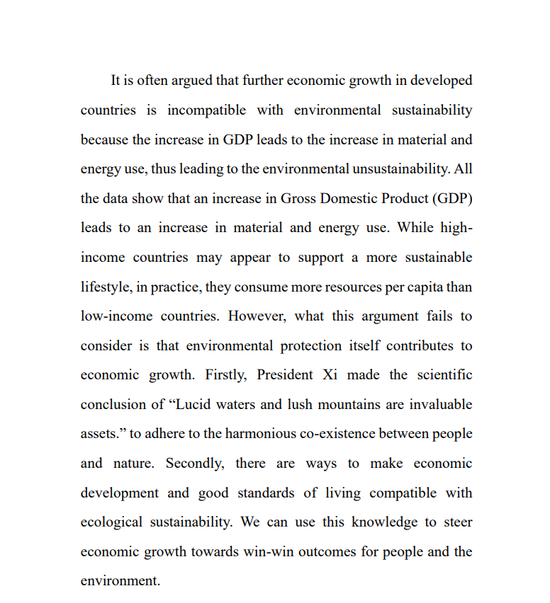
Assignment
Unit Project
Assessment
Read to Write
Unit Project
Assessment
Assessment
Assignment
Read to Write
Counter-argument
Reason
Rebuttal
Evidence

Slide 24
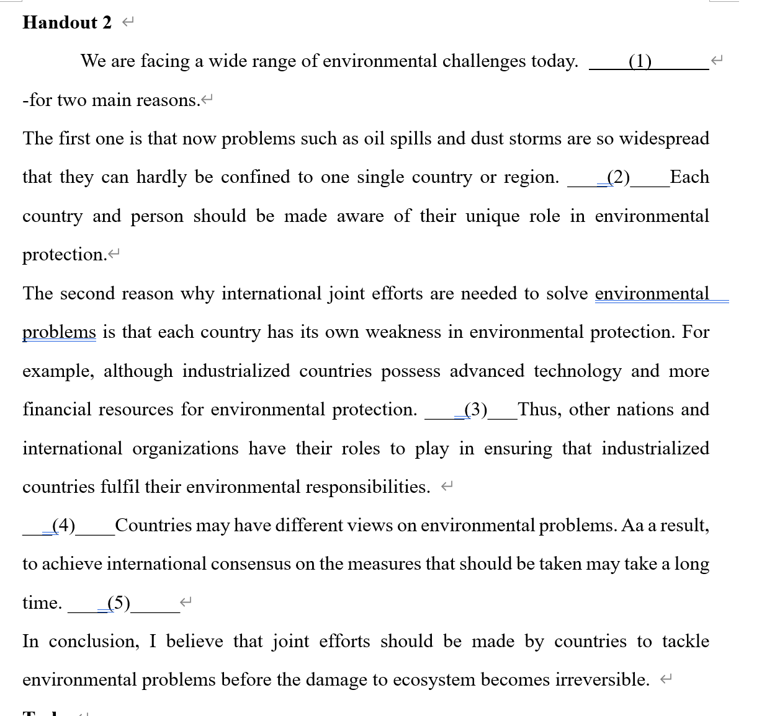
Assignment
Unit Project
Assessment
Read to Write
Read to Write
Topic Sentence
International problems cannot be solved by one or a few countries, instead, they should be solved with international effort.

Slide 25
Assignment
Assignment
Unit Project
Assessment
Read to Write
Assignment
Modify your essay using counterargument and rebuttal skills and submit it online.

Slide 26
Thank you

