Slide 1
2020年外研社“教学之星”大赛全国半决赛
演绎中国力量 讲好中国故事
大学英语组

Slide 2
Unit 3
Giving Your First Speech
Beijing 2020

Slide 3
Contents
1
5 Minutes’ Introduction
2
10 Minutes’ Demonstration

Slide 4
Contents of Introduction
Teaching Context
Teaching Methodology
Unit Design

Slide 5
Target Students
University
211 Project
Hierarchy Language Teaching
A-level Non-English Major Students
Strong Learning Motivation
Teaching Unit
Teaching Book
The Art of Public Speaking
Unit 3 is Designed to ‘break the ice’ in the Public Speaking

Slide 6
Production-Oriented Approach
(Wen Qiufang, 2016)
Motivating
Enabling
Guiding and Designing
Assessing
Scaffolding
Collaborating
.

Slide 7
Unit
Design
Teaching & Learning Materials
Teaching Procedures
Learning Objectives

Slide 8
The Teaching & Learning Materials
Unit
Unit 3: Giving Your First Speech
MOOC
Online - Public Speaking by Shanghai International Studies University
Additional Materials
1. Watching & Listening: The Next Outbreak ?We’re not Ready by Bill Gates (Ted Talk); Safeguard Wuhan against COVID-19
2. Reading: 1. Speech script of ‘The Next Outbreak? We’re not Ready’; 2. Speech script of ‘Safeguard Wuhan against COVID-19

Slide 9
The Teaching Procedures
Blended Learning
Classroom Learning
1
2
Online Learning
Enabling
The production tasks
Assessments
Preparation
Review

Slide 10
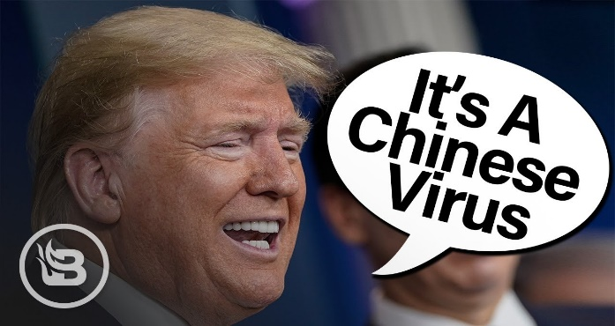
Production-Oriented Approach
Motivating- iTarget
Task-Initiating
The Scenario
The Production Task:
Epidemic Fight in My City/Residential Community

Slide 11
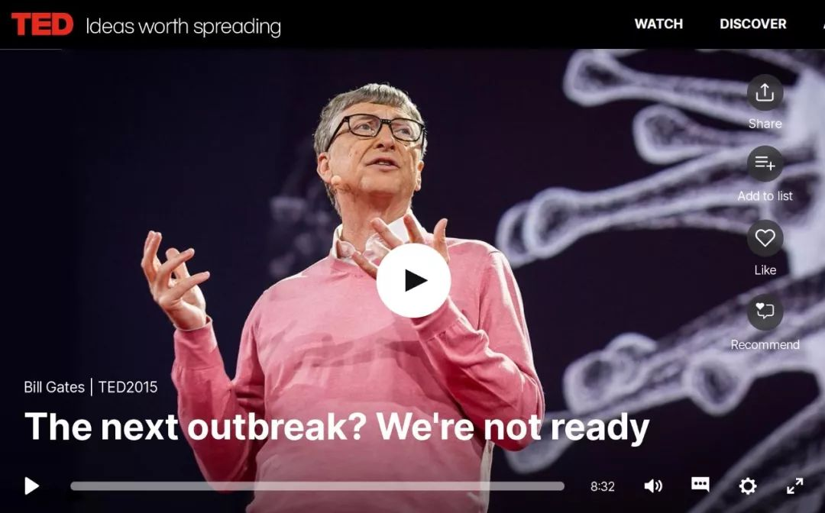
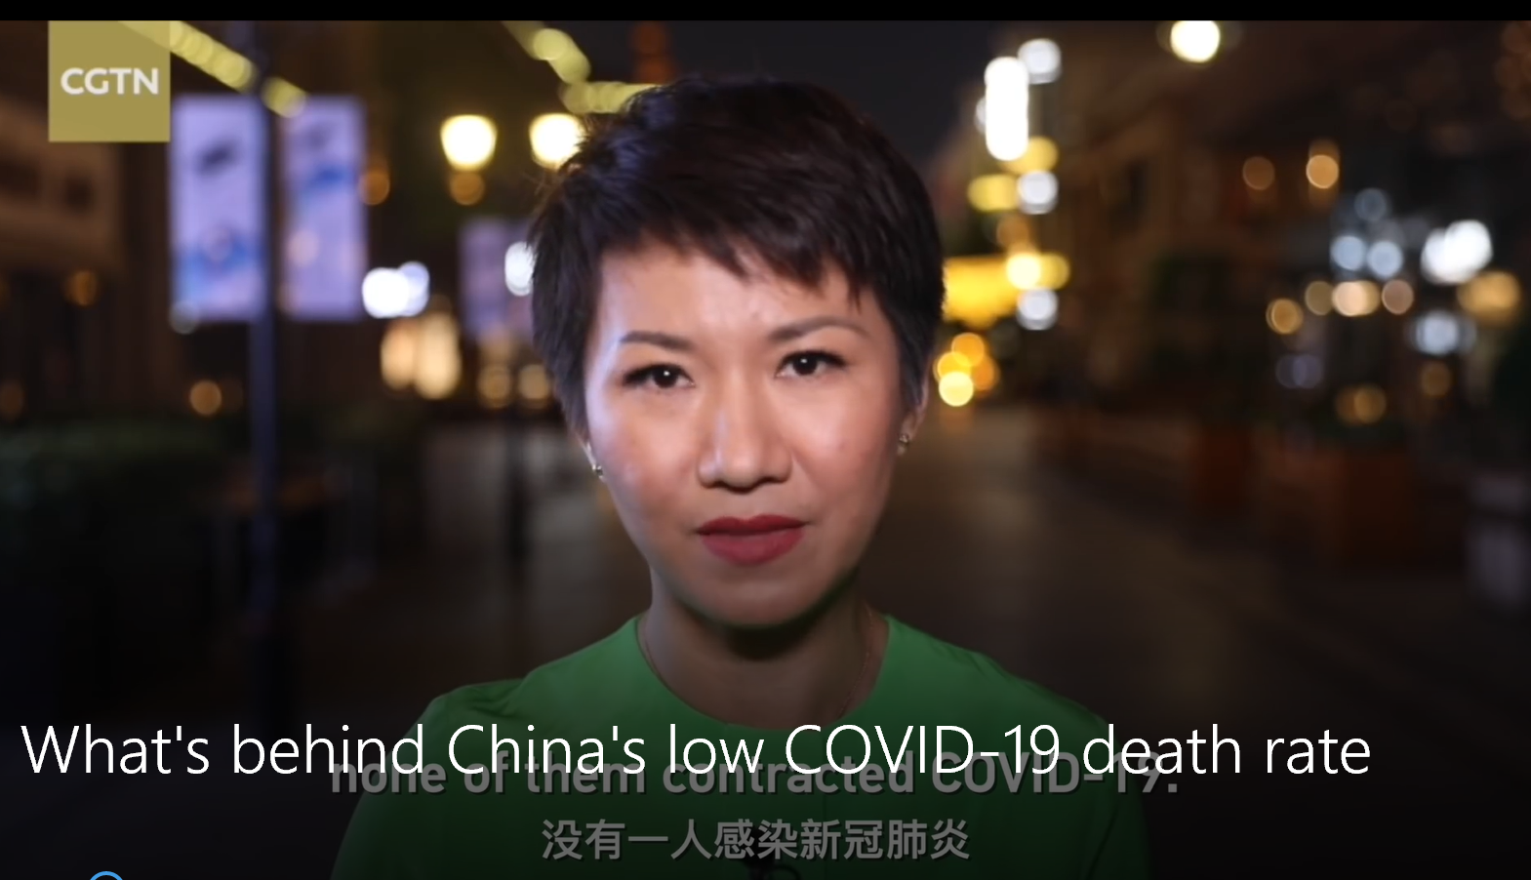
Sub-task 1
To Obtain Crucial Structure from Sample Speeches
Enabling - iExplore
Sub-task 2
To Prepare Students for the Strategy for Development
The Production Tasks with Sub-tasks
Sub-task 3
To Build Students’ Language

Slide 12
Teacher
Pre-class
In-class
Assessing - iReflect
Student
Teacher-Student Collaborative Assessment
After-class

Slide 13
Assessment Checklist of the Speech Organization
Speaker:
Topic: Epidemic Fight in My City/Residential Community
Rate the Speaker on each point: 5-Excellent 4-Good 3-Average 2-Fair 1-Poor
Introduction Scale
Gained attention and interest | 5 4 3 2 1
Introduced topic clearly | 5 4 3 2 1
Body
Topical Order | 5 4 3 2 1
Conclusion
Reinforced central idea | 5 4 3 2 1

Slide 14
Assessment Checklist of the Oral Performance
Speaker:
Topic: Epidemic Fight in My City/Residential Community
Rate the Speaker on each point: 5-Excellent 4-Good 3-Average 2-Fair 1-Poor
Introduction gained attention Subject introduced clearly Main ideas easily followed Language clear Language vivid Strong conclusion Sufficient eye contact Voice used effectively Nonverbal communication effective
5 | 4 | 3 | 2 | 1
5 | 4 | 3 | 2 | 1
5 | 4 | 3 | 2 | 1
5 | 4 | 3 | 2 | 1
5 | 4 | 3 | 2 | 1
5 | 4 | 3 | 2 | 1
5 | 4 | 3 | 2 | 1
5 | 4 | 3 | 2 | 1
5 | 4 | 3 | 2 | 1

Slide 15
Learning Objectives
Understand the Basic Structure of a Speech: Introduction, Body and Conclusion
(language learning
moral education
Construct Your First Speech
Enhance Cultural Confidence and Tell China’s Story Well

Slide 16
参考文献：
[1] 文秋芳，输出驱动假设在大学英语教学中的应用：思考与建议[J], 外语界，2013
(6)：14-22。
[2] 文秋芳，构建 “产出导向法”理论体系 [J], 外语教学与研究，2015，(4): 547-558。
[3] 文秋芳，“产出导向法” 与对外汉语教学 [J], 世界汉语教学，2018，(3): 387-400。
[4] 文秋芳，“师生合作评价”：“产出导向法”创设的新评价形式 [J]，外语界，
2016,(5): 37-43。
[5] Wen, Q.F. (2016). The Production-oriented Approach to Teaching University Students
English in China. Language Teaching 15:1-15.

Slide 17
PART TWO
02
DEMONSTRATION

Slide 18
Unit 3
Giving Your First Speech

Slide 19
Epidemic Fight in My City/Residential Community
A 3-min speech on the epidemic fight against COVID-19

Slide 20
Enabling-Structure
Introduction
Body
Conclusion

Slide 22
The Introduction
“The greatest risk looks like this.”
Action
Storytelling
Step 1
Step 2
Step 3
Gain the attention and interest
Reveal the topic

Slide 23
The Introduction
Action
Storytelling
Epidemic fight in my city/residential community
Attention-getter
Questions
Startling statements

Slide 24
The Conclusion
Tie back to the introduction
So I think this should absolutely be a priority. There's no need to panic. We don't have to hoard cans of spaghetti or go down into the basement. But we need to get going, because time is not on our side. In fact, if there's one positive thing that can come out of the Ebola epidemic, it's that it can serve as an early warning, a wake-up call, to get ready. If we start now, we can be ready for the next epidemic.
The Next Outbreak? We’re Not Ready.
Bill Gates
Appeal to action

Slide 25
The Conclusion
Tie back to the introduction
Reinforce the central idea
Appeal to action
Sum up the main points

Slide 26
The Body
The City of Wuhan
Most visible
I. The city is locked down.
Safeguard Wuhan against COVID-19
Liu Xin
Other cities
II. Medics nationwide come to support Wuhan.
III. The government adheres to the principle that every life matters.
Government
IV. People trust the government.
Least visible
People
Topical Order

Slide 27
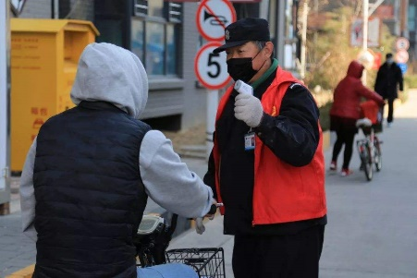
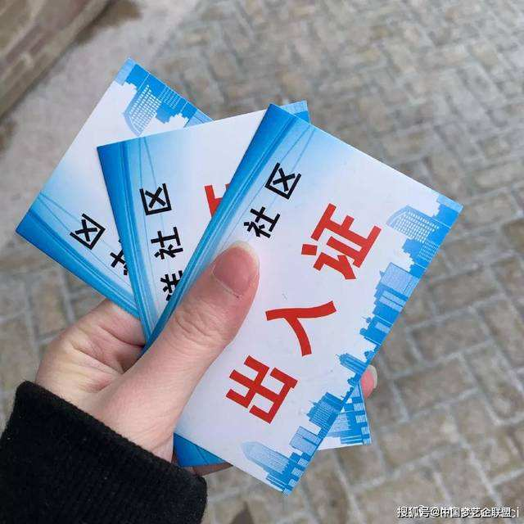
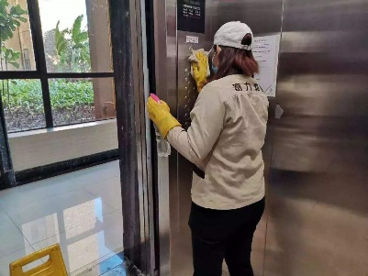
The Body-Topical Order
Epidemic Fight in My Residential Community
The residential property management takes strict measures to guard against the spread of virus.
Main Point
1
Main Point
2

Slide 28
Summary
Gain the attention and interest
(action, storytelling, questions, startling statements)
Introduction
Reveal the topic
Body
Topical order
Reinforce the central idea
(tie back to the introduction, appeal to action,
sum up the main points)
Conclusion
Enabling-Strategy for Development & Language (next session)

Slide 29
Thank you

