Slide 1
FLTRP Star Teacher Contest
Exploring College English Teaching Design
from the Ideological and Political Perspective
FLTRP, 2020

Slide 2
Contents
Introduction
Demo class

Slide 3
Background
Course, learners, teaching materials
Introduction
Concepts
POA, integration, blended learning
Design
Objectives, procedures, features

Slide 4
Background
1. Course
Required course with two phases (EGP+ESP)
Dynamic and multi-dimensional evaluation system
Whole-person education

Slide 5
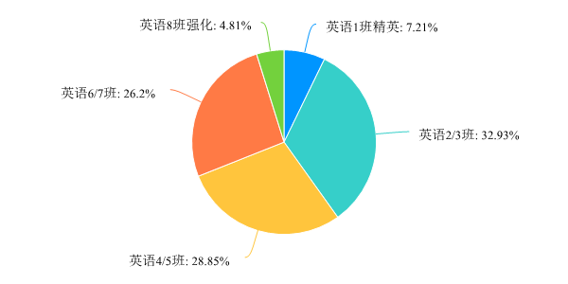
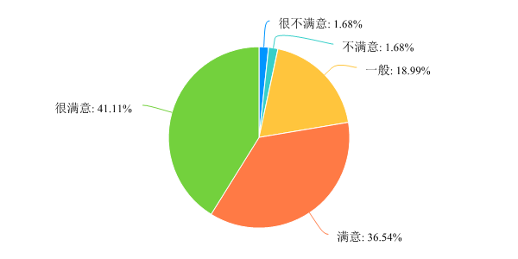
Background
2. Learners
第2题 本学期你所在的英语班级
第3题 你对本课程现状的满意程度

Slide 6
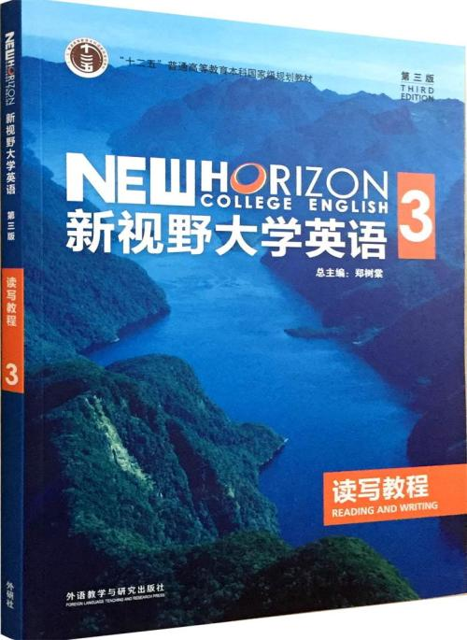
Background
3. Teaching materials
Unit 8 Section A
Reflections of a Chinese Mother
in the West

Slide 7
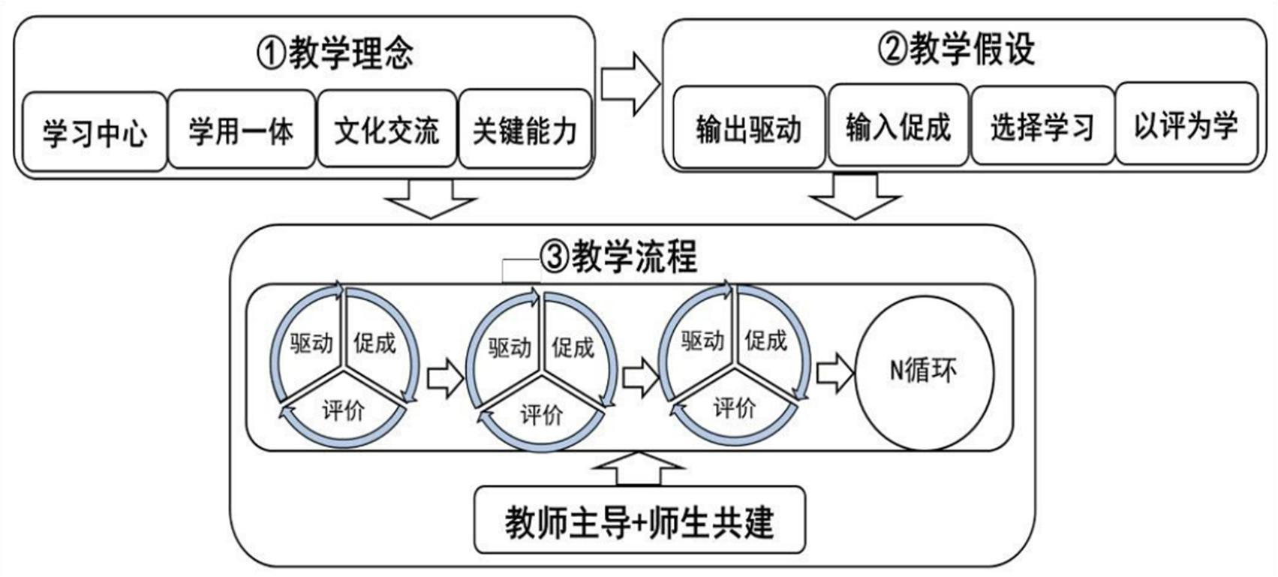
Concepts
Production-oriented Approach
图 1.POA 理论体系（文秋芳，2018，P393）

Slide 8
Concepts
2. Integration
Assessing
Enabling
1
Motivating
2
I&P
3
Unity, Truth, Innovation, Dedication

Slide 9
Concepts
3. Blended learning
第7题 你平时利用哪些平台进行线上学习？
选项 | 小计 | 比例
钉钉 | 25 | 6.01%
U校园 | 394 | 94.71%
中国大学MOOC（慕课） | 367 | 88.22%
哔哩哔哩 | 82 | 19.71%
腾讯会议或课堂 | 54 | 12.98%
瞩目会议 | 363 | 87.26%
其他 | 28 | 6.73%
本题有效填写人次 | 416
第10题 你更倾向于哪种教学方式？
选项 | 平均综合得分
线上线下混合课程 | 2.07
线下面授课程 | 0.96
线上网络课程 | 0.9

Slide 10
Design
1. Objectives
1
To understand different parenting approaches in the west and China through analytical reading
To apply basic writing techniques to illustrate cultural differences in parenting styles
To evaluate the current social dispute with cultural inclusiveness
2
3

Slide 11
Design
2. Procedures
Unipus
To-do list
Machine assessment
Before class
online
In class
offline
Motivating (gap-task-goal)
Enabling (idea-techniques-language)
Assessing(self/peer/T-S)
online
After class
FIF+iWrite
Autonomous learning
Man-machine assessment

Slide 12
Design
3. Features
Language competence
Professional development
Talent cultivation quality
Learners
Teachers
Courses

Slide 13
References
[1] Larsen-Freeman, D. Resonances: Second Language Development and Language Planning and Policy from a Complexity Theory Perspective [M]. Springer International Publishing, 2018.
[2] Sheldon, Smith. Academic Writing Genres: Essays, Reports & Other Genres [M]. Evident Press, 2019.
[3] 文秋芳. “产出导向法” 与对外汉语教学[J]. 世界汉语 教学，2018，(3)：387-400.
[4] 杨永林. 大学英语在线课程及其建设[J]. 外语教学， 2019，(1): 53-58.
[5] 张华. 思政教育体系融入大学英语教学的探索与实践路 径研究[J]. 教育现代化，2019，(41):156-158.

Slide 14
Demo class

Slide 15
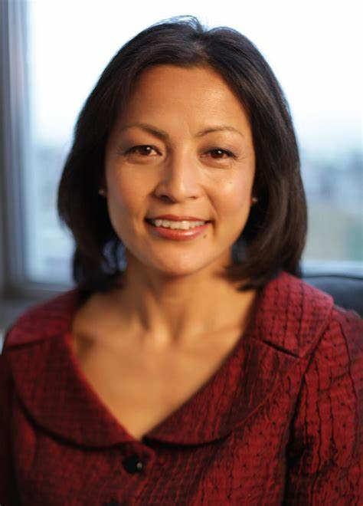
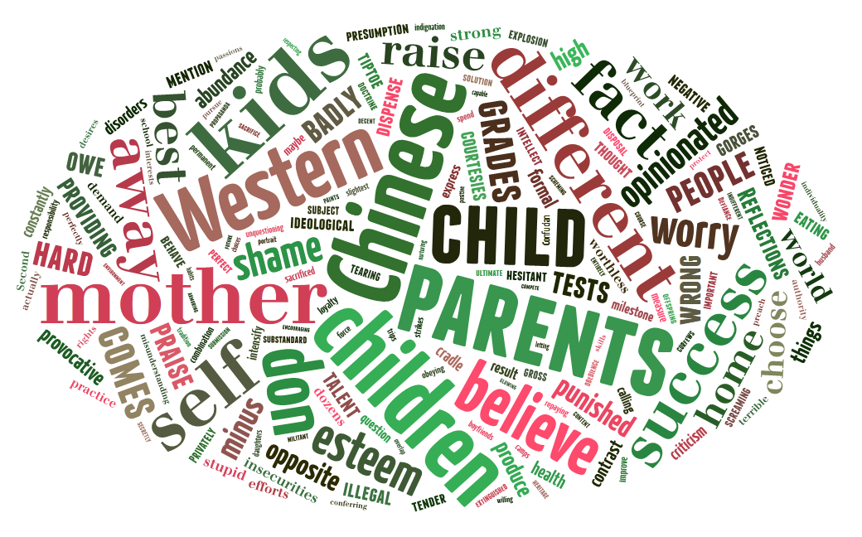
Unit 8 Section A
Reflections of a Chinese Mother
in the West

Slide 16
Teaching Objectives:
To understand different parenting approaches in the west and China through analytical reading
To apply basic writing techniques to illustrate cultural differences in parenting styles
To evaluate the current social dispute with cultural inclusiveness

Slide 17
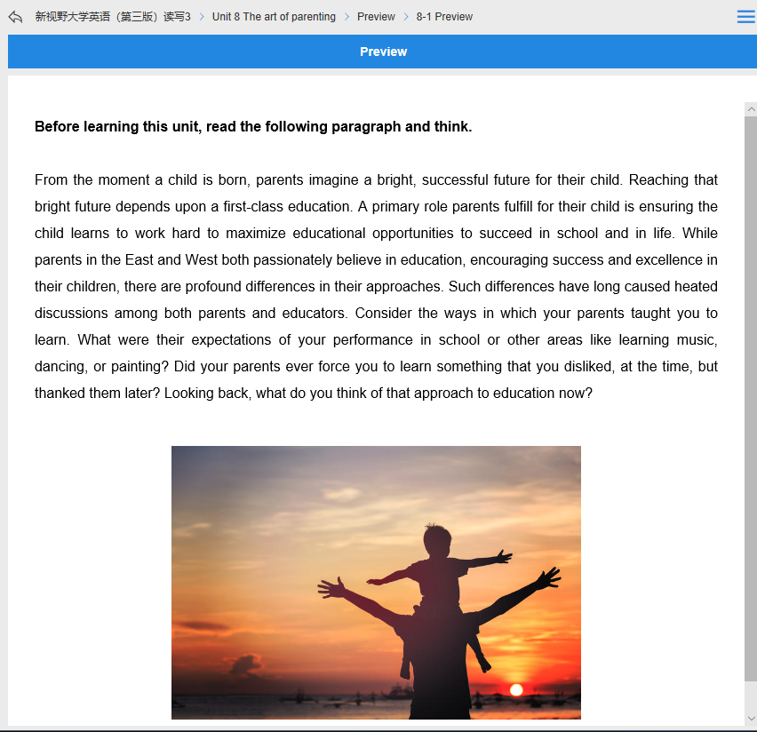
Pre-reading tasks:
Pre-reading activities on Unipus

Slide 18
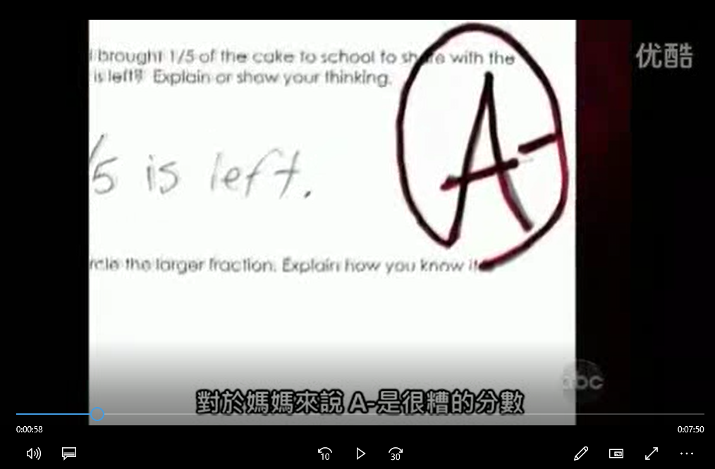
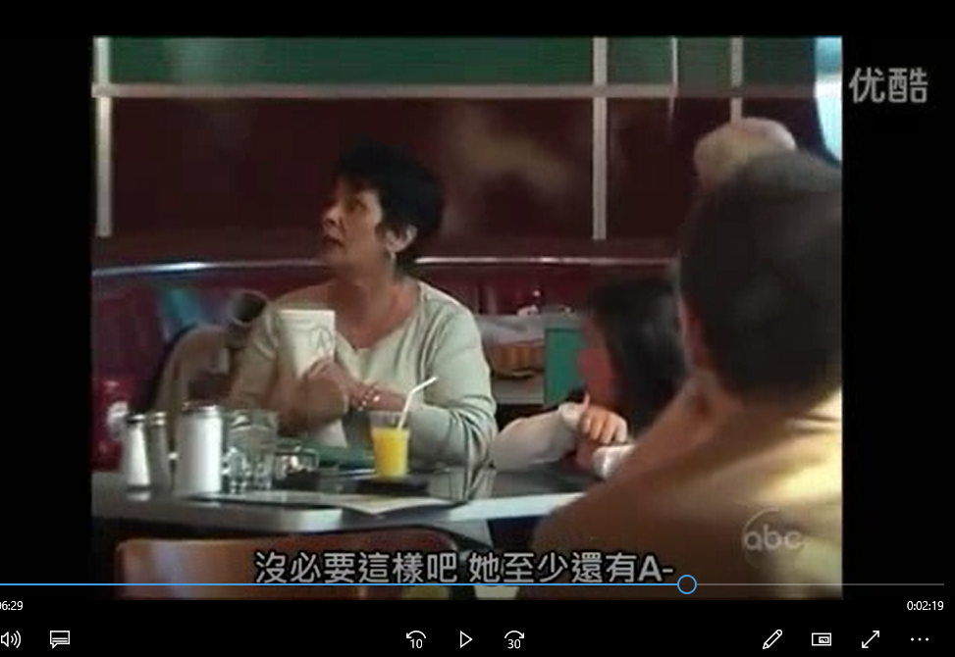
Pre-reading tasks:
Video : What would you do ?

Slide 19
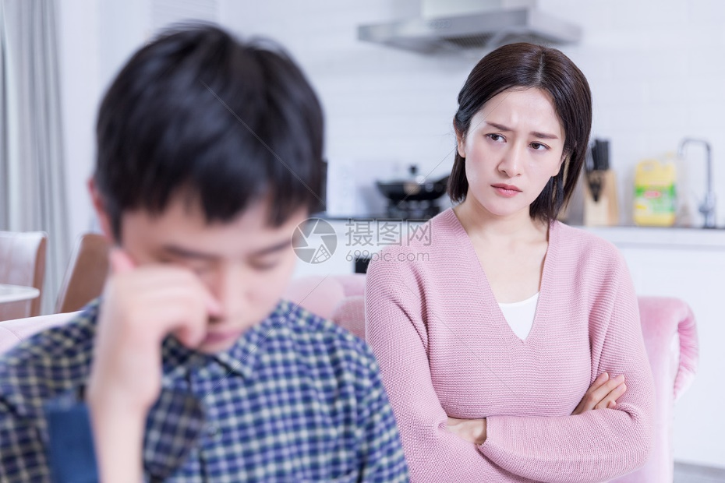
Western Parenting V.S. Chinese Parenting
?
Western parents are humane.
Chinese parents are militant.

Slide 20
Parenting
self-esteem
Ideological differences
relationship
authority

Slide 21
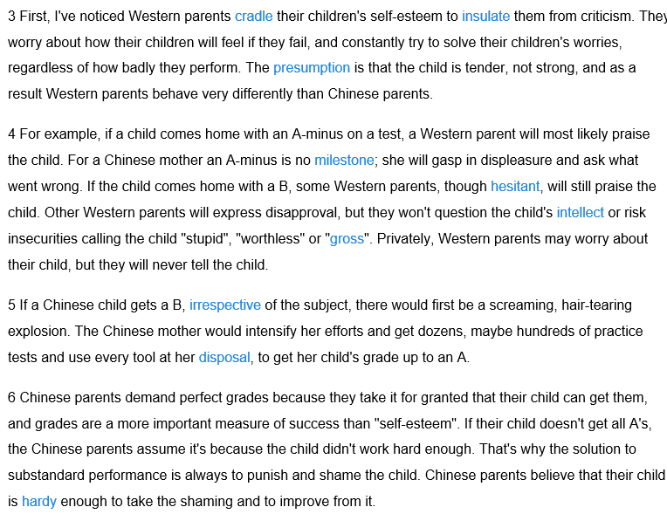
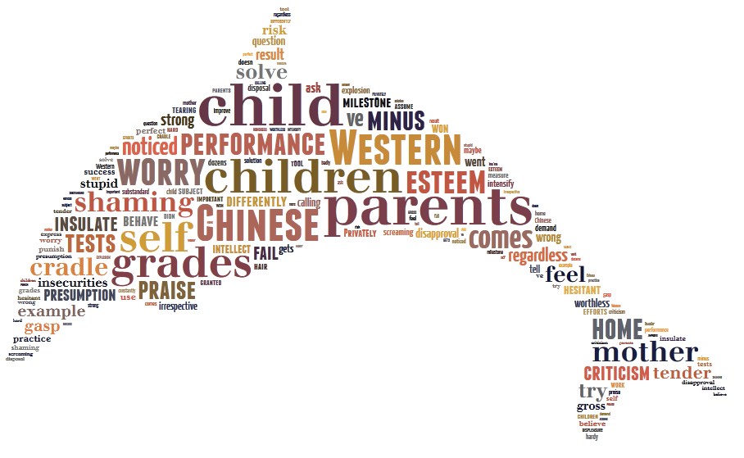
“cradle their children’s self-esteem”
self-esteem
“grades are a more important measure of success than ‘self-esteem’”

Slide 22
“The presumption is that the child is tender, not strong,…”
self-esteem
“Chinese parents believe that their child is hardy enough ,…”

Slide 23
self-esteem

Slide 24
Self-esteem
presume child is tender, not strong
believe child is hardy enough
praise the child
solve their children’s worries
insulate them from criticism
express disapproval
be a screaming, hair-tearing explosion
punish and shame the child
Task：Rewrite paras.3-6

Slide 25
Introducing difference
By using prepositions (unlike…)
By using antonyms (verbs, adjectives, nouns)
By using conjunctions (while, whereas, but… )
By using transitional words (by contrast, in contrast, however, on the other hand... )

Slide 26
Task：Rewrite paras.3-6
Western parents cradle their children’s self-esteem for they presume that the child is______, not strong, ______ Chinese parents believe that their children are ______ enough. For example, if a child comes home with an A-minus, a Western mother will most likely ________________. ____________, a Chinese mother will _______________. If the child comes home with a B, some western parents will _____________________and constantly try to _______________. ______ that, Chinese parents’ solution is always to _______________ the child, and there would be__________________________.
praise the child
solve his/her worries
tender
hardy
Unlike
punish and shame
By contrast
express disapproval
a screaming, hair-tearing explosion
while
insulate him/her from criticism

Slide 27
Don’t get me wrong—it’s not Chinese parents don’t care about their children. In fact, just the opposite!
They just have an entirely different parenting model.
I think this is a misunderstanding on both sides.
Of course there is some overlap—all decent parents wants to do what’s best for their children.
It’s the methodology that’s different.
Two paths lead to the same destination.
Cultural Inclusiveness

Slide 28
Western Parenting V.S. Chinese Parenting

Slide 30
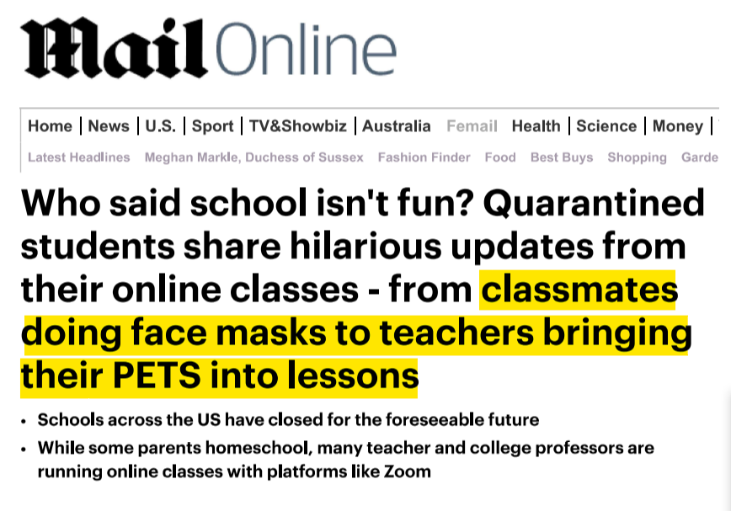
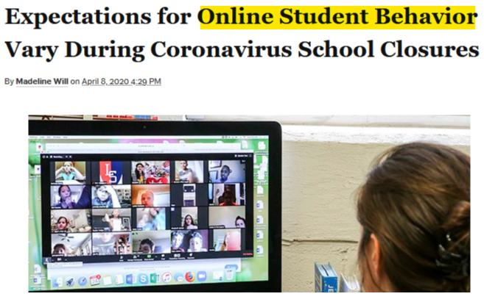
Different online class rules in west and China
during Coronavirus Pandemic
V.S
“leave to be” rules
“strict” rules

Slide 31
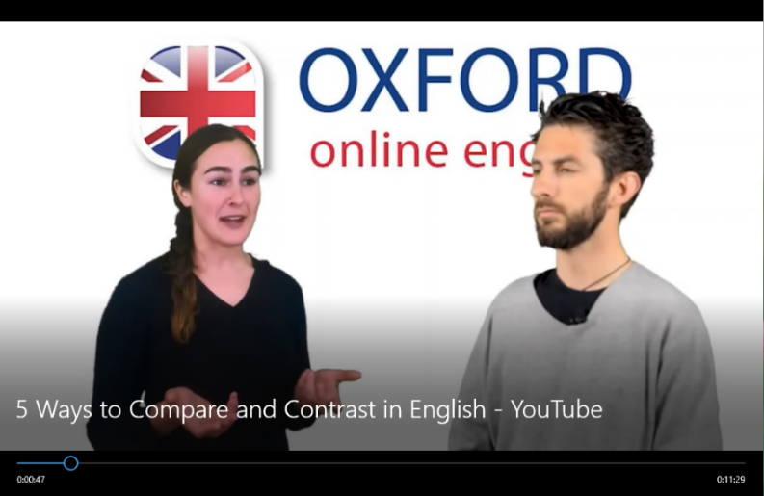
Post-reading tasks:
1.Make an oral report on “online class rules in west and China” and submit it online through FIF
2. Watch “5 ways to compare and contrast in English” on OXFORD online English
https://www.oxfordonlineenglish.com/compare-contrast

