Slide 1
Introduction
Notes:
Good afternoon ladies and gentlemen. We are very glad today to introduce and demonstrate the presentation reflecting our understandings on college English teaching integrated with ideological education.

Slide 2
Introduction
Teaching context
Teaching design
Notes:
My introduction is composed of two parts. Teaching context and Teaching design

Slide 3
Teaching Context
Students
Text
Notes:
Here is the Teaching context. I will talk about our students and the text we used for the teaching design.

Slide 4
Teaching Context
Students
medical-related majors
high academic competence and strong learning motivation
higher demand for medical professional English learning especially in academic reading and writing in medical context
Notes:
Our students are mainly medical-related majors with generally high academic competence and strong learning motivation. Compared with other Chinese undergraduates, our students in particular have a higher demand for medical professional English learning, especially in academic reading and writing in medical context.

Slide 5
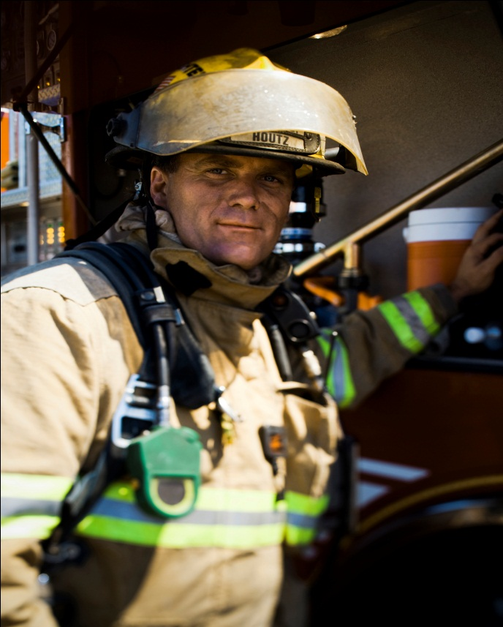
Teaching Context
Text
New Standard College English, Book Three,
Unit 7 Streets Full of Heroes
Notes:
The text we are going to focus on today comes from New Standard College English, Book three, unit 7 Streets full of heroes.

Slide 6
Teaching Design
Unit task
Objectives
Procedure
Notes:
Now, I will move on to our teaching design which consists of three parts, unit task, objectives and procedure.

Slide 7
Unit Task
Recently, the official WeChat platform of Beijing review is calling for stories about how people respond to COVID-19. In those days, people were overwhelmed by panic at the beginning and then gradually became calm and confident in this battle. Now even though this battle is not over, the country and citizens are more prepared to fight it. As a medical student, write your story entitled “Responding to COVID-19, from Panic to Preparedness” describing the change of your state of mind and providing the reasons of the change, and submit it to the WeChat platform.
Notes:
First, our task scenario is like this:
Recently, the official WeChat platform of Beijing review is calling for stories about how people respond to COVID-19. In those days, people were overwhelmed by panic at the beginning and then gradually became calm and confident in this battle. Now even though this battle is not over, the country and citizens are more prepared to fight it. As a medical student, write your story entitled “Responding to COVID-19, from Panic to Preparedness” describing the change of your state of mind and providing the reasons of the change, and submit it to the WeChat platform

Slide 8
Teaching Objectives
Communicative objectives:
to clearly describe the change of your state of mind to the COVID-19
to logically explain and critically reflect on the reasons of the change
Language objectives:
to describe feelings from five senses
to grasp the ways of citing sources
Ideological education objectives:
to reflect on the dedication of medical workers
to explore scientific and rational attitude
Notes:
Now I will talk about our three teaching objectives.
The communicative objectives are to clearly describe the change of your state of mind to the COVID-19 and to logically explain and critically reflect on the reasons of the change.
The Language objectives are to master the specific and detailed ways to describe feelings and to grasp the ways of citing sources
The Ideological education objectives are to reflect on the dedication of medical workers and to explore scientific and rational attitude in the face of public health emergencies.

Slide 9
Teaching Procedure
Session 1 （2 periods）
Session 2 （2 periods）
Session 3 （2 periods）
Production-Oriented Approach
Notes:
To achieve these goals, the following teaching procedure is adopted. The whole class for this unit is divided into three sessions and each session has two periods. The Production-oriented Approach is adopted.

Slide 10
Session 1
Before class
the teacher assigns the unit task and students try to produce the paper
The first sub task is using five senses to describe the change of feelings to COVID-19.
The second sub task is logically explaining the reasons of the change.
Notes:
Session 1
Before class, the teacher assigns the unit task and students try to produce the paper. Finding out students’ difficulties and problems, the teacher divides the task into two sub tasks. The first task is using different senses to describe the change of “feelings” to COVID-19. The second sub task is logically justifying the reasons of the change.

Slide 11
Session 1
In class
The teacher works on the first sub task
Students try to describe their feelings on the dedication of the medical workers during the epidemic from five senses
Notes:
In class, the teacher works on the first task and illustrates on describing feelings from different senses. Then, for practice and checking, students try to describe their feelings on the dedication of the medical workers during the epidemic.

Slide 12
Session 1
After class
Students submit their first drafts of their writings.
Notes:
After class, students submit their first draft of their writing.

Slide 13
Session 2
Before class
The teacher selects sample writings from the first drafts.
Notes:
Session 2
Before class the teacher selects sample writings from the first draft.

Slide 14
Session 2
In class
Teacher-student collaborative assessment
The teacher works on the second sub task and uses brainstorming and mind maps to help students critically reflect on and logically explain the reasons of the change.
Through helping students to correctly cite sources they have read, scientific and rational attitude will be emphasized.
Notes:
In class, the teacher analyzes one sample to show how to assess the description of feelings. Then teacher and students assess the rest of the samples together. After that, the teacher works on the second sub task and uses Brain storming and mind maps to help students critically reflect on and logically explain the reasons of the change. Through helping students to correctly cite sources they have read, scientific and rational attitude will be emphasized.
my colleague will demonstrate this part later.

Slide 15
Session 2
.
After class
Students submit their second drafts of their writings.
Notes:
After class, students submit their second draft of their writing.

Slide 16
Session 3
Before class
The teacher selects sample writings from the second drafts
In-class
Teacher-student collaborative assessment
Notes:
Session 3
Before the class, the teacher selects sample writings from the second draft
In class ,the teacher analyzes one sample to show how to do assess the reasons of the change. Then teachers and students will assess the rest of the samples together.

Slide 17
Check List
Evaluation Sheet
Criteria |  | Notes | Score
Content | Describe the change of feelings (20%)
 | Explain the reasons of change logically (20%)
Language | Describe feelings from five senses (20%)
 | Use quotations and paraphrase from experts, literatures and doctors (20%)
Ideological Cognition | Reflect on the dedication of medical workers (10%)
 | Show scientific attitude towards the public health emergency (10%)
Notes:
Here is the check list about the content, language and ideological cognition.

Slide 18
Session 3
After class
Students submit their final drafts.
Notes:
After class students submit their final draft.

Slide 19
Highlights
1. Integrated the cultivation of dedication and scientific attitude into the language teaching and production
2. Designed the challenging task under the real scenario demanding both the descriptive skills and critical reflection skills
3. Used brainstorming and mind maps to enable students to analyze the reasons of change
Notes:
At last, I would like to summarize the highlights of our class
We integrated the cultivation of dedication to work and scientific attitude into the language teaching and production.
We designed the challenging task under the real scenario demanding both the descriptive skills and critical reflection skills..
We Used brain storming and mind maps to enable students to analyze the reasons of change.
This is the end of my introduction, now my colleague will show you the demo class.

Slide 20
Responding to COVID-19: From Panic to Preparedness
Explaining Reasons for Change

Slide 21
Unit Task:
Responding to COVID-19: From Panic to Preparedness
Description
Draft A
Description of five senses
Critical reflection
Draft B
logical explanation of reasons
Final draft
Notes:
In the last class we have discussed our first sub-task: how to describe feelings with touching and impressive details through appealing to our senses，and just now we have done a detailed student sample analysis to urge you to focus on description of senses, now let’s move on the second sub-task: to find out reasons for the change from panic to preparedness.

Slide 22
Unit task
Evaluation Sheet
Criteria |  | Notes | Score
Content | Describe the change of feelings (20%)
 | Explain reasons of change logically (20%)
Language | Describe feelings from five senses (20%)
 | Use quotations and paraphrase from experts, literature and doctors (20%)
Ideological Cognition | Reflect on the Dedication of medical workers (10%)
 | Show scientific attitude towards the public health emergency (10%)
Notes:
Here is the second half of the student sample. Remember in the evaluation sheet we attached with the task description, , on the dimension of content, we required a logical explanation on the reasons of change. Please work in pairs with reference to this sheet, and give your comment.

Slide 23
A sample
“I'd like to show my deep respect to our heroes who fight courageously against COVID-19 in the front line, the medical workers together with other dedicated workers who drive away this epidemic and protect our happy life. My attitude changed when I saw this. I realized that I will be, someday, on the front line when similar public health emergencies occur in the future. Panic won't do me any good then; I will try to save lives with nothing but my professionalism, my commitment and my preparedness.”
From student A’s draft A
Notes:
S: The writing only describes the devotion of medical workers, and seems a little bit simple.
T: Right. The author describes “the medical workers together with other dedicated workers who drive away this epidemic and protect our happy life.” She left other ‘dedicated workers’ unmentioned. The change, however, need be a complex process involving many factors. Here actually we are practicing the skill of critical reflection, which is an important aspect of critical thinking, including both categorizing factors and arguing for reasons. After all, How can we make our reflective analysis more profound and convincing? This is what we aim to achieve in this session.

Slide 24
Teaching objectives
After this class, you will be able to
1. reflect on the dedication of medical workers;
2. explain reasons for change of attitude logically;
3. use citation in explaining to add objectivity.

Slide 25
Teaching procedures
1. Brainstorming possible reasons for
attitude change;
2. Clarifying reasons for the change.

Slide 26
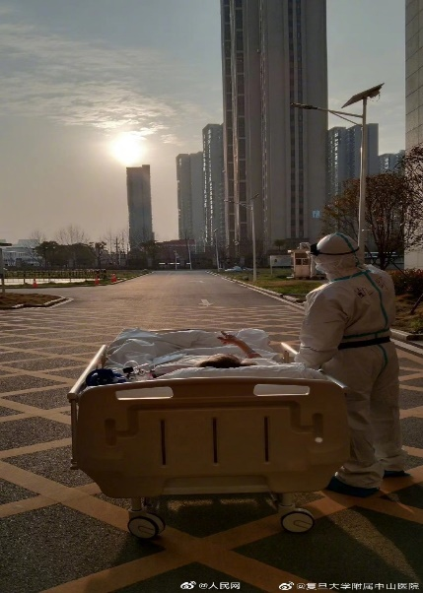
Brainstorming: Devotion of doctors
“To cure sometimes, to relieve often, and to comfort always.”
“People call us heroes, but we were just doing our job.”
“We also feel fear, but when we put on the white robe, we feel the courage.”
Notes:
So what indeed has brought about the change? Let’s do a brainstorming task. Maybe Mike?
Mike: I was assured because I saw during the covid 19 outbreak, many healthcare workers risked their own lives to save others, and I know that my life will be safeguarded.
T: So You will grow up to be medical practitioners, how have you been touched by the doctors’ and nurses deeds?
Mike: I actually experienced personal and professional growth. My understanding of medical professionalism before the epidemic is mainly treating diseases, curing sicknesses. It’s more medical, but now I realized We have to treat not only patients’ physical state, but also their mentality.
T: especially encountering a novel disease. Now we have a better understanding of ‘to cure sometimes, to relieve often, and to comfort always’. , and the spirit of ‘respect for life, saving the illness, will to sacrifice and boundless love’“敬佑生命、救死扶伤、甘于奉献、大爱无疆” So do you think they are heroes, as Picaccino in ‘Last man down’?
S: Yeah they shoulder great responsibility and risks under extreme pressure.
T: But also we see touching moments on TV that doctor Zhao Yingming’s husband promised to her that ‘When you come back safe and sound, I would take over all housework’…
S: Yeah, actually at the same time, they are vulnerable—-away from their families, exposed to the virus directly, seeing death everyday, wondering whether their efforts will pay off. Just seeing them won’t back off, and the resilience and sacrifices they show us that inspires me, as a medical student, to become just one of them.
T: So a follow up question, if you are a mature doctor now in a position to stand out, what would be your choice, and how would you tell your beloved family?
S: to be honest, I think I might have to battle myself to go. Eventually I think I will go, and I will persuade my parents that it’s our responsibility to do that.
T: Yeah, it is our responsibility. As one doctor said“We also feel fear, but when we put on the white robe, we feel the courage”. Ordinary people become heroes when they are, as Picciotto stated ‘just doing their jobs’.

Slide 27
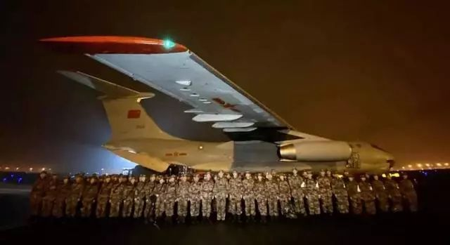
Brainstorming: Government’s response
"Life is of paramount importance. This is a price we must
pay, at any cost."
Notes:
So what indeed has brought about the change? Let’s do a brainstorming task. Maybe Mike?
Mike: I was assured because I saw during the covid 19 outbreak, many healthcare workers risked their own lives to save others, and I know that my life will be safeguarded.
T: So You will grow up to be medical practitioners, how have you been touched by the doctors’ and nurses deeds?
Mike: I actually experienced personal and professional growth. My understanding of medical professionalism before the epidemic is mainly treating diseases, curing sicknesses. It’s more medical, but now I realized We have to treat not only patients’ physical state, but also their mentality.
T: especially encountering a novel disease. Now we have a better understanding of ‘to cure sometimes, to relieve often, and to comfort always’. , and the spirit of ‘respect for life, saving the illness, will to sacrifice and boundless love’“敬佑生命、救死扶伤、甘于奉献、大爱无疆” So do you think they are heroes, as Picaccino in ‘Last man down’?
S: Yeah they shoulder great responsibility and risks under extreme pressure.
T: But also we see touching moments on TV that doctor Zhao Yingming’s husband promised to her that ‘When you come back safe and sound, I would take over all housework’…
S: Yeah, actually at the same time, they are vulnerable—-away from their families, exposed to the virus directly, seeing death everyday, wondering whether their efforts will pay off. Just seeing them won’t back off, and the resilience and sacrifices they show us that inspires me, as a medical student, to become just one of them.
T: So a follow up question, if you are a mature doctor now in a position to stand out, what would be your choice, and how would you tell your beloved family?
S: to be honest, I think I might have to battle myself to go. Eventually I think I will go, and I will persuade my parents that it’s our responsibility to do that.
T: Yeah, it is our responsibility. As one doctor said“We also feel fear, but when we put on the white robe, we feel the courage”. Ordinary people become heroes when they are, as Picciotto stated ‘just doing their jobs’.

Slide 28
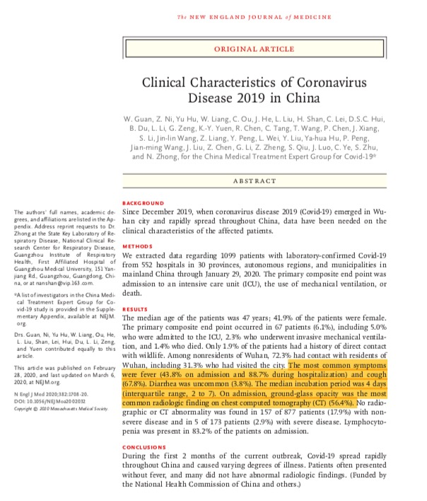
Brainstorming: Power of science
fever and cough
Symptoms
median incubation period
lymphocytopenia
‘the strongest weapon to fight against diseases
is science”
Notes:
S: My attitude changed when I see our government has managed to do their best to help us through the crisis. Now, we can buy face masks and basic medicine just like any other grocerys, and it's just a matter of time our lives get back to normal.
T: I agree, the victory we have against the virus is also attributed to the efficiency the government reacted towards the pandemic. We are sorry to see how the virus is still rampant in other countries.
There has been rumor online concerning how the disease could be contained by drinking aquarium cleaners, and how getting in touch with people from Wuhan could get one affected. Were you afraid?
S: To be honest at first I was frightened, I even began to store up life supplies because of little concrete knowledge about the virus. But I was relieved when I searched relevant information in authoritative database and found a bunch of well-organized researches which are revealing the mechanism step by step.
T: after a period of being restless, maybe we would calm down and resort to science.
S: Yes, I was impressed by the prudent approach in scientific research. In one of the pre-class reading materials, I found one of the first articles on COVID-19 infection describes the course of development of the disease, including its initial symptoms like fever and cough, the median incubation period, and biochemical indicators like lymphocytopenia. I think these studies provide clinicians with solid science to cope with the disease.
T: Right, we know academician Chen Wei is already working on the third round of clinical trial of the COVID-19 vaccine. We are witnessing the power of science in the global fight. As President Xi said ‘the strongest weapon to fight against diseases is science’.

Slide 29
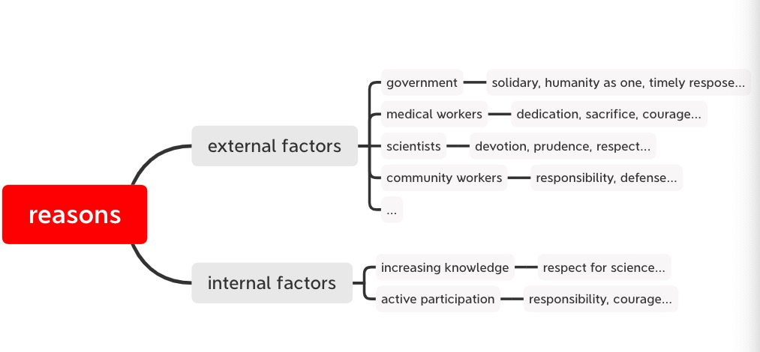
Mind map: Reasons for change
Notes:
Very good discussions. In the brainstorming activity, we have come up with multiple reasons that brought about the change. Now can we work in groups to draw a mind map to sort out the reasons for the change, and if possible, list related expressions.
So this is my version of the mind map. We are assured because of the joint efforts by the government, doctors, scientists, and of course, ordinary people in the face of difficulties. We can even catergorize these factors into external factors and internal factors. 2020 is a difficult year, we experienced the ruthless virus, and now the devastating flood, but we as a nation survived these challenges, because of the courage of doctors, dedication of soldiers and solidary of citizens. All are ordinary people, but when we are fulfilling our obligations in the positions, we are heroes.
Sorting out these reasons help us to make our writing orderly. When we are describing reasons for change, we need to follow the structure of writing cause-effect paragraphs. We have discussed this in the last unit.

Slide 30
Using sources
Citation:
making writing more objective and convincing
Quote
Paraphrase
Notes:
Today we will learn how to make the explanation more objective and reliable through introducing voices other than the author’s into the text, that is citing sources. Let’s reflect on our change of state of mind, is there a moment that you gained confidence when President Xi promised that ‘people’s health would be put first’ , or when Academician Zhong Nanshan assured that the disease could be effectively contained if social distance is maintained, Or maybe when you read Professor Chenwei’s article concerning the development of the vaccine? If we incorporate ideas from experts, medical workers, or from literature into our writing, then we are not just talking about our own personal and maybe partial thoughts, and could make the writing more objective and convincing.
Today we will learn how to make the explanation more objective and reliable through introducing voices other than the author’s into the text, that is citing sources. Let’s reflect on our change of state of mind, is there a moment that you gained confidence when President Xi promised that ‘people’s health would be put first’ , or when Academician Zhong Nanshan assured that the disease could be effectively contained if social distance is maintained, Or maybe when you read Professor Chenwei’s article concerning the development of the vaccine? If we incorporate ideas from experts, medical workers, or from literature into our writing, then we are not just talking about our own personal and maybe partial thoughts, and could make the writing more objective and convincing.

Slide 31
Using sources: paraphrasing
Using synonyms
Changing word class
Changing word order

Slide 32
Review
In this class, we have:
Appreciated the professionalism of medical workers and power of science;
Practiced how to critically reflect on a change of psychological state through using brainstorming and mind map.

Slide 33
Homework
Revise Draft A on “Responding to COVID-19: From Panic to Preparedness”:
Analyze reasons for change logically;
Incorporate at least 2 quotes, and 2 paraphrases in your revision.

Slide 34
Thank you!

