Slide 1
College English Reading & Writing

Slide 2
1
Introduction
2
Demonstration

Slide 3
Contents of Introduction
1
Teaching feature
2
Teaching context
3
Teaching design

Slide 4
I. Teaching feature
Design
“ 3 Blending”
after class English practice with
classroom teaching
moral education
online and offline resources
Methodology
Flipped classroom
Task-based approach
Philosophy
Learner-oriented education
Whole-person education

Slide 5
Teaching feature: online resources
1
Textbook
1
2
UMOOCS
+
Unipus
Language skills
2
3
Culture
4
3
Workplace
4

Slide 6
《新视野大学英语》
《英语听力技能与实践》
《英语演讲技巧与实训》
《TOEFL® Test Preparation》
《中国文化概况》
《印象英美—穿越时空之旅》
《文化差异与跨文化交际》
《英语畅谈中国文化》
《职业素养英语》
《职场英语》

Slide 7
Teaching feature: online resources
textbooks
1
1
Utalk
2
UMOOCS
+
Unipus
2
3
iTest
4
iWrite
3
4

Slide 9
II. Teaching Context
About our university
Orientation of our school
Application-oriented Education
knowledge/ability/moral quality
0 1
02
0 4
03
About our students
About the text
non-English major students
intermediate oral and writing competence
lack of the competence to apply writing skills
Unit 4 Heroes of our time
Text B A Hero’s aspiration

Slide 10
III. Teaching Design
Learning objectives
Production task
Teaching procedures
The highlights

Slide 11
Learning objectives
Production task
Teaching procedures
The highlights
Language skill
Ability
reading skill：Scanning
writing skill：SHOW DON’T TELL
delivering a speech
Quality
a profound understanding of Heroism
actively practicing Heroism

Slide 12
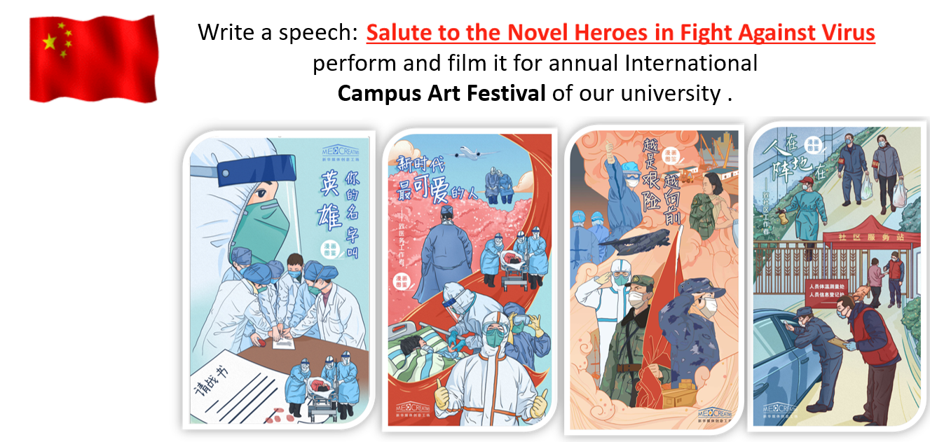
Learning objectives
Production task
Teaching procedures
The highlights

Slide 13
Learning objectives
Production task
Teaching procedures
The highlights
Autonomous learning + Inquiry learning
Students：UMOOCs + Unipus +iWrite
Teachers review the 1st drafts and select sample writings.
Creative thinking+Cooperative learning
iWrite +English Club practice
Pre-class
Online Assessment
“Online+Teacher+Peer” Assessment
Students submit the 2nd draft to iWrite and prepare for the speech
Blended
teaching
Post-class
In-class
Assessment of the 1st drafts; Students read the text to polish their 1st drafts .
Flipped classroom +TBLT
Cooperative learning + Critical thinking
“Teacher+Peer” Assessment

Slide 14
The features
IV. Teaching design: a sample lecture
Learning objectives
Production task
Teaching procedures
The highlights
“online + teacher + peer” assessemet
Assessment
Writing+ ME
Synthesis
Writing
Text analysis+ ME
Analysis
Reading to write+ ME
Application
Reading
Scanning for details + Moral Education(ME)
Comprehension
Progressive task
Bloom’s Taxonomy

Slide 15
参考文献
[1] “AIC WRINTING TIPS—topic: show don’t tell level: intermediate skill”
https://v.qq.com/x/page/n05164t7w5k.html
[2] 鲁东大学2019教学之星获奖作品 https://heep.unipus.cn/news/detail.php?NewsID=5214
[3] 文秋芳. 输出驱动假设在大学英语教学中的应用：思考与建议 [J]. 外语界，2013，（6）：14-22.
[4] 文秋芳. 构建“产出导向法”理论体系 [J].外语教学与研究，2015,（4）：547-558.
[5] 文秋芳.“师生合作评价 ”：“产出导向法”创设的新评价形式 [J]. 外语界，2016，（5）： 37-43.
[6] 谢晓燕. 大学英语专业课堂教师反馈研究 [J].解放军外国语学院学报，2011，（2）：50-55.
[7] 张文娟. 基于“产出导向法”的大学英语课堂教学实践 [J].外语教学与研究，2016，（2）：106-114.

Slide 16
Introduction
1
2
Demonstration

Slide 17
Unit 4 Heroes of our time
Text B A Hero’s aspiration

Slide 18
Objectives
Unit Project
Read to Write
Assignment
To practice reading skill：Scanning
To learn / practice writing skill：SHOW DON’T TELL
To have a profound understanding of “Hero”

Slide 19
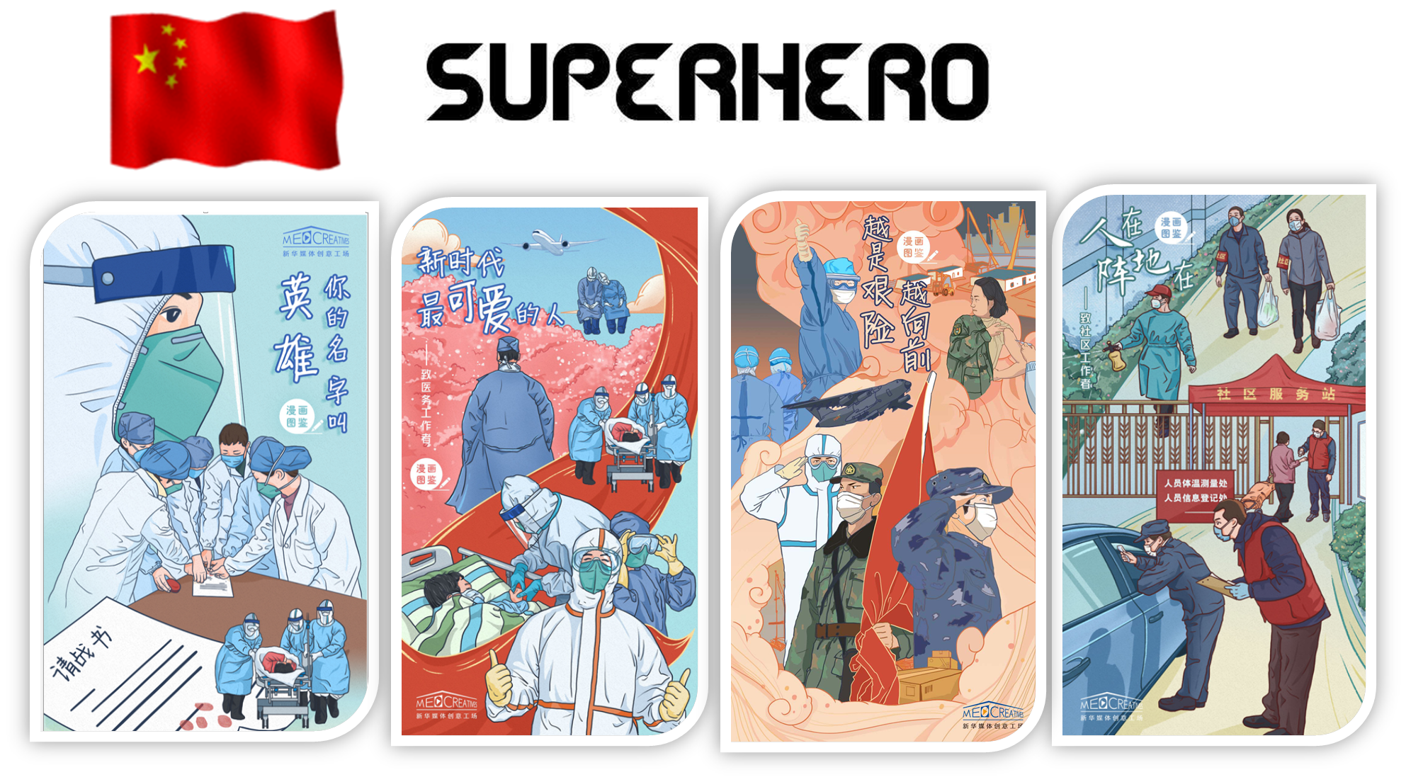
Unit Project
Read to Write
Assignment
Write a speech: Salute to the Novel Heroes in Fight against Virus,
perform and film it for the annual Campus Art Festival of our university.

Slide 20
Unit Project
（Assessment of first draft）
Read to Write
Assignment
Question
Narration
Structure
√
Example
question-example-conclusion
Conclusion

Slide 21
Unit Project
Read to Write
（writing skill: SHOW DON’T TELL）
Assignment
Please read the two versions of description, and pay attention to the difference.
Telling or showing?
Version1：Weather condition is severe.
a telling statement
√
Version2：The rain had swelled the river into a raging monster. It roared well over its banks rushing swiftly with tree limbs caught in the raging current. And half submerged in the current was the car. As big as it was the force of the water had heaved it against a tree the passenger seat submerged water rushing over the windshield. “Dear Lord!” Jonda prayed. “Never again!” This is too much too familiar Jonda thought. (Para.5 from Text B )
a showing statement
SHOW DON’T TELL?
to demonstrate to readers, to describe the actions and feelings exactly to show what is happening instead of using more general words.

Slide 22
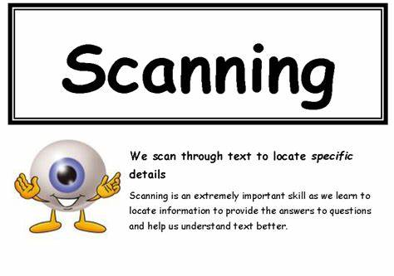
Task: Please scan Para. 5 for the detailed description about the severe weather.
Unit Project
Read to Write
（reading skill: scanning）
Assignment
How to “show don’t tell”?

Slide 23
Unit Project
Read to Write
（writing skill: SHOW DON’T TELL）
Assignment
How can we make more showing than telling ?
Method 1: Be specific
Telling: Weather condition is severe.
Showing: The rain had swelled the river into a raging monster. It roared well over its banks rushing
swiftly with tree limbs caught in the raging current. And half submerged in the current
was the car. As big as it was the force of the water had heaved it against a tree the
passenger seat submerged water rushing over the windshield. “Dear Lord!” Jonda prayed.
“Never again!” This is too much too familiar Jonda thought. (Para.5 from Text B)
Can you identify the descriptive words that are specific about the terrible weather ?

Slide 24
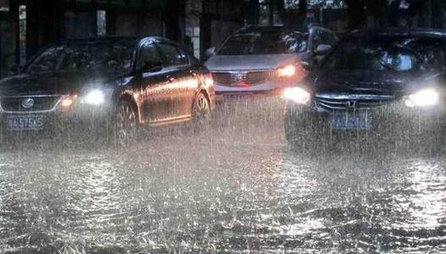
Unit Project
Read to Write
（understanding of “hero”）
Assignment
Para.5 in Text B
Challenge to the hero
(Courage of the hero)

Slide 25
Unit Project
（Assessment of first draft）
Read to Write
Assignment
Narration
Structure |  | √
Descriptive devices | Be specific
They brought equipments for the ICU , medicines and personal protective equipments.

Slide 26
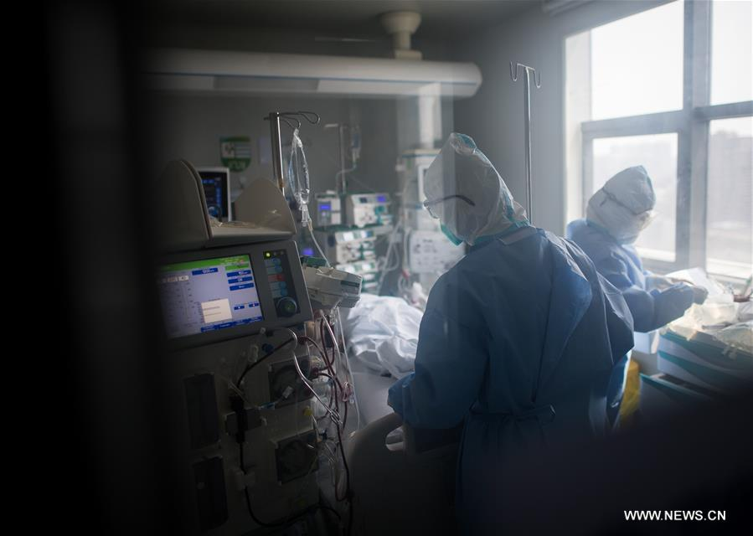
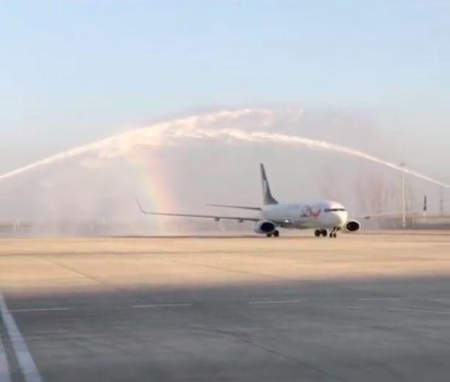
description of courage of heroes
Unit Project
（Assessment of first draft）
Read to Write
Assignment
Narration
Structure |  | √
Descriptive devices | Be specific
 | ? | ?
Contents | Challenge | √
 | Courage
 | …
(Photo/China Youth Daily)

Slide 27
Unit Project
Read to Write
（reading skill: scanning）
Assignment
Task: Please scan Paras. 12&13 for the description about rescue.
What words or impressions impressed you most?
12 Jonda leaned in and wrapped her arms around the woman. "We're not going to lose you Sandy! Put your arms around my neck and hold on! David grab my waist and pull!".
With all her strength in the icy water Jonda grabbed the slender woman out of her seat and through the broken window David pulling at her waist. The car heaved one last time and just as the woman cleared it, it was swallowed by the water.

Slide 28
Unit Project
Read to Write
（writing skill: SHOW DON’T TELL）
Assignment
Task: Please scan Paras. 12&13 for the description about rescue.
How can we make more showing than telling ?
Method 2: To focus on actions (verb.)
12 Jonda leaned in and wrapped her arms around the woman. "We're not going to lose you Sandy! Put your arms around my neck and hold on! David grab my waist and pull!".
With all her strength in the icy water Jonda grabbed the slender woman out of her seat and through the broken window David pulling at her waist. The car heaved one last time and just as the woman cleared it, it was swallowed by the water.

Slide 29
Unit Project
（writing skill: SHOW DON’T TELL）
Read to Write
Assignment
Your first draft
Narration
Structure |  | √
Descriptive devices | Be specific
 | To focus on actions | ×
Contents | Challenge | √
 | Courage
 | …
How can you modify the essay with more details focusing on actions to show courage
of heroes?
improved version
Words or expressions?

Slide 30
Unit Project
Read to Write
（writing skill: SHOW DON’T TELL）
Assignment
Watch a video clip of news report and pay attention to the description of actions.

Slide 31
Unit Project
（practice writing skill）
Read to Write
Assignment
Your first draft
The night the doctors are dispatched, some of them even wrote down their bank card passwords and last words.
Even though cleaners are afraid, they took responsibility and still stuck to their post on the frontline, cleaning and disinfecting the street.
At first, kids even couldn’t recognize their parents on the phone.
…
Improved version

Slide 32
SHOW DON’T TELL
Unit Project
Read to Write
Assignment
Method：Be specific
To focus on actions (verb)
Function : to gain the reader’s interest and sympathy
to make a writing vivid and exciting
to convince the reader of your point

Slide 33
Unit Project
Read to Write
Assignment
Narration
Structure | Descriptive devices |  | Contents
question-example-conclusion | SHOW DON’T TELL | Be specific | What do the heroes do? Why do you think they are heroes？ What qualities do they have in common? …
 |  | To focus on actions (verb)
√ | √ |  | ?

Slide 34
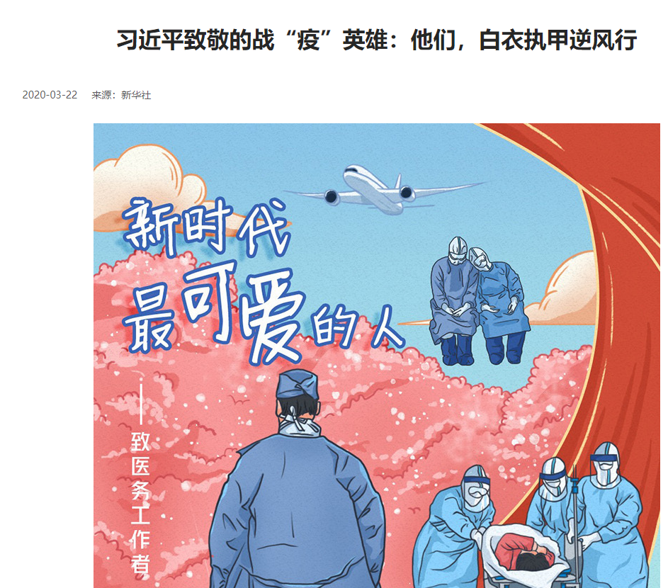
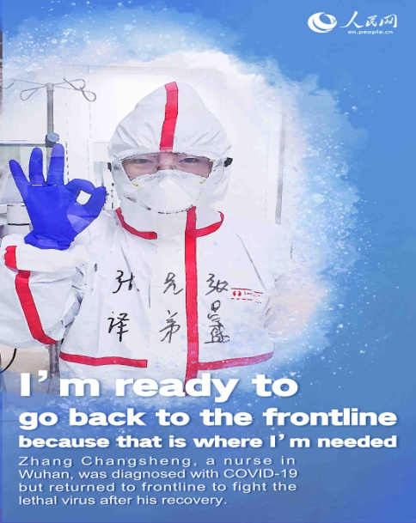
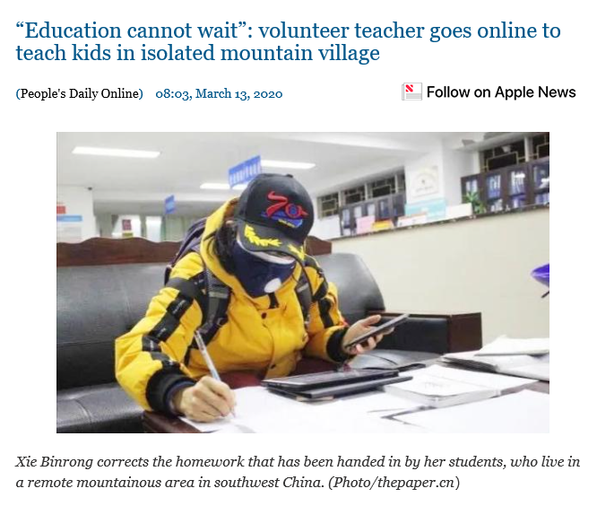
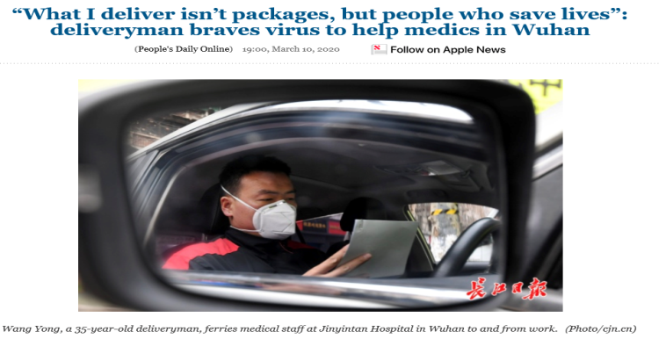
Unit Project
Read to Write
Assignment
The profound understanding of “hero”
Who can be called heroes in the fight against COVID-19?
volunteer teacher
deliveryman

Slide 35
Unit Project
Read to Write
Assignment
The profound understanding of “hero”
Discussion: Why do you think they are heroes?
What qualities do they have in common?
sense of responsibility；
strong determination；
working hard;
courage ;
sacrifice
…
“President Xi hailed the people as the true heroes in serving as the source of strength and confidence for China to fight the virus.” (www.xuexi.cn)

Slide 36
Unit Project
Read to Write
Assignment
Telling Chinese Stories
Collect more detailed information about the Hero you write about
Modify your writing using at least one method of SHOW DON’T TELL and submit it to “iWrite”
Practice your speech for China Voice (the activity of English Clubs), preparing for Campus Art Festival of our university
“To do a common thing uncommonly well brings success.”

