Slide 1
FLTRP
Teaching Design
Unit 6 To be or not to be

Slide 2
01
Introduction
02
Teaching design
CONTENTS
03
Demo class

Slide 3
01
Introduction

Slide 4
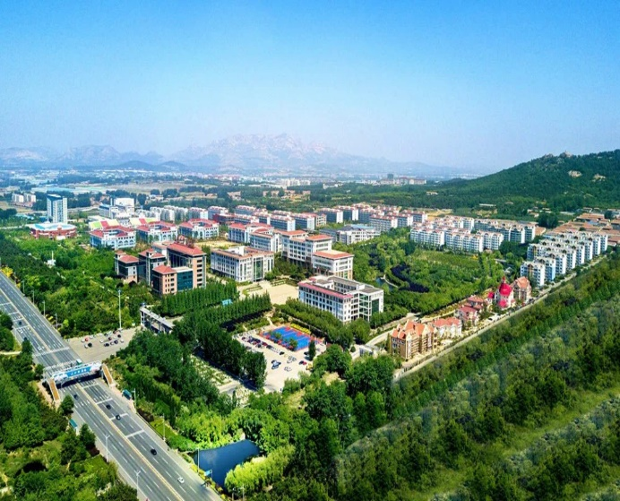
School orientation
Undergraduate level vocational education
High level applied technical talents

Slide 5
Talent training mode
Knowledge
01
02
03
Ability
Value

Slide 6
About our students
Basic and polarized language proficiency
Passive knowledge receiver
Vulnerable in values

Slide 7
02
Teaching design

Slide 8
Teaching content
Unit 6 To be or not to be
iProduce
Advanced writing skills
Moral education value

Slide 9
Learning objectives
Build up words and expressions relating to “choice” ;
Apply effective writing skills to give suggestions on major choosing;
Establish the concept of major selecting combining personal interest and
social responsibility.

Slide 10
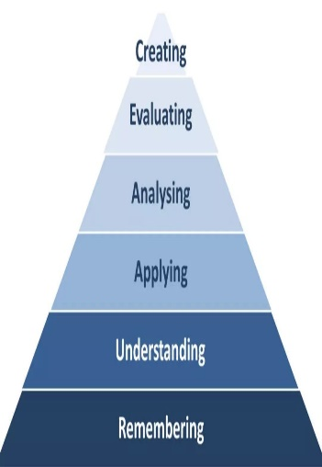
Production-Oriented Approach
Motivating
Enabling
Assessing
Bloom’s
Taxonomy of Learning

Slide 11
Learning procedure
Period 1&2
Period 3&4
Period 5&6
Intensive teaching and practicing
Subtask 1: sharing ideas in group activities
Subtask 2: applying writing skills
in Unit project
Offline
Advanced
Initiative
Challenging
Self-learning on
iExplore 1 &2
Language training and consolidating
Self-learning
and feedback
Unit
assessment
Online

Slide 12
Language learning & Moral education integration
篇章
读
说
主题
In-class
Moral
Objective
After-class
听
词汇
写
练习
译

Slide 13
Multiple evaluation
Assessment of learning
Assessment as learning
Self
Peer
Teacher

Slide 14
03
Demo class

Slide 15
Unit Project
iProduce
You will write an essay in which you reflect on how you chose your major and then give suggestions to students in your high school.

Slide 16
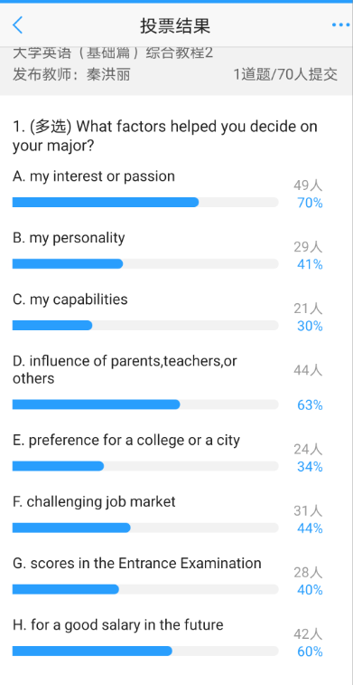
What factors help to decide on your major?

Slide 17
How to make your point more persuasive?

Slide 18
The author CONVINCED readers through:
Follow a career passion?
Let it follow you
his own experience √
rhetorical device √

Slide 19
TEXT : If we have the courage to discover this calling…we’ll end up happy, If we lack this courage, we’ll end up bored and unfulfilled… (Para 2)
TEXT: …, the right question is not “What is this job offering me ?” but, instead, “What am I offering this job?” (Para 6)

Slide 20
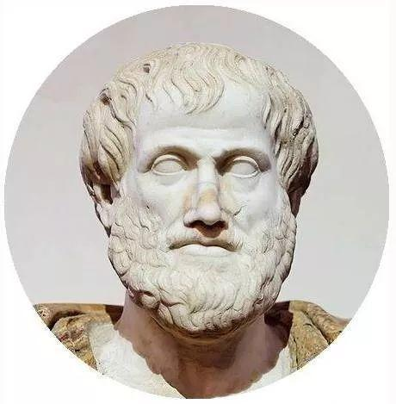
Antithesis
To compare and emphasize
To make a sentence easier to remember
To make the audience better understand the point

Slide 21
Examples
two contrasting ideas
parallel in structure
“Too err is human; to forgive, divine. ”
“That's one small step for a man, one giant leap for mankind. ”
“The mother looked young and the daughter looked old”

Slide 22
Can you work in groups to make your point better understood by using antithesis?
Internal Factors
External Factors
influence of parents, teachers, or others
preference for a college or a city
challenging job market
scores in the Entrance Examination
financial shortage
...
my career philosophy
my interest or passion
my personality
my capabilities
...

Slide 23
What determines a successful major?
Internal factors OR External factors
Other factors?...

Slide 24
再有的话，就是那种探索古代社会并且有所成果的时候，那种成就感吧。这一点从民族情感而言，也有类似的意义。
在这个价值观和利益多元化的时代，“钱”途并不是人生的唯一选择。

Slide 25
Words for you to think…
Every individual is a tiny droplet in the vast ocean of the society.
Find out your self value, while achieving the social value.

Slide 26
Writing
1.Reconsider your points about major choosing, write your suggestions using rhetorical devices, and submit it to the online learning platform.
2. Peer–review your partners’ essay.
Assignment

Slide 27
Assessment criteria
Specifics | Score
The central idea is clearly stated. | 1-5
The essay is logically developed. | 1-5
The author’s feeling and solution are described vividly. | 1-5
The author tried to use antithesis properly. | 1-5
mistakes in spelling, grammar and punctuation are avoided | 1-5

Slide 28
2020
Thank you!
FLTRP

