Slide 2
01
Instructional Design
Unit Presentation
College
English
Course
01
02

Slide 3
UNIT 1
How we behave is who we are

Slide 4
non-English major
undergraduates in the 2nd year
Target Students
lower-intermediate level

Slide 5
Linguistic
Knowledge
Critical
Thinking
Educate students to be bilinguals
who can listen and speak
(Course Objective)
Critical
Thinking
Cultural and Intercultural Competence
Cultural and Intercultural Competence
Linguistic
Skills
Teaching Objectives

Slide 7
Learning-using integration principle
(LUIP)
Whole-person
education
principle
(WPEP)
the POA
Teaching
Principles

Slide 8
T- do formative classroom assessment
Teacher-led
T- carefully plan, effectively organize and
professionally direct activities
Student-centered
Ss- participate
individually,
in pairs
and in groups
In class
Teaching
Procedure
T- assign tasks related to the topic
T- provide feedback and guidance
Before
class
After
class
T & Ss- do achievement assessment
Ss- fulfill the tasks online & offline
e.g. Unipus
Ss- practice more online & offline
e.g. Unipus

Slide 9
more useful language points related to the topic (behavior)
Listening
one of listening skills
better understanding descriptions and opinions on behavior
Unit
Teaching
Objectives
comparing and contrasting behavior in different countries
one of speaking skills
practicing it in role-play and group discussion
Speaking
describing and commenting on different kinds of behavior in life
ways of persuading others to change their inappropriate behavior
Notes:
in order to make them produce

Slide 10
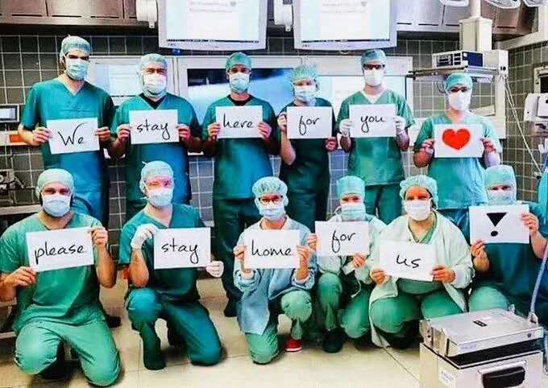
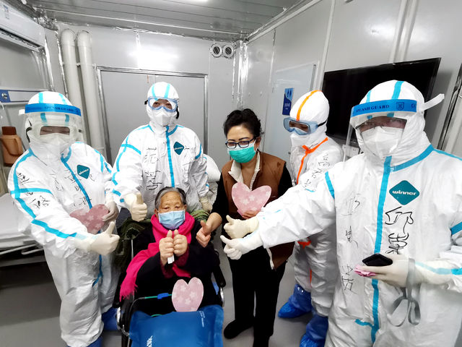
Achievement assessment
Behavior in the face of covid 19

Slide 11
02
Instructional Design
Unit Presentation
College
English
Course
01
02

Slide 12
Viewing & Listening & Speaking

Slide 13
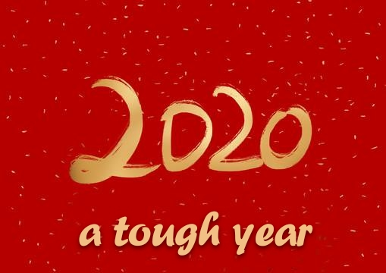

Slide 14
BEHAVIOR of China
Care
Help
Immediate
New technology
Altogether
此生无悔入华夏
来世还做中国人

Slide 15
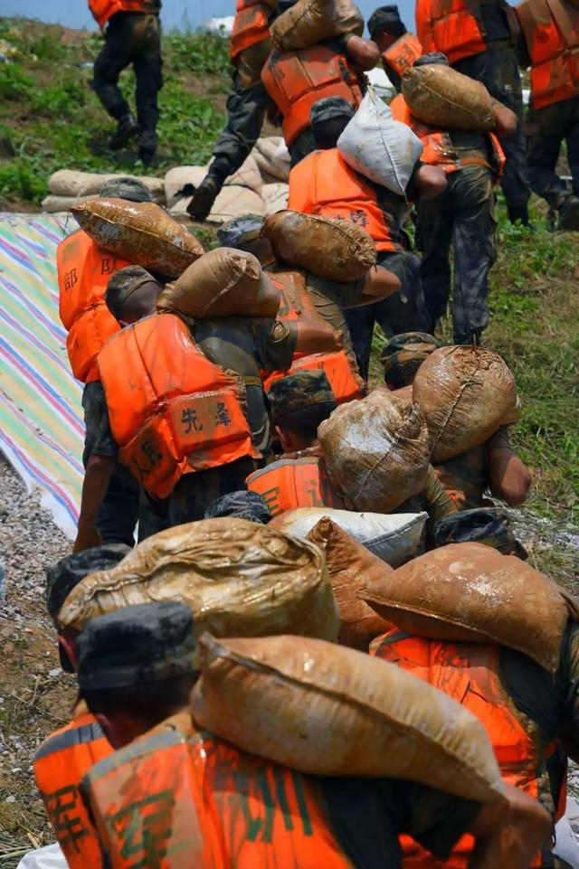
BEHAVIOR of People from All Walks of Life
Respect life,
Respect duty,
Respect rules,
Sacrifice the most to save
others from the worst.
“00后”的肩膀,
扛得住！

Slide 16
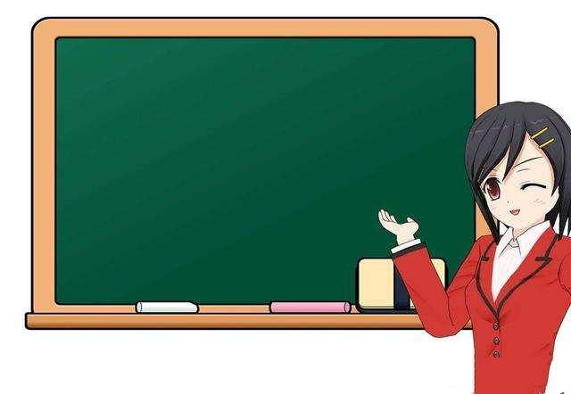
UNIT 1
How we behave
is who we are

Slide 17
Meaning/Usage
behave yourself

Slide 18
some general categories of BEHAVIOR
Opening up
Before class
tell any BEHAVIOR you saw or heard in life
video yourselves with examples
preview
check
&
discuss
share and add more examples in each category of BEHAVIOR
learn more about BEHAVIOR in Unit 1
In class
find more about BEHAVIOR in life now
describe different BEHAVIOR with more examples
After class
review

Slide 19
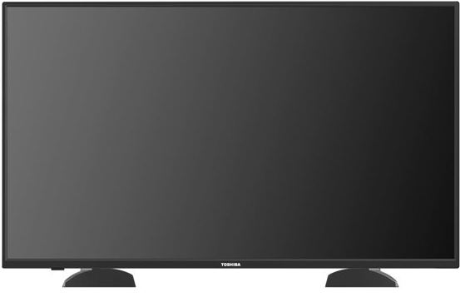
While watching, write down the types of behavior you hear.
Notes:
do you understand they were talking about? right? They gave up some examples about different types of behavior. Here is one thing I'd like to stress. that is PRONUNCIATION. 板书：纠音：cooperative; contribute covid-19 virus or novel coronavirus

Slide 20
Please put types of behavior mentioned in the video clip in order.
A
polite behavior
B
violent behavior
C
cooperative behavior
D
risky behavior
E
annoying behavior
F－E－B－D－A－C
F
moral behavior

Slide 21
Group work
Group 1 Top Ten Moral Behavior
Group 2 Top Ten Polite Behavior
Group 3 Top Ten Cooperative Behavior
Group 4 Top Ten Risky Behavior
Group 5 Top Ten Annoying Behavior
Group 6 Top Ten Violent Behavior

Slide 22
Reference answers
moral behavior: spreading no rumors, being honest and just, treating people fairly, escaping no responsibility, not speaking badly of others, offering seat to elderly people, etc.
polite behavior: being modest and/or humble, expressing thanks to people who help you, being punctual, presenting and receiving business cards with two hands, etc.
cooperative behavior: helping people on your team, contributing ideas to your group, participating in discussions, listening carefully to your team members, fulfilling tasks in time, etc.
risky behavior: drunk driving, using cell phones or texting while driving, speeding, using drugs, drinking alchohol, stealing, cheating in exams, gambling, insider stock trading,etc.
annoying behavior: talking loudly in public places,smoking in non-smoking areas,interrupting other people, intruding on personal space, complaining endlessly, etc.
violent behavior: physical fighting, assaulting, punching, kicking, hitting, etc.

Slide 23
Reference words and phrases
civilized
harmonious
beneficial
impersonal
tick off It really ticks me off...
get on sb.'s nerves

Slide 24
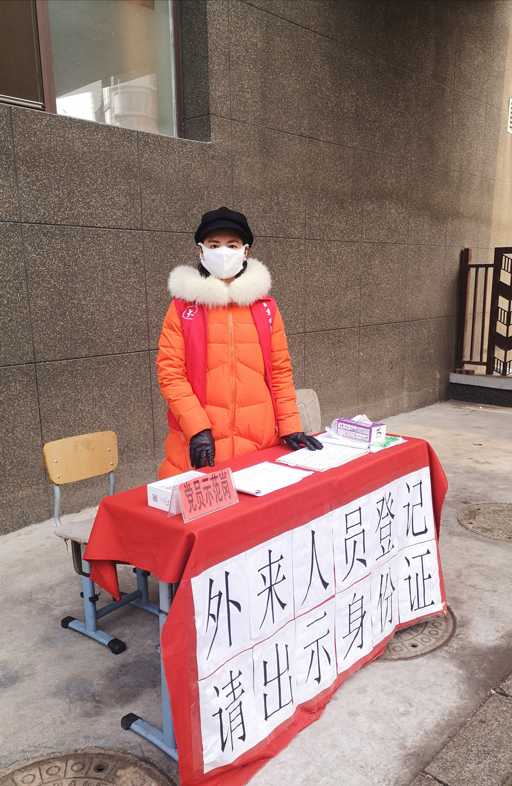
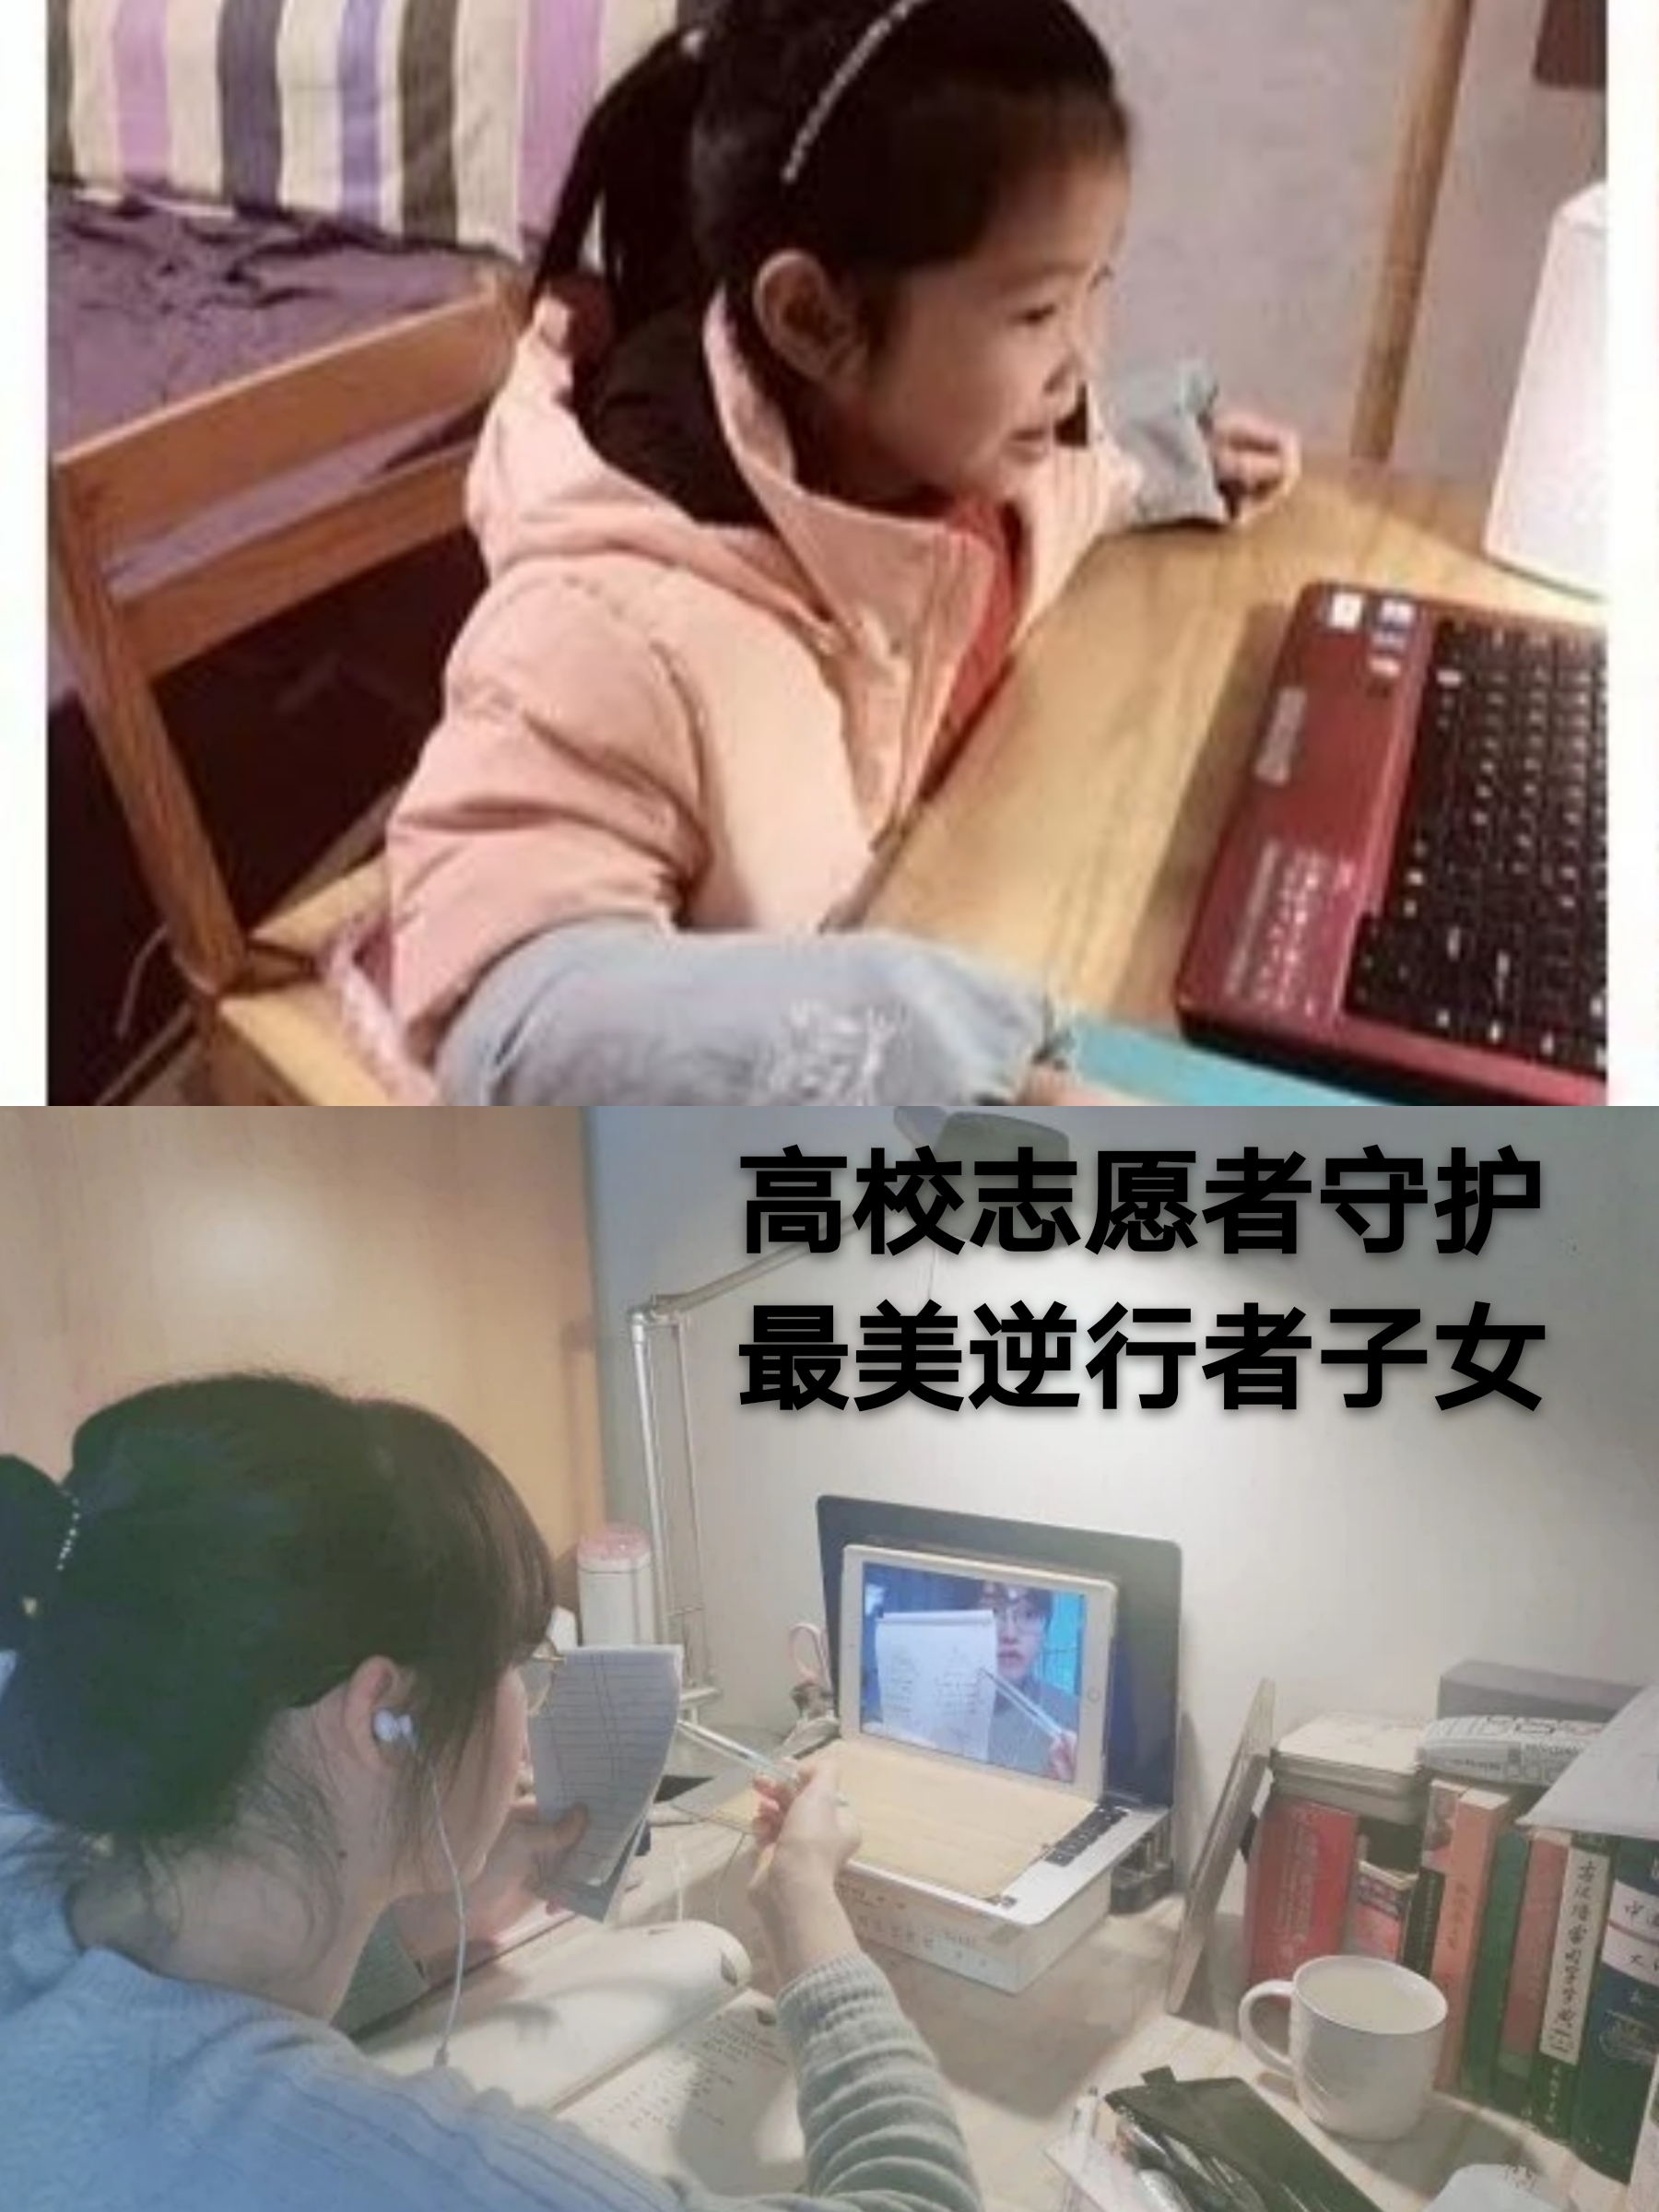
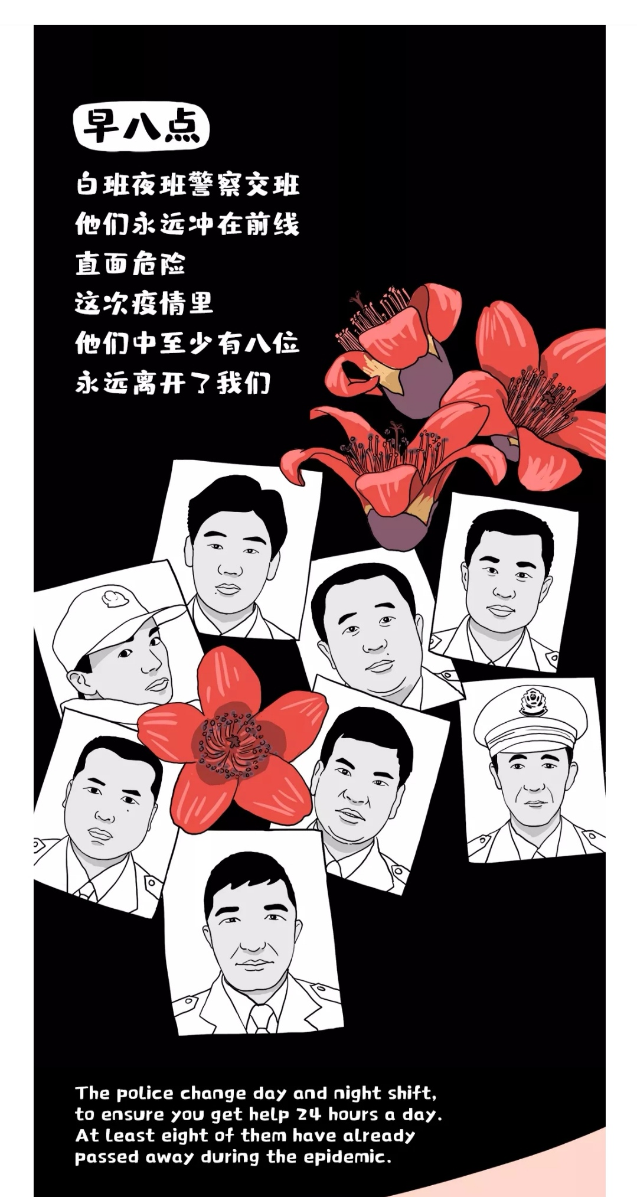
Moral behavior in the face of COVID-19

Slide 26
Assignment for critical thinking
1. How do cultural factors affect people's behavior in
treating the old?
2. How to practice “ Filial piety is the most important of
all virtues. ” in your real life?

Slide 27
THANK YOU !

