Slide 1
College English Teaching

Slide 2
CONTENTS
01
Introduction
02
Demonstration

Slide 3
Contents of the Introduction
1.Teaching Context
2. Teaching
Objectives
A
B
C
D
3. Teaching Design
4. Course Features

Slide 4
PART ONE
Teaching context

Slide 5
About our university
About our students
About teaching materials
1. Teaching Context

Slide 6
1.1 About our university
Application-oriented
Media-dominated
Responsible to cultivate media talents for the society
Notes:
Our univer

Slide 7
1.2 About our students
Language profeciency:
used to exam-oriented education (good at doing exercises, not good at using English)
communication skills in speaking and writing should be taught
Various media-related majors
including Acting, Media and Communication, Visual Design,..
Gender: most of them are female

Slide 8
1.3 About teaching materials
Textbook | Unit 7: Women: Making a difference
Videos | 1) TED: Can we “have it all” 2) For women in pursuit of motherhood and a career 3) Anne Hathaway Speech 4) TV series: a speech to fight against Feminism from Mrs. America 5) Speech: Emma Watson “He for she”
Readings | 1) This 1995 “Good House Wife’s Guide” explains how wives should treat their husbands； 2) Not Just A Mum 3) Books (optional): women leadership
Other learning resources | 1) how to write a talk Pre-class tasks: (https://penandthepad.com/how-5801612-write-t alk-show-script.html) 2) collocations that might be useful for the talk show: https://linggle.com 3) Reading: http://mrw.so/4YdSBS (Cambridge University Press Textbooks)
Notes:
make a difference and tell china's story to the world

Slide 9
1.3 About teaching materials
Textbook | Unit 7: Women; Making a difference
Videos | 1) TED: Can we “have it all” 2) For women in pursuit of motherhood and a career 3) Anne Hathaway Speech 4) TV series: a speech to fight against Feminism from Mrs. America 5) Speech: Emma Watson “He for she”
Readings | 1) This 1995 “Good House Wife’s Guide” explains how wives should treat their husbands； 2) Not Just A Mum 3) Books (optional): women leadership
Other learning resources | 1) how to write a talk Pre-class tasks: (https://penandthepad.com/how-5801612-write-t alk-show-script.html) 2) collocations that might be useful for the talk show: https://linggle.com 3) Reading: http://mrw.so/4YdSBS (Cambridge University Press Textbooks)
Both reading materials and videos are provided to meet the needs of different learning styles

Slide 10
1.3 About teaching materials
Textbook | Unit 7: Women; Making a difference
Videos | 1) TED: Can we “have it all” 2) For women in pursuit of motherhood and a career 3) Anne Hathaway Speech 4) TV series: a speech to fight against Feminism from Mrs. America 5) Speech: Emma Watson “He for she”
Readings | 1) This 1995 “Good House Wife’s Guide” explains how wives should treat their husbands； 2) Not Just A Mum 3) Books (optional): women leadership
Other learning resources | 1) how to write a talk Pre-class tasks: (https://penandthepad.com/how-5801612-write-t alk-show-script.html) 2) collocations that might be useful for the talk show: https://linggle.com 3) Reading: http://mrw.so/4YdSBS (Cambridge University Press Textbooks)
Opinions of proponents and opponents of feminism are provided to form a more comprehensive and informative picture of the issue.

Slide 11
1.3 About teaching materials
Textbook | Unit 7: Women; Making a difference
Videos | 1) TED: Can we “have it all” 2) For women in pursuit of motherhood and a career 3) Anne Hathaway Speech 4) TV series: a speech to fight against Feminism from Mrs. America 5) Speech: Emma Watson “He for she”
Readings | 1) This 1995 “Good House Wife’s Guide” explains how wives should treat their husbands； 2) Not Just A Mum 3) Books (optional): women leadership
Other learning resources | 1) how to write a talk Pre-class tasks: (https://penandthepad.com/how-5801612-write-t alk-show-script.html) 2) collocations that might be useful for the talk show: https://linggle.com 3) Reading: http://mrw.so/4YdSBS (Cambridge University Press Textbooks)
Other learning resources are also provided to enhance Ss self learning skills

Slide 12
PART TWO
2. Teaching objectives

Slide 13
2. Teaching objectives
Unit project:
working on a talk show: a host, a few managers, both male and female answer questions about management styles
learn about related vocabulary and sentence structures
figure out questions about management styles
express their opinions about management styles clearly
Teaching difficulty:
students generate meaningful questions from the materials they have researched
Notes:
Teaching focus:
combining course content with educating?

Slide 14
PART THREE
3. Teaching design

Slide 15
3. Teaching design-
a communicative teaching method
to create a natural context and provide a reason for students to learn;
Engage
Study
Activate
context and task setting: unit project
pre-class tasks: Readings; Videos; Learning resources; Research
to motivate Ss to 'discover' knowledge
Notes:
students learn the necessary knowledge and skills to fulfil the task via
At the very beginning, we engage students by setting tasks, which is the unit project i mentioned before. Then, Ss will study the necessary knowledge and skills to fulfil the task. At last, student need to apply the knowledge to complete the task.

Slide 16
3. Teaching design-
a communicative teaching method
to create a sense of achievement and develop Ss learning ability;
to improve Ss collaboration and conversation skills
Engage
Study
Activate
context and task setting: unit project
pre-class tasks: Readings; Videos; Learning resources; Research
language and skills focus: via scaffolding and group discussion
controlled and freer practice
T constantly checks students' understanding via CCQs
to master knolwedge step by step, focus on accuracy
to make sure Ss are ready for the task
Notes:
students learn the necessary knowledge and skills to fulfil the task via
At the very beginning, we engage students by setting tasks, which is the unit project i mentioned before. Then, Ss will study the necessary knowledge and skills to fulfil the task. At last, student need to apply the knowledge to complete the task.

Slide 17
3. Teaching design-
a communicative teaching method
to develop Ss perspective;
to check Ss understanding;
to let Ss apply the knowlwdge
Engage
Study
Activate
context and task setting: unit project
pre-class tasks: Readings; Videos; Learning resources; Research
language and skills focus: via scaffolding and group discussion
controlled and freer practice
T constantly checks students' understanding via CCQs
critical thinking discussion
apply the knolwedge to complete the task, including written script and presentation
post-class consolidation
to activate students' ideas and knowledge in a new context;
focus on fluency and communication
Notes:
students learn the necessary knowledge and skills to fulfil the task via
At the very beginning, we engage students by setting tasks, which is the unit project i mentioned before. Then, Ss will study the necessary knowledge and skills to fulfil the task. At last, student need to apply the knowledge to complete the task.

Slide 18
Assessment
Formative Assessment
Self-assessment
Peer-assessment
Teacher-assessment
Summative Assessment

Slide 19
A. Written Script (Teacher Assessment) - 60%
Area of Assessment | Description | Score
Content, Research & Analysis(40%) | 1) Includes sufficient information in the script. For example, there are specific examples and anecdotes. (0-10)
 | 2) Presents information accurately with clear citation and reliable sources. (0-10)
 | 3) Raises original and innovative opinions, thoughts, and concerns regarding the issue discussed in the script. (0-10)
 | 4) Predicts possible questions from the audience and generates proper responses. (0-10)
Organization, Structure & Format(20%) | 1) Organizes the script in a clear way with acceptable formatting and arranges appropriate lines for each role. (0-10)
 | 2) Uses language coherently and accurately throughout the script. (0-10)
Comments:

Slide 20
B. In-Class Presentation (Peer Assessment) - 40%
Feature | Description | Score
1) Professionality(10%) | Each member in the group has a clear role and presents themselves accordingly. | 1 2 3 4 5
 | The contents introduced in the presentation are informative and engaging with accurate and reliable sources. | 1 2 3 4 5
2) Familiarity (20%) | Everyone in the group demonstrates profound understanding on the selected topic. | 1 2 3 4 5
 | Every member in the group is well-prepared in the way that they speak coherently and fluently. | 1 2 3 4 5
 | The group presents unique insights on the related issue(s). | 1 2 3 4 5
 | The group is able to respond to questions from the audience properly. | 1 2 3 4 5
3) Skill & Style(10%) | The presentation is interactive, innovative, and engaging. | 1 2 3 4 5
 | Every presenter in the group expresses themselves clearly and naturally. | 1 2 3 4 5
Total score: ____ / 40
Comments:

Slide 21
PART THREE
4. Course Features

Slide 22
4. Course Features
Advanced
Innovative
Challenging
Communicative teaching
Cultivating critical thinking and learning abilities
Combining online and offline teaching
Content: generating meaningful questions
In content-additional materials
In task-
talk show
Notes:
Ss cognitive development

Slide 23
Reference
1. 邓 忍. 高职教育英语教改的人文建构——基于知识、技能、文化和交际的反思[J]. 高等职业教育（天津职业大学学报），2015（3）：50-54.
2. Boston, Carol (2002). The concept of formative assessment. Practical Assessment, Research & Evaluation, 8(9).
3. Brown, H. D., & Abeywickrama, P. (2010). Language assessment: Principles and classroom practice. New York, U.S.: Pearson Longman.
4. Dörnyei, Z. (2013). Motivation in second language learning. In M. Celce-Murcia, D. M. Brinton, & M. A. Snow (Eds.), Teaching English as a second or foreign language (pp. 518-531). Boston, MA: Cengage Learning.
5. Harmer, J. (2015). The practice of English language teaching. UK: Pearson Education.
6. Hurley, S. R., & Tinajero, J. V. (Eds.). (2001). Literacy assessment of second language learners. Boston: Allyn & Bacon.
7. Larsen-Freeman, D., & Anderson, M. (2011). Techniques & principles in language teaching (3rd ed.). Oxford, UK: Oxford University Press.

Slide 24
CONTENTS
02
Demonstration

Slide 33
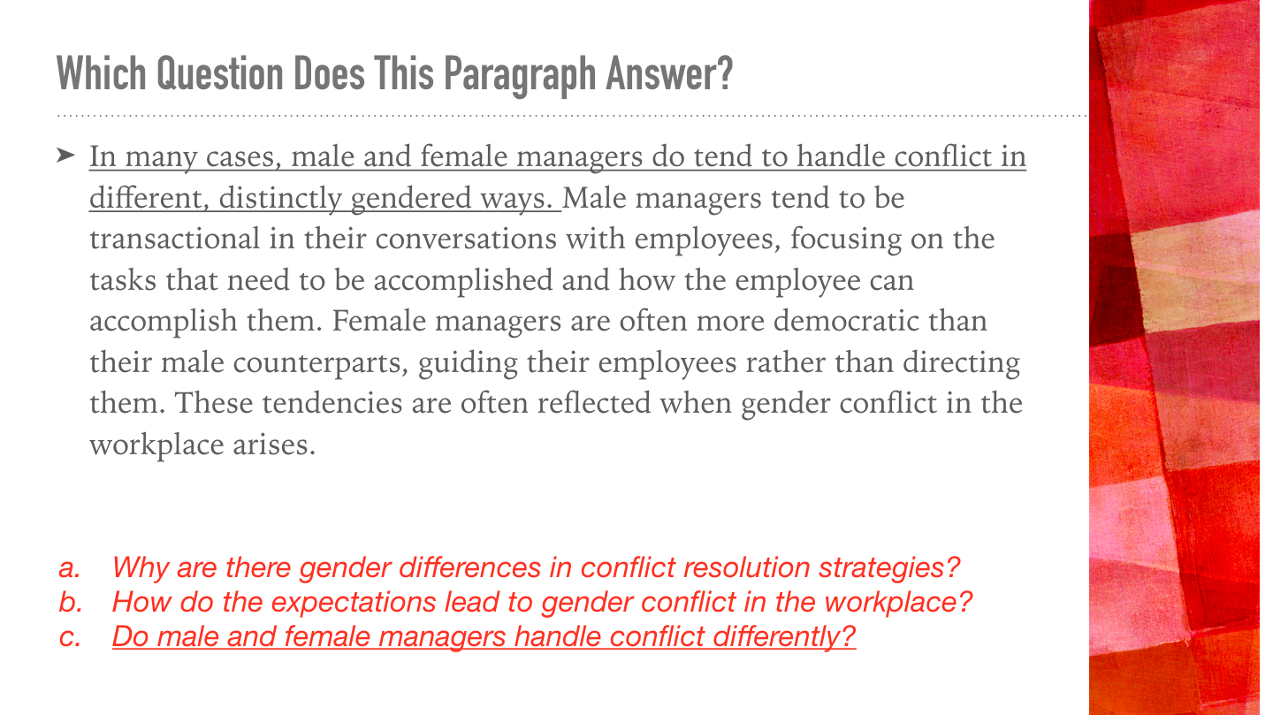

Slide 42
THANK YOU

