Slide 1
Headlines of 2020
FLTRP Teaching Contest

Slide 2
01
Learning context
02
Course design
Outline
03
Unit design
04
Demo class

Slide 3
01
Learning Context
Notes:
First, Learning context.

Slide 4
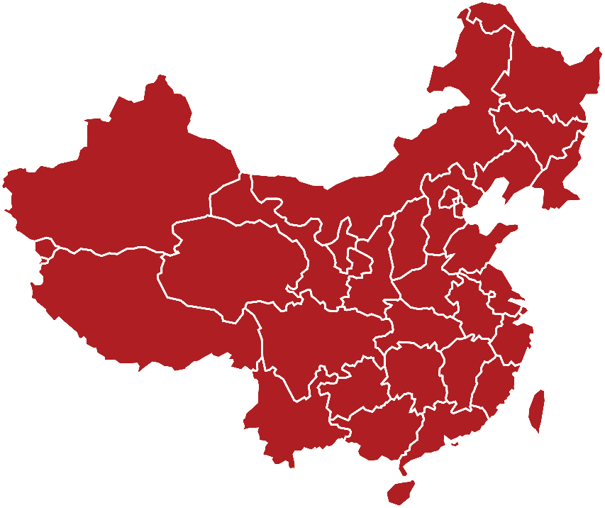
Our University and Students
Applied Research Foreign Studies University
Non-English majors
- in their first or second school year
- with lower English proficiency
Embracing
Diversity,
Pursuing
Excellence
(海纳百川，
学贯中外)
>70%
from west China

Slide 5
Educational Spirit of Our University
Responsibility
Openness
Practicality
Inclusiveness

Slide 6
02
Course Design

Slide 7
Course Design: Aims “1234”
2 Core Abilities
Comprehensive applied English ability;
Intercultural ability
1 Focus
Foster virtue
through education
4 professional
competencies
3 extended abilities
Comparison
Connection
Community
Communication
Creativity
Critical thinking
Teamwork

Slide 8
Product-Oriented Approach (文秋芳，2017）
4 Units
4 Projects (Macro-products）
Moral education through culture and practice (文化育人和实践育人)
Food, Glorious Food
Family Affairs
News 24/7
Arrivals and Departures
TV Program: Chinese food
Survey Report: Family values home and abroad
E-magazine:
Headlines of 2020, Voice of Students
Travel Brochure:
Red tourism sites

Slide 9
03
Unit Design

Slide 10
Unit Objectives
Project:
E-magazine:
Headlines of 2020,
Voice of Students
Language-related
objectives
Educational
objectives

Slide 11
Unit Objectives
Project:
Explaining the elements of newsworthiness
Assessing the newsworthiness of domestic and overseas news
Discussing different media perspectives and the influence of modern technology on media
Grasping the skill of using comparison and contrast to write editorials
E-magazine:
Headlines of 2020,
Voice of Students
Language-related
objectives
Educational
objectives

Slide 12
Unit Objectives
Project:
Explaining the elements of newsworthiness
Assessing the newsworthiness of domestic and overseas news
Discussing different media perspectives and the influence of modern technology on media
Grasping the skill of using comparison and contrast to write editorials
E-magazine:
Headlines of 2020,
Voice of Students
Language-related
objectives
Educational
objectives

Slide 13
Unit Objectives
Project:
1. Communication: negotiation of meaning
2. Creativity: E-magazine design
3. Critical thinking: compare and contrast
4. Teamwork: responsible and
constructive
5. International perspective &
cultural self-confidence: open and inclusive
E-magazine:
Headlines of 2020,
Voice of Students
Language-related
objectives
Educational
objectives

Slide 14
Unit Structure: flipped classroom
8*90mins. sessions
Online
Face-to-face
（before/after class）
（in class）
Motivating
Session 2 (MOOC)
Session 1 (project intro)
Enabling
Session 4 (peer review)
Session 3 (Text 1)
Enabling:
Micro-product
Session 5 (MOOC)
Session 6 (Text 2)
Session 7
(language study)
Session 8
(project presentation)
Assessing

Slide 15
Teacher-Student Collaborative Assessment （文秋芳，2017；孙曙光, 2020）
e.g. Three Rounds of Evaluating editorials
Genre: Compare and contrast
Cohesion and coherence
Grammar and mechanics
Implicit Moral Education(石坚，2019)
e.g.
Discussion etiquette (Open and inclusive )
Feedback (Responsible and realistic)

Slide 16
04
Demo Class

Slide 17
About the demo class (Task: choose the frontpage headline)
Assessing phase:
feedback
reflection
3
STEP
2
Enabling phase:
STEP
1
1. Analysis of criteria
2. Venn diagram
3. Presentation
STEP
Motivating phase:
identity

Slide 18
References
石坚. 润物细无声：课程-思政-育人(四川大学外国语学院讲座)[V/OL].(2019-07)[2020-05-02].https://v.qq.com/x/page/b3047jqj382.html?.
孙曙光.“产出导向法”中师生合作评价原则例析[J].外语教育研究前沿,2020,3(2):20-27.
文秋芳. "师生合作评价":"产出导向法"创设的新评价形式[J]. 外语界, 2016(5):37-43.
文秋芳. "产出导向法"的中国特色[J]. 现代外语, 2017, 40(3):348-358.

Slide 19
Text: making the headlines

Slide 20
Session 3
Unit 5 Active Reading 1 Making the Headlines
1
Lead-in
2
Text organization
3
Newsworthiness
4
Headlines of 2020 (task)
5
Writing assignment:
Editorial (Compare & Contrast)

Slide 21
Unit 5 Active Reading 1 Making the Headlines
Task
HEADLINES of
2020

Slide 22
Hi Phoebe, we have multiple news items for our E-magazine, can you help us select one as our frontpage headline?
Of course!

Slide 23
Editorial board of …..
China Daily ---People’s Republic of China
New York Times---The United States
BBC ---The United Kingdom
Headlines of 2020

Slide 24
China Daily
Assume you’re working for a specific news agency, and want to select a frontpage news story for the Headlines of 2020.
New York Times
BBC

Slide 25
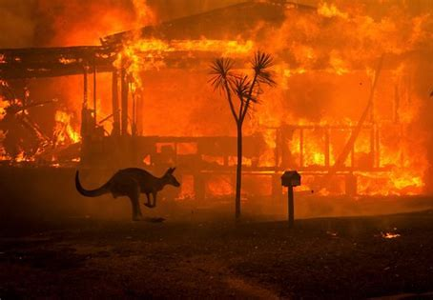
Headlines of 2020

Slide 26
Headlines of 2020
UK’s ‘Brexit’ From the EU (Jan.31th)
Wuhan reopens after 76-day lockdown (Apr. 7th)
Chinese blogger Li Ziqi’s followers on YouTube surpass 10 million (Apr. 27th)
Multiple vaccinations for covid-19 are in the clinical trial phase (July)
Australian Bushfire (Jan.)

Slide 27
Analysis
Venn diagram
Presentation
One
Two
Three

Slide 28
Step One Analysis Decide criteria of newsworthiness

Slide 29
Proximity
Historical & international significance
Conflict
Shock & horror
/Emotion
Human Interest
Newsworthiness
Newsworthiness
Relevance
Oddity/
unexpectedness
Celebrity
Immediacy
Impact
Textbook
Class Discussion

Slide 30
Step Two Venn diagram Choose the frontpage headline

Slide 31
a) Li Ziqi, a quarantine queen (Mar.)
b) Trump impeachment (Jan.)
Contrast
Contrast
Compare
a) Emotion: uplifting
b) Impact: relief
c) Relevance:
relatable
a) Emotion:
Anger + divisiveness
b) Impact: political
c) Relevance: ally
a) International
b) Celebrity

Slide 32
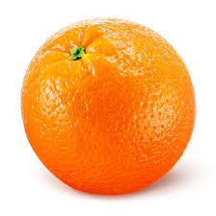
Transition words
Contrast
Compare
Contrast
Although
Different from
However
In contrast
Instead of
Less than
More than
Alike
As well as
Compared with
Either.. or
Likewise
Same as
Similar to
Similarly
While
Unless
As opposed to
On the contrary

Slide 33
Work in groups and draw the Venn diagram
UK’s ‘Brexit’ From the EU (Jan. 31th)
Wuhan reopens after 76-day lockdown (Apr. 7th)
Chinese blogger Li Ziqi’s followers on YouTube surpass 10 million (Apr. 27th)
Multiple vaccinations for covid-19 are in the clinical trial phase (July)
Australian Bushfire (Jan.)
Contrast
Compare
Contrast

Slide 34
Step Three Present your headline

Slide 35
Ladies and gentlemen, I am the editor-in-chief from .
Our news agency’s objective is to ____________________.
For newsworthiness, we choose as our criteria. (criteria of newsworthiness).
Between a) , and b) , we pick as our headline. The reasons are as follows: (Choose the frontpage headline).
Compare: __________________________________________________
Contrast:
a) ____________________; b)__________________________
Conclusion: __________________________.
Template: Present your headline

Slide 36
Presentation

Slide 37
Checklist
1. Did you explain how your media identity helped inform your criteria of newsworthiness?
2. Did your headlines include elements of newsworthiness in our textbook/discussion? Explain it.
3. Did you use specific supporting details in compare and contrast?
4. Did you use transition words to compare and contrast between ideas?
5. Did you listen to partners attentively or disagree politely?
Headlines of 2020

Slide 38
Homework
Watch the video on UNIPUS: Composing an editorial
Work with your group members and write the first draft of a compare and contrast editorial for your E-magazine
Headlines of 2020
E-magazine

Slide 39
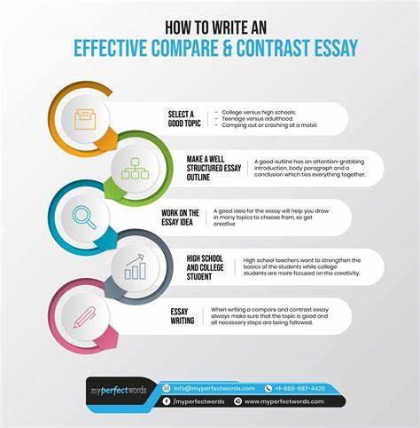
This assignment is due next Tuesday at 11:00 pm.
Please upload it to www.Pigai.org, where we will have a peer review.

Slide 40
Your participation is appreciated. Keep up the hard work.
Thank you!

