Slide 1

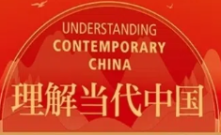
CONTENTS
Teaching Context
Demo Design
Demo Class
1
2
3

Slide 2
1
Teaching Context

Slide 3


1.1
Needs analysis
Project 985
University
Key comprehensive
8
CSE 6-7
7
Sophomore
Target students
Highly motivated
6
Understand
Contemporary China
5
Tell China’s stories
4
承担新时期外语教育的新使命（孙有中，2022）
China’s Standards of English Language Ability (2018)

Slide 4


1.2
Teaching Focus
Understanding Contemporary China

Slide 5

2.3
Teaching Methodology
Blended learning
POA approach
Motivating
Assessing
Enabling

Slide 6
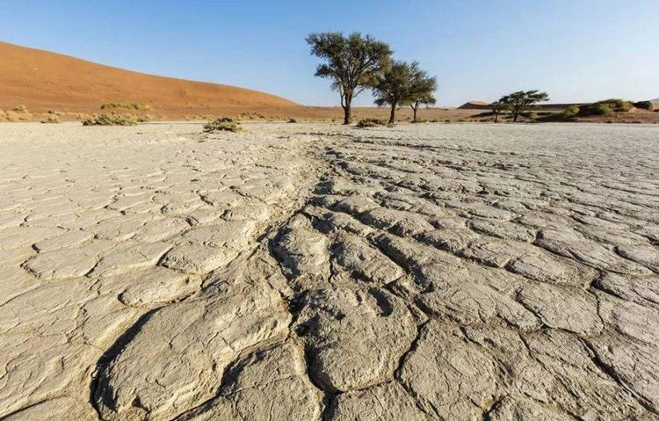

Unit Project
1.4
Scenario
A 5-min speech for an International Youth Forum：
China’s Green Development
Environmental problems
（P98 Activity 1）
China’s solutions
（P99-104 Activity 2）
Strategies to begin and end a speech（P105-108 activity 3+4 ）

Slide 7
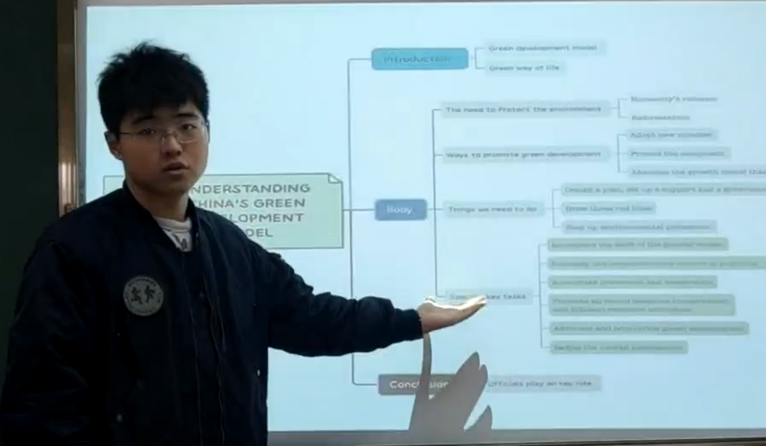
2.2
Why This Demo?
1.5
Unit Project: 5-min Speech about China’s Green Development
Task 2 Mind map China’s solutions (P99-102)
Tryout 初次产出
Diagnosis 诊断性前测
Gap:
Strategies to begin a speech
DEMO (P105-107 activity 3)

Slide 8
2
Demo Design

Slide 9

2.1
Motivating
DEMO
Unit 6 Live Green, Live Better
2-step speech openers to tell China’s stories of green development.
output
P105-107
2步开篇法讲述中国的环保故事

Slide 10
2.2
Teaching objectives
01
Knowledge
Exemplify China’s efforts in green development
Use strategies to begin a speech
02
Ability
Tell China’s stories of green development
03
Morality
绿水青山就是金山银山

Slide 11
2.3
Enabling
7 steps
Idea & Language & Structure
1. Unipus materials
Pre-class
2. Mind mapping
st
3. Bullet comments + Word cloud
4. Review
In-class
5. Lecturing + Drill
6. Game
CONTROL
7. Exploratory talk & Case study

Slide 12

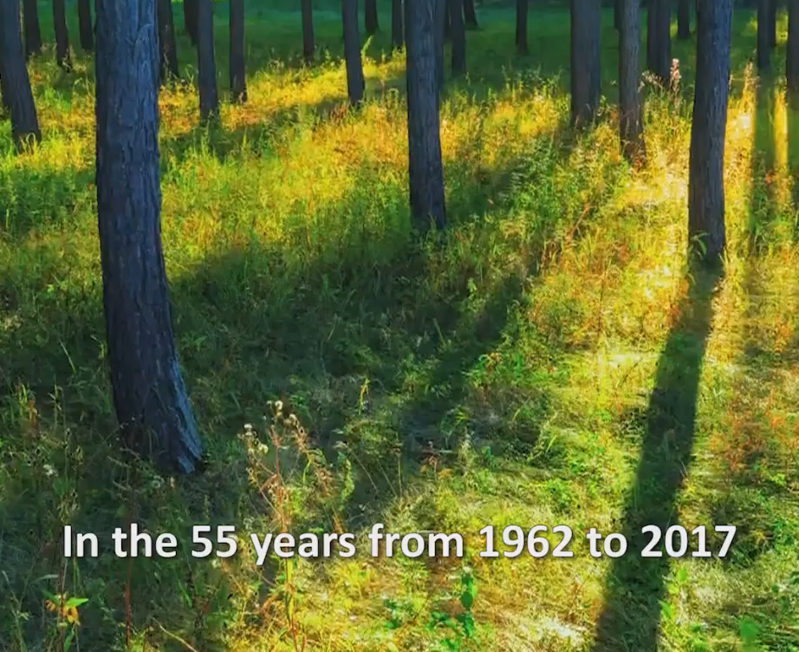
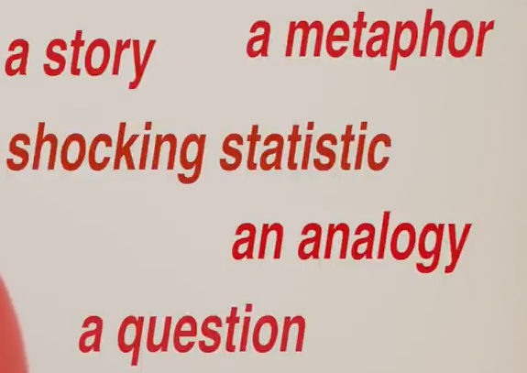
2.4
Enabling
Pre-class Input
Rich and authentic
Unipus materials
Enhance face-to-face class efficiency
CCTV
Video about Saihanba
塞罕坝精神
Micro-lecture about hooks
“演讲开篇”微课

Slide 13

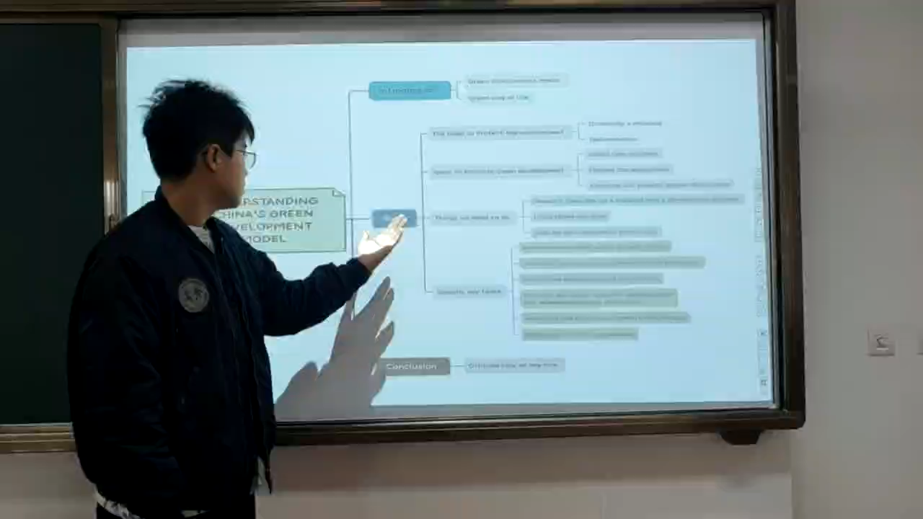
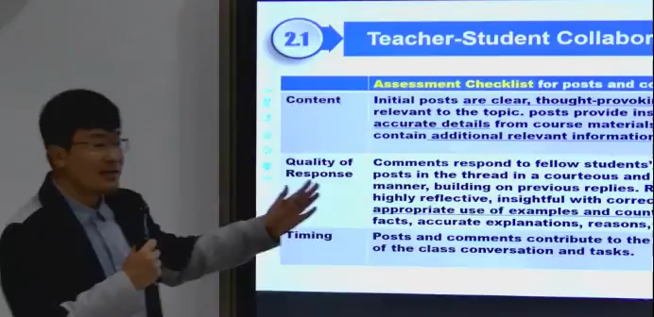
2.3
Enabling
Remedial Instruction
2. Mind mapping China’s solutions (P99-104）
Flip class
Student’s presentation
Teacher’s feedback

Slide 14
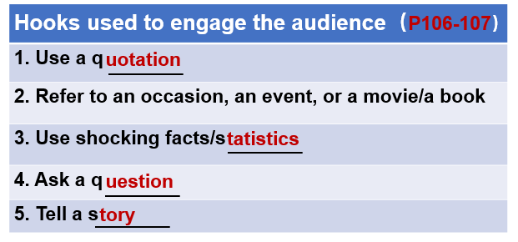
2.3
Structure
Enabling
5 types of hooks
3. Review of micro-lecture
Consolidate understanding

Slide 15
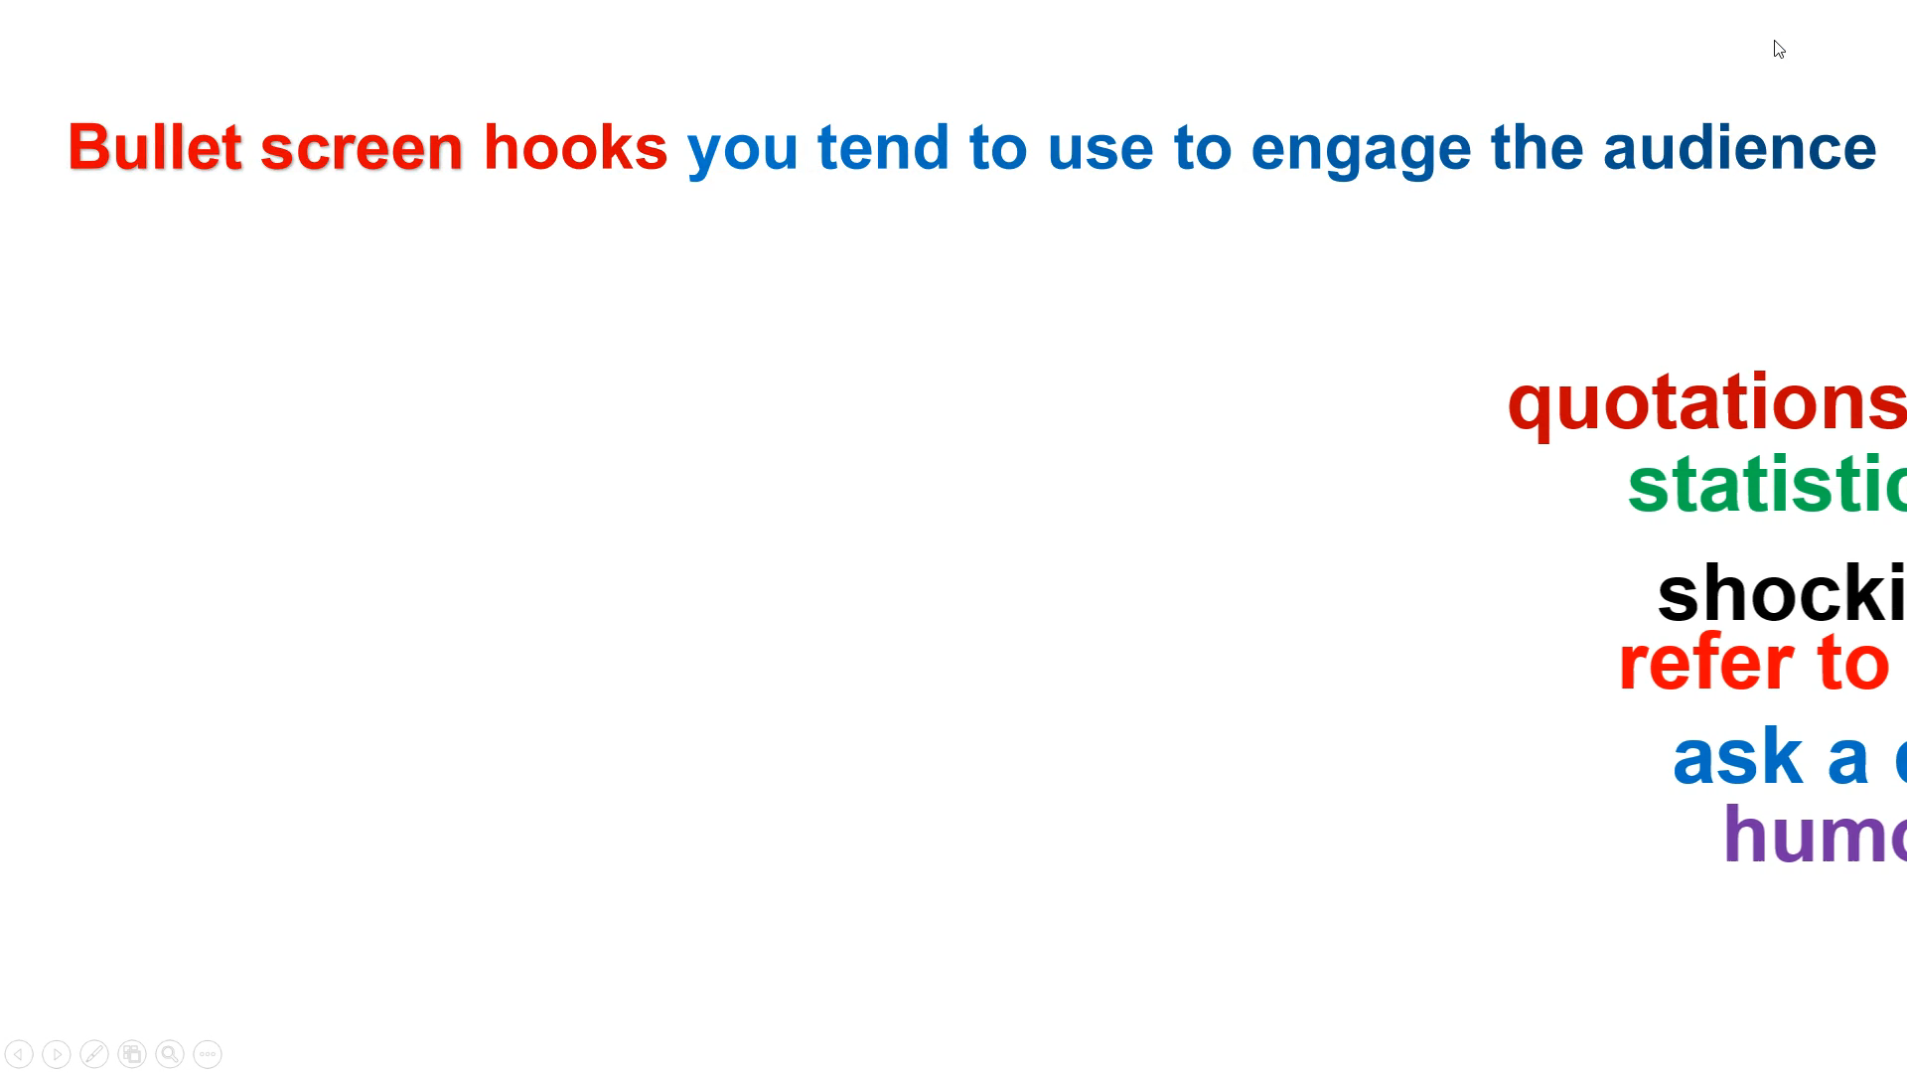
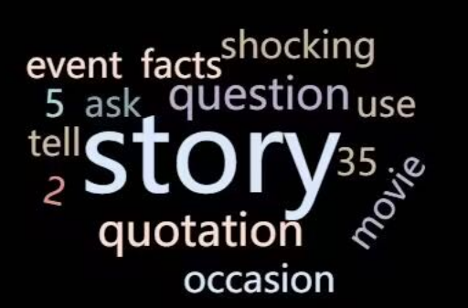
2.3
Enabling
Structure
Students’ preference for hooks
4. Bullet comments & Word cloud
Engage more students
弹幕
词云

Slide 16
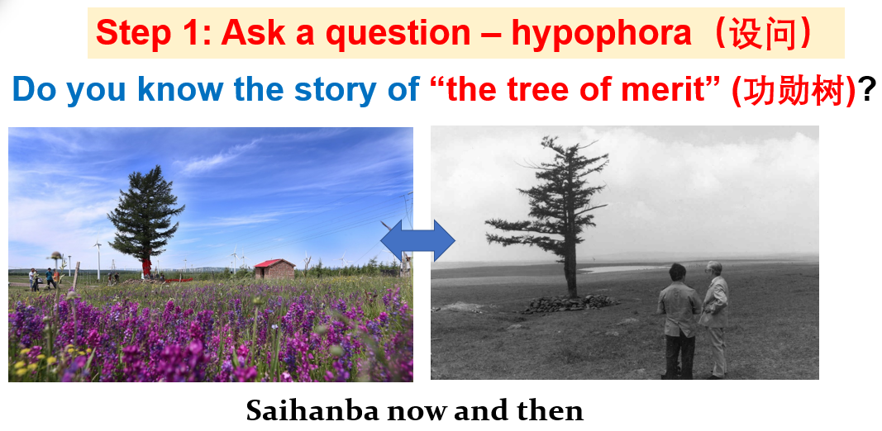

2.3
Enabling
Structure& Language
Hooks &Transition to thesis
5. Lecturing & Drill of 2-step
speech openers
Scaffolding

Slide 17
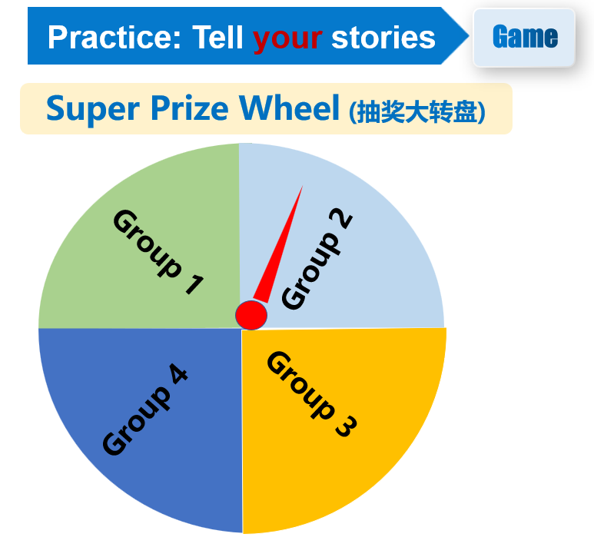
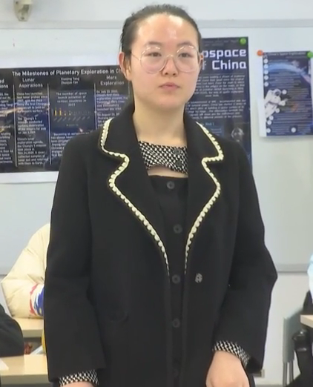
2.3
Enabling
Idea & Language & Structure
6. Game of telling your own stories
Guarantee effective output

Slide 18
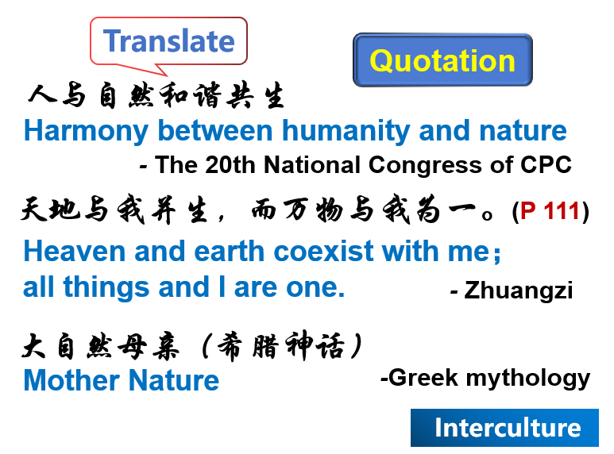
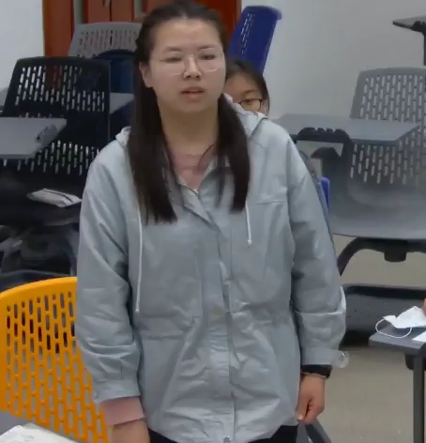
2.3
Enabling
Morality
Tell China’s stories
7. Exploratory talk & Case study
Call for action

Slide 19
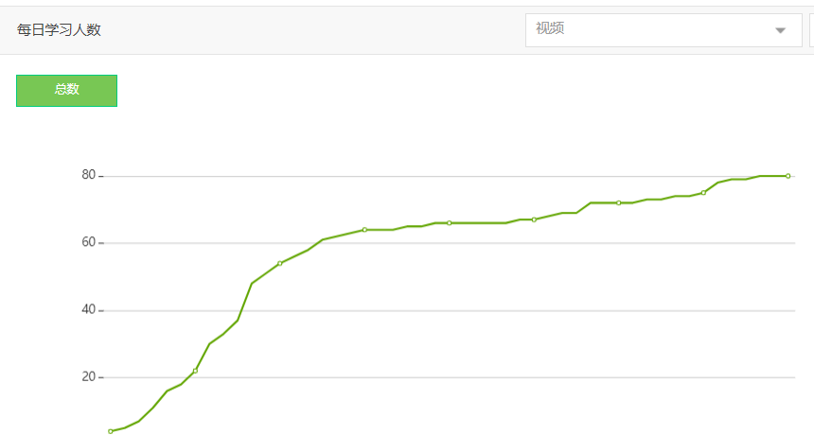



2.4
Assessment
2.
Students’ online data
As diagnostic assessment
Micro-lecture about hooks
TSCA for mind mapping

Slide 20
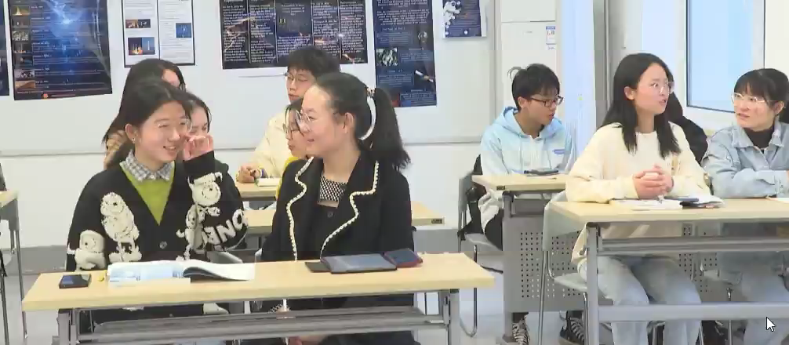
2.4
Assessment
TSCA
2. Detailed checklist
Make “assessment as learning”
TSCA for “telling your stories”
 | “Telling your stories” checklist | YES | NO
Step 1 | Is there a hook?
Step 2 | Is there a transition to thesis?

Slide 21
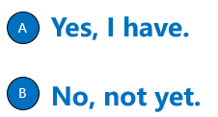

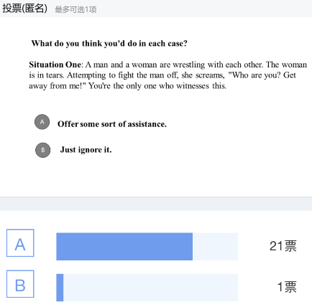
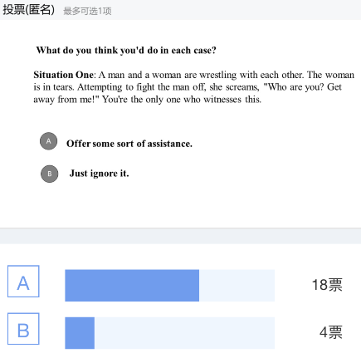
2.4
Assessment
Affective identification 情感认同
3. Opinion polls
As morality assessment
Lead-in poll
Post-assessment poll
Do you have confidence in China’s commitment to achieving carbon neutrality before 2060?
Have you seen any changes in the natural environment of your hometown?

Slide 22
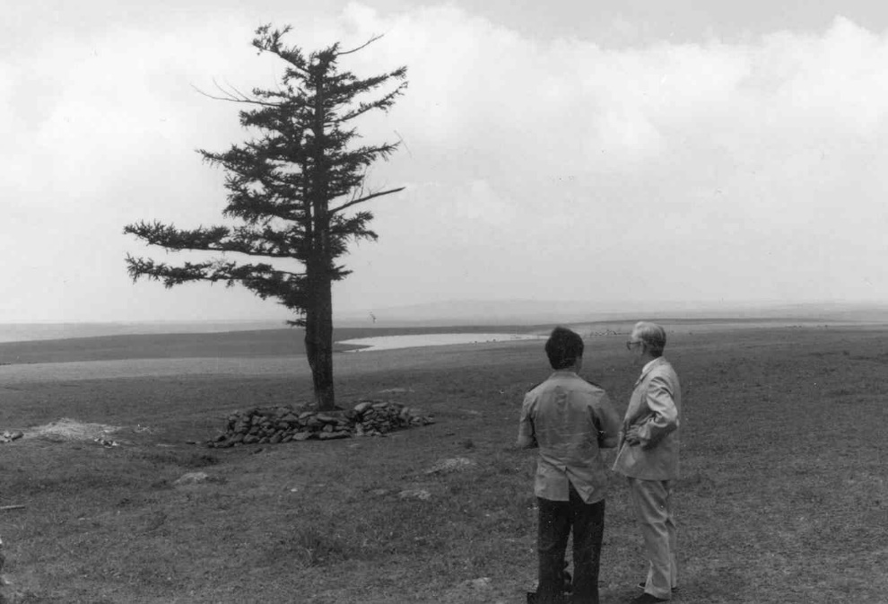
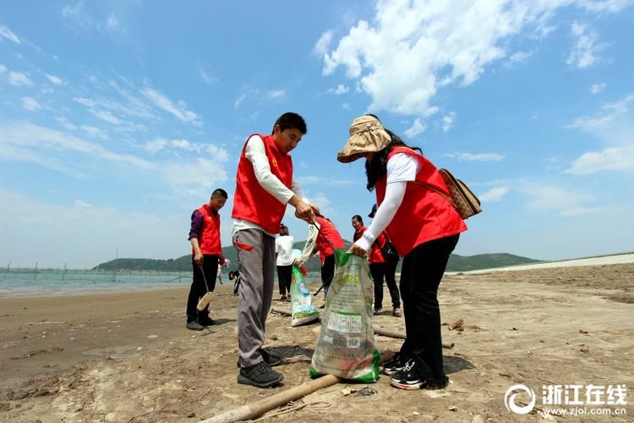

2.5
Highlights
Textbook design principle
1. Tell “3 stories”
Understanding contemporary China
理解当代中国
Devotion
Responsibility of a big country
Other’s stories
Students’ own stories
China’s stories
Saihanba
Build a community with a shared future for mankind

Slide 23
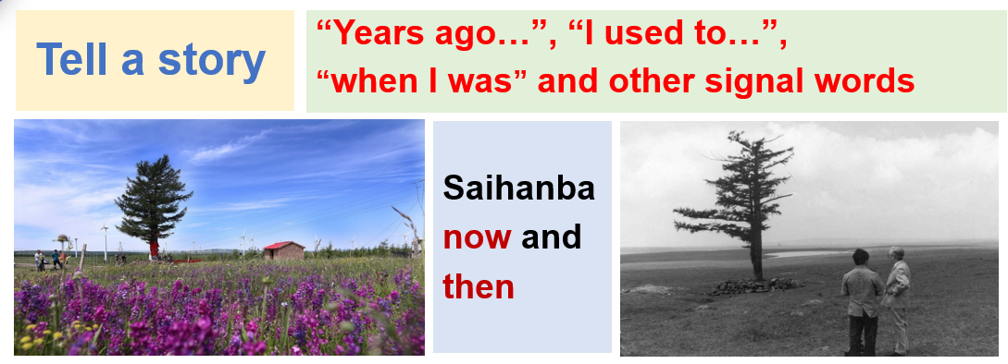

2.5
Highlights
Make China’s voice heard
融道于术
Textbook design principle
2. Integrate language teaching
with moral education
CLIL
(Content and Language Integrated Learning) 融合学习

Slide 24
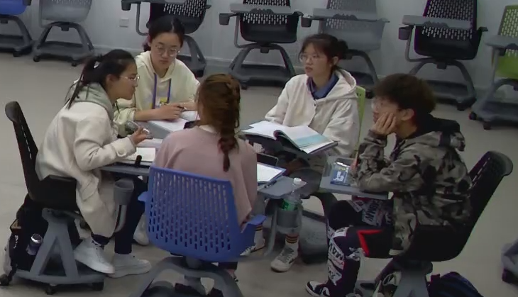
2.5
Highlights
批判思维 国际视野
Textbook design principle
3. Diversified activities facilitate
critical thinking and deep learning
Ability-oriented
能力导向
Review
Bullet screen
Game
Exploratory talk
Opinion polls

Slide 25
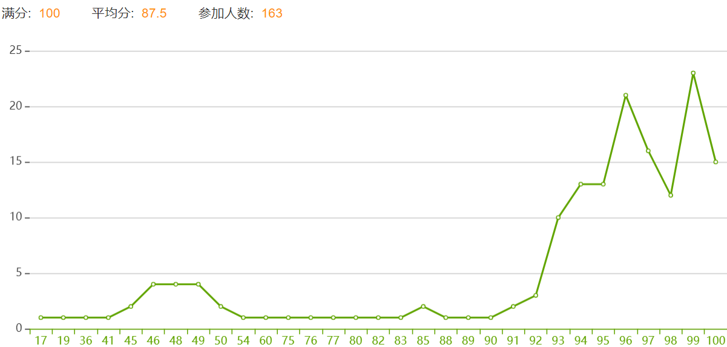
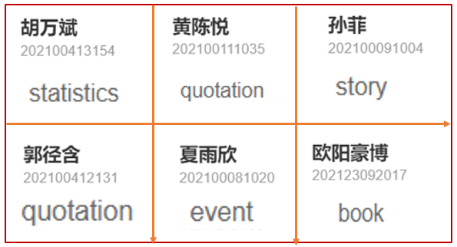
2.5
Highlights
“精准扶智”
4. Technology makes assessment objective, accurate & targeted
“Targeted education”
（Ministry of Education, 2021)
Online data
Face-to-face class data
Mind mapping
Bullet comments 弹幕数据

Slide 26

DEMO
2.6
Summary
Base on & Go beyond
Coursebook Basis
P105-107
Teachers “Use the Coursebook Creatively” (Tomlinson, 2015)
Levels + Needs + Interests
Authentic materials
Diversified activities
Aligned assessment
University
德才并重 为国育贤
Students
心怀“国之大者”
China
讲述当代中国故事
Bring the world to the classroom and the classroom to life!

Slide 27
Reference
1. 孙有中，金利民.《理解当代中国》（英语演讲教程），外语教学与研究，2022.
2. 文秋芳. 构建“产出导向法”理论体系 [J]. 外语教学与研究，2015,（4）：547-558.
3. 孙有中. 思辨英语教学原则 [J]. 外语教学与研究, 2019 (6): 825-837
4. Wiggins, Grant. (1998). Ensuring authentic performance. Chapter 2 in Educative Assessment: Designing Assessments to Inform and Improve Student Performance. San Francisco: Jossey-Bass, pp. 21 – 42.
5. Earl, Lorna. (2003). Assessment as Learning: Using Classroom Assessment to Maximize Student Learning. Thousand Oaks, CA: Corwin Press.
6. Krathwohl, D.R., Bloom, B.S., and Masia, B.B. (1964). Taxonomy of educational objectives: Handbook II: Affective domain. New York: David McKay Co.
7. Tomlinson, Brian (2015). Challenging teachers to use their coursebook creatively. In A. Maley& N. Peachey (Eds.), Creativity in the language classroom (PP. 24-28). London: British Council.
8. Tomlinson, Brian (2011). Material development in Language Teaching (2nd Ed.).Cambridge: Cambridge University Press.
9. Xi Jinping:The Governance of China

Slide 28
3
Demo Class
Notes:
.

Slide 29
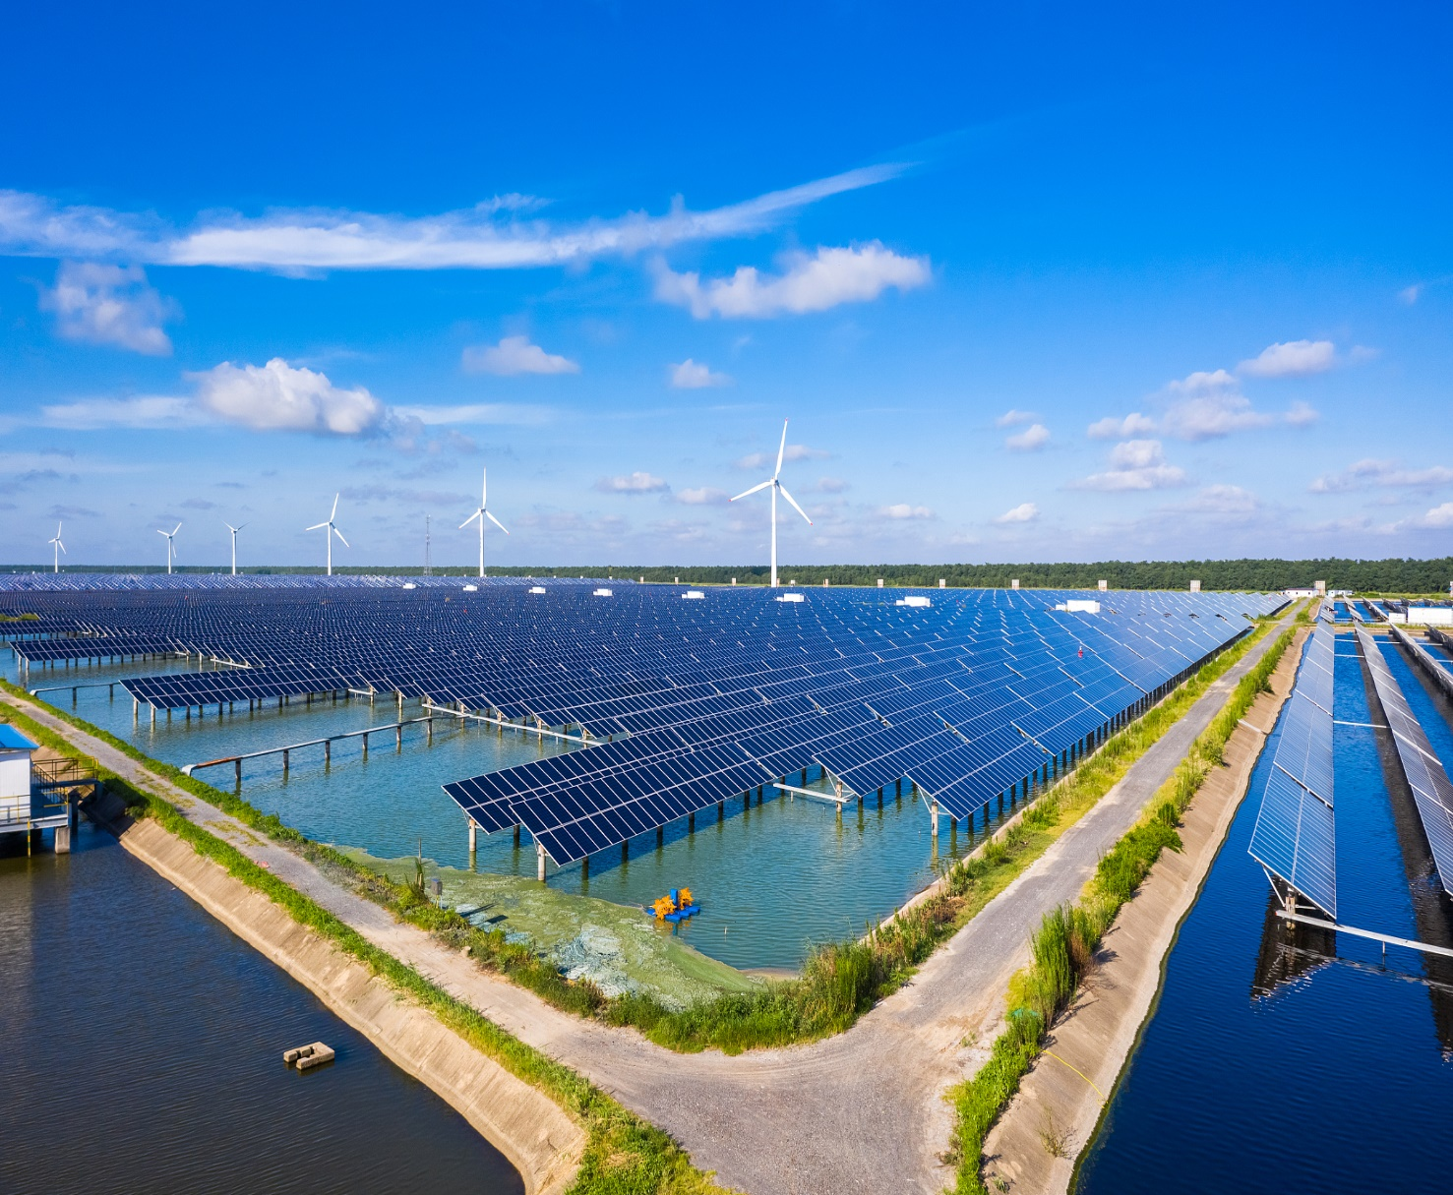
DEMO CLASS
Unit
6
Live Green,
Live Better.

Slide 30

A Public Speaking Course
Unit 6 Live Green, Live Better
DEMO
3rd Period
Tell China’s Stories of Green Development:
2-step Speech Openers（P105-107 Activity 3）

Slide 31

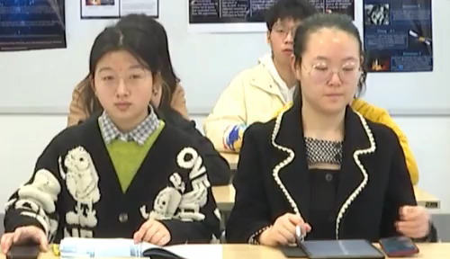

投票
最多可选1项
1.1
Lead-in Opinion Poll（P97）
Have you seen any changes in the natural environment of your hometown?
A
Yes, I have.
B
No, not yet.
提交

Slide 32
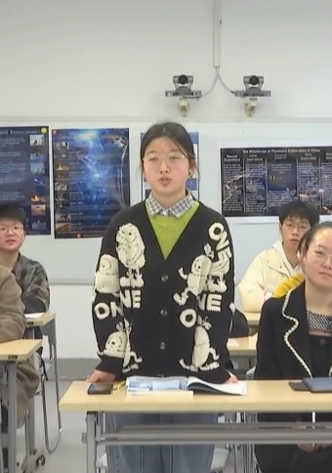

投票
最多可选1项
1.1
Lead-in Opinion Poll（P97）
Have you seen any changes in the natural environment of your hometown? Examples？
A
Yes, I have.
B
No, not yet.
查看

Slide 33
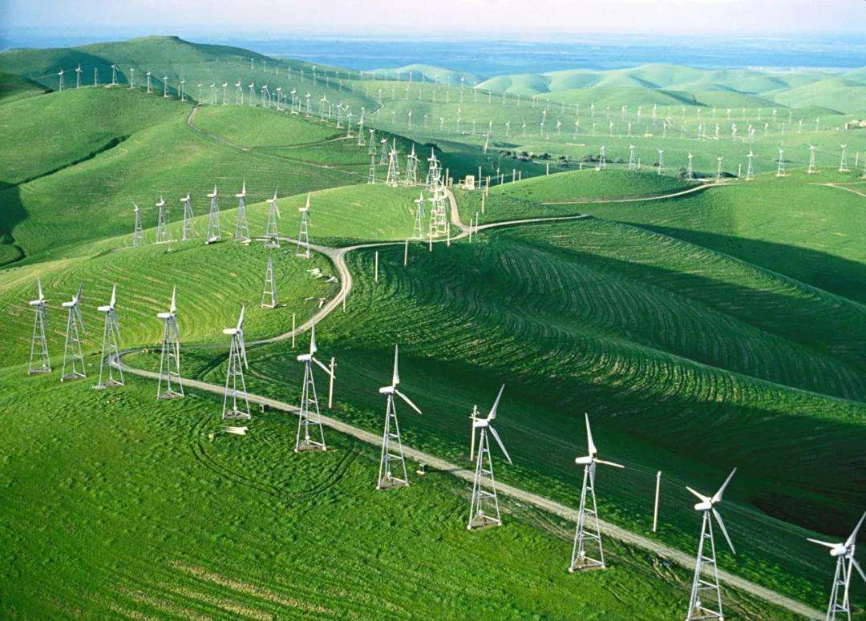

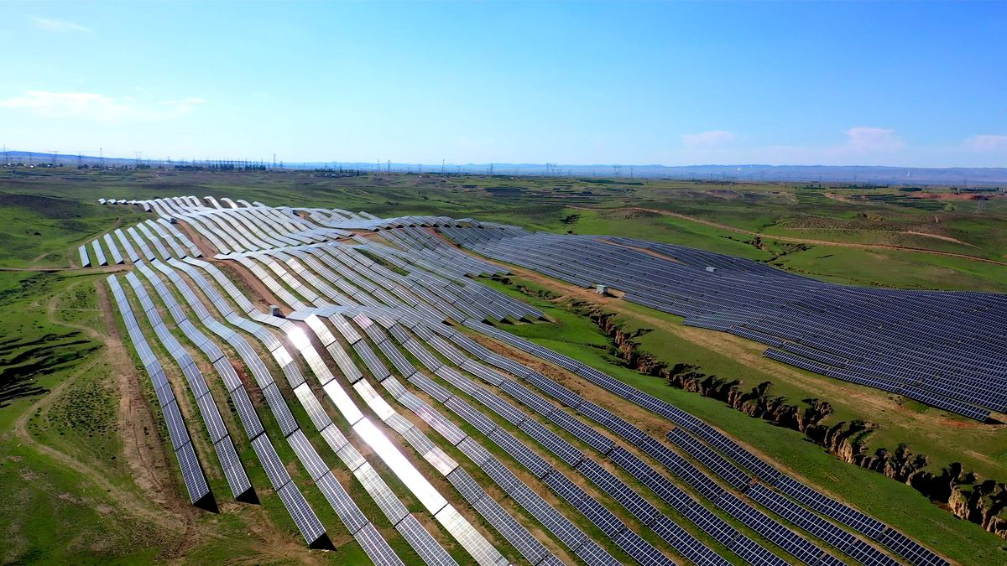
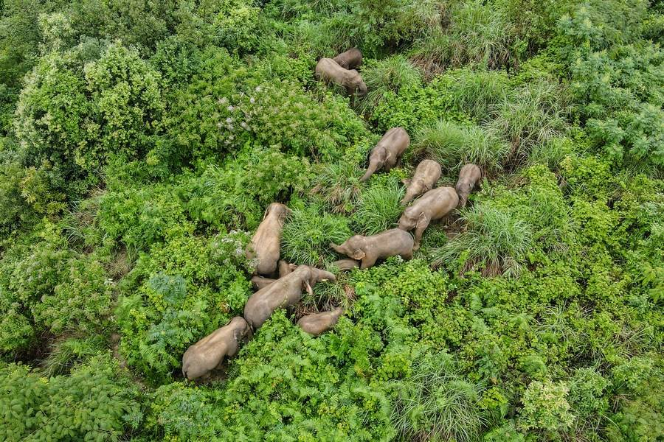
China’s Green Development

Slide 34

1.2
Pre-assessment
Blended Learning
TSCA
Online data of mind mapping
线上思维导图数据
Mind map China’s efforts in green development (P99-102)
线下思维导图展示
TSCA | Checklist for Mind Mapping | OK | NO
Content | Extensions of key ideas show a deep understanding of the content.
Form | Images and key words are clearly shown.
Idea √
Language ↑
Structure ↑
Strategies to start a speech

Slide 35
1.3
Learning Objectives
01
Knowledge
Exemplify China’s efforts in green development
Use effective techniques to begin a speech
02
Ability
03
Tell China’s stories of green development
Morality
绿水青山就是金山银山

Slide 36

1.4
Make China's Voice Heard
Output-driven
A 5-min Speech for an International Youth Forum：
China’s Green Development
Environmental Problems
（P98 Activity 1）
China’s Solutions
（P99-104 Activity 2）
Strategies to begin and end a speech
（P105-108 Activity 3+4）

Slide 37
2-step Speech Openers：Hook+Transition
to tell China’s stories of green development.
（P105-107 Activity 3）

Slide 38
2.1
Review: Micro Lecture
Blended Learning
Pre-class Input
Types of Hooks
Hooks used to engage the audience（P106-107）
1. Use a q
2. Refer to an occasion, an event, or a movie/a book
3. Use shocking facts/s
4. Ask a q
5. Tell a s
uotation
tatistics
uestion
tory

Slide 39
2.2
Bullet Screen (弹幕) - Hooks
Structure Enabling
结构促成
Bullet screen hooks you tend to use to engage the audience
story telling
quotations
statistics
shocking fact
refer to a movie
ask a question
humor

Slide 40
2.2
Word Cloud（词云）- Hooks
Structure Enabling
结构促成
Word cloud - hooks you tend to use to engage the audience

Slide 41
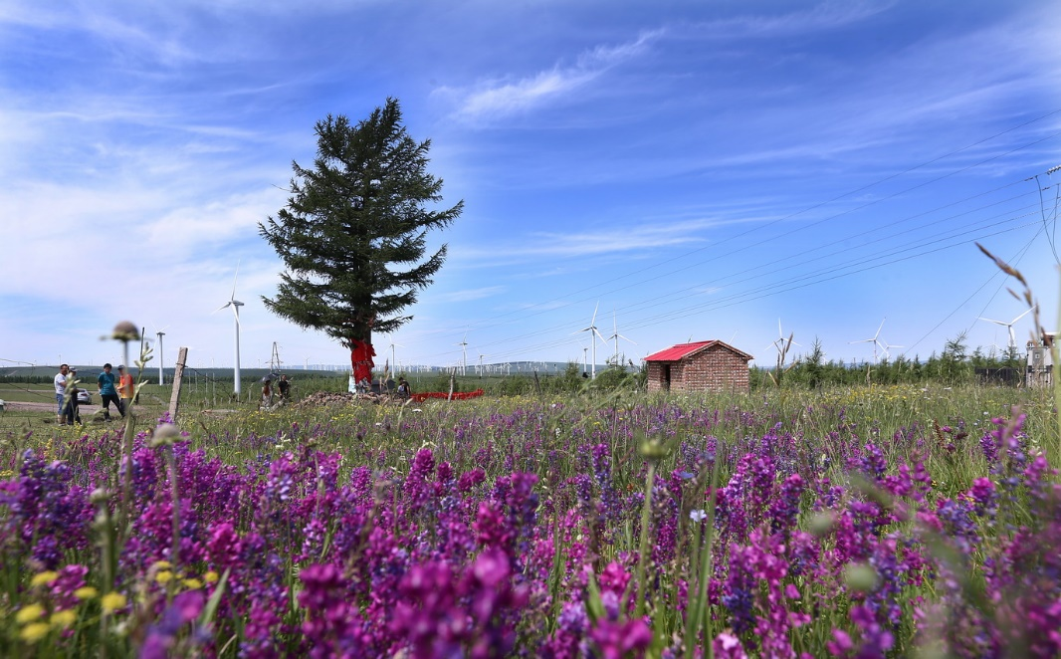

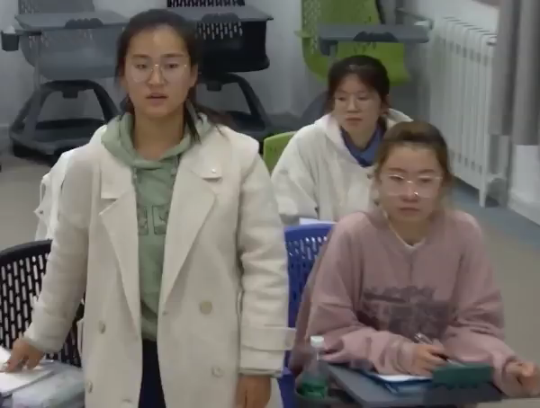

2.3
Step 1: Hook 1- Ask a Question
Idea & Structure Enabling 内容&结构促成
Hypophora（设问）
Saihanba now and then
Do you know the story of “the tree of merit” (功勋树)?

Slide 42
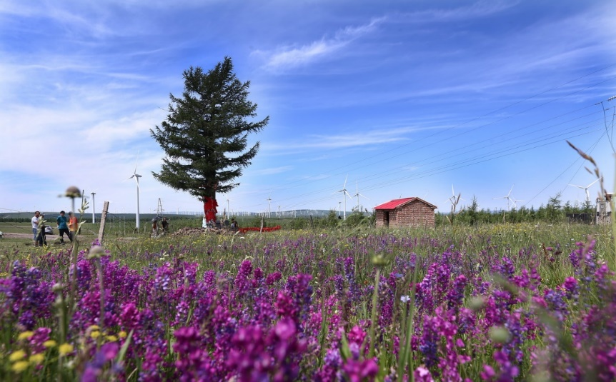

2.3
Step 1: Hook 2 - Tell a Story
Language & Structure Enabling 语言&结构促成
Signal Words: years ago, I used to,
when I was, years past,...
Steps: beginning,
changing and ending
Saihanba now and then
Years ago I went to Saihanba, and saw “the tree of merit” . It was once the only tree in sight when forestry experts visited there in 1962. They were inspired and convinced that more trees could be planted there. Years past, Saihanba has been transformed from wasteland to woodland.

Slide 43
2.4
Step 2: Transition to Thesis
Language & Structure Enabling 语言&结构促成
Transition to your topic/thesis statement
Thesis statement
China's green development efforts are making a positive impact.
Effective Transitions:
1. You might be wondering what “the tree of merit” has to do with today’s speech.
2. I tell that story because Saihanba is the showcase of the transformation through the extraordinary efforts of three generations of Chinese people.
3. This story/ picture/number illustrates…
Notes:
Step 2 Transition. Transition plays an essential role in relating hook part to thesis statement，and getting audience’s atention back to your topic.
For instance， the thesis is that China's green development efforts are making a positive impact
Here are some cases of effective Transitions:
1. You might be wondering what “the tree of merit” has to do with today’s speech.
2. I tell that story because Saihanba is the showcase of the transformation through the extraordinary efforts of three generations of Chinese people.
3. This story/ picture/number illustrates…the theme of your speech~
in this case，we can natrually Transiti to the topic or 初心. (That's all about 2-step speech openers including a hook and a transition~

Slide 44
2.5
Practice: Tell Your Stories
Idea, Language & Structure Enabling
Game
Choose a word to tell a story about green development. (选词讲故事)
stars
sky
water
mountain
river
tree(s)
plastic bags
sandstorm
Instruction:
Everyone can choose one term to tell a story about green development.
Transit your story to thesis statement.
Share with your group.
Select ONE story according to the checklist.
Self-evaluation
Peer-evaluation
Is there a hook?
Is there a transition?

Slide 45
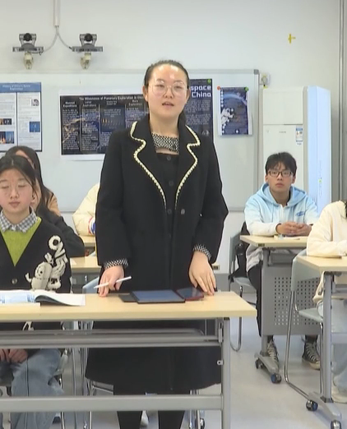
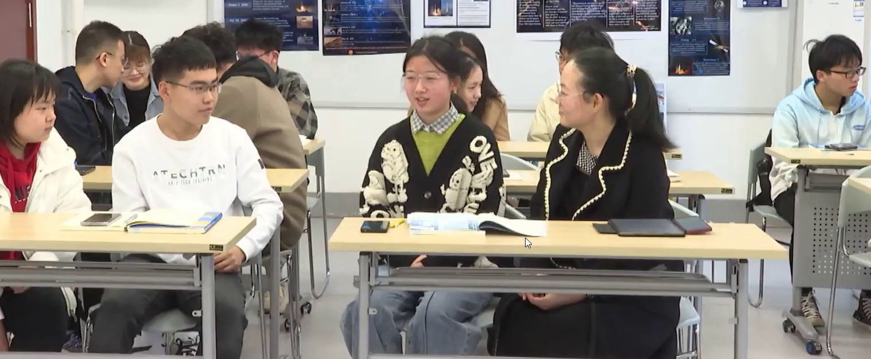
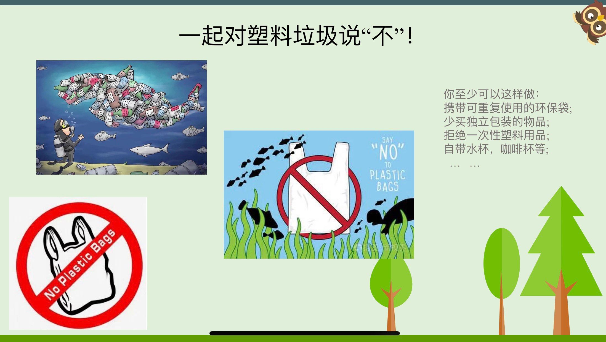

2.5
Practice: Tell Your Stories
TSCA
Game
Super Prize Wheel (抽奖大转盘)
Hook√
Transition√
Language√
Group 1
Group 2
Group 4
Group 3

Slide 46
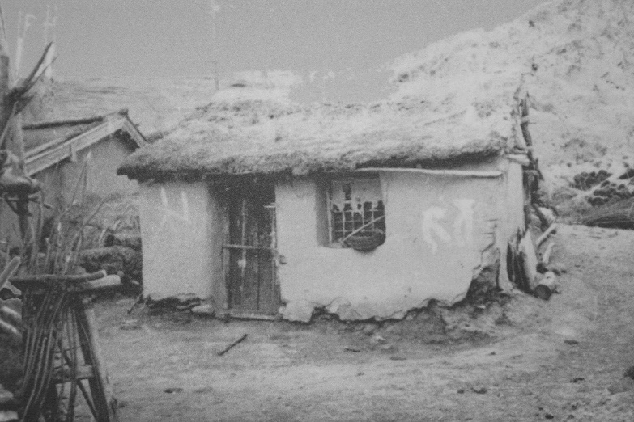
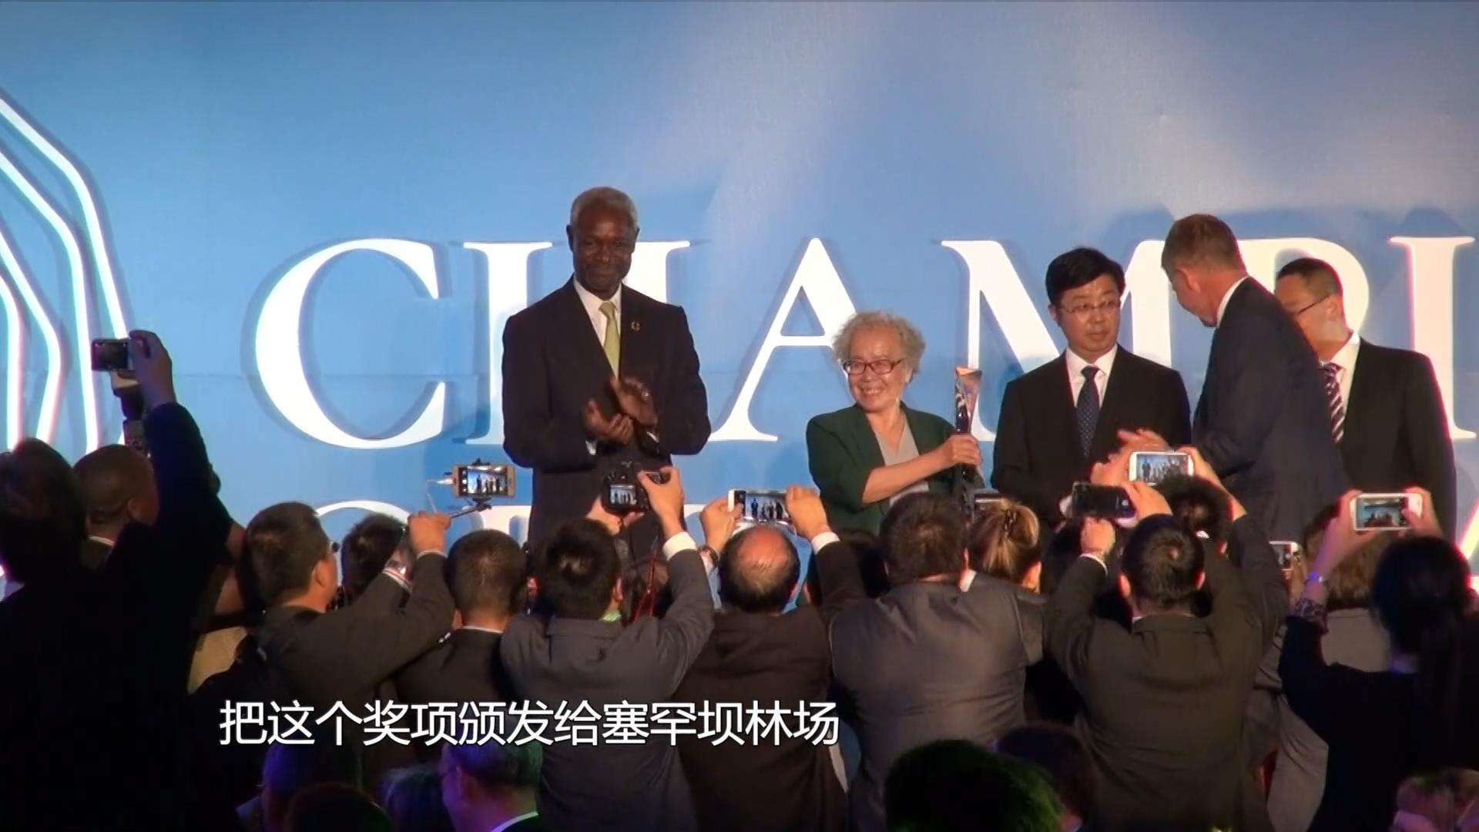
3.1
Inspiration- Tell China’s Stories
Morality Enabling
价值引领
Make China’s Voice Heard
Saihanba Spirit
塞罕坝精神
Refer to an event
Devotion and Struggling
奉献奋斗
From Generation to Greneration
薪火相传
Shelter foresters built in Saihanba in the 1960s
Saihanba received the highest environmental honor from the UN in 2017.
Saihanba spirit showcases China’s commitment to achieving carbon neutrality
Transition to Thesis
Mind Map China’s Solutions（P99-104 Activity 2）

Slide 47


3.2
Inspiration- Tell China’s Stories
Morality Enabling
价值引领
Make China’s voice heard
23%
Now of China is covered in forest.
35%
Since 2009， of China’s cabon
emission has been reduced.
Startling Statistics
Responsibility of a big country to build a community with a shared future
for mankind
Transition to Thesis

Slide 48

3.3
Inspiration- Tell China’s Stories
Idea, Language & Morality Enabling
Make China’s voice heard
Use quotations
Translate
1.人与自然和谐共生
Harmony between humanity and nature
- The 20th National Congress of CPC
2.天地与我并生，而万物与我为一。(P 111)
Heaven and earth coexist with me；all things and I are one.
- Zhuangzi
3.大自然母亲（希腊神话）
Mother Nature
-Greek mythology
Everyone should fulfil responsibilities to protect Mother Nature.
Transition to Thesis
Interculture

Slide 49
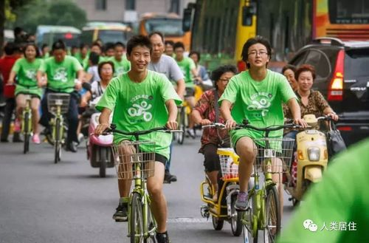
3.4
Call for Action
Morality Enabling
Protecting the environment is our duty!
保护环境，人人有责。
Green commuting
Reducing white pollution

Slide 50
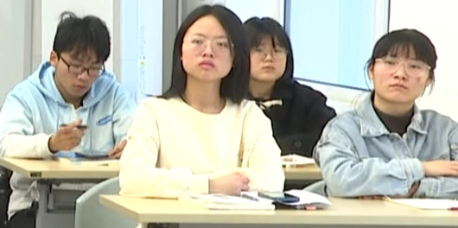
投票
最多可选1项
4.1
Post Assessment - Opinion Poll (后测)
Do you have confidence in China’s commitment to achieving carbon neutrality before 2060?
A
Yes，definitely.
B
I have doubts about it.
提交

Slide 51

投票
最多可选1项
4.2
Result of Opinion Poll
Morality Assessment
Do you have confidence in China’s commitment to achieving carbon neutrality before 2060?
Post-assessment Poll
Yes，definitely.
A
I have doubts about it.
B
提交

Slide 52
5
Summary
Exemplify China’s efforts in green development
01
Knowledge
Use effective techniques to start a speech
02
Ability
03
Tell China’s stories of green development
Morality
绿水青山就是金山银山

Slide 53
6
Make China's Voice Heard
Assignment
A 5-min Speech for an International Youth Forum：
China’s Green Development
Environmental Problems
（P98 Activity 1）
China’s Solutions
（P99-104 Activity 2）
Strategies to begin and end a speech
（P105-108 Activity 3+4）

Slide 54
6
Checklist for the Unit Project
Assessment
as Learning
TCSA | Assessment Checklist | OK | Need to work
1.Structure & Content | I have stated my central argument clearly.
 | I have used effective strategies to begin my speech.
 | I have used effective strategies to end my speech.
 | I have provided enough evidence to support my view.
2.Language | I have used proper language about green development.
 | I have used sentence patterns about proposing a solution.
3.Morality | I have demonstrated China’s green development model, measures, or achievements in my speech.
4.Delivery | I have tried to use better articulation and intonation to involve the audience.

Slide 55


