Slide 1
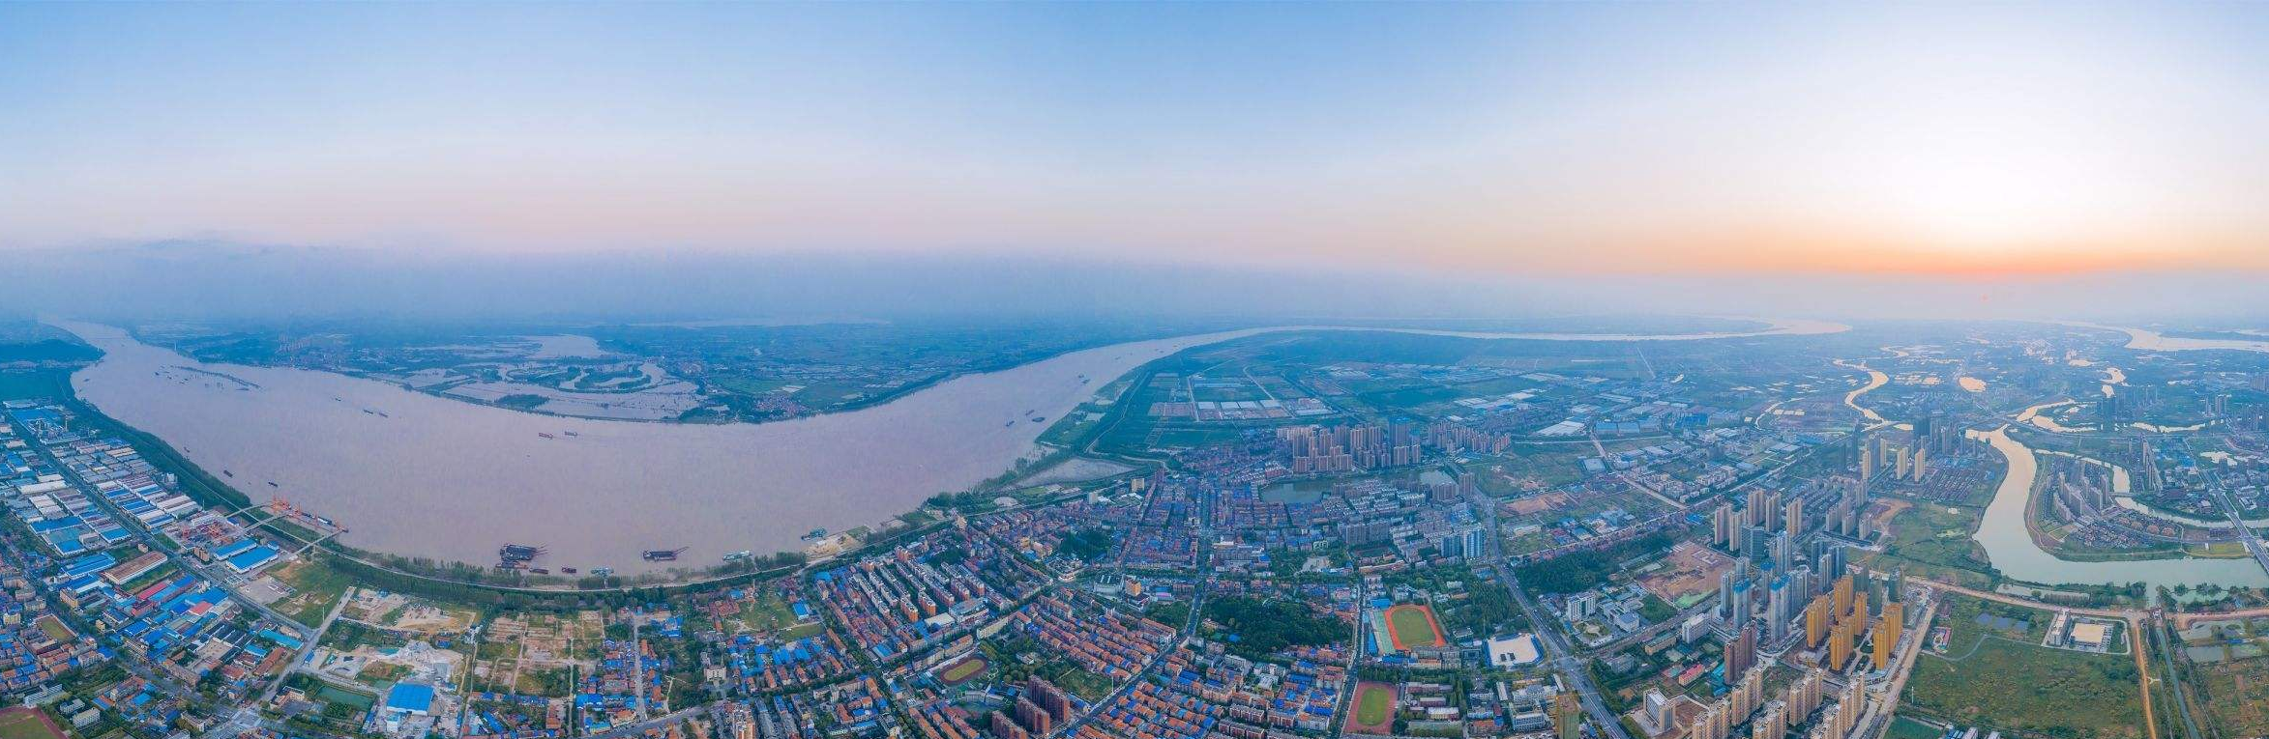
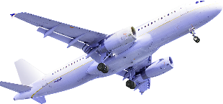
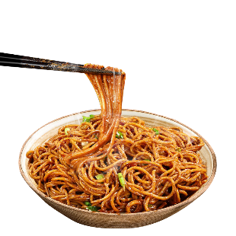
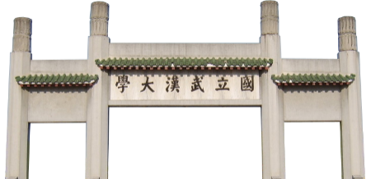
CHINA

Slide 2
CONTENTS
01
02
03
Teaching
Context
Teaching
Design
Teaching Material

Slide 3
1.2 Teaching Content
Unit 1 (Dis)connecting in the digital age
Unit 2 Word hard, work smart
Unit 3 Secrets of advertising
Unit 4 Impressions matter
Unit 5 Harmony in diversity
Unit 6 Bringing light to other

Slide 4
CONTENTS
01
02
03
Teaching
Context
Teaching
Design
Teaching Demo

Slide 5
2.1 Teaching Objectives
Language
Skill
Moral education
Expand topic-related words and expressions;
Design promotional videos with scientific methods；
Enhance patriotism and cultural confidence;
Master bridging sentences and various ways to express appreciation.
Use appropriate strategies to illustrate one’s points.
Promote equality, mutual learning, dialogue, and mutual accommodation between civilizations.

Slide 6
2.2 Teaching Methodology
Production-oriented Approach
Motivating
Enabling
Assessing

Slide 7
2.3 Teaching Procedure
Project
Create a promotional video for China tourism

Slide 8
2.3 Teaching Procedure
Unit 6 Impressions matter
Episode 1
(period 1-2)
Choose target audience and select content ideas
Episode 2
(period 3-4)
Outline the style and structure of your video
Text A
(period 5-6)
Analyze the text structure and writing skills
Evaluation and Extension
(period 7-8)
Evaluate the projects and offer some tips for revision
first draft
Demo class
illustrating strategies
second draft

Slide 9
2.4 Demo class
Importance & Necessity
Important to the
final production
Teacher’s
diagnostic analysis
To make the video more persuasive
1. listing numbers
2. listing examples
How to use your evidence effectively?

Slide 10
2.4 Objectives of demo class
Learn tips for using evidence to support ideas
Knowledge
Use evidence effectively by employing the tips learned in class
Skills
Enhance patriotism and cultural confidence
Promote equality, mutual learning, dialogue, and mutual accommodation between civilizations
Moral Education

Slide 11
2.4 Demo class
iPrepare
iPractice
iProduce
iPromote

Slide 12
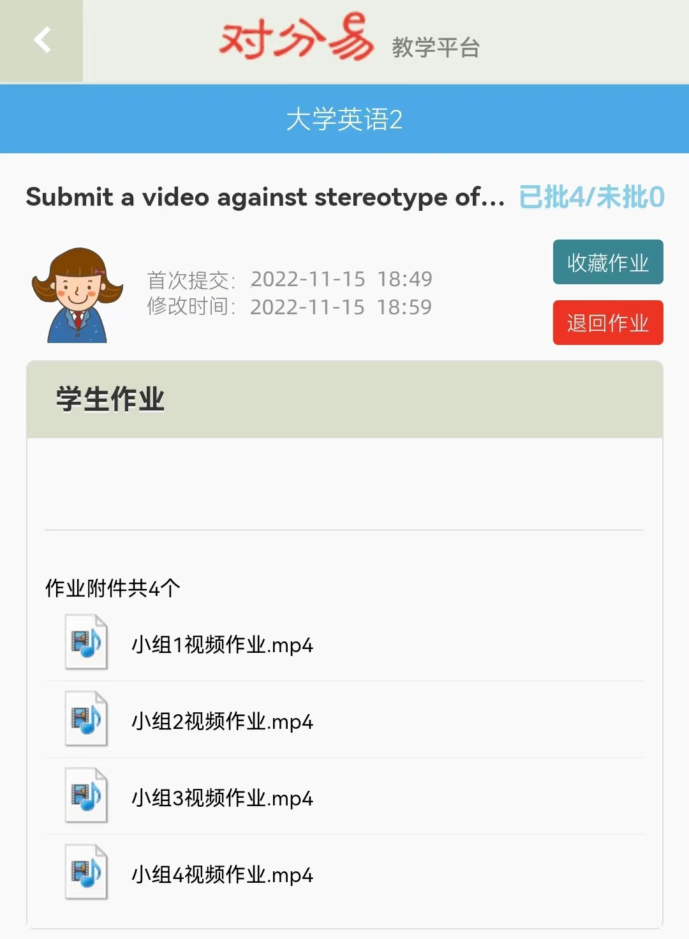
2.4 Demo class
iPrepare
iPractice
iProduce
iPromote
make quick comments on the projects
select two videos for further explanations

Slide 13
2.4 Demo class
iPrepare
iPractice
iProduce
iPromote
learn and apply
1 tip for
using statistics
2 tips for
using examples
make the video more persuasive

Slide 14
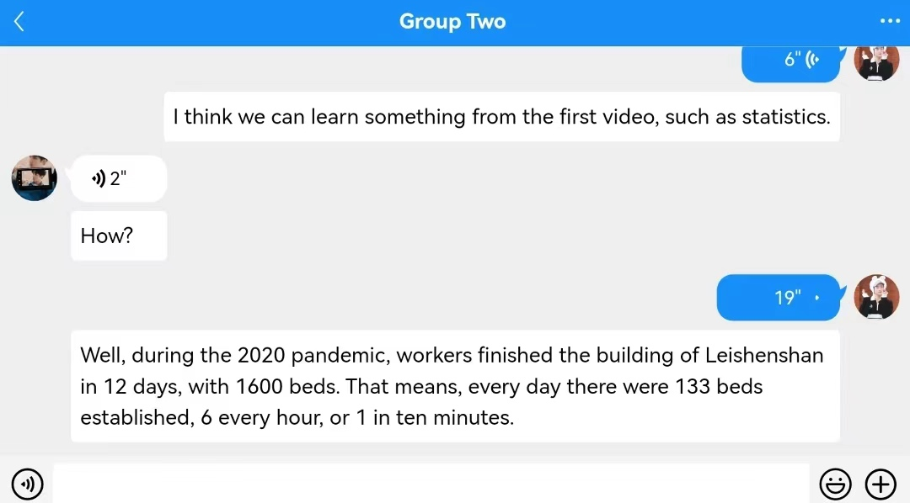
2.4 Demo class
iPrepare
iPractice
iProduce
iPromote
Group discussion

Slide 15
2.4 Demo class
iPrepare
iPractice
iProduce
iPromote
How to deal with stereotypes?

Slide 16
CONTENTS
01
02
03
Teaching
Context
Teaching
Design
Teaching Material

Slide 17
Mateirals Use
Selecting
调
Adapting
Output-oriented
Improve teaching efficiency
Supplementing

Slide 18
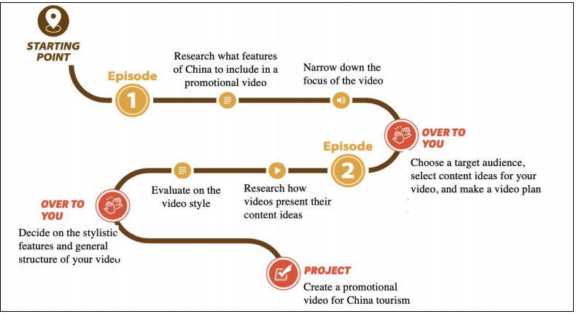
3.1 Selecting
P96
Provide a guiding framework for students to create videos

Slide 19
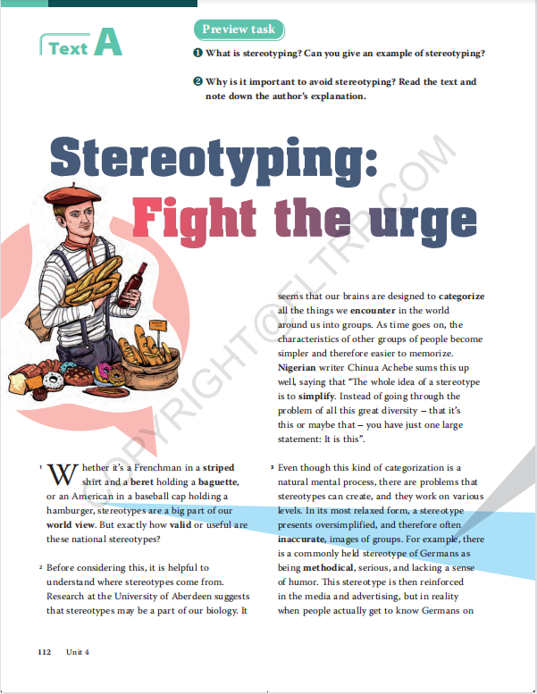
3.1 Selecting
P112
Provide students with three strategies to illustrate their points

Slide 20
3.2 Adapting
P96
a promotional video of Wuhan to refute some stereotypes about the city
China

Slide 21
3.3 Supplementing
Statistics: Explaining
Example: Extending
Example: Focusing
three tips for using evidence
various materials for better understanding of the tips

Slide 22
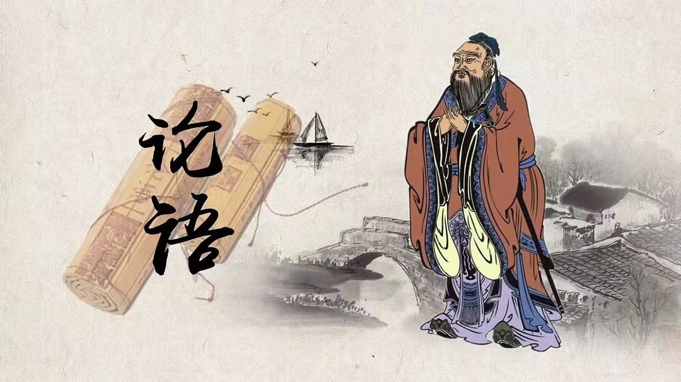
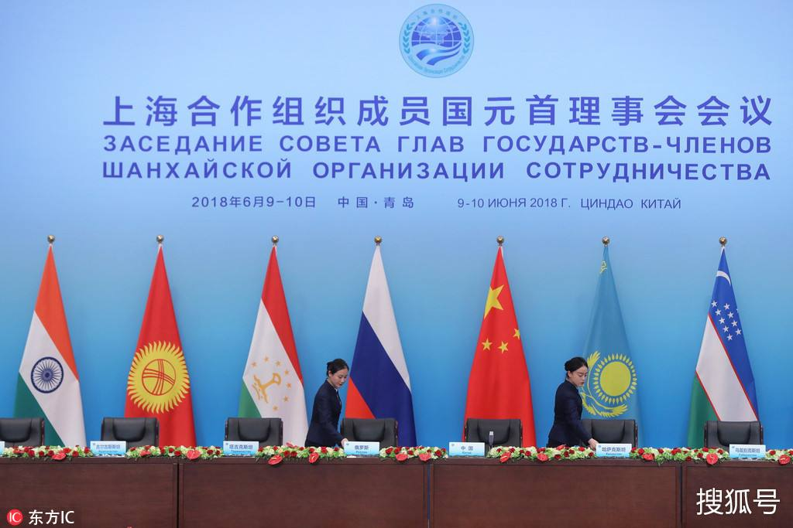
3.3 Supplementing
Confucius
President Xi

Slide 23
Conclusion
教材特色
多元能力发展观，融合外语教育与全人教育
《新未来大学英语》体现外语教学多元能力发展观，不仅关注学生语言能力的发展，而且致力于促进其思辨能力、跨文化能力、学习能力等多元能力的发展，实现通过语言实践活动融合多元能力培养、通过多元能力发展促进语言能力发展的双重目标。与此同时，本系列教材寓全人教育于外语教育之中，以润物细无声的方式实现外语思政教育目标。

Slide 24
Conclusion
Critical thinking ability
Cross-cultural competence
integration of foreign language teaching and whole person education
integration of foreign language teaching and whole person education
multi-competence
Learning ability
Communicative skills

Slide 25
Reference
1. 邱琳. 产出导向法促成活动设计[M]. 外语教学与研究出版社，2020.
2. 孙曙光. 产出导向法中师生合作评价[M]. 外语教学与研究出版社，2020.
3. 文秋芳. 构建“产出导向法”理论体系[J]. 外语教学与研究，2015(4): 547-558.
4. Stephen E. Lucas. 演讲的艺术[M]. 外语教学与研究出版社，2021.
5. 文秋芳. “产出导向法”教学教材使用与评价理论框架[J]. 中国外语教育，2017(2): 17-23.
6. 毕争. “产出导向法”教学材料的使用理念与实践[J]. 外语教育研究前沿，2018(3): 35-42.

Slide 26
CHINA

Slide 27
CONTENTS
01
02
03
04
iPrepare
iPractice
iProduce
iPromote

Slide 28
t
01
iPrepare

Slide 29
iPrepare
Pre-class Survey
What is your impression on Wuhan?
选项 | 小计 | 比例
The weather in Wuhan appears to be extremely hot / cold. | 131 | 87.3%
Wuhan is a “big village” with an unpleasant environment. | 118 | 78.7%
The average income of Wuhan is relatively low. | 115 | 76.7%
Wuhan is still a second-tier city and hasn’t made its place as a modern metropolis. | 106 | 70.1%
Wuhan owns convenient transportation system. | 142 | 94.7%
Wuhan residents are hot-tempered and somehow indifferent. | 97 | 64.7%

Slide 30
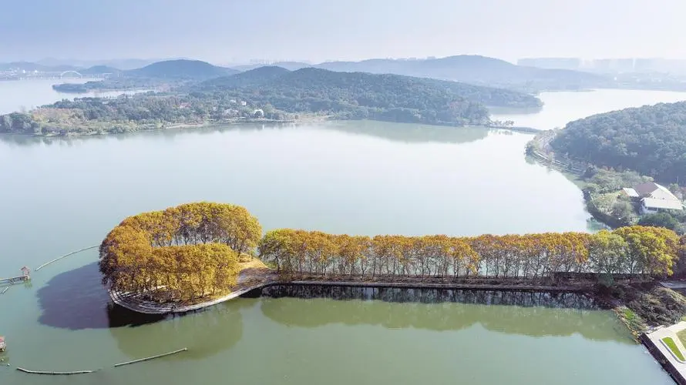
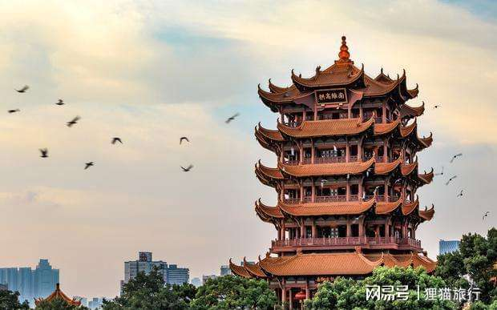
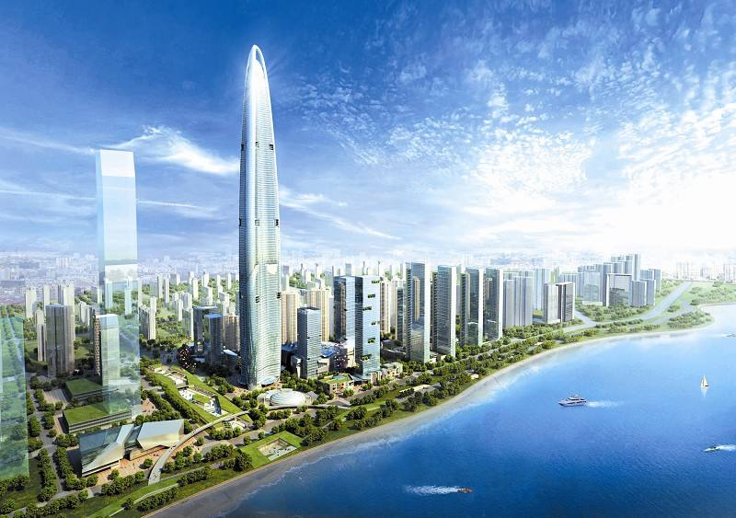
iPrepare
Pre-class Project
environment
spirit
tourism
economy

Slide 31
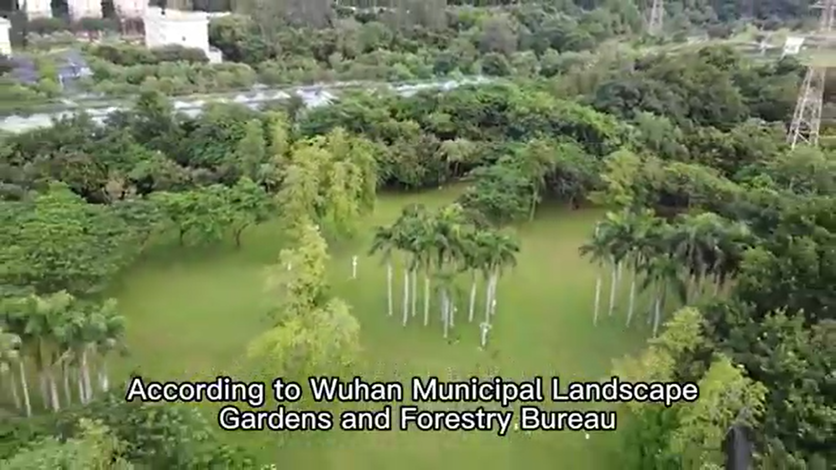
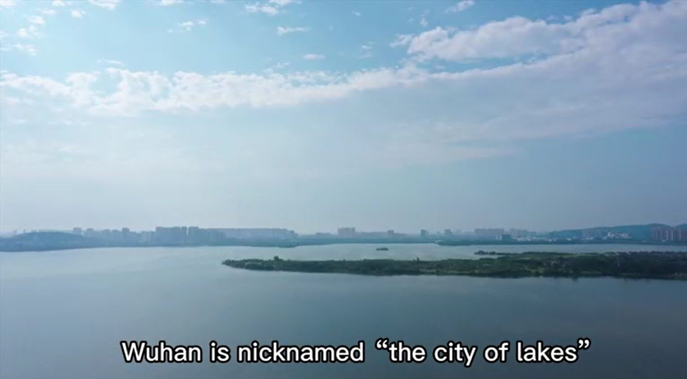
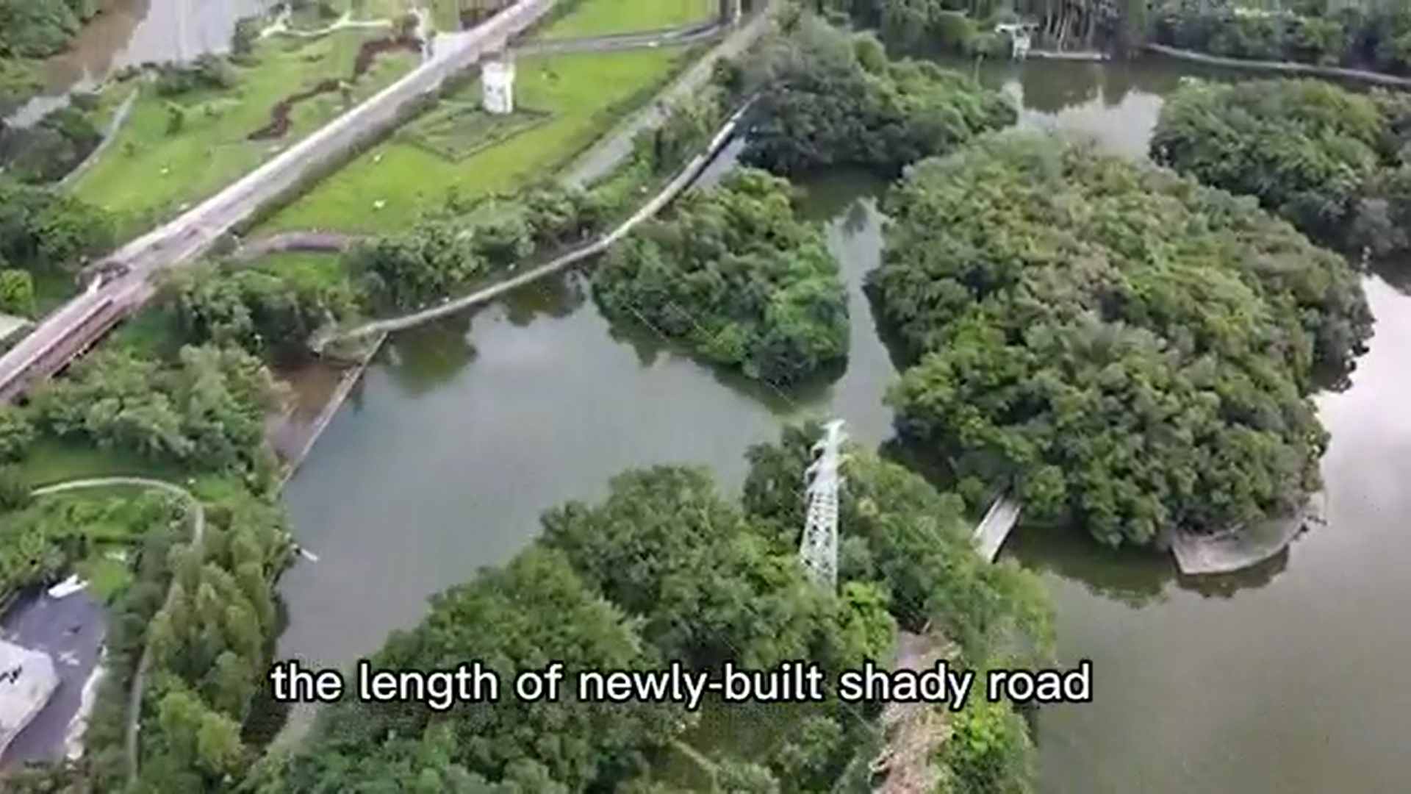
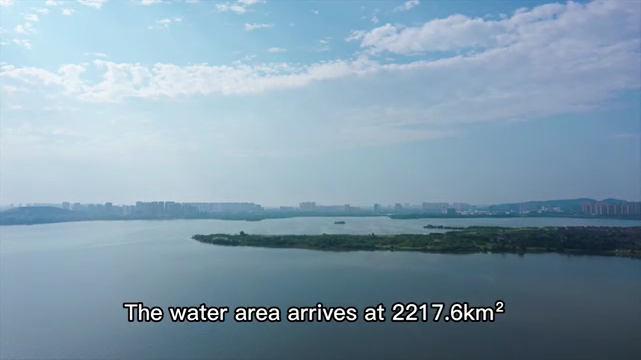
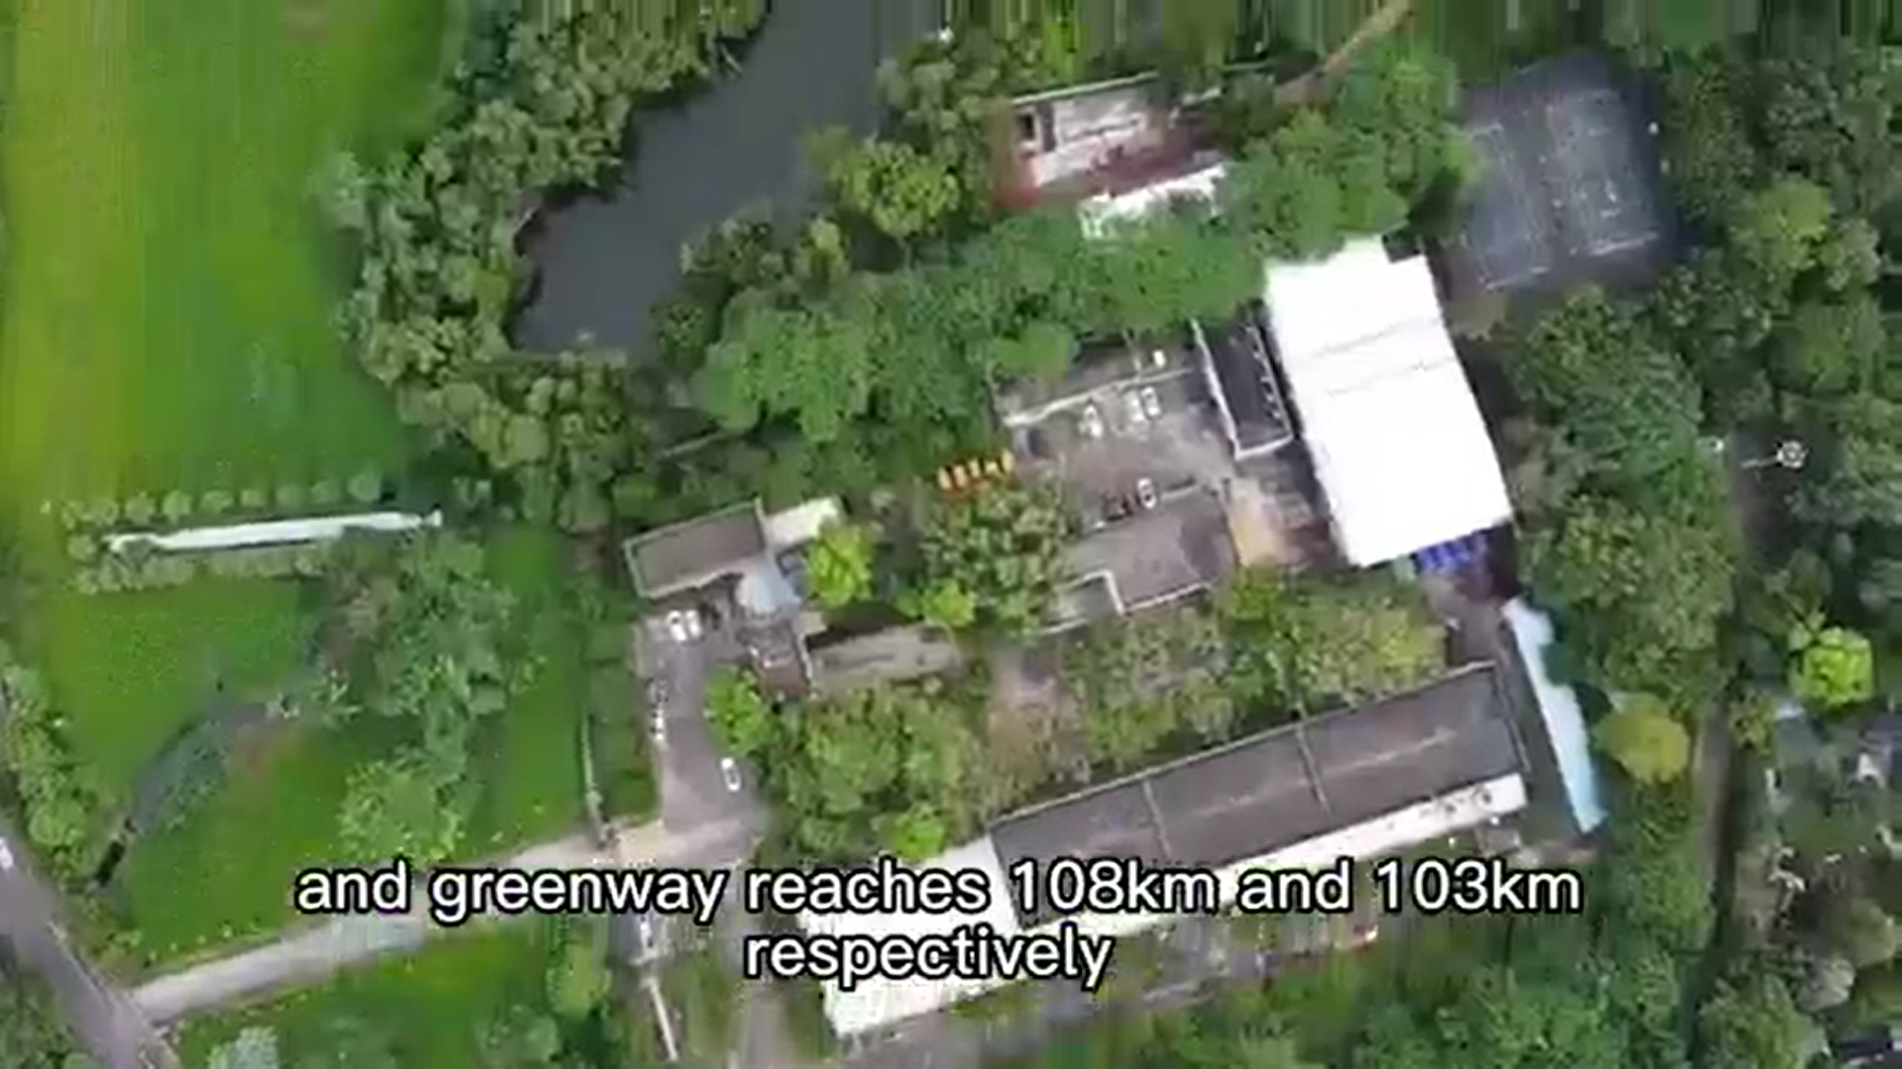
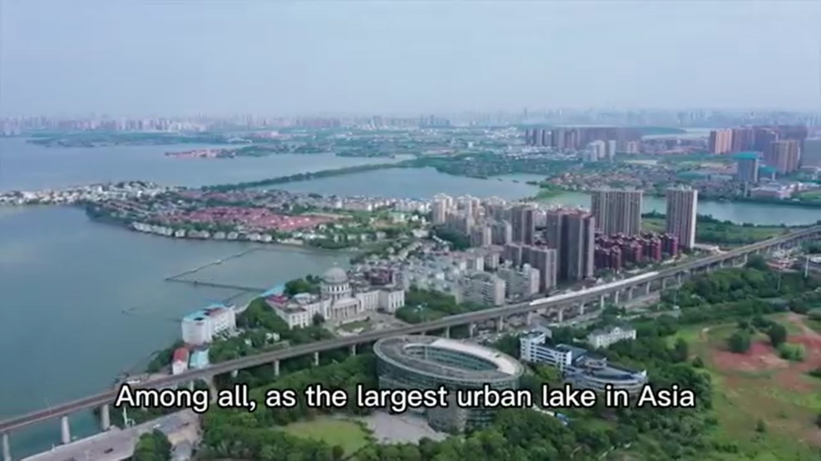
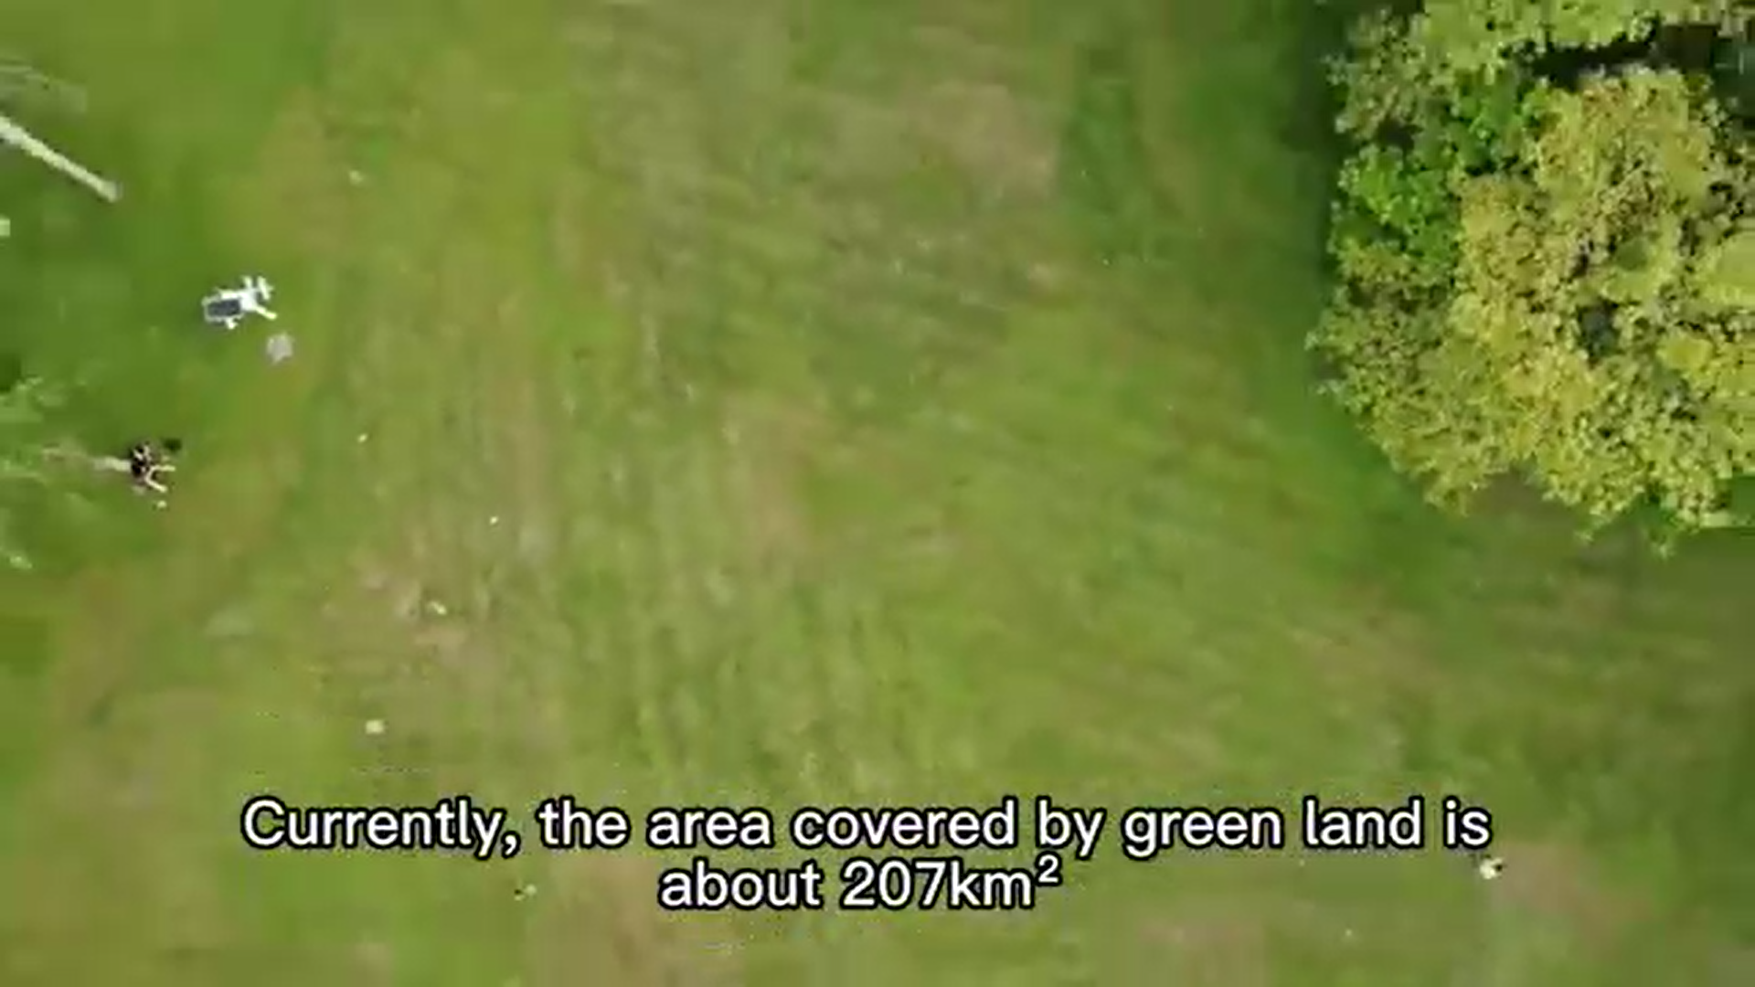
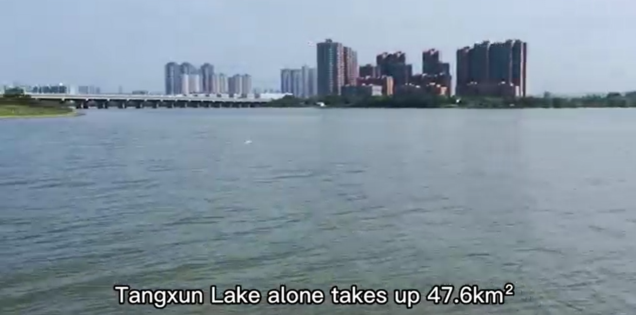
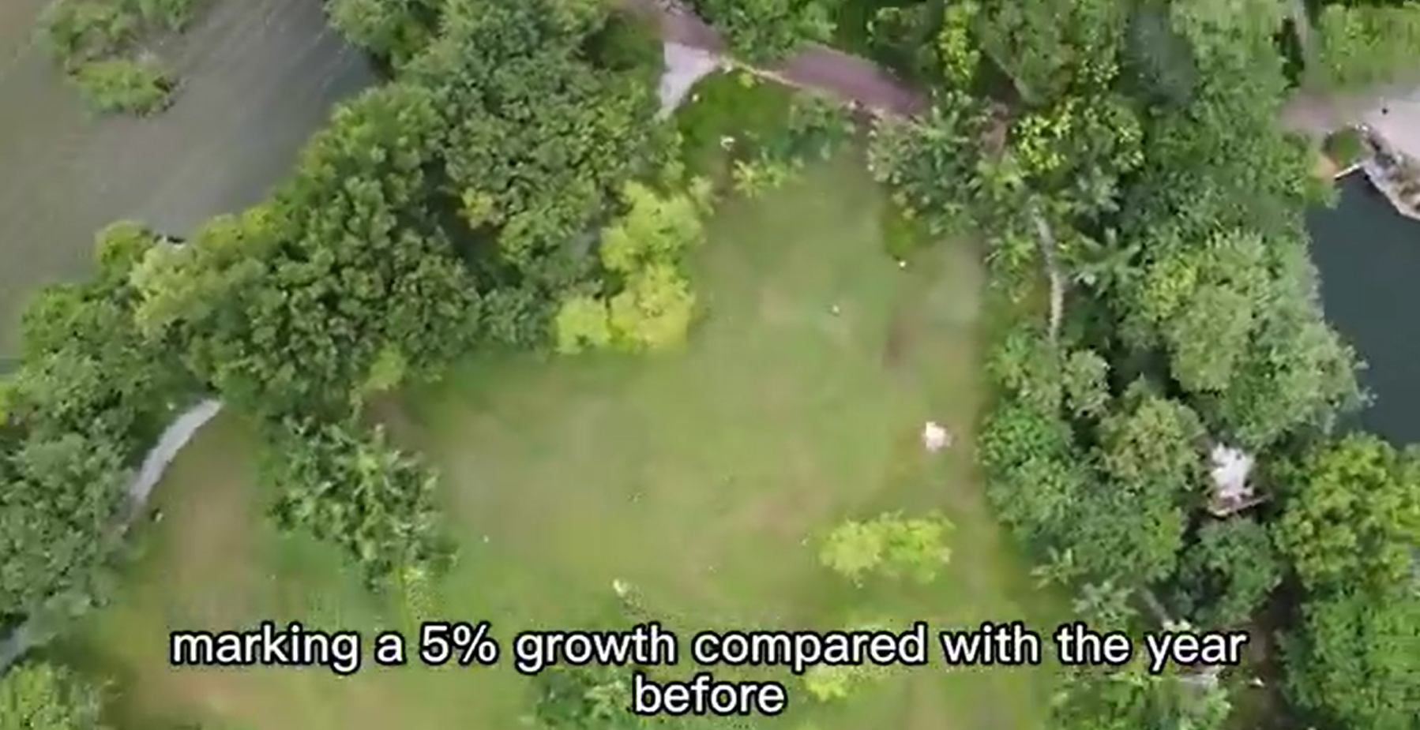
iPractice
Watch the promotional video clip submitted by 1st group.
Numbers /
Statistics!

Slide 32
Numbers / Statistics
iPractice
VIDEO ①
Checklist
Are my statistics varied and diverse?
Are my statistics representative of what they purport to measure?
Are my statistics from authorized sources?
Do I round off the complicated statistics?
Do I explain my statistics and relate them to the audience?

Slide 33
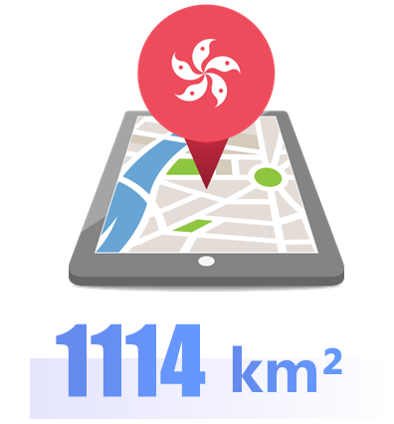
iPractice
VIDEO ①
Statistics: Explaining
2217
km²

Slide 34
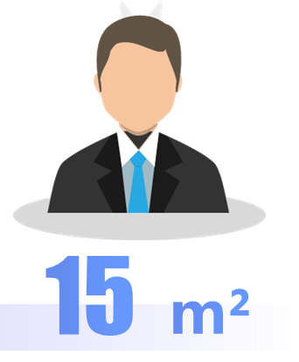
iPractice
VIDEO ①
Statistics: Explaining
14,000,000
207
14,000,000
km²
15
m²

Slide 35
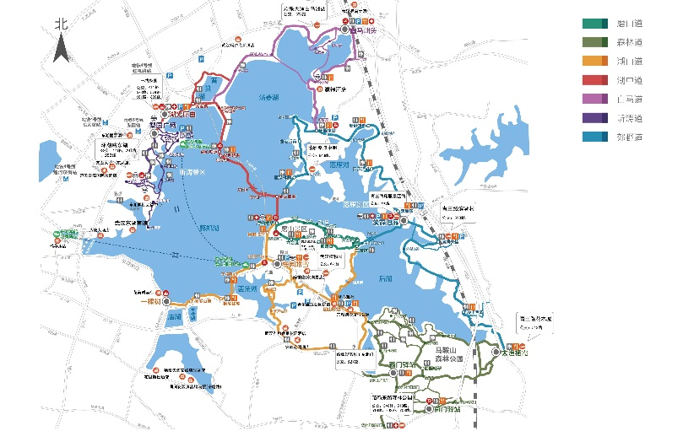
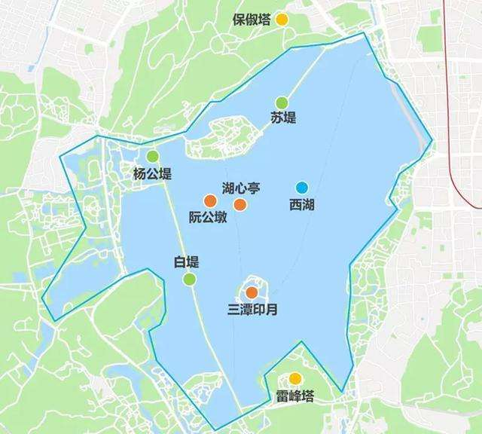
iPractice
VIDEO ①
Statistics: Explaining
Exercise 1: Choose the best answer.
The East Lake Scenic Area is about 73 square kilometers, among which the water covers about 33km², that is _____ the West Lake.
东湖
1km²?
A. thirty times larger than
B. six times larger than
C. two times larger than
✓
西湖
twice

Slide 36
iPractice
VIDEO ①
Statistics: Explaining
Sentence Patterns
For each minute, China’s Space Station can fly for 460.8km, faster than high-speed railway by 90 times.
比较级+than+n.
+by+倍数
China boasts a coastline extending over 32000km, that is 759 times as long as one full marathon.
倍数+as+adj.+as
Based on National Forestry and Grassland Administration, the forest area covers more than 2000000km², that is about ten times the size of Hubei Province.
倍数+the size of

Slide 37
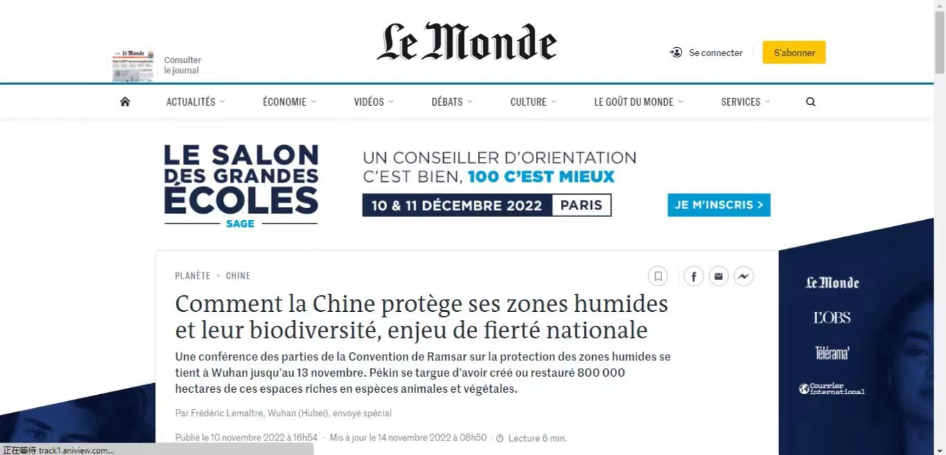
iPractice
VIDEO ①

Slide 38
iPractice
Watch the promotional video clip submitted by 2nd group.

Slide 39
iPractice
VIDEO ②
Checklist
Are the examples relevant to the topic?
Are the examples authentic and accurate?
Are the examples typical and representative?
Do I present the examples vividly with details?
Do I organize the examples logically?

Slide 40
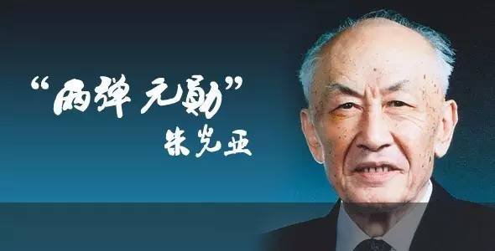
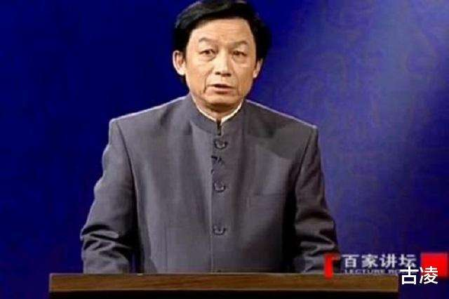
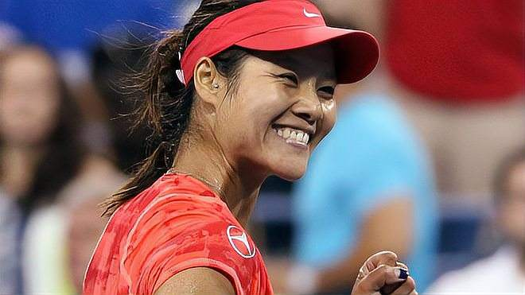
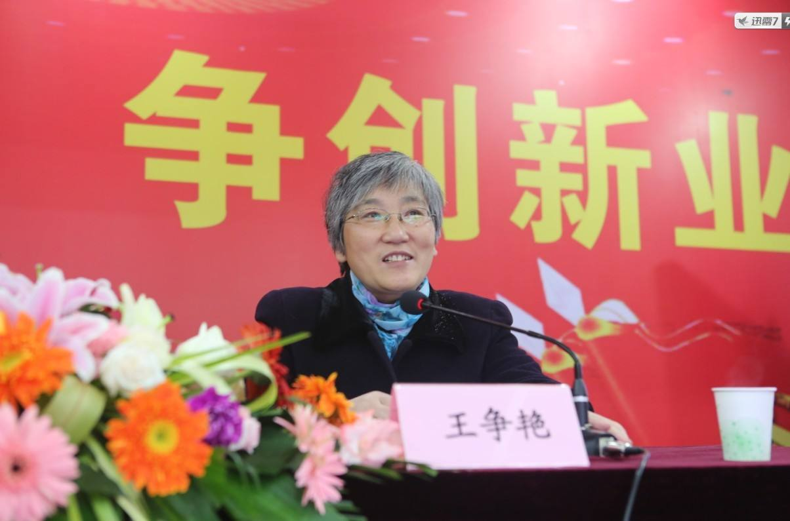
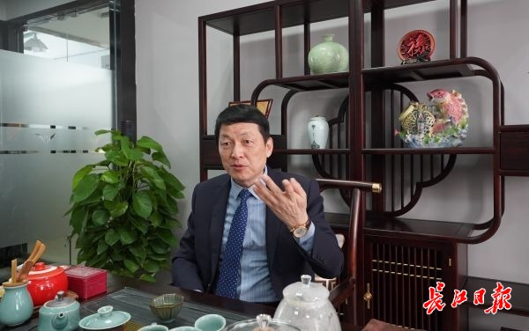
iPractice
VIDEO ②
Example: Extending
朱光亚
易中天
李娜
撒贝宁
王争艳
刘敦安

Slide 41
iPractice
VIDEO ②
Example: Extending
Individual
朱光亚
李娜
刘敦安
Community
Dongfeng Motor
Wuchang
shipbuilding
Government

Slide 42
iPractice
VIDEO ②
Example: Extending
Sentence Patterns
From A and B to C and D, you can spend a lifetime exploring and experiencing…
With its A, B and C, China’s intangible cultural heritage never fails to amaze.
From deeds of individuals, communities to government, you can feel how excellent and pioneering Wuhanese were.
With deeds of individuals, communities to government, Wuhan people’s courage and kindness never fails to amaze.

Slide 43
iPractice
VIDEO ②
Example: Focusing
朱光亚
易中天
李娜
撒贝宁
王争艳
刘敦安

Slide 44
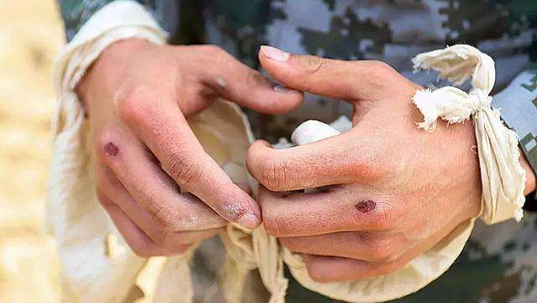
iPractice
VIDEO ②
Example: Focusing
Exercise 2: Describe the pictures with the given phrases.
long and knotted hands
a newly recruited soldier
A. long and knotted hands
A. long and knotted hands
B. trembling and wrinkled hands
B. trembling and wrinkled hands
C. flexible and calloused hands
C. flexible and calloused hands
D. rough and warm hands
D. rough and warm hands
Staring at the flying flag in the clean sky, with his long and knotted hand, Liu Dun’an, a newly recruited soldier, gave a smart salute.

Slide 45
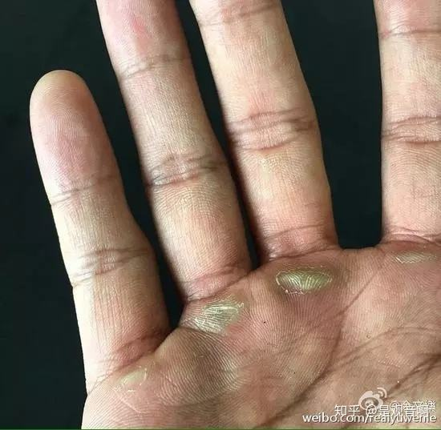
iPractice
VIDEO ②
Example: Focusing
Exercise 2: Describe the pictures with the given phrases.
flexible and calloused hands
in the hope that
B. trembling and wrinkled hands
B. trembling and wrinkled hands
C. flexible and calloused hands
C. flexible and calloused hands
C. flexible and calloused hands
D. rough and warm hands
D. rough and warm hands
Liu Dun’an sit in the study, typing something with his flexible and calloused hands, in the hope that one day his catering company would develop into the top one in Wuhan.

Slide 46
iPractice
VIDEO ②
Example: Focusing
Exercise 2: Describe the pictures with the given phrases.
rough and warm hands
a stream of meals
B. trembling and wrinkled hands
B. trembling and wrinkled hands
D. rough and warm hands
D. rough and warm hands
D. rough and warm hands
The rough and warm hands supplied a stream of meals for the medical personnel during the 2020 pandemic.

Slide 47
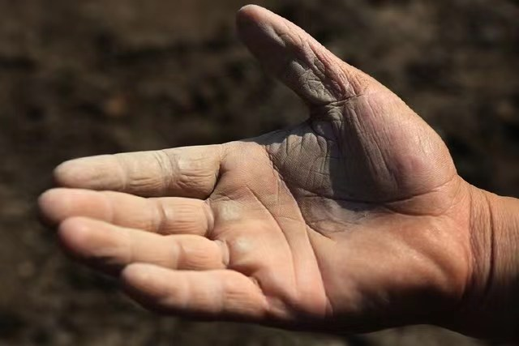
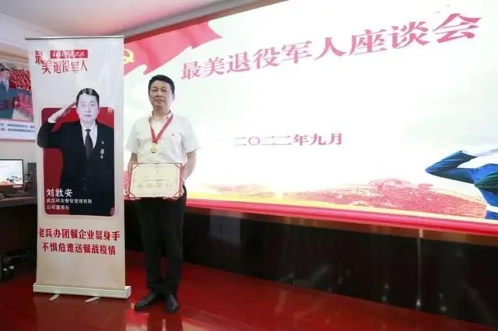
iPractice
VIDEO ②
Example: Focusing
Exercise 2: Describe the pictures with the given phrases.
trembling and wrinkled hands
be hailed as; glitter
B. trembling and wrinkled hands
B. trembling and wrinkled hands
When he was hailed as the most beautiful ex-soldier, medals were glittering in his trembling and wrinkled hands.

Slide 48
iPractice
VIDEO ②
Example: Focusing
specify one example with details
Details
enrich and vivify
Example

Slide 49
t
0 3
iProduce

Slide 50
iProduce
Group Discussion
Any idea of improvement?

Slide 51
iProduce
Project Evaluation
Output Grading Scale
Criteria | Description | Excellent | Average | Poor
Content | The video provides enough evidence to the selected stereotype.
 | The video is informative, interesting and attractive.
Language | The video uses related words and expressions.
Organization | The video is cohesive and coherent.
Method | The video uses statistics.
 | The video uses examples.
 | The video uses quotes.
 | The video uses comparison.
Delivery | The video integrates images and music to support its ideas.
Assignment List
✓ | Further revise your video script with methods learnt in class

Slide 52
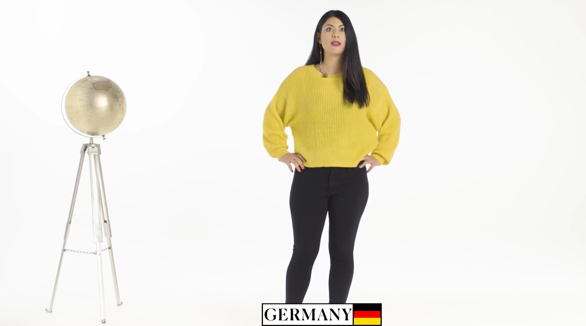
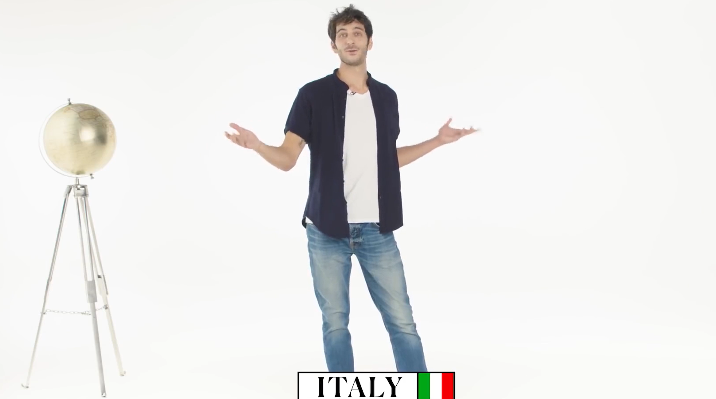
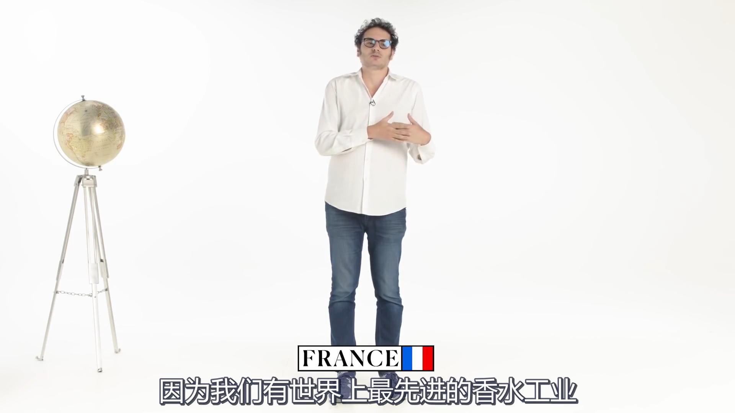
iPromote
China’s education centers around examination and score.
Chinese women are subordinate to men.
Chinese people look exactly the same.
China-made products are of poor quality.
Chinese people are not good at sports.
Chinese people are not good at sports.

Slide 53
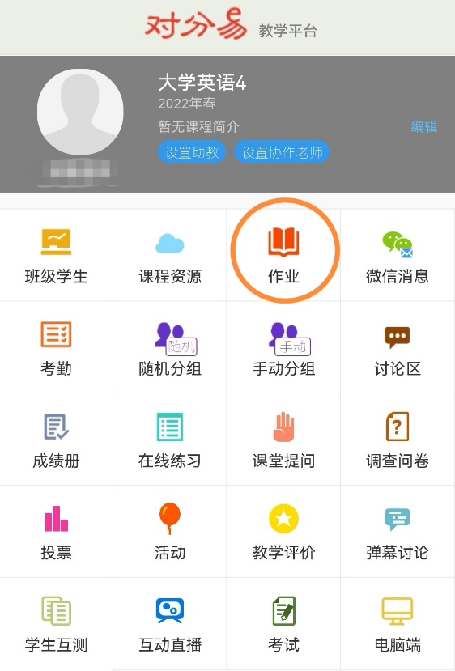
iPromote
Stereotype exists anywhere
Chinese people look exactly the same.
Chinese people are not good at sports.
Assignment List
✓ | Further revise your video script with methods learnt in class
✓ | Pick one stereotype against China and give your refutation
Chinese women are subordinate to men.
China’s education centers around examination and score.
China-made products are of poor quality.

Slide 54
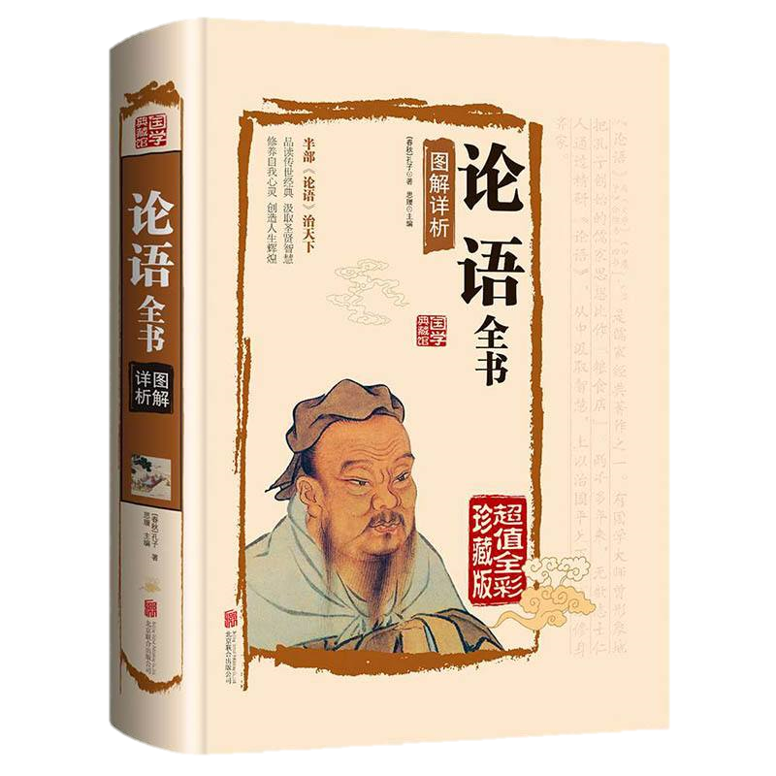
How to deal with stereotypes?
iPromote
How to deal with stereotypes?
君子和而不同，小人同而不和。
——《论语》
要树立平等、互鉴、对话、包容的文明观，以文明交流超越文明隔阂，以文明互鉴超越文明冲突，以文明共存超越文明优越。
——在上海合作组织成员国元首理事会上的讲话

Slide 55
CHINA

