Slide 1
2022 FLTRP Star Teacher Contest National Finals
Unit 6
Live Green，Live Better

Slide 2
Teaching design
Teaching Objectives
Teaching Procedures
Teaching Materials

Slide 3
1. Teaching Objectives
Core objectives
Stakeholders
Textbook
Knowledge
Value
Synthesize and evaluate
Knowledge
Skill
Skill
Apply and analyze
value
Knowledge
Remember and understand
Adapted from Bloom’s Taxonomy

Slide 4
1. Teaching Objectives
Core objectives
Stakeholders
Textbook
School Mission: “New Business School”
Business Knowledge+High tech+Global perspective
Knowledge
Skill
Level 3-4 in CSE
Non-English majors
Sophomore
value
value

Slide 5
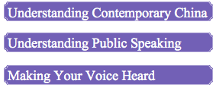
1. Teaching Objectives
Core objectives
Stakeholders
Textbook

Slide 6
2. Teaching Procedures
Unit task
Methods
Production
1
Discuss China’s green development model, measures, and achievements;
Understand, organize, and report information presented in diagrams;
Use effective strategies to begin and end your speeches.
2
3

Slide 7
2. Teaching Procedures
Unit task
Methods
Production
Knowledge
Vocabulary
Expressions with Chinese Characteristics
Skill
Use diagrams to support a speech
Green development
Value
Business students’ sense of responsibility to achieve a green economy.

Slide 8
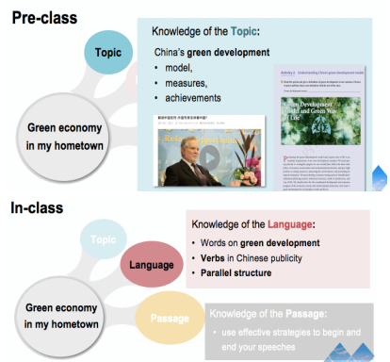
2. Teaching Procedures
Unit task
Methods
Production
Blended Learning
Pre-class & In-Class & After-class
Online Learning & Offline Learning

Slide 9
2. Teaching Procedures
Unit task
Methods
Production
Production⁃oriented approach (POA)
Motivating
Enabling
Assessing

Slide 10
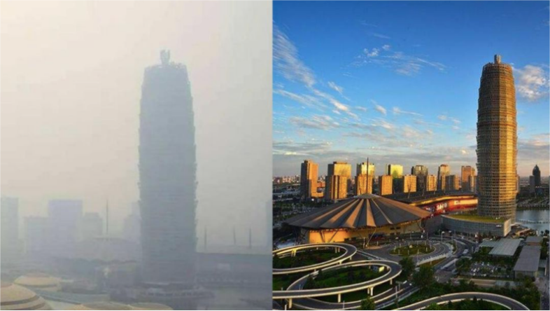
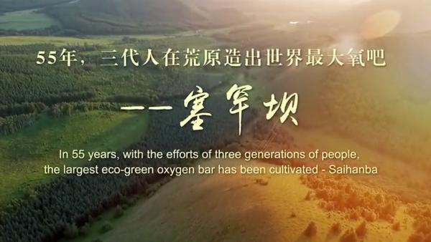
2. Teaching Procedures
Unit task
Methods
Production
Motivating
Enabling
Assessing
Scenarios
Real
Evoking

Slide 11
2. Teaching Procedures
Unit task
Methods
Production
Motivating
Enabling
Assessing
Speech
Evidence
Paragraph
Sentence
Diagram & Data
words
Parallel Structure
Green development

Slide 12
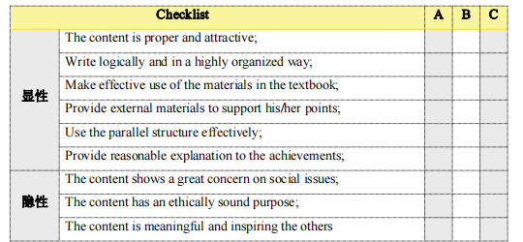
2. Teaching Procedures
3. Teaching Assessment
Unit task
Methods
Production
Motivating
Enabling
Assessing
Five-step evaluation
Peer Review
Self Review
II
Final Check
Online
Offline
Self Review
TSCA
(Teacher-Student Collaborative Assessment)

Slide 13
2. Teaching Procedures
3. Teaching Assessment
Motivating
Enabling
Assessing
Online discussion
Pre-class activities
15%
10%
Original post and two responses
10%
Unit task
Test
Group work
20%
Engagement
Participation
Online and Offline
After-class task
25%
In-class discussion
20%
Presentation; Class response
Multiple data

Slide 14
2. Teaching Procedures
Unit task
Methods
Production
Business Major Featured
1
From governors’ perspective
3
From consumers’ perspective
2
From entrepreneur's perspective

Slide 15
3. Teaching Materials
Selecting
Revising
Supplementing
Unit 6 Live Green, Live better
1
Discuss China’s green development model, measures, and achievements;
2
Understand, organize, and report information presented
in diagrams;
3
Use effective strategies to begin and end your speeches

Slide 16
3. Teaching Materials
Selecting
Revising
Supplementing
Unit 6 Live Green, Live better
1
Discuss China’s green development model, measures, and achievements;
2
Understand, organize, and report information presented
in diagrams;
3
Use effective strategies to begin and end your speeches

Slide 17
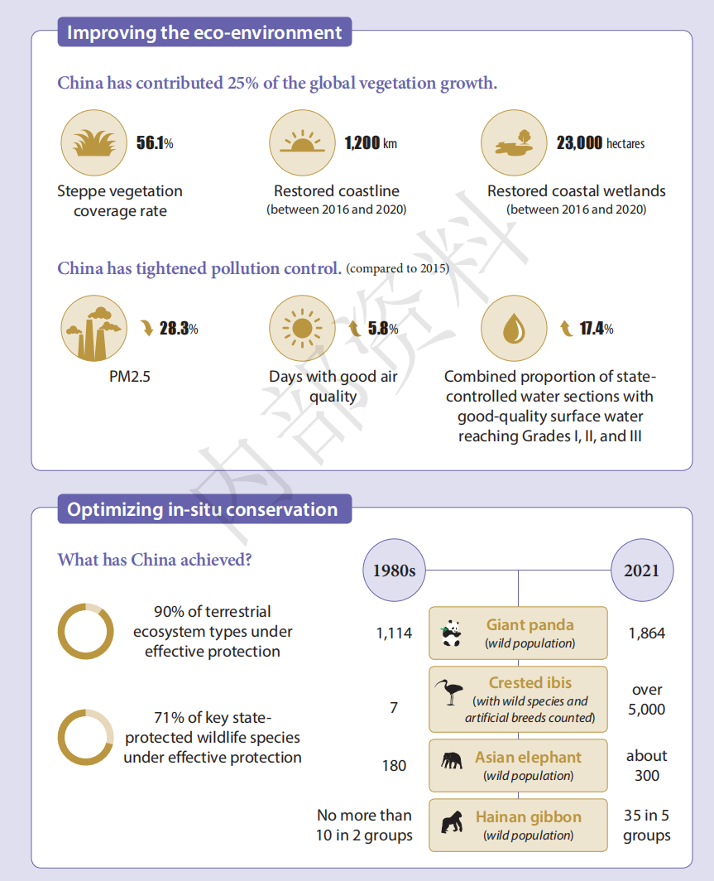
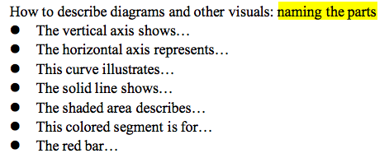
3. Teaching Materials
Selecting
Revising
Supplementing
Diagram as evidence P.104

Slide 18
3. Teaching Materials
Selecting
Revising
Supplementing
Green production
Green governance
Business Majors
Green economy
Green
tech
Green
tech
Green finance
Green marketing
Green accounting
Green management
Green Development

Slide 19
Summary
Objectives
Textbook
Make your voice hear
POA
Value
Skill
Skill
Understand pubilc speaking
Knowledge
Understand contemporary China
Adapted from Bloom’s Taxonomy

Slide 20
Class demonstration...
Enabling
Speech
Evidence
Paragraph
Sentence
Words
Diagrams &
data
Parallel structure
Content: Green development

Slide 21
UNDERSTANDING CONTEMPORARY CHINA
A Public Speaking Course
Unit 6
Live Green，
Live Better
理解当代中国 英语演讲教程

Slide 22
Task of the Unit
The Conference “Carbon neutrality and Coordinated development of the Beijing-Tianjin-Hebei region” will be held in our university.
In order to welcome the coming conference, our university will hold an speech contest, which requires the candidates to give a five-minute speech with the name “Green economy in my hometown” to introduce the transformation brought about by the development of green economy.
Let’s take part in the contest!

Slide 23
Task of the Unit
Topic
Language
Paragraph
Green economy
in my hometown

Slide 24
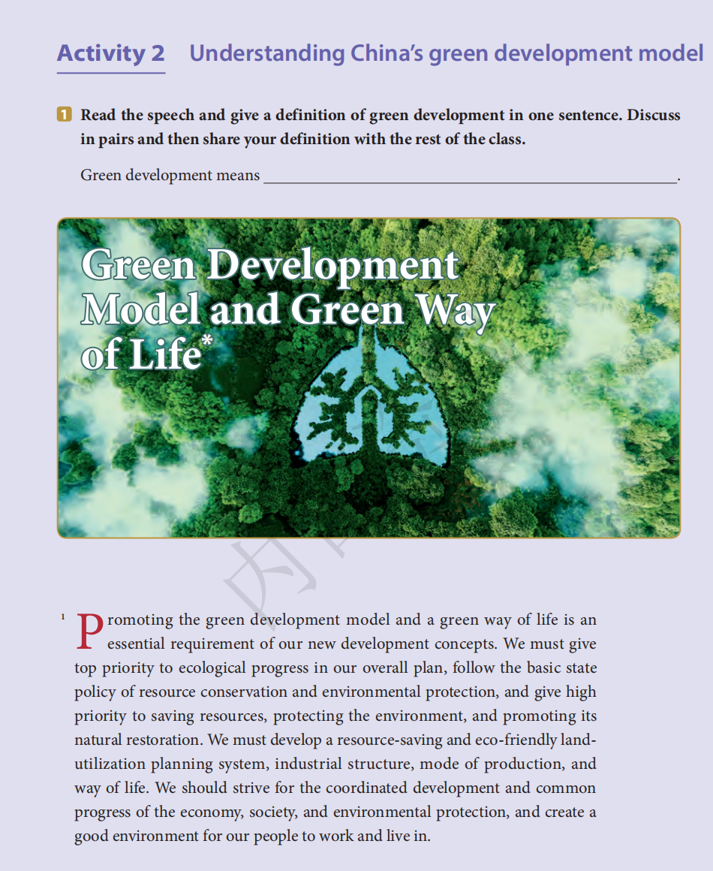
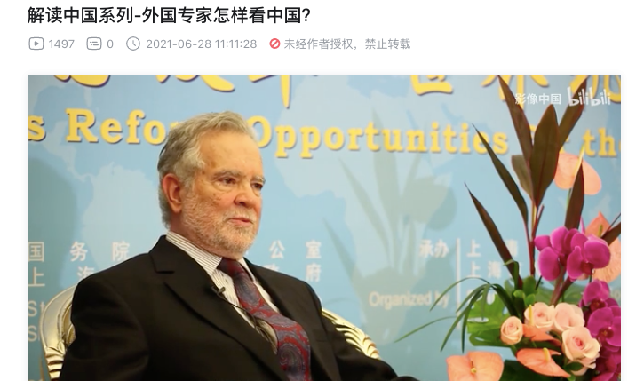
Task of the Unit
Pre-class
Knowledge of the Topic:
Topic
China’s green development
model,
measures,
achievements
Language
Passage
Green economy
in my hometown

Slide 25
Task of the Unit
In-class
Topic
Knowledge of the Language:
Words on green development
Verbs in Chinese publicity
Parallel structure
Language
Paragraph
Green economy
in my hometown
Knowledge of the Paragraph:
use effective strategies to begin and end your speeches

Slide 26
Task of the Unit
In-class
Topic
Knowledge of the Language:
Words on green development
Verbs in Chinese publicity
Parallel structure
Language
Paragraph
Green economy
in my hometown
Knowledge of the Paragraph:
use effective strategies to begin and end your speeches

Slide 27
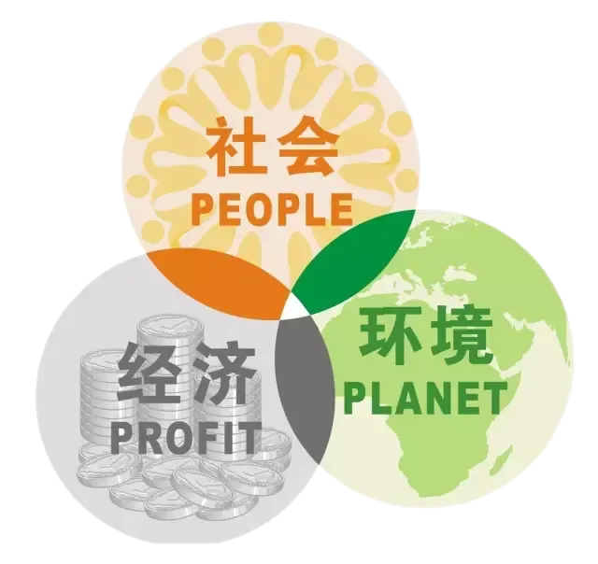
Procedures to achieve
Language focus
Step 1
Focus on words on green development
Skim the text and answer the question:
What does green development mean?
KEY:
Green development means the coordinated development and common progress of the economy, society, and environmental protection (para.1).
Coordinate
Government officials visited the earthquake zone on Thursday morning to coordinate the relief effort.

Slide 28
Procedures to achieve
Language focus
Step 1
Focus on words on green development
Other related expressions:
eco-civilization
ecological progress
sustainable development
biodiversity
symbiosis

Slide 29
Procedures to achieve
Language focus
Step 1
Focus on words on green development
Other related expressions:
sustainable：
eco-civilization
ecological progress
sustainable development
biodiversity
symbiosis
sustainable forest management
an environmentally sustainable society
sustainable economic growth

Slide 30
Procedures to achieve
Language focus
Step 1
Focus on words on green development
Other related expressions:
biodiversity：
eco-civilization
ecological progress
sustainable development
biodiversity
symbiosis
A high level of biodiversity is desirable.

Slide 31
Procedures to achieve
Language focus
Step 1
Focus on words on green development
Other related expressions:
symbiosis：
eco-civilization
ecological progress
sustainable development
biodiversity
symbiosis
Humanity relies on nature, and the relationship between the two is one of symbiosis. (para.2)

Slide 32
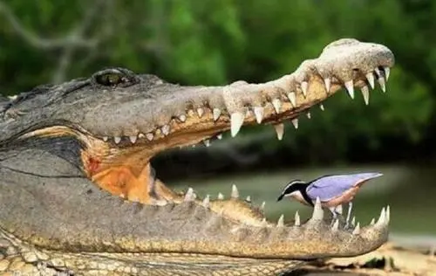
Procedures to achieve
Language focus
Step 1
Focus on words on green development
Other related expressions:
symbiosis：
eco-civilization
ecological progress
sustainable development
biodiversity
symbiosis

Slide 33
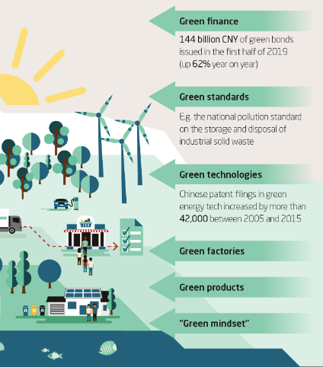
Procedures to achieve
Language focus
Step 1
Focus on words on green development
Green development includes different aspects, like green fiance, green standards, green technologies, green factories, green products, and green mindset.

Slide 34
Procedures to achieve
Language focus
Step 1
Focus on words on green development
Skim the text and answer the question:
What are the green standards— the “three red lines” mentioned in the text?
KEY:
ecological function security
basic environmental quality standards
natural resource utilization. (para 4)

Slide 35
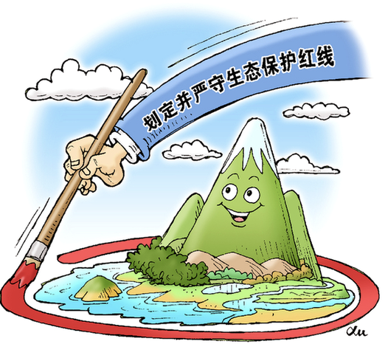
Procedures to achieve
Language focus
Step 1
Focus on words on green development
Green standards— the “three red lines”
Online learning resource bank

Slide 36
Procedures to achieve
Language focus
Step 1
Focus on words on green development
Green mindset:
Fill in the blanks with the words or expressions in the text based on the given Chinese.

Slide 37
Procedures to achieve
Language focus
Step 1
Focus on words on green development
推动形成绿色发展方式和生活方式
promote .
保护自然资源 conserve the .
加速可持续社会和经济发展 accelerate social and economic development
维持生物多样性 maintain .
建设生态文明 build an .
中国正走向经济发展与自然环境的共生
China is moving towards the of economic development and natural environment.
green development model and a way of life
natural resources
sustainable
biodiversity
ecological civilization
symbiosis

Slide 38
Procedures to achieve
Language focus
Step 2
Focus on verbs in Chinese publicity
1. We should strive for the coordinated development. (para 1)
We should strive to build a beautiful China. (para 4)
More examples:
In their efforts to protect the environment, companies must strive to become ecologically efficient.
In developing the economy, we should strive for a higher level every few years.

Slide 39
Procedures to achieve
Language focus
Step 2
Focus on verbs in Chinese publicity
2. We must give top priority to ecological progress in our overall plan...
We must give high priority to saving resources, protecting the environment, and promoting its natural restoration (para. 1)
More examples:
The government’s first priority is to build more power plants.
The proposals deserve support as they give priority to the needs of children.

Slide 40
Procedures to achieve
Language focus
Step 2
Focus on verbs in Chinese publicity
2. We must give top priority to ecological progress in our overall plan...
We must give high priority to saving resources, protecting the environment, and promoting its natural restoration (para. 1)
In your opinion,
is a top priority for college students.
is a first priority for the fiance majors.
give
top
take
high
priority
get
attach
first

Slide 41
Procedures to achieve
Language focus
Step 2
Focus on verbs in Chinese publicity
3. We will resolve the pressing problems of air, water, and soil pollution on a
priority basis....(para.7)
We must be resolute in casting aside the growth model that harms or even destroys the environment. (para.3)
resolution:
The UN has passed two major resolutions calling for a complete withdrawal.
They made a resolution to lose all the weight gained during the Christmas period.

Slide 42
Procedures to achieve
Language focus
Step 2
Focus on verbs in Chinese publicity
Fill in the blanks with “resolute” “resolve” and “resolution”.
When you a question or problem, you come to a conclusion, and once you've reached a conclusion you can proceed to act. So in your New Year's , you make up your mind and be__ _ _to do something. Unfortunately, New Year's _ _ aren't a good illustration of the meaning of , since only about one in ten actually seems to succeed.
resolve
resolutions
resolute
resolutions
resolute

Slide 43
Procedures to achieve
Language focus
Step 2
Focus on verbs in Chinese publicity
4. We must place it high on our agenda...(para.4)
high or top on agenda
Meaning: if a subject or plan is at the top of somebody’s agenda, it is the most important thing they want to discuss or deal with.
More example:
The government has realized the need for placing environmental protection at the top of its agenda.
Your sentence?

Slide 44
Procedures to achieve
Language focus
Step 2
Focus on verbs in Chinese publicity
We must give top priority to ecological progress in our overall plan...
We must give high priority to saving resources, protecting the environment, and promoting its natural restoration (para. 1)
We must be resolute in casting aside the growth model that harms or even destroys the environment. (para.3)
We must place it high on our agenda...(para.4)

Slide 45
Procedures to achieve
Language focus
Step 2
Focus on verbs in Chinese publicity
We must give top priority to ecological progress in our overall plan...
We must give high priority to saving resources, protecting the environment, and promoting its natural restoration (para. 1)
We must be resolute in casting aside the growth model that harms or even destroys the environment. (para.3)
We must place it high on our agenda...(para.4)
“Must” shows zero tolerance of Chinese government to the violation of the “three red lines”!

Slide 46
Procedures to achieve
Language focus
Step 3
Focus on parallel structure
Parallel structure means using the same pattern of words to show that two or more ideas have the same level of importance.
It is a balance within one or more sentences of similar phrases or clauses that have the same grammatical structure.
Online learning resource bank

Slide 47
Procedures to achieve
Language focus
Step 3
Focus on parallel structure
I have a dream that one day this nation will rise up and live out the true meaning of its creed: "We hold these truths to be self-evident, that all men are created equal."
I have a dream that one day on the red hills of Georgia, the sons of former slaves and the sons of former slave owners will be able to sit down together at the table of brotherhood.
I have a dream that one day even the state of Mississippi, a state sweltering with the heat of injustice, sweltering with the heat of oppression, will be transformed into an oasis of freedom and justice.
——Marin Luther King’s “I Have a Dream”
Powerful, clear and easy to remember

Slide 48
Procedures to achieve
Language focus
Step 3
Focus on parallel structure
Parallel structure in the text
We will step up environmental protection in all respects, in all places, and in all the processes of production, distribution and consumption. (para.4)
Word
level
Repetition of single words in a sentence
We should strive to build a beautiful China where skies are blue, mountains green, and waters lucid. (para.3)
Phrase level
Repetition of similar phrase structure in a sentence

Slide 49
Procedures to achieve
Language focus
Step 3
Focus on parallel structure
Parallel structure in the text
We should protect the ecosystems as preciously as we protect our eyes, and cherish it as dearly as we cherish our lives. (para. 3)
Clause level
A repeated clause structure with in a sentence
First, accelerate the shift of the economic growth model. (para 6)
Second, intensify the comprehensive control of environmental pollution. (para 7)
Third, accelerate environmental protection and restoration. (para 8)
Paragraph level
A series of consecutive sentences that use the same grammatical structure.

Slide 50
Procedures to achieve
Language focus
Task
Group work
Look at the achievements China has made in environmental protection shown in the next diagrams and discuss in groups of three or four how these achievements have been made.
You should:
1. Use as many words and expressions in and as possible;
2. Use the facts and evidence (Diagrams in the textbook or external materials);
3. Use the parallel structure.
Step 1
Step 2

Slide 51
Procedures to achieve
Language focus
Word bank
coordinated development
ecological civilization
ecological progress
sustainable development
biodiversity
symbiosis
green development
green standards
green mindset
protect the ecosystem
conserve the natural resources
strive for sth./ strive to do sth.
resolve/ be resolute
give top / high priority to
place it high on our agenda...

Slide 52
Thank you!
Man and nature are a community of life.
UNDERSTANDING CONTEMPORARY CHINA
A Public Speaking Course

