Slide 1
2022外研社杯“教学之星”大赛全国总决赛
《新编大学英语（第四版）综合教程2》
Unit 5 The Power of Words

Slide 2
Part I
Design Introduction

Slide 3
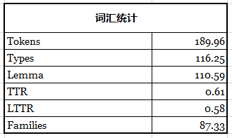
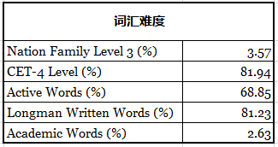
University & Target students
a key national university
first year, non-English majors
intermediate language proficiency
Writing
- insufficient use of new vocabulary
- little use of rhetorical devices
- mixed use of formal & informal styles
rare reflection on the values of tradition culture
* Based on statistics on iWrite

Slide 4
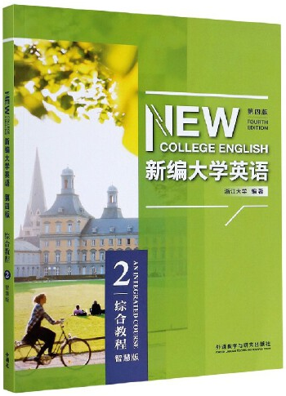
Learning objectives
explain the benefits of reading books
1. explain the benefits of reading classical Chinese poems
2. use new linguistic forms of Reading 1 in writing
3. use questions as rhetorical devices in writing
4. use formal language in writing
P114, Learning objectives

Slide 5
Teaching methodology
Motivating
Enabling
Production-Oriented Approach
Assessing

Slide 6
Motivating
Scenario
I am an exchange student from China at an American university. I am taking Creative Writing this semester and this week’s assignment is to write an essay on the benefits of reading poems. I decided to write about the benefits of reading classical Chinese poems. Would you please help me?

Slide 7
Enabling & Assessing
to use new linguistic forms of Reading 1 in writing
to use questions as rhetorical devices in writing
to use formal language in writing
Scenario
first
draft
1st
revision
2nd
revision
3rd
revision
M
E
M
M
E
A
E
A
writing
task
A
final
version
Session 1 & 2
Session 3 & 4
Session 5 & 6
self-assessment
peer assessment
automated assessment
teacher assessment

Slide 8
Demo design
M
Sample writing of the 1st revision
review of key words
a gap of it: the use of questions as rhetorical devices
1st
revision
M
2nd
revision
E
A
E
Micro-lecture
Examples in Reading 1
Multiple-choice question
Matching
Rewriting
Session 3 & 4
What
Why
How
A
Teacher assessment
Peer assessment
Self-assessment

Slide 9
Materials used in demo class
Selecting | Examples | P117-119, Reading 1
Adapting | Writing Task | P122, Read and Think
 | Micro-lecture | P125, Read and Write
 | Multiple-choice | P97, Read and Write, Teacher’s Book
Supplementing | Blank filling | Samples from students’ writing
 | Matching
 | Rewriting

Slide 10
Part II
Demonstration

Slide 11
Sample writing of the 1st revision
console grieve insight shape
companionship a life-long relationship with
Classical Chinese poems: a life-long friend of us
Unit 5 Reading 1 Vocabulary
Didn’t you read poems like “Thoughts on a tranquil night” when you were a kid?
We all have classical Chinese poems. They are like a playmate that we met at an early age. At the time, we did not understand our friend very well. As we grow older, we gradually gain into our friend’s feelings, emotions, and thoughts. It dawns on us that we have been by the friend who has been our companion for many years, us when we are , and rejoicing with us when we are joyful. The continues to grow when we introduce the long-time friend to our children and children’s children.
a life-long relationship with
insight
shaped
consoling
grieving
companionship

Slide 12
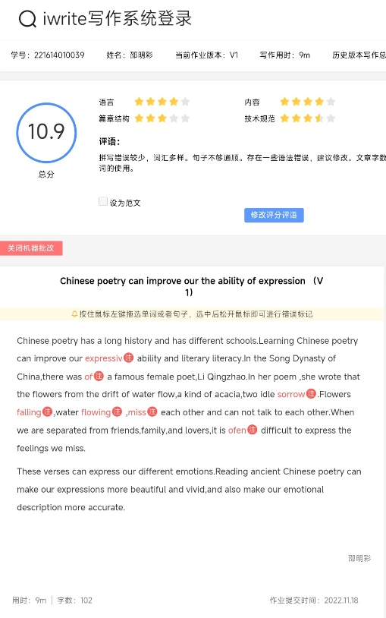
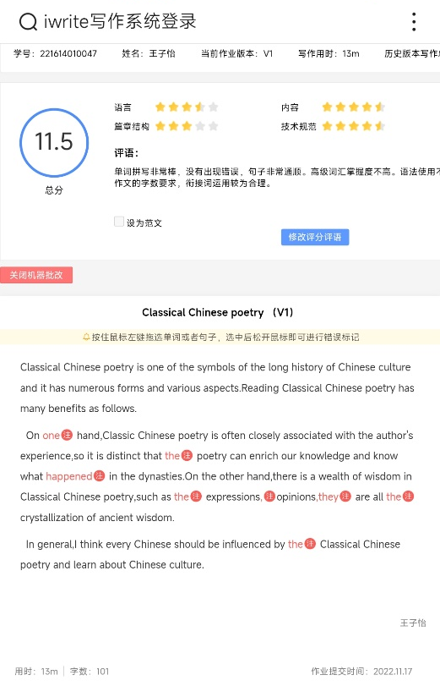
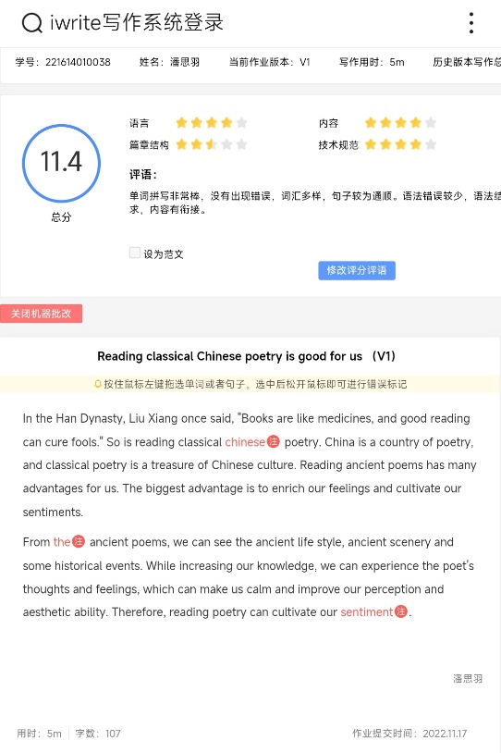
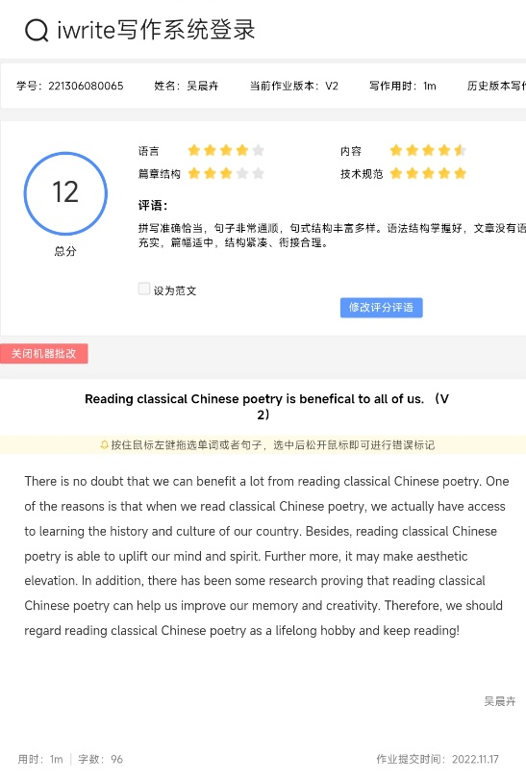
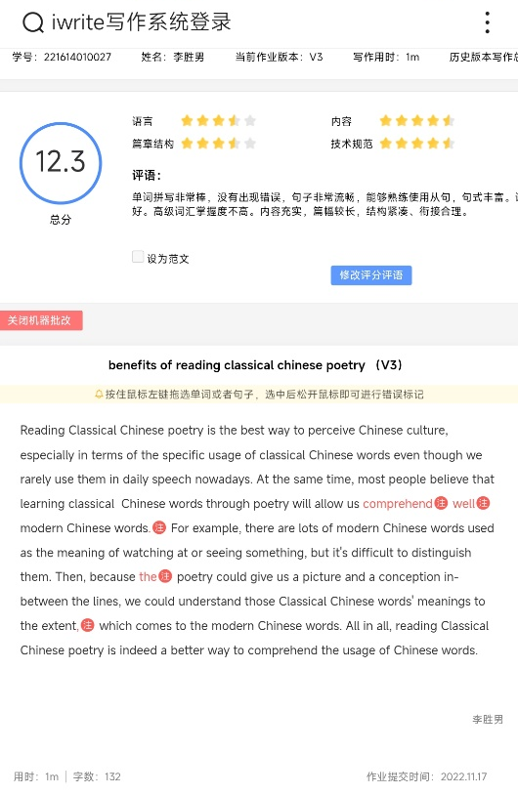
0
questions as rhetorical devices
612
all sentences
Based on your first draft on iWrite

Slide 13
Learning objectives
use questions as rhetorical devices in writing
define rhetorical questions and hypophoras
explain the difference between rhetorical questions and hypophoras
reflect on the benefits of reading classical Chinese poems

Slide 14
Questions as rhetorical devices
Micro-lecture adapted from P125, Read and Write

Slide 15
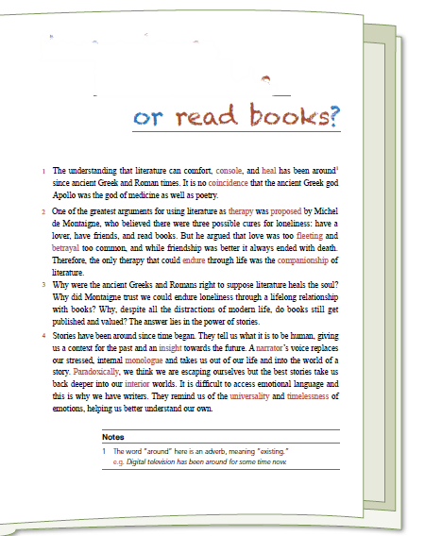
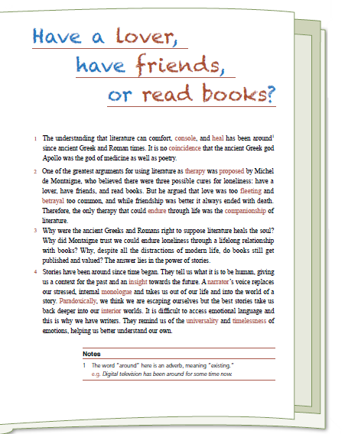
Questions as rhetorical devices in Reading 1
3 Why were the ancient Greeks and Romans right to suppose literature heals the soul? Why did Montaigne trust we could endure loneliness through a lifelong relationship with books? Why, despite all the distractions of modern life, do books still get published and valued? The answer lies in the power of stories.
(hypophora)
P117, Reading 1

Slide 16
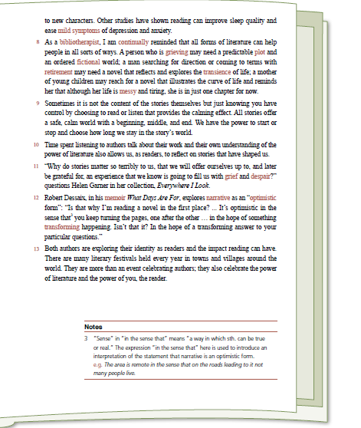
Questions as rhetorical devices in Reading 1
12 Is that why I’m reading a novel in the first place? … It’s optimistic in the sense that you keep turning the pages, one after the other … in the hope of something transforming happening.
(hypophora)
12 Isn’t that it?
(rhetorical question)
P119, Reading 1

Slide 17
Effects of questions as rhetorical devices
What effects can be achieved by the two types of questions?
a. Arouse readers’ curiosity
b. Set readers thinking
c. Help readers better understand the point
d. Improve the force of argument
e. All of the above
Adapted from P97, Read and Write, Teacher’s Book

Slide 18
Matching
1. Poems contain powerful messages that can move and motivate us.
a. How can we make a connection with our traditional culture? The answer is reading classical poems.
2. Reading classical poems can help us improve our writing skills.
b. Haven’t you ever been touched by the homesickness conveyed by the poem “Thoughts on a tranquil night”?
3. We can make a connection with traditional culture via reading classical poems.
c. What can we learn from reading classical poems? Among other things, we can learn the writing techniques of ancient poets.

Slide 19
Rewriting
Reading poems can help us be reminded of our cultural heritage.
Gentlemen 5人
得分；暂无得分
Couldn’t we learn more about our traditional culture by reading poems?
999 4人
得分；暂无得分
How could we have a better understanding of our cultural heritage? The answer is reading poems.
Cola 4人
得分；暂无得分
We learned in childhood that we shouldn’t waste food from the poem “Toiling Farmers”, didn’t we?

Slide 20
Checklist
Checklist
I AM ABLE TO …
… define rhetorical questions and hypophoras. | 5 □ 4 □ 3 □ 2 □ 1 □
… explain the difference between rhetorical questions and hypophoras. | 5 □ 4 □ 3 □ 2 □ 1 □
… explain the effects of rhetorical questions and hypophoras. | 5 □ 4 □ 3 □ 2 □ 1 □
… use questions as rhetorical devices in writing. | 5 □ 4 □ 3 □ 2 □ 1 □
… reflect on the benefits of reading classical Chinese poems. | 5 □ 4 □ 3 □ 2 □ 1 □

Slide 21
Thank you！

