Slide 1
The Art of Public Speaking
2017 外研社“教学之星”大赛
Supporting Your Ideas

Slide 2
I. Smart design
Supporting Your Ideas
– The Art of Public Speaking

Slide 3
The course
An oral English course
For non-English majors at the intermediate level
A “learning by doing” design

Slide 4
The Teaching Design
I. Lecture
II. Task
III. Feedback
Unit 6 Supporting Your Ideas
-- The Art of Public Speaking

Slide 5
I. Lecture
I. Lecture
II. Task
III. Feedback
(20 minutes)
By testimony
By statistics
(The lecture session is usually arranged at the end of the task presentation of the previous unit.)

Slide 6
II. Task
I. Lecture
II. Task
III. Feedback
Preparation (1 week, off class)
A mini-research + A report
What is an appropriate English translation of “中国梦”?
Presentation (1.5 hours, in class)
A group oral presentation
Your answer
By testimony
Library research
Interview/Q survey
By statistics
Questionnaire survey
Library research

Slide 7
III. Feedback
I. Lecture
II. Task
III. Feedback
(after each group presentation)
Q & A sessions
Peer feedback
Teacher feedback

Slide 8
II. Classroom Teaching Demo
Supporting Your Ideas
– The Art of Public Speaking

Slide 9
Supporting Your Ideas
by
Testimony
Statistics

Slide 10
1. Testimony
Testimony
quotations or paraphrases
of other people
Expert testimony
Peer testimony

Slide 11
Expert testimony
“Judging from the outbreak of Chinese restaurants all over town, the city has gone ‘chop-suey’ mad.” – New York Times 1904

Slide 12
Peer testimony
Lee, “Fried gelato is not Chinese.”
Her Italian neighbor, “It’s not? But they serve it in all the Chinese restaurants in Italy.”

Slide 13
Tips for Using Testimony
Use qualified and reliable sources.
Identify the sources.
Decide whether to quote or paraphrase.
Quote or paraphrase accurately.

Slide 14
2. Statistics
Statistics
numerical data/ numbers
Single statistics
Multiple statistics

Slide 15
Multiple statistics
Leaders | Women
Head of State | 9/190
Member of Parliament | 13%
Top positions of corporate sector | 15-16%

Slide 16
Tips for Using Statistics
Use reliable sources, and identify the sources.
Use representative statistics.
Sample size
Subject selection
Explain statistics.
A 12-Gigabyte-memery card

Slide 17
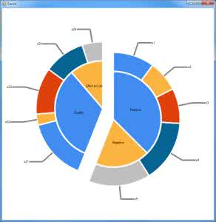
Tips for Using Statistics
Round off complicated statistics.
Visualize statistics.
31.27%?
vs.
30%

Slide 18
Teaching Assessment

