Slide 1
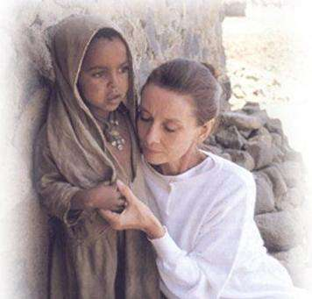
Audrey Hepburn
― A true angel in this world

Slide 2
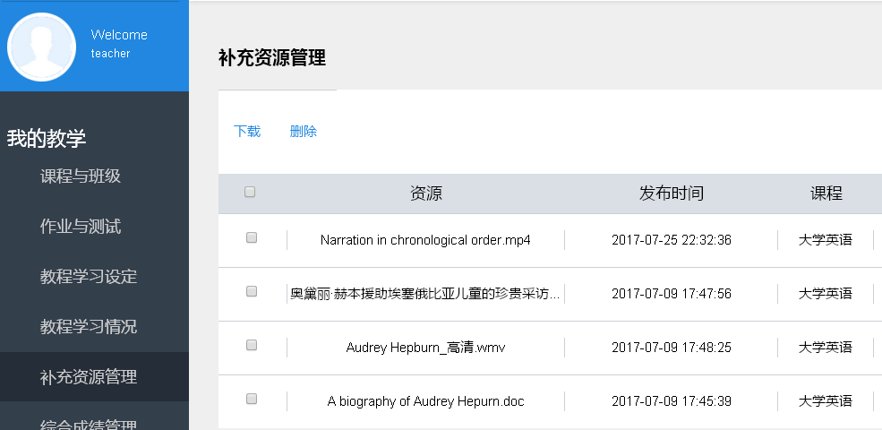
Assignment review
Suppose you are to introduce to one of your foreign friends a Chinese celebrity who you think equals Audrey Hepburn’s good will and dedication.
Work in groups of four and write a narrative essay in chronological order in about 250 words.
Micro-lecture

Slide 3
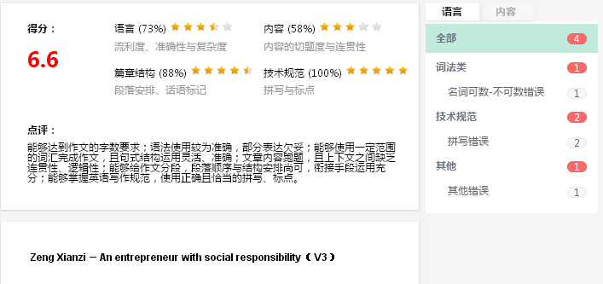
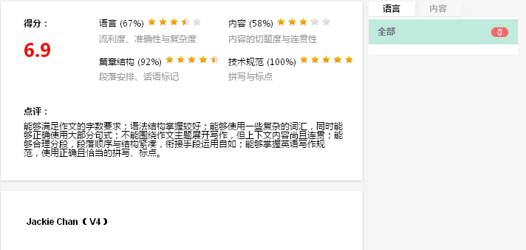
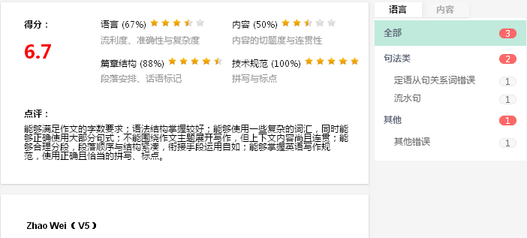
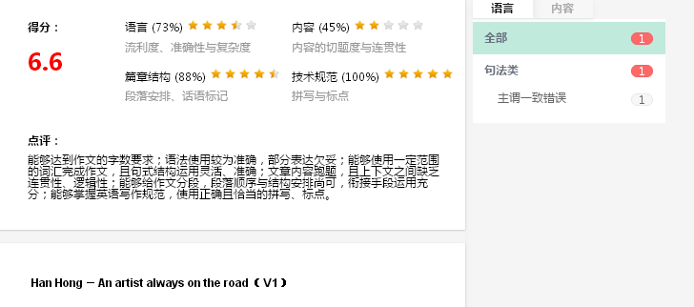
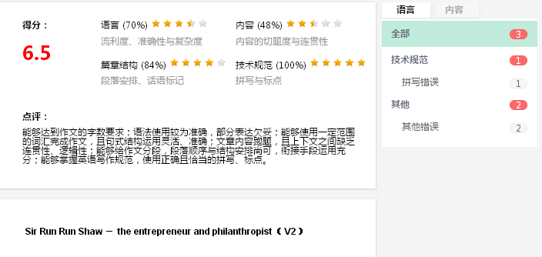
Assignment review
7.6
7.9
7.7
7.6
7.5

Slide 4
Sample analysis (1)

Slide 5
Sample analysis (1)
Group 3

Slide 6
Sample analysis (1)
Group number
 | 1 | 2 | 3 | 4 | 5
1. Is the essay a narrative of a Chinese celebrity? (2’)
2. Is there a central point in the introductory paragraph? (2’)
3. Are supporting details adequately supportive to the central point? (2’)
4. Are the time signals used appropriately to develop a coherent narrative? (2’)
5. Is there a concluding paragraph which restates the central point? (2’)
Total (10’)
Evaluation questions
2’ 2’ － 2’ 2’
2’ 2’ － 2’ 2’
1’ 1’ － 1’ 1’
2’ 2’ － 2’ 2’
2’ 2’ － 2’ 2’
9’ 9’ － 9’ 9’

Slide 7
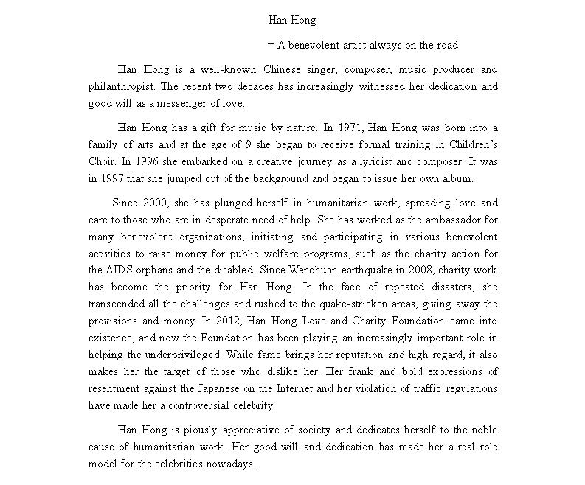
Sample analysis (1)
Group 3
Introduction
Body
Conclusion

Slide 8
Sample analysis (1)
While fame brings her reputation and high regard, it also makes her the target of those who dislike her. Her frank and bold expressions of resentment against the Japanese on the Internet and her violation of traffic regulations have made her a controversial celebrity.
Irrelevant details！
Unity!

Slide 9
Sample analysis (2)

Slide 10
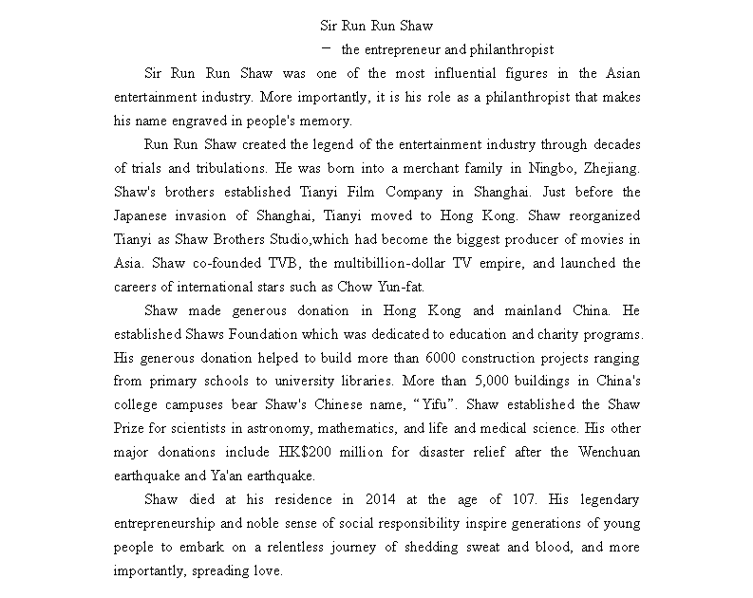
Sample analysis (2)
Group 1

Slide 11
Sample analysis (2)
Group number
 | 1 | 2 | 3 | 4 | 5
1. Is the essay a narrative of a Chinese celebrity? (2’)
2. Is there a central point in the introductory paragraph? (2’)
3. Are supporting details clearly and adequately supportive to the central point? (2’)
4. Are the time signals used appropriately to develop a coherent narrative? (2’)
5. Is there a concluding paragraph which restates the central point? (2’)
Total (10’)
Evaluation questions
－ 2’ 2’ 2’ 2’
－ 2’ 2’ 2’ 2’
－ 2’ 2’ 2’ 2’
－ 0’ 0’ 0.5’ 0’
－ 2’ 2’ 2’ 2’
－ 8’ 8’ 8.5’ 8’

Slide 12
Sample analysis (2)
Group 1

Slide 13
Sample analysis (2)
Shaw made generous donations in Hong Kong and mainland China. He established Shaws Foundation which was dedicated to education and charity programs. His generous donation helped to build more than 6000 construction projects ranging from primary schools to university libraries. More than 5,000 buildings in China's college campuses bear Shaw's Chinese name, “Yifu”. Shaw established the Shaw Prize for scientists in astronomy, mathematics, and life and medical science. His other major donations include HK$200 million for disaster relief after the Wenchuan earthquake and Ya'an earthquake.
During the past decades, Shaw made generous donations in Hong Kong and mainland China. In 1973, He established Shaws Foundation which was dedicated to education and charity programs. Since 1985, his generous donation has helped to build more than 6000 construction projects ranging from primary schools to university libraries. More than 5,000 buildings in China's college campuses bear Shaw's Chinese name, “Yifu”. In 2002, Shaw established the Shaw Prize for scientists in astronomy, mathematics, and life and medical science. His other major donations include HK$200 million for disaster relief after the 2008 Wenchuan earthquake and 2013 Ya'an earthquake.
Time signals for coherence!

Slide 14
The four bases for effective writing
UNITY
SUPPORT
A clear central point
No irrelevant details
Supporting details
Specific information
SENTENCE SKILLS
COHERENCE
Revision
Error free
A clear organization
Transitions

Slide 15
Audrey Hepburn's life story
Audrey Hepburn
― A true angel in this world

Slide 16
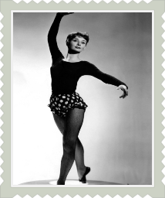
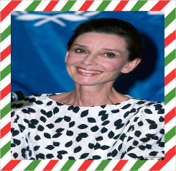
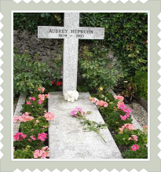
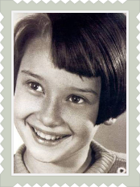
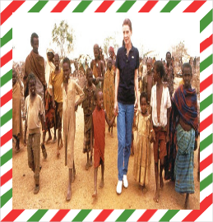
Audrey Hepburn's life story in chronological order
as a young girl during the war
during her last 5 years
later
after the war
in 1988
in 1992
Notes:
Why in chronological order? Yes. It is in chronological order that the author revealed to us Audrey's life during the war, after the war, at the peak of her career and her late years of humanitarian work in a clear and logical manner.

Slide 17
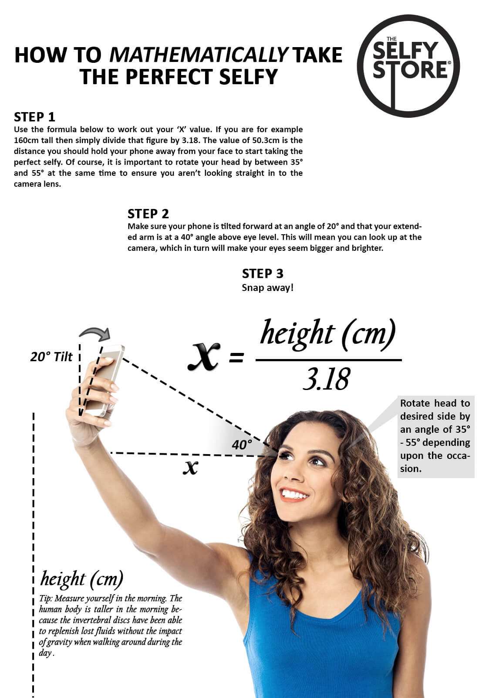
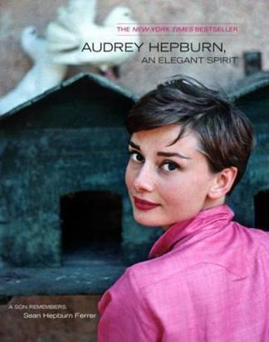
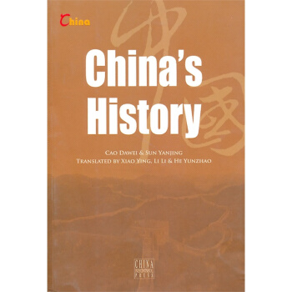
Application of chronological order

Slide 18
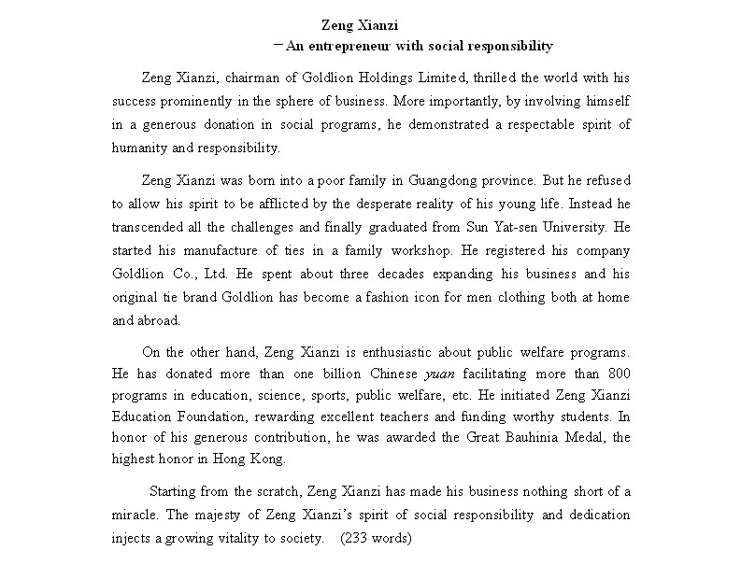
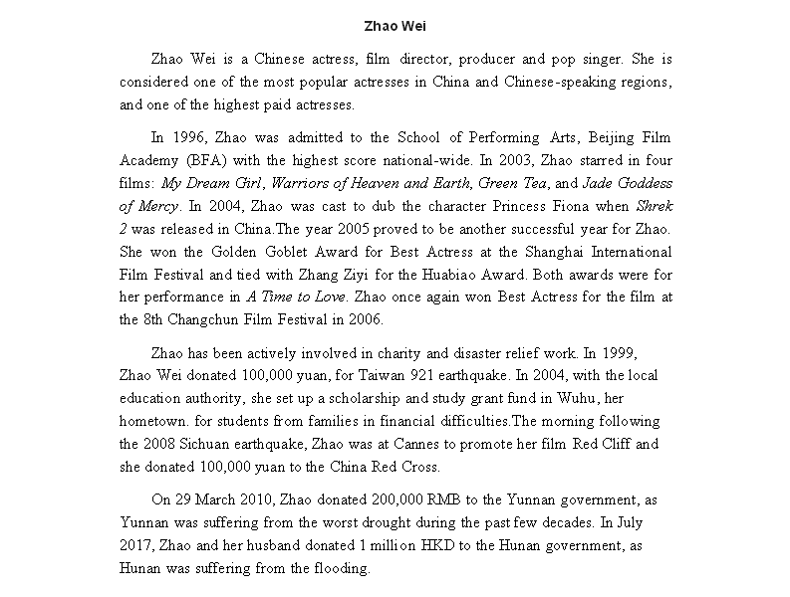
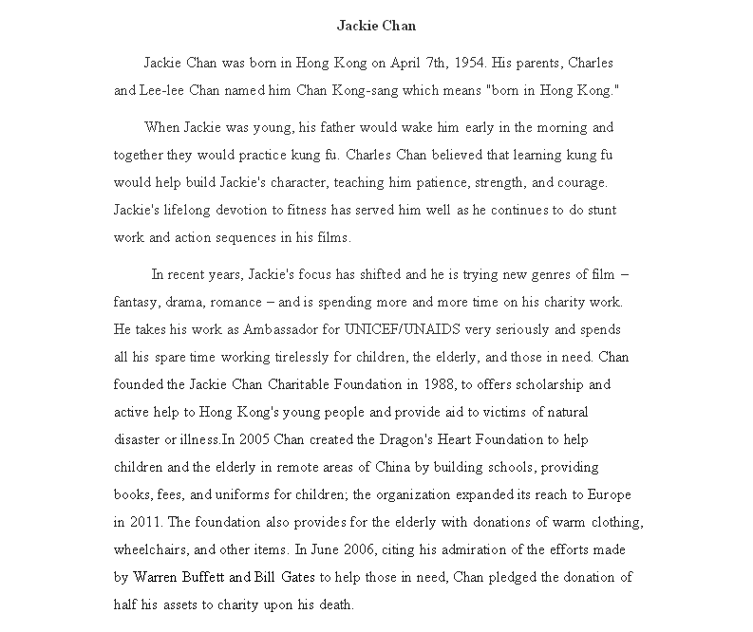
Assignment
Revision & submission

Slide 19
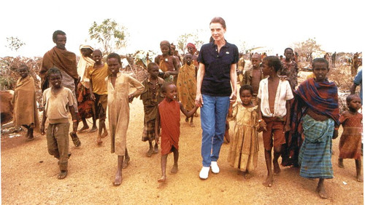
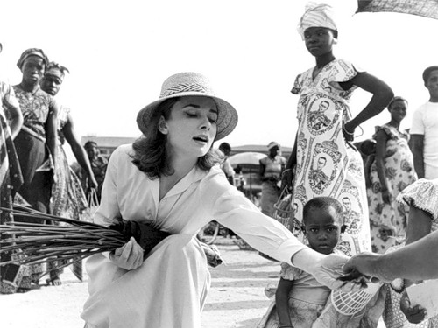
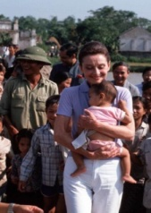
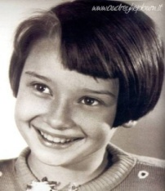
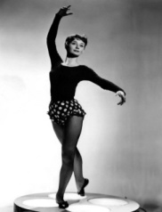
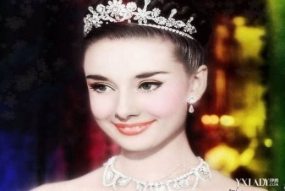
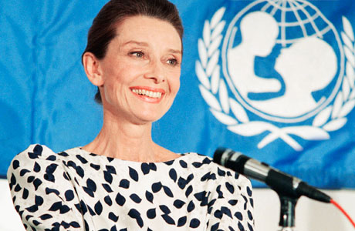
Thank you!

Slide 20
Teaching Assessment

Slide 21
1. Which of the following works is NOT supposed to be organized in chronological order?
A. “The Story of an Eyewitness: The San Francisco
Earthquake”
B. A Woman in Charge: The Life of Hillary Rodham
Clinton
C. “How to Make Perfect Brownies”
D. “Nudist Trailer Park”

Slide 22
2. Choose the appropriate time signals.
______, he received a film camera as his birthday present. _____, he became increasingly interested in cinematography. After 13 years of relentless pursuit of his beloved cause, he won himself a seven-year contract with Universal Studios where he strove hard and produced numerous notable movies. _____, he revealed that his lifelong conviction was to “Make sure you are right and go on!”, which has immensely inspired the young with the dream of film.
A. When Steven was eight years old ; As the renowned movie director; Since then
B. When Steven was eight years old ; Since then; As the renowned movie director
C. Since then; As the renowned movie director; When Steven was eight years old
D. As the renowned movie director; Since then; When Steven was eight years old

Slide 23
3. Suppose you are writing a narrative of a celebrity you admire. Which of the following details about him or her can be effective supporting details?
A. Poverty in childhood times
B. Pursuit of dreams
C. Interesting experiences or stories
D. Contribution to society

