Slide 1
听文化
思异同
陈观点
－－新视野视听说教程（第三版）
王倩
西北工业大学

Slide 2
王守仁, 2014，北京 高等学校大学英语教学改革与发展学术研讨会
中国情怀、国际视野、跨文化沟通
ICC(Inter-cultural Communicative Competence): 知识、技能、态度和意识
Byram, 1997

Slide 3
Unit Components
AIDA
A = Attention
-opening up
I = Interest
-listening
Listening to the world
D = Desire
-viewing
A = Action
-speaking for communication
Further listening practice

Slide 4
听力教学选材
口语教学选材
有效性
文化性
关联性
准备性
难度性
深化主题
拓展知识
培养技能
启发思考
适合水平

Slide 5
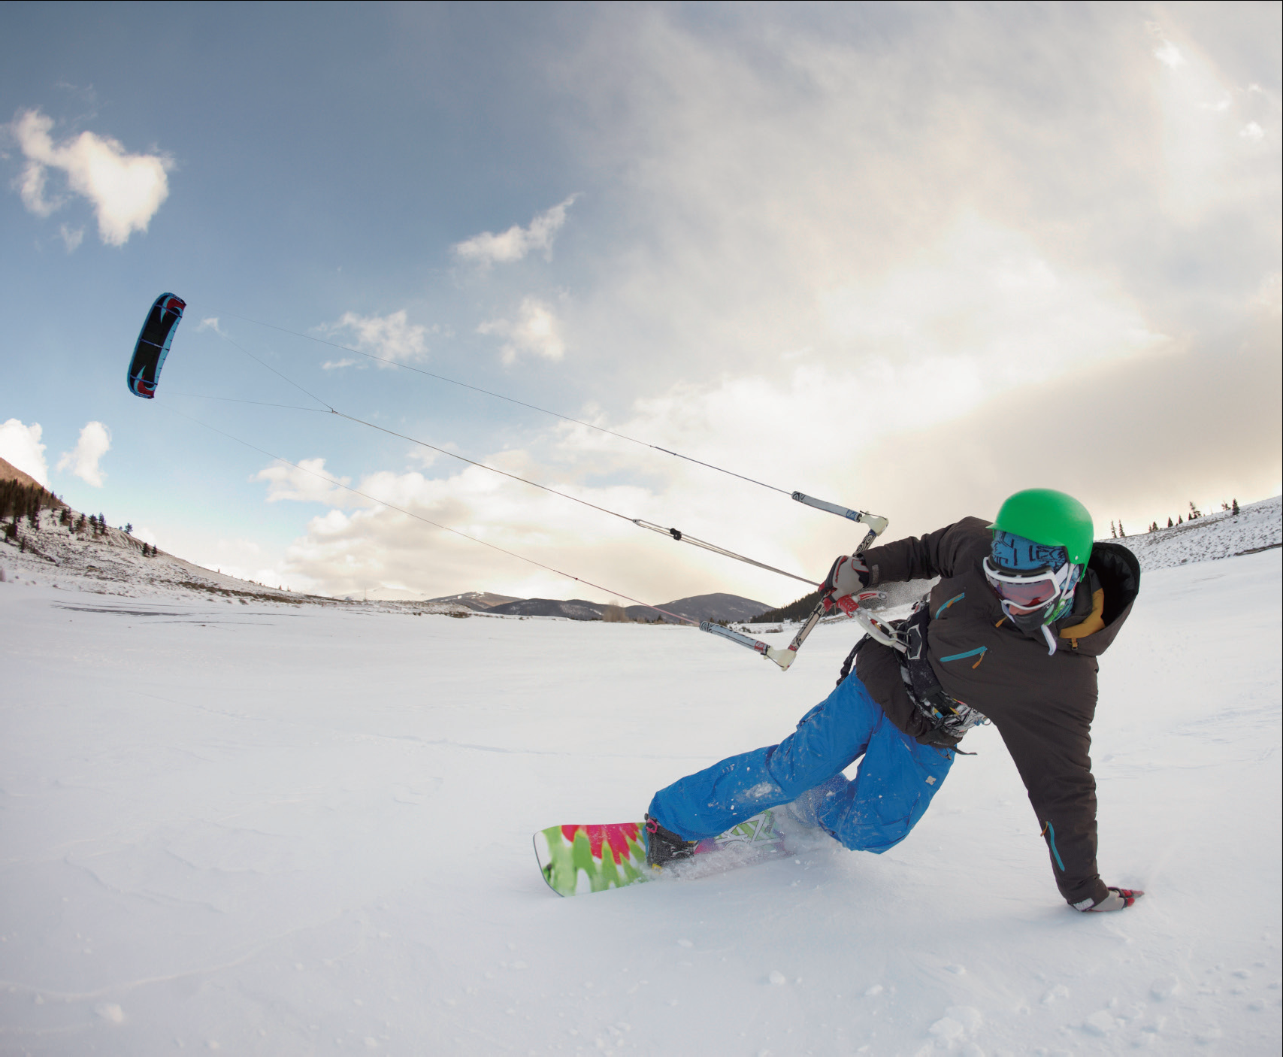
Demo teaching: Unit 2 Book I
UNIT 2
A break for fun

Slide 6
Teaching Procedures
Step 1
pre-learning activities
(输出驱动): 说 /写、听
Step 2
while-learning activities
2
(输入+输出)：听、读、说
Step 3
post-learning activities
(输出+输入)：读、写、 说
“四位一体”

Slide 7
Learning objectives
Talk about leisure activities
Identify words and expressions for describing people’s appearance
A break for fun
Ask and give recommendations
Describe an event

Slide 8
听力材料处理
The bottom-up model：figure out meaning of words, phrases, and structures.
The top-down model：listen for gist, making use of the contextual clues
听前预测激活 + 听中重构解码
+ 听后复述强化

Slide 9
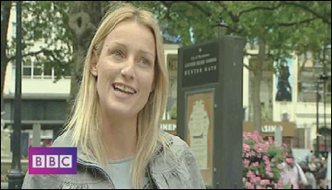
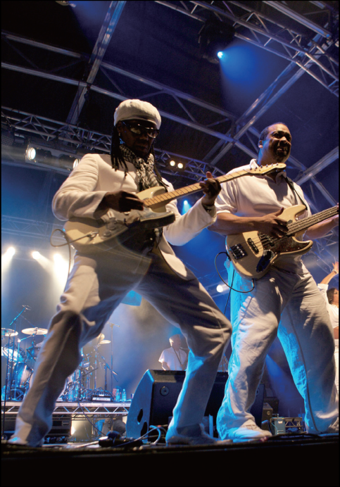
Listening to the world
Podcast
1
How often do they go to the cinema?
but
1) I like going to the cinema a lot, probably only get there about ____________.
once a month
2
What kinds of film do you like?
romantic
2) I always like_________ comedies. Slumdog Millionaire was a _________movie.
great
BBC viewing
3
Festival Highlights
3) So, if there’s one answer to the question, One thing that everyone talks about is this: __________________.
why are you here?
being together

Slide 10
口语活动设计
Step 1
pre-learning activities (输出驱动):说/写
Task: Students’ Union, this year, is responsible for accommodating international students who pursue Master of Science degree in Northwestern Polytechnical University. Three international students (1from America, 1 from Korea, 1 from Pakistan) will arrive at Xi’an tomorrow at different times. As the president of the Students’ Union, you met them before in previous summer camp, but your new assistant, Michael, a foreign exchange student who is going to meet them in the airport did not. Therefore, you have to describe the 3 students to Michael and make sure he won’t have troubles to recognize them in the airport.

Slide 11
Step 2
while-learning activities (输入+输出)：听、说
Listening tasks check-up
Q&A session (5 mins)
1.What aspects will we consider when describing people?
2. How do we comment on the actors and actresses?
3. Why people go to the Bestival, a music festival held in Isle of Wight?

Slide 12
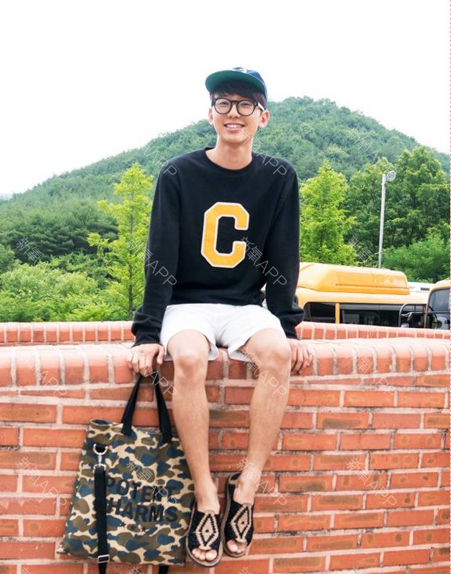
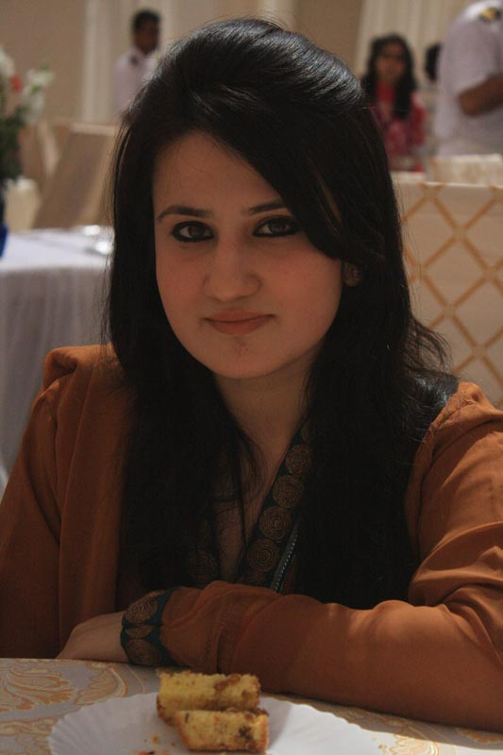
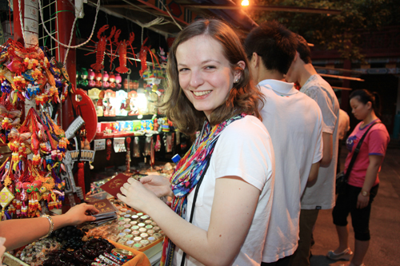
Step 2
while-learning activities (输入+输出)：听、说
Task1: individual work（15mins）listening skills: describe people 以听促说
Directions: Please describe the three foreign students coming to NPU to Michael with the expressions you’ve learnt from listening.

Slide 13
Step 2
while-learning activities (输入+输出)：读、说
Task2: 1）Intra-group work（20 mins） speaking skills: asking and giving recommendations 以读促说
Directions: Please read the card assigned to you and get to know more information about leisure activities enjoyed by Chinese people. Report the leisure activity given to you in your group.
http://www.calligraphyforgod.com/leisure-activities-china.html
Mahjong
Ping Pong/Badminton
Shopping
Going to a Park
Karaoke

Slide 14
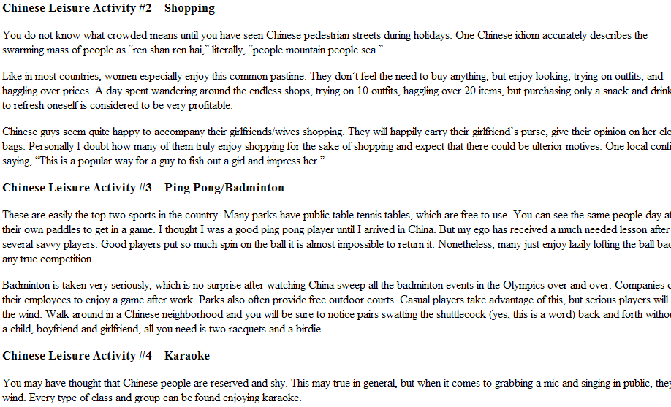
Mahjong

Slide 15
Step 2
while-learning activities (输入+输出)：读、说
Task2: 2）Inter-group work: role-play（25 mins） speaking skills: ask and give recommendations 以读促说
2）Directions: In the last day of “Orientation Week” for international students, there is a “welcome party” for them. In the party, your new foreign friend asks you about what Chinese people do for fun and what leisure activities they could have access to in NPU. Role-play the conversation and learn to use the expressions related with asking and giving recommendations. Note: you are supposed to report the leisure activity you’ve heard from your group members just now. (P30)

Slide 16
Step 2
while-learning activities (输入+输出)：听、说
Step 2
Task3: group discussion (20mins) : describe an event
Directions: In the “experience exchange” session of the “welcome party”, students are encouraged to share any exciting moment they have experienced to better understand each other. How do you start with a recent event you went to ? (e.g, a festival, a concert, a sports event, a play, or anything you would like to share).
Sentence models:
1. (starting) I will never forget about the time I did…;
The interesting topic reminds me of the time I did… It was amazing / unforgettable.
2. (climax) Do you know what happened?/ Can you imagine what happened?/ You will never guess what happened?/ Do you know what I felt like at that moment?/ Imagine the surprise when I …/ I was happy to death./ I could jump for joy.
(ending) Anyway, what happened in the end was like this…
Clues: 5 w+ 1h
• What was the event? When and where was it?
• Why did you go there? What did you do or see?
• How do you feel about it?

Slide 17
Step 3
post-learning activities (输出+输入)：读、写、 说
Step 2
Assignments (5 mins)
1. Group Project.
1) People’s ideas about free time and leisure activities vary from country to country. Carefully study the chart below and discuss with group members after class concerning the following points:
a. What conclusion can you get from the chart?
b. How people differ in spending their leisure time around the world?
c. Do you think that people will spend more time on internet and less time on reading in the future? why?
图表作文
作文/口语-差别类话题
口语-预测将来话题

Slide 18
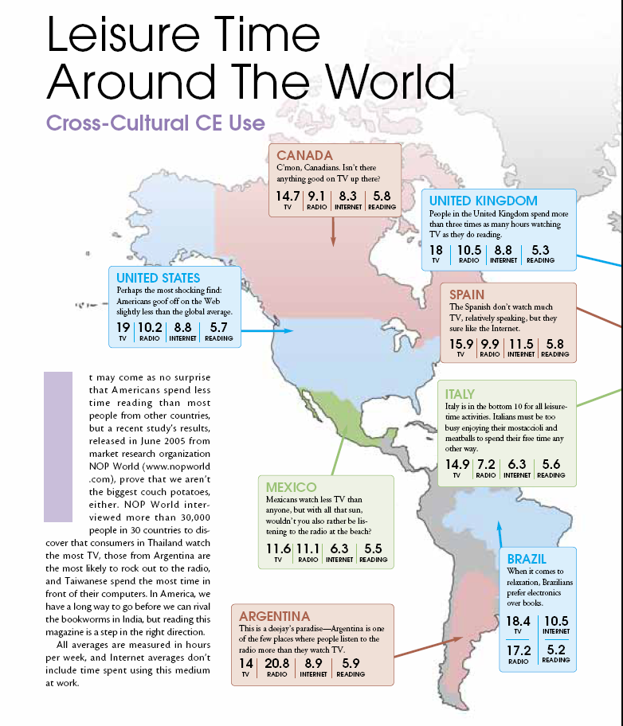
Notes:
18

Slide 19
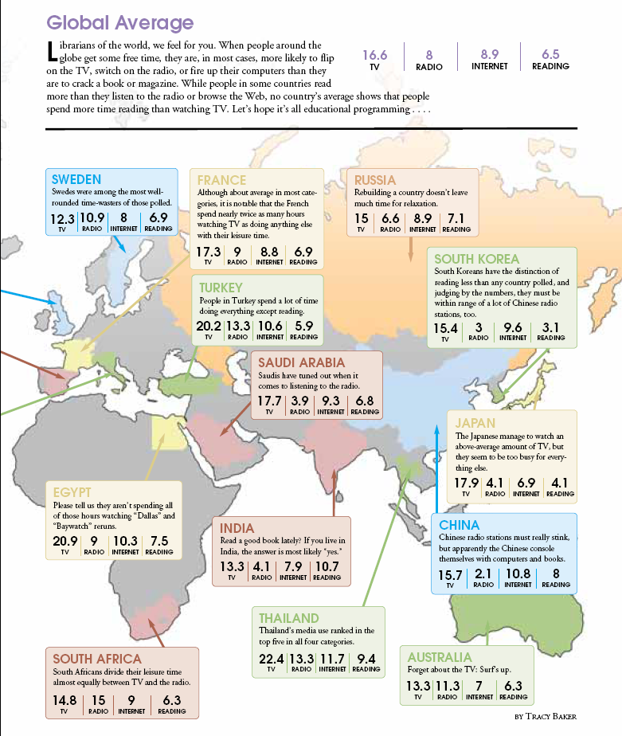
Notes:
19

Slide 20
post-learning activities (输入+输出)：读、写、 说
Step 3
Step 2
Assignments (5 mins)
2) Based on the discussion with your group members and your research after class, please write a report on what you have found in the chart (200-300 words). Please focus on the differences in leisure preferences in different countries through comparison and contrast with relevant examples you would like to include. You will be invited to present your project to the whole class next time with PPT.
• 探究+协作+沟通

Slide 21
Step 3
post-learning activities (输入+输出)：读、写、 说
Step 2
Assignments (5 mins)
2. Please check the previewing task of unit 3 and finish the listening parts of Unit 3.

Slide 22
结束语
“新心相印”
用“新”教
用“心”学
“合作共赢”
处处是创造之地，天天是创造之时,人人是创造之人。—陶行知

Slide 23
Thank You !

