Slide 1
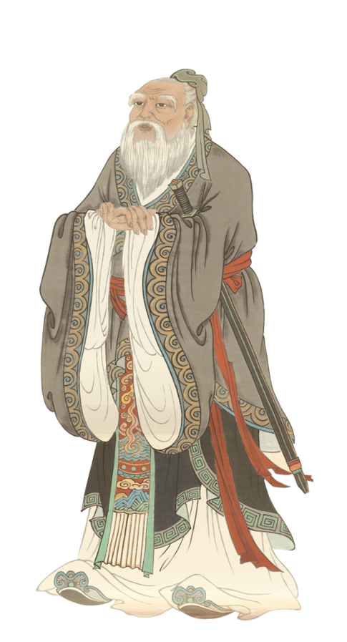
A teaching design of the flipped classroom
A glimpse of Confucius’
teaching philosophy

Slide 2
Contents
1
Key elements to specify
2
Teaching procedures
3
Reflection & conclusion

Slide 3
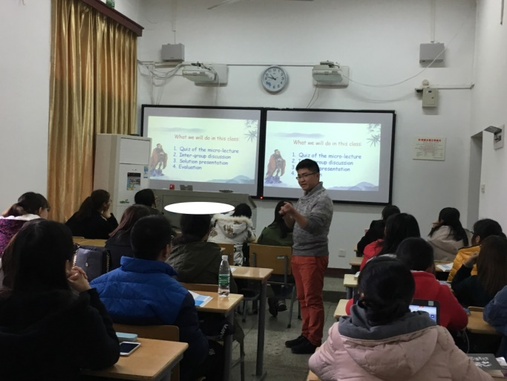
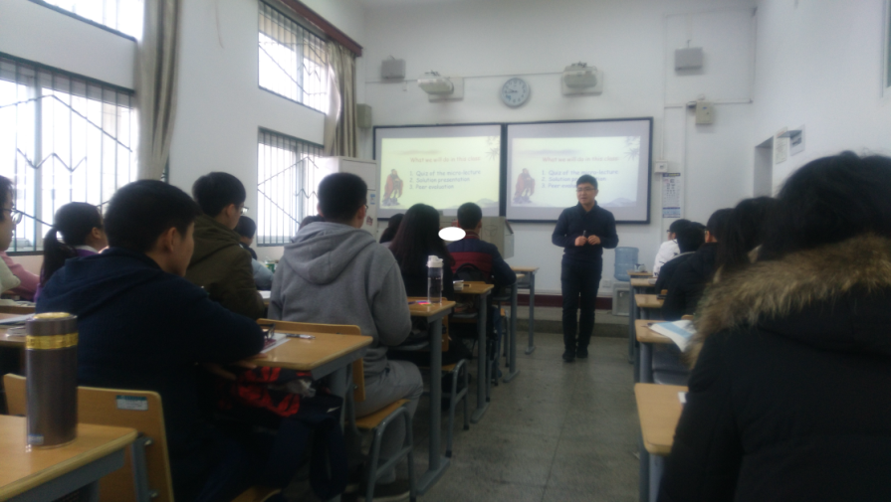
Key elements to specify
1.Based on teaching practice
Key elements
2.Target students
English level: intermediate
Sophomore non-English majors of a normal university (“211”)
To check students’ acquisition of the micro-lecture
To apply students’ knowledge of Confucius‘ teaching philosophy to practice
To evaluate students’ presentations
3.Teaching objectives

Slide 4
Teaching Procedures
Before
Class
During
Class
After
Class
Video watching
Discussion
Presentation preparation
Lead-in
Class activities
Assignment

Slide 5
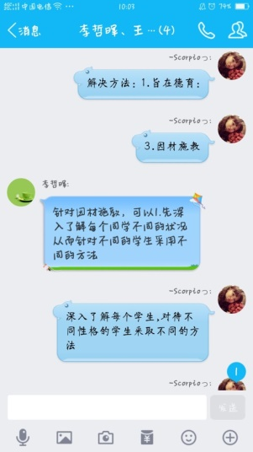
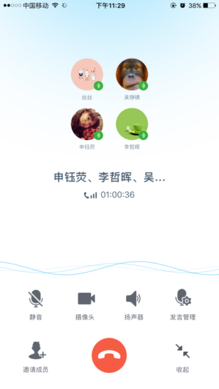
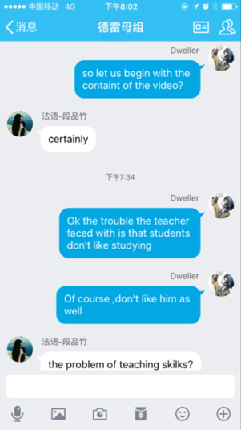
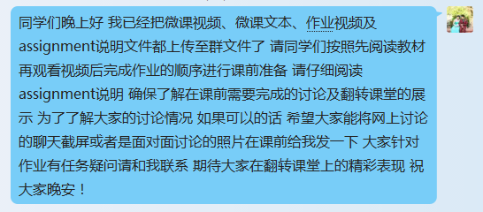
Video watching
Before
Class
1. micro-lecture video
2. case study video
Discussion
During
Class
1. group discussion
2. online discussion (Q&A)
Presentation preparation
After
Class
rehearsal & practice

Slide 6
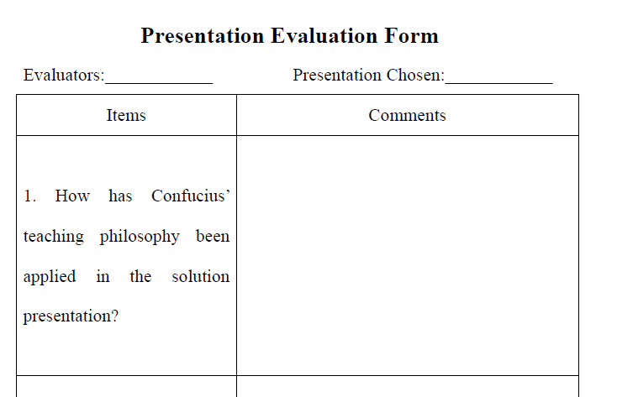
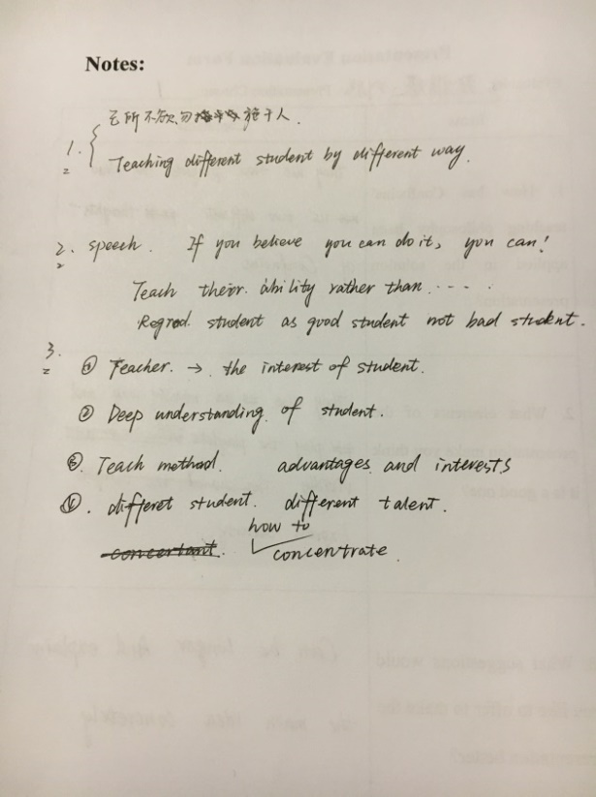
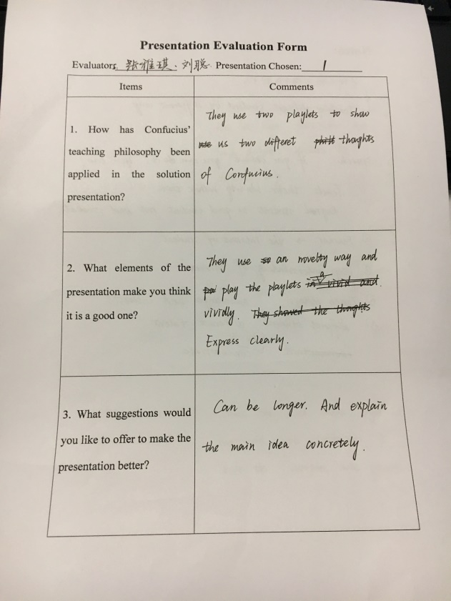
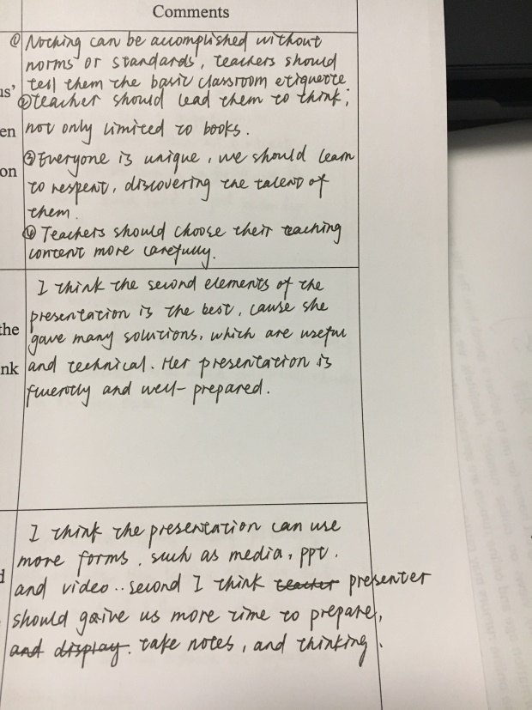
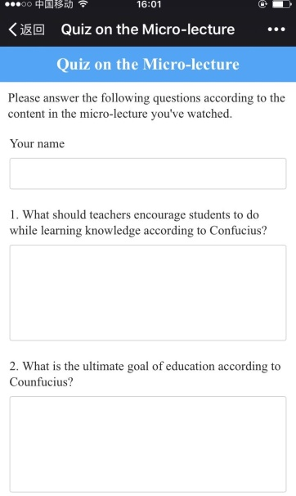
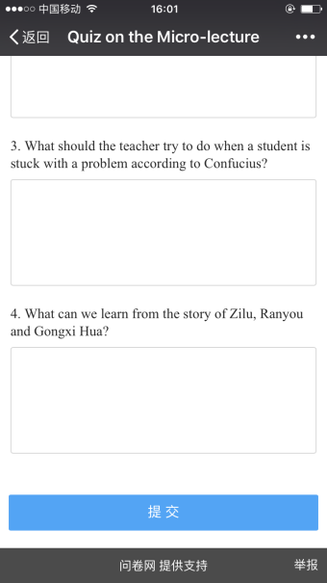
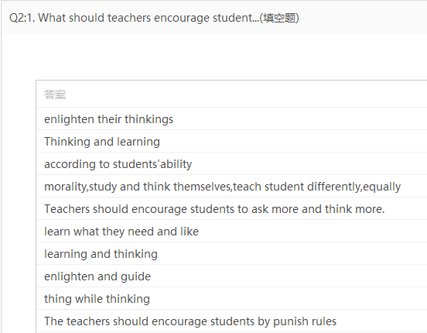
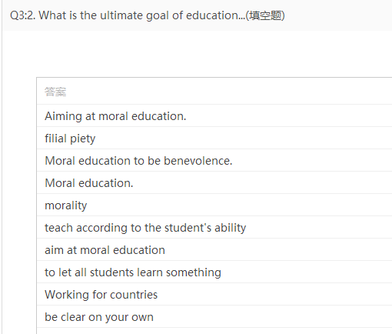
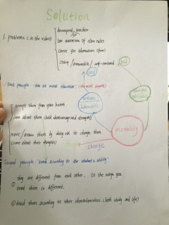
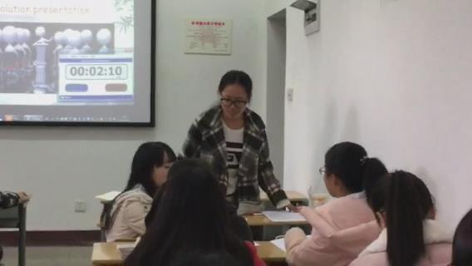
1. Lead-in (1 min)
Before
Class
to have a glimpse of the activities in the class
How has Confucius’ teaching philosophy been applied in the solution presentation?
What elements of the presentation make you think it is a good one?
What suggestions would you like to offer to make the presentation better?
2. Quiz on the micro-lecture (3 mins)
to check students’ acquisition of the micro-lecture
During
Class
3. Presentation & feedback (12 mins)
to apply knowledge of Confucius‘ teaching philosophy to practice
four questions on the understanding of Confucius’ four teaching principles
After
Class
4.Peer evaluation (4 mins)
to evaluate students’ presentations

Slide 7
Before
Class
Assignment
Watch the whole movie to know how the teacher solves the teaching problem
During
Class
Use Socrates’ and Confucius’ teaching philosophies to evaluate the way the teacher solves the teaching problem and write a reflective journal
After
Class

Slide 8
Reflection & conclusion
the flipped classroom
the micro-lecture
Bloom’s taxonomy of
educational objectives

