Slide 1
大学英语口语课程设计
北京外国语大学
邱枫

Slide 2
Course Design
Teaching objectives
Course plan
Teaching material
Adjusting course plan according to classroom observation or evaluation data
Teaching strategies
Assessment

Slide 3
Teaching Objectives
交际
文化
思维
学术

Slide 4
Teaching Objectives
通过采取课堂中启发式、讨论式、发现式、研究式等活动达到以下目的
交际：日常生活、人际交往
文化：文化差异、国际视野和本土意识
思维：多元视角、逻辑清晰、论点明确、论据有力
学术：记录、分析、归纳、总结、讨论、展示
通过教师的反馈、过程性评价以及指导，培养学生的以下能力
学习策略&自主学习意识
批判性思维能力

Slide 5
Course Plan
1学期或2学期
每学期16周
每周2 学时

Slide 6
Teaching Material
交际 Daily communication
文化 Culture bridge
思维 Points of view
学术 Academic communication
Highlights
Culture bridge
Academic communication

Slide 7
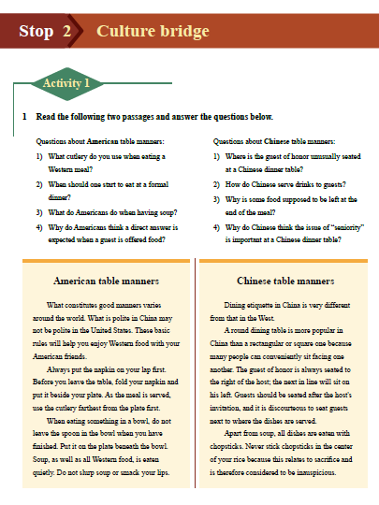

Slide 8
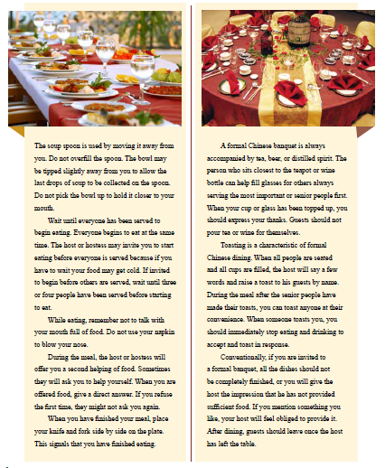

Slide 9
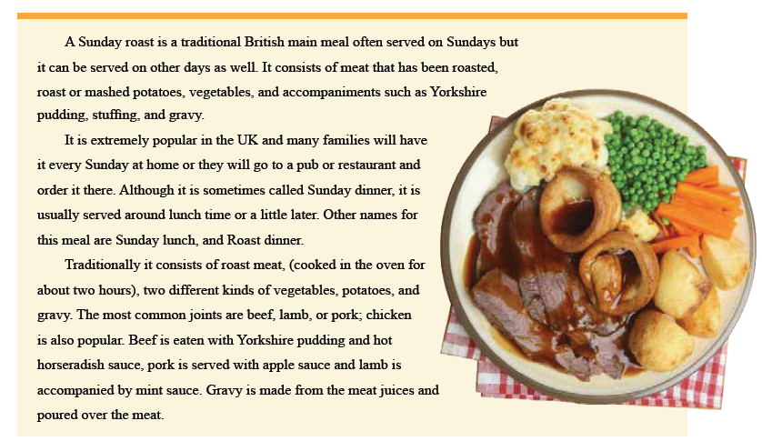

Slide 10
Adjusting Course Plan
课堂活动的阶梯性 （难度循序渐进）
学生学习水平在统计学上有显著差异
课堂活动话题的多样化
学生学习兴趣和动机的差异
课堂活动板块的灵活性
课程学时和大学对口语教学的重视程度差异

Slide 11
Teaching strategies
Scaffolding
The Input Hypothesis ( Stephen D. Krashen，1985)
语言能力 （linguistic competence）
语际能力 （extra- linguistic competence ）
i+1模式
语言水平
话题内容

Slide 12
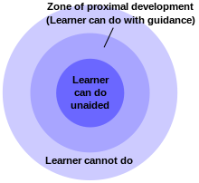
Zone of Proximate Development

Slide 13
Case Study: A Class Activity from “ Points of View”

Slide 14
Pre-class tasks
Compulsory tasks:
Look up the definition of humanities in OED, Wikipedia and Britannica
Compare the definition of humanities with social science
List 5- 8 departments of humanities education in your college
Optional task:
Do a survey of 3-5 peers’ opinions on whether they will send their children to college for humanities education and ask them to justify themselves.

Slide 15
OED’s Definition of Humanities
Learning concerned with human culture, especially literature, history, art, music, and philosophy

Slide 16
Wikipedia’s Definition of Humanities
The humanities are academic disciplines that study human culture, using methods that are primarily analytical, critical, or speculative, and having a significant historical element, as distinguished from the mainly empirical approaches of the natural sciences.

Slide 17
Britannica’s Definition of Humanities
Those branches of knowledge that concern themselves with human beings and their culture or with analytic and critical methods of inquiry derived from an appreciation of human values and of the unique ability of the human spirit to express itself.

Slide 18
Teacher’s Role in Pre-class tasks (传统教法)
查找生词
背景知识
教师补充和总结

Slide 19
Pre-class tasks (Scaffolding)
Stimulate learners’ interests in the topic
Familiarize learners with the useful expressions about humanities education
Help learners to tell the difference between humanities and social science
Instruct them to use online resources properly, especially to form the habit of referring to authoritative/academic online resources

Slide 20
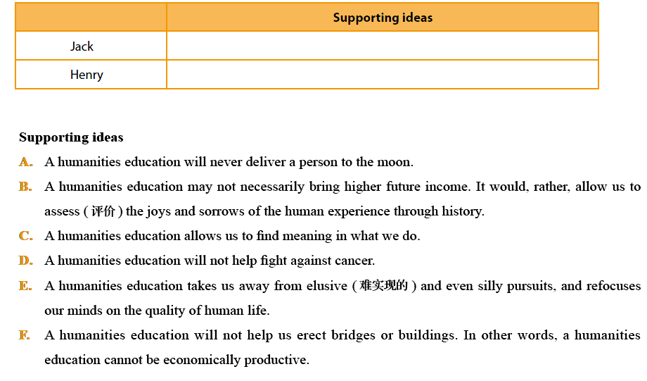

Slide 21
In-class tasks (Scaffolding)
Identify Jack’s and Henry’s views (Pair-work)
Can you distinguish facts and opinions in Jack’s views? (Class discussion)
Can you distinguish facts and opinions in Henry’s views? (Class discussion)
Is Jack’s opinion convincing? Why?
Is Henry’s opinion convincing? Why?

Slide 22
In-class tasks (Scaffolding)
If you were about to choose your major in the college, would you choose to major in humanities? Exchange your opinion with your partner. (Pair-work)
Brainstorming specific examples to back up your opinion. (Pair-work)
Present your opinion to your partners. (Group work of 3 students)
Deliver the revised presentation to your partner and be prepared to present to the class. (Pair-work)

Slide 23
In-class tasks (Scaffolding)
Ask 2 students to present their opinions in class and motivate the class to make comments.
Wrap up the activity with teacher’s comments on students’ presentations, especially the strength and weakness that reflect the current level of most learners in the class.
Provide guidance on learning strategies.

Slide 24
Student B’s Peer Evaluation Worksheet (For in-class task 9)
Delivery
Eye contact
Vocal and facial expressiveness
Fluency
Content
Is the central idea clear?
Do all the supporting examples relate to the central idea?
Are all the supporting examples arranged in a cohesive way?

Slide 25
Student C’s Peer Evaluation Worksheet (For in-class task 9)
Language
Grammar (use of pronouns, tense, agreement of gender and number)
Collocation (Chinglish phrases, coined phrases)
Pronunciation

Slide 27
Teacher’s Role In-class tasks (传统教法)
教师无法调动每个学习者都有效参与活动
教师偏重对语言的指导，而忽视对逻辑内容的指导
教师缺乏对学习策略的指导

Slide 28
Teacher’s Role in In-class tasks (Scaffolding)
Understand the learners’ current level and reduce their anxiety in class discussion
Boost their confidence in speaking out
Increase each learner’s share of speaking in class
Develop learners’ critical think competence
Identify the main idea and supporting examples
Evaluate the validity of an argument
Distinguish facts from opinions

Slide 29
Teacher’s Role in In-class tasks (Scaffolding)
Provide class activities for them to enhance language competence of making presentation
Delivery
Content
Language
Give learners implicit instruction on learning strategies via peer evaluation worksheets
Take measures to push the learner to create their own ideas

Slide 30
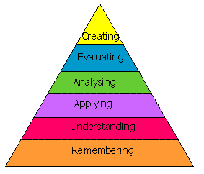
Anderson's Taxonomy
在合适的scaffolding下，教师可以完成多级认知任务，而不是仅仅停留在remembering 和understanding这最低的两级。

Slide 31
Reflection on Teaching Strategies
教师在讲台前的时间比例减少
直接语言讲解和语言纠错减少
教师辅助的层次提高
作为导演和课堂灵魂的教师
教师对教材提供的各种活动的灵活取舍
提供为特定学习者群体“量身定做”的scaffolding
教师对学习策略的指导
从课内拓展到课前和课后活动，从单一知识提供者转型为知识和学习策略的指导者

Slide 32
Assessment
Attendance 10%
Class performance: 10%
Presentation: 20% (3 students per week)
Mid-term：30%
Conversation (20%)
Topic-based presentation (10%)
Final exam: 30%
Conversation (10%)
Topic-based presentation (20%)

Slide 33
小结
口语课堂中的输出环节的显性教学目标
打好基础——基本的交际技能
传播文化——提高中西方文化异同的意识
重视思维——从receptive/repetitive到productive
促进学术——表达能力的全面提升
口语课堂中的输出环节的隐性教学目标
学习策略&自主学习意识
批判性思维能力

Slide 34
Appendix
Conversation skills
Initiating a conversation
Advising and persuading
Agreeing/Disagreeing
Inviting/Declining
Expressing gratitude
Expressing regrets
Asking for / expressing opinions
Asking for help
Asking for clarification and clarifying
making compliments
Expressing doubt and reservation
Expressing certainty/determination
Acknowledging differences and compromising
Hesitating and taking time to think
Exclamation
Interrupting politely

Slide 35
Appendix
Presentation skills
Opening a presentation
Giving an overview
Effective use of voice (pacing, pausing, rhythm and intonation)
Highlighting important points
Defining
Classifying / categorizing
Sequencing / listing ideas
Exemplification
Explaining cause and effect
Comparing and contrasting
Hypothesizing
Leading a discussion
Quoting
Handling interruptions
Summarizing a group discussion / presentation
Handling Q & A

