Slide 1
S
M
A
R
T
Smart Design
Unit 3 Language and Communication

Slide 2
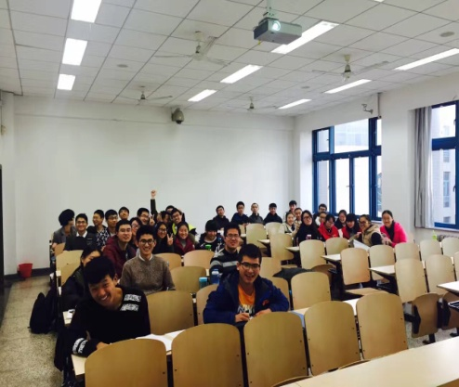
Target Students
A class of 30 students
Non-English Major
Second semester of the 1st year
Above CET4
Teaching Material
Unit 3, Language and Communication
Book 2, iEnglish (Integrated Course)

Slide 3
Teaching Objectives
Knowledge
Relevant words and expressions
Comm-YOU-nication principle
Skills
1. Comm-YOU-nication in practice
2. How to be polite in English?
Competence
The importance of language in communication
The relationship between language and thought

Slide 4
Smart Design
· Scenerio dicussion
· Ted Talk
· Advertisement slogans
POA
Pre-class Activities
motivating
A
(Production-Oriented Approach)
1. Video Recording and Submission
Padlet Interaction
(scafolding)
B
Production
enabling
2. Opinion Essay Writing
assessing
C

Slide 5
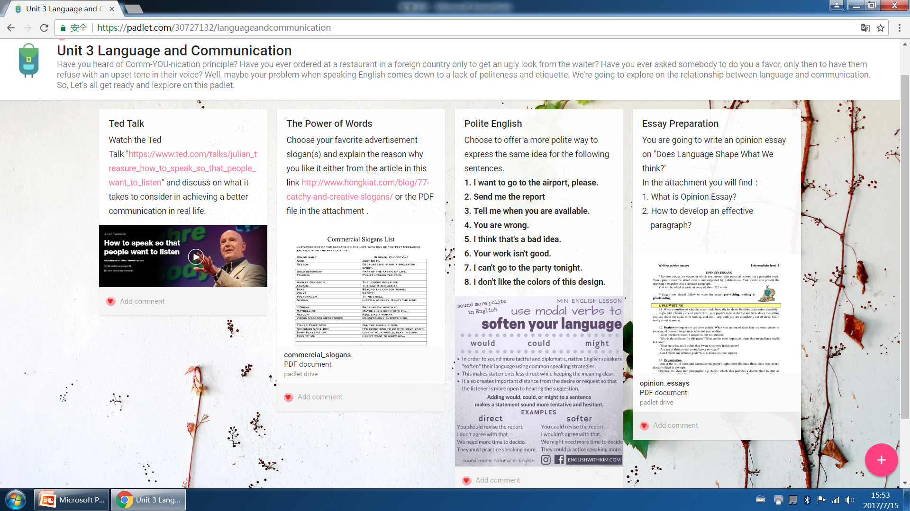

Slide 6
Smart Design
· Scenerio dicussion
· Ted Talk
· Advertisement slogans
Pre-class Activities
motivating
A
POA
(Production-Oriented Approach)
1. Speech and Video Recording
Production
Padlet interaction
B
enabling
On-line Interactive Learning
2. Opinion Essay Writing
· Peer review
· Teacher’s evaluation
C
Evaluation
assessing
Cooperative Learning

