Slide 1
Discovery of a new life stage
--- Class Design

Slide 2
My Smart Design
Target Students
Teaching Objectives
Teaching
Procedures
Teaching
Principles

Slide 3
content
Target Students
Class Size: 30
Freshmen, non-English majors
English Level: intermediate
Goal : to use English in practice

Slide 4
Teaching Objectives
Skill
To talk about the topic of growing pains.
To learn the writing device of contrast and comparison
Knowledge
Emotion
To master the independent structure led by with.
To master some ways of word building.
To know the origin of the word Odyssey.
To have a positive outlook on life.

Slide 5
Teaching Procedures
A
Pre-class
B
In-class
C
After-class
Notes:
Warming-up Activities

Slide 6
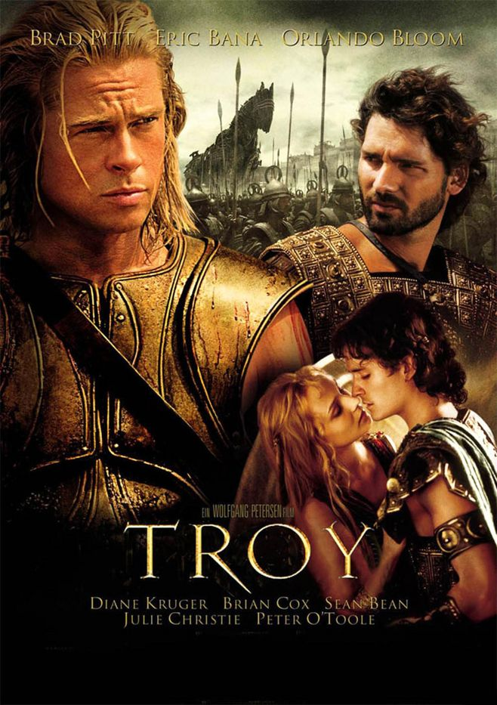
content
A
Pre-class
Teaching Procedures
Task 1: Watch the film Troy
Task 2: Group work
Each group prepares one story about the difficulties Odysseus’ encounter in his journey back home.

Slide 7
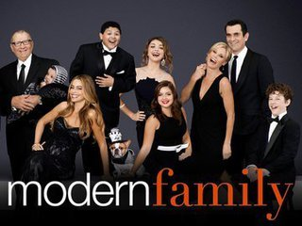
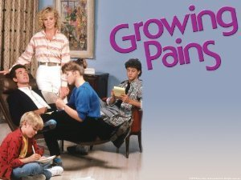
B
In-class
Presentation (pre-class)
Lead-in
Discussion
1. Do you have conflicts with your parents like the characters in the video? If yes, what are they?
2. Can you share some other growing-pain stories with us?
Text
exploration
Exercise
Application

Slide 8
B
In-class
The Seven Ages of Man
--- William Shakespeare
Lead-in
All the world's a stage,
And all the men and women merely players; They have their exits and their entrances; And one man in his time plays many parts His acts being seven ages.
At first the infant, Mewling and puking in the nurse's arms; Then the whining school-boy, with his satchel And shining morning face, creeping like snail Unwillingly to school…
Emphasize the link between text A and text B
Encourage the students to discuss strategies to overcome the odyssey years after analyzing the para.11&para.12 of section A
Text
exploration
Exercise
Application

Slide 9
B
In-class
Lead-in
Fill in the blanks with the independent structure.
1. He stood at the door, ____________（电脑在他的手上）。
2.The boy lay on the grass, _____________ (双眼望着天空)。
3. （有这么多工作要做）____________,
we had to sit up the whole night.
Text
exploration
Modified exercise in section A p.69
Self-designed exercises
Exercise
Application

Slide 10
B
In-class
Lead-in
Materials:
Rich Dad Poor Dad
The generals :Ulysses S. Grant and Robert E. Lee
An essay from CET- 4(2016.12)
Text
exploration
Exercise
Ss: To master the writing device of comparison and contrast
Application

Slide 11
content
C
After-class
Conduct a survey on the odyssey years.
Task 1
Task 2
Write an essay on the topic of generation gap between parents and children .

Slide 12
content
Teaching Principles
The old- new association
The output -oriented instruction
The task-based teaching

Slide 13
Teaching Procedures
A
Pre-class
I prepare
B
In-class
I explore
C
After-class
I produce
Notes:
Warming-up Activities

Slide 14
Writing devices
Comparison and Contrast
---an effective way to develop an essay

Slide 15
Comparison and Contrast
when
what
how

Slide 16
Comparison and Contrast
when
what
how
1. When should we use comparison and contrast?

Slide 17
1. When should we use comparison and contrast?
Comparison and Contrast

Slide 18
1. When should we use comparison and contrast?
Comparison and Contrast
When you watched the video, did you make comparison and contrast?

Slide 19
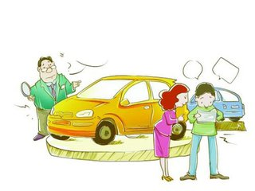
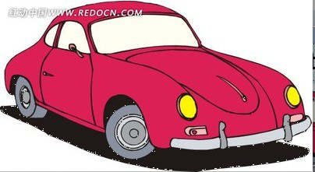
1. When should we use comparison and contrast?
Comparison and Contrast
Honey, I think this car is better than the one we saw yesterday.
？

Slide 20
1. When should we use comparison and contrast?
Comparison and Contrast
To show the superiority
(buy a car, choose a department)
To present information (unfamiliar-familiar)
To help the reader understand or evaluate two things. (two jobs)

Slide 21
Comparison and Contrast
when
what
how
2. What does comparison and contrast mean?

Slide 22
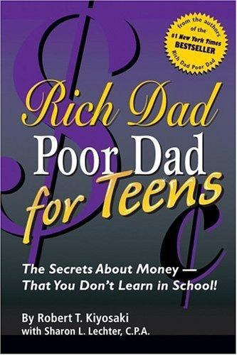
2. What does comparison and contrast mean?
Comparison and Contrast

Slide 23
2. What does comparison and contrast mean?
Comparison and Contrast
Rich Dad Poor Dad
I had two fathers, a rich one and a poor one. One was highly educated and intelligent; he had a Ph.D. and completed four years of undergraduate work in less than two years. The other father never finished the eighth grade. Both men were successful in their careers, working hard all their lives.
Both earned substantial incomes. Yet one struggled financially all his life. The other would become one of the richest men in Hawaii. One died leaving tens of millions of dollars to his family, charities and his church. The other left bills to be paid.
(comparison )
To compare means to show the similarities;
To contrast means to show the differences.
(contrast )
(contrast )
(contrast )
(comparison )

Slide 24
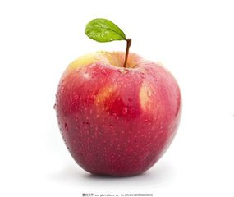
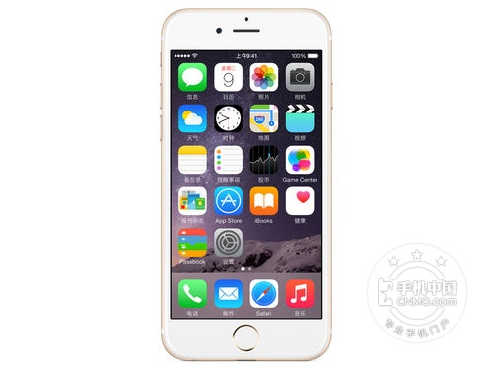
2. What does comparison and contrast mean?
Comparison and Contrast
There is one thing we should notice :
Can they be compared or contrasted?
No!

Slide 25
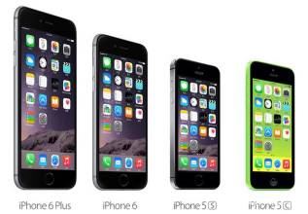
2. What does comparison and contrast mean?
Comparison and Contrast
From the same category.
Comparable.

Slide 26
Comparison and Contrast
when
what
how
3. How can we organize the essay of comparison and contrast?

Slide 27
3. How can we organize the essay of comparison and contrast?
Comparison and Contrast
point-by-point
Two Patterns
subject-by-subject
Point refers to the aspects you would like to use to develop your essay.
Subject refers to the two items or people you want to compare or contrast.

Slide 28
3. How can we organize the essay of comparison and contrast?
Comparison and Contrast
I had two fathers,
a rich one and a poor one.
subject

Slide 29
3. How can we organize the essay of comparison and contrast?
Comparison and Contrast
point by point
concept of money
education
point 3
point 1
career
point 2
One was highly educated and intelligent; he had a Ph.D. and completed four years of undergraduate work in less than two years. The other father never finished the eighth grade.
Yet one struggled financially all his life. The other would become one of the richest men in Hawaii. One died leaving tens of millions of dollars to his family, charities and his church. The other left bills to be paid.
Both men were successful in their careers, working hard all their lives. Both earned substantial incomes.

Slide 30
3. How can we organize the essay of comparison and contrast?
Comparison and Contrast
subject by subject
Grant
Lee
subject 1
subject 2
Grant descended from a family whose members participated in American Revolution. He received his his commission of second lieutenant from West Point …
Lee also descended from a family which engaged in the American Revolution. He, too, received his commission from West Point…
The generals :Ulysses S. Grant and Robert E. Lee.

Slide 31
3. How can we organize the essay of comparison and contrast?
Comparison and Contrast
Writing
take a job
go to a graduate school
VS.
(from CET-4 2016.12 )
point
Personal cultivation
Economic
reward
Employ-
ment
subject
point by point
Rewarding immediately
lower salary
harder
wide in choice
take a job
Rich in
experience
go to a graduate school
Money-consuming
Rewarding in a long run
Proficient in major
much easier
limited in choice
subject by subject

Slide 32
3. How can we organize the essay of comparison and contrast?
Comparison and Contrast
point : 1 2 3
subject: A B
A 1 B1
A 2 B2
point by point
A 3 B3
A 1 A2 A3
subject by subject
B 1 B2 B3

Slide 33
3. How can we organize the essay of comparison and contrast?
Comparison and Contrast
The generals :Ulysses S. Grant and Robert E. Lee
Do you know the key to writing a successful and coherent essay of comparison and contrast ?
Rich Dad Poor Dad
Both earned substantial incomes. Yet one struggled financially all his life. Both men offered me advice, but they did not advise the same things. Both men believed strongly in education but did not recommend the same course of study.
Although Ulysses and Robert Lee were fierce adversaries, their lives, both military and nonmilitary, has a great deal in common. Grant descended from a family whose... He received his… Lee also descended from a family which engaged in the American Revolution. He, too, received his commission from West Point…

Slide 34
Do you know the key to writing a successful and coherent essay of comparison and contrast ?
Comparison and Contrast
The generals :Ulysses S. Grant and Robert E. Lee
Rich Dad Poor Dad
Both earned substantial incomes. Yet one struggled financially all his life. Both men offered me advice, but they did not advise the same things. Both men believed strongly in education but did not recommend the same course of study.
Although Ulysses and Robert Lee were fierce adversaries, their lives, both military and nonmilitary, has a great deal in common. Grant descended from a family whose... He received his… Lee also descended from a family which engaged in the American Revolution. He, too, received his commission from West Point…
comparison and contrast structure words

Slide 35
structure words
Comparison:
Contrast:
similarly, likewise, also, too, as, just as, like, just like, similar to, alike, the same as, not only … but also…, both … and …,etc.
on the other hand, in contrast, however, in comparison, even though, although, though, whereas, while, but, different from, unlike, etc.

Slide 36
Summary
when
what
how
To show the superiority
To present information
of sth. Unfamiliar
To understand or evaluate
Comparison: similarity
Contrast: difference
Two patterns:
point by point
subject by subject
Comparable
structure words

Slide 37
Homework
Topic：generation gap between
parents and children
Group 1：use the point-by-point pattern
Group 2: use the subject-by-subject
pattern

Slide 38
Teaching Assessment
1. When you write an essay, the writing method of showing the differences is called_____.
A. classification B. comparison
C. contrast D. listing
2. The following of which is the pattern of contrast or comparison in organizing your essay?
A. subject by subject B. sentence by sentence
C. object by object D. word by word
答案: C
答案: A

Slide 39
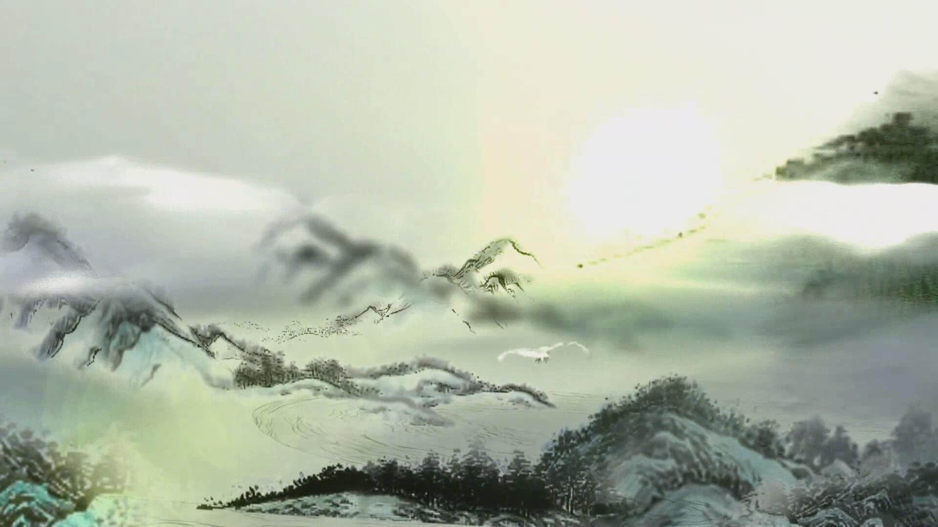
THANK YOU！

