Slide 1
Flipped Class
Audience Analysis
In Public Speaking
Notes:
本模板由微信公众号欢乐PPT和夏影联合发布，请勿私自传播；更多模板和教程，请关注微信公众号：欢乐PPT

Slide 2
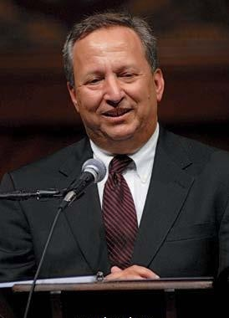
27th president
2001-2006
28th president
2007 - now
The Importance of Audience Analysis
Lawrence Summers
Catharine Drew Gilpin Faust

Slide 3
Teaching Procedures
Micro-lecture
01
05
Assignment
create
Flipped Class
Creating Evaluating
evaluate
Review
Remembering
Understanding
analyze
02
04
apply
Presentations
Analyzing
Creating
Practice
understand
Applying
Analyzing
03
remember

Slide 4
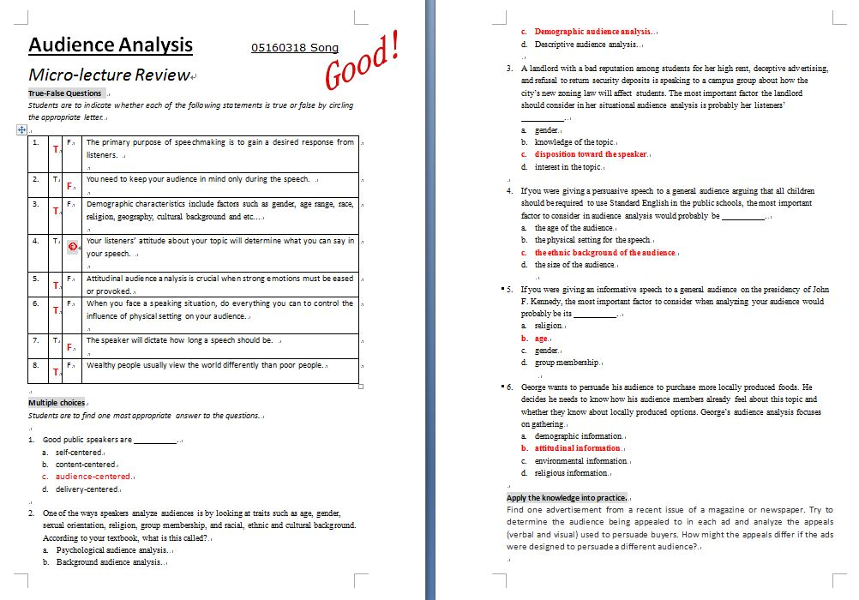
Review
T/F Questions
01
Feedbacks
Sample

Slide 5
Review
T
The primary purpose of speechmaking is to gain a desired response from listeners.
You need to keep your audience in mind only during the speech.
The speaker will dictate how long a speech should be.
George wants to persuade his audience to buy more organic foods. He needs to know how they already feel about this topic, so his analysis focuses on gathering demographic factors...
before, during and after
F
occasion
F
F
attitudinal

Slide 6
Review
Demographic
02
Classify the KEYWORDS
Audience emotions
Audience physical comfort
religion
race
attitude about the speaker
geography
gender
attitude about the topic
culture
Audience coverage
time
age
occassion
physical setting
Attitudinal
Environmental

Slide 7
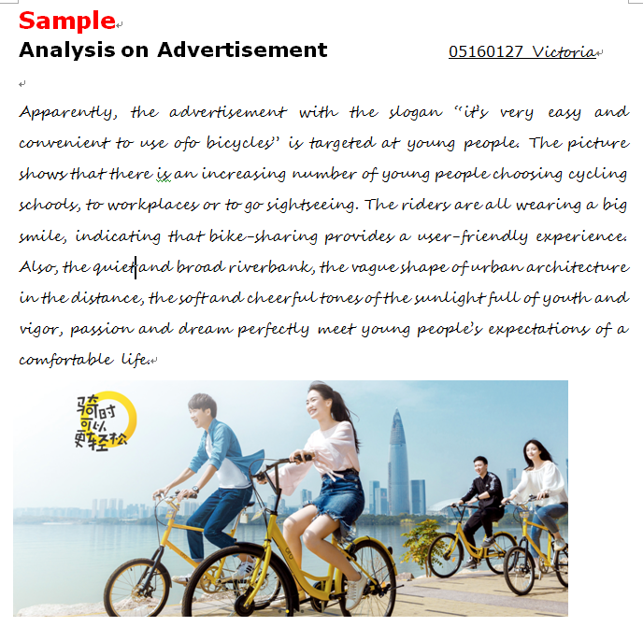
Practices
01
Choose the more heart-winning advertisement for the following target audiences.

Slide 8
Practices
01
A male marketing manager , single
A
B

Slide 9
Practices
A woman worries a
lot about healthy skin
A
B

Slide 10
Practices
A father who is a
heavy smoker
A
B

Slide 11
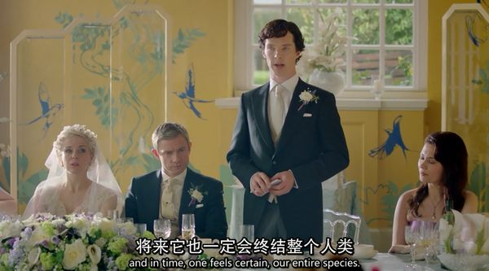
Practices
Error Finding Game
02
BBC
Sherlock Holmes
WeddingToast

Slide 12
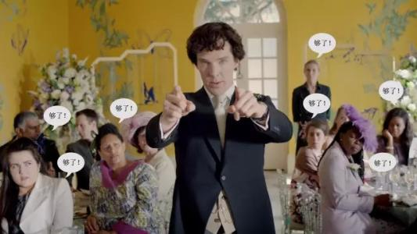
Practices
His major fault is about…?
Demographic | age gender race culture …
Attitudinal | about speaker about topic
Environmental | occasion time physical setting

Slide 13
Presentations

Slide 14
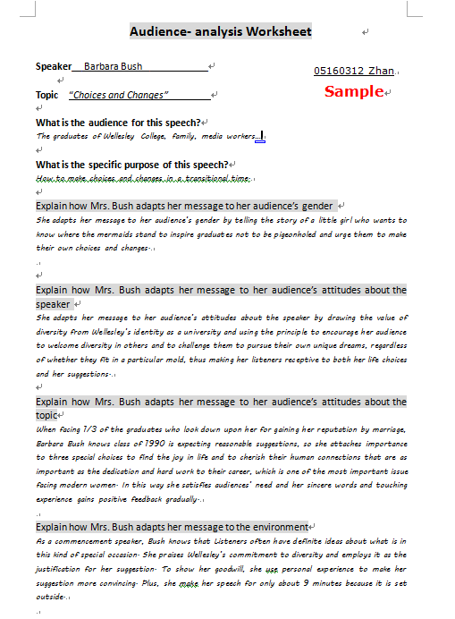
Presentations
Commencement Address
at Wellesley College
Students’ worksheets
Students’ shared audios

Slide 15
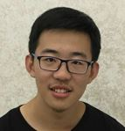
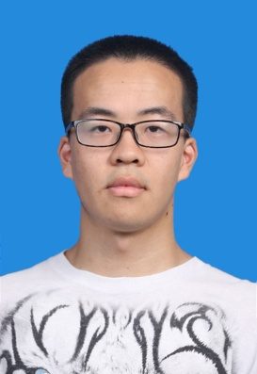
Presentations
How
More ideas?
Story about mermaid
A couple’s debate
A female president
Effects
David
Yin
cover more audiences
appeal to target listeners
ease hostile emotions
satisfy need
build credibility
ensure comforts
gain positive feedbacks
Diversity - common ground
Alice Walker as first choice
Victoria
June
Need for suggestions
Sincere words
Touching experience
how she adapts to
gender
attitudes about the speaker
attitudes about the topic
environment
Occasion: Commencement
Outside - 10 minutes

Slide 16
Assignment
As a college student create a speech for your target audience regarding GAME ADDICTION

Slide 17
Assignment
0
Group division
Roles
Organize ideas
Group discussion
collect ideas
Presentation online
Group of Four
Role of the audience
Role 1: primary school students
Role 2 : teachers
Role 3 : parents
Role 4 : game engineers

Slide 18
THANK YOU

