Slide 4
Teaching Design of Unit 6
Unit 6 Gender equality

Slide 5
Teaching Design of Unit 6
Teaching Process
Target Students
Main Focus
·support an argument
with personal experiences
·voice own opinions on gender equality
sophomore
non-English majors
argument
opinions

Slide 6
Teaching Objectives
Knowledge
·to master subjunctive mood without “if”
·to grasp usage of participles & vocabulary
Skill
·to talk about gender equality
·to support an argument with personal experiences and observations
Quality
·to respect others regardless of gender
·to pursue gender equality

Slide 7
Teaching Objectives
Knowledge
·to master subjunctive mood without “if”
·to grasp usage of participles & vocabulary
Skill
·to talk about gender equality
·to support an argument with personal experiences and observations
Quality
·to respect others regardless of gender
·to pursue gender equality

Slide 8
Teaching Objectives
Knowledge
·to master subjunctive mood without “if”
·to grasp usage of participles & vocabulary
Skill
·to talk about gender equality
·to support an argument with personal experiences and observations
Quality
·to respect others regardless of gender
·to pursue gender equality

Slide 9
Teaching Objectives
Knowledge
·to master subjunctive mood without “if”
·to grasp usage of participles & vocabulary
Skill
·to talk about gender equality
·to support an argument with personal experiences and observations
Quality
·to respect others regardless of gender
·to pursue gender equality

Slide 10
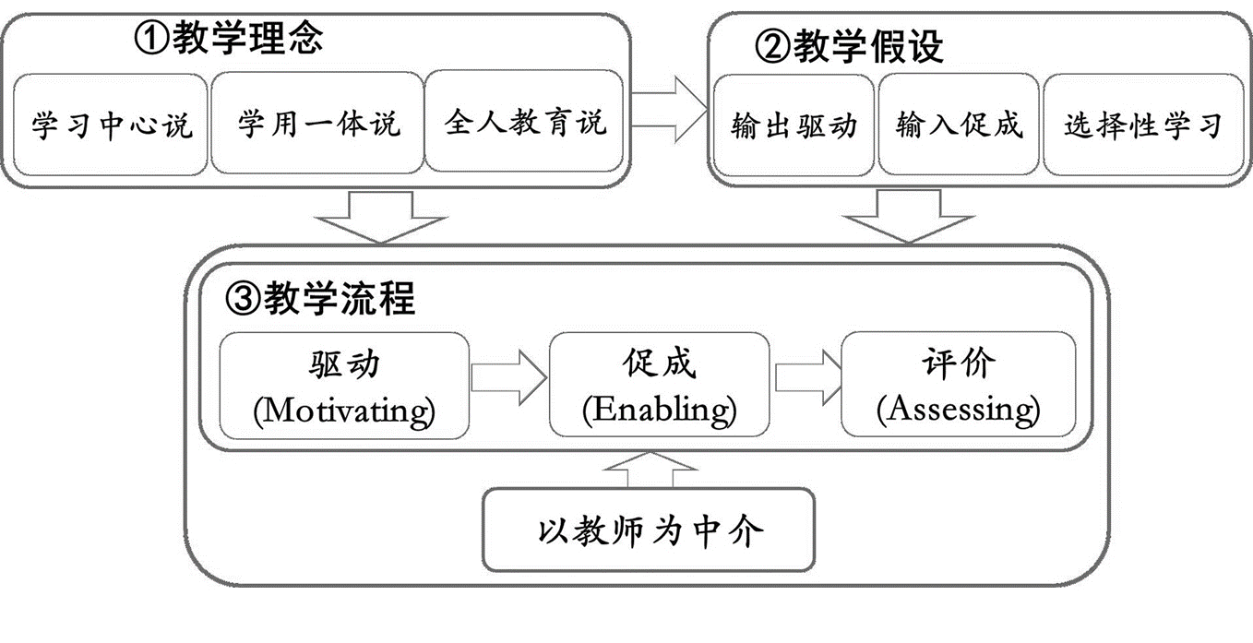
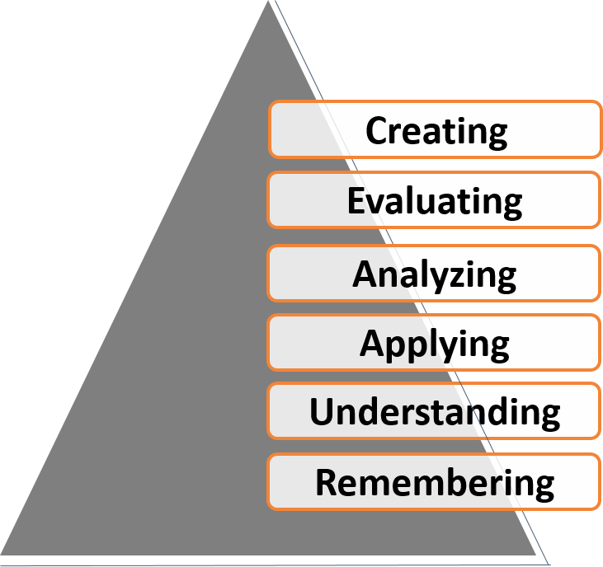
Teaching Theories
Bloom’s Taxonomy- Cognitive Domains
Production-oriented Approach-Wen Qiufang

Slide 11
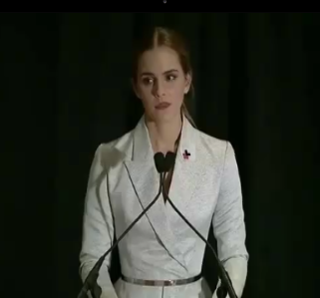
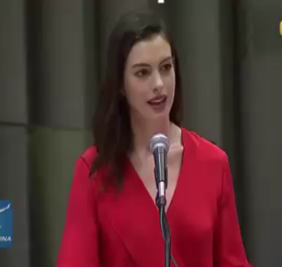
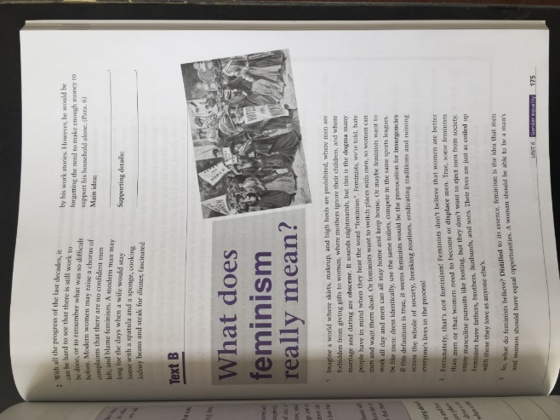
MY Teaching Process
Output-driven
Tasks (lead-in questions + essay writing)
·arouse interests
·create sense of ”hungry”
Initial Try
Output1:
Sentence translation
Subtask 1: Exercise + Unipus
Input 1: Text A
Enabling
Enabling
Output2: Discussion+
Oral presentation
Subtask 2: Summary + Comparison + Critical thinking
Input 2: Online videos + Text B
Output3: Writing+
Group review + Polish
Input 3: Writing analysis
Reorganize
·writing skills explanation
·sample analysis
Subtask 3: First draft writing
Mission accomplished
Assessment

Slide 12
MY Teaching Process
Output-driven
Tasks (lead-in questions + essay writing)
Initial Try
Output1:
Sentence translation
Subtask 1: Exercise + Unipus
Input 1: Text A
Enabling
Enabling
Output2: Discussion+
Oral presentation
Subtask 2: Summary + Comparison + Critical thinking
Input 2: Online videos + Text B
Output3: Writing+
Group review + Polish
Input 3: Writing
analysis
Subtask 3: First draft writing
Mission accomplished
Assessment

Slide 14
Support an argument with personal experiences and observations
Review
Sample
Summary
Assignment
Make a forceful argument

Slide 15
Review

Slide 16
Review

Slide 17
Review
Argument:
state your position and give reasons for it.
≠assertion
Debatable thesis
Supporting details
relevant, convincing
emotions, intuitions, personal preferences
Conclusion

Slide 18
Review
What can be used to support your thesis?
Quotations
Statistics
Facts or Examples
Personal experiences &
Observations

Slide 19
Sample
… Here for the first time I met women who told me that men were guilty of having kept all the joys and privileges of the earth for themselves. I was puzzled, and demanded clarification. What privileges? What joys? I thought about the grim, wounded lives of most of the men back home. What had they allegedly stolen from their wives and daughters? The right to work five days a week, 12 months a year, for 30 or 40 years, wedged in tight spaces in the textile mills, or in the coal mines, struggling to extract every last bit of coal from the rock-hard earth? The right to die in war? The right to fix every leak in the roof, every gap in the fence? The right to pile banknotes high for a rich corporation in a city far away? The right to feel, when the lay-off came or the mines shut down, not only afraid but also ashamed?
Para.5
Sample Analysis

Slide 20
Sample
… Here for the first time I met women who told me that men were guilty of having kept all the joys and privileges of the earth for themselves. I was puzzled, and demanded clarification. What privileges? What joys? I thought about the grim, wounded lives of most of the men back home. What had they allegedly stolen from their wives and daughters? The right to work five days a week, 12 months a year, for 30 or 40 years, wedged in tight spaces in the textile mills, or in the coal mines, struggling to extract every last bit of coal from the rock-hard earth? The right to die in war? The right to fix every leak in the roof, every gap in the fence? The right to pile banknotes high for a rich corporation in a city far away? The right to feel, when the lay-off came or the mines shut down, not only afraid but also ashamed?
Opposing idea

Slide 21
Sample
… Here for the first time I met women who told me that men were guilty of having kept all the joys and privileges of the earth for themselves. I was puzzled, and demanded clarification. What privileges? What joys? I thought about the grim, wounded lives of most of the men back home. What had they allegedly stolen from their wives and daughters? The right to work five days a week, 12 months a year, for 30 or 40 years, wedged in tight spaces in the textile mills, or in the coal mines, struggling to extract every last bit of coal from the rock-hard earth? The right to die in war? The right to fix every leak in the roof, every gap in the fence? The right to pile banknotes high for a rich corporation in a city far away? The right to feel, when the lay-off came or the mines shut down, not only afraid but also ashamed?
Personal observations
Verbs, adjectives
wedged in tight
Repeated words
extract every
Parallel structure
last bit of
rock-hard earth
Rhetorical questions
Vivid sensory details

Slide 22
Sample
… Here for the first time I met women who told me that men were guilty of having kept all the joys and privileges of the earth for themselves. I was puzzled, and demanded clarification. What privileges? What joys? I thought about the grim, wounded lives of most of the men back home. What had they allegedly stolen from their wives and daughters? The right to work five days a week, 12 months a year, for 30 or 40 years, wedged in tight spaces in the textile mills, or in the coal mines, struggling to extract every last bit of coal from the rock-hard earth? The right to die in war? The right to fix every leak in the roof, every gap in the fence? The right to pile banknotes high for a rich corporation in a city far away? The right to feel, when the lay-off came or the mines shut down, not only afraid but also ashamed?
Opposing idea
Personal observations
Verbs, adjectives
wedged in tight
Repeated words
extract every
Parallel structure
last bit of
rock-hard earth
Rhetorical questions
Vivid sensory details

Slide 23
Sample
Personal experiences and observations in public speaking

Slide 24
Sample
Personal experiences and observations in public speaking—Further exploration

Slide 25
Sample
Check
Addiction to IPAD
Thesis: It causes a lot of troubles to me
S1: do harm to the health
visual fatigue, spine collapse
S2: less time with the friends or family
talk, care
S3: weaken the interpersonal skills
find a place(GPS vs. Locals), play games
S4: Don’t watch it, because I hate it.
S5: You shouldn’t get addicted to it, or else you’ll regret.
Conclusion: Isn’t it better to get rid of it?

Slide 26
Summary
What is an argument
01
How to support an argument
02
Sample analysis
03
Public speaking
04

Slide 27
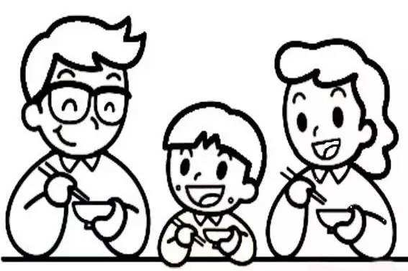
Assignment
Write an argumentative essay of no less than 200 words on the following topic.
Life as a single child
Introduction:
· Introduce the background
· State the thesis
Body:
Support the main idea with personal experience
· The way parents and grandparents treated me
· My feelings of growing up as a single child
Conclusion:
Restate the thesis
Polish it better(group review)

Slide 29
Q. 1. When selecting details coming from personal experiences and observations, you should make sure these details can create a , powerful effect or a dominant impression on the reader.
(choose single answer)
A. general B. unified C. diversified D. unique

Slide 30
Q. 2. While you are creating an outline of your argument, you need to include the following parts :
(choose multiple answers)
A. Introduction and background
B. Thesis statement
C. Arguments in support of your thesis
D. Refutation of opposing arguments
E. Conclusion

Slide 31
Q. 3. In addition to personal experiences and observations, what others can be employed to support an argument?
(choose multiple answers)
A. facts B. statistics C. quotations D. examples

