Slide 1
Unit 3 Journey through the Odyssey Years
Notes:
Good morning, distinguished judges and dear teachers from all over the country, the lesson I’ll teach today is Journey through the Odyssey years.

Slide 2
Student analysis
√
＊
understandable
＊
The Odyssey & the Odyssey years
＊
comparison and contrast
critical thinking
Notes:
When I was preparing the lesson, I firstly read the text and made a student analysis, and then I knew that generally speaking, this text is understandable for our students without any difficult grammatical structures, although there are some new words. Therefore, in order to make students fully understand the lesson, there are three teaching focuses that we should pay special attention to. The first one is to make students understand the two key cultural concepts of “The Odyssey” and “the Odyssey years” which are totally new for them. The second one is to make students use the new writing technique of “comparison and contrast” to analyze the causes and characteristics of “the Odyssey years”. And the last one is to cultivate students’ critical thinking which will help them form their own opinions on how to cope with “the Odyssey years” in their future lives.

Slide 3
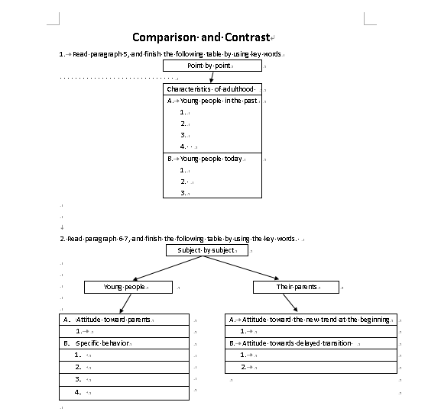
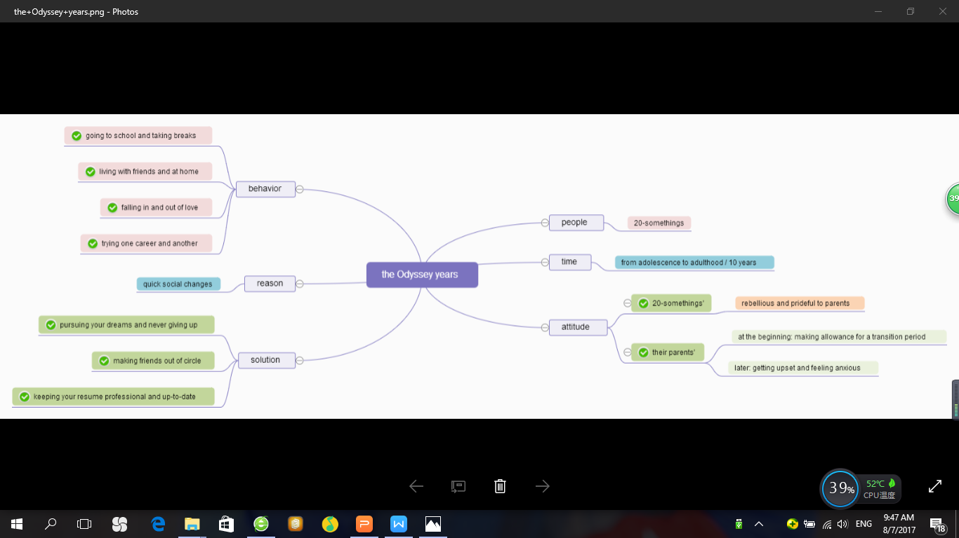
Introduction to my “Smart Design”
comparison and contrast
critical thinking
The Odyssey & the Odyssey years
Notes:
So to fulfill these teaching aims, we have some tasks to finish, such as, for “comparison and contrast”, the text and an online reading material are presented to students to read, as well as three supplemented exercises for students to finish. For “critical thinking”, students are required to draw a mind map like this to illustrate what they have learned and based on this, two opened-end questions are raised to trigger their thinking. As for “the Odyssey” and “the Odyssey years”, I make a micro lecture to explain what “the Odyssey” is, and a flipped class is applied to illustrate the concept of “the odyssey years” . And in today’s presentation, I’ll focus on the flipped class. Here I have to tell you in advance, this flipped class is made on the basis of collecting data from the homework assignment of “how do you understand ‘the odyssey years’”. This question is left at the end of the micro lecture. And now, let’s come into the flipped class.

Slide 4
Your understanding of “the Odyssey years”
Wordle
Who exactly?
What to do?
too general
Which?
+ How long?
Notes:
So my dear students, do you still remember the question that I left in the micro-lecture? Yes, that’s “How do you understand the odyssey years?” Actually, I received all of your answers through the Internet, and when I pasted them into wordle, I got the following complicated yet fantastic picture. This picture tells me which word you used most to express your understanding of the odyssey year. So which word? Great, period. And other eye-catching words are: (can you tell me?) yes, challenges, struggle, experience, people, phase, years, suffering, difficult. As you can see the bigger size the words are, the more frequently you used them in your understanding.
Therefore, answers including these words can be seen everywhere in your homework assignment. For example, this girl said “this term is closely related to the hero in Homer’s epic poem-Odysseus. After the winning of Trojan war, it took him nearly 10 years to go back home during which he has suffered a lot and experienced many adventures. I think, nowadays, the odyssey years has become a special term to characterize a certain period or phase, like man’s growing or struggling through difficult times”.
When I read your answers, I was quite pleased because you’ve gained a right understanding from the micro-lecture, but as a reader, I still have some doubts. You said a certain period, so what do you mean by “certain”? that is to say, which life period are you talking about? Adolescence, adulthood, or middle age? And how long does this period last? 1 year, 5 years, or even10 years? And who is this man exactly? or How old is the man? As for struggling and difficult times, we know it means difficulties. I just wonder what do these people do to go through the difficulties? Therefore, this answer is too general. We need more details to make a complete picture of the odyssey years. So let’s read the definition of the odyssey years.

Slide 5
The Odyssey years
Which?
+How long?
“the decade of wandering that frequently occurs between adolescence and adulthood,
Who exactly?
during which 20-somethings
go to school and take breaks from school.
uncertainty
What to do?
They live with friends and they live at home.
They fall in and out of love.
They try one career and they try another.”
David Brooks "The Odyssey Years" - The New York Times
http://www.nytimes.com/2007/10/09/opinion/09brooks.html
Notes:
Which is given by David Brooks on his article “the odyssey years” published on New York Times in 2007. It is “the decade of wandering that frequently occurs between adolescence and adulthood, during which 20-somethings go to school and take breaks from school. They live with friends and they live at home. They fall in and out of love. They try one career and they try another.”
Well, my dear students, from this definition, can you find out the answers to the previously mentioned questions? For instance, Which life period does the odyssey years refer to? It refers to a stage between adolescence and adulthood. Actually it is newly appeared phase corresponding to the changes of modern world. How long does this life phase last? A decade. That’s right, 10 years. Who will experience this stage? 20-somethings. That is to say, young people in their 20s. And what do they do to go through the difficulties? Yes, this is their behavior. And we can detect pairs of opposite words here, such as “go to and take breaks. with friends and at home. in and out. one and another”. Through this description, my dear students, if I ask you to use one word to comment on their behavior, which word will immediately come into your mind? Changeable! Wow, I like your idea. these young people always shift from one idea to another. They are wandering here and there. And why? Why do they do so? Don’t they know this will leave on us a not-very-good-impression of uncertainty? Or Just because they are immature? So next let’s come to our discussion part.

Slide 6
Discussion
Notes:
Why do young people nowadays always shift their ideas? Excellence. Because they do not have a sense of direction in their life. They do not know where their future is. In fact, I think that is really a stressful time for young people. They are not used to the quickly changing society in the process of from a schoolman to a social man. Some of them even live at home with their parents. So they have to tolerate the complaint from parents about their delayed permanent employment. And we suggest people like this just set up a goal and follow your heart. no matter how hard the situation is, please pursue and trust your ideas and aspirations. This life stage requires us to say yes to the things that interest us as well as things that scare us. Only in that way can you gradually make an ideal life for yourselves. Well, the above is my explanation of the odyssey years. Next let’s check what you have learned just now.

Slide 7
Q&A
1. When do people usually experience “the odyssey years”?
A. 10-20 years old B. 20-30 years old C. 30-40 years old D. 40-50 years old
2. Which of the following words in you opinion can represent “the odyssey years”?
A. uncertain B. struggling C. stressful D. enlightening
Notes:
The first question “When do people usually experience the odyssey years”? Yes, the correct answer is B. Easy, right? And the second question “Which of the following words in you opinion can represent the odyssey years”? You can choose more than one word. “uncertain” because they shift from one idea to another, and wander here and there. “struggling” because they come across a lot of difficulties in their lives. “stressful”, because they have their job, marriage and child-bearing delayed, and tolerated the complaint from their parents. “enlightening” because it is a life stage of self-discovery, you will finally know what you really want in your life if you follow your heart.

Slide 8
Thank You!
Have a nice day

