Slide 1
Understanding Product Life Cycle

Slide 2
Chapter 1 Smart Design

Slide 3
Basic Information
Chapter Six:
Marketing
Teaching Demo:
Product Life Cycle

Slide 4
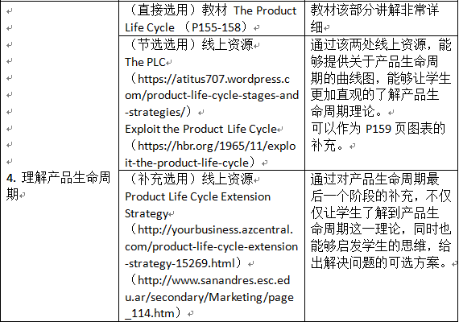
Teaching Materials

Slide 5
Teaching Aims
Try to understand the basic marketing concepts, such like: marketing, marketing mix, product life cycle and so on.
Try to arouse the students’ interests of leaning marketing, since they barely know nothing about business English or marketing English.
Try to have some fun.

Slide 6
Chapter 2 Teaching Demo

Slide 7
Agenda
A Little Flash Back
What is marketing ?
What is product ?
What is marketing mix ?
What is PLC?
Development Stage
Introduction Stage
Growth Stage
Maturity Stage
Decline Stage
Discussion
Case Study

Slide 8
A Little Flash Back

Slide 9
A little look back
What is Marketing?
Marketing is the process of planning and executing the conception, pricing, promotion, and distribution of goods and services to create exchanges that satisfy individual and organizational objectives.

Slide 10
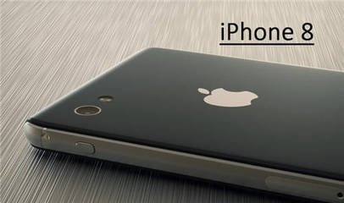
Product
A product is ‘anything that can be offered to a market to satisfy a need or want’ .
Goods
Services

Slide 11
Marketing mix?
The marketing mix is ‘the combination of variables that a business uses to carry out its marketing strategy and meet customer needs’.
The marketing mix is often called
the 4Ps

Slide 12
What is PLC?

Slide 13
The Product Life Cycle
The Product Life Cycle is a model that predicts the general trend that most successful products or services will follow during their lifetime.
In simple words:
The product life cycle is a series of stages that a product goes through from when a business first creates and sells it until the time nobody wants it any more.

Slide 14
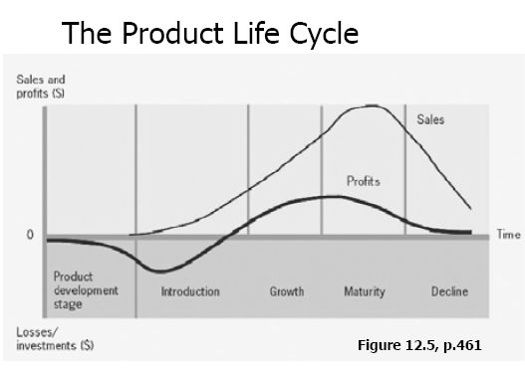

Slide 15
Development Stage
Begins when the company develops
a new-product idea
Sales are zero
Investment costs are high
Profits are negative

Slide 16
Introduction Stage
The primary goal is to establish a market and build primary demand for the product class.
Marketing Mix:
Product: one of few products, relatively undifferentiated
Price: high if using a skimming pricing strategy
low if using a penetration pricing strategy
Place: distribution is selective and scattered as the firm commences implementation of the distribution plan
Promotion: aimed at building brand awareness.

Slide 17
Growth Stage
Rapid revenue growth.
Sales increase as more customers become aware of the product and its benefits.
Marketing Mix:
Product: new product features and packaging options, improvement of product quality
Price: maintaining at a high price if demand is high, or reducing the price to capture additional customers.
Place: distribution becomes more intensive.
Promotion: increasing advertising to build brand preference.

Slide 18
Maturity Stage
Sales continue to increase, but on a slower pace.
Brand awareness is strong, then we can reduce the advertising investment.
However, its competitors may fight back harder than ever.
Promotional activities can be implemented.

Slide 19
Maturity Stage
Marketing Mix:
Product: modifications are made and features are added in order to differentiate the product from competing products that may have been introduced.
Price: possible price reductions in response to competition while avoiding a price war.
Place: new distribution channels and incentives to resellers in order to avoid losing shelf space.
Promotion: emphasis on differentiation and building of brand loyalty. Incentives to get competitor’s customers to switch to your advantage.

Slide 20
Decline Stage
The product is losing its appeal and sales or interest might have dropped.
It may DIE.
Product extension strategy could be used
Maintain the product in the hope that competitors will exit. Reduce costs and find new uses of the product.
Harvest it, reducing marketing support and coasting along until no more profit can be made.
Discontinue the product when no more profit can be made or there is a successor product.

Slide 22
Discussion

Slide 23
Your Turn
Try to find out one company or some companies to best represent each stage of the Product Life Cycle by yourself.
Try to explain your choice(s) to your teammates.
Try to select the best illustration for each stage of the Product Life Cycle of your group.

Slide 24
Case Study

Slide 25
What?

Slide 26
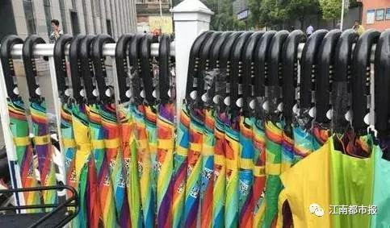
The Story
Quantity: 30,000 Sharing Umbrellas
Deposit: 19 RMB
Rate: 0.5 RMB/30 Mins
That’s how Sharing Bike, Sharing Power Banks, Sharing @#^*%# operates, ha?

Slide 27
The Fact
Shanghai:
Only one day, it’s all gone!
Hangzhou:
Only one day, it’s banned!

Slide 28
The Truth
The Quantity :
30,000 Umbrellas
The Cost:
9.9 RMB per Umbrella
Only in one day, it sold out with the price of 19 RMB.
Without any salespersons, NO labor costs.
Meanwhile, you’ve collected 30,000 personal information of customers!

Slide 29
Chapter 3 Assessment Demo

Slide 30
Thank You!

