Slide 1
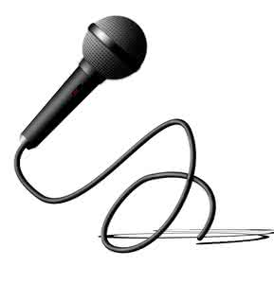
So far…
Delivery
Vocal
Physical
Content
Language
Course Orientation
Notes:
迅速回顾之前已学习内容及本节在整个课程中的位置及作用

Slide 2
Session 7 Vocal Delivery
Public Speaking and Debating in English
Notes:
幻灯片整体采用极简设计与鲜明色彩对比以突出重点

Slide 3
Recapping
Volume
Pitch
Pause
Rate
Notes:
简单回顾微课要点并以之分析奥巴马案例即微课作业

Slide 4
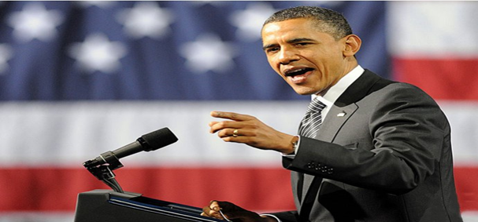
Recapping
Hello, Chicago！
If there is anyone out there who still doubts that America is a place where all things are possible, who still wonders if the dream of our founders is alive in our time, who still questions the power of our democracy, tonight is your answeanswer.
inflection
Did he speak aloud?
Volume
Did he speak in a high pitch?
Pitch
Pause
Rate
Notes:
简单回顾微课要点并以之分析奥巴马案例即微课作业

Slide 5
Recapping
Did he speak aloud?
Volume
Did he speak in a high pitch?
Pitch
Pause
Rate
Did he pause a lot?
Did he speak fast?
110-120
120-150
104
Notes:
简单回顾微课要点并以之分析奥巴马案例即微课作业

Slide 6
Hello, Chicago！
If there is anyone out there who still doubts that America is a place where all things are possible, who still wonders if the dream of our founders is alive in our time, who still questions the power of our democracy, tonight is your answer.
Notes:
停顿

Slide 7
thought groups
Hello, Chicago！
If there is anyone out there who still doubts that America is a place where all things are possible, who still wonders if the dream of our founders is alive in our time, who still questions the power of our democracy, tonight is your answer.
Information focus
Notes:
停顿

Slide 8
Now your turn!
Hello, Chicago！
If there is anyone out there who still doubts that America is a place where all things are possible, who still wonders if the dream of our founders is alive in our time, who still questions the power of our democracy, tonight is your answer.
Notes:
停顿

Slide 9
Now your turn!
Hello, Hangzhou！
If there is anyone out there who still doubts that China is a place where all things are possible, who still wonders if the dream of our founders is alive in our time, who still questions the power of our democracy, today is your answer.
Notes:
停顿

Slide 10
Can you make some rules for vocal delivery?
Project your voice, but don’t shout;
Vary the speed and pause;
Let your voice rise and fall naturally;
Pause between the thought groups;
Stress the information focus;
…
All rules are there to be broken.
Notes:
请学员总结声音运用的原则。在此基础上提出声音运用的多样性和灵活性

Slide 11
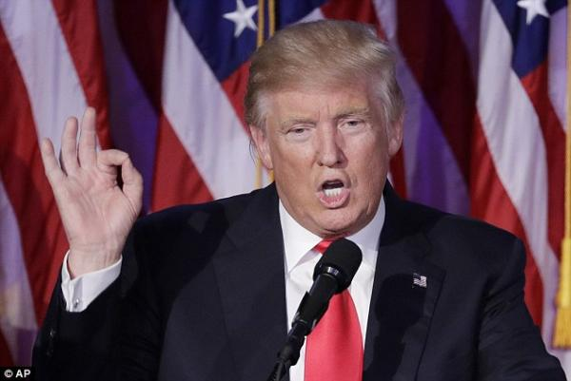
This is Donald Trump…
Notes:
对比特朗普的就职演讲（音频或者视频），说明个人风格差异导致的不同声音使用，不做具体分析，仅感受，简单点评。

Slide 12
What is your style of vocal delivery?
Notes:
提醒学员思考自己的演讲风格及声音运用

Slide 13
Now your turn!
Hello, everyone!
I’m glad to be here. For me, it is a great pleasure to be in the worldly heaven Hangzhou. One thing I like about Hangzhou is that…
Notes:
学员操练半即兴演讲

Slide 14
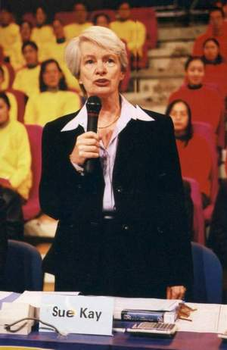
Wrapping up
“ Your voice is like good music: sometimes relaxing, sometimes inspiring, sometimes moving but never boring, deafening or unpleasant!”
Notes:
一句话总结

Slide 15
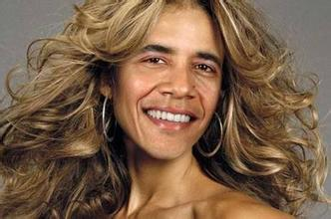
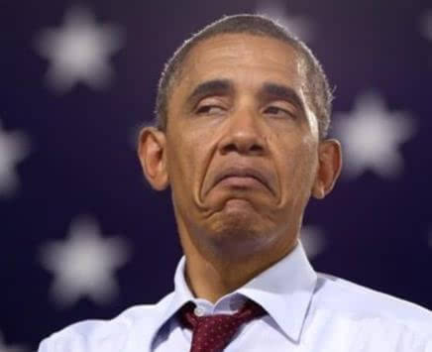
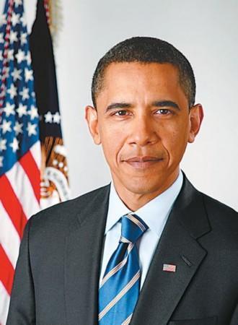
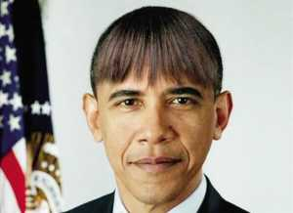
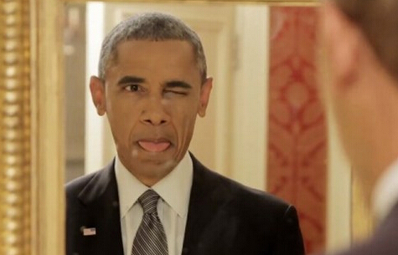
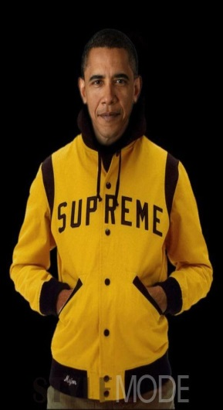
Next…
Notes:
通过呈现奥巴马的不同表情及服饰引入下次主题：physical delivery。

Slide 16
So far…
Delivery
Vocal
Physical
Content
Language
Course Orientation
Notes:
迅速回顾之前已学习内容及本节在整个课程中的位置及作用

Slide 17
E-Assignments
5
1
13
Notes:
作业为用手机录一个自己的演讲，观看5个TED视频演讲并做分析，自学外研社《演讲的艺术》数字课程phsical delivery部分。 二维码用于各个作业的详细要求及布置（还没做好）

