Slide 1
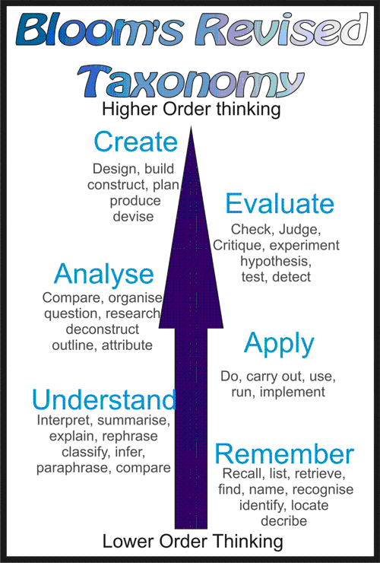
An introduction to my Smart Design
1. Supporting Theory
2. Flipped Class
Remember → apply → create
Cognitive domain, psychomotor domain, Affective domain
Pre-class: watch and read
While-class: discuss, induce and create
After-class: reflect and evaluate

Slide 2
Hilights of my Smart Design
while-calss
vis- à -vis class
Directly select from the book 3
materials
3 periods
45min each
Off-line
Adapt 2 materials from the book
to provide enough input
How to begin and end a speech
Supplement 4 extra speech materials
to reorganize the teaching resources
Online
Integrate 1 extra speech material with
the textbook to generate the techniques
before and after class

Slide 3
Unit 8
Beginning and Ending the Speech
Focus Today
Master the skills
of beginning a speech
Appreciate
Brainstorm
Conclude

Slide 4
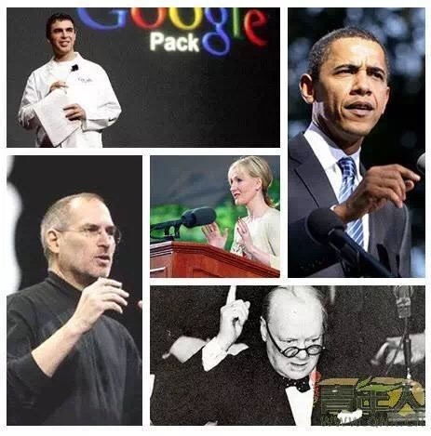
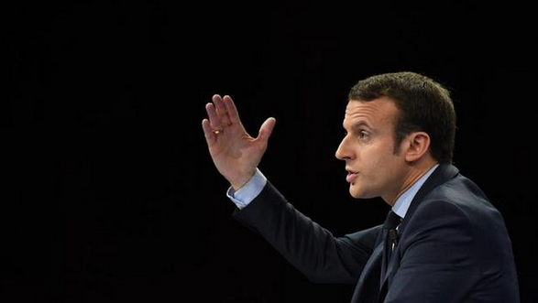
Appreciate
作乐府亦有法, 曰凤头、猪肚、豹尾六字是也。
——（元）乔梦符

Slide 5
Appreciate Linguistic features
RED
Rythmic
Easy
Dynamic
“Controlable but incurable.”
Simple words and sentences
EXAMPLE
“As I speak today…”;
“What is this silent killer?”
EXAMPLE

Slide 6
Brainstorm Discourse features
How does the beginning captivate the audience?
Suspend the audience
SPA
Present statistics
Adopt parallelism

Slide 7
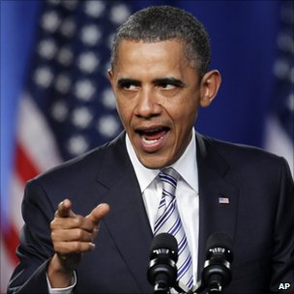
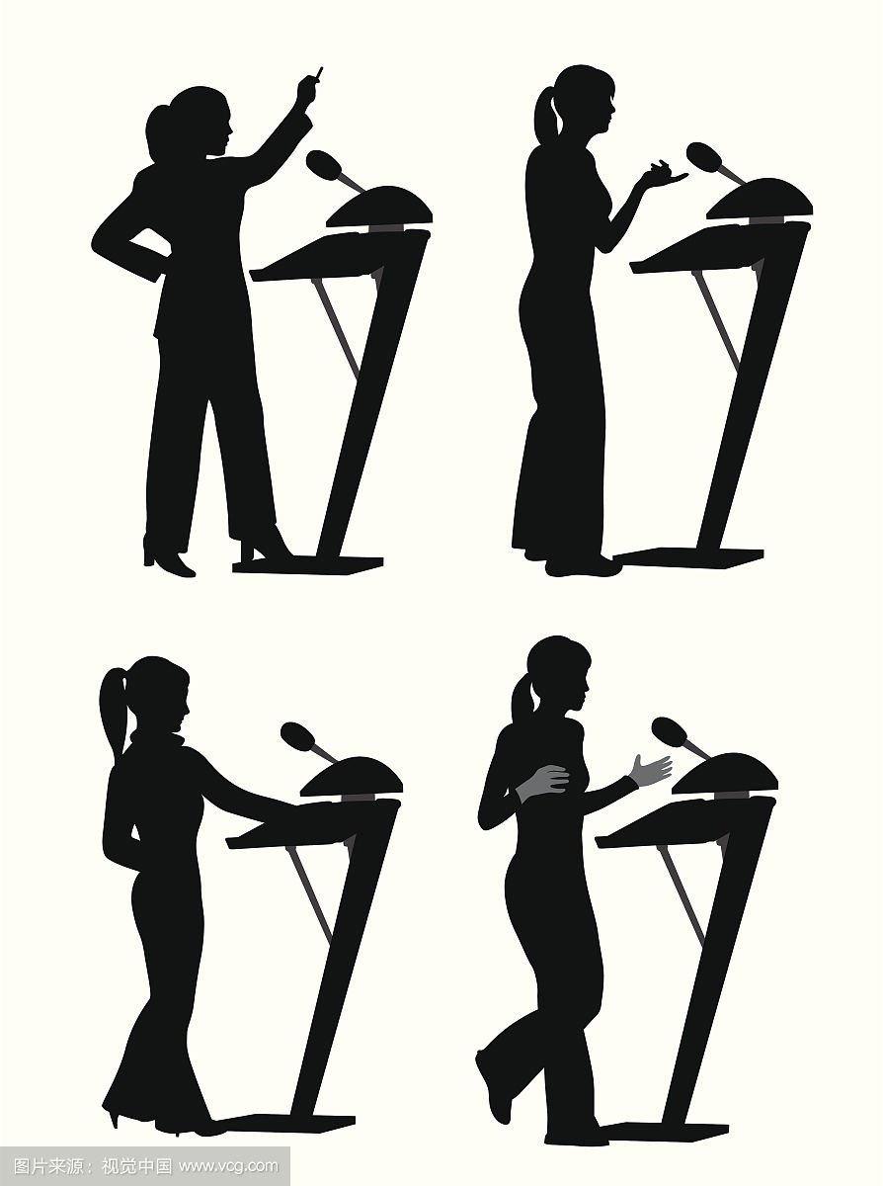
Conclude
Techniques and skills
www.americanrhetoric.com
Arouse curiosity
Tell a story
Startle the audience
Begin with a quotation
Question the audience
RED SPA

Slide 8
Teaching Assessment

