Slide 1

《新一代大学英语》
产出导向教学法
试用分享
高秀平
北京语言大学
2015年7月
Notes:
非常感谢文老师和外研社高英分社给了我这次机会，可以和各位老师分享我试用《新一代大学英语》和“产出导向教学法”的一些体会，同时也有一些困惑，希望能得到大家的解答和帮助。我是两个月前第一次接触这个教材和教法的，对我来说，这个机会来得特别及时。今天是我教书的第六年，六年不长也不短，我自己感觉是一个很尴尬的阶段，因为当初刚刚参加工作的那种激情已经被消磨得差不多了，可是又没有积累起足够多的经历和经验能够让自己上起课来比较自在。学生早已不是当年的那拨学生，可我还是当年的我，教材还是当年的教材，当然最主要的是教法还是当年的教法，都已经让我开始有点嫌弃，可是又不知道该如何改变。

Slide 2
新一代大学英语
iEnglish
单元结构
Viewing/Listening
Reading
1
iPrepare
2
iExplore
3
iProduce
设定学习目标
展现应用场景
语言学习
观点准备
技能提升
Viewing/Listening
Reading
聚焦产出
凝练思想
产出导向 驱动学习
Output-oriented, Product-driven
Notes:
我就是在这种心态下试用这个教材和这个教法的，所以刚拿到教材样章和文老师的文章时，我感觉很新鲜，同时也很困惑。后来，经过外研社编辑的介绍和文老师的讲解，有了一个模糊的理解，然后把本单元的两篇文章看了一遍就开始设计教案。在这个过程中，我的心思主要花在了iPrepare和iProduce两个环节，也就是开头和结尾，可是一直在逃避中间的iExplore环节，一直逃避了两个多星期，直到真正要上课的前几天，我又开始困惑了，甚至有些慌张，因为我发现这个环节是占时间最多的，如果两节课100分钟完成一篇课文，iPrepare和iProduce两个环节加起来最多四十分钟，我还剩下60分钟该怎么安排呢？而且中间的iExplore才是学习真正发生的环节，或者至少是输入发生的环节，可是我并不知道该干什么。当然是要上课，可是怎么上呢，和我以前一样上么？那样的话我并没有做太多改变。

Slide 3

Notes:
于是我开始反思自己以前上课的方法，反思我为什么要讲某些知识点或做某些活动。我发现只要时间允许，课文里出现的知识点都会讲到，讲的原因或出发点有这么几种：我觉得是难点的要讲，我觉得有用的当然也要讲，我觉得有趣的或者我了解的比较多的要大讲特讲，要尽量扩展。
当然，这些文化知识和语言知识本身没什么不好，而且在遥远的将来可能也会有用，但是很多知识和课文本身并没有太大的关系，而且即使学习完之后设计了产出任务，很多知识和产出任务也没有太大的关系，学生不需要用这些知识也能完成任务，或者完成任务时根本没有机会来使用和巩固这些文化知识或语言知识。我现在把自己这种讲解方法称为无谓的扩展或者无意义的发散，因为没有一个明确的目标和方向。

Slide 4

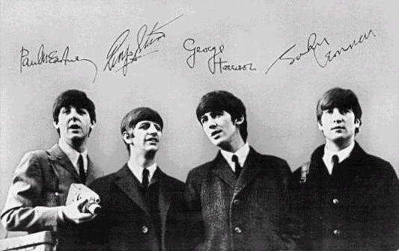

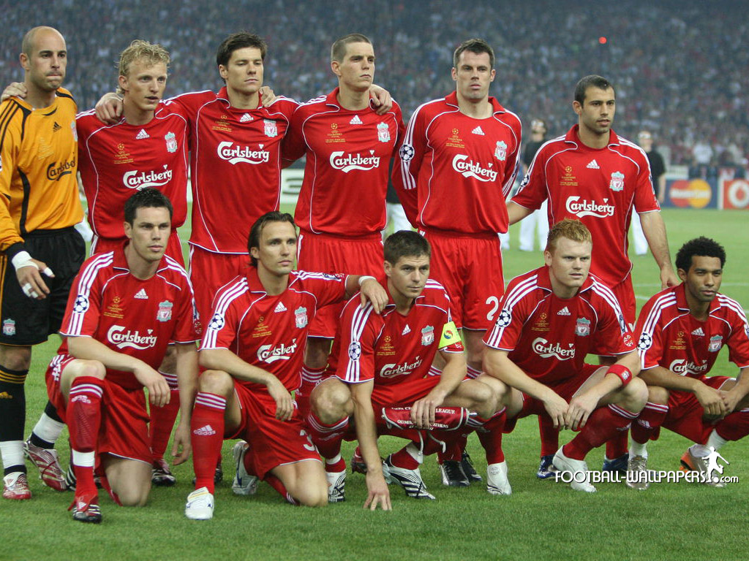
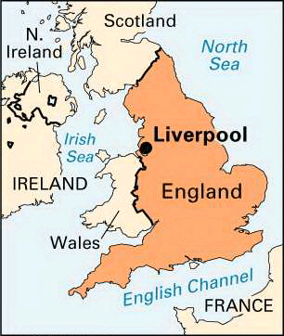



Part 1
After too long on the Net, even a phone call can be a shock. My boyfriend’s Liverpool accent suddenly becomes impossible to interpret after his easily understood words on screen; a secretary’s clipped tone seems more rejecting than I’d imagined it would be. Time itself becomes fluid -- hours become minutes, or seconds stretch into days. Weekends, once a highlight of my week, are now just two ordinary days.
P
Notes:
我印象很深的一个例子是一篇课文里出现了Liverpool利物浦，在讲解课文的时候问学生，what is Liverpool，他们知道是Liverpool，于是再追问一句，where is Liverpool, it’s a coastal city in Western England，顺便展示一张地图。可是我并没有就此停止，因为我还想到了利物浦足球队，想到了Beatles，甚至想到了奴隶贸易，然后就顺便都讲了讲，而且每个知识点都提供了图片，恨不得做个关于利物浦的小专题。我当时的想法可能是：你看我知识多么丰富，思维多么发散，而且还花时间认真地去找图片做PPT的动画。在讲语言点的时候提到这些文化知识，学生挺感兴趣，以前没有这些知识的学生感觉学到了知识，以前知道也挺开心，课堂也显得很热闹。

Slide 5
Interpret
My boyfriend’s Liverpool accent suddenly becomes impossible to interpret after his easily understood words on screen.
What’s the synonym?
(1) understand (sth. said, ordered, or done)
The gift is generally interpreted as a bribe.
She made a gesture, which he chose to interpret as an invitation.
I fight my boyfriend as well, misinterpreting his intentions. (L.45)
No one in the tour group spoke Spanish so we had to ask the guide to interpret.
(2) translate what is said in one language into another
Interpreter
Interpretation
Notes:
文化知识点这样扩展，语言知识点也差不多，某个重点词除了讲课文里的意思，还要讲讲词典里的其他意思，每个意思给个例句，辨析一下同义词，可能还要再讲讲构词。

Slide 6
新一代大学英语
iEnglish
单元结构
Viewing/Listening
Reading
1
iPrepare
2
iExplore
3
iProduce
设定学习目标
展现应用场景
语言学习
观点准备
技能提升
Viewing/Listening
Reading
聚焦产出
凝练思想
产出导向 驱动学习
Output-oriented, Product-driven
Notes:
这一块怎么讲还没写好。
大概就是说“产出导向教学法”
iExplore环节所做的一切都尽可能为iProduce服务。

Slide 7
Lesson Plan
Learning materials:
Unit 1: Philosophy and Thoughts
Text A: The Man Who Asked Questions
Text B: The Greatest Sage in China
Notes:
说课

Slide 8
Lesson Plan
Time duration:
Two sessions, four periods
Students:
Class 1 (26 students), Class 2 (28 students)
Freshmen majoring in the Chinese Language and Literature
Notes:
说课

Slide 9
Lesson Plan
Learning objectives:
After learning this unit, students will be able to:
Introduce Socrates and his essential ideas.
Introduce Confucius and his essential ideas.
Compare these two philosophers and their thoughts in a structured way.
Compare Socrates and Confucius in a specific aspect (e.g. education or ethics) based on extensive reading. (Optional)
Notes:
说课

Slide 10
Time Allotment
1 | iProduce (previous text) | 20 minutes
2 | iPrepare | 5 minute
3 | Warming-up | 10 minutes
4 | Reading (no preview) | 15 minutes
Break
5 | Learning: 语言、观点、技能 | 45 minutes
6 | Assigning homework | 5 minutes
Notes:
说课

Slide 11
Unit 1
Philosophy & Thoughts
高秀平
北京语言大学
2015年7月
Notes:
从这儿进入说课

Slide 12
1 – iPrepare
1
2
3
Scenario
Scenario
Scenario
Notes:
说课

Slide 13
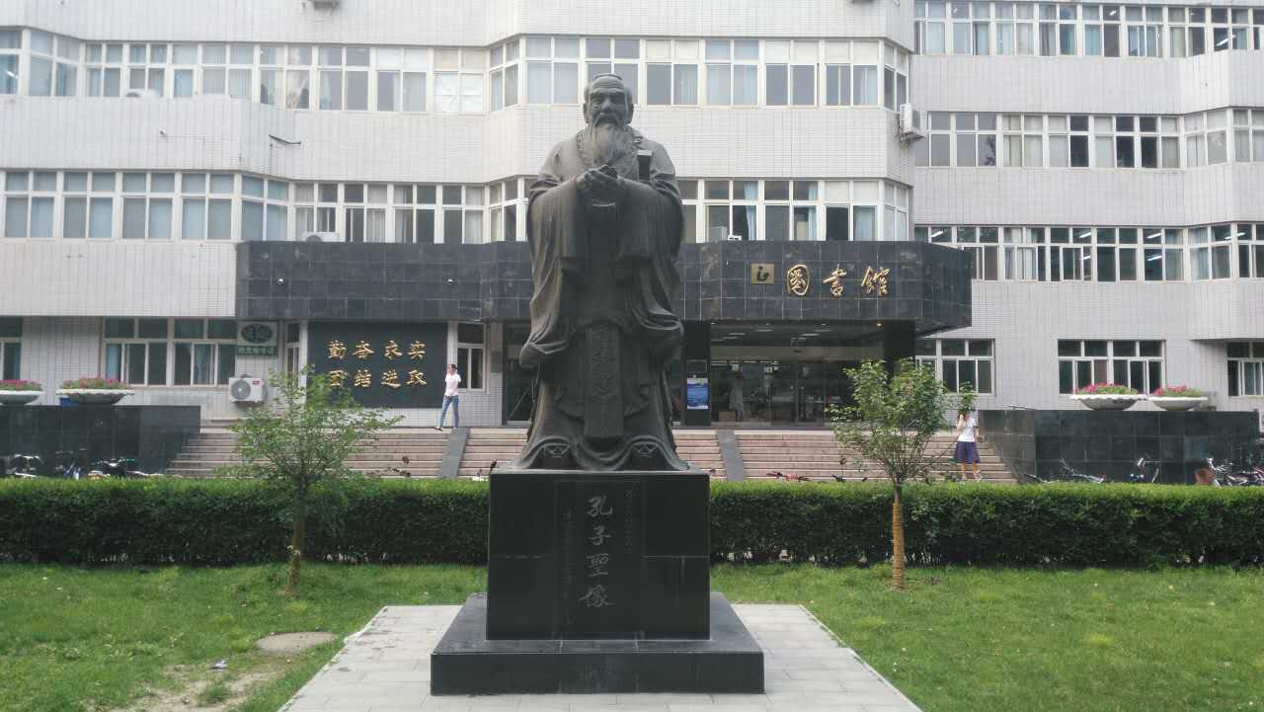
1 – iPrepare
1
Scenario
Notes:
说课

Slide 14

1 – iPrepare
2
Scenario
Notes:
说课

Slide 15
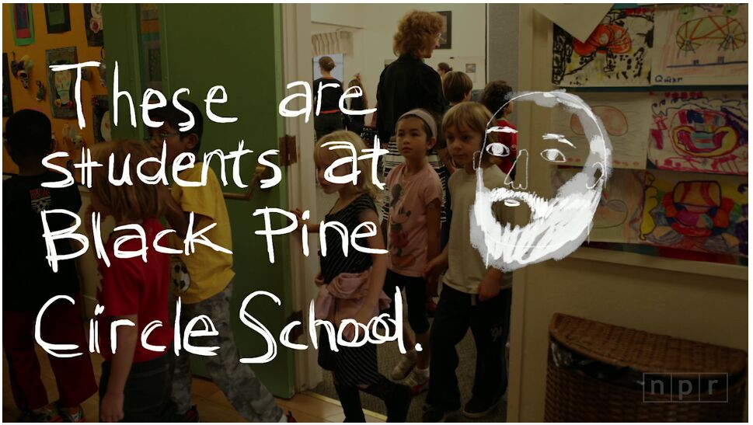
1 – iPrepare
2
Scenario
Notes:
说课

Slide 16
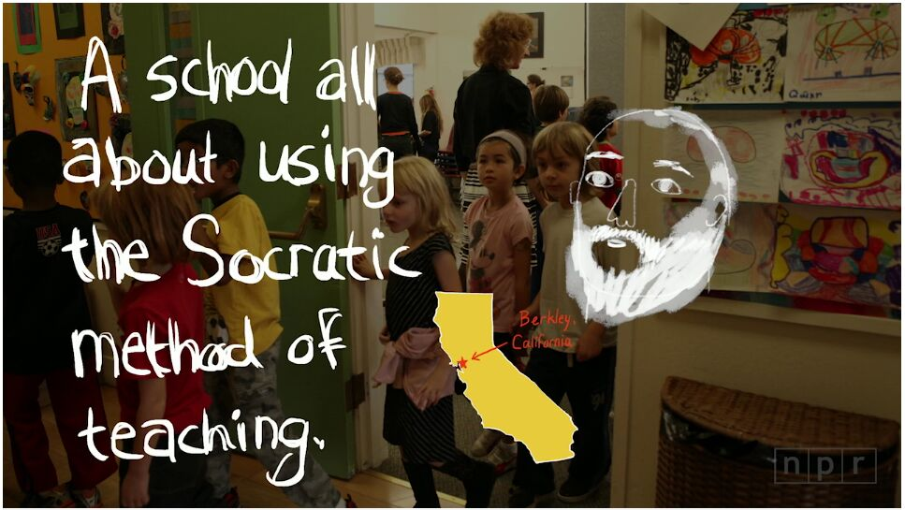
1 – iPrepare
2
Scenario
Notes:
说课

Slide 17
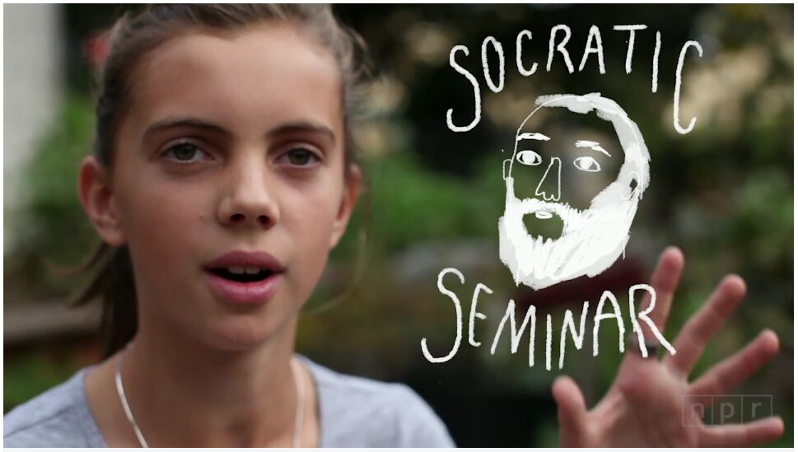
1 – iPrepare
2
Scenario
Notes:
说课

Slide 18
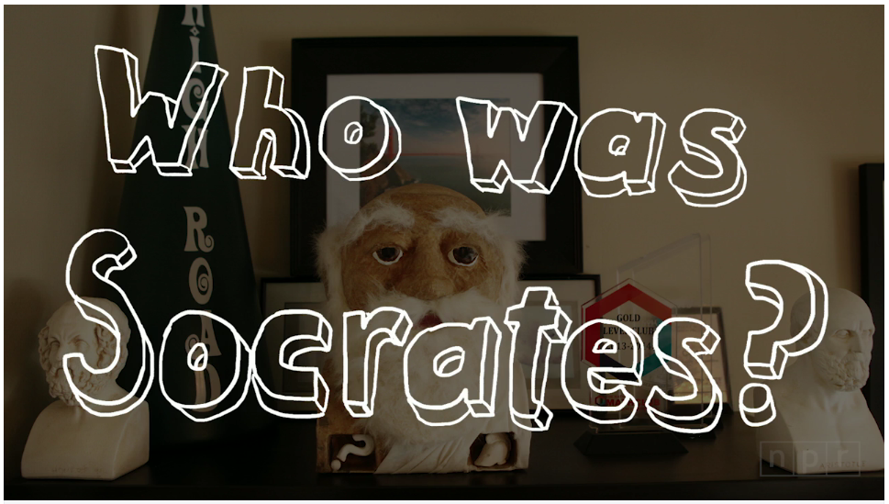
1 – iPrepare
2
Scenario
Notes:
说课

Slide 19

1 – iPrepare
3
Scenario
When Socrates Meets Confucius
Notes:
说课

Slide 20
1 – iPrepare
Learning objectives
1. Introduce Socrates and his major achievements.
2. Introduce Confucius and his essential ideas.
3. Compare these two philosophers and their thoughts in a structured way.
? 4. Compare Socrates and Confucius in a specific aspect (e.g. education or ethics)
Notes:
说课

Slide 21
1 – iPrepare
Identifying the gaps
Information gap?
Language gap?
Skill gap?
Thought gap?
Setting a personal goal
Notes:
说课

Slide 22

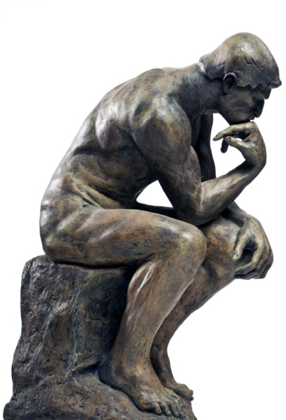
2 – iExplore
Notes:
这儿开始进入讲课

Slide 23
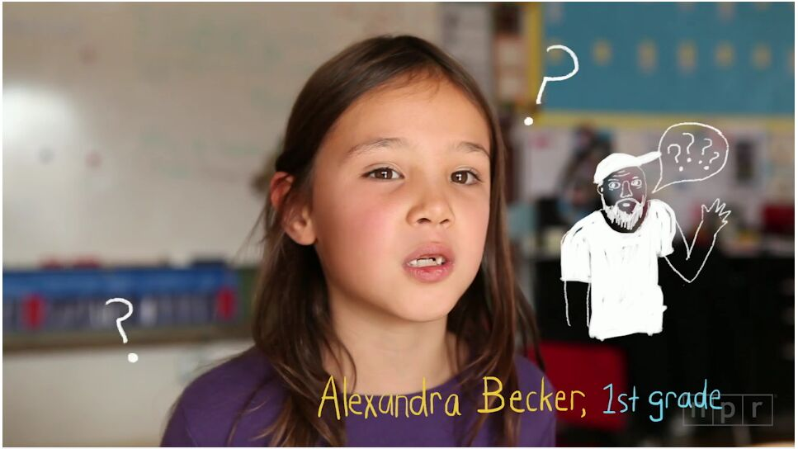
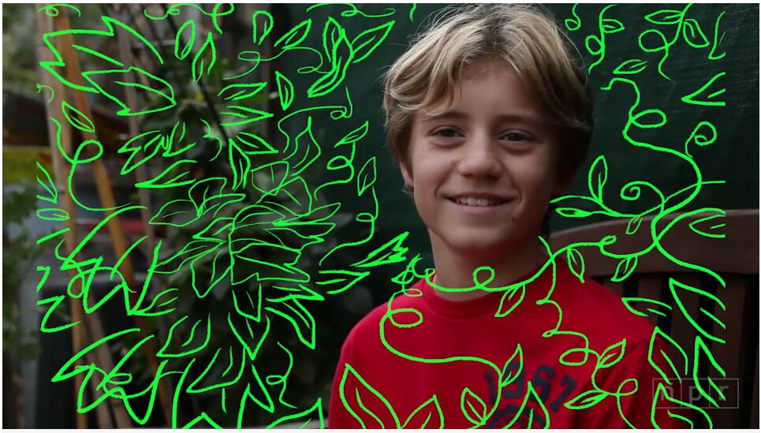


2 – iExplore
Notes:
讲课

Slide 24
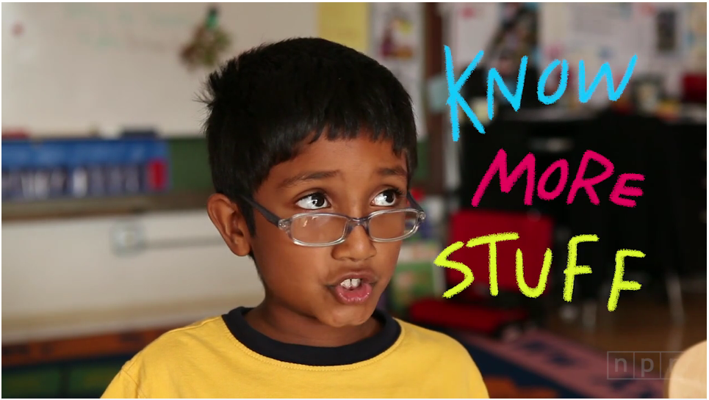
2 – iExplore
Notes:
讲课

Slide 25

2 – iExplore
Notes:
What do you think of this question?
Do you think Socrates would ask the same questions?
What questions did Socrates ask?
Why did he ask question?

Slide 26
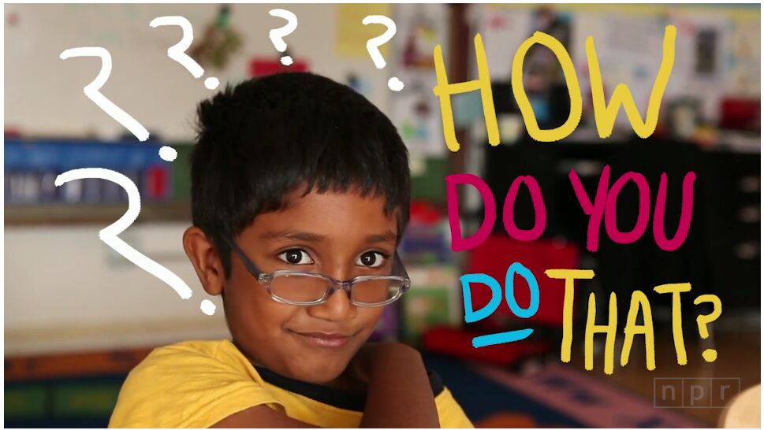
2 – iExplore
Why do people wear clothes?
Would Socrates ask the same question?
What kind of questions did Socrates ask?
Why did he ask questions?
How did he ask questions?
What did his questions lead to?

Slide 27
2 – iExplore
Why do people wear clothes?
Would Socrates ask the same question?
What kind of questions did Socrates ask?
Awkward
Razor-sharp
Straightforward
Tough
Page 12
Building your language

Slide 28
2 – iExplore
Why did he ask questions?
To reveal the limits of what people genuinely understood
To question the assumptions on which they built their lives

Slide 29
2 – iExplore
How did he ask questions?
Paragraphs 4 & 5
Socrates asked .
Euthydemus of course it does.
Then Socrates asked .
So, .
Socrates used a .

Slide 30
2 – iExplore
What did his questions lead to?
Socrates showed that…..
Socrates demonstrated that……
A military commander would begin ….. but leave…..
Socrates’ conversations ended in……
Pages 12&13
Building your language

Slide 31
2 – iExplore
What questions did Socrates ask?
Why did he ask questions?
How did he ask questions?
What did his questions lead to?

Slide 32
1 – iPrepare
Learning objectives
1. Introduce Socrates and his essential ideas.
2. Introduce Confucius and his essential ideas.
3. Compare these two philosophers and their thoughts in a structured way.
? 4. Compare Socrates and Confucius in a specific aspect (e.g. education or ethics)
Notes:
What other information should be included?
What aspects should be covered in the introduction to a person?
The introduction to Socrates?

Slide 33
2 – iExplore
Learning objective
Introduce Socrates and his essential ideas.
Biographical information
Features
People’s opinions
Philosophy
Notes:
What other information should be included?
What aspects should be covered in the introduction to a person?
The introduction to Socrates?

Slide 34

2 – iExplore
Biographical information
Socrates was .
He was born in in .
, he had been a brave soldier .
In middle age, he .
In 399 bc, .
Notes:
How do we present the biographical information?
In what order?
Time order

Slide 35

2 – iExplore
Biographical information
Socrates was .
He was born in in .
, he had been a brave soldier .
In middle age, he .
In 399 bc, .
One of the most influential of the ancient Greek philosophers.
Athens, 469 bc.
As a young man, fighting in the wars against the Spartans.
Shuffled around the marketplace, stopping people and asking them awkward questions.
He was sentenced to death for asking too many questions

Slide 36
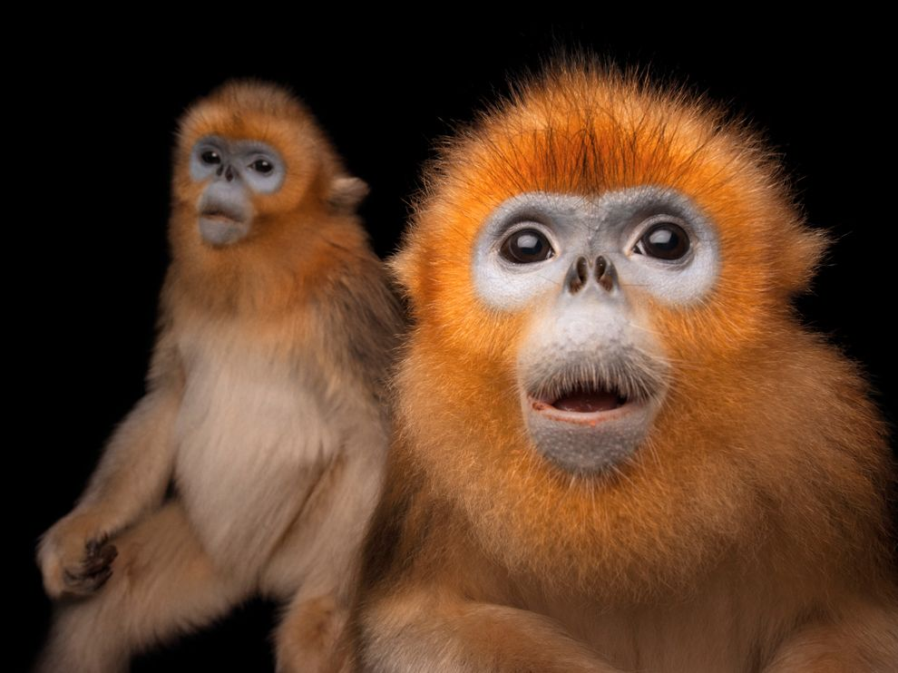
2 – iExplore
2. Features
Physically……
snub-nosed, podgy, ugly
shabby, unwashed
But……
great charisma, a brilliant mind
annoying, wise
Page 12, Building your language

Slide 37
2 – iExplore
3. People’s opinions
Some ……
Others……
Socrates ……. Sophists
Socrates was the wisest ……. the oracle of Apollo
Athens as a whole …….
Many Athenians …….
Socrates …….

Slide 38

2 – iExplore
Some… Others…
…….The oracle of Apollo …….Sophists
Athens as a whole… Many Athenians…
Socrates…
Some loved him
Others thought him a dangerous influence
He was not popular with Sophists
He was the wisest according to the oracle of Applo
Athens as a whole didn’t value him
Athenians felt that Socrates was dangerous and was deliberately undermining the government
Socrates saw himself as a gadfly, which is irritating but doesn’t do serious harm

Slide 39
2 – iExplore
4. Philosophy
Paragraphs 9, 10 & 11
Summarize Socrates’ philosophy

Slide 40

2 – iExplore
Paragraphs 9, 10 & 11
Summarize Socrates’ philosophy
“Philosophy” in Greek means……
The wisdom Greece valued is based on ……
For Socrates , wisdom is not ……, or …… but ……
To pursue wisdom, Socrates ……
For Socrates, life is ……
Socrates would rather …… than ……

Slide 41
2 – iExplore
Socrates asking questions
Biographical information
Features
People’s opinions
Philosophy
Notes:
A quick review
Then how do you select information?
And how do you organize the information in the introduction to Socrates?

Slide 42
1 – iPrepare
Learning objectives
1. Introduce Socrates and his essential ideas.
2. Introduce Confucius and his essential ideas.
3. Compare these two philosophers and their thoughts in a structured way.
? 4. Compare Socrates and Confucius in a specific aspect (e.g. education or ethics)
Notes:
Never forget the objective

Slide 43
2 – iExplore
Socrates asking questions
Biographical information
Features
People’s opinions
Philosophy
Select information?
Organize information?
Notes:
A quick review
Then how do you select information?
And how do you organize the information in the introduction to Socrates?

Slide 44
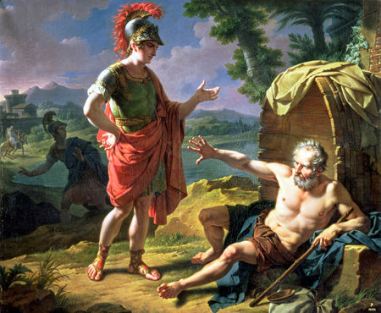
2 – iExplore
Preparing for structure
“A Brief Introduction to Diogenes”

Slide 45
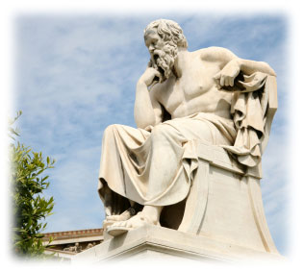
3 – iProduce

Slide 46
3 – iProduce
Assignment
A two-minute oral report
Information
Language
Structure
Write down the script!!!
Accuracy
Fluency
Expressiveness
Extra resources!

Slide 47
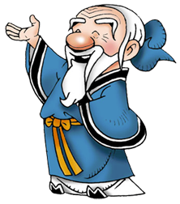
Time Allotment
1 | iProduce (Text A) | 20 minutes
2 | Warming-up | 15 minutes
3 | Reading | 15 minutes
Break
4 | Learning: 语言、观点、技能 | 45 minutes
5 | Assigning homework | 5 minutes
Notes:
说课

Slide 48
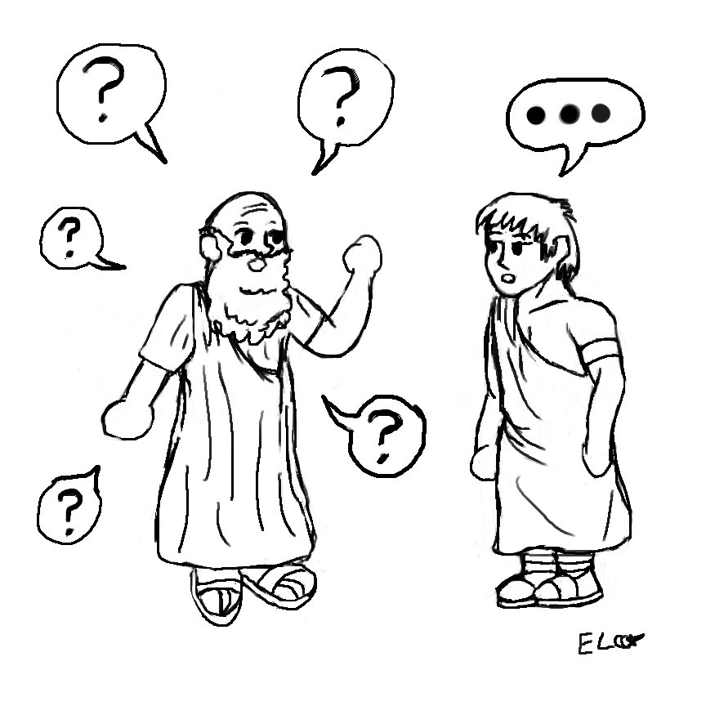
3 – iProduce
Pair work

Slide 49
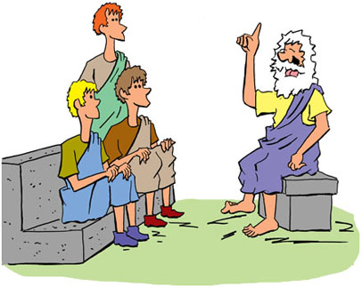
3 – iProduce
Reporting

Slide 50
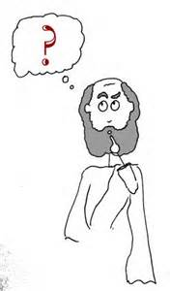
出现的问题
内容：
扩展太多，忽视课文
语言：
不能有意识使用所学语言
形式：
多次重复

Slide 51
Time Allotment
1 | iProduce (Text A) | 20 minutes
2 | Warming-up | 15 minutes
3 | Reading | 15 minutes
Break
4 | Learning: 语言、观点、技能 | 45 minutes
5 | Assigning homework | 5 minutes
Notes:
说课

Slide 52
Text B
1
Scenario
Notes:
Text B

Slide 53
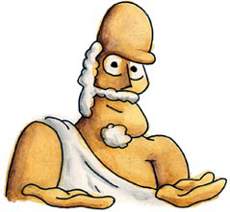
2 – iExplore
Hi, I’m Socrates.
Confused?... I’m a philosopher.
I pursued wisdom by asking questions.
你好！I’m Confucius！
I’m a philosopher 2.
I……

Slide 54
2 – iExplore
What did Confucius pursue?
Why did he pursue it?
How did he pursue it?
Did he accomplish his mission?

Slide 55
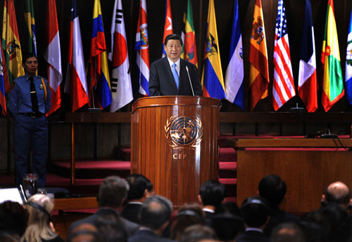
习近平接受拉美四国媒体联合采访
问：玻利瓦尔革命始终倡导捍卫和推动建设多极化世界，您如何看待国际关系民主化？

Slide 56
习近平接受拉美四国媒体联合采访
答：当前，国际形势正在发生深刻复杂变化，世界多极化深入发展，多个发展中心在世界各地区逐渐形成，新兴市场国家和发展中国家整体实力增强，国际力量对比朝着有利于维护世界和平方向发展。
“大道之行也，天下为公。”公平正义是世界各国人民在国际关系领域追求的崇高目标。中国坚决维护国际公平正义，致力于推动世界多极化、国际关系民主化。我们主张世界的命运必须由各国人民共同掌握，世界上的事情只能由各国政府和人民共同商量来办。世界各国不分大小、强弱、贫富，都是国际社会的平等成员，应该共同推动国际关系民主化。

Slide 57
习近平接受拉美四国媒体联合采访
“大道之行也，天下为公。”
"When the great way is followed, all under the heaven will be equal."

Slide 58
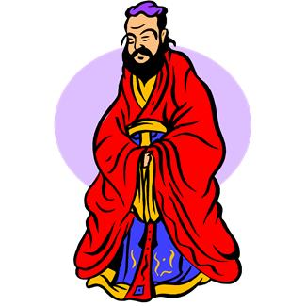

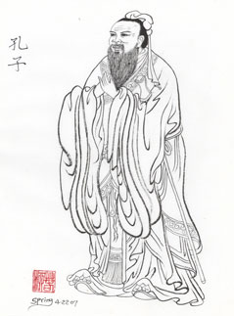

3 – iProduce
大道之行也，天下为公，选贤与能，讲信修睦。
故人不独亲其亲，不独子其子。使老有所终，壮有所用，幼有所长，鳏、寡、孤、独、废疾者皆有所养。男有分，女有归。
货恶其弃於地也，不必藏於己。力恶其不出於身也，不必为己。
是故谋闭而不兴，盗窃乱贼而不作。故外户而不闭，是谓大同。
What do you mean?

Slide 59
3 – iProduce
Comparison

Slide 60
3 – iProduce
Pair work

Slide 61
3 – iProduce
Reporting

Slide 62
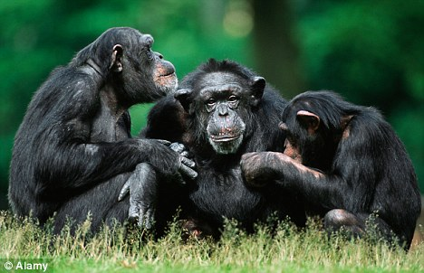
3 – iProduce
When Socrates meets Confucius!
In what aspect did they compare Socrates and Confucius?
What did their comparison lead to?

Slide 63
学生的反馈
Likes：
内容更充实
场景更真实
目标更明确
少预习，多复习
Suggestions：
iExplore讲解更细一些？
iProduce形式更多一些？

Slide 64
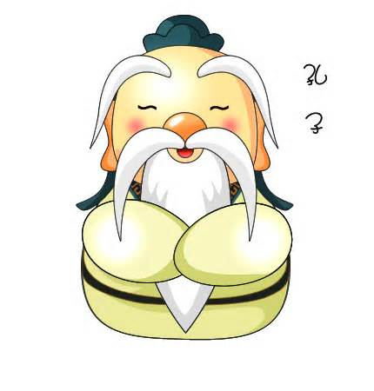
谢谢！

