Slide 1
Chinese Tradition and Culture
Unit 8

Slide 2
A few clarifications
Time constraint
Students
Previously given tasks

Slide 3
Objectives
statement; specific evidence
information about the Chinese writing system; comparisons and contrasts
theme-related expressions; ways to show contrasts
Structure
Content
Language

Slide 4
iExplore 2
The Chinese Language

Slide 5
Introduction

Slide 7
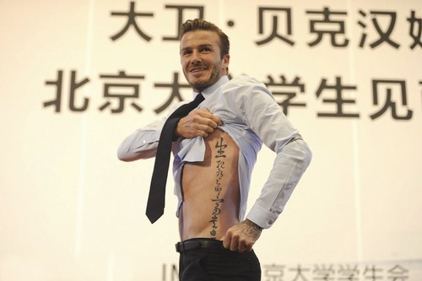

Slide 8
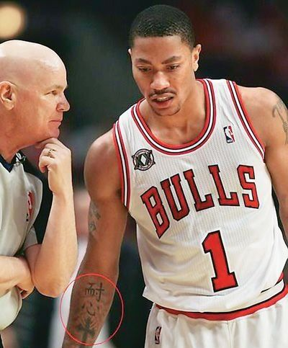

Slide 9
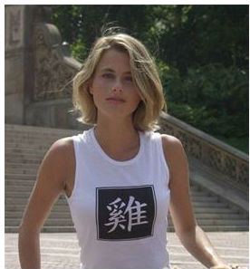
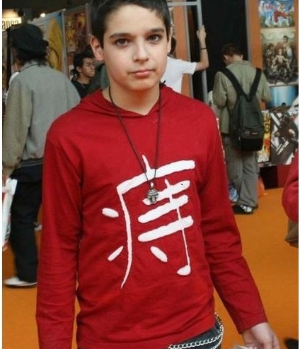
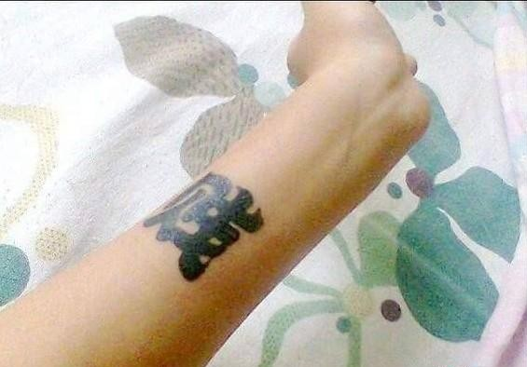

Slide 10
Fill in the blanks with the Chinese characters so that the proverbs are relevant to the definitions.
叽里________（ga la）：各个角落
不落_______ （ke jiu）：比喻有独创风格，不落俗套
旮旯
窠臼

Slide 11
Information
Brainstorm
The Chinese Language

Slide 12
Long History
Over 3000 years

Slide 13
Most Spoken
over 1 billion people

Slide 14
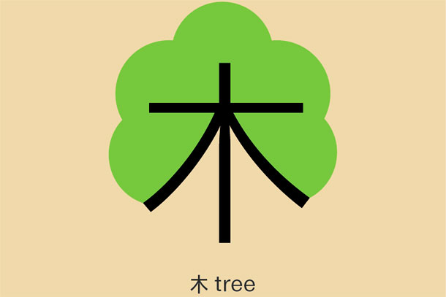
Pictures
象形文字
pictograph
ideograph
?

Slide 15
Tones
Tone pitch
the four tones of Standard Chinese
High level 第一声
High rising 第二声
Low falling-rising 第三声
High falling 第四声
Neutral 轻声

Slide 16
Variations
Dialects
7 - 13 main regional groups of Chinese
Wu Yue Min …
mutually unintelligible

Slide 17
Standard Chinese
Putonghua/Mandarin
one of the six official languages of the United Nations
Chinese Characters

Slide 18
iExplore 2 Reading
The Chinese Writing System
(P.145)

Slide 19
Work Sheet (given last week)
Task 1- Group 1
Task 2- Group 2
Task 3- Group 3
Task 4- Group 4
Task 5- Group 5
Task 6- Group 6

Slide 20
In-Depth Text Analysis
Authors: 2 westerners
Informative
Contrastive

Slide 21
Introduction
para 1
background

Slide 22
Task 1 Difficult sentences
1. The Chinese have always felt a complete cultural and racial identity with the ancient inhabitants of their land, and here is striking proof that they are right in doing so. They have good reason to feel a greater sense of direct continuity from the Shang Dynasty than Westerners feel from the early Egyptians and Mesopotamians, or even the ancient Greeks and Romans. (Para. 1)
Adopt this structure to compose two sentences. The first states a fact; the second supports the former sentence with examples.

Slide 23
Sample Answer
I have always chosen Summer as my favorite season of the year and I believe I’m right in doing so. I have good reason to feel a greater sense of relaxation and pleasure from the two-month vacation, the colorful closet and the variety of out-door activities than from the other seasons, or even the Spring Festival vacation.

Slide 24
Main Characteristics of the Chinese language
para.2-3
informative

Slide 25
Task 2
List the main characteristics of the Chinese language with words and phrases.
Raise 1 example to illustrate each of the features.

Slide 26
Sample answer
the Sinitic languages
monosyllables (line 2, para 2)
the absence of inflections (line 4, para 2)
tonal character (line 8, para 2)

Slide 27
Sample Answer
monosyllabic
uninflected
tonal
爱
爱上
爱4

Slide 28
Task 3 Difficult sentences
2. The monosyllabic and uninflected nature of the Chinese language helps account for the retention by the Chinese of a writing system which, like that of ancient Egypt, originated from pictographs but, unlike hieroglyphics, always remained true to basic principle that each monosyllabic word should have its unique symbol, or character. (Para. 3)
Find the word to describe the writing system of ancient Egypt.
Separate this sentence to two simpler ones with similar meaning.

Slide 29
Sample Answer
hieroglyphics
The Chinese language is uninflected and monosyllabic. Therefore, the writing system remained largely unchanged with each monosyllabic element having its own character.

Slide 30
Drawbacks and merits of the Chinese writing system
para.4-9
contrastive

Slide 31
Task 4
Summarize the drawbacks and merits of the Chinese writing system listed by the authors.

Slide 32
Sample Answer
Drawbacks
Merits
takes more time and effort to master
(line 2, para 4)
education focusing on memory ability
(line 7, para 4)
literacy more difficult to achieve
(line 8, para 4)
aesthetic value (line 3, para 5)
vitality (line 1, para 6)
easily surmounts differences of dialect and pronunciation (line 1, para 8; line 5, para 9)

Slide 33
Task 5
Find evidence used by the authors to illustrate each of the drawbacks and merits of the Chinese characters.

Slide 34
Sample Answer
takes more time and effort to master
the education focusing on memory ability
literacy more difficult to achieve
as many as 25 strokes
囔
2000-3000 characters must be memorized to read simple texts
limit upper-class life to the relative few
士大夫阶层

Slide 35
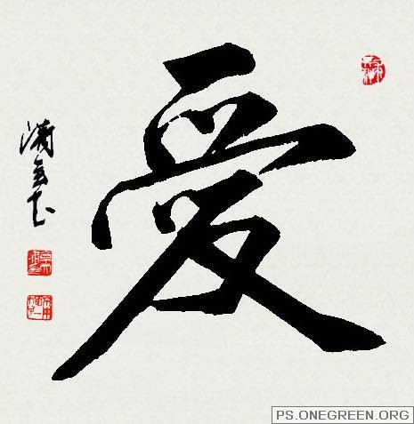
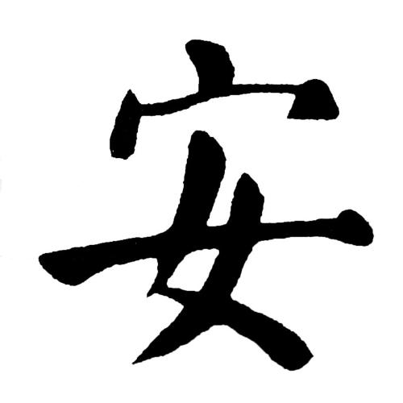
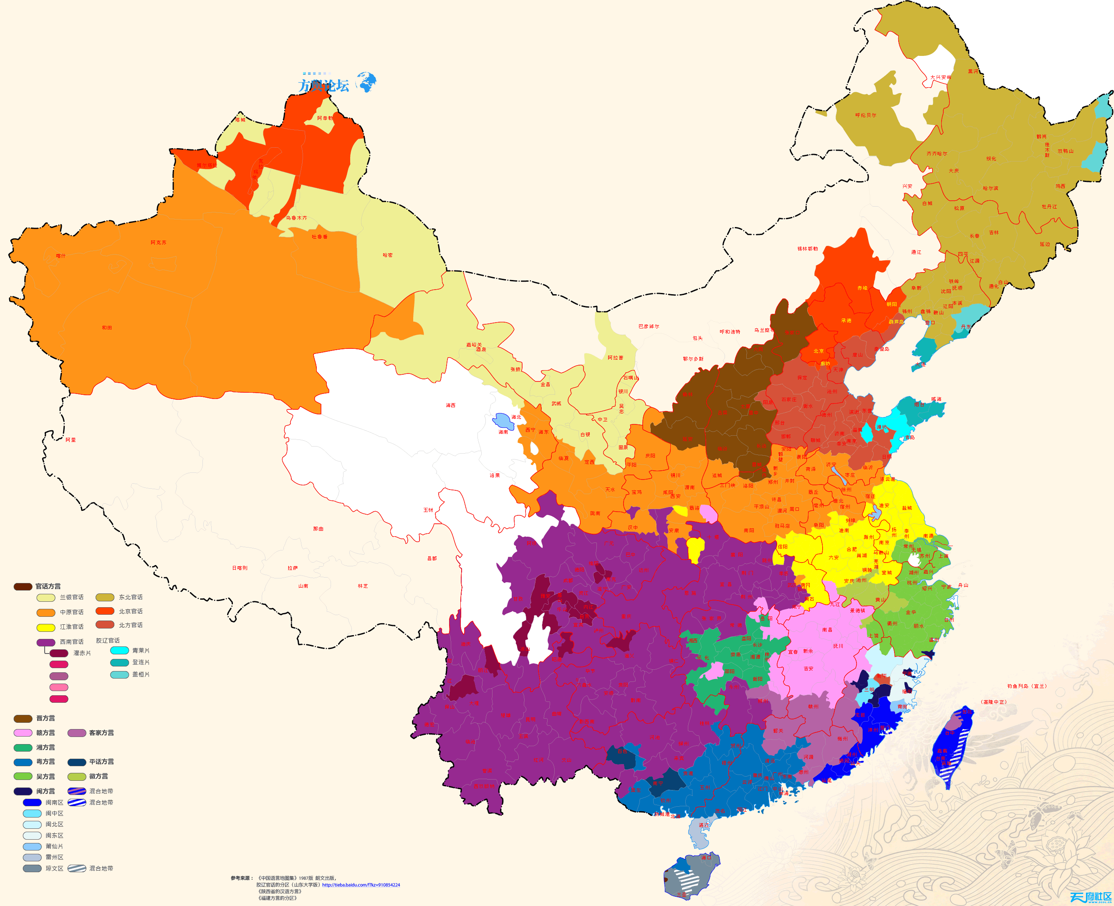
Sample Answer
aesthetic value
vitality
surmounts the differences of dialect and pronunciation
calligraphy
the character for “peace”
China as the largest
national grouping

Slide 36
Task 6 Difficult sentences
3. It is easy to imbue the character with magic qualities, as the ancient Chinese undoubtedly did. The written word always took precedence over the spoken. (Para. 7)
Combine the two sentences to one with similar meaning, using a phrase in the same paragraph.

Slide 37
Sample Answer
The ancient Chinese people attach magic qualities to the character, which helps account for the written word being more important than the spoken.

Slide 38
The differences between the Chinese and Western writing systems
Contrast
Chinese Writing System | Western Writing System
monosyllabic
multisyllabic
uninflected
inflectional
tonal
untonal
of high complexity
simpler
high aesthetic values
less aesthetic values
hieroglyphic
phonetic
surmount differences of dialect
dialects result in separate national groups

Slide 39
Building your language Theme-related words and expressions
Draw on the text to translate the following expressions between English and Chinese.
死记硬背 (para.5)
奏折 (para. 7)
古文 (para. 8)
protracted study (para. 4)
subtle overtone (para. 6)
terse vividness (para. 6)
rote memory work
memorials to the throne
classical Chinese
长期的学习
微妙影射
精妙

Slide 40
Assignment I
Select and collect useful words/phrases/expressions/sentences from the text.
Explain the meaning of these language points and make sentences with them.
Share with your classmates your collection and your work.

Slide 41
Insight Pairwork
The authors seem to believe that Chinese education has put a premium on writing instead of speaking. Do you agree? Why or why not? And if you think in traditional Chinese society writing did outweigh speaking in education, do you think that is still the case today? (p. 149)

Slide 42
culture
famous documents, few great speeches
traditional imperial examinations
modern examinations
speaking enjoying a greater weight
interpersonal, international, intercultural communication

Slide 43
Integration Mini-project
You are asked to give an explanation of your Chinese given name to a foreign audience.
Prepare for a relevant talk and deliver within your group. Ask for feedbacks and suggestions.
Try to use as many terms as possible from the text.

Slide 44
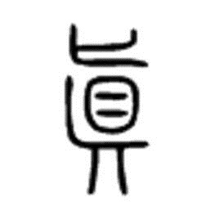
真
pronunciation-Jen not Zen
tone-high level
dialect-pretty
strokes-10
hieroglyph
real
sincere
true

Slide 45
Content
Given Name
Form
Sound
Meaning

Slide 46
Assignment II iProduce Project
Designing a poster: Introducing one Chinese character to people from other countries

Slide 47
The checklist of a good poster (p.151)
Make sure
Include information that is brief and easy to read.
Illustrations or pictures are relevant and easy to understand.
Make it neat. The flow of information should be clear.
Use colors sparingly.
Use horizontal letters.
Check your spelling.

Slide 48
真
pronunciation-Jen not Zen
tone-high level
dialect-pretty
strokes-10
hieroglyph
real
sincere
true

Slide 49
iProduce Present your posters and Vote for the top 3

Slide 50
Summary
statement; specific evidence
information about the Chinese writing system; comparisons and contrasts
theme-related expressions; ways to show contrasts
Structure
Content
Language

