Slide 1
Part 1
Smart Design

Slide 2
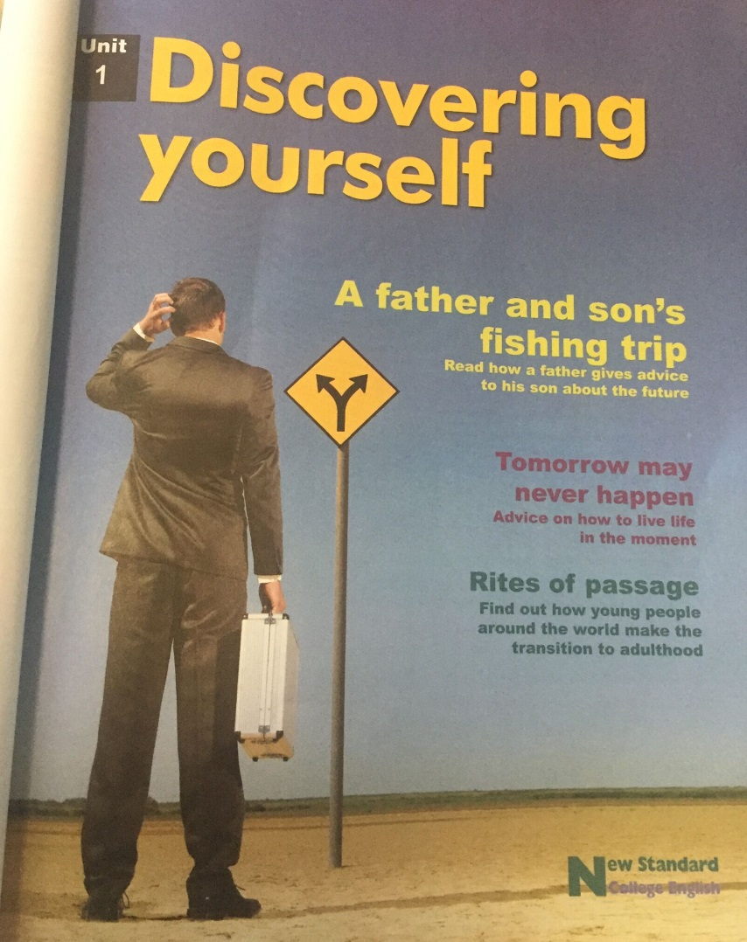
√
√

Slide 3
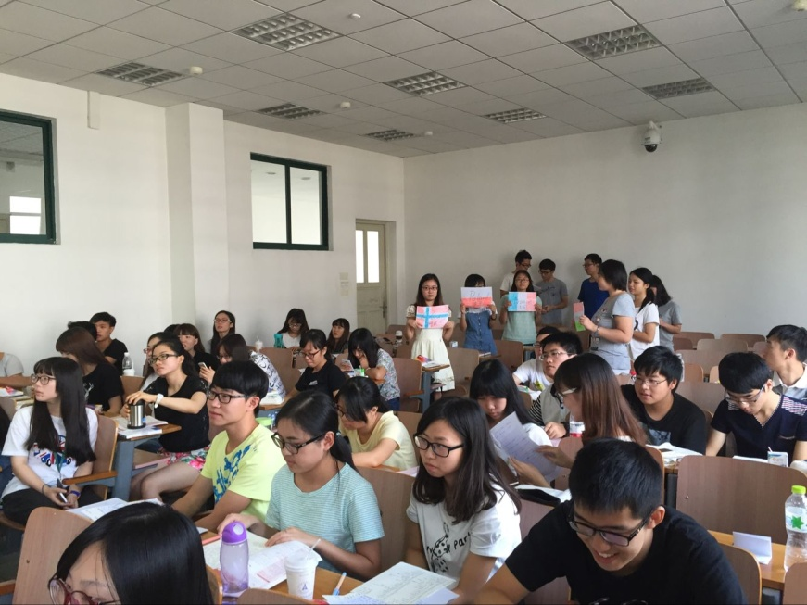
Target Students
English proficiency: intermediate
Sophomores
211

Slide 4
Teaching Objectives
1. to practice reading skills
2. to learn and apply vocabulary and sentence structures
3. to learn and apply narrative devices
4. to acquire cross-cultural knowledge
5. to develop autonomous and collaborative learning abilities
6. to discover oneself (career)
7. to develop critical thinking
linguistic
competence
whole-person
education
non-lingustic:
core competencies and values

Slide 5
Teaching Philosophy
Bloom’s taxonomy of
educational objectives

Slide 6
Teaching Philosophy
Psychology (Expressive Art Therapy)
storytelling
imagery
dream-work
visual arts
poetry
dance
movement
music
drama

Slide 7
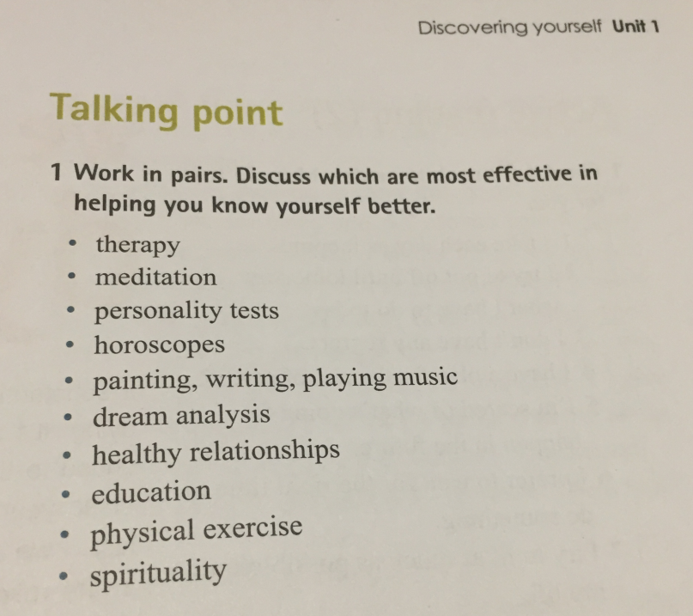
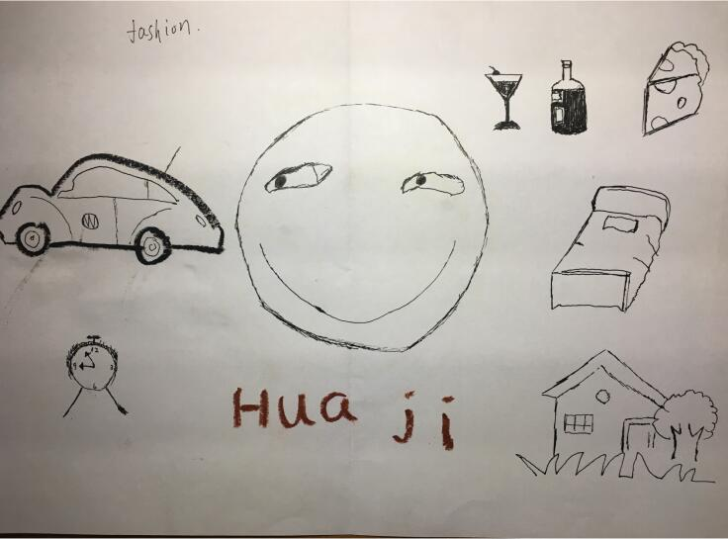
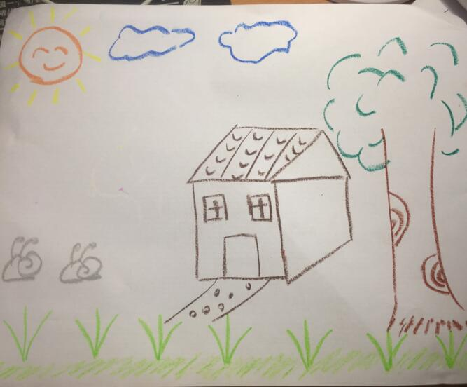
Teaching Philosophy
Psychology (Expressive Art Therapy)

Slide 8
Teaching Procedures
Period
1-2
Period
3-4
Period
5-6

Slide 9
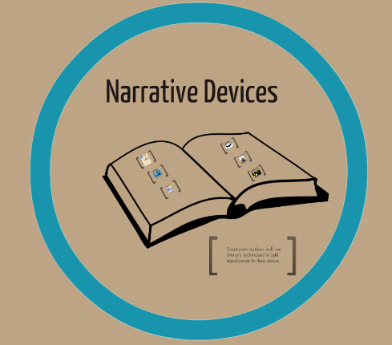
Teaching Procedures
Period
1-2
warm-up/reading activities/narrative devices
Online Tasks
Classroom Teaching
Assignments
online audios and videos
on narrative devices
1. Story writing by using narrative devices
2. Vocabulary and sentence structures learning & exercise
3. Preparation for the role-play of the story
1. Warm-up activities: drawing oneself & sharing (15 min)
2. Reading activities (30 min)
3. Narrative devices learning and applying (45 min)

Slide 10
Teaching Procedures
vocabulary / sentence structure / role-play
Online Tasks
Classroom Teaching
Assignments
Period
3-4
1. Review on the vocabulary & sentence structures
2. Group Presentations of the text “Rites of passage” in the Reading across cultures
1. vocabulary and sentence structures learning & exercise
2. micro-lectures on sentence structures:
It is/was... that/who...
It is/was not just... but...
1. Quiz & Discussion on vocabulary (15 min)
2. Quiz & Discussion on sentence structures (15 min)
3. Application of the sentence structures (15 min)
4. Students’ role-play and evaluation (45 min)

Slide 11
Teaching Procedures
presentations on “Rites of passage” and evaluation
Online Tasks
Classroom Teaching
Assignments
1. Quiz & Discussion on the text (25 min)
2. Students’ group presentations (45 min)
6 groups, 7 minutes for each group
3. Peer evaluation of group presentations (10 min)
Work in pairs to finish an evaluation form
4. Teacher’s feedback (10 min)
Online quiz of the unit
recommended videos and
texts on “Rites of passage”
Period
5-6

Slide 12
Part 2
Classroom
Teaching Demo

Slide 13
Teaching Objectives
1. to practice reading skills
2. to learn and apply vocabulary and sentence structures
3. to learn and apply narrative devices
4. to acquire cross-cultural knowledge
5. to develop autonomous and collaborative learning abilities
6. to discover oneself (career)
7. to develop critical thinking

Slide 14
Teaching Procedures
Period
1-2
warm-up/reading activities/ narrative devices
Online Tasks
Classroom Teaching
Assignments
1. Warm-up activities: drawing oneself & sharing (15 min)
2. Reading activities (30 min)
3. Narrative devices learning and applying (45 min)

Slide 15
Teaching Procedures
Period
1-2
3. Narrative devices learning and applying (45 min)
1. Explain the definition of narrative devices (8 min)
2. Analyze narrative devices (7 min)
3. Apply narrative devices in story writing (30min)

Slide 16
Analyze narrative devices
Narrative devices in Cinderella

Slide 17
Analyze narrative devices
Narrative devices in fairy tales
Para. 1: There was once a prince who wanted to marry a princess.
But she had to be a real princess. So he travelled all round the world to find one, but there was always something wrong—there were plenty of princess, though whether they were real princesses he could never quite find out: there was always something that was not just right. So he came home again and was very unhappy because he wanted so much to have a real princess.
a time expression
a sentence

Slide 18
Analyze narrative devices
Narrative devices in fairy tales
it thundered and lightened and the rain poured down in torrents—it was really quite frightening! Then there came a knock at the town-gate, and the old king went out and opened it.
Para. 2: One evening there was a dreadful storm:
a time expression
Para. 3: It was a princess who stood outside. But my, what a sight she was with the rain and the storm! Her hair and her clothes were running with water: water was runing in through the toes of ther shoes and out at the heels. she said she was a real princess.
a sentence

Slide 19
Analyze anarrative devices
Narrative devices in fairy tales
Para. 4: “Well, we shall soon find out” thought the old queen to herself...
Para. 5: And there the princess had to spend the night.
Para. 6: In the morning they asked here how she had slept.
Para. 7: “Oh, terribly badly!” said the princess. “I have hardly shut my eyes the whole night! Heaven knows what there was in the bed! I have been lying on something hard—I am black and blue all over! It's really dreadful!”
direct speech
direct speech

Slide 20
Analyze narrative devices
Summary
Function:
to spark interest, to encourage reading
to change between description, narration of events and dialogue
Form:
a sentence, a time expression, direct speech
Position:
usually at the beginning, sometimes at the end

Slide 21
Analyze narrative devices
Follow-up Story Writing
Para. 36: My father started the motor and we set off back home.
a final sentence

Slide 22
Analyze narrative devices
Follow-up Story Writing
My father started the motor and we set off back home.
I longed to travel around the world and be a writer. Therefore, after my graduation, I left home and started my dream journey.
I kept surfing the Internet and tried to get information related to writing and traveling. However, for a month or two, I could not find a satisfying job. But I did not give up. One day, a job advertisement caught my eyes. A Chinese university was looking for a foreigner to teach writing...
On that night, I made a decision. I longed to travel around the world and be a writer. Therefore, after my graduation, I left home and started my dream journey.
But how could I realize my dream? I kept surfing the Internet and tried to get information related to writing and traveling. However, for a month or two, I could not find a satisfying job. But I did not give up. One day, a job advertisement caught my eyes. A Chinese university was looking for a foreigner to teach writing...

Slide 23
Analyze narrative devices
Follow-up Story Writing
My father started the motor and we set off back home.
I longed to travel around the world and be a writer. Therefore, after my graduation, I left home and started my dream journey.
I kept surfing the internet and tried to get information related to writing and traveling. However, for a month or two, I could not find a satisfying job. But I did not give up. One day, a job advertisement caught my eyes. A Chinese university was looking for a foreigner to teach writing...
On that night, I made a decision. I longed to travel around the world and be a writer. Therefore, after my graduation, I left home and started my dream journey.
But how could I realize my dream? I kept surfing the internet and tried to get information related to writing and traveling. However, for a month or two, I could not find a satisfying job. But I did not give up. One day, a job advertisement caught my eyes. A Chinese university was looking for a foreigner to teach writing...

Slide 24
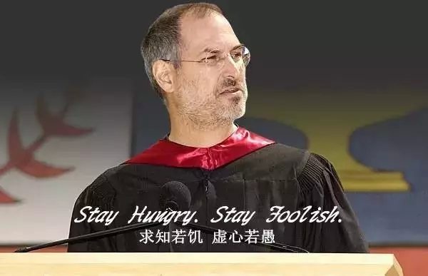
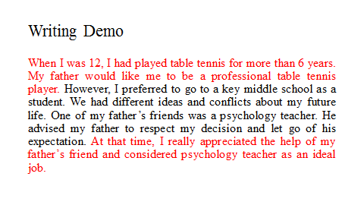
Assignment
Watch the video and write your story with narrative devices about your journey to find your job interest.

Slide 25
Part 3
Teaching
Assessment

