Slide 1
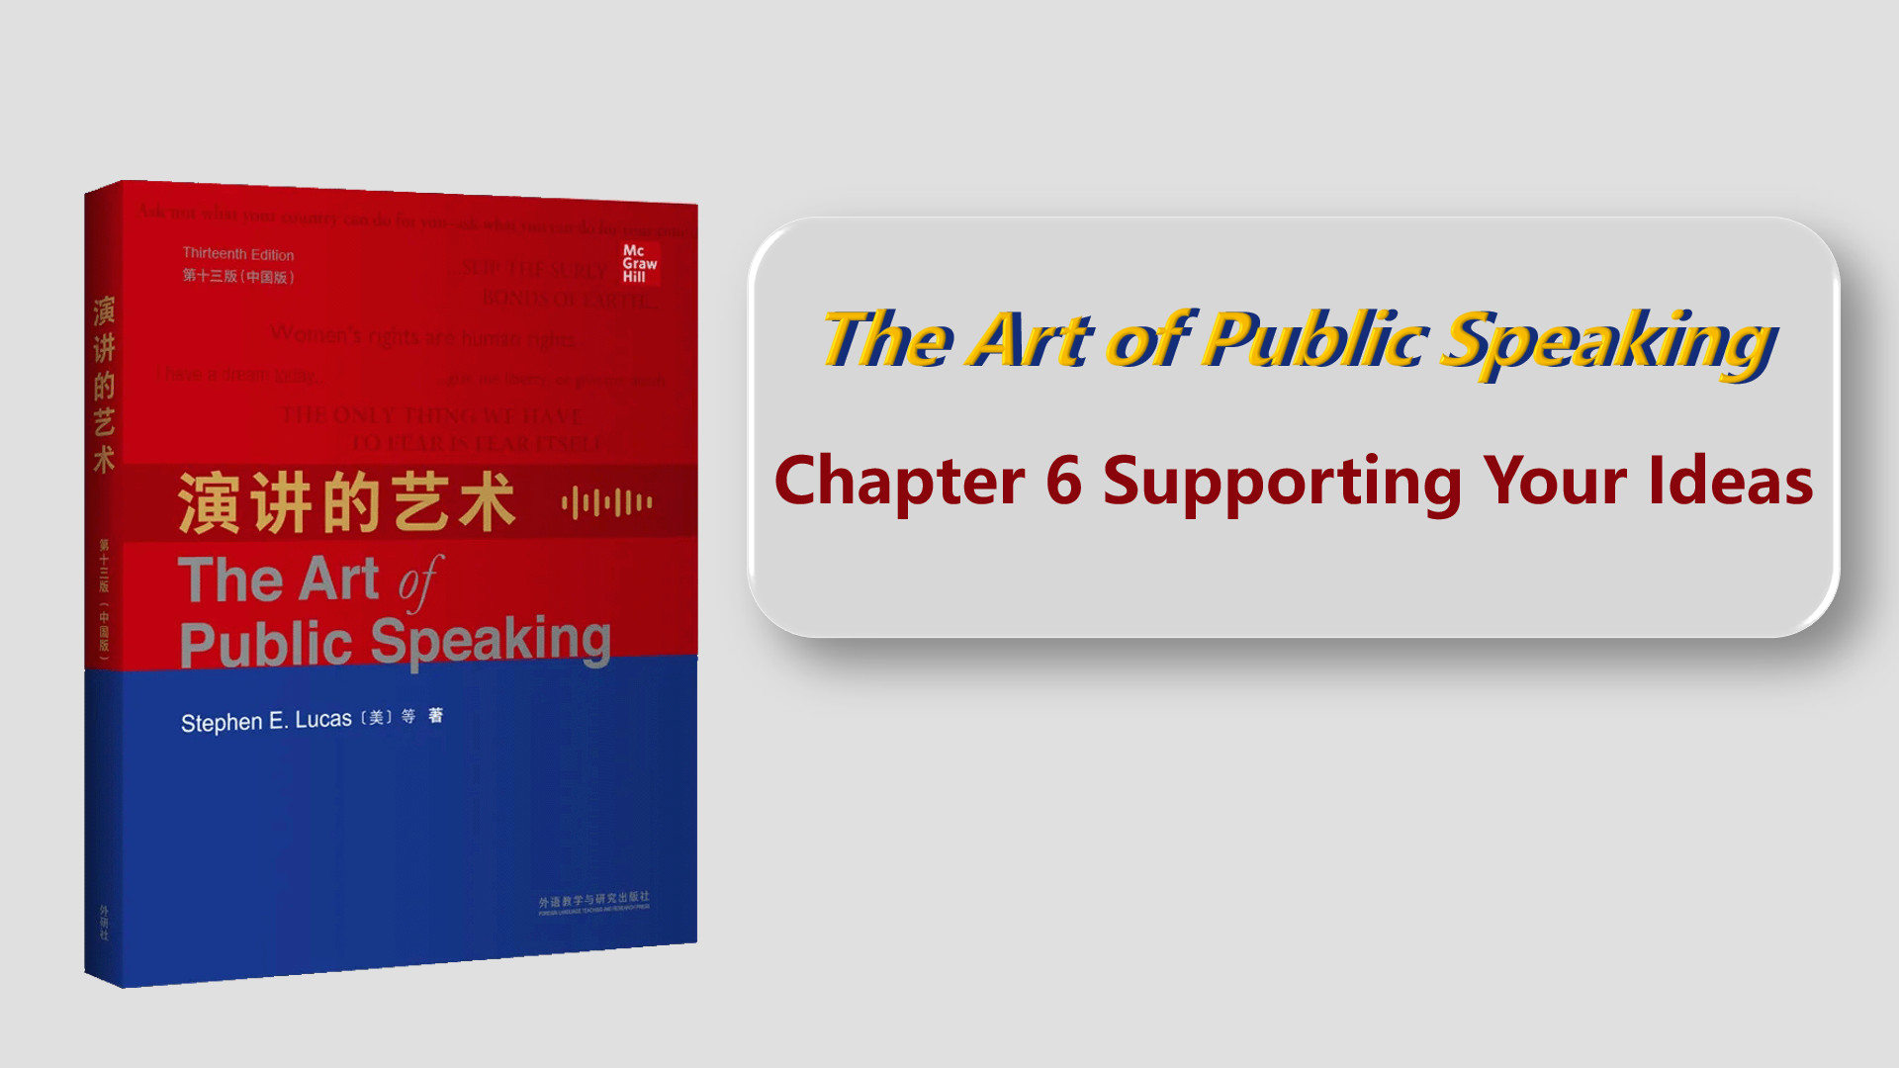

Slide 2

Target Students
Second-year,
non-English majors
80% having passed CET 6
Well-motivated
Different levels of
speaking proficiency,
collaboration skills,
and critical thinking

Slide 3

Chapter 6
Supporting Your Ideas
Teaching design
Use of the textbook
Introduction to the demo class
The Art of Public Speaking

Slide 4
Teaching Design
1
Objectives
Contents
Procedure
Assessment
The Art of Public Speaking

Slide 5
Teaching Design--
Objectives
1. Express ideas logically with the PRES pattern;
2. Cooperate in group work to fulfill assigned roles;
3. Analyze controversial issues in an unbiased way.
The Art of Public Speaking

Slide 6
Teaching Design--
Procedure
Session 1
Online
Micro lecture: The PRES Pattern in Speech
Session 2
Offline
Session 3
Online
Session 4
Offline
The Art of Public Speaking

Slide 7
I have an opinion on this topic …
P
Point
Present the point
R
Reason
Explain the reasons
Provide concrete evidence (examples/statistics/testimony)
E
Evidence
S
Summary
Summarize the speech

Slide 8
Teaching Design--
Procedure
Session 1
Online
Micro lecture: The PRES Pattern in Speech
Session 2
Offline
Practice using the PRES pattern
Session 3
Online
Micro lecture: Exemplification in Speech
Session 4
Offline
Practice using supporting materials
The Art of Public Speaking

Slide 9
Teaching Design--
Assessment
Formative assessment
Independent learning (micro lectures)
Attendance
Participation (Q&A, speech delivery)
Peer evaluation
After-class performance (speech revision)
The Art of Public Speaking

Slide 10
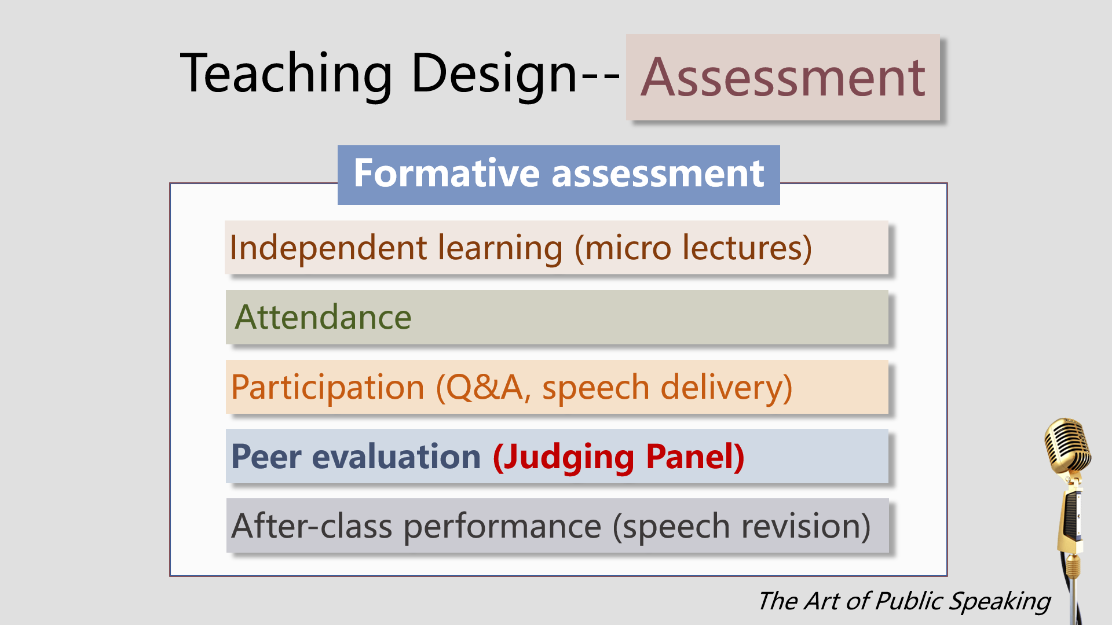

Slide 11
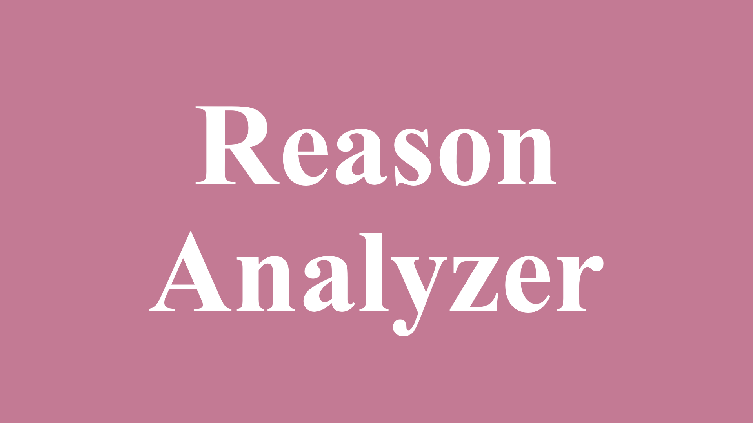




Judging Panel

Slide 12
Use of the textbook
2
The Art of Public Speaking

Slide 13
Use of the textbook
Integrate contents
Chapter 6 Supporting Your Ideas
Examples
Statistics
Testimony
The Art of Public Speaking

Slide 14
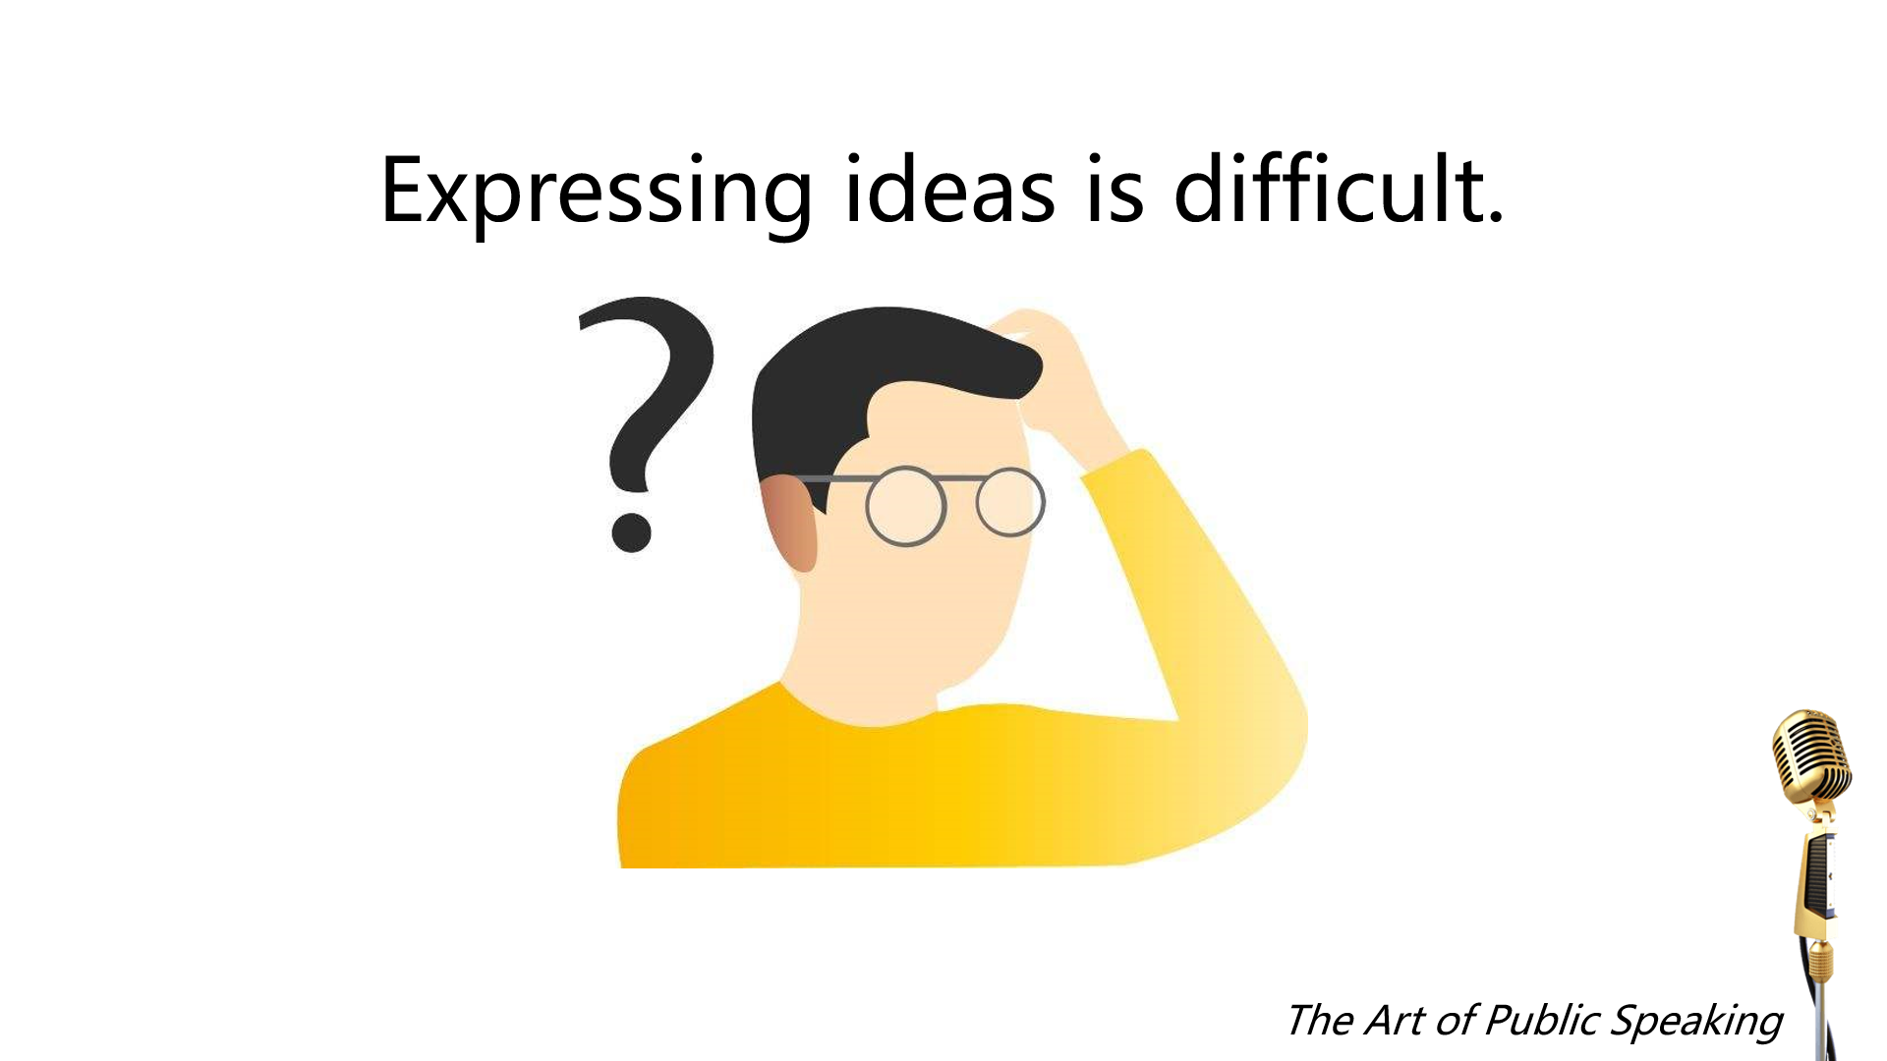

Slide 15
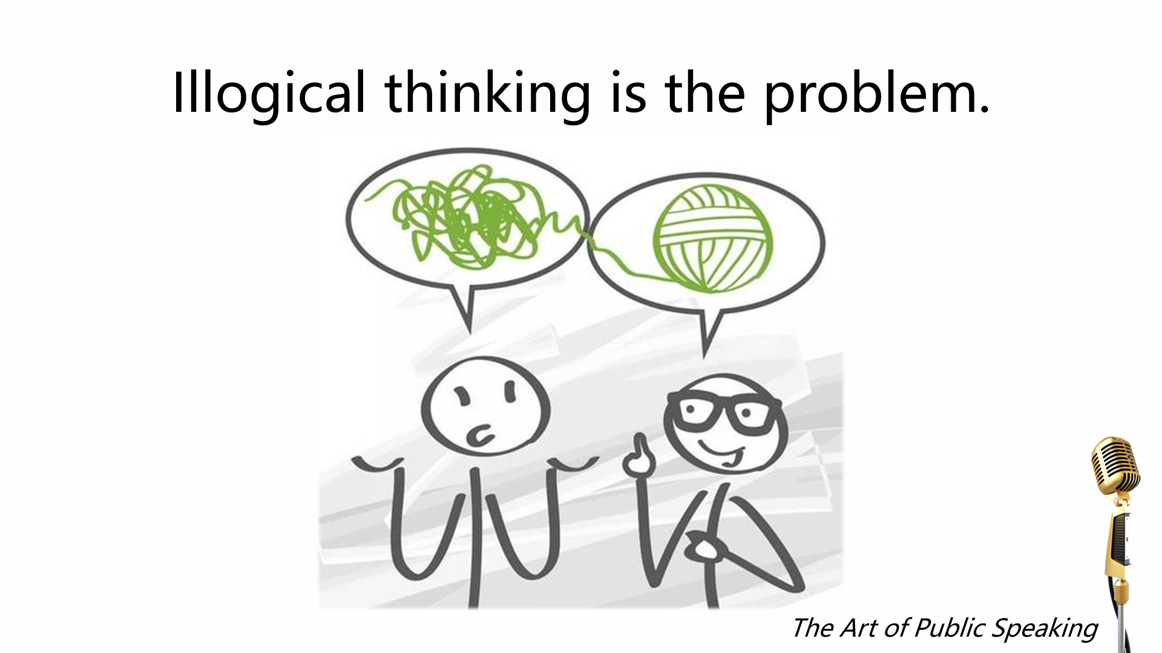

Slide 16
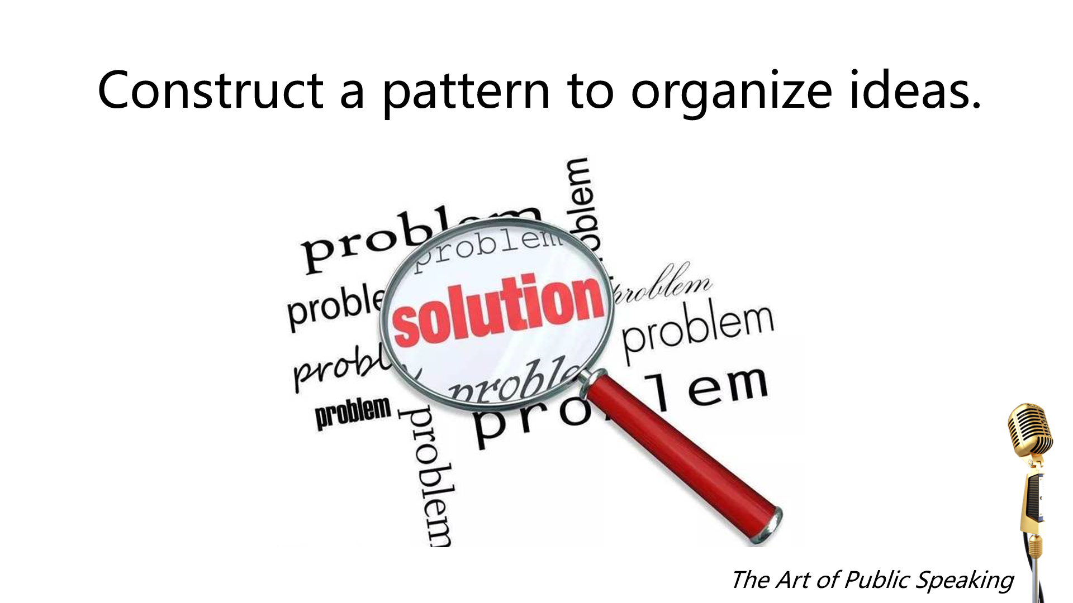

Slide 17
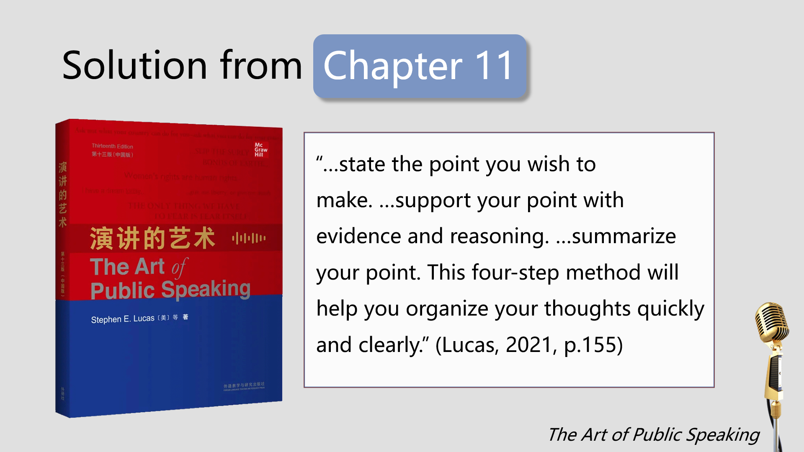

Slide 18
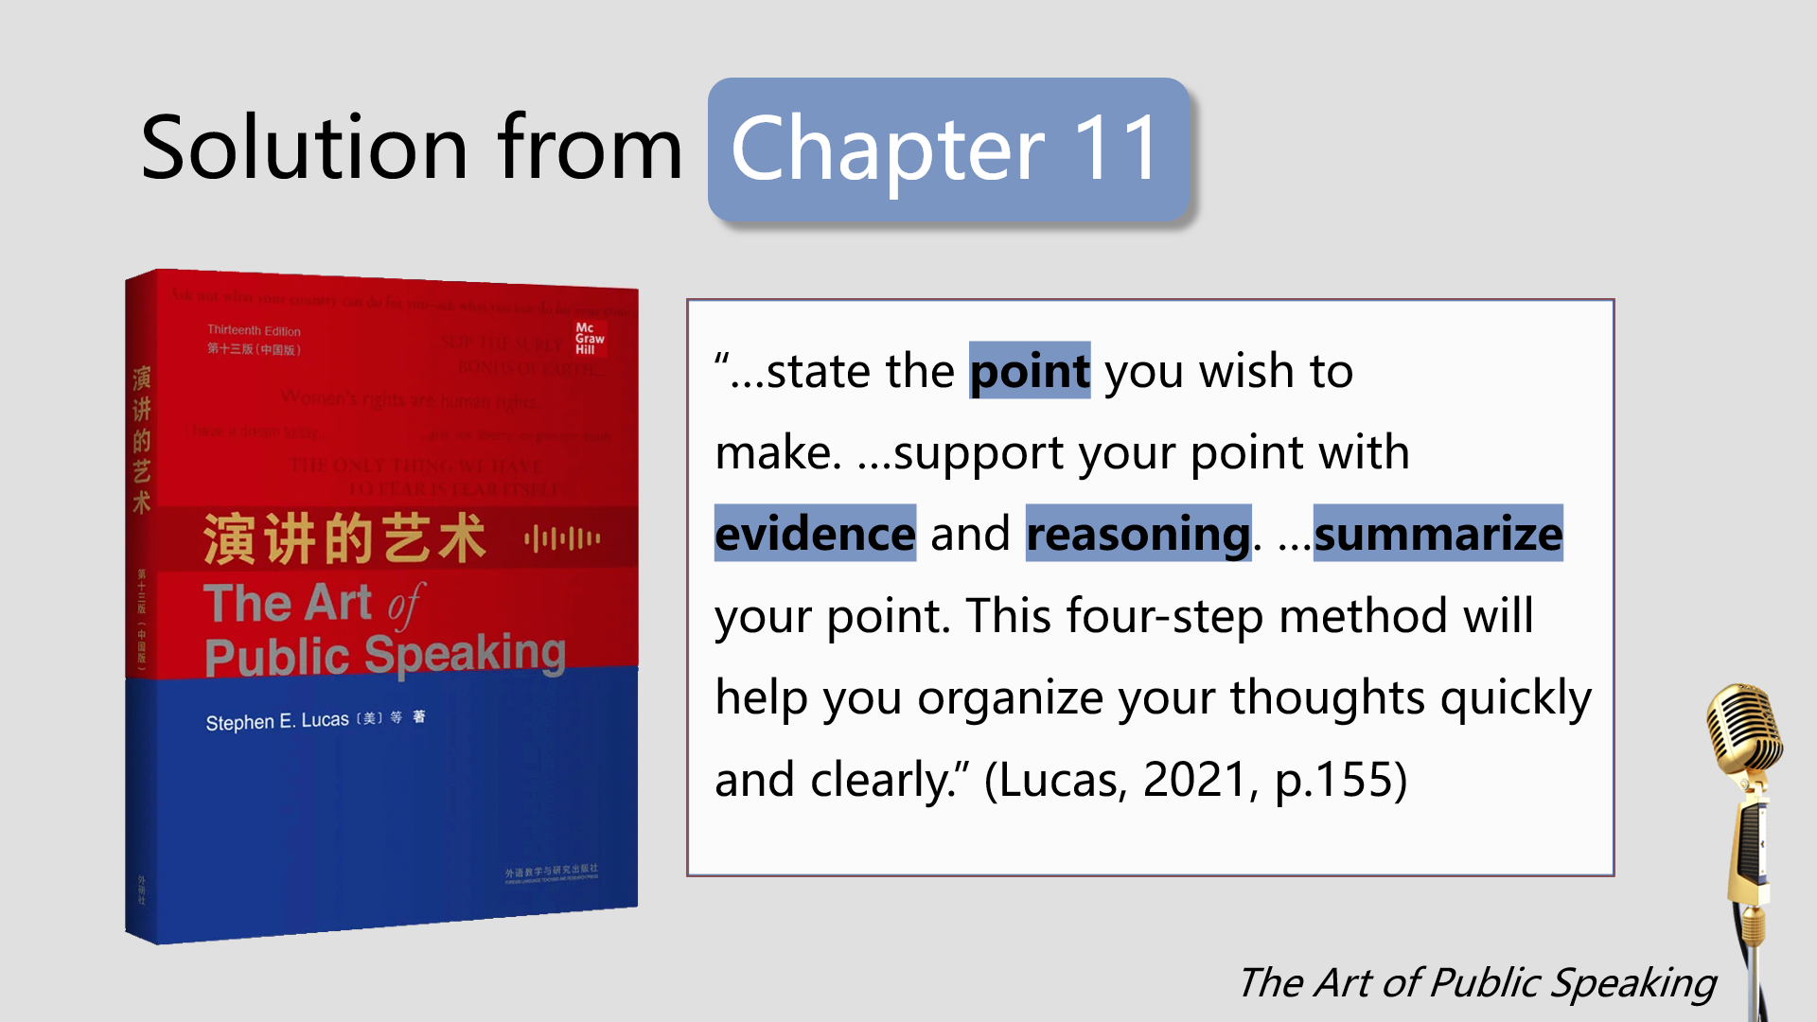

Slide 19
Use of the textbook
Form the PRES pattern to help students think logically.
“As with all versions of the book, this adaptation reflects my belief that the most important part of speaking is thinking.” (Lucas, 2021, p. ii)
The Art of Public Speaking

Slide 20


Use of the textbook
Combine examples from the textbook and contests.
The Art of Public Speaking

Slide 21
Use of the textbook
Combine examples from the textbook and contests.
“It also follows David Hume’s advice that ‘He who would teach eloquence must do it chiefly by examples.’” (Lucas, 2021, p. ii)
The Art of Public Speaking

Slide 22
Use of the textbook
Put principles from the textbook into practice.
Deliver speeches in class;
Evaluate classmates’ speeches;
Participate in nationwide speaking contests.
The Art of Public Speaking

Slide 23
Use of the textbook
Put principles from the textbook into practice.
“You cannot become a skilled speaker just by following a set of rules in a textbook. In the long run, there is no substitute for experience.” (Lucas, 2021, p.154)
The Art of Public Speaking

Slide 24
Use of the textbook
Integrate contents from different chapters.
Combine examples from the textbook and contests.
Put principles from the textbook into practice.
The Art of Public Speaking

Slide 25
Introduction to the demo class
3
The Art of Public Speaking

Slide 26
Demo class design from
Session 2
Offline
Objective
To speak logically and convincingly with PRES
Procedure
Review
Practice
Assignment
Assessment
Peer evaluation
(Judging Panel)
&
Teacher feedback
Objective
Procedure
Assessment
The Art of Public Speaking

Slide 27
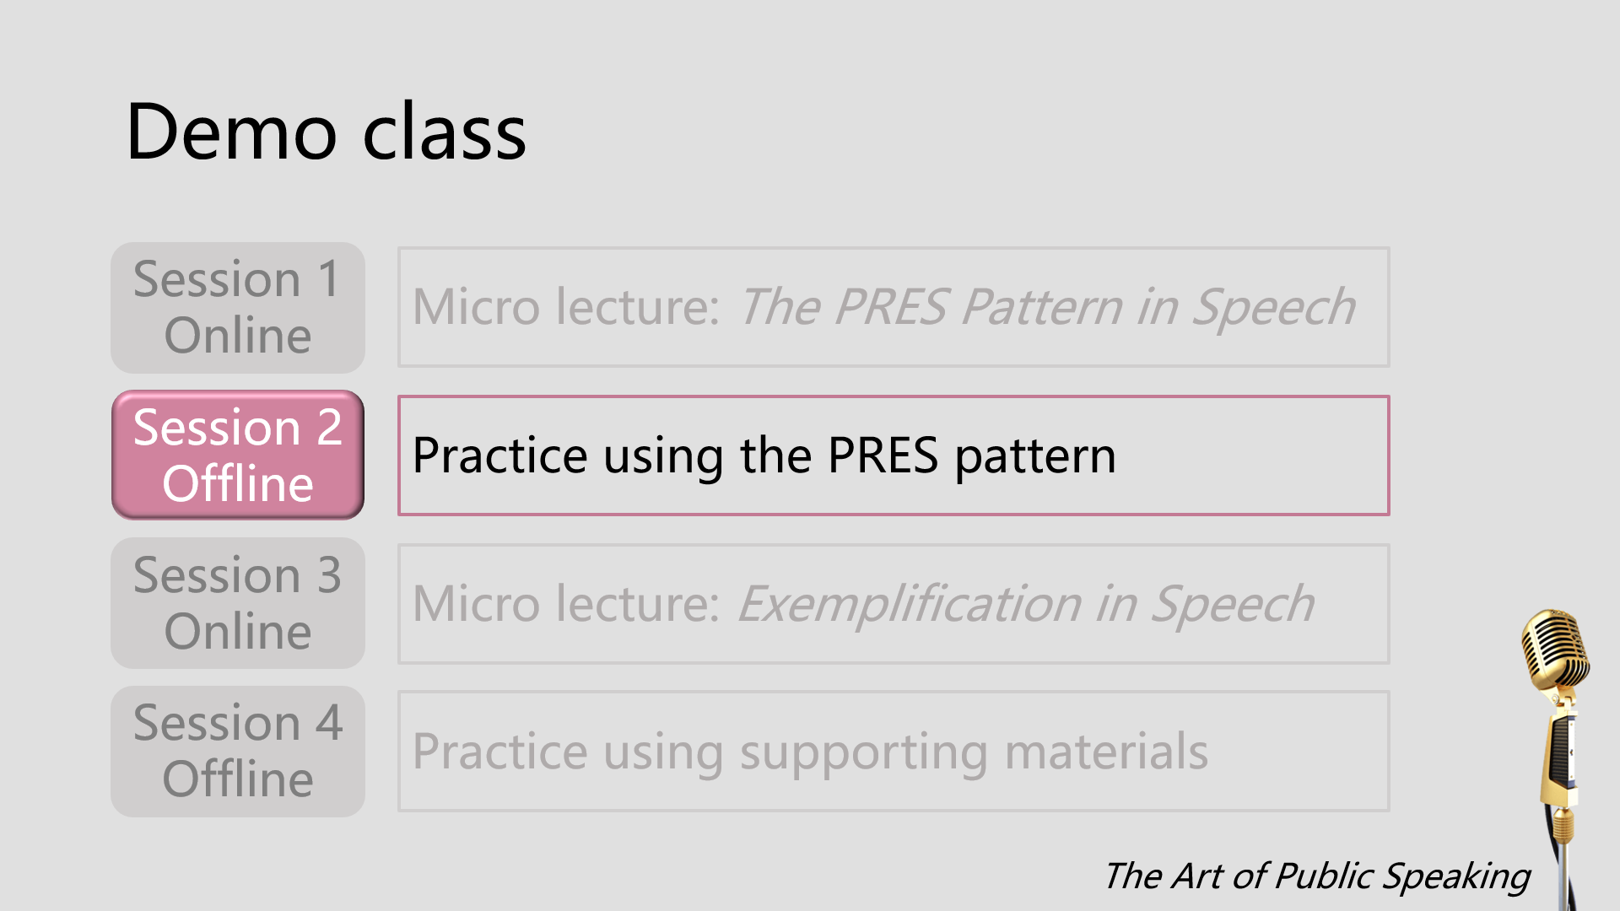

Slide 28
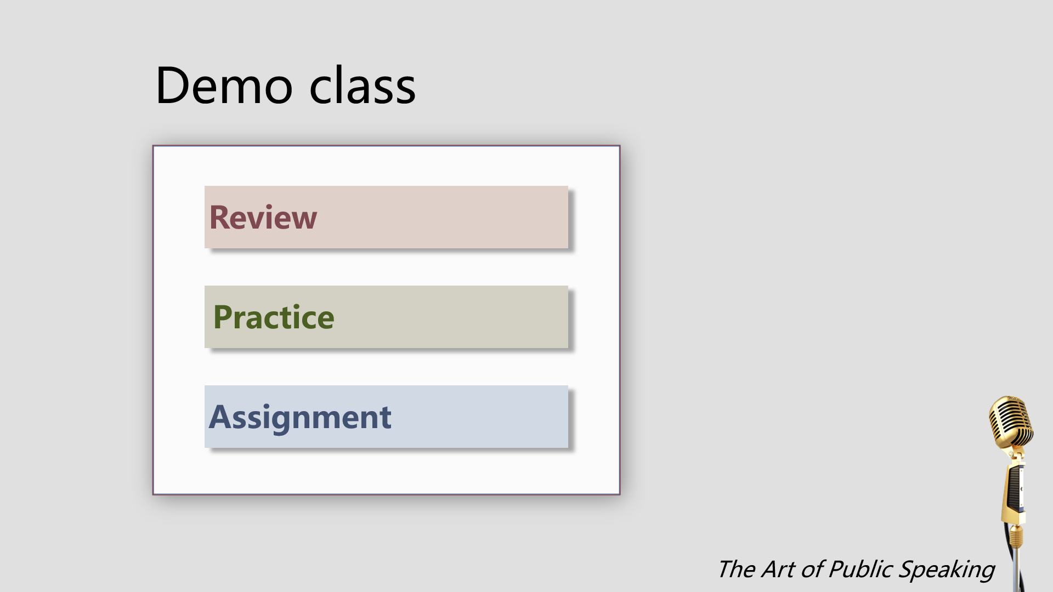

Slide 29
What is the PRES pattern?
P
Point
R
Reason
E
Evidence
S
Summary
The Art of Public Speaking

Slide 30
What’s your opinion on…
What is your point?
Present the point
Why do you think so?
Explain the reasons
How can you justify it?
Provide concrete evidence (examples/statistics/testimony)
Summarize the speech
The Art of Public Speaking

Slide 31
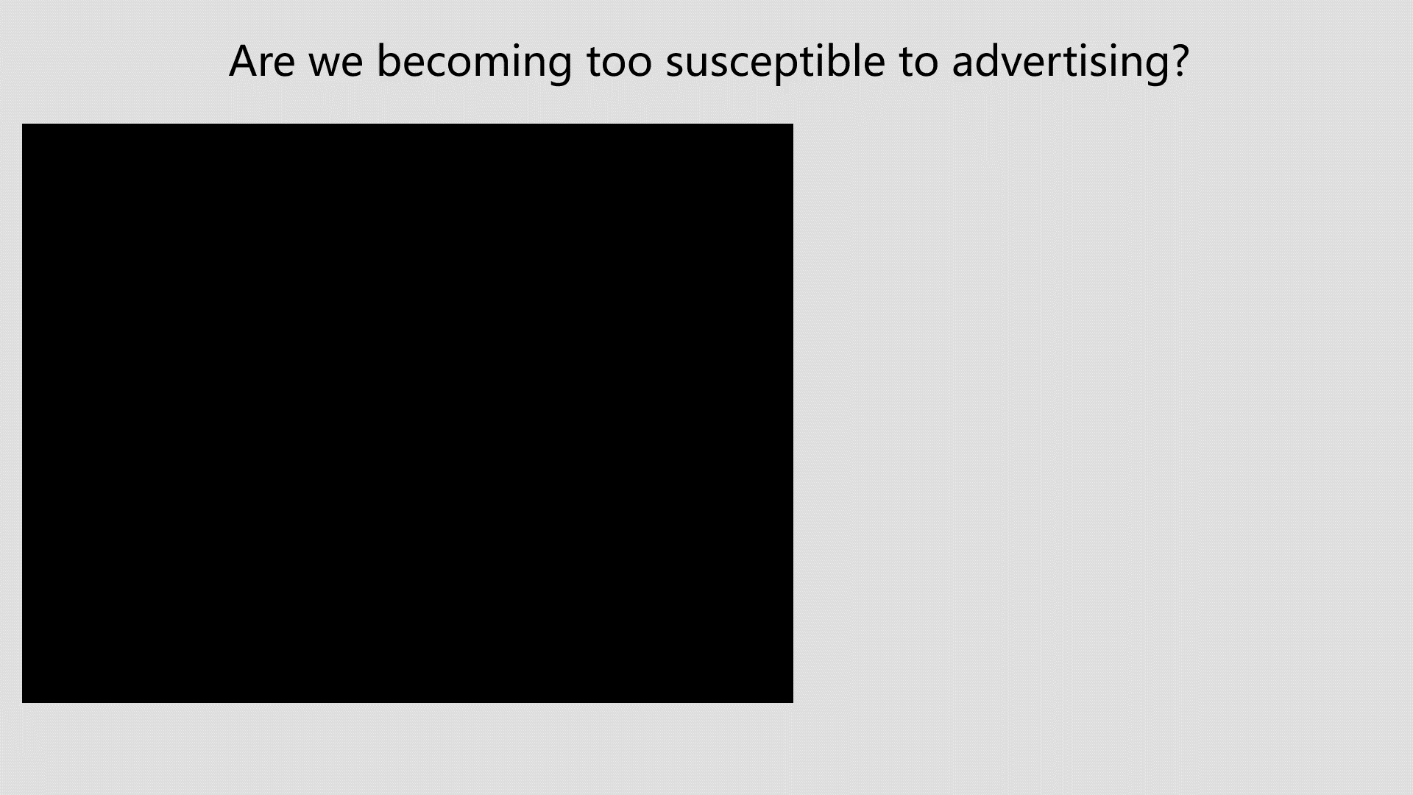

Slide 32
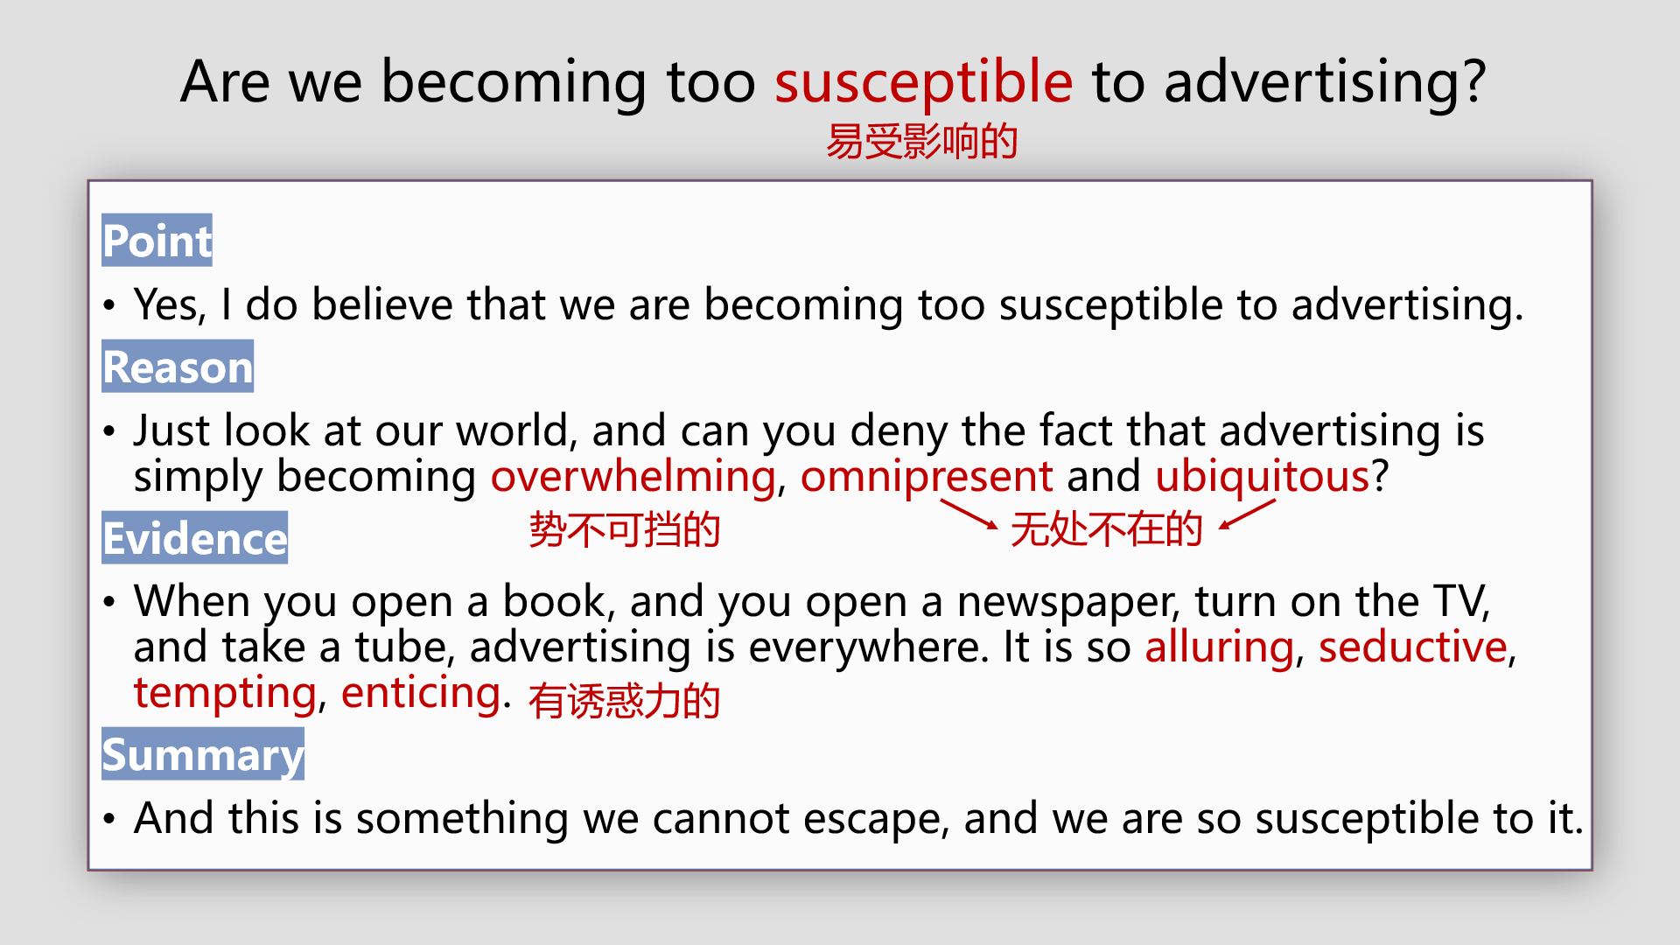

Slide 33
Judging Panel
1. Is the point clearly stated?
2. Does the summary reinforce the point?
1. What are the reasons?
2. Are the reasons logical and convincing?
1. What kind of evidence does the speaker use?
2. Is the evidence relevant and strong?
1. Does the speaker use time effectively?
2. Remind the speaker of the time.

Slide 34
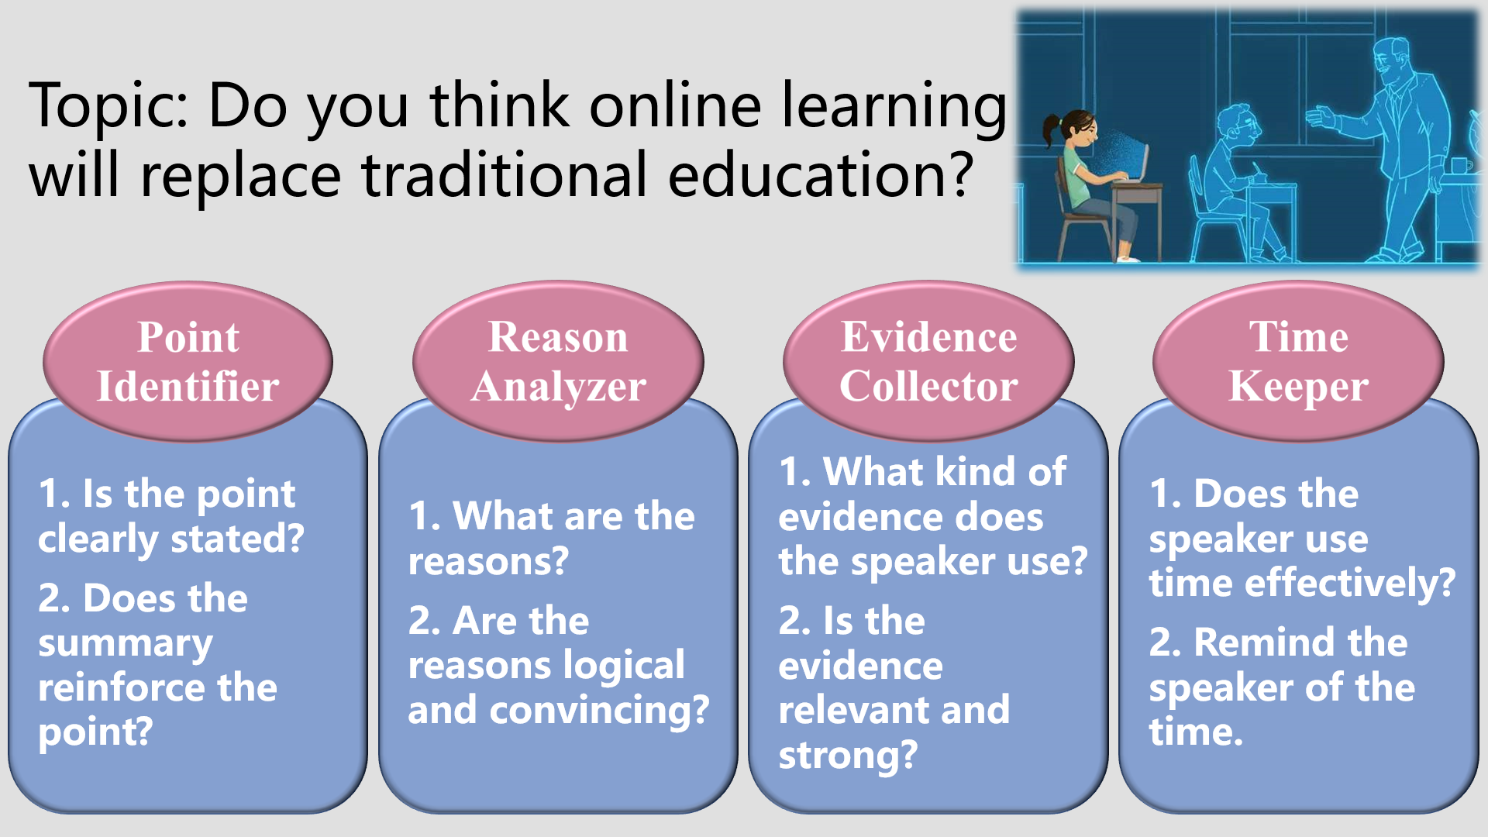

Slide 35
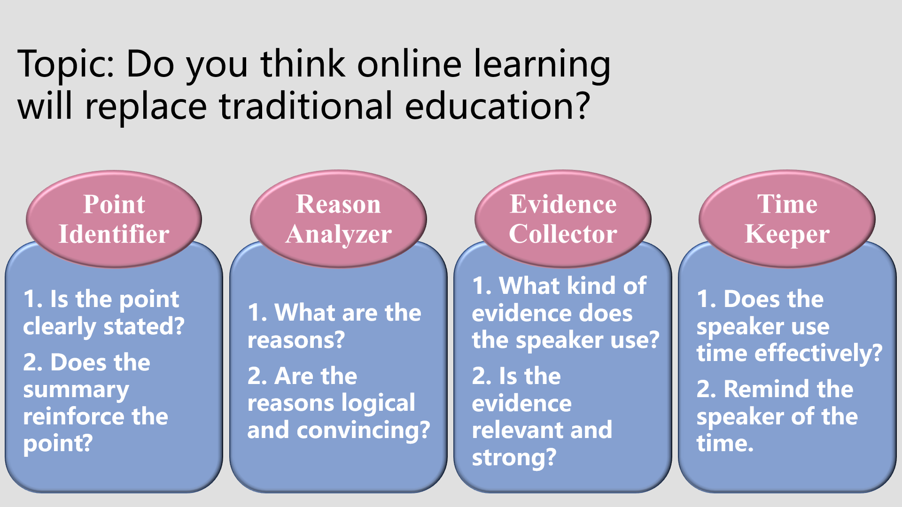


Slide 36
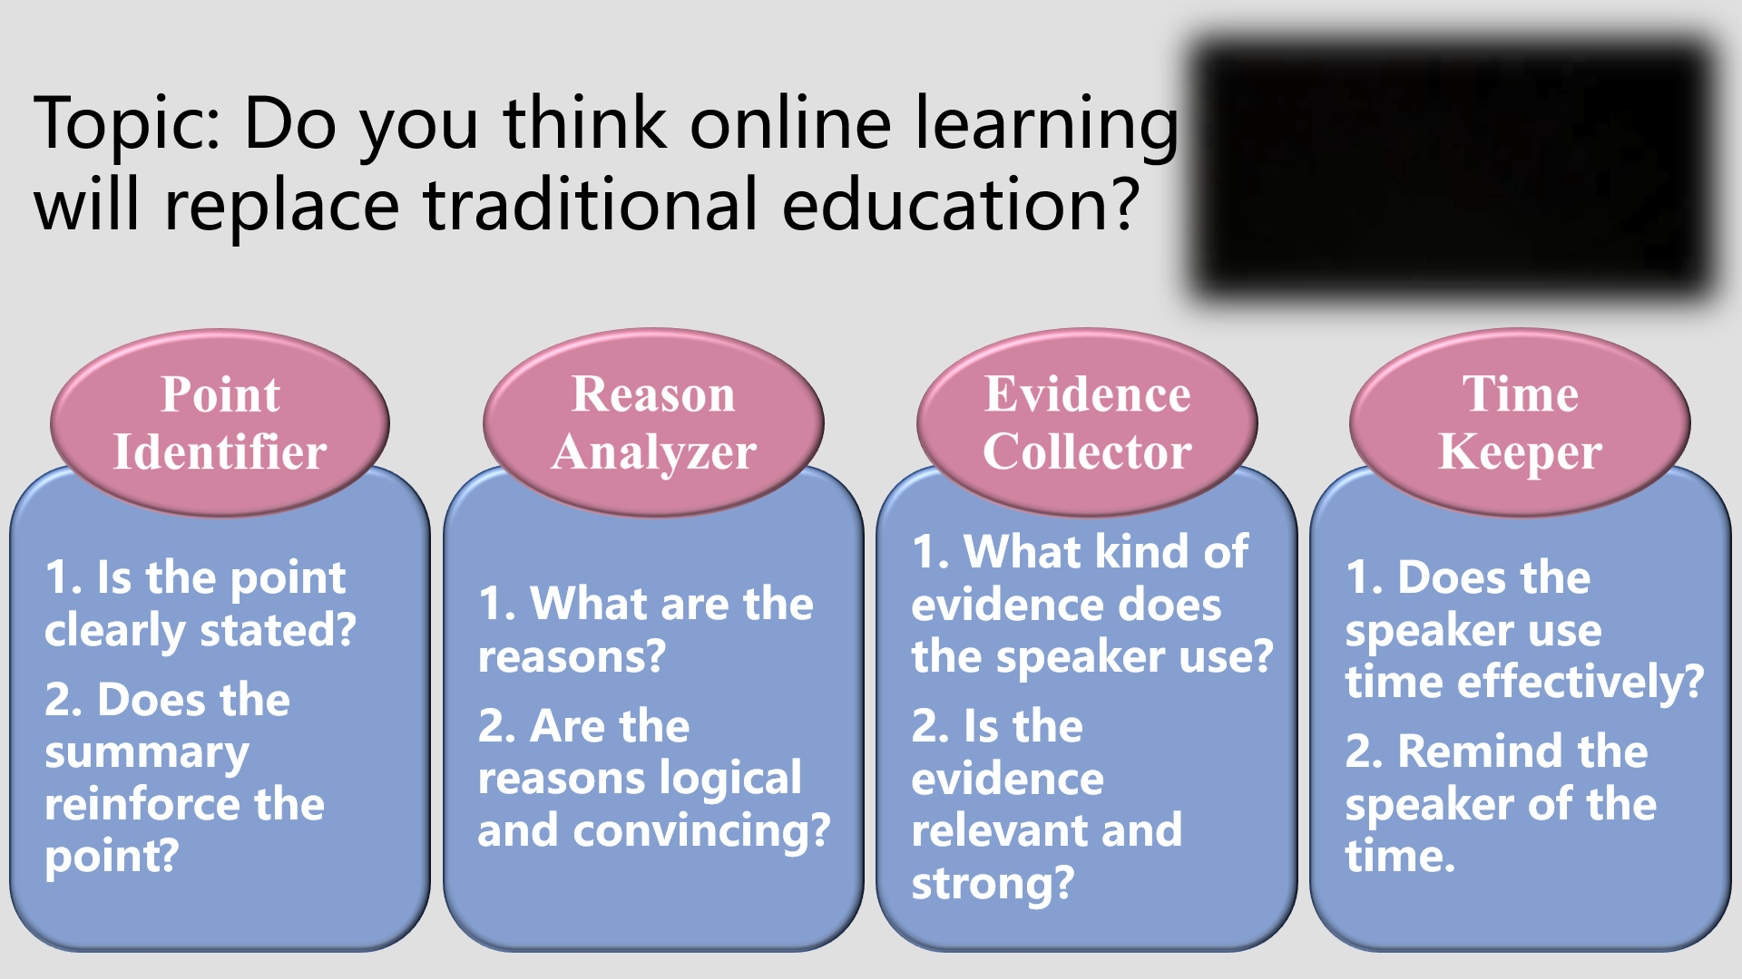

Slide 37
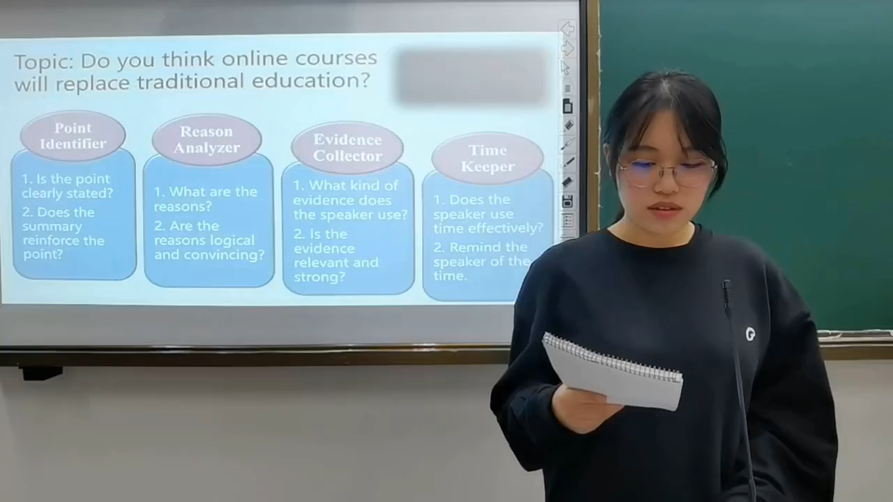
Topic: Do you think online learning will replace traditional education?

Slide 39
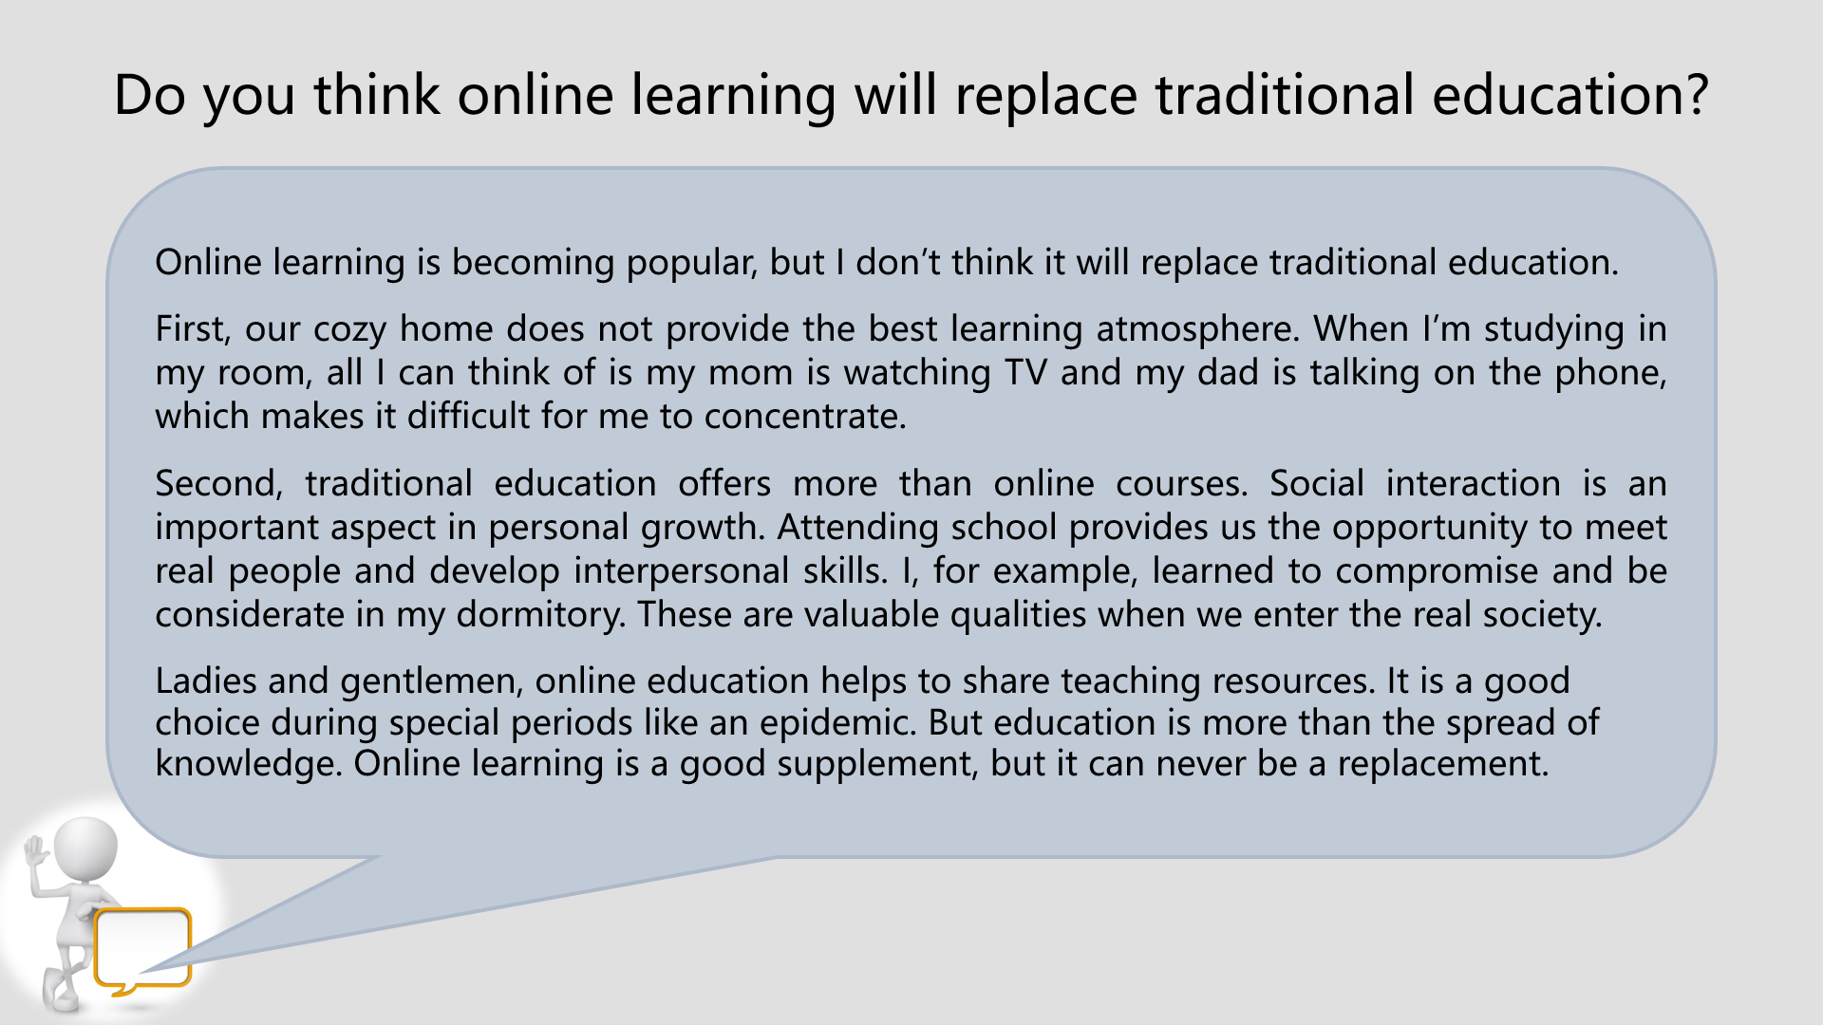

Slide 40
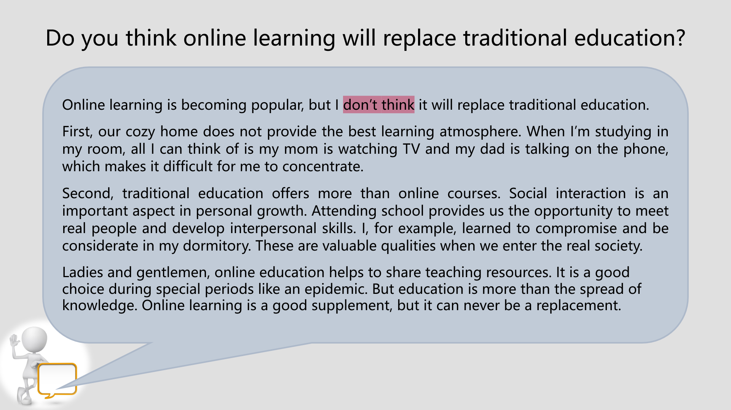

Slide 41
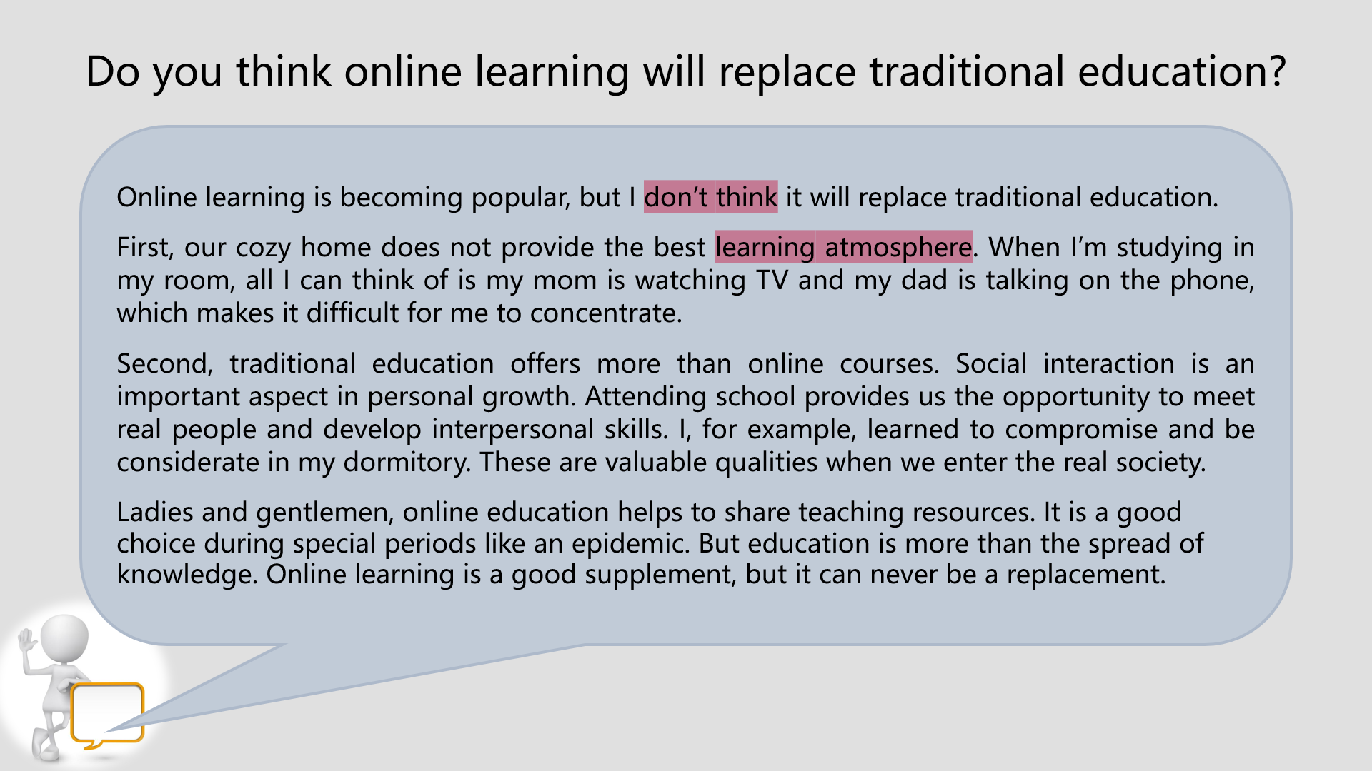

Slide 42
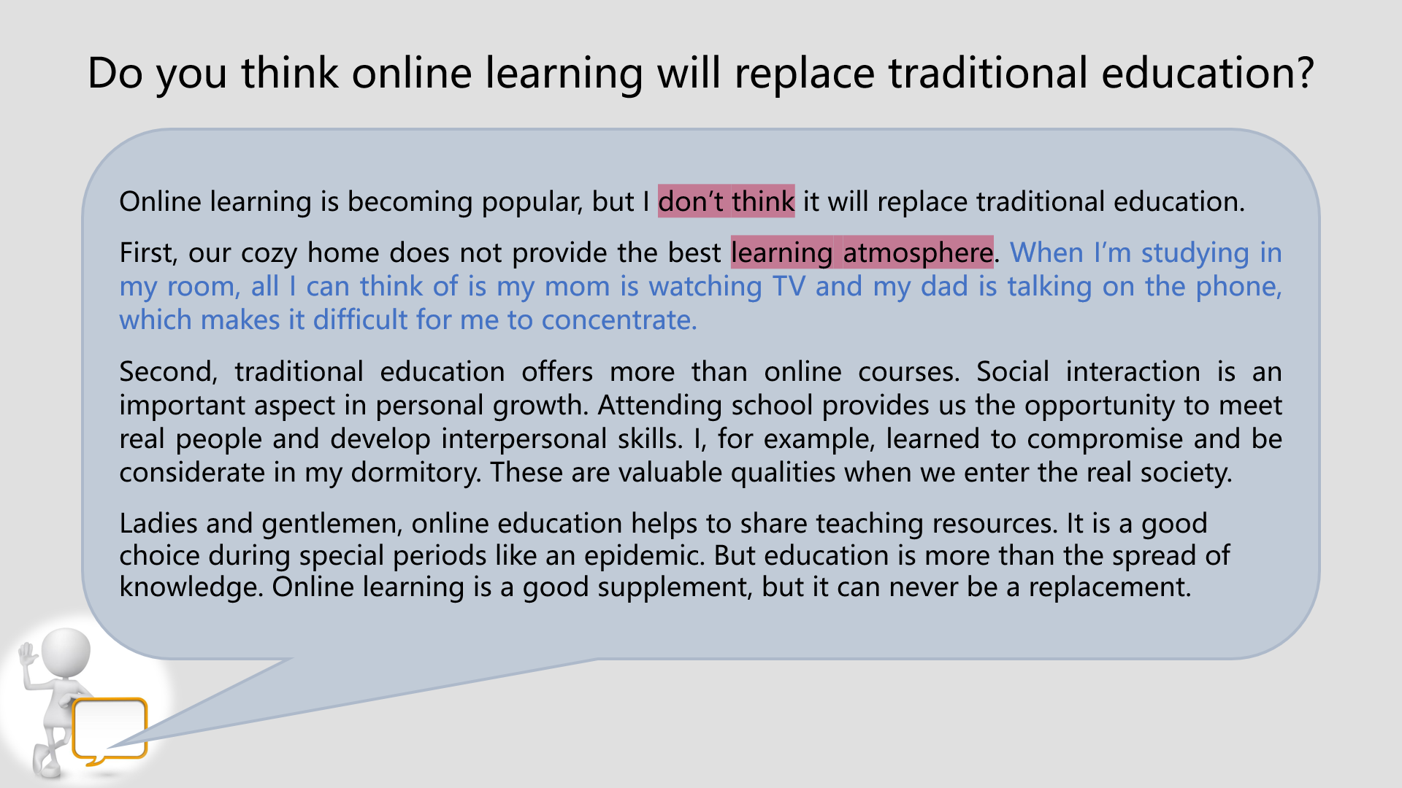

Slide 43
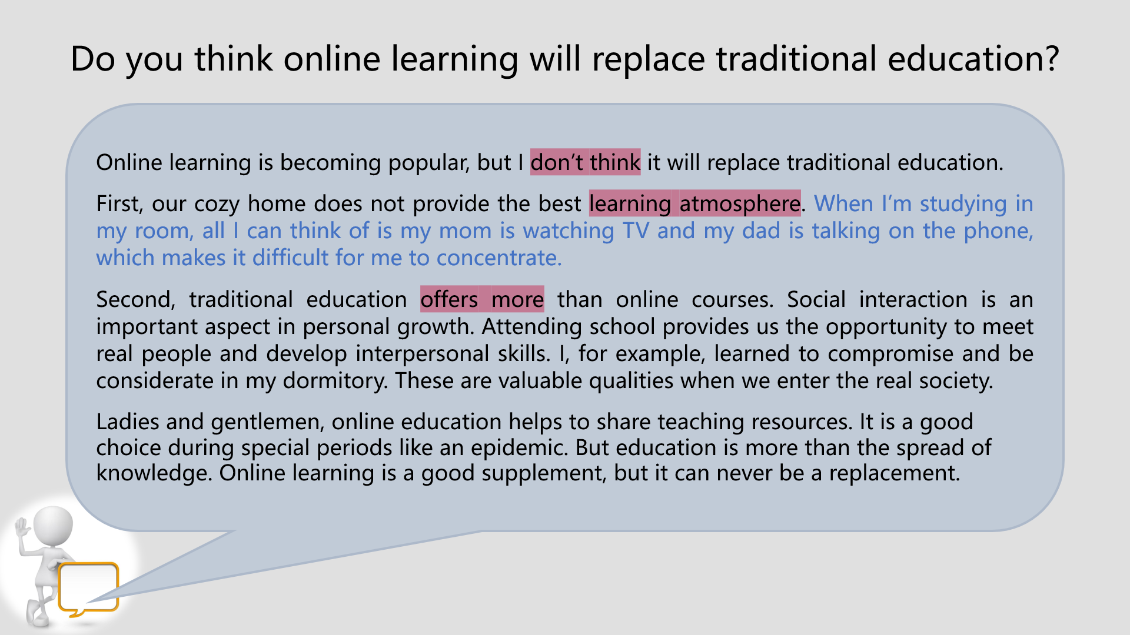

Slide 44
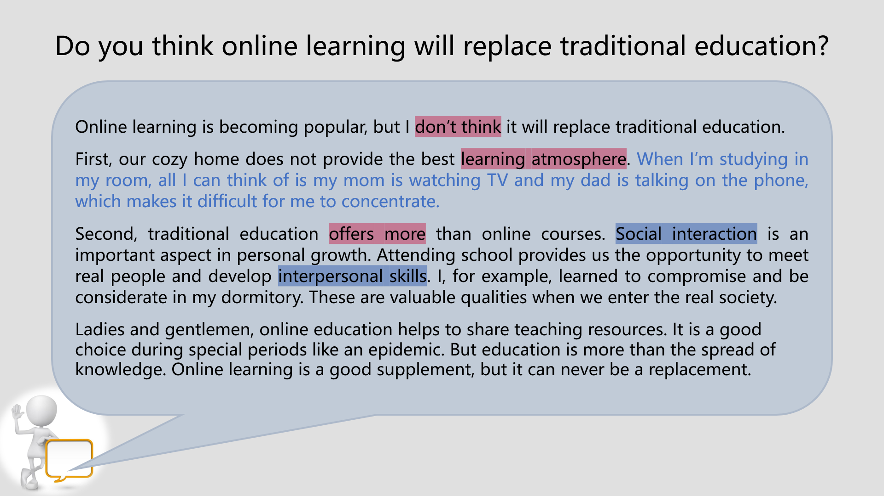

Slide 45
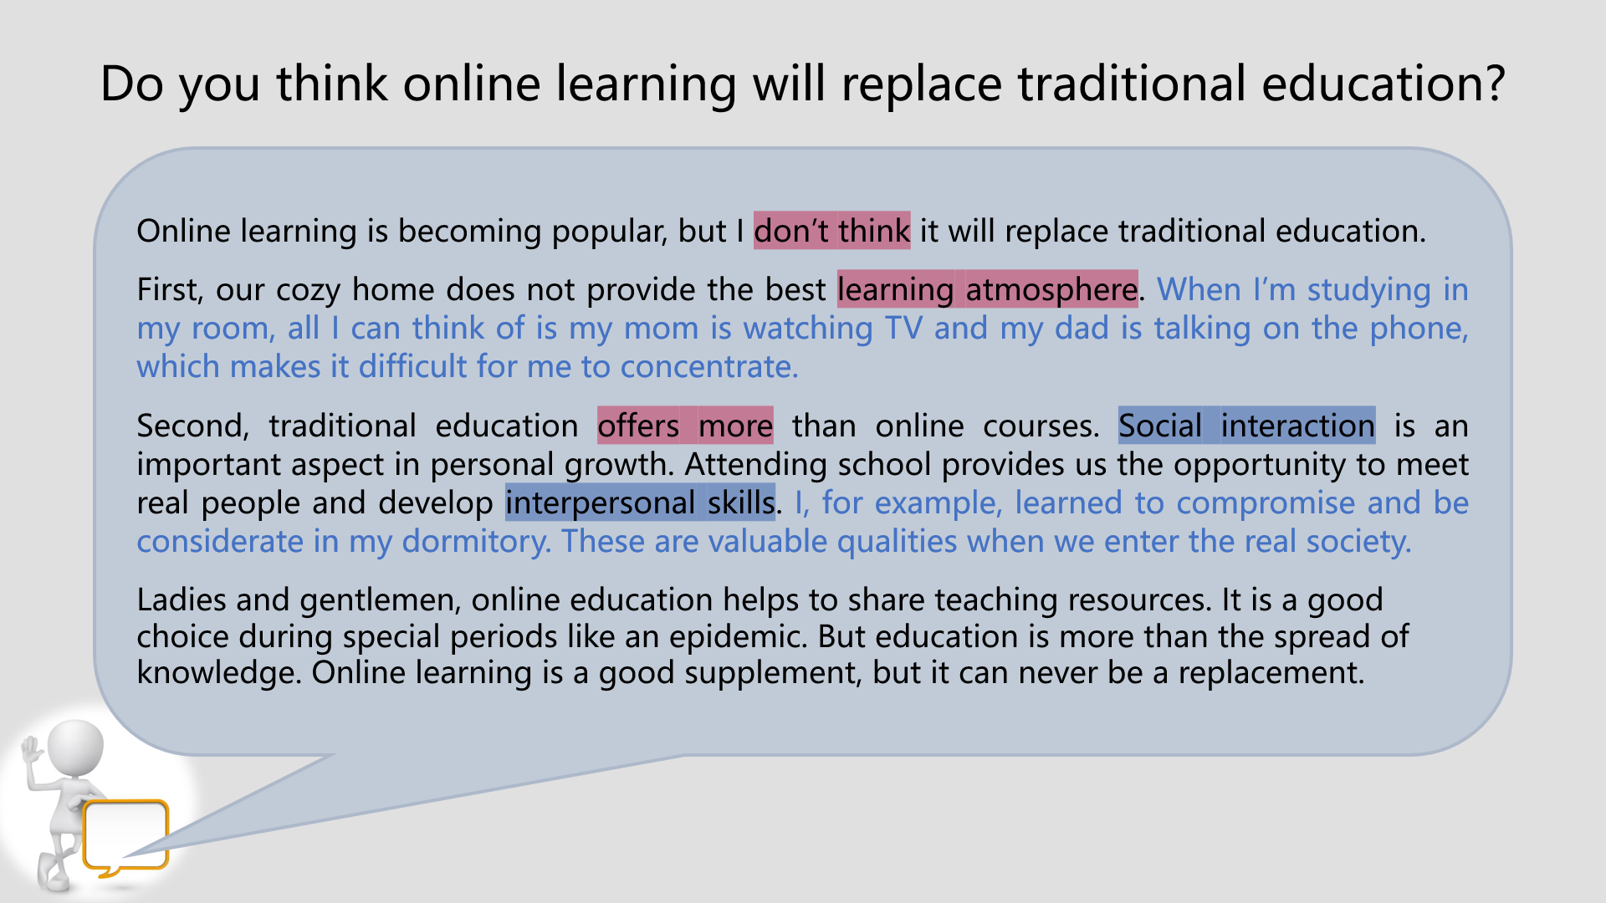

Slide 46
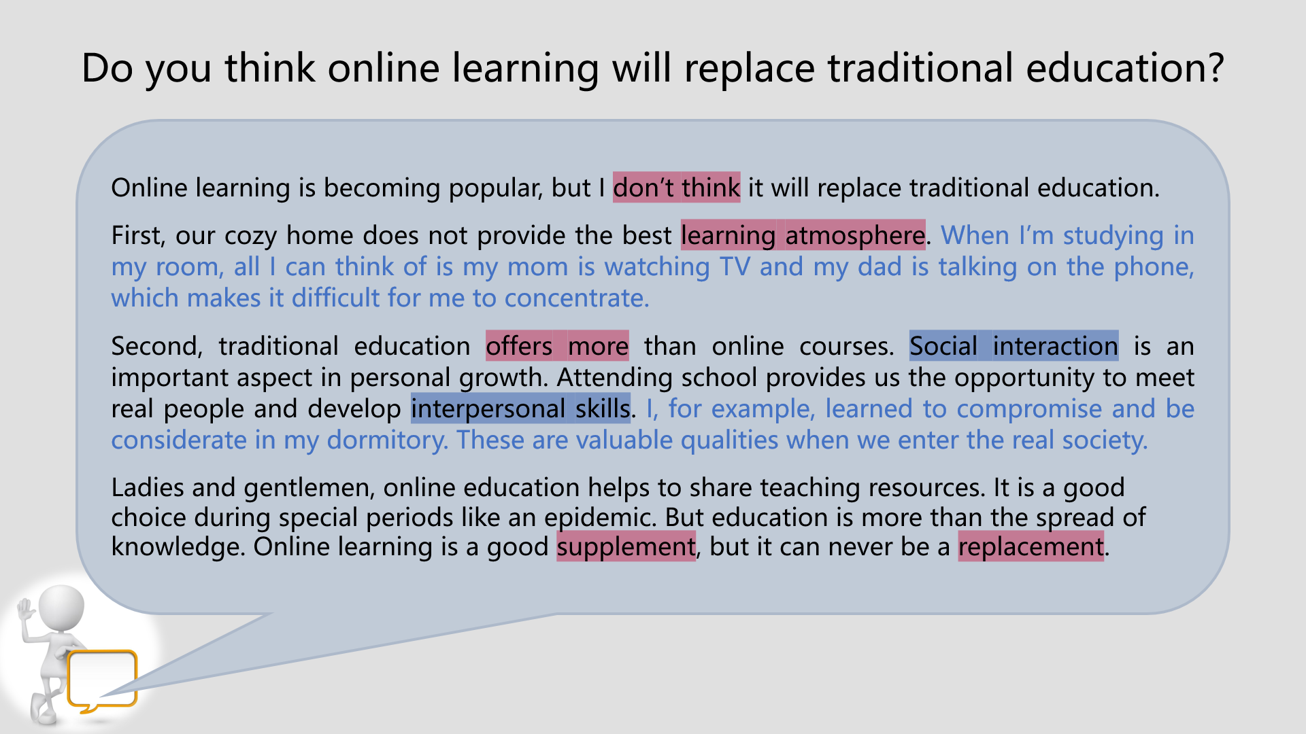

Slide 47
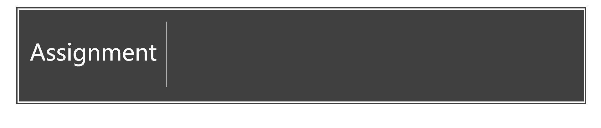

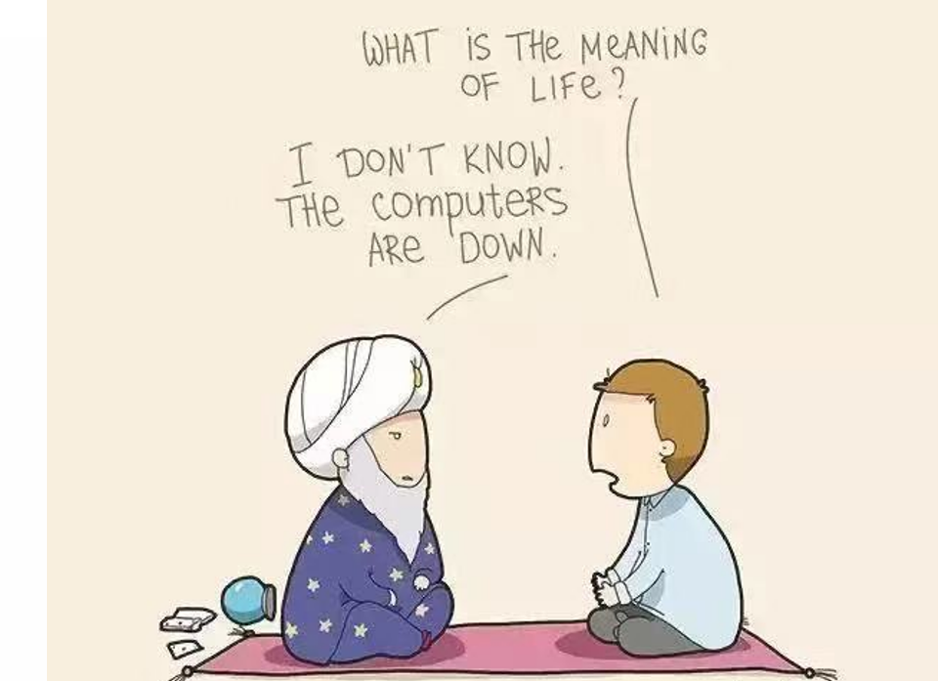

Do you think the Internet is interfering with our independent thinking?
How do you understand the spirit of volunteering?
Do you think this lesson is helpful?

Slide 48
