Slide 1

FLTRP Star Teacher Contest
2021

Slide 2

01
Students Analysis
02
CONTENTS
Teaching Design
03
Demo Class

Slide 3


1
Students Analysis
Basic English Foundation
Low Language Proficiency
(Writing)
Chinese Major
Freshmen
Lack of Critical Thinking Skills
Strong Learning Motivation

Slide 4
2
Teaching Design
Assessment
Procedures
4
Methodologies
3
Materials
2
1

Slide 5


Materials
Methodologies
Procedures
Assessment
TeachingMaterials
Project: Essay Writing
To Compare and Contrast Viewpoints
——
Unit 6 ● Section 1●Episode 1

Slide 6
Materials
Methodologies
Procedures
Assessment
Methodologies
Blended
Learning
POA
TSCA
Production-Oriented Approach
Teacher-Student Collaborative Assessment
Online and Offline

Slide 7
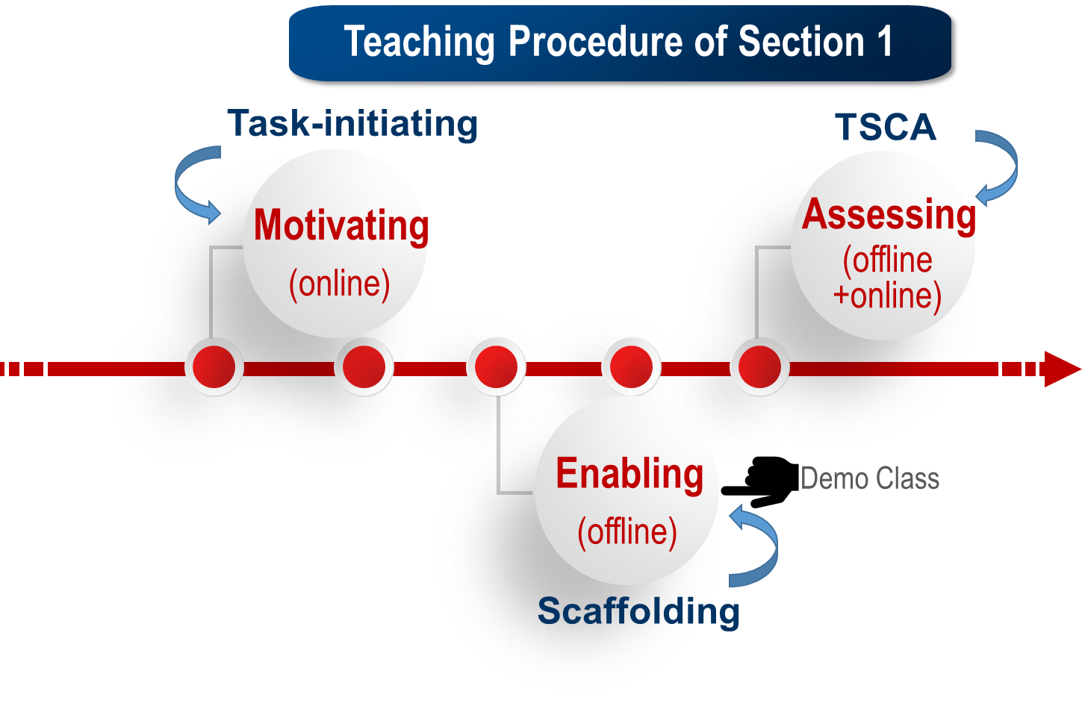
Materials
Methodologies
Procedures
Assessment
Production-Oriented Approach

Slide 8


Materials
Methodologies
Procedures
Assessment
Production-Oriented Approach
—Enabling Stage
Production Task of Section 1:
Comparison and Contrast Writing
Step1
Enabling of the Content
Step2
Enabling of the Language
Step3
Enabling of the Structure
The Writing Patterns of Comparison and Contrast Essay

Slide 9

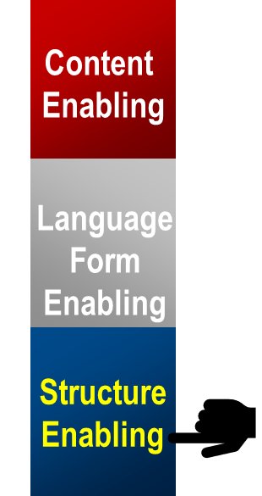
Materials
Methodologies
Procedures
Assessment
Demo Class ——Objectives
1
Language
point-by-point pattern
& subject-by-subject pattern
2
Skills
to build a mind map
3
Morality
to be a critical thinker

Slide 10
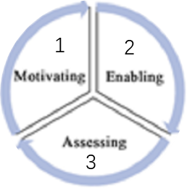
Materials
Methodologies
Procedures
Assessment
Demo Class ——Procedures
A Production
Task
Assessing
1.TSCA
2.Online and Offline Blended Assessment
3 Stages
4
Production Task
1. To draw a mind map of the posts in the forum.
2. To learn to be a critical thinker.
3
Enabling
Writing pattern analysis
2
Motivating
1. To check the pre-class task
2. To compare the differences between the two generations.
1

Slide 11
Materials
Methodologies
Procedures
Assessment
Assignment
A comparison and contrast essay writing based on your interview:
How are the dreams of your generation different from your parents’?
Teacher-Student Collaborative Assessment
Online and Offline Blended Assessment

Slide 12
Materials
Methodologies
Procedures
Assessment
Assignment
Teacher-Student Collaborative Assessment (TSCA)
Ss
Ss
&Teacher
Ss
&Teacher
Teacher
To finish the writing assignment.
1. To evaluate one typical writing in detail.
2.To make error correction exercises.
1. To evaluate the typical writing together.
2. To finish exercises.
1. Ss: self-revision
2. Teacher: To give comments on ss’ writing.
Online
Online
Offline
Online+Offline

Slide 13

03
Demo Class

Slide 14



Project: Essay Writing
Section 1●Episode 1
To Compare and Contrast Viewpoints
Notes:
Let’s move on to the demo part. In the following 10mins, We gonna explore together the skills of comparing and contrasting viewpoints.

Slide 15

01
√
Basic information about the comparison and contrast essay
Writing Principles
02
√
Semantic elements
03
Paragraph developing pattern
Notes:
We’ve already talked about the Basic information and Semantic elements. Now we are at the third part of the writing principle: Paragraph developing pattern analysis.

Slide 16
Checking the
Pre-class Task
Analyzing the
Writing Patterns
Building a Mind Map
(Task)
Learning to be a Critical Thinker
Assignment
Online pre-class task: Conducting an Interview
Scenario
Your college has established a website for the undergraduates, which contains a column named the Cultural Diversity in China. The theme of this month is “How are the dreams of your generation different from those of your parents’？” You are going to conduct an interview and contribute a report to this column.
Notes:
Previously, you were given an online task to conduct an interview about different dreams of different generations.

Slide 17


Checking the
Pre-class Task
Analyzing the
Writing Patterns
Building a Mind Map
(Task)
Learning to be a Critical Thinker
Assignment
1.Pre-class interview:
How are the dreams of your generation different from those of your parents’？
Cohesive structure
√
√
Clear key points
√
Concise language
A good example of the interview
Notes:
I’ve checked your assignment and picked A very good example of the interview. It’s from Jack and Emily. Let’s watch their interview. Please take notes and write down what points are compared in the interview.
Jack and Emily did a really good job. You may find its structure is cohesive, the points are clear and the language is concise.
I’ve checked your assignment and picked A very good example of the interview. It’s from Jack and Emily. Let’s watch their interview. Please take notes and write down what points are compared in the interview.
Jack and Emily did a really good job. You may find its structure is cohesive, the points are clear and the language is concise.
加点评
挑出了一个代表性的survey
同时，让学生拿出纸笔，记下How many points are compared in the survey?

Slide 18

Checking the
Pre-class Task
Analyzing the
Writing Patterns
Building a Mind Map
(Task)
Learning to be a Critical Thinker
Assignment
2. Discussion
Can you think about the reasons that make the differences based on your interview?
More Cultural Exchange
…
Economy Growth
Rapid Changes in Society
Notes:
Then what about yours? After conducting the interview, have you ever thought about the possible reasons behind the generation differences?
Who would like to share your ideas with us?............(回答) 1.yes Linda says the economic development makes the differences. And Tom says the social changes is the major reason, and anything else? Oh…yes. good job Cultural Exchange is another good reason.
based on your interview. Then would you please figure out
学生写的：
1.The development of The Times provides more opportunities for the younger generation
2. Improvement of economic conditions
3. National policy support
4. Cultural exchanges make the young generation more diverse in their thinking

Slide 19
Checking the
Pre-class Task
Analyzing the
Writing Patterns
Building a Mind Map
(Task)
Learning to be a Critical Thinker
Assignment
3. What points are compared in the interview?
How are the dreams of your generation different from those of your parents’？
YOUR PARENTS
YOU
To settle down
To take more challenges
1
Dream of Life
2
A science teacher
Ideal Job
a digital nomad
3
a harmonious family
Ideal Family
single
a complete victory over the COVID-19 pandemic
4
To boost the economy
Chinese Dream
Notes:
I’ve mentioned their interview is cohesive in structure, then let’s take a look at it!
Based on the notes you’ve taken, What points did you find are compared in the interview?（回答）
Yes! They are dream of life, ideal job ideal family and Chinese dream.
And How are these points developed? One point by another. （回答）
What
数字游民 digital nomad：to use telecommunication technologies to earn a living

Slide 20
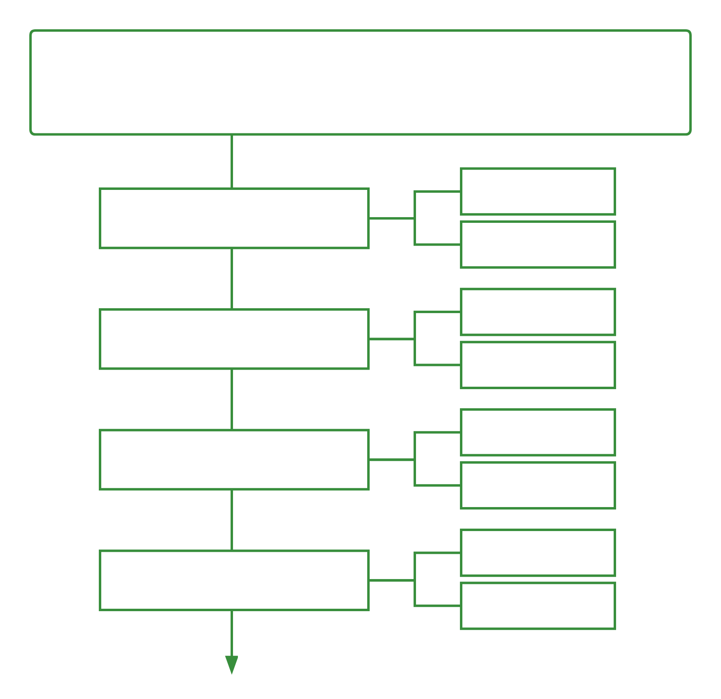
Checking the
Pre-class Task
Analyzing the
Writing Patterns
Building a Mind Map
(Task)
Learning to be a Critical Thinker
Assignment
1. How are these points developed?
How are the dreams of your generation different from those of your parents’?
Mind Map:
You
Point 1 Dream of Life
Your parents
You
Point-by-point
pattern
Point 2 Ideal Job
Your parents
You
Point 3 Ideal Family
Your parents
You
Point 4 Chinese Dream
Your parents
Notes:
And How are these points developed? Here is a blank mind map for you, Can you reorganize the information and fill in the blanks(回答)
It’s easy to find that These points are developed one by one. So this pattern is called point by point pattern.
What
数字游民 digital nomad：to use telecommunication technologies to earn a living

Slide 21
Checking the
Pre-class Task
Analyzing the
Writing Patterns
Building a Mind Map
(Task)
Learning to be a Critical Thinker
Assignment
2. Structure Analysis
Two Writing Patterns
Pattern A
Point-by-Point Pattern
Pattern B
Subject-by-Subject Pattern
Notes:
So when comparing things, besides point by point, we can also adopt another pattern, which is Subject-by-Subject pattern.

Slide 22
Checking the
Pre-class Task
Analyzing the
Writing Patterns
Building a Mind Map
(Task)
Learning to be a Critical Thinker
Assignment
2. Structure Analysis
Two Writing Patterns
Point-by-Point Pattern: explains the similarities and differences
in each point of both subjects in turn.
01
Subject 1
Subject 2
Subject 1
Subject 2
Subject 1
Subject 2
Point A：
Point B：
Point C：
Notes:
So, in point by point pattern, it explains the similarities and differences in each point of both subjects in turn.
It can be illustrated by the following diagram.

Slide 23
Checking the
Pre-class Task
Analyzing the
Writing Patterns
Building a Mind Map
(Task)
Learning to be a Critical Thinker
Assignment
01
Point-by-Point Pattern
Thesis: School Systems in Europe and the US
Point 1: the number of hours per day that ss must attend school
Subject A: Schools of Europe
Subject B: Schools of the US
Point 2: the choice of academic schools
Subject A: Schools of Europe
Subject B: Schools of the US
Point 3: the number of ss who go on to higher education
Subject A: Schools of Europe
Subject B: Schools of the US
Notes:
Here is one example. This is a comparison between school system in Europe and the us. It is developed by point by point

Slide 24
Checking the
Pre-class Task
Analyzing the
Writing Patterns
Building a Mind Map
(Task)
Learning to be a Critical Thinker
Assignment
2. Structure Analysis
Two Writing Patterns
02
Subject-by-Subject Pattern: Discuss the important features of one subject first and then turn to the second subject.
Point 1
Point 2
Point 3
Point 1
Point 2
Point 3
Subject A：
Subject B：
Notes:
让 学生自己来， 加一张

Slide 25
Checking the
Pre-class Task
Analyzing the
Writing Patterns
Building a Mind Map
(Task)
Learning to be a Critical Thinker
Assignment
02
Subject-by-Subject Pattern
Thesis: School Systems in Europe and the US
Subject A:
Schools of Europe
Point 1: the number of hours per day that ss must attend school varies widely
Point 2: some countries require ss to choose academic and vocational schools
Point 3: only 30%-40% of high school graduates enter a college or university
Schools of US
Subject B:
Point 1: the number of hours per day that children must attend school is
almost the same
Point 2: all the ss have the opportunity to go on to a college or university
Point 3: over 50% of high school graduates enter a college or university
Notes:
This is the same thesis, but we can also change it into Subject-by-Subject Pattern

Slide 26

Checking the
Pre-class Task
Analyzing the
Writing Patterns
Building a Mind Map
(Task)
Learning to be a Critical Thinker
Assignment
Let’s practice
1
Read the online forum carefully.
2
Find out the Generational Differences.
3
Draw a mind map of their viewpoints.
P162
Notes:
Now, let’s have a try. Would you please.

Slide 27

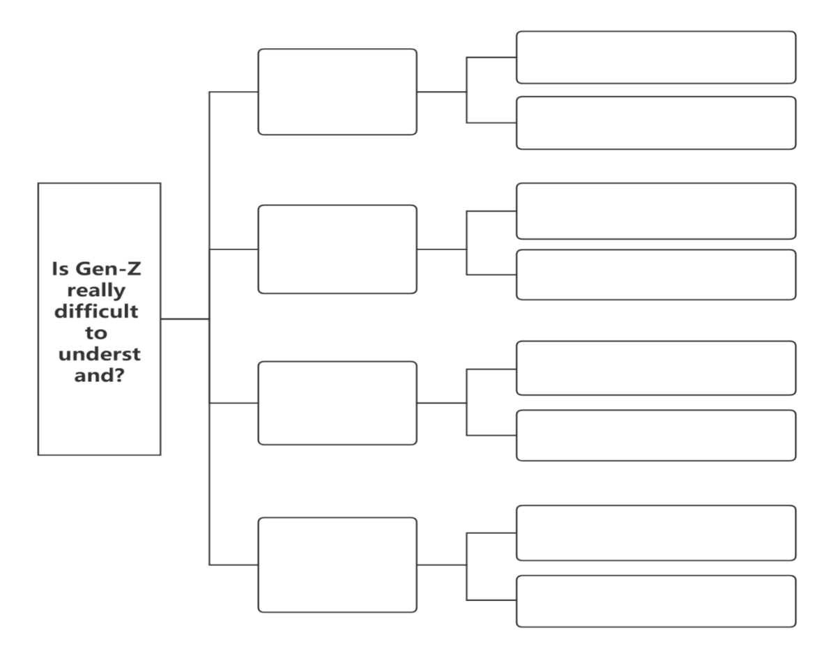
Checking the
Pre-class Task
Analyzing the
Writing Patterns
Building a Mind Map
(Task)
Learning to be a Critical Thinker
Assignment
Build a Mind Map of the Generational Differences.
Jason's Uncle:
Point 1: Posting pictures on social media isn't a valuable use of time.
Point 2: Travelling around the world isn't a good ambition.
P162
Notes:
So here is a blank mind , let’s fill in it with the proper information together.
板书：besides Jason’s uncle, there’re 4 other subjects, Subject1 2 3 and 4 , and each one has 2 points, respectively. Ponit 1 and point 2.
Now let’s check them out.
Thank you Jerry,

Slide 28

Checking the
Pre-class Task
Analyzing the
Writing Patterns
Building a Mind Map
(Task)
Learning to be a Critical Thinker
Assignment
Build a Mind Map of the Generational Differences.
Subject 1
Martha
Point 1
Point 2
Subject 2
Li Wei
Point 1
Point 2
subject-by-subject
pattern
Subject 3
Sandra’s
mom
Point 1
Point 2
Subject 4
Oliver
Point 1
Point 2
P162
Notes:
停2秒
互动时间 zitibianda

Slide 29

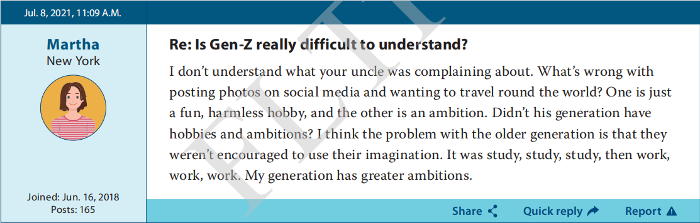

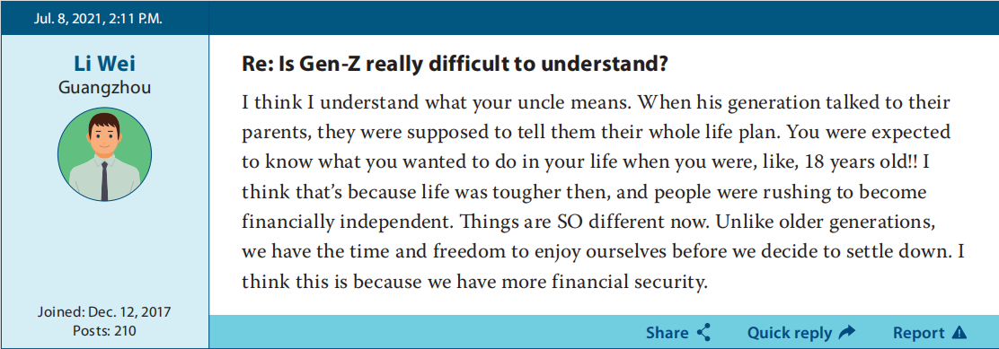
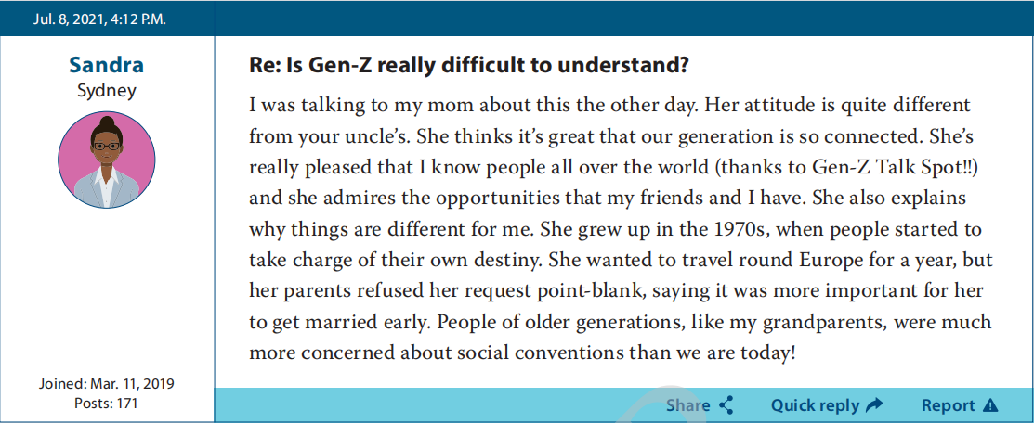
Checking the
Pre-class Task
Analyzing the
Writing Patterns
Building a Mind Map
(Task)
Learning to be a Critical Thinker
Assignment
To think critically and rationally.
Similarity?
P162
Notes:
So, in their posts, did you find any other similarities?

Slide 30
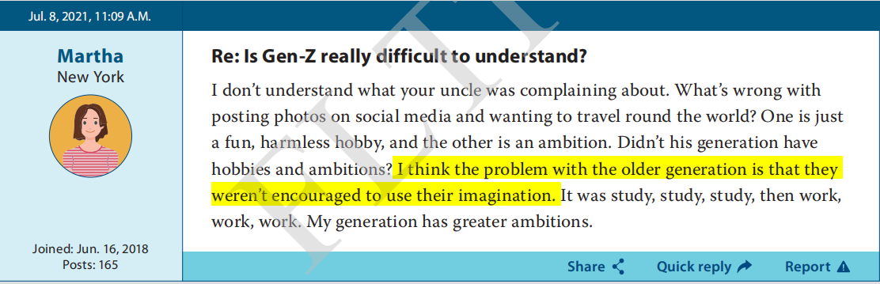
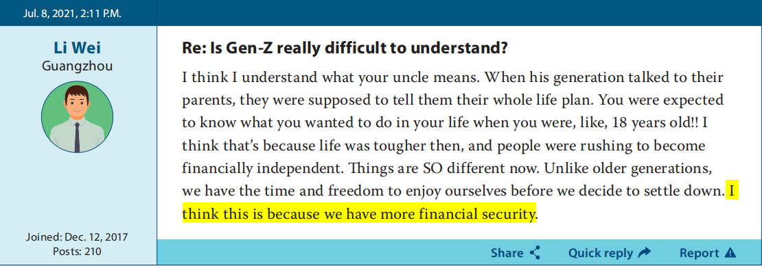
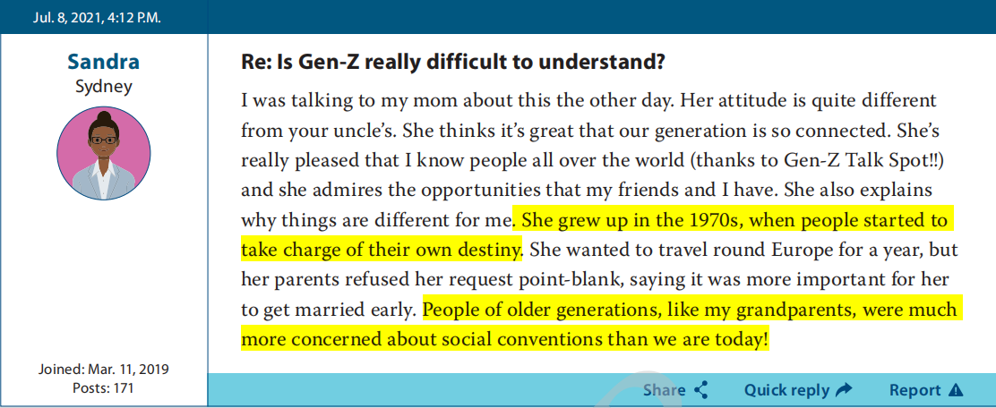
Checking the
Pre-class Task
Analyzing the
Writing Patterns
Building a Mind Map
(Task)
Learning to be a Critical Thinker
Assignment
To think critically and rationally.
Reasons
Similarity!
P162
Notes:
Did you notice the highlighted parts provide the reasons for their viewpoints?
So when making comparison, we are supposed to explore the reasons behind the differences. So that your essay could be more critical and rational.

Slide 31

Checking the
Pre-class Task
Analyzing the
Writing Patterns
Building a Mind Map
(Task)
Learning to be a Critical Thinker
Assignment
More Examples
Different Table Manners between
China and Western Countries
We ’re socializing and cooperating
 | Western Countries | China
Chinese people have bad table manner.
Eating Manners
Avoid making loud noise while eating
Laughing and chatting while eating
Notes:
Here are more examples.
When you are comparing the different table manners, Chinese people are used to laughing and chatting while eating. But does it mean we have bad table manners?
Actually, this is a way of socializing and cooperating.
But why?

Slide 32
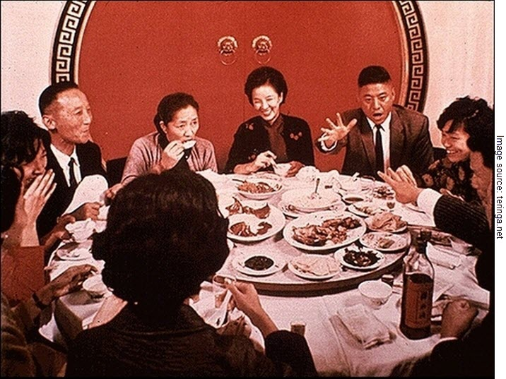
Checking the
Pre-class Task
Analyzing the
Writing Patterns
Building a Mind Map
(Task)
Learning to be a Critical Thinker
Assignment
laughing &chatting
means
more involved in the dinner conversation
“Unity” and “Cooperation” in Chinese dining etiquette
Notes:
Laughing and chatting means they are more involved in the dinner conversation.
Which reflects the “Unity” and “Cooperation” in Chinese dining custom.

Slide 33
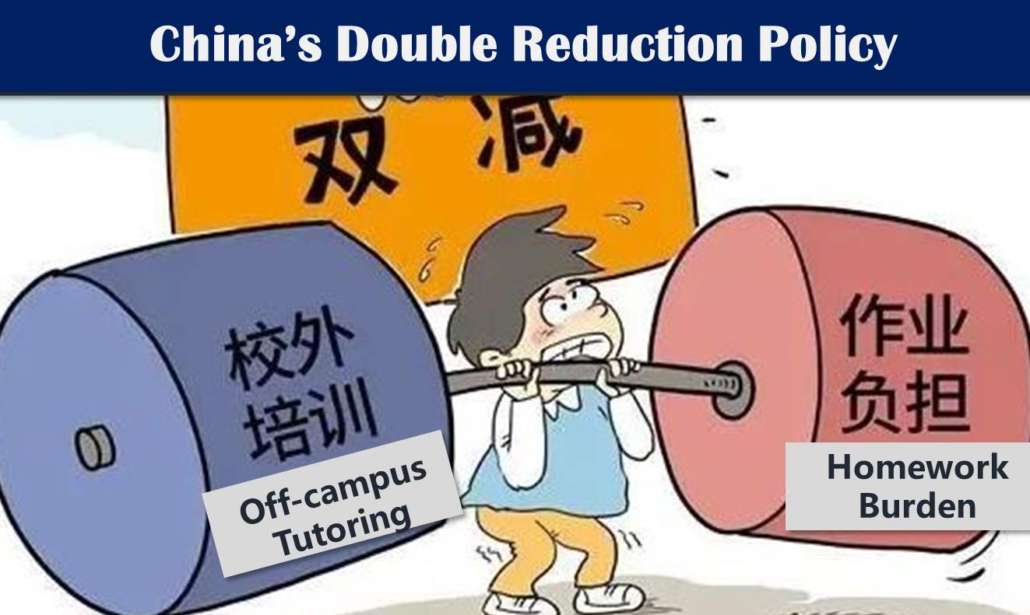
More Examples
China’s “Double Reduction” Policy
Before VS. After
popular
Before
regulated
Tutoring
After
The policy has the support of the parents.
Homework
Before
excessive homework
After
reduced
Notes:
Here is another example. After the “Double Reduction” policy, the tutoring is regulated and After school care is provided.
Does it mean The policy has the support of the parents?

Slide 34
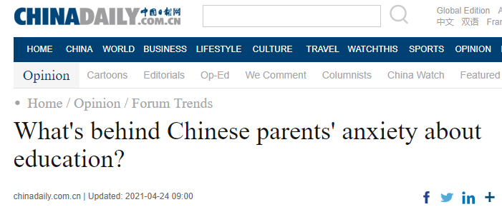
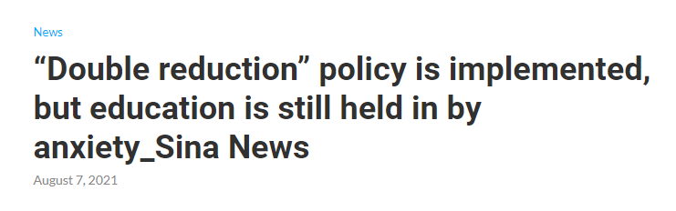

Checking the
Pre-class Task
Analyzing the
Writing Patterns
Building a Mind Map
(Task)
Learning to be a Critical Thinker
Assignment
More Examples
Reasons:
rapid changes in society,
heavy population pressure…
Notes:
In fact, according to the latest news report, some of the parents are more anxious than before.
And their anxiety may be caused by the social changes and heavy population …

Slide 35
Checking the
Pre-class Task
Analyzing the
Writing Patterns
Building a Mind Map
(Task)
Learning to be a Critical Thinker
Assignment
Different Attitudes and Behaviors towards COVID-19 at the Early Stage of the Outbreak.
 | CHINA | US
The U.S. Did Wrong on Combating COVID-19.
staying at home
Yes
No
forced quarantine
No
forced hospitalization
building temporary hospitals
Yes
Collectivism VS. Individualism
Notes:
and as for Different Attitudes towards COVID-19.
Because the Americans refused forced quarantine and hospitalization, you just criticized that they did wrong on COVID-19.
In fact, before making a judgement, you’d better think about Collectivism and Individualism in Chinese and American’s culture

Slide 36


Checking the
Pre-class Task
Analyzing the
Writing Patterns
Building a Mind Map
(Task)
Learning to be a Critical Thinker
Assignment
X
Avoid overgeneralizing！
X
Avoid making hasty judgements！
Reasons
Explore every possible reason behind the differences！
√
P164
Notes:
So when you are making comparison, please…

Slide 37

Checking the
Pre-class Task
Analyzing the
Writing Patterns
Building a Mind Map
(Task)
Learning to be a Critical Thinker
Assignment
Writing Assignment
Scenario
Your college has established a website for the undergraduates, which contains a column named the Cultural Diversity in China. The theme of this month is “How are the dreams of your generation different from those of your parents’？”
You are going to write an essay about 200 words on this theme based on your pre-class interview and upload it to the website.
Notes:
At last here is your assignment, please write an essay about different dreams based on your interview.

Slide 38
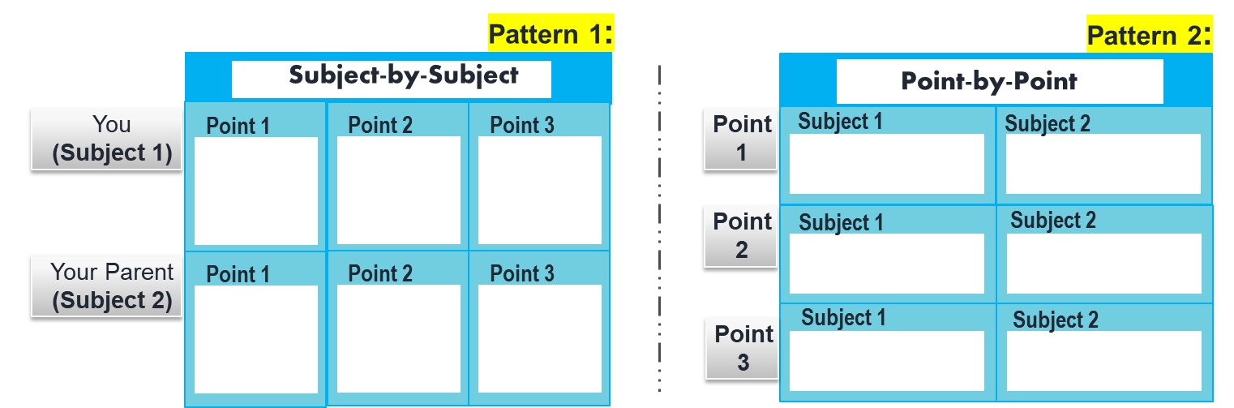
Online Peer Assessment:
YES
NO
1. Does your peer’s essay choose the proper pattern?
YES
NO
2. Does it explore every possible reason behind the differences?
YES
NO
3. Has it avoided mistakes in spelling and grammar?
Notes:
Before submitting your homework. Please do a peer assessment online.
And check 1. whether your peer chooses the proper pattern.
2. are the reasons explored?
3. any spelling or grammatical mistakes

Slide 39
Thank You

