Slide 1
1
Teaching plan
CONTENTS
2
Demo class

Slide 2









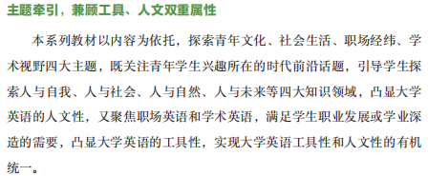
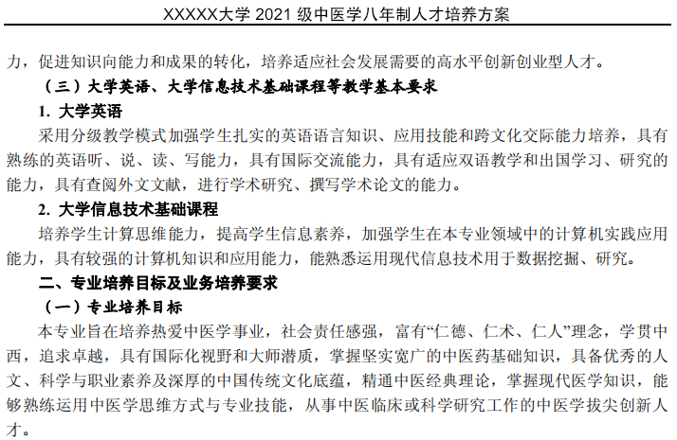
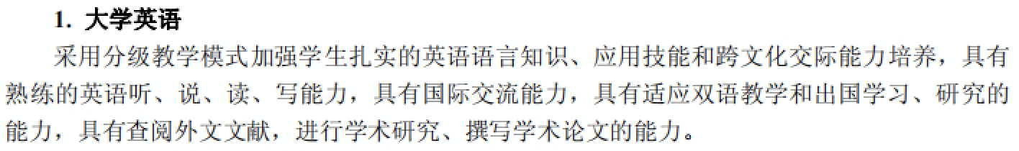

Needs
analysis
Teaching
objectives
Use of
the text
Teaching Method
and Procedure
Assessment
Major: 8-Year program freshmen, majoring in TCM
Strengths: Intermediate level (4-5) according to CSE
Strong learning motivation
Moderate autonomous learning ability
Moderate receptive skills
Weakness: Critical thinking ability
Productive ability
“Double First-Class University Plan”
Clinical Medicine & Pharmacology and Toxicology 1% of global ESI database
Text
Students
University

Slide 3

Needs
analysis
Teaching
objectives
Use of
the text
Teaching Method
and Procedure
Assessment
Unit 6: Passing the Torch
① to summarize the construction
history of FAST
② to understand the features of
your/different generations in
China and US
Language
① to invite contributions in discussion
② to compare and contrast viewpoints
③ to master the definition and features
of biography
Knowledge
① to analyze the chronology of
events using a timeline
② to develop the outlook of time
and space
Ability
① to open up mind about different people
and cultures
② to build up national confidence and
international view
③ to reflect on hero you want to become
Moral
education

Slide 4
Needs
analysis
Teaching
objectives
Use of
the text
Teaching Method
and Procedure
Assessment
Presentation
Episode 1: Generational differences
PP6(Final): Creating you dream-
the hero you want to become
Productive Project (PP)1: Write down the
features of your generations
Principles
6
1
1
Text A: Sky-high Ambition to fulfill an“unreachable”dream
Selecting
2
Reordering
Writing genre: biography
5
2
Episode 2: Hopes for the future
Critical thinking: meaningful life
of one current TCM hero
PP2 :Write down your hopes for the future
3
Revising
PP5: Blank filling: Wisdom of China
4
3
4
Supplementing
Text A: Sky-high Ambition to fulfill an“unreachable”dream
Text B:Working across the age gap
PP3:Talk about the features of different
generations in China
PP4: Global and detailed reading

Slide 5
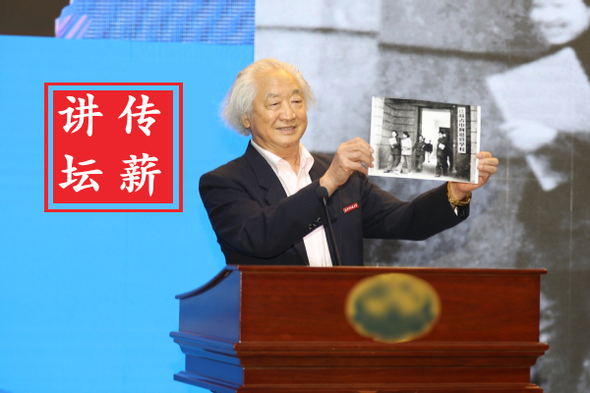
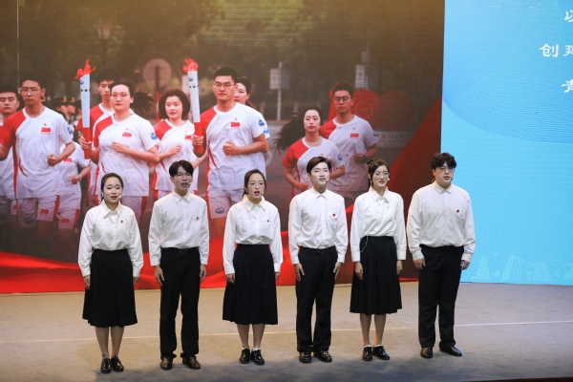
Needs
analysis
Teaching
objectives
Use of
the text
Teaching Method
and Procedure
Assessment
Space
Online
1
2
3
Pre-class
Autonomous Study
Assessment
Motivating
Enabling
Post-class
Assessment
In-class
Learning
POA
To share their current dreams and qualities
at U campus
(1) Introduction of
chronology and
radar chart
(2) Supplement of the
Wisdom of China
and one current
TCM hero story
TSCA
Time
Offline

Slide 6
Needs
analysis
Teaching
objectives
Use of
the text
Teaching Method
and Procedure
Assessment
Attendance
Formative
Instant Evaluation
Class performance
Teacher
Assignment completeness
Teacher
|
Student
Collaborative Assessment
(TSCA)
Assessment
Presentation: peer-review rating scale
Peer
Teacher
Writing
Self
Quiz
Summative
Delayed Evaluation
Self
China’s Standards of English Language Ability

Slide 7
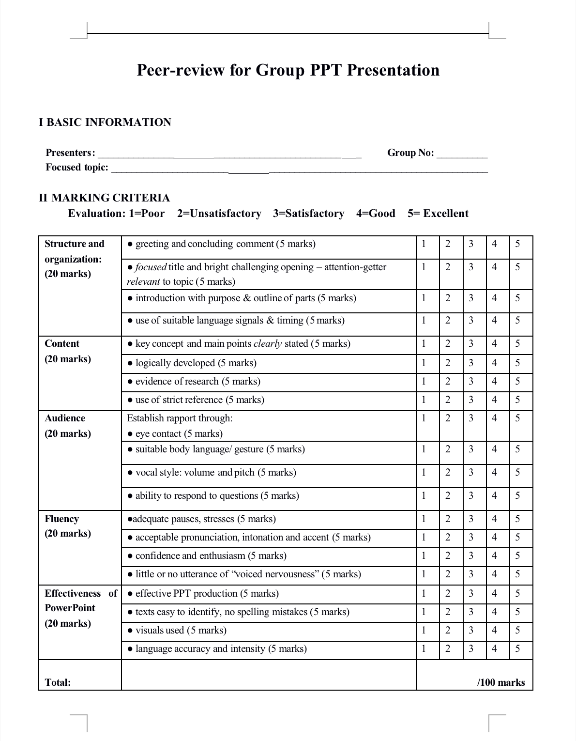
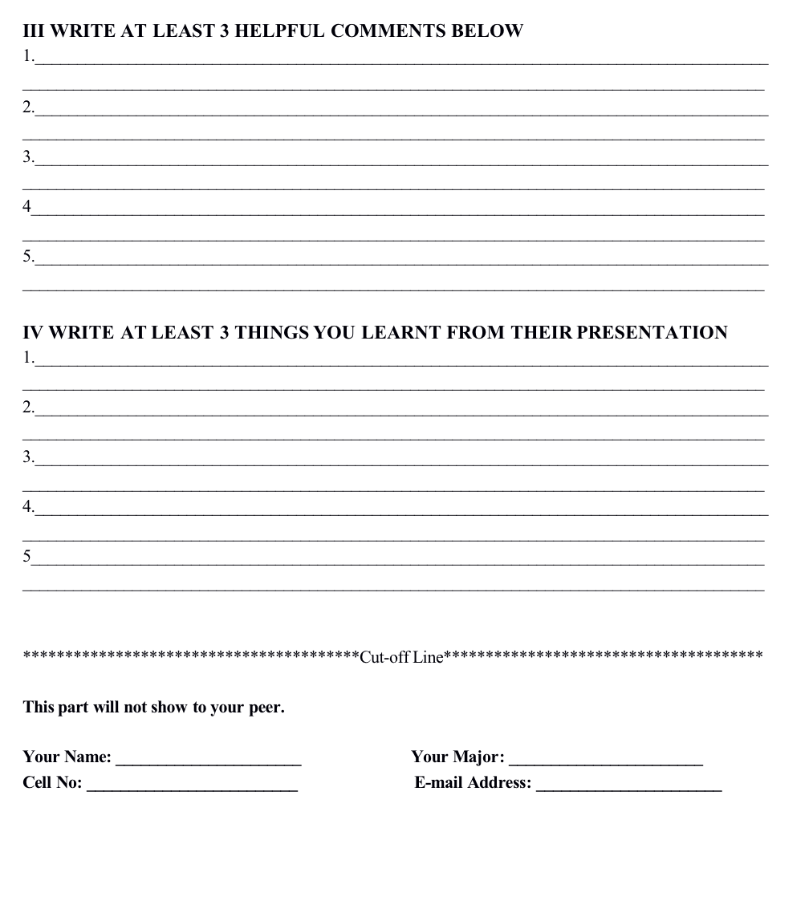
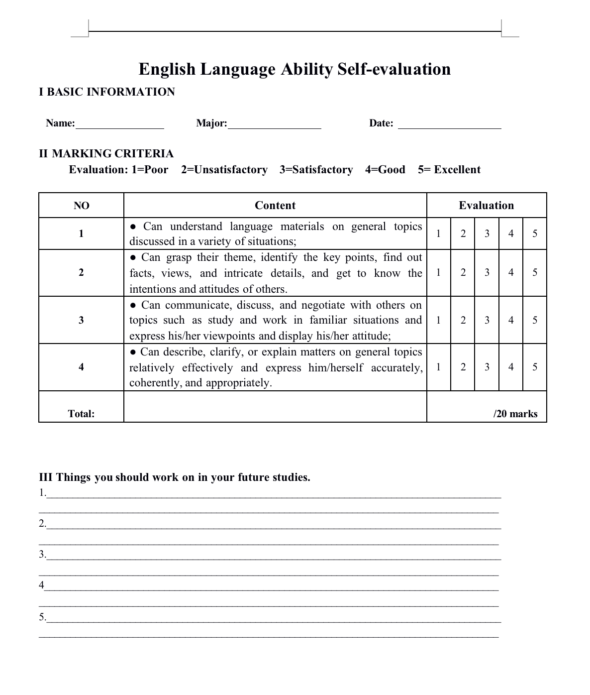
Needs
analysis
Teaching
objectives
Use of
the text
Teaching Method
and Procedure
Assessment

Slide 8
Needs
analysis
Teaching
objectives
Use of
the text
Teaching Method
and Procedure
Assessment
Highlights
1
Connecting language learning and practice with the application of POA;
2
Combining professional and social practices with moral education;
3
Cultivating systemic autonomous learning ability with the time-space outlook.
培根铸魂
启智增慧

Slide 9
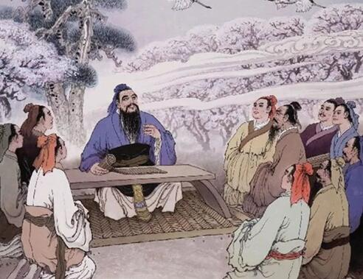
Needs
analysis
Teaching
objectives
Use of
the text
Teaching Method
and Procedure
Assessment
References
[1] 戴炜栋,胡壮麟,王初明,李宇明,文秋芳,黄国文 & 王文斌.(2020).新文科背景下的语言学跨学科发展. 外语
界(04),2-9+27.
[2]文秋芳 & 毕争.(2020).产出导向法与任务教学法的异同评述. 外语教学(04),41-46.
[3]文秋芳.(2020).专栏引言：“产出导向法”教学流程再解读. 外语教育研究前沿(02),3.
[4]文秋芳 & 孙曙光.(2020).“产出导向法”驱动场景设计要素例析. 外语教育研究前沿(02),4-11+90.
[5]陈浩 & 文秋芳.(2020).基于“产出导向法”的学术英语写作名词化教学研究——以促成教学环节为例. 外
语教育研究前沿(01),15-23+86-87.
[6]孙有中 & Janet Bennett.(2017).走向跨文化教育:孙有中教授和Janet Bennett博士学术对话. 外语与外语教学
(02),1-8+146.
[7]文秋芳.(2016).“师生合作评价”:“产出导向法”创设的新评价形式. 外语界(05),37-43.
[8]文秋芳.(2015).构建“产出导向法”理论体系. 外语教学与研究(04),547-558+640.
[9]孙有中.(2015).外语教育与思辨能力培养. 中国外语(02),1+23.
[10]Anderson, L.W, &Krathwohl, D.R and Bloom, B.S (2001) A Taxonomy for Learning , teaching, and assessing:
a revision of Bloom’s Taxonomy of educational objectives. New York: Longman.
One tree shakes another tree;
One cloud pushes another cloud;
One soul awakens another soul.
--- German educator and philosopher
Karl Theodor Jasper

Slide 10

Unit 6
Passing the torch

Slide 11
General Motivating
Lesson Plan
Enabling
Overall Assessing
Enabling Activity/ Scaffolding | Content | Language | Skills (3Cs)
Evaluating characteritics | Necessary qualities of achieving dreams | Positive appraisal | Collaboration
Analyzing Genres | Description of Nan Rendong’s life in chronological order | Authentic； Prosaic | Critical thinking --- the chronology of events
Constructing dreams | Nan’s dream & the Chinese dream | IDEA --- meaningful life | Creative skills --- Self regulation

Slide 12
General Motivating
Lesson Plan
Enabling
Mini-activity 1
Overall Assessing
Essential qualities of achieving your dreams
Intelligence
Bravery
Compassion
Strength
Conviction
Proficiency
Achieving
dreams
Empathy
Self-sacrifice
Benevolence
Persistence
……
Courage

Slide 13

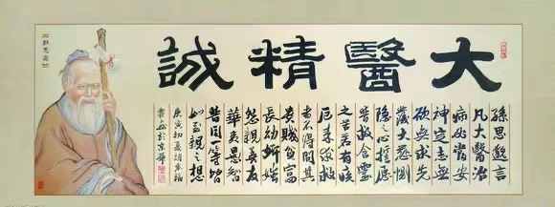
General Motivating
Lesson Plan
Enabling
Mini-activity 1
Overall Assessing
Evaluate your potential qualities for achieving dreams by drawing a radar chart
Benevolence
Benevolence
10
8
6
4
2
0
10
8
6
4
2
0
Intelligence
Conviction
Intelligence
Conviction
Proficiency
Persistence
Proficiency
Persistence

Slide 14
General Motivating
Lesson Plan
Enabling
Mini-activity 1
Overall Assessing
Authentic
Prosaic
When
Milestone
Ambition
Essential qualities
Childhood
Falling in love with the universe
Intelligence
10
8
6
4
2
0
Early 1990s
Hitting on the bold idea to build a radio
Ambition
Intelligence
Conviction
1994
Returning to China to pursue his dream
Conviction
Finding the ideal place for construction in Guizhou
After 12 years of searching , Nan discovered the perfect place hidden away in a mountainous area.
2006
Persistence
March 2011
Beginning the construction
Proficiency
2016
Completing the construction
Proficiency
Proficiency
Persistence
2017
Passing away
Persistence

Slide 15
General Motivating
Lesson Plan
Enabling
Mini-activity 2
Overall Assessing
Nan’s Dream
a dream-chaser
... as ______________, he thought big and ran at full speed toward achieving _____________________.In the end, his career and _________________ made an ________________________ not just to China’s astronomy research, but to _________________ as well.
Para 10
his “unreachable” dream
personal success
extraordinary contribution
the Chinese Dream

Slide 16
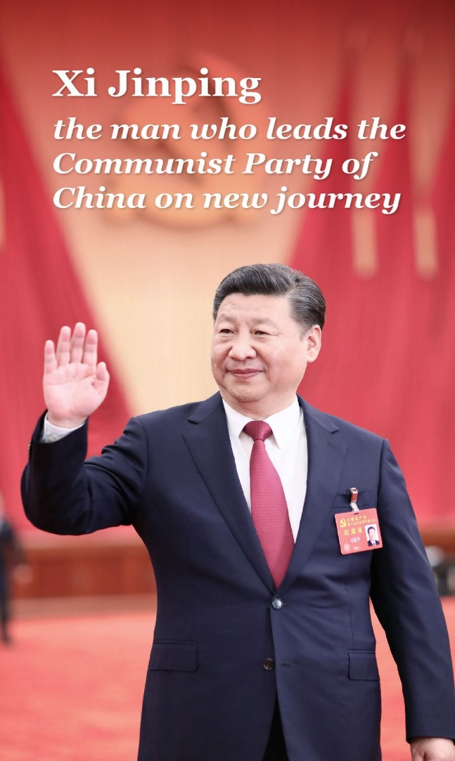
General Motivating
Lesson Plan
Enabling
Mini-activity 2
Overall Assessing
The Chinese Dream
The Chinese Dream in essence means _____________________.________________________have the opportunity to enjoy a successful life, the opportunity to realize their dreams, and the opportunity ________ and progress ______________.
the dream of the people
All the
Chinese people
to grow
with the country

Slide 17
General Motivating
Lesson Plan
Enabling
Mini-activity 2
Overall Assessing
a dream-chaser
1
the dream of the people
2
8
grow & progress with the country
his “unreachable” dream
Mutually Dependent
3
7
all the Chinese people
the Chinese Dream
4
6
extraordinary contribution
personal success
5

Slide 18
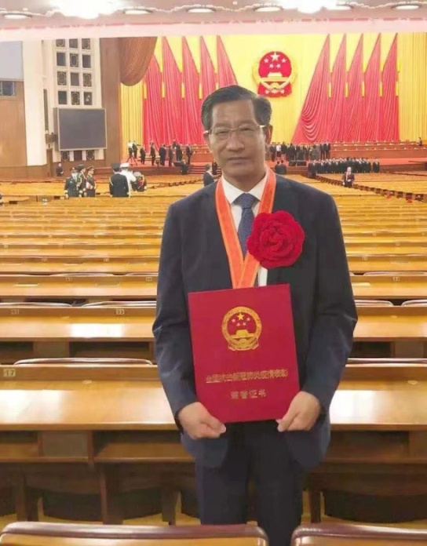
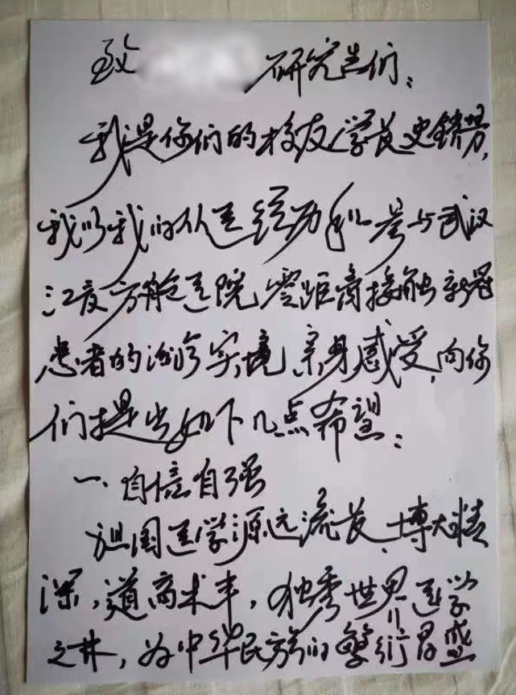
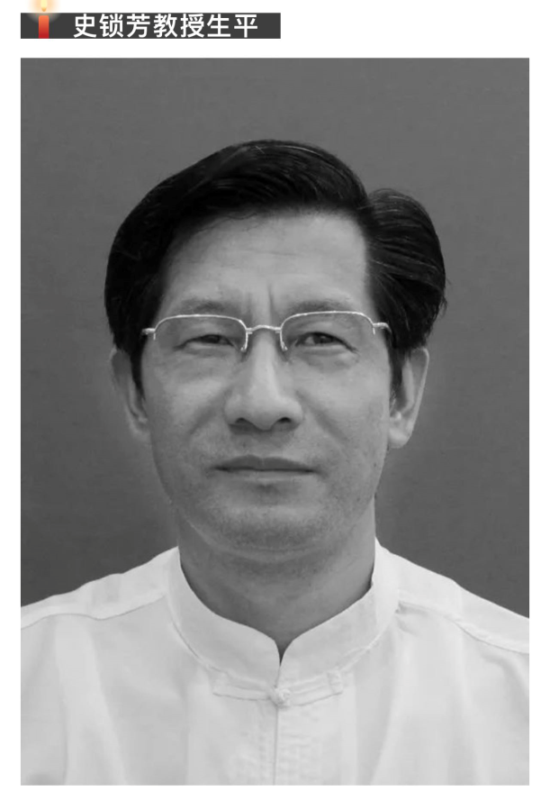

General Motivating
Lesson Plan
Enabling
Mini-activity 2
Overall Assessing
Hero in harm’s way

Slide 19
General Motivating
Lesson Plan
Enabling
Mini-activity 2
Overall Assessing
≠
Meaningful life
Happy life
Exploring
Advancing
IDEA
Developing
Inheriting
E
A
D
I
Build a healthy China
Chinese
Dream
TCM Dream

Slide 20
General Motivating
Lesson Plan
Enabling
Mini-activity 2
Overall Assessing
--
Meaningful life
Best version of yourself
Benevolence
10
8
6
4
2
0
Chinese Dream
My Dream
Intelligence
Conviction
TCM Dream
Proficiency
Persistence

Slide 21
General Motivating
Lesson Plan
Enabling
Overall Assessing
Homework: Presentation
Topic: Creating my dream--- the hero I want to become
who
What
Which
Benevolence
10
8
6
4
2
0
Intelligence
Conviction
How
Proficiency
Persistence

Slide 22
General Motivating
Lesson Plan
Enabling
Overall Assessing
Enabling Activity/ Scaffolding | Content | Language | Skills (3Cs)
Evaluating characteritics | Necessary qualities of achieveing dreams | Positive appraisal | Collaboration
Analyzing Genres | Description of Nan Rendong’s life in chronological order | Authentic； Prosaic | Critical thinking --- the chronology of events
Constructing dreams | Nan’s dream & the Chinese dream | IDEA --- meaningful life | Creative skills --- Self regulation
Benevolence
Benevolence
10
8
6
4
2
0
10
8
6
4
2
0
Intelligence
Conviction
Intelligence
Conviction
Proficiency
Persistence
Proficiency
Persistence

Slide 23
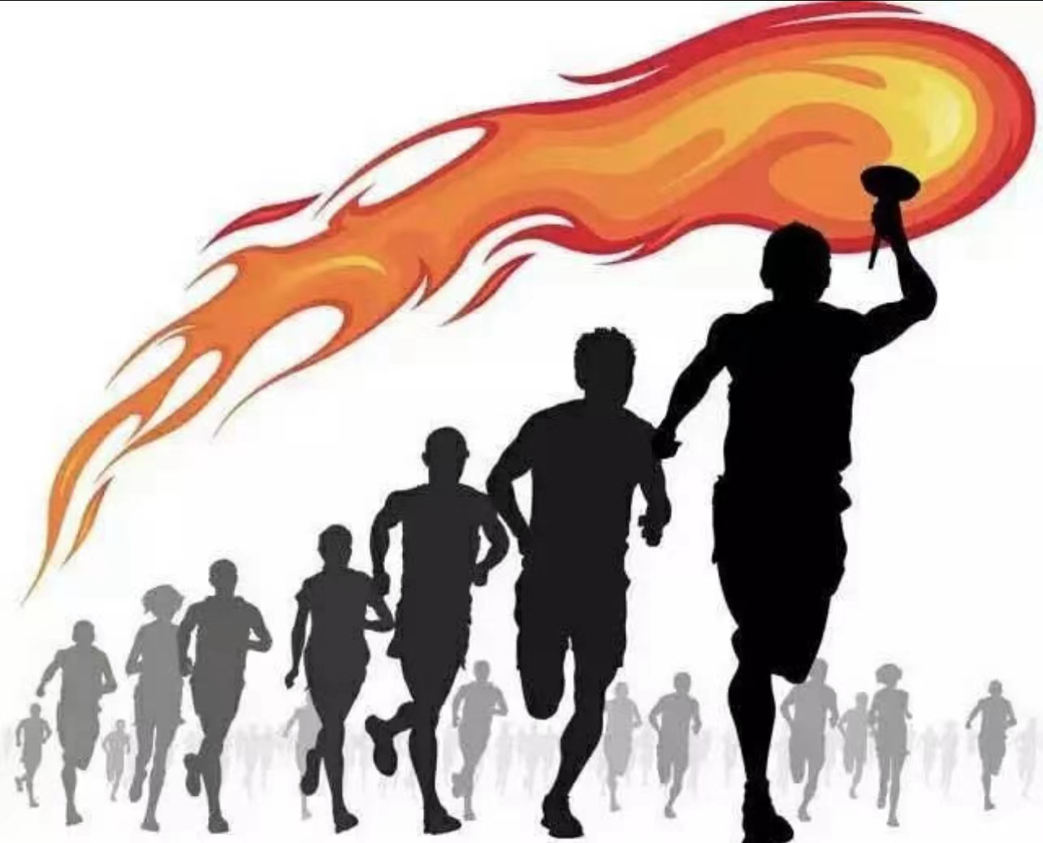
IDEA
Inheriting Developing Exploring Advancing

