Slide 1

2020 FLTRP
Star Teacher Contest
Be dedicated,
and love what you do.
Dec. 16, 2020
Beijing, China

Slide 2
Introduction
Introduction
01
01
Demonstration
02

Slide 3
01 Introduction
Our students and text
Principles and teaching objectives
Demo design and rationale

Slide 4
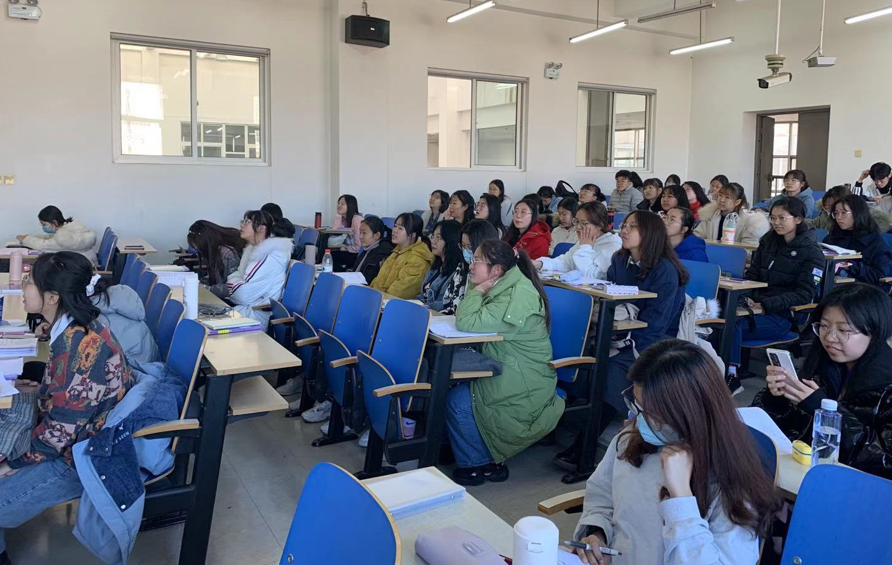
Our students
2nd-year undergraduates
Non-English, liberal arts majors
Intermediate or advanced learners
Highly motivated and good at exams
Weak at speaking and writing

Slide 5
Our students
CSE 8
2nd-year undergraduates
Non-English, liberal arts majors
Intermediate or advanced learners
Highly motivated and good at exams
Weak at speaking and writing
CSE 7
CSE 6
CSE 5
(China’s Standards of English Language Ability, 2018)

Slide 6


Our text
Unit 6 To be or not to be
iExplore 2 Reading
Follow a career passion?
Let it follow you (pp. 133-134)

Slide 7
Our guiding principles
POA
Production-oriented
Approach
Moral Education
Holistic Education
TSCA
Teacher-Student
Cooperative assessment
Bloom’s taxonomy of cognitive process

Slide 8
Teaching objectives
1) explain with examples the value of interest in making choices;
2) use appropriate and diversified verbs in telling a story;
3) explain what factors to consider when choosing a major or career;
4) use antithesis to make arguments more persuasive.
1) understand the relationship between passion and making choices and view it critically;
2) have a better understanding of “dedication” in socialist core values;
3) find their signature strength or realize the importance to locate their signature strength.
2) have a better understanding of “dedication” in socialist core values;
4) use antithesis to make arguments more persuasive.

Slide 9

Unit scenario & production task
Scenario: The summer intern program for a renowned transnational company is now open for application. To apply, you should prepare an English self-introduction that includes:
Your personal information (name, major, college, etc.)
Why did you choose your major?
What is your competitive edge?
What is your career goal?
Task: Prepare a short self-introduction to apply for the internship.
You should first write down your script, and then get ready for a mock interview in the third session.

Slide 10
General teaching procedure
Unit project: summer intern application
Session 3
Writing task
Oral task:
Mock interview
Session 1
Session 2
Demo session 😊
“Use ‘antithesis’ to highlight arguments”
Sub-task 1: Write a story about why you chose your major
Sub-task 2&3: state your competitive edge over other applicants and career goals

Slide 11

Why Session 2 or ‘Antithesis’?
Competent in avoiding basic grammatical errors and following general writing conventions, but ...
… a lower level of lexical diversity and usage of rhetorical devices

Slide 12

Why Session 2 or ‘Antithesis’?
Overall written expression (CSE 7)
- Can plot complex narratives, using rhetorical devices appropriately so as to enhance liveliness and expressiveness of the language.
Overall oral expression (CSE 8)
- Can effectively discuss a wide range of topics in formal and informal settings, using
appropriate rhetorical devices to enhance the effect utterances.
‘Antithesis’ it is!
Source: http://www.neea.edu.cn/res/Home/1908/0c96023675649ac8775ff3422f91a91d.pdf

Slide 13
Demo design (enabling activities)
Words & phrases
Sentences(s)
… and beyond
Lead-in: Find antithesis in textbook
Drill 1: Find antithesis in examples of different rhetorical devices
Understanding
(Comparing)
Compare: effects of using antithesis
Application in given situations
Drill 2: Complete sentences using antithesis
Drill 3: Imitative writing 1+1
Drill 4: Evaluating: revisiting pre-class assignments
Evaluating
After-class: assignments revision
Producing
(Qiu, 2017; Anderson et al., 2001)

Slide 14
Demo design (assessment)
Formative
Assessment
Assessment for learning
Real-time feedback
Summative
Assessment
TSCA in-class and after-class

Slide 15
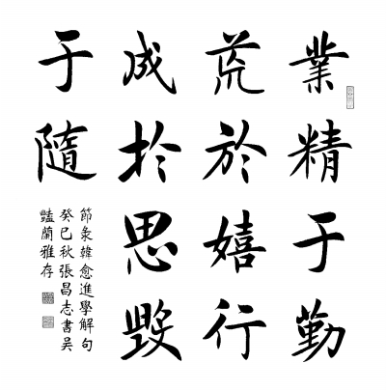

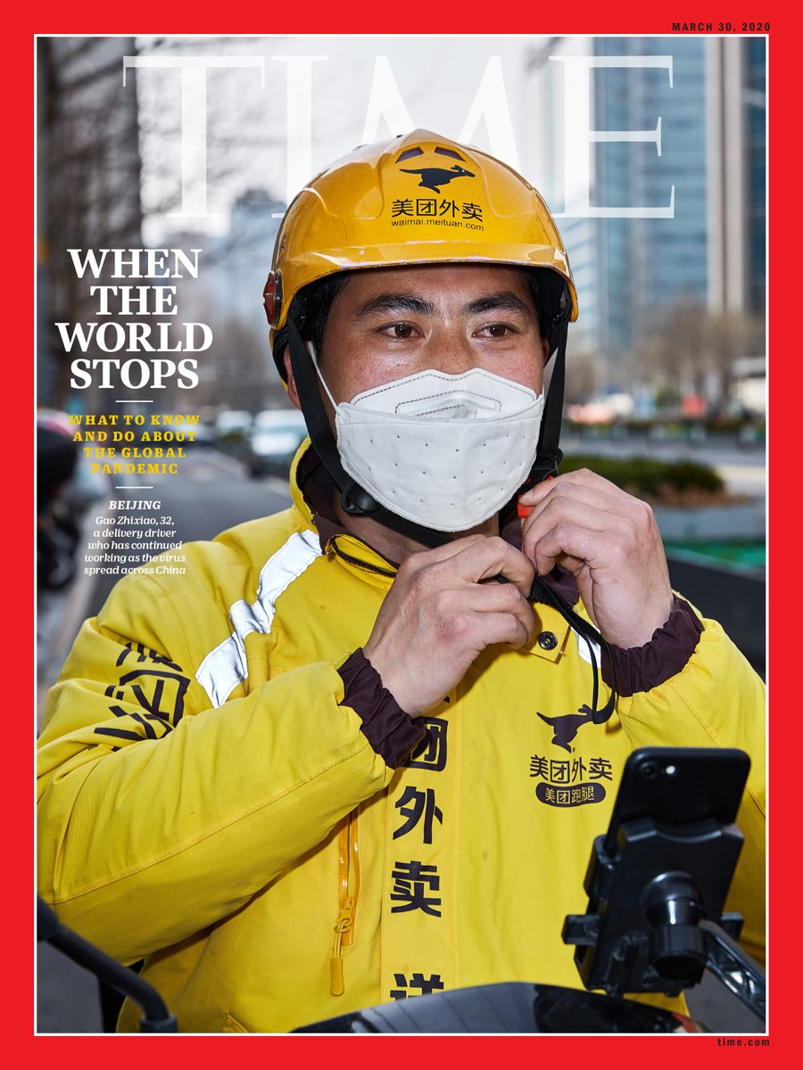
Demo design (moral elements)
Bilingual examples of antithesis to establish cultural confidence
Embedding notions of “dream” and “dedication” in material used
Introduction of role models to learn from
Source: http://news.cctv.com/2020/05/18/ARTIyd3ueImfxfv0CLgkoId0200518.shtml; http://epaper.gmw.cn/gmrb/html/2014-09/03/nw.D110000gmrb_20140903_8-07.htm

Slide 16
Highlights
Challenging production task designed
Challenging
Innovative activities arranged
Innovative
Advanced writing/oral skill acquired
Advanced

Slide 17
Introduction
01
Demonstration
Demonstration
02
02

Slide 18



Unit 6
To be or not to be

Slide 19

Personal info
Written script
Why choosing your major
Self-introduction
for a summer intern program
Your competitive edge
Your competitive edge
Oral presentation
(mock interview)
Your career goal

Slide 20
What do they have in common?
Building valuable skills is hard and takes time. For someone in a new position, the right question is not “What is this job offering me?” but, instead, “What am I offering this job?” (para. 6, p.134)
Passion is not something you follow. It’s something that will follow you as you put in the hard work to become valuable to the world. (para.11, p.134)

Slide 21
What do they have in common?
Building valuable skills is hard and takes time. For someone in a new position, the right question is not “What is this job offering me?” but, instead, “What am I offering this job?” (para. 6, p.134)
Passion is not something you follow. It’s something that will follow you as you put in the hard work to become valuable to the world. (para.11, p.134)

Slide 22

What is antithesis?
Source:
https://kzclip.com/video/egYfx7FesSo/antithesis-30-second-shakespeare-special-double-episode.html

Slide 23

Antithesis: a figure of speech
Antithesis (Greek for “setting opposite”) means a contrast or opposite;
Antithesis pairs exact opposite or contrasting ideas in a parallel grammatical structure;
It can be an obvious contrast in the words, clauses, or sentences.
Source: https://www.masterclass.com/articles/how-to-use-antithesis-in-your-writing

Slide 24

Antithesis: a figure of speech
“If we have the courage to discover this calling and to match it to our livelihood, … we’ll end up happy. If we lack this courage, we’ll end up bored and unfulfilled ...”
(para.2, p.133)

Slide 25
Drill 1: Can you spot antithesis?
A. “All the world’s a stage, and all the men and women merely players. They have their exits and their entrances.” – Shakespeare
B. “Bitter sweet memories; that is all I’m taking with me.” – I will always love you by Whitney Houston
C. “I came, I saw, I conquered.” -- Julius Caesar
D. "One small step for man, one giant leap for mankind." -Neil Armstrong
Notes:
这里加了一页 【】内部是修辞手法. 需不需要换个颜色或者字体？

Slide 26
Drill 1: Can you spot antithesis?
A. “All the world’s a stage, and all the men and women merely players. They have their exits and their entrances.” – Shakespeare
B. “Bitter sweet memories; that is all I’m taking with me.” – I will always love you by Whitney Houston
C. “I came, I saw, I conquered.” -- Julius Caesar
D. "One small step for man, one giant leap for mankind." -Neil Armstrong
metaphor
oxymoron
parallelism
antithesis
Notes:
这里加了一页 【】内部是修辞手法. 需不需要换个颜色或者字体？

Slide 27
Compare: What are the effects of antithesis?
a. Passion will follow you as you put in the hard work to become valuable to the world.
A. Passion is not something you follow. It will follow you as you put in the hard work to become valuable to the world. (para. 11, p. 134)
B. You don’t change the world simply by looking at it, you change it through the way you choose to live in it. (Amelia Wren in Aeronauts)
b. You change the world through the way you choose to live in it.
c. I have a dream that my four children will one day live in a nation where they can be judged by the content of their character.
C. I have a dream that my four children will one day live in a nation where they will not be judged by the color of their skin but by the content of their character. (MLK, I have a dream)

Slide 28
Effect of antithesis
Antithesis highlights the stark difference between opposing ideas by placing them side-by-side in exactly the same structure, which can make the better idea obvious;
Antithesis is also a great literary device to create rhythm, as it sets up a repetitive structure that sounds musical.
Source: https://www.masterclass.com/articles/how-to-use-antithesis-in-your-writing

Slide 29

Effect of antithesis
“Ask not what your country can do for you — ask what you can do for your country.”
John F. Kennedy's inaugural address

Slide 30
Drill 2: Complete the sentence using antithesis
Study or career is mastered by _______, but it can be wasted in _____; things succeed through repeated _______, but they can be destroyed by mindless _________.
业精于勤荒于嬉，行成于思毁于随。
-- 韩愈，《进学解》

Slide 31
Drill 2: Complete the sentence using antithesis
Reference answer:
Study or career is mastered by diligence, but it can be wasted in games; things succeed through repeated thinking, but they can be destroyed by mindless randomness.
业精于勤荒于嬉，行成于思毁于随。
-- 韩愈，《进学解》

Slide 32

Drill 2: Complete the sentence using antithesis
Chinese delivery courier Gao Zhixiao (高治晓) was featured on the cover of TIME magazine for March 19.
Headline: "When the world stops — A delivery driver who has continued working as the virus spread across China".
Notes:
这页（）想给学生个提示方向 OK不？

Slide 33
Drill 2: Complete the sentence using antithesis
"I __________ how to help with the virus fight, but ________ I could help when people couldn't go out for daily necessities," Gao said.
Source: https://www.chinadaily.com.cn/a/202003/25/WS5e7b4bfea310128217281ff4.html
Notes:
这页（）想给学生个提示方向 OK不？

Slide 34

Drill 2: Complete the sentence using antithesis
"I didn't know how to help with the virus fight, but I knew I could help when people couldn't go out for daily necessities," Gao said.
Source: https://www.chinadaily.com.cn/a/202003/25/WS5e7b4bfea310128217281ff4.html
Notes:
这页（）想给学生个提示方向 OK不？

Slide 35

Drill 3: Imitative writing 1+1
伟大梦想不是等得来、喊得来的，而是拼出来、干出来的。
A great dream will not come true through waiting or chanting slogans; it can only be fulfilled with hard work and perseverance.
脱贫摘帽不是终点，而是新生活、新奋斗的起点。
Source: https://cn.chinadaily.com.cn/a/202009/07/WS5f558884a310084978423960.html

Slide 36

Drill 3: Imitative writing 1+1
脱贫摘帽不是终点，而是新生活、新奋斗的起点。
Being lifted out of poverty is not an end in itself but the starting point of a new life and a new pursuit.
(reference answer)
Source: https://cn.chinadaily.com.cn/a/202009/07/WS5f558884a310084978423960.html

Slide 37

Assignment: a revisit
Talking of my advantages over others, I think it is my courage, hospitality and ability to solve problems that counts.
And I never think that people without working experience can succeed, so I’ll practice in the company as long time as I can to accumulate the skills.

Slide 38
Assignment: a revisit
Talking of my advantage over others, I don't think it is my score or my awards, but is my courage, hospitality and ability to solve problems that occurs.
And I never think that people without working experience can succeed. If I do nothing in my summer vacation, I will never succeed, but if I can practice in the company as long time as I can to accumulate the skills, I may stand a chance.

Slide 39
A quick wrap-up
What is antithesis
Effect of antithesis
Assignment

Slide 40
A quick wrap-up
Please revise your first draft of self-introduction, try to use antithesis in highlighting your signature strength, and upload it on U-Campus.
Assignment

Slide 41


CREDITS: This presentation template was created by Slidesgo, including icons by Flaticon, infographics & images by Freepik and illustrations by Stories

Slide 42
References
[1] Anderson, L. W., D. R. Krathwohol, P. W. Airsasian, K. A. Cruikshank, R. E. Mayer, P. R. Pintrich, J. Raths & M. C. Wittrock (eds). 2001. A Taxonomy for teaching, learning, and assessing: A revision of Bloom’s taxonomy of educational objectives [M]. New York: Longman
[2] 曹巧珍.“产出导向法”之教师中介作用探析——以《新一代大学英语》第二册第四单元为例[J].中国外语教育,2017,10(01):15-22+100.
[3] 邱琳.“产出导向法”语言促成环节过程化设计研究[J].现代外语,2017,40(03):386-396+439.
[4] 邱琳.“产出导向法”促成环节设计标准例析[J].外语教育研究前沿,2020,3(02):12-19+90.
[5]孙曙光.“产出导向法”中师生合作评价原则例析[J].外语教育研究前沿,2020,3(02):20-27+90-91.
[6] 孙曙光.“师生合作评价”课堂反思性实践研究[J].现代外语,2017,40(03):397-406+439.
[7] 文秋芳.构建“产出导向法”理论体系[J].外语教学与研究,2015,47(04):547-558+640.
[8] 中华人民共和国教育部国家语言文字工作委员会.中国英语能力等级量表[EB/OL]. 2018, http://www.moe.gov.cn/srcsite/A19/s229/201804/W020180416628057803028.docx

